Slide 1
Radiological and Environmental Monitoring System (REMS)
Alasdair DAY
ESHAC #8, 11th April 2018
www.europeanspallationsource.se

Slide 2
Recommendations
Three main recommendations from ESHAC #7
Location & type of monitors should be defined …
Market search & collaboration
First installations, REMUS & collaboration
Addressing the recommendations
Procurement / Budget
REMS Project / CERN Collaboration
Resources
Space
Misc
Notes:
The location and type of monitors should be defined by a RP/Beam line/Target physicist
Market search for appropriate RP monitoring system must be done as soon as possible. This project must have highest priority. In this context, collaborations with other laboratories, e.g. CERN or DESY should be investigated, to benefit, e.g. via technology transfer, from existing systems (REMUS at CERN, PANDORA at DESY).
For the ion source and test stand commissioning, the collaboration between CERN and ESS in HSE matters should be pursued. ESS and CERN should study the pros and cons of using REMUS for ESS. Orders for monitors could be grouped by CERN and ESS. The possibility exists to establish a time plan and to check with CERN during which period even more CERN detectors could be lent.

Slide 3
Procurement – Request for Information
RFI process to identifier suppliers for full suite of instrumentation
  Launched 15th Dec 2017
  Closed 23rd Feb 2018
20 Submissions
Already purchased
  Berthold LB6419 (DESY Pandora) for comparison on TS2, then Warm Linac, with CROME
  Various handheld monitors for testing by RP
  Radioactive source safes
  Radioactive sources (awaiting licence)
  Traka key control system
Notes:
Talk about suppliers, Also Desy Cern and Fermilab designing own systems, market exposure.

Slide 4
Overview
Full equipment requirements ongoing
Asset management – FBS structures defined, LBS ongoing
Equipment catalogue ongoing
 | Equipment | Infrastructure | Installation |  | Total
2018 | €1,157,998 | €349,833 | €47,600 |  | €1,555,431
2019 | €2,380,733 | €186,125 | €106,800 |  | €2,673,658
2020 | €3,453,336 | €183,300 | €95,400 |  | €3,732,036
2021 | €832,496 | €58,250 | €24,900 |  | €915,646
2022 | €1,154,864 | €103,583 | €59,200 |  | €1,317,648
2023 | €1,024,506 | €103,583 | €62,200 |  | €1,190,290
Total | €10,003,933 | €984,675 | €396,100 |  | €11,384,708
Notes:
From ESHAC#7 presented cost 6.8 million

Slide 5
Budget - 2018
Change Control Board 15th December approved CR0192 for 1.5M€ for 2018
800k€ Environmental & RP Lab equipment
350k€ Environmental Civil Engineering & Infrastructure
100k€ Environmental Monitoring
85k€ Hand & Foot Monitors
60k€ Gas / Aerosol Monitors
50k€ Hand Held Equipment
50k€ Installation Cost (resources)
RP monitoring costs for TS2 & Warm Linac rolled over into 2019 due equipment loaned through collaboration agreement.

Slide 6
Procurement – pipeline
Civil engineering for the Environment Monitoring Program CFPRO-85
Stray radiation monitoring cabinets – awaiting CF confirmation
Labs and Workshop bungalows – tendering launched
5 year HFM contract – meeting likely supplier in two weeks
Gas and aerosol monitor for Warm Linac – waiting for temporary shielding wall to be finalised.
Lab equipment – awaiting specifications
Meteorological weather mast – need 3rd quote

Slide 7
Timeline
Timeline, not taking into account project re-baselining process
  Test Stand 2 June 2018
  Warm Linac October 2018
  Cold Linac June 2019
  Waste building Oct 2019 (start)
  Target Building July 2020
  Active cell 2021
  User program 2023

Slide 8
Collaboration Addendum with CERN
ESS ES&H / CERN HSE
CROME NDA signed 23/02/2018
Collaboration addendum for CROME supply – with legal services
TS2
  2 x Area Gamma Monitors
  1 Area X-ray monitor
Warm Linac
  5 x Area Mixed Field Monitors
  3 x Area induced activity Monitor
  1 x Hand & Foot Contamination Monitor
Including spare detectors, power supplies, alarm units, cabling, etc.
Training for ultra low current connectors

Slide 9
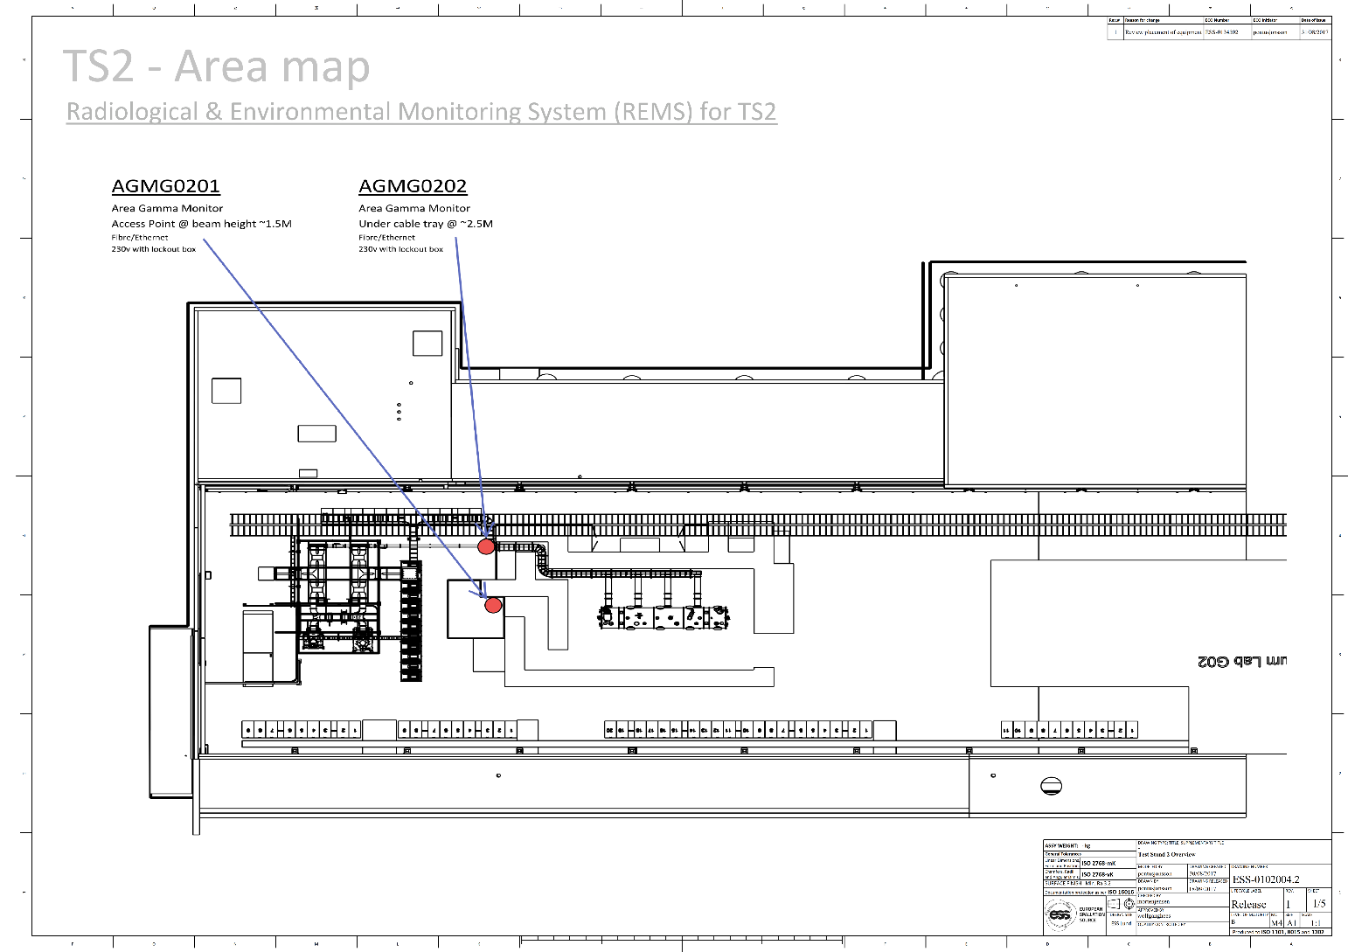
Radiation Protection - Test Stand 2 (TS2)
Notes:
2 x AGM (1 Pandora in parallel) & 1 XRM (similar layout X-box)
integrated

Slide 10
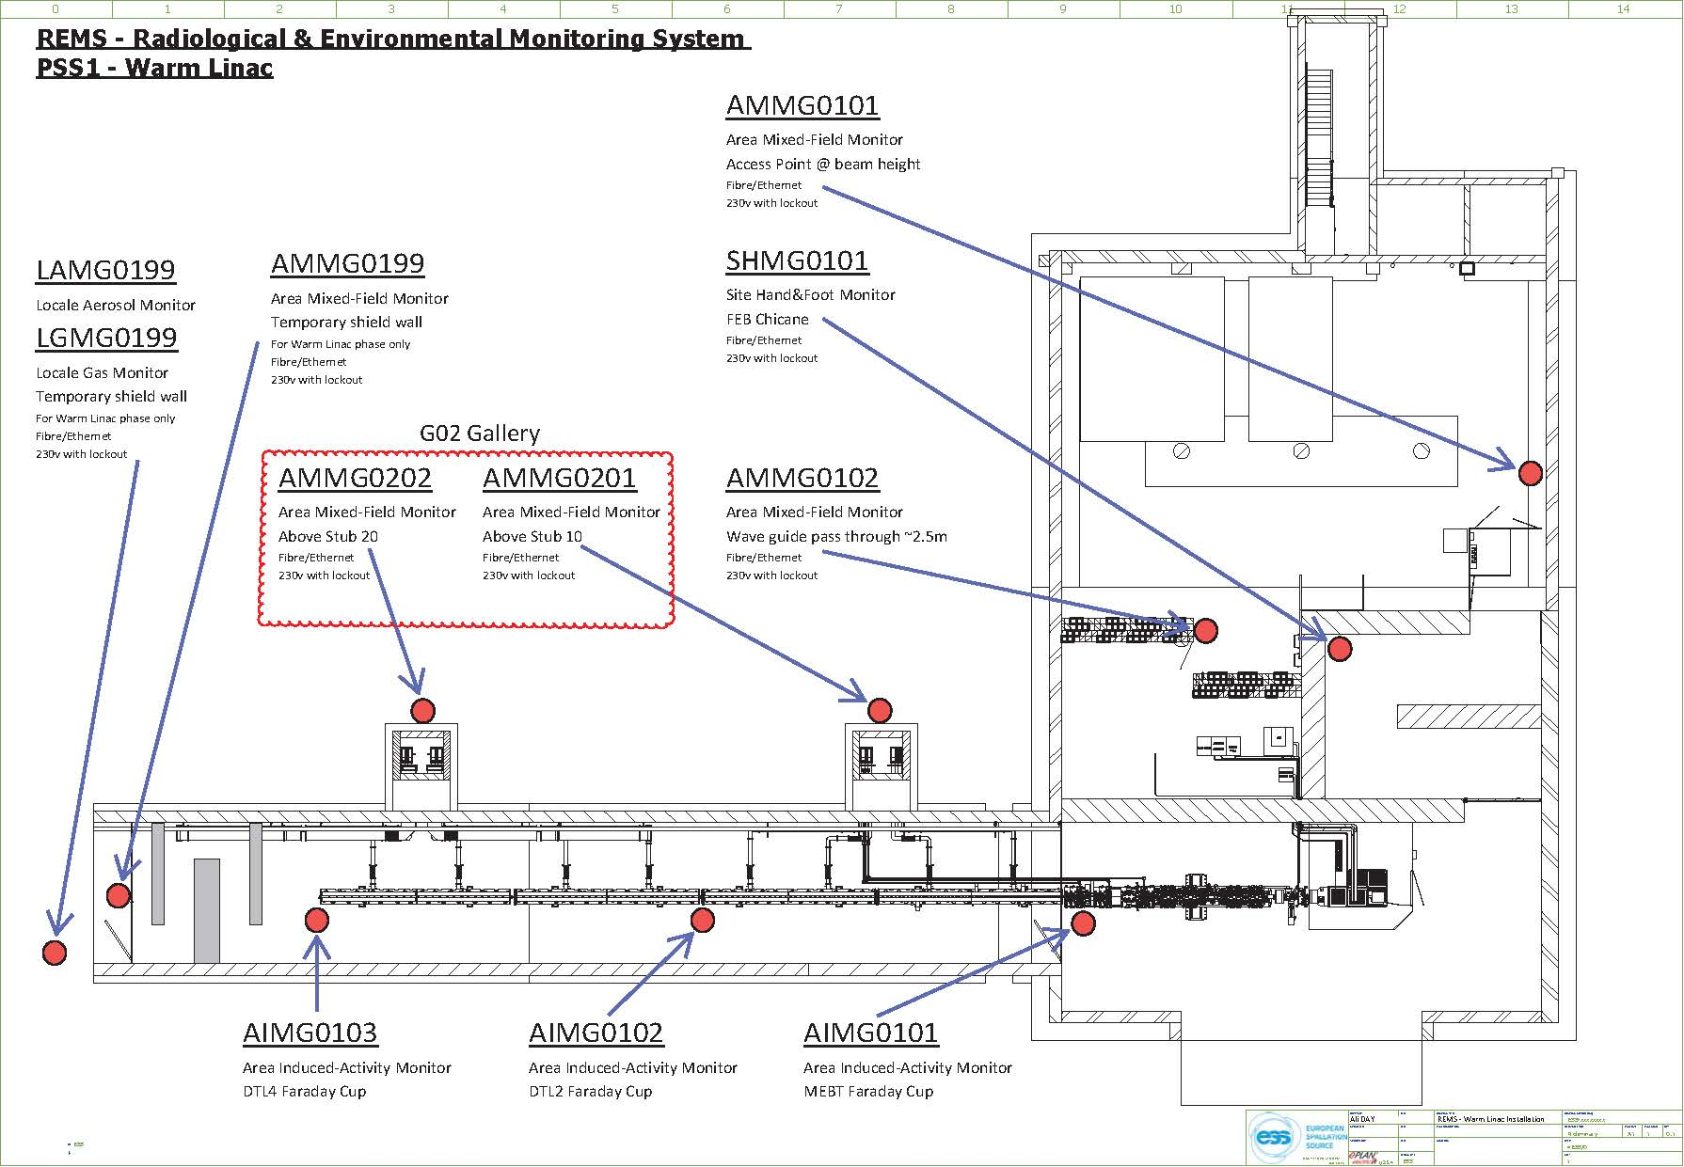
Radiation Protection - Warm Linac

Slide 11
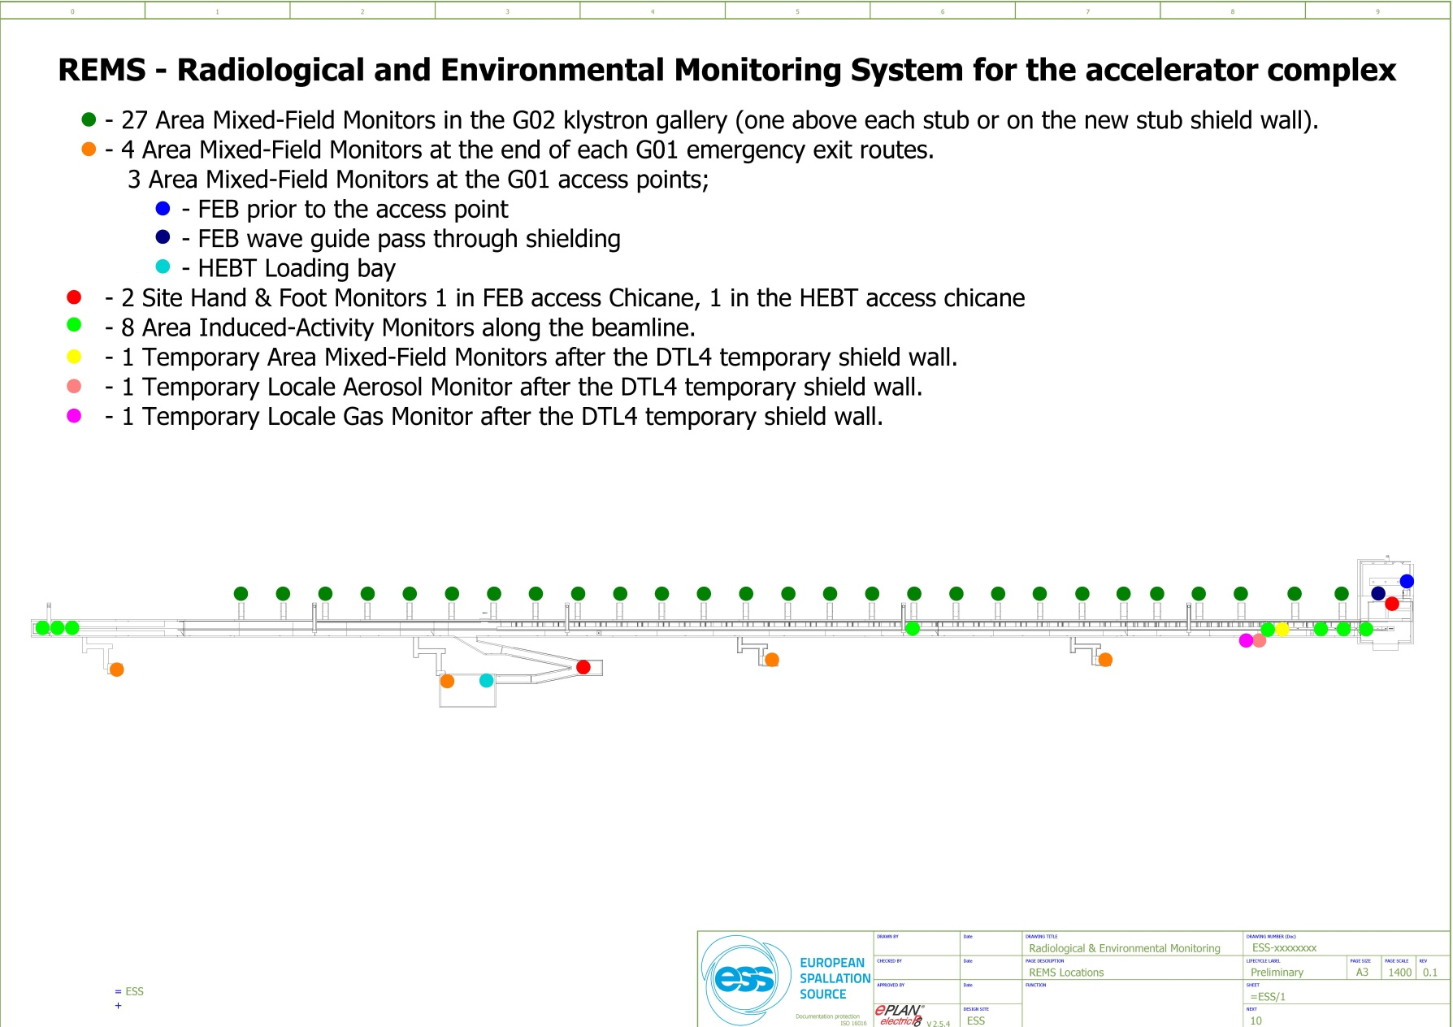
Radiation Protection – Cold Linac
Notes:
Then talk about Target … NSS

Slide 12
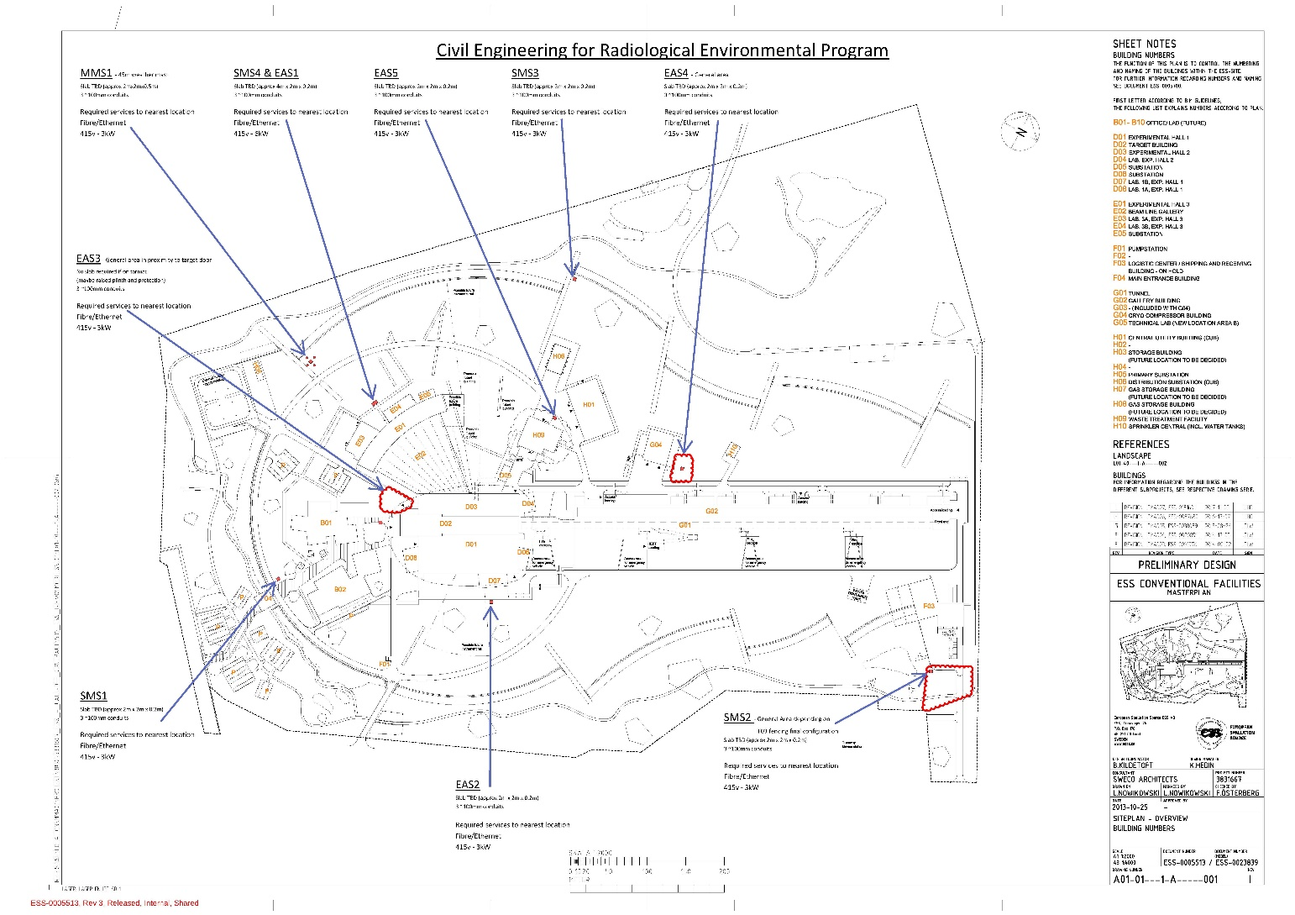
Radiological Environmental Program

Slide 13
Resources
Systems Integration Engineer responsible for all REMS equipment integration into EPICS.
  Juha HAST started 3rd April
Post for 1st Maintenance & Operations Technician launch during April/May.
2 Technicians loaned from AD for our installation in TS2
  Will be sent to CERN in May for specialist ultra low current connector training.
50% Engineer from ICS for infrastructure and installation around Warm Linac.
Meeting in two weeks with Nuvia to possibly provide M&O contract technicians.
* Laboratory/Sources manager post (at ES&H level)

Slide 14
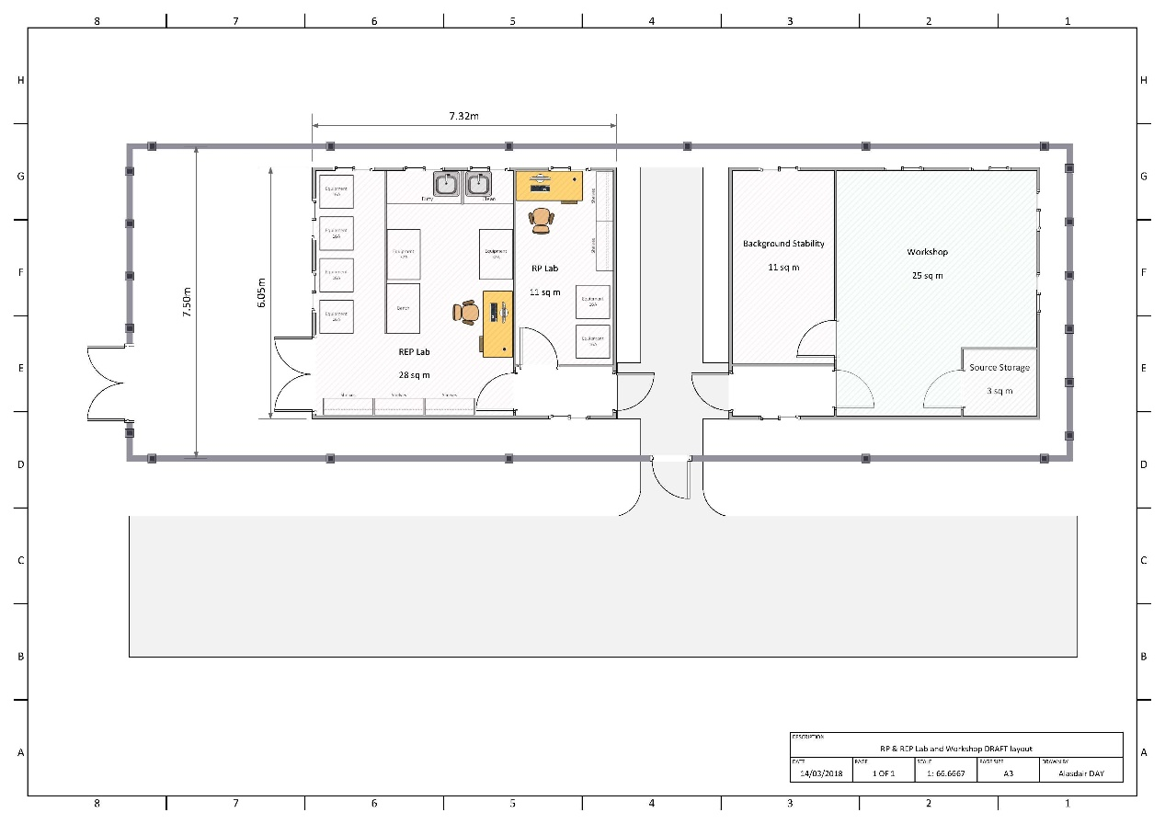
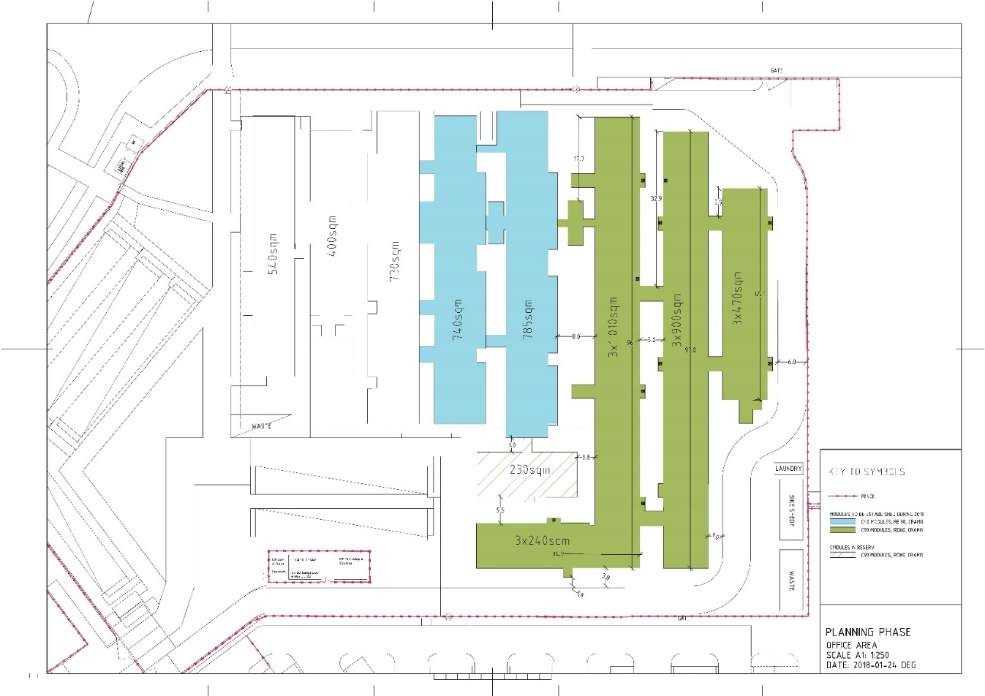
Space - Workshop, labs & source storage
Notes:
F03 extenstion solution.

Slide 15
Misc
Site gate monitors for F03 & F04
Offsite reference environmental monitoring
Databases (LIMS, Dosimetry, etc)
Radioactive source service
  Receive sources into temporary lab and permanent solution
  Source holders
RP Handbook Chapter 7
Infrastructure

Slide 16

Six months in, what have I missed

