Slide 1
Requirements document ESS-0041176 - Update
Erik Nilsson
Mechanical Engineer
ESS Chopper Group
www.europeanspallationsource.se
8 May, 2018

Slide 2
Current Document Status
Currently being reviewed by management.
No major changes expected.
Indicated changes:
Clarified instructions for who should approve rules exceptions.
Clarified the bunker access times and strategies.
Clarified the crane capacities in juncture with RH activities.
Clarified tolerances for positioning and guide pins (Crane accuracy and final positioning accuracy).
Specified the potential decontamination fluids.
More description on the tooling and added timeline.

Slide 3
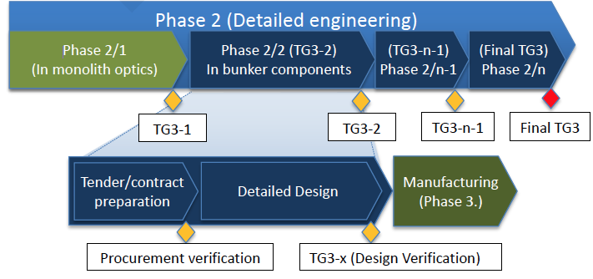
TG3 Remarks
Define module clearly
Classify each module with RH classification (Full-Limited-No)
Add classification requirements to the design scope (extraction, activation, etc.)
Failure analysis with respect to RH interfaces

Slide 4
Confluence page
https://confluence.esss.lu.se/display/SD/NSS+Remote+handling+Homepage
Access to the latest version of requirements document
Area by area pages on technical standards and best practices
Electrical and fluid interfaces (WIP)
Fasteners (Released)
Guide Z-alignment system
Identification aids and supplements
Lifting and handling features (Released)
Location and alignment devices (WIP)
Remote handling bellow and clamp (WIP)
RH requirements for gaps between components

Slide 5
Thank you for your attention Questions?
Notes:
Add extra slides on what we are looking at.

