Slide 1
Remote Handling Workshop Introduction
Erik Nilsson
Mechanical Engineer
ESS Chopper Group
www.europeanspallationsource.se
7 May, 2018

Slide 2
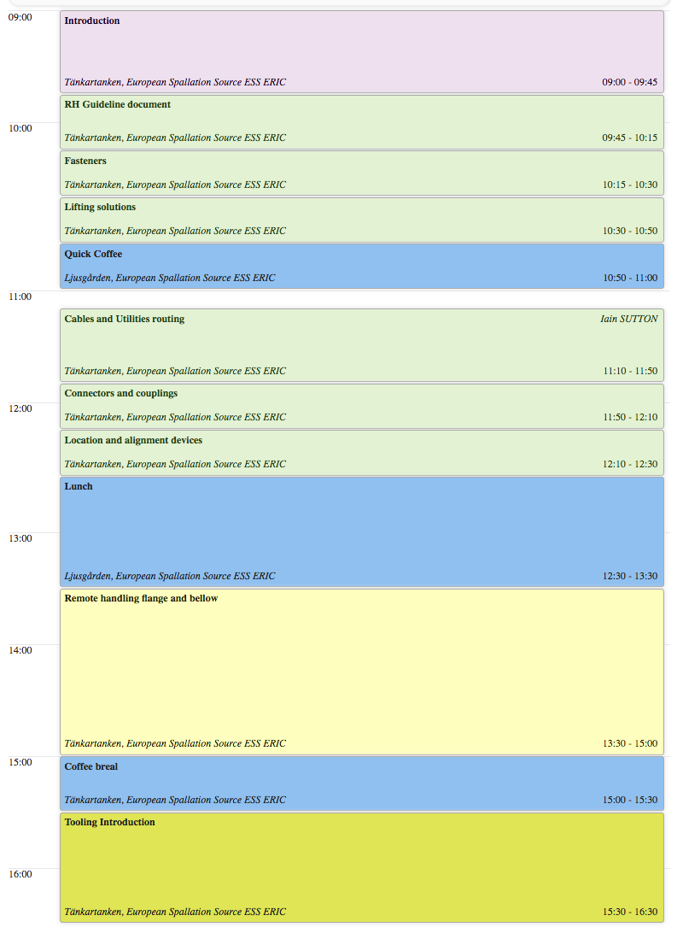
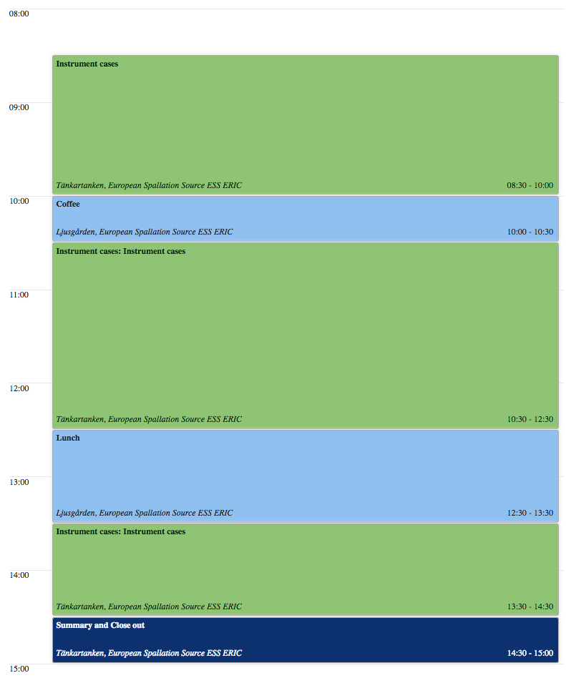
Introduction

Slide 3
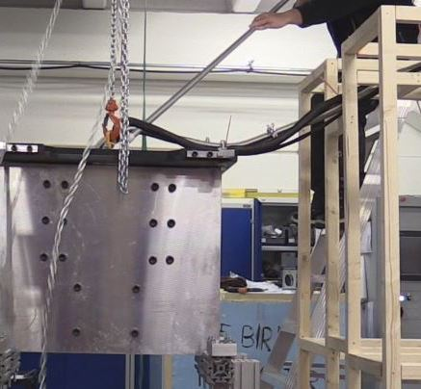
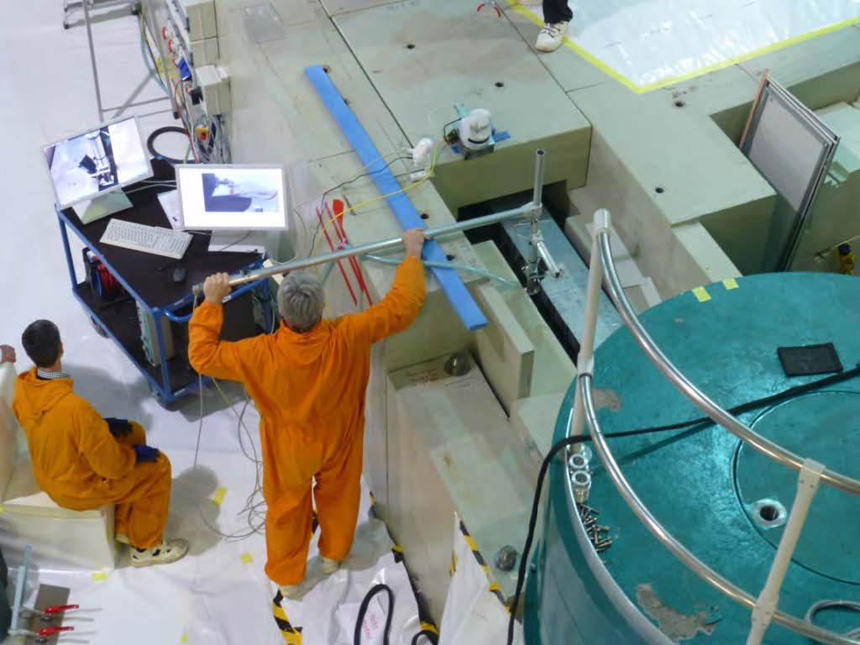
What is remote handling
ESS chopper extraction test
FRM-II Guide replacement
Image courtesy of E. Calzada
ISIS Long tool test
Image courtesy of P. Galsworthy

Slide 4
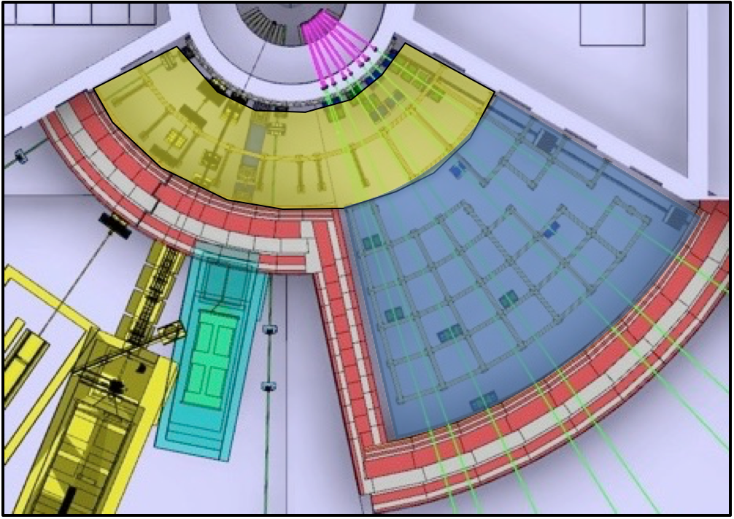
Implementation
Separation
After 48-72hrs
Front access
RH only
Rear access
Hands on (hotspot removed)
After 10-15days
Front access
RH only
or Hands (hotspot removed)
Rear access
Hands on
Restricted activities
‘Front’
Full-RH or Limited-RH
‘Back’
Full-RH or No-RH
Notes:
No in-situ RH maintenance is foreseen.
Installation is not considered a RH-activity.

Slide 5
RH workshop 1 – November 2017
15 participants from 6 institutes
Topics:
Remote handling justification and guidelines
Basic information on technical solution areas
System solutions vs. component solutions
Alignment issues for Z-alignment of guides
Results:
General understanding of the requirements and environment
No non-ESS resources available for solution development.
ESS develops all solutions and provides to partners.
Report available in ESS-0191767

Slide 6
Action list RH-workshop 1
Area | Task | Note | Status
Administrative | Create and maintain component database |  | In Progress
Location and alignment devices | Basic rules |  | In progress
 | Basic set of components |  | In progress
Lifting and handling features | Chain test | Test to investigate possibility to remotely attach normal chain type lifting rigs to components. | Completed
 | Single lifting point standard | Development and test of a series of standard single point lifting assemblies. | Completed
 | Multiple lifting point standard | Evaluation and conceptual design of multiple lifting point method. | Completed
Fasteners | Common design | Development and release of common design of series of RH fasteners. | Completed
Electrical and fluid connectors | Selection and specification | Select and specify standard range of connectors. | Not started (Planned for end of May)
 | Investigate shielding need. | Investigate need to shield connectors within the bunker. If so, conceptual design of simple radiation shield is needed. | Not started
RH bellow | Inflatable bellow | Development and test of inflatable vacuum bellow | Disregarded
 | Mechanical bellow | Development and test of mechanical bellow | In Progress – Industrial solution on the way
Guide positioning and realignment | Conceptual design | Conceptual design of guide housing realignment system.
Routing | Snorkel design, build and test |  | Not started

Slide 7
Workshop charge
Goal:
Provide updates on relevant technical developments
Show common issues and potential solutions for all instruments
Discuss and solve instrument specific issues
Important information required for TG3 systems
Day 1
Update on guideline development
Update on technical standards development
Vacuum flange and below development
Utilities routing and cabling
Short presentations – please ask questions and comment
Day 2
Instrument specific issues and challenges
Workshop spirit
Focus on finding solutions with a plausible way forward
Open and equal discussions
Transparent discussion

Slide 8
RH Deployment
Development
Baseline strategy
Technical standards
Operations strategy
Internal validation
External validation
Developed with collaborators.
External validation.
Released as packages.
Aligned with SSM application
Developed internally
Deployment
Roll-out
Compliance checks
IKON
Newsletter
FtF meetings
During detailed design
During procurement phase
TG3
Implementation
Tools development
Prototypes and testing
Development of foreseen tools.
Prototyping of critical systems, tools and components.
June-17
Jan-18
June-18
Jan-19
June-19
Notes:
Reduce the amount of information. Refer to the document and point out the key. Aim for 30min content.
ESS-0042943

Slide 9
Thank you for your attention Questions?
Notes:
Add extra slides on what we are looking at.

