Slide 1
Lifting & Handling features
Erik NIlsson
Mechanical Engineer
ESS Chopper Group
www.europeanspallationsource.se
8 May, 2018

Slide 2
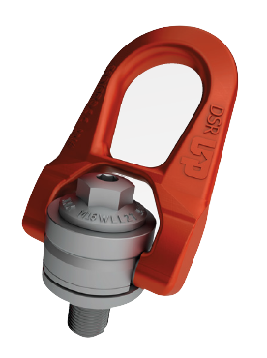
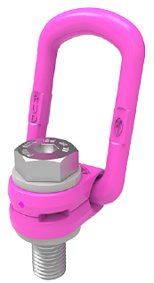
Single point lifting
One point lifting – in combination with guide rods/rollers
Simple engagement and disengagement
Lack of height
Lifting eyes are left in place during operation
Visibility
Ensure that the lift point is visible to the remote handling operator during hook engagement and disengagement.
Dimensioned for abnormal lifts (SF>5)
Approved components
CODIPRO/Gradup DSR (M14 or larger) – Primary choice
RUD VLBG (M18 or larger) – Secondary choice
CODIPRO DSR
RUD VLBG

Slide 3
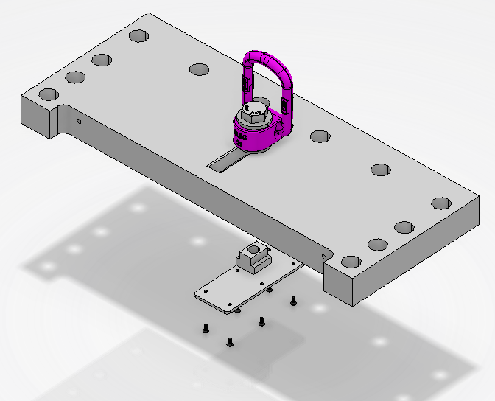
Adjustable lifting eye
Adjustable in x-direction (along the beam).
Compensate for COG alterations due to caused by cables and utilities.
Stabilize lift to minimize the risk of damaging equipment.
Example

Slide 4
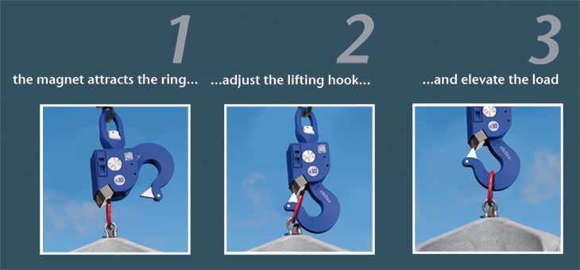
Current Hook assumption
Automatic lifting Hook
One 5 ton lifting Hook
One 20 ton lifting Hook

Slide 5
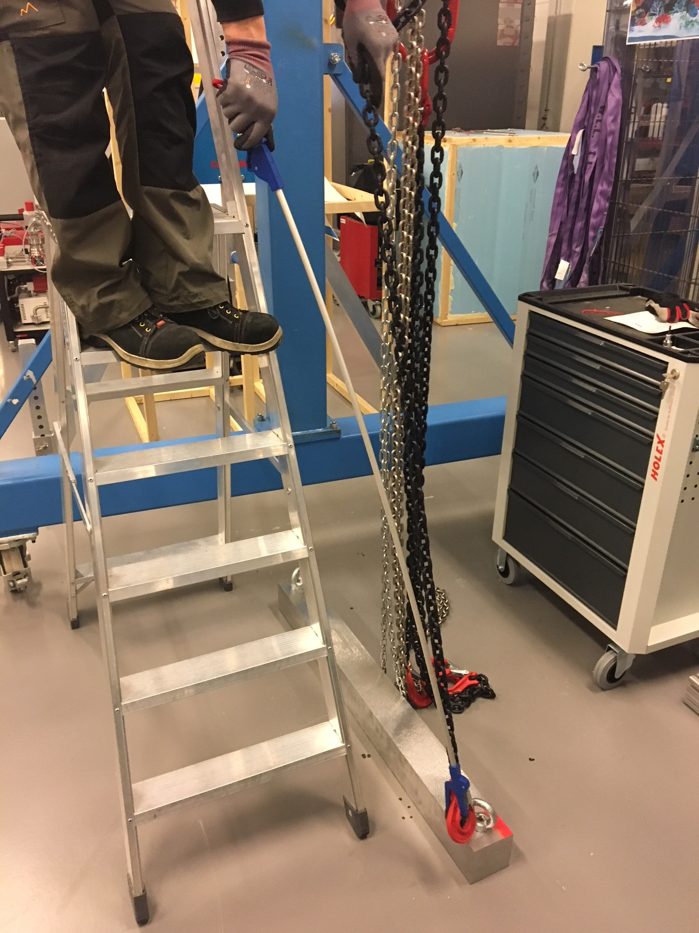
Multiple point lifting
Tests performed
Successful
Not preferable
Specialized tool required
Approved components
Use DIN580 or DIN582
M20 or larger
Material C-15 (1.1141)

Slide 6
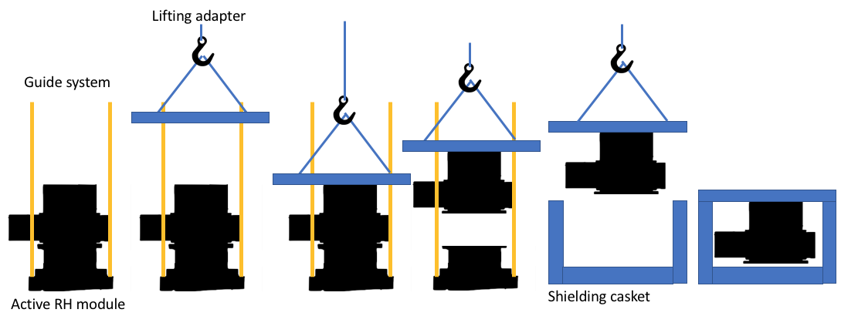
Lifting adapters
For some components integrated lifting adapters might be required

