Slide 1
Remote Handling Fasteners
Erik Nilsson
Mechanical Engineer
ESS Chopper Group
www.europeanspallationsource.se
8 May, 2018

Slide 2
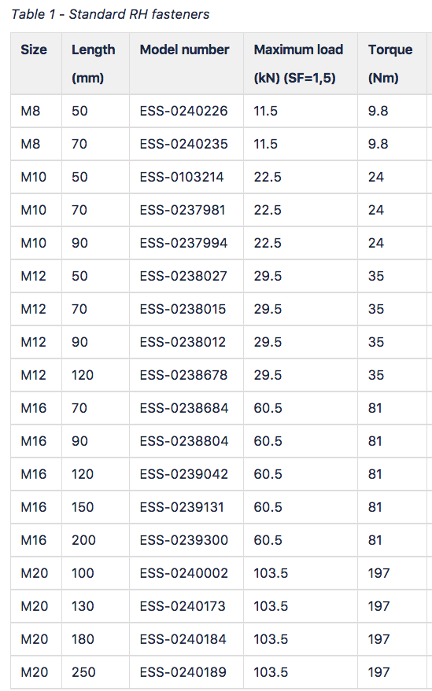
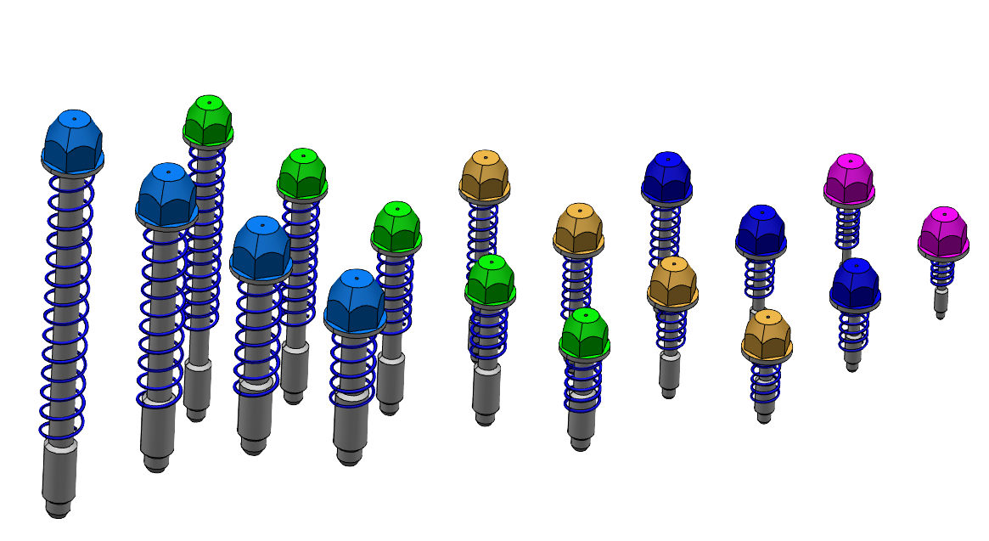
Standard screws
Remote handling fasteners for remote handling interfaces.
Few bolts as possible.
Few sizes as possible.
Titanium screws.
Threads in aluminium shall be made using threaded inserts. Helicoil Plus A4 inserts or equivalent are recommended.

Slide 3
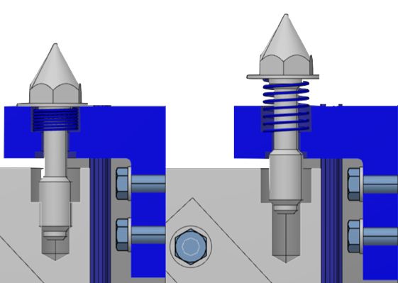
Captive pop-up design

Slide 4
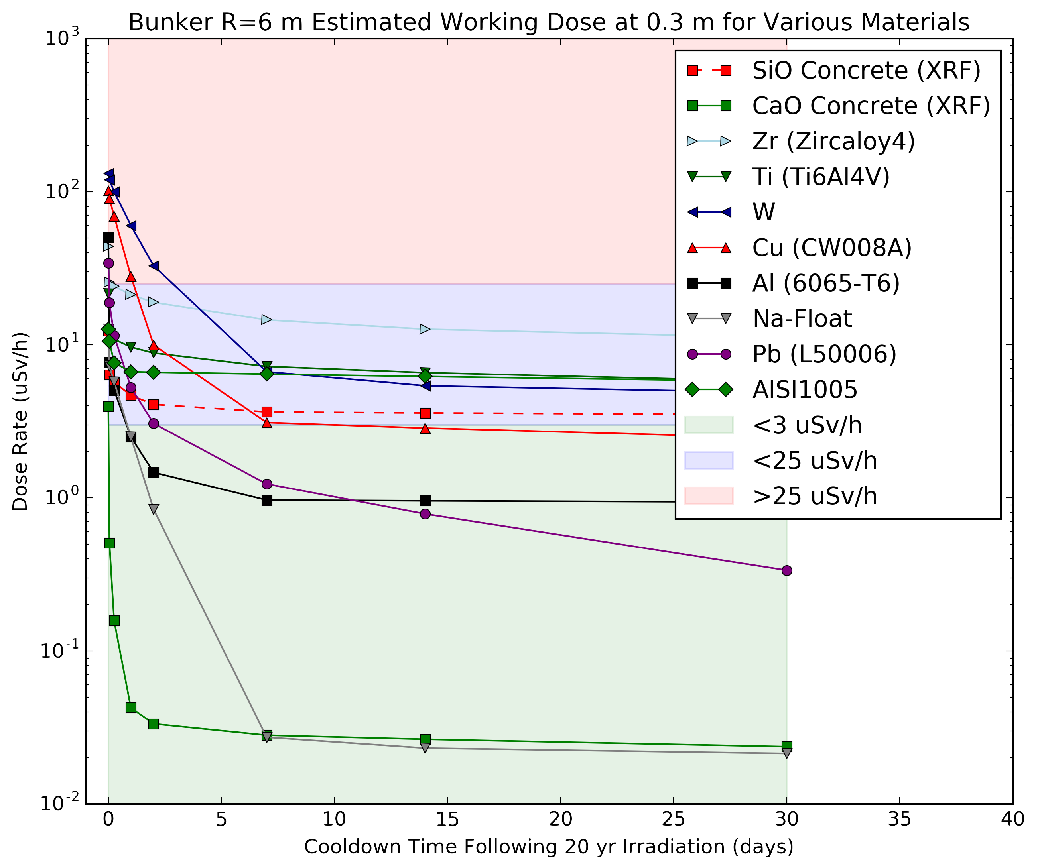
Materials changes – Updated activation tables (March)
The source term was updated to the most recent one (significant change).
The duct source variance reduction was turned off, and the source position moved (minor tweak).
The method of computing the worker dose was originally a very rough area multiplication with the DCHAIN output. The new normalisation uses a microkernel method for arbitrary source shapes, and is cross-checked against the 1 m sphere calculation reported in DCHAIN results
The activation concentrations were thoroughly cross-checked with similar calculations done by target division.

Slide 5
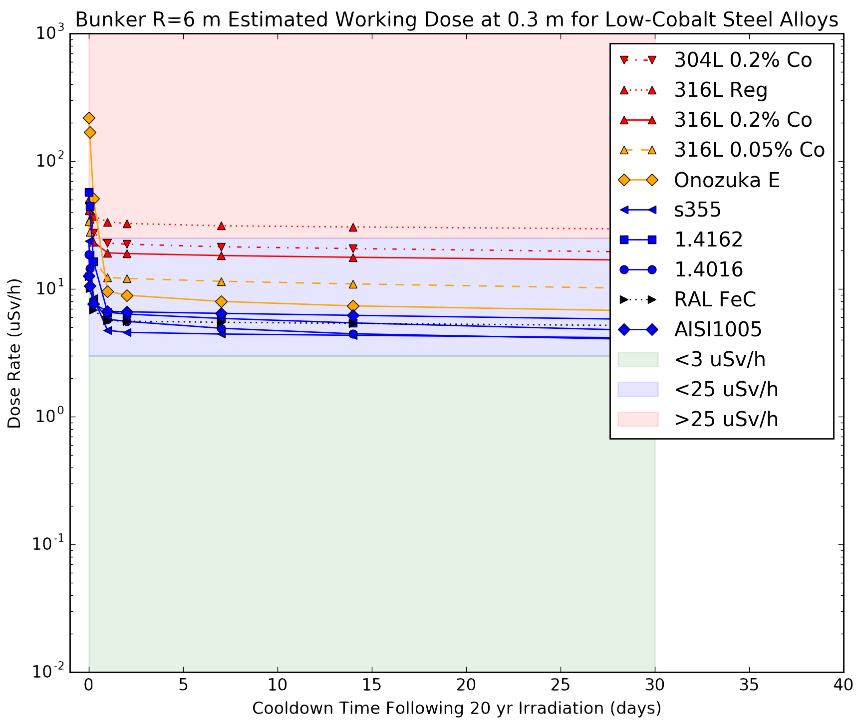
Materials changes
Some steels are comparable to Titanium now.
Lower comparable strengths (880MPa Yield to ~300MPa Yield).
1.4404
1.4162
1.4016
8.8 (impurities issues)

Slide 6
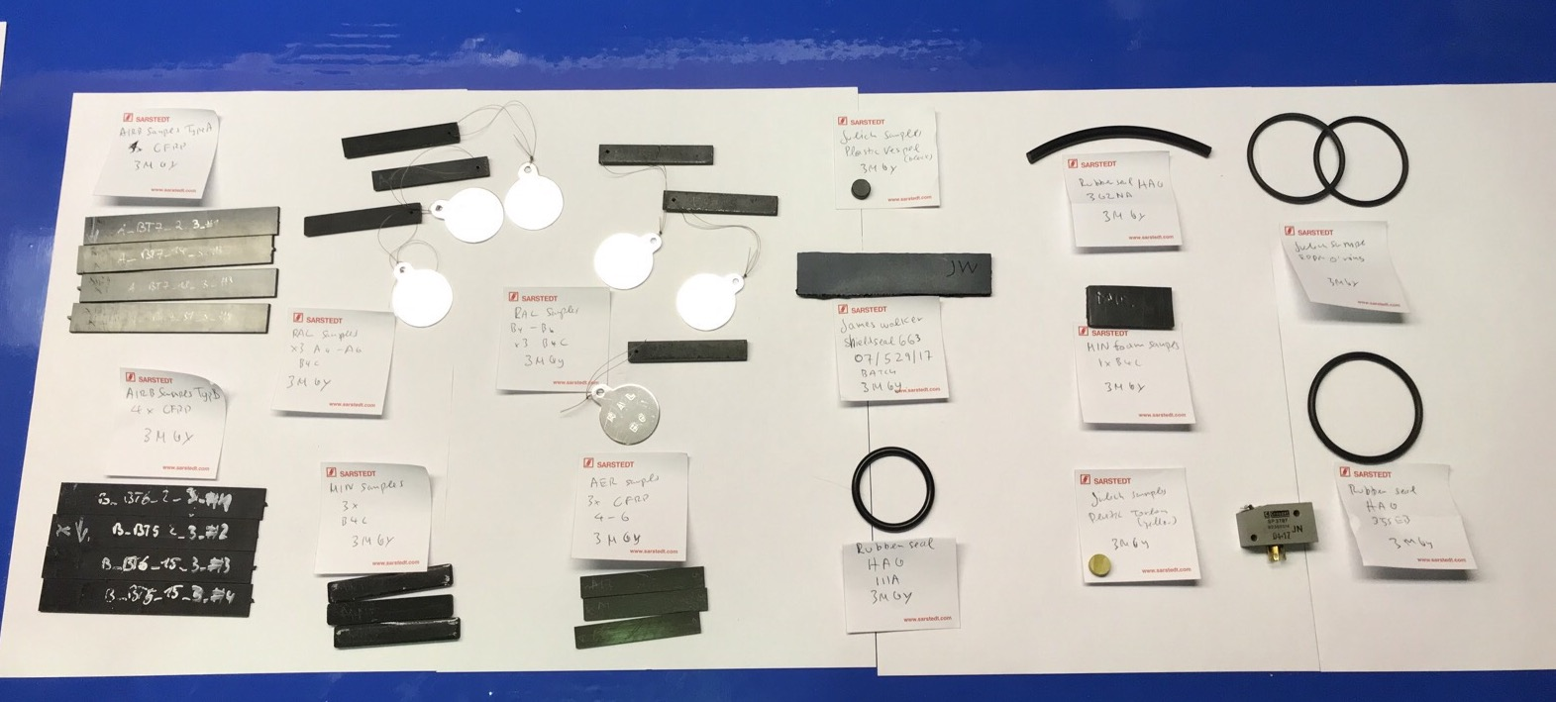
Way forward
Suggestion:
Keep Titanium bolts for general RH use.
Possibility to use Low strength stainless if calculated accordingly
Irradiation tests planned to confirm simulations

