Slide 1
Location and Alignment devices
Erik Nilsson
Mechanical Engineer
ESS Chopper Group
www.europeanspallationsource.se
14 May, 2018

Slide 2
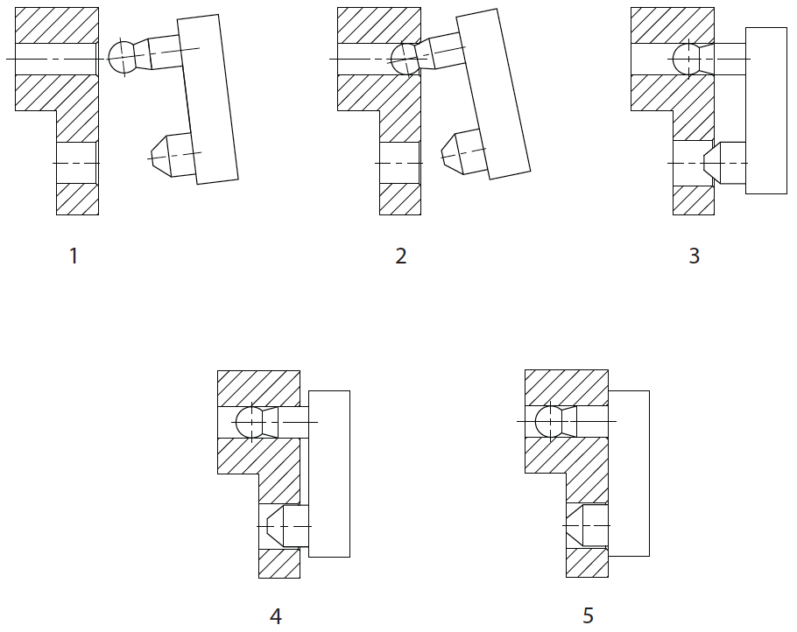
Best practices – Safe alignment of module
Step | DoF’s | Type
1. Module held in free space | 6 | 3 Translation 3 Rotation
2. Module located on dowel ball-end | 4 | 1 Translation 3 Rotation
3. Module located on single long ball-ended dowel pin | 2 | 1 Translation 1 Rotation
4. Module item located on second short dowel pin | 1 | 1 Translation 0 Rotation
5. Module fully in contact with mating face | 0 | 0 Translation 0 Rotation
Example of gradual kinematic constraint

Slide 3
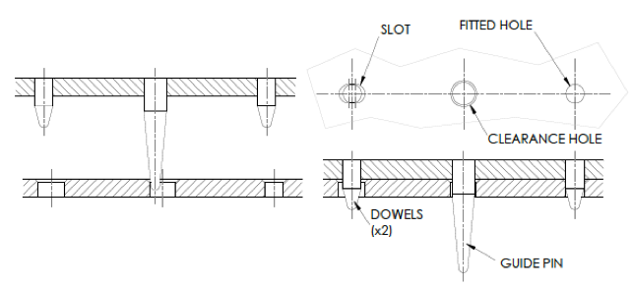
Dowel arrangement

Slide 4
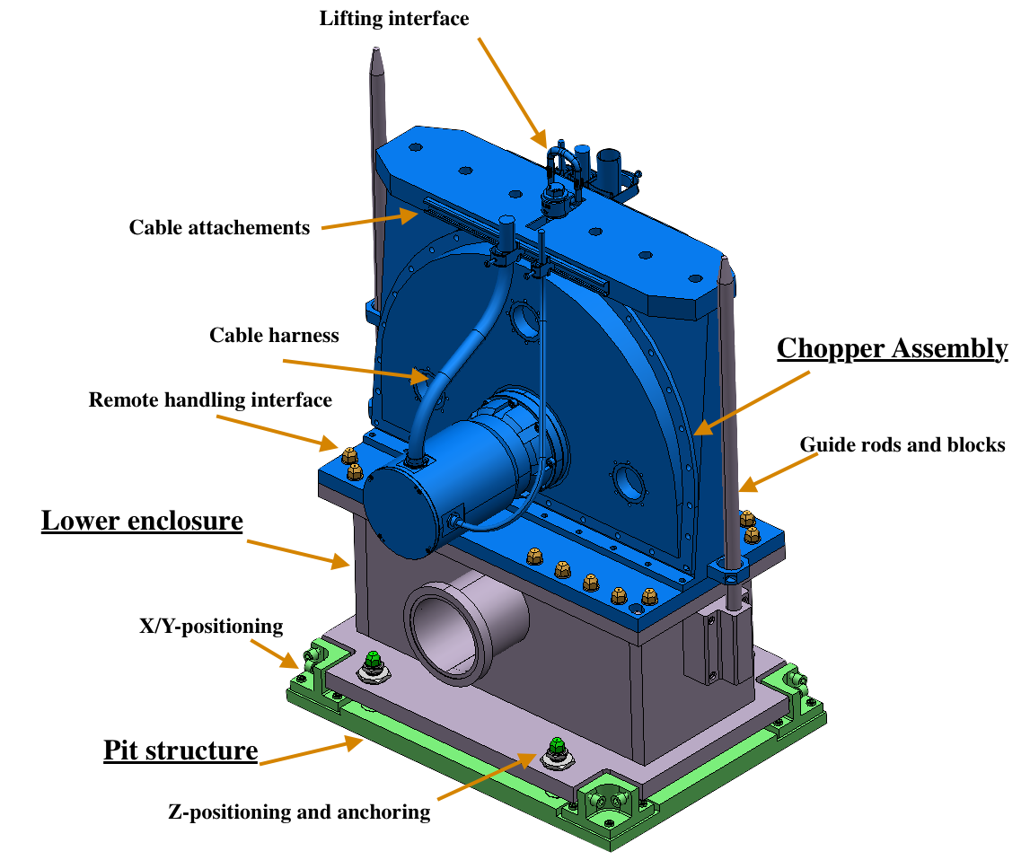
Positioning example
Length of guide rods to allow bunker installation (and protect surrounding)
Second guide block to prohibit tilt
Positioning dowels (fitted and slotted holes)
Remote Z-realignment available

Slide 5
Chopper Z-realignment component
Based on industrial component

Slide 6
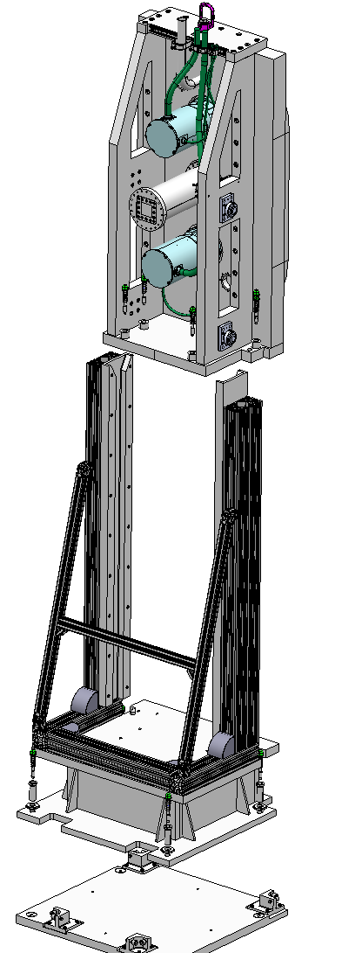
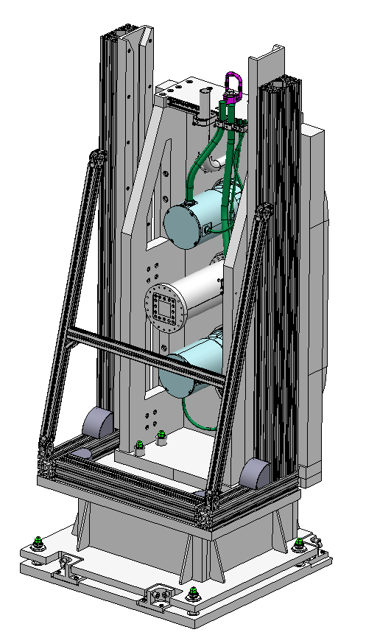
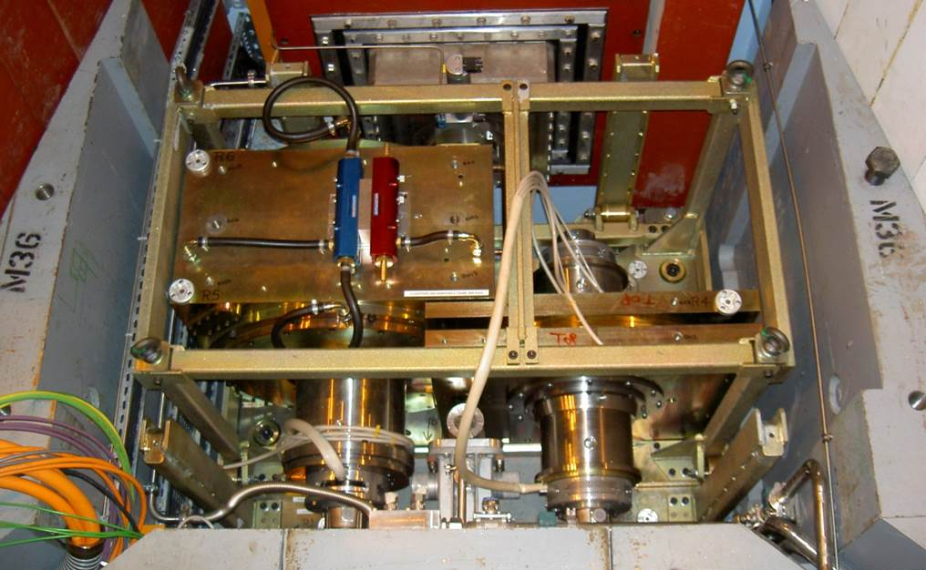
Rollers – example
LARMOR (ISIS)

Slide 7
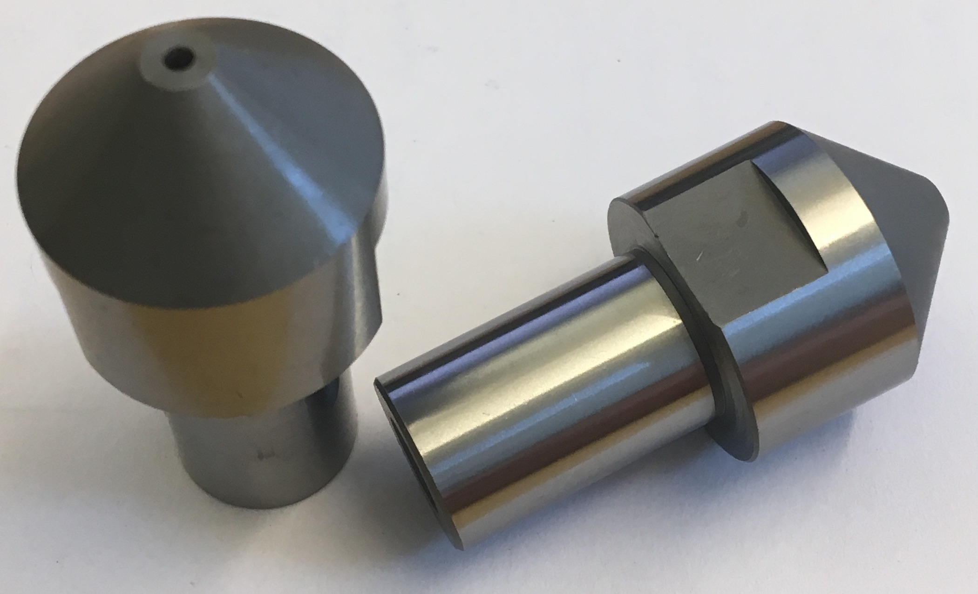
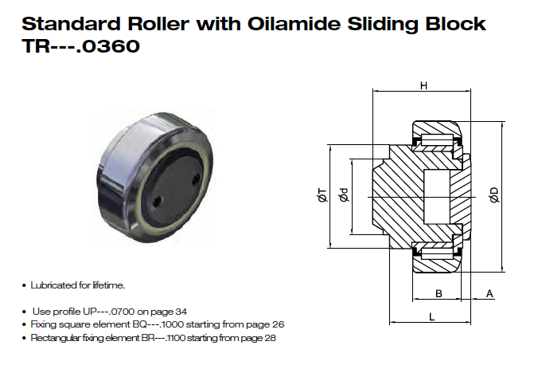
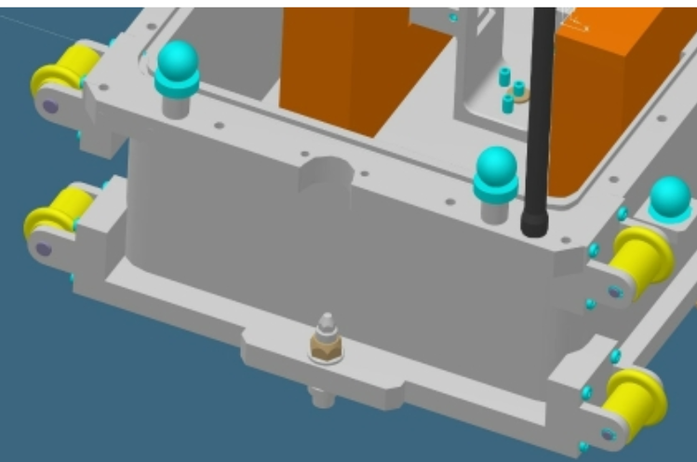
Component examples
Misumi dowels
currently being evaluated
Rollco stainless roller
currently being evaluated
Plastic rollers
currently being evaluated
Same materials issues as with fasteners.
Send in your suggestions!
Notes:
Activities restricted to
Extraction (RH-I and RH-II)
Reinstallation (RH-I)
Inspection and/or realignment of component/module (if required)
Complex RH activities shall be avoided.
Reduced design complexity
Reduced construction cost
Reduced tooling cost
No in-situ RH maintenance is foreseen.
Modules/components stored on site during cool down.
Exchange of a module for a spare unit will be the quickest method to repair (hot-swap).

Slide 8
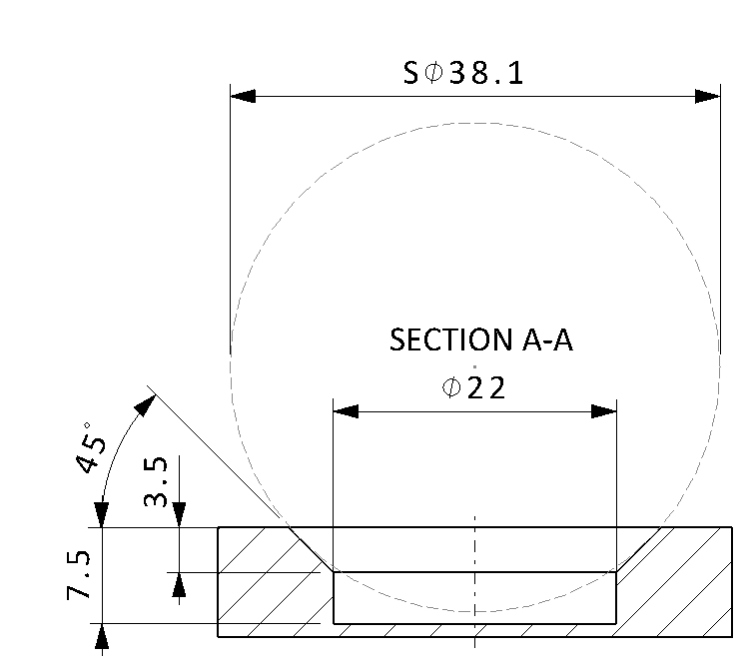
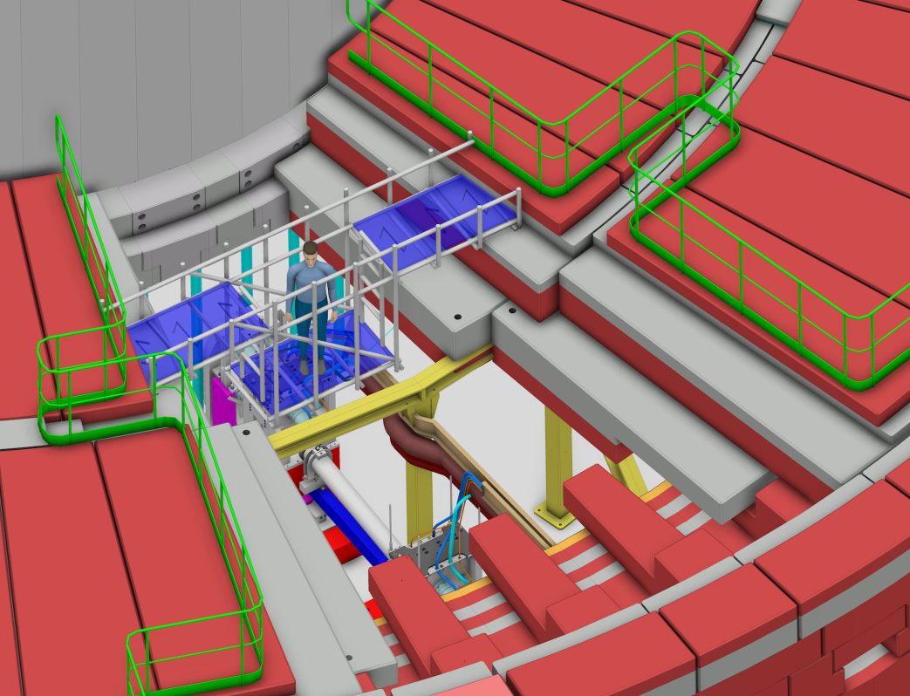
Survey and alignment
ESS Survey cone
3 points visible from platform
Notes:
Activities restricted to
Extraction (RH-I and RH-II)
Reinstallation (RH-I)
Inspection and/or realignment of component/module (if required)
Complex RH activities shall be avoided.
Reduced design complexity
Reduced construction cost
Reduced tooling cost
No in-situ RH maintenance is foreseen.
Modules/components stored on site during cool down.
Exchange of a module for a spare unit will be the quickest method to repair (hot-swap).

