Slide 1
Introduction to tooling
Erik Nilsson
Mechanical Engineer
ESS Chopper Group
www.europeanspallationsource.se
14 May, 2018

Slide 2
Foreseen tooling
Lifting equipment
Work platform
Torque tool
Z-realignment tool
Gripping tool
Lifting engagement tool
Prism placement tool
Cleaning tool
Lighting system
Vision system

Slide 3
Long torque tool test
ISIS performed tests in 2017
Successful
Build and test ESS version.
Torque test required

Slide 4
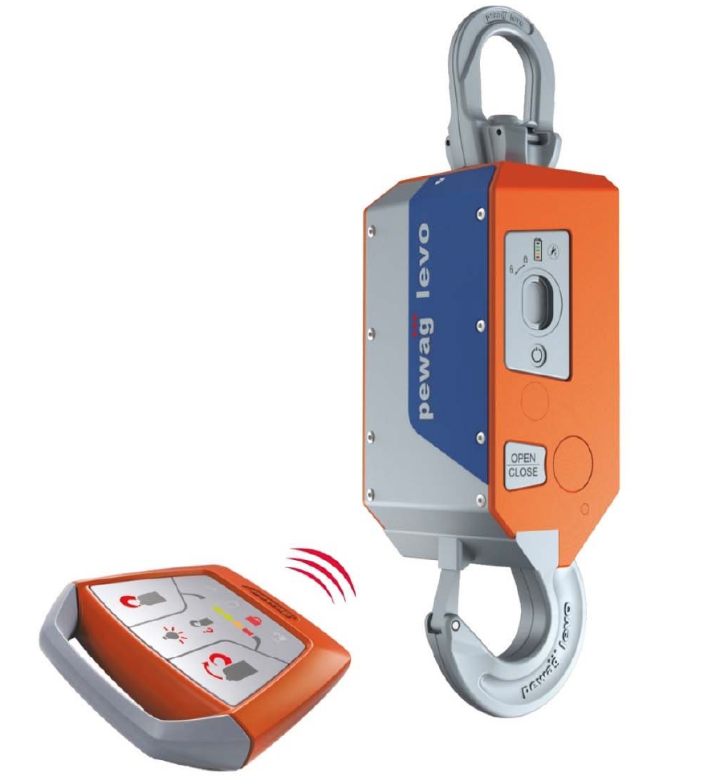
Overhead hook
Opening and closing
Rotating
Procure and evaluate during 2018

Slide 5
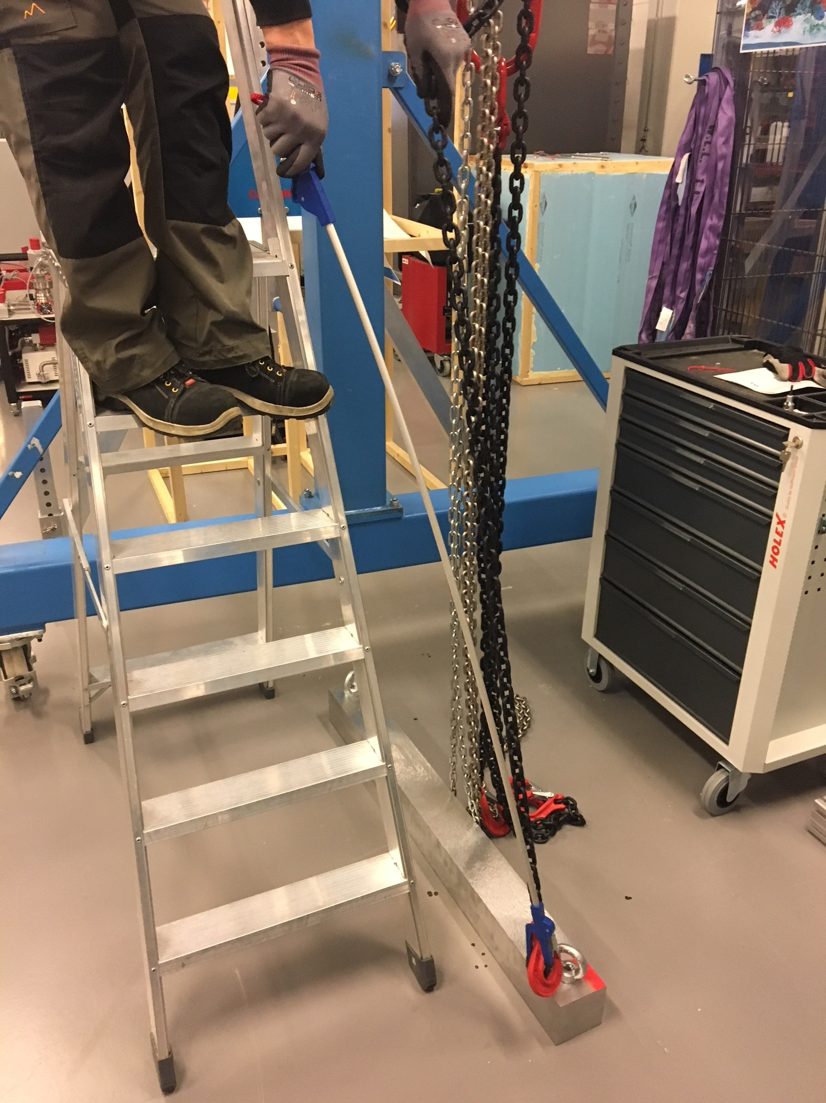
Lifting engagement tool
Test using medical gripping tool.
Possible to attach hooks from distance.
Stiffer and more stable tool needed (and longer).

Slide 6
Guidance tool

Slide 7
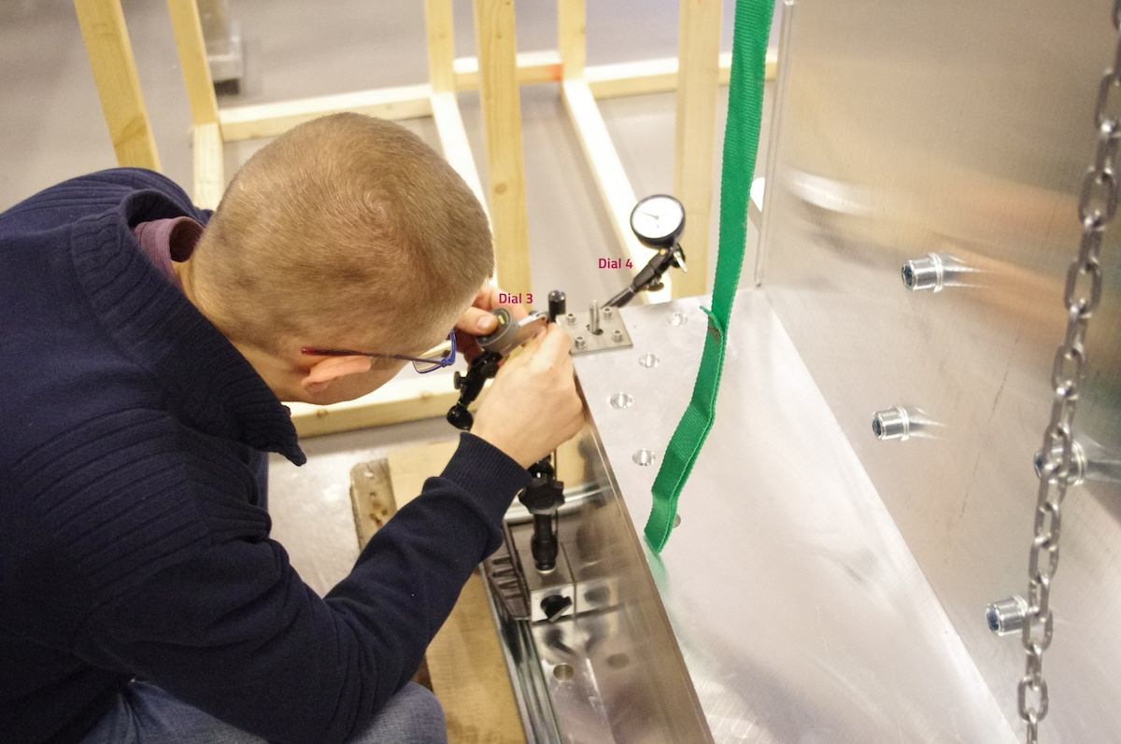
Guidance tool
Good repeatability
Safe lowering
No jamming
Results: https://confluence.esss.lu.se/display/CG/Horizontal+split+test+v2

