Slide 1
Raster Scanning Magnet System CDR-3
Validation of Pre-Series
Heine D. Thomsen, Søren Pape Møller
Aarhus University (AU), Denmark
www.europeanspallationsource.se
January 13, 2017

Slide 2
CDR 2
Delivery to Aarhus
Preliminary Design
FAT I
Outdated schedule; for indication only!
Phase 1
CDR 1
Design
Pre-Series
Prod. + Assembly + Inst.
First Protons on Target, 570 Me V (12 Aug. 2019)
Phase 2
@Danfysik
CDR 3
RFI (10 Apr. 2019)
SAT I
FAT II – SAR 1
Pre-Series Test
Delivery to ESS
Phase 3
@Aarhus
Pre-Series Extended Test
TRR
SAT II – SAR 2
Phase 4
@Danfysik
Prod.-Series
Production + Assembly
Phase 5
@ESS
Testing & Commissioning
2015
2016
2017
2018
2019
2020
2021
Notes:
Flanges are identical size
External power supply expert at CDR-3
Thermal breakers on RSMs
6. Ceramic chamber spares
7+8: FDU and EVR
PDR

Slide 3
RSM Past, Present & Future
2015.10.08, CDR-1: to start procurement
2016.06.01, Contract signed with vendor (Danfysik, Taastrup, DK)
2017.01.13, CDR-2: Validation of DDR & FAT-I
2017.11: FAT-I
2017.12-2018.04: SAT-I
2018.05.15, CDR-3: approving the performance of the pre-series
2018.06.11: Purchase period II. Vendor initiates procurement of remaining materials and parts
  Spares?
2018.11: delivery of RSMS to ESS (following FAT-2)
Notes:
Danfysik: Gantt-chart

Slide 4
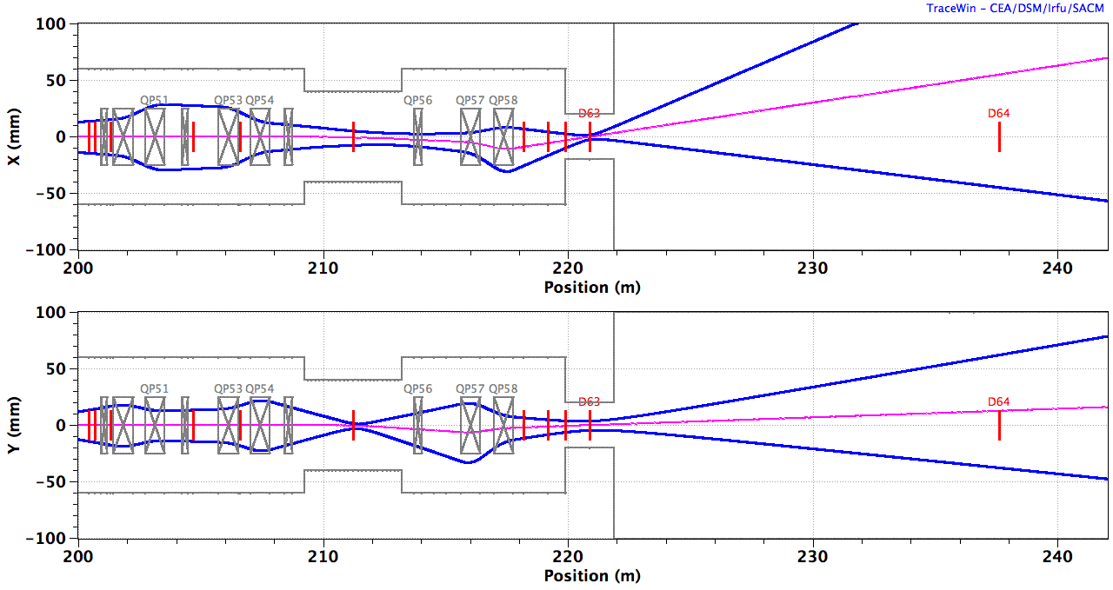
A2T Beam Optics
Centroid
10 x RMS beamlet
BEW
QP1-4
8 x RSMs
QP5,6
PBW
B_{y} B_{y} B_{x} B_{x} | B_{x} B_{x} B_{y} B_{y}
ACH
A2T
AP
CO
2.0 GeV: B_{x}L = ±2.6 mT.m, B_{y}L = ±1.5 mT.m, ±5 mT.m
Notes:
RSM physical apertures

Slide 5
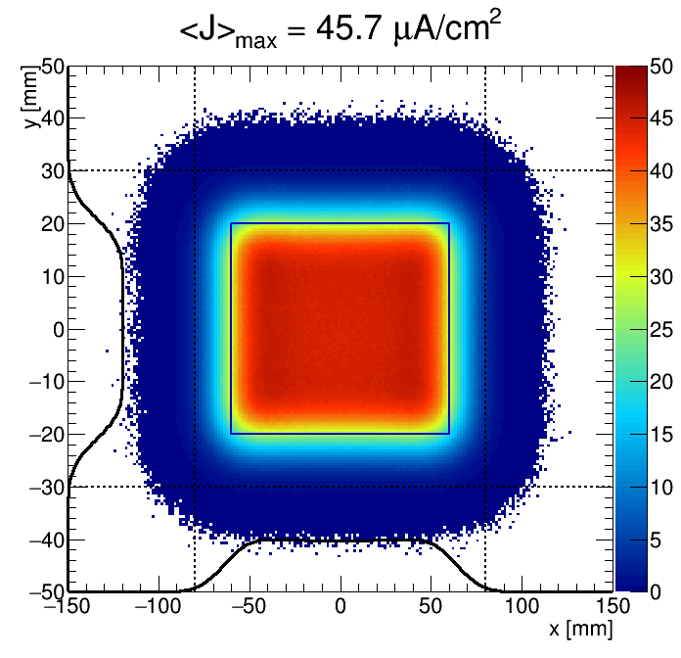
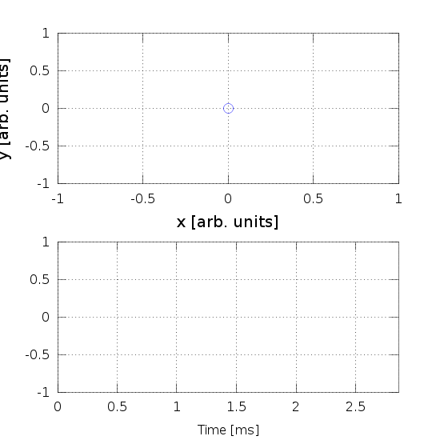
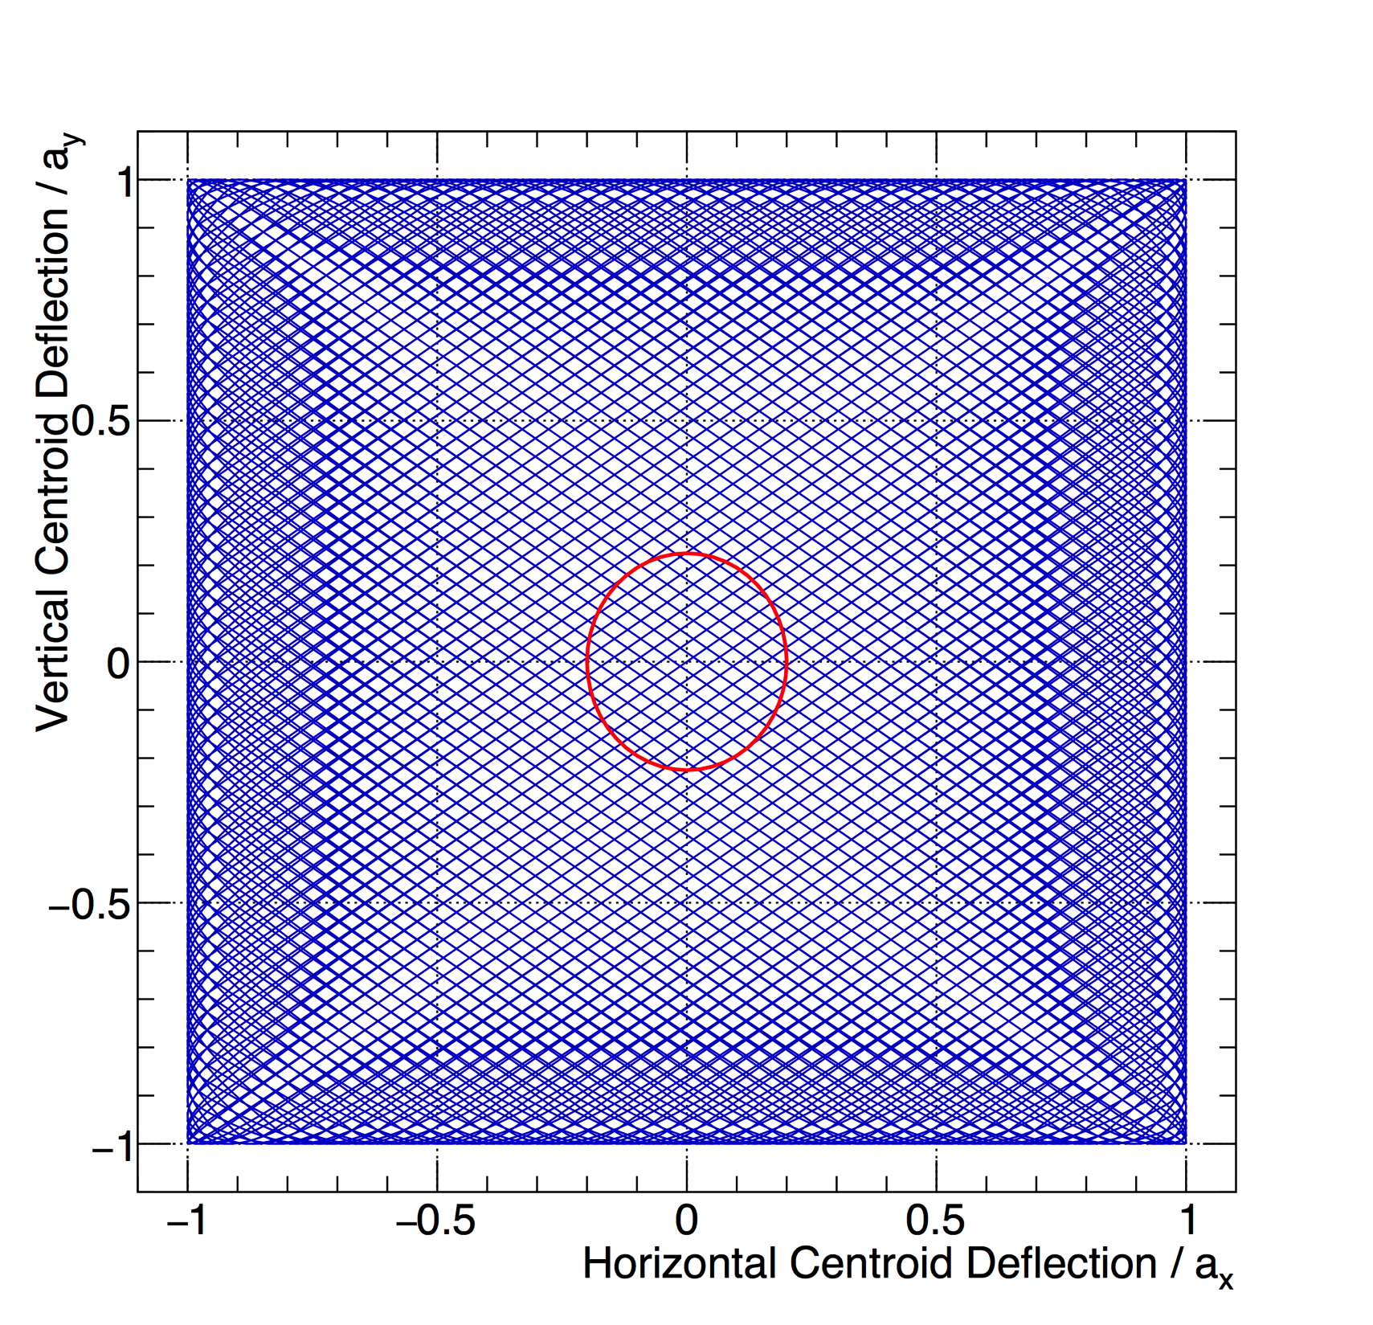
Lissajous Pattern
Closed pattern (f_{x}/f_{y}, ϕ_{xy}, a_{x}, a_{y}) within a beam pulse:
T₀ = 2.86 ms = (350 Hz)⁻¹ f_{x} = n_{x} / T₀, f_{y} = n_{y} / T₀
Triangle waveforms => No lingering near edges, crosshatch
f_{x} / f_{y} ~ 1 => A single (magnet + supply) design
f_{x} = 39.6 kHz
f_{y} = 29.1 kHz
5/4 pattern
(a_{x}, a_{y}, σ_{x}, σ_{y}) = (60, 20, 12, 4.5) mm
113/83 pattern (200 kHz filter)
Hor / Ver wfm
Beamlet RMS
Notes:
produce and monitor frequencies
The simplicity makes the system easy to comprehend for any operator.
Suppresses beamlet profiles
pure Gaussian vs end-to-end beam

Slide 6
Functional Description
Provides
Requires
Triangular beam deflections in H and V at distinct frequencies
Status & monitoring signals
Vacuum along beam axis
Mechanical support for its components
Configuration (frequency, amplitude)
Trigger, polarity
Electrical power
Notes:
Maintenance

Slide 7
System Requirements
Shall raster the 0.2-2.0 GeV beam in both horizontal (H) and vertical (V) direction across the target
  maintain distinct H&V amplitude setpoints
    5 mT.m / magnet (nominally B_{y}L =1.5 mT.m and B_{x}L =2.6 mT.m)
  maintain distinct H&V frequency setpoints
    configurable up to 40 kHz (10-40 kHz)
Shall be synchronized to (and fully cover) the proton beam pulse (14 Hz x 3.57 ms = 5% duty cycle)
Shall be robust towards localized component and configuration failures:
  4-fold redundancy in both planes, individually powered by dedicated (identical supplies)
…
Notes:
5 mT.m = 100%
Danfysik spreadsheet

Slide 8
An Early Block Diagram
Notes:
Bdot
Interlocks

Slide 9
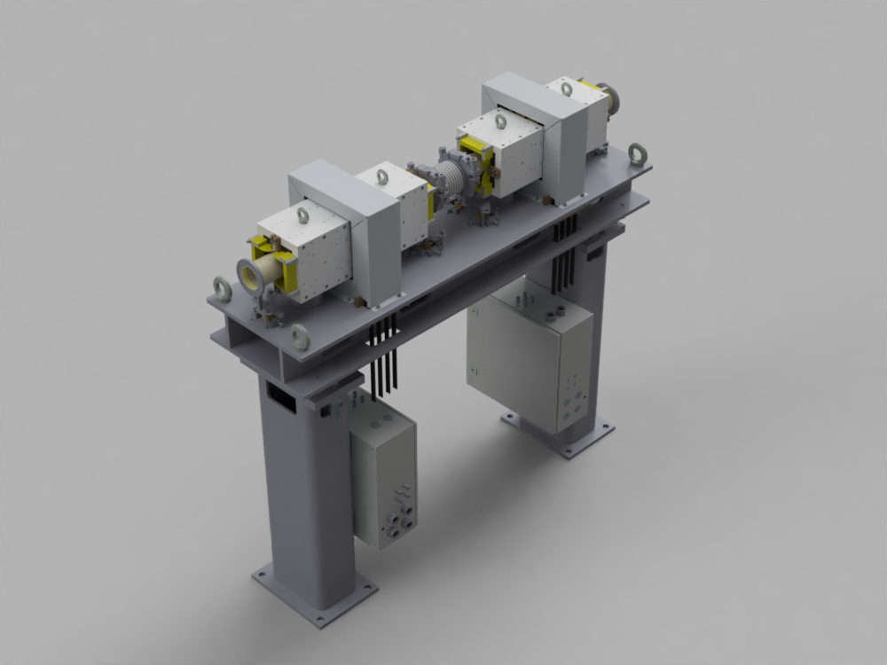
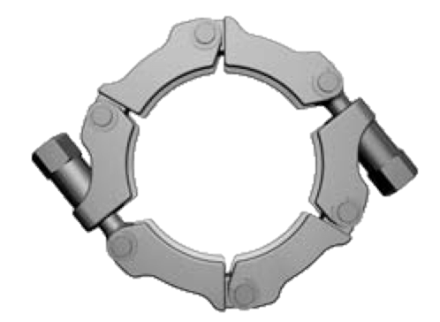
Magnets + Support
1 / 2
Notes:
Cooling water
Bellows, pumps, gauges
Girder

Slide 10
RSM Supply (feasibility study level)
(MPS: Magnet Power Supply)
Input Converter
Output Converter
35 m
Controller
Regulation

Slide 11
BDS Optics Design
(Same state as CDR-2)

Slide 12
A2T Beam Optics
Centroid
10 x RMS beamlet
BEW
QP1-4
8 x RSMs
QP5,6
PBW
B_{y} B_{y} B_{x} B_{x} | B_{x} B_{x} B_{y} B_{y}
ACH
A2T
AP
CO
2.0 GeV: B_{x}L = ±2.6 mT.m, B_{y}L = ±1.5 mT.m, ±5 mT.m
Notes:
RSM physical apertures

Slide 13
Multiparticle Studies
1000 HEBTs x 10⁶ particles
RSM aperture (s = 207 m) appears adequate
NSW aperture (s = 220 m) appears adequate
IPAC’14, WEPRO074

Slide 14
A2T Quadrupole Magnet Harmonics?
A2T quad harmonics were scanned in log. steps, 1 u to 100 u (u_{n} = ∫∆B_{n}/B0 x 10⁴ = 1 u)
500 k particles tracked to target
7.7 unit contamination for each u_{n}

Slide 15
RSM Systematic Sextupole?
u₃ = ∫∆B₃/B₀(t) x 10⁴
Beam along RSMs:
  rms size < 1 mm
  dx, dy < 3 mm
RSMs
  GFR = ± 15 mm
  Gap = ± 50 mm
  Aperture = 78.0±2.5 mm
RSM u₃ < 10³ (or 10%)
Systematic sextupole (u₃) in H RSM set

Slide 16
RSM Alignment Errors?
Insensitive to displacements:
  dx, dy < 0.5 mm
  dz < 0.3 mm
Roll errors:
  distorts pattern outline (shearing)
  depends on average roll error in H/V set
  pitch, yaw, roll < 1 mrad
Roll error distribution < 100 mrad

Slide 17
Magnets

Slide 18
Raster Scanning Magnet (RSM)
Window frame magnet (CMD5005 NiZn ferrite)
Field quality: Δ(∫Bdl)/∫Bdl < 10% @ GFR = ± 15 mm
Notes:
Out of vacuum magnet
40 kHz, Ceramic chamber
Alignment & field quality
Alignment positions

Slide 19
RSM Connections
Bus bars at top and bottom of coil ends
Bdot loop: 1 / RSM
  a single loop around return yoke
  ± 51 V at full amp. Divided to ± 10 V

Slide 20
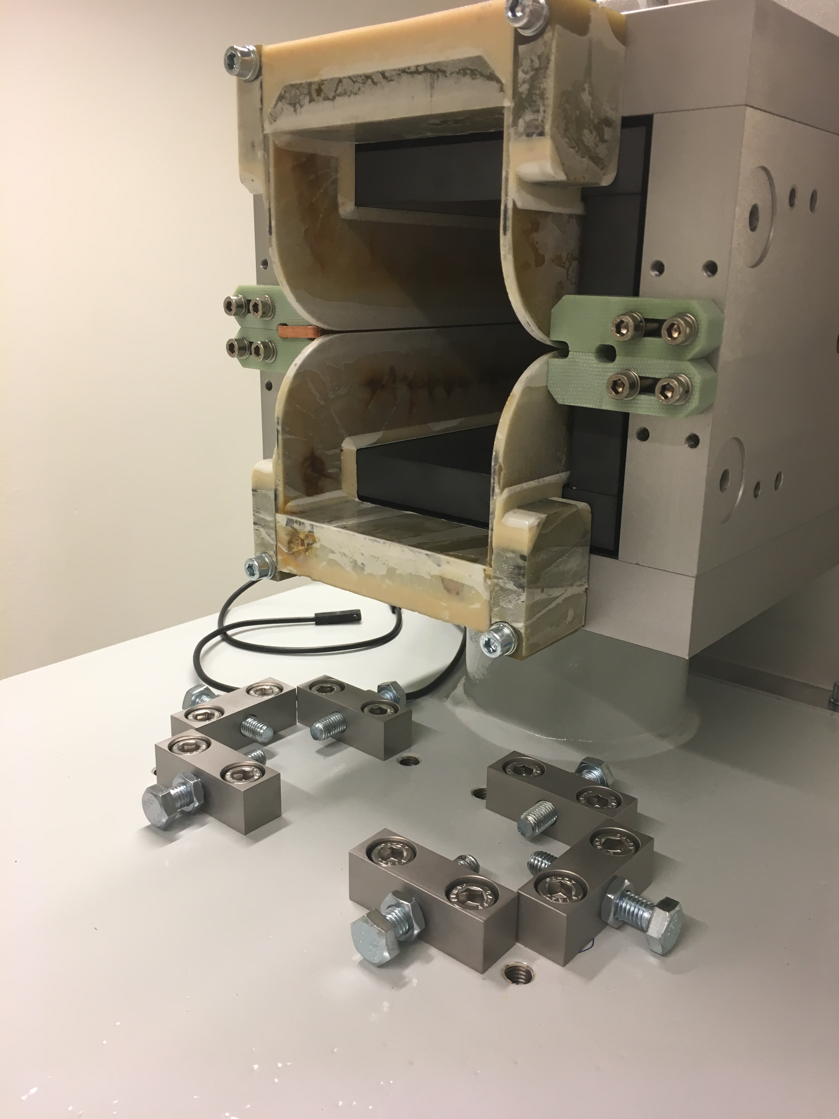
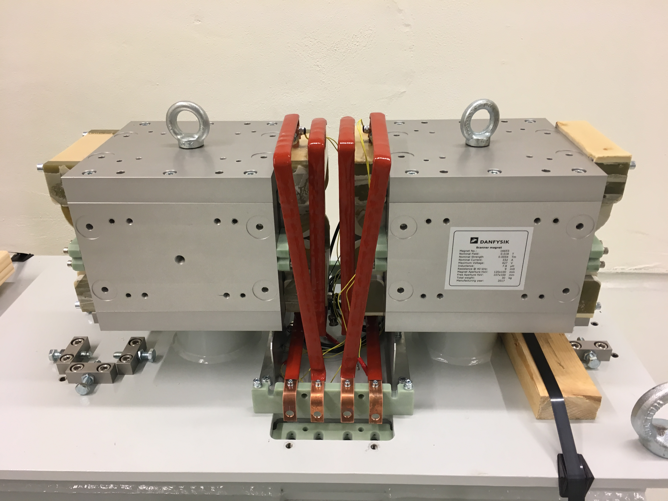
RSM Pair
Thermal circuit breakers
Coil ends
RSM housing
Ceramic chamber
alignment
Coil busbars
Notes:
mechanical properties, G11 Etronax pieces are added to the vulnerable areas and the spaces between each loop will be filled with G11 Etronax pieces.
Not prototype: machining, paint job, equipment labels, etc.

Slide 21

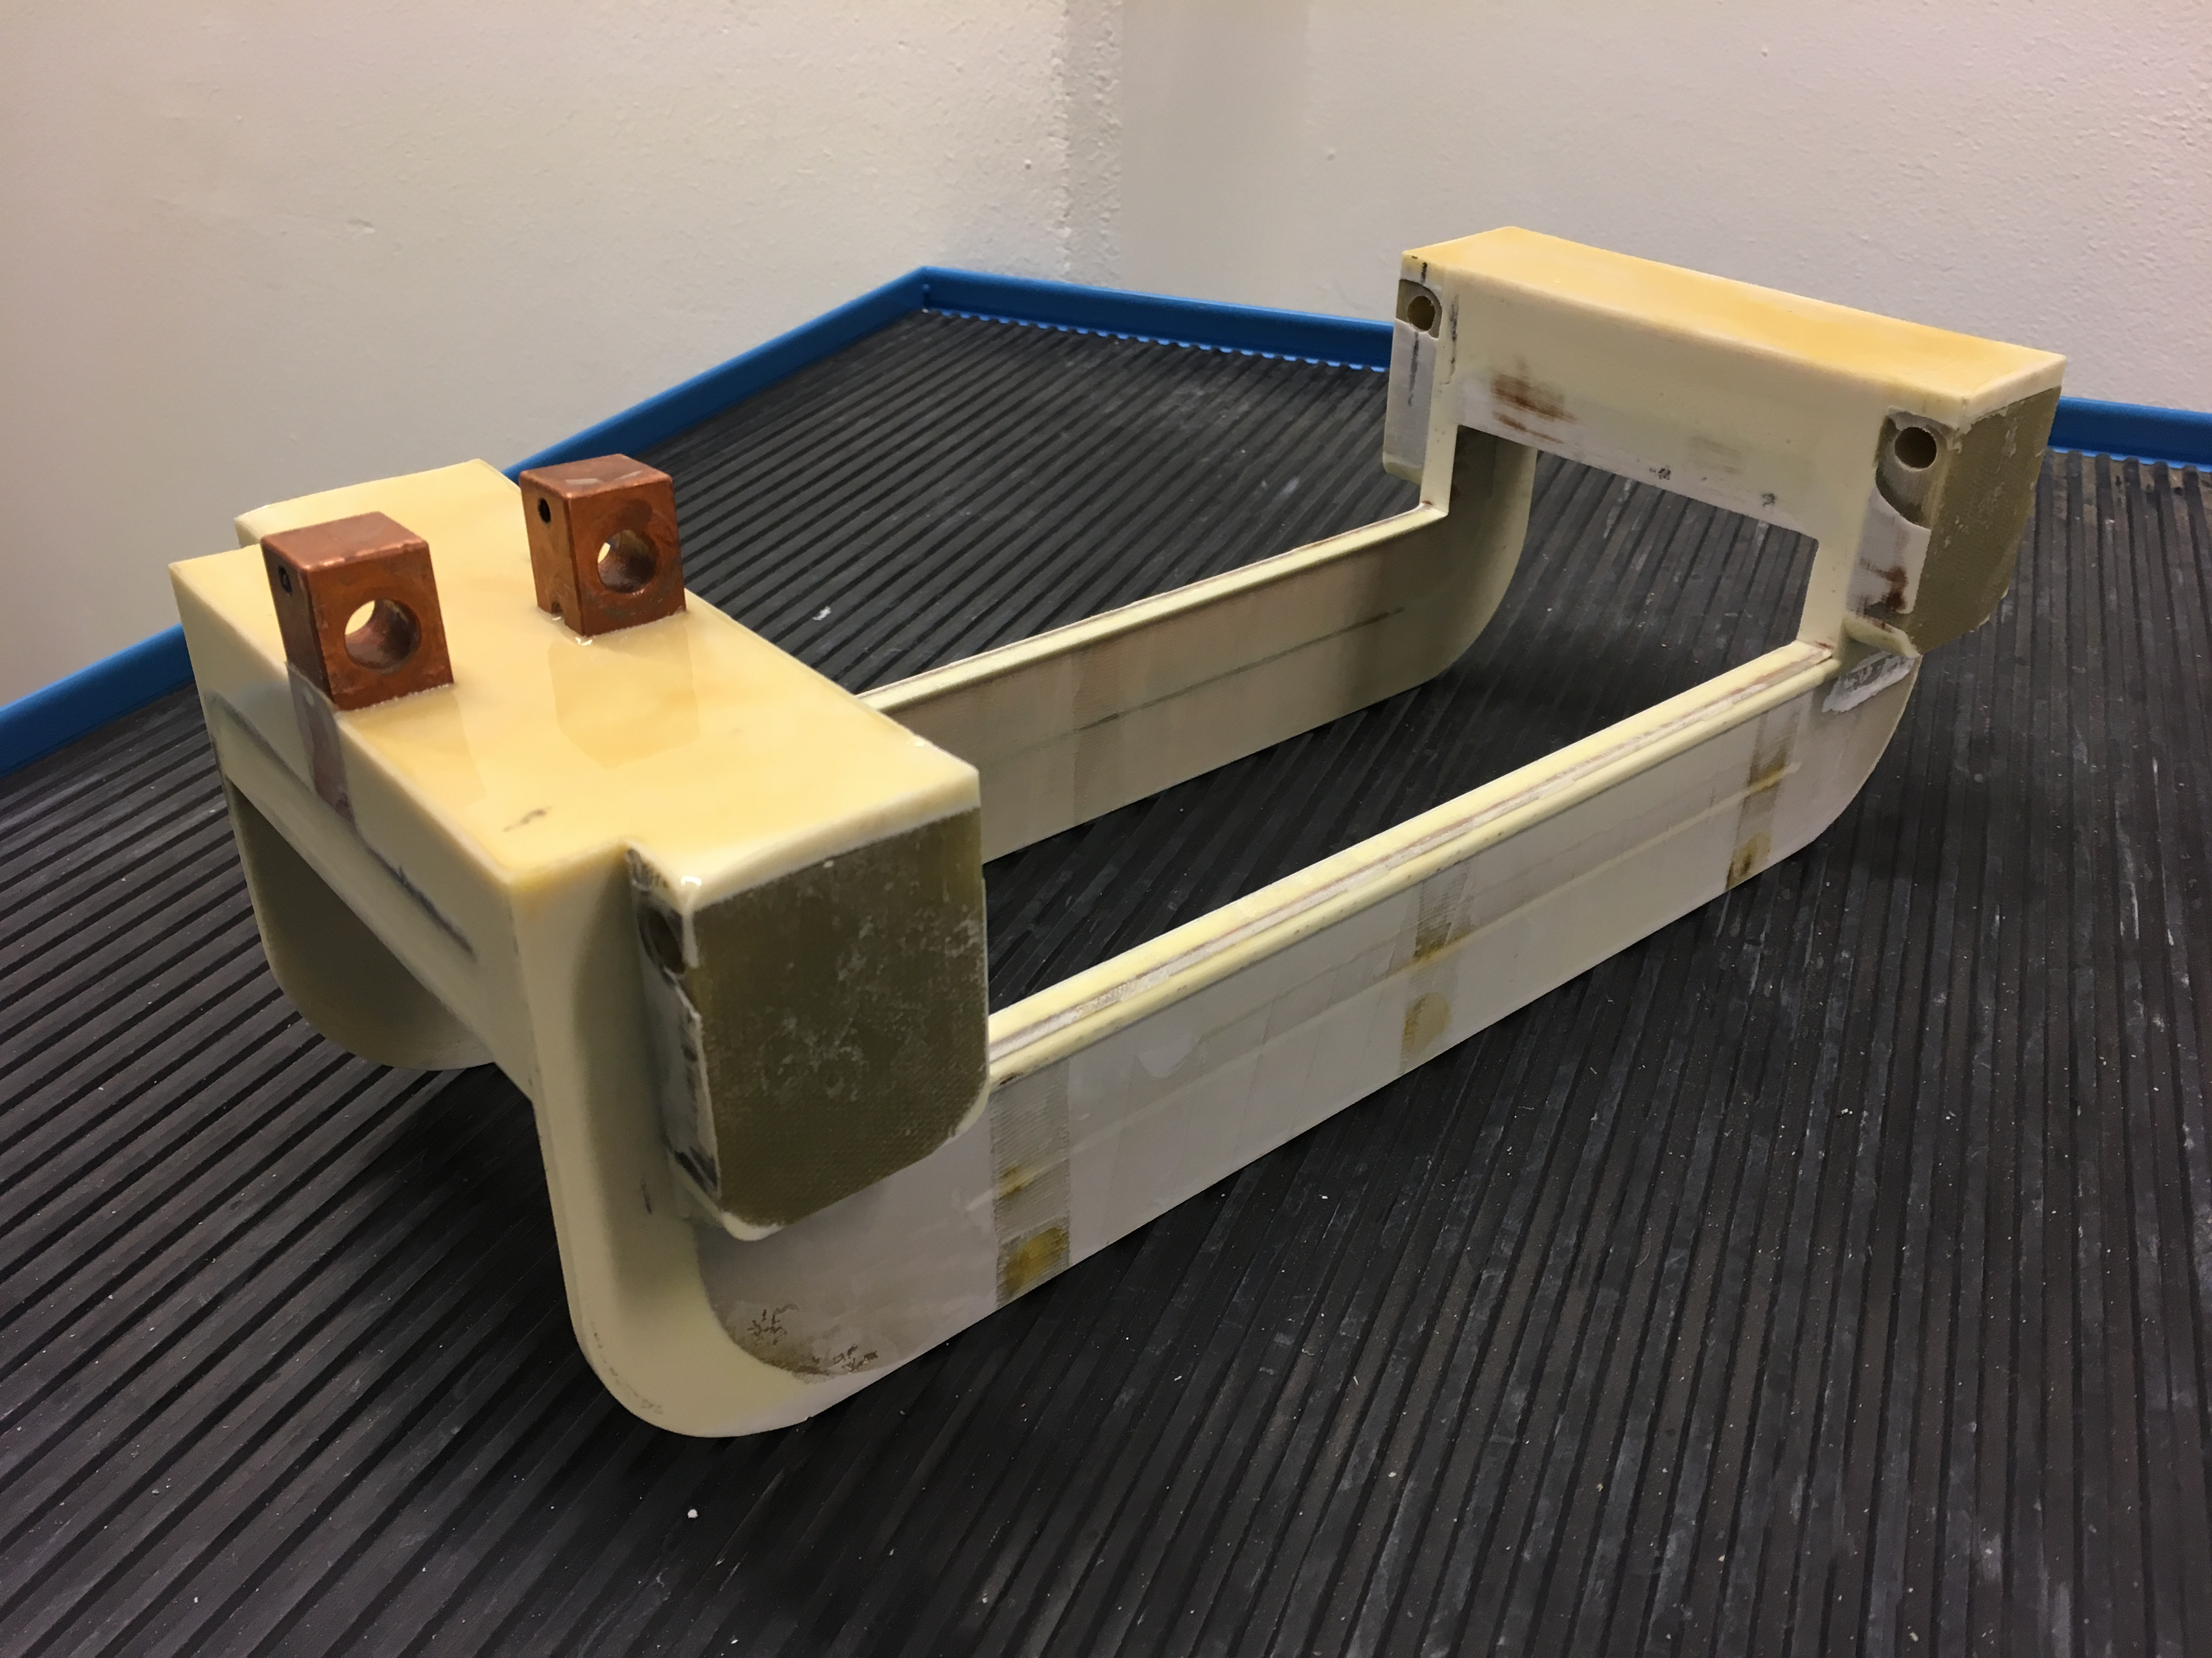
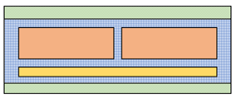
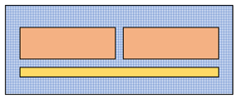
Coil Impregnation Design?
v1
v2
Cu
G11
epoxy
epoxy + alumina
v3
~60% glass / alumina fill factor in epoxy matrix
Radiation resistance of glass and alumina assumed to be similar
v3: a simpler coil, i.e. expected to be cheaper
Notes:
- coils will be vacuum resin impregnated with radiation resistant CTD101K (25 MGy) inside a mould
CTD403 / CTD422

Slide 22
Magnetic Field Studies – 2D & 3D
Using the transient module in Opera 2D, eddy current and proximity effects have been evaluated
  current distributions are affected but the design is not compromised at 40 kHz (skin depth ~0.3 mm in Cu)
Only minor surprises found:
  The inductance is found to be larger than the analytical calculation.
Integrated field homogeneity @ GFR = 15 mm (spec. <10%)
  DDR simulations: 1%
  FAT: <= 0.26% (calibrated strip line probe)
Thermal calculation: ~15 W (300 W x 5% duty cycle) is dissipated in each magnet

Slide 23
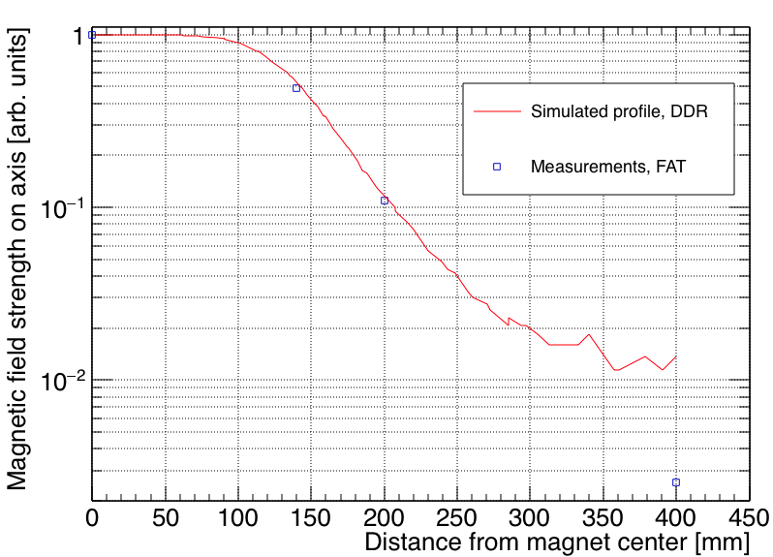
Field Measured with 1 cm² Pickup Coil
Notes:
Comment on FAT2

Slide 24
Vacuum Chambers & Support Structures

Slide 25
Vacuum System
Vacuum system consists of
Ceramic (Al₂O₂) chambers at the RSMs
Quick-Conflat flanges
Hydro-formed bellows, ID Ø120 mm
No pumps, gauges, etc. are relevant
No metallization layer is provided (but prepared)
One chamber design, QCF100+QCF100
Notes:
- - “design and manufacturing shall follow … ESS vacuum standard handbook” and UHV standards in general. Oil free…
- brazed transition pieces made from NiFe alloy
- The ceramic pieces will be prepared for a possible metallization of its interior by having the metallization for brazing extended on the inner surface by 4-5mm.

Slide 26
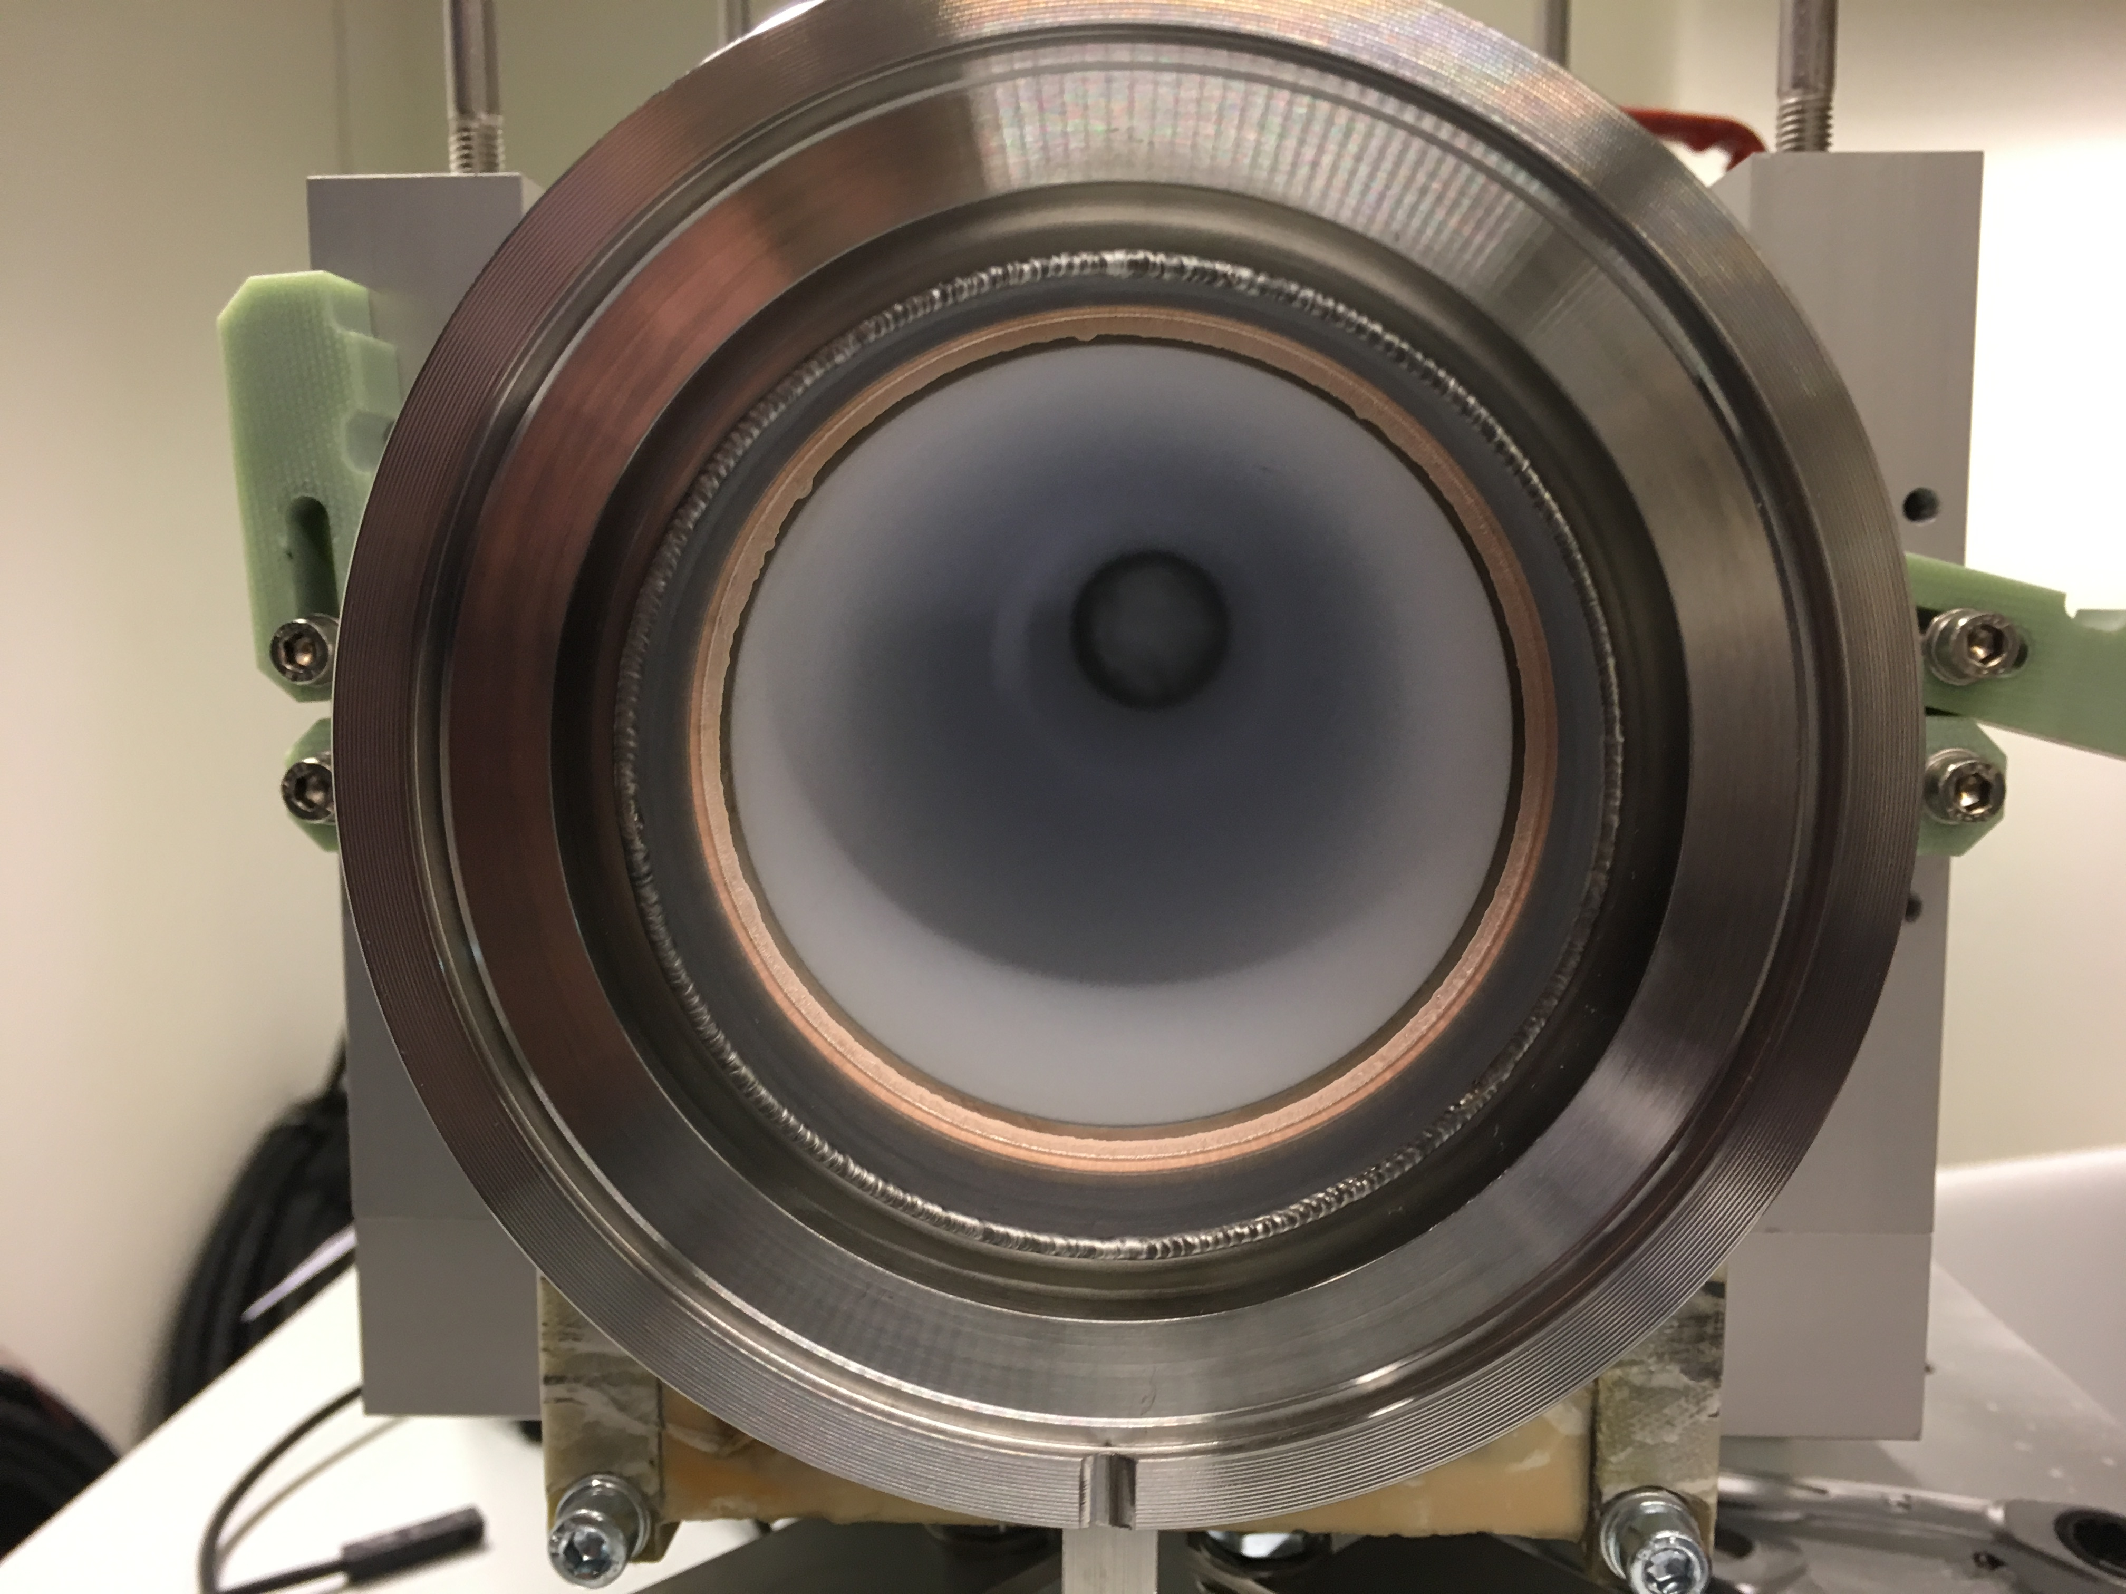
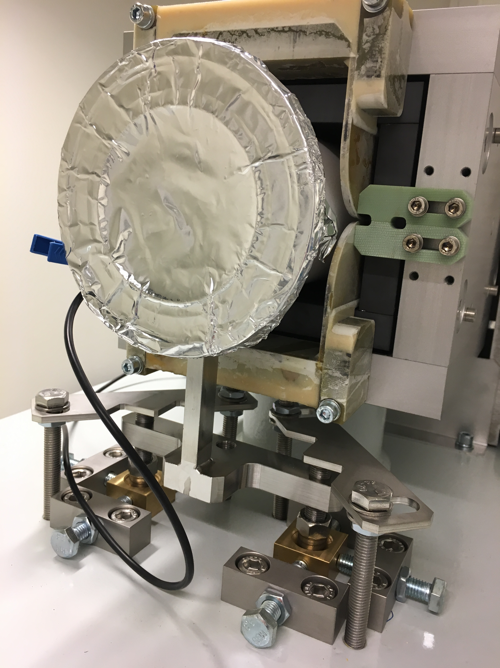
Ceramic Chambers
Notes:
Metallization plans + thickness

Slide 27
Ceramic Chamber Coating?
Chamber inner surface is to be metallized at ESS coating facility
Thickness is to be
  Small; enough to be transparent to raster freqs.
  Thick; shielding bunch freqs.
  Uniform? Verified at ESS?
  Could be ~< 1 µm. Capability of coating facility?
Need to align schedules…
Verification? Measure before and after coating and compare.
For a given current amp, note:
  Supply capacitor voltage
  Signal from probe coil + voltage integrator
Probe coil could be
  As wide as chamber ID
  Narrow (to allow scans)
Notes:
Chambers coated? Pre-series offer testing.

Slide 28
RSM Support (1 of 2)
Notes:
fixed but removable metallic covers for HV connections
alignment procedure
(dx, dy) < 0.5 mm, dz < 0.3 mm
(ϕ_{x}, ϕ_{y}, ϕ_{z},) < 1 mrad

Slide 29
Support
Girder-based: most elements are fixed to precision-machined surfaces on a girder that is aligned as a rigid body relative to two support stand columns.
  magnet-to-magnet alignment will be checked within a girder section during assembly
3 screws + 3 turnbuckles provide six degree of freedom for alignment of the girder
A total of ±25 mm horizontal range and ±35 vertical range
Alignment – iterate:
  reach nominal beam height of 1500 mm
  angular alignment to ±0.1° (pitch/yaw/roll)
  transverse adjustments
RSM housing top plate features
  a set of alignment fiducial holes
  room for a precision level gauge

Slide 30
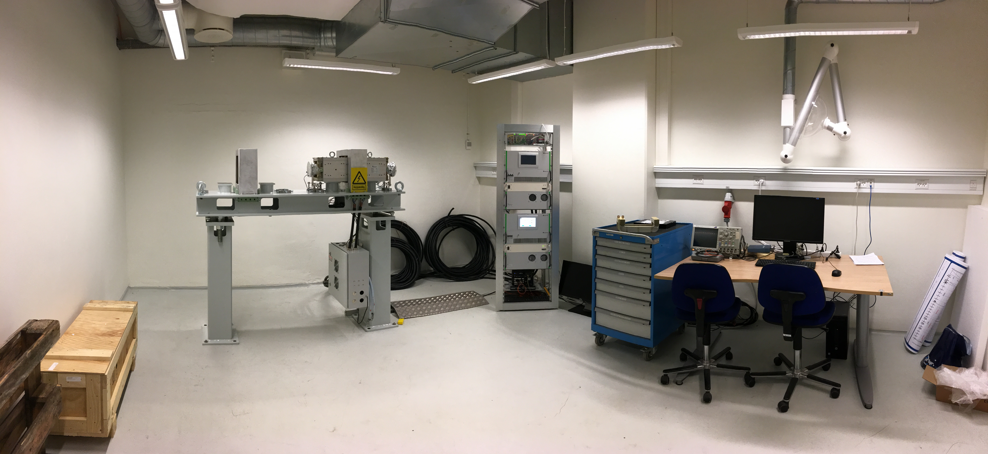
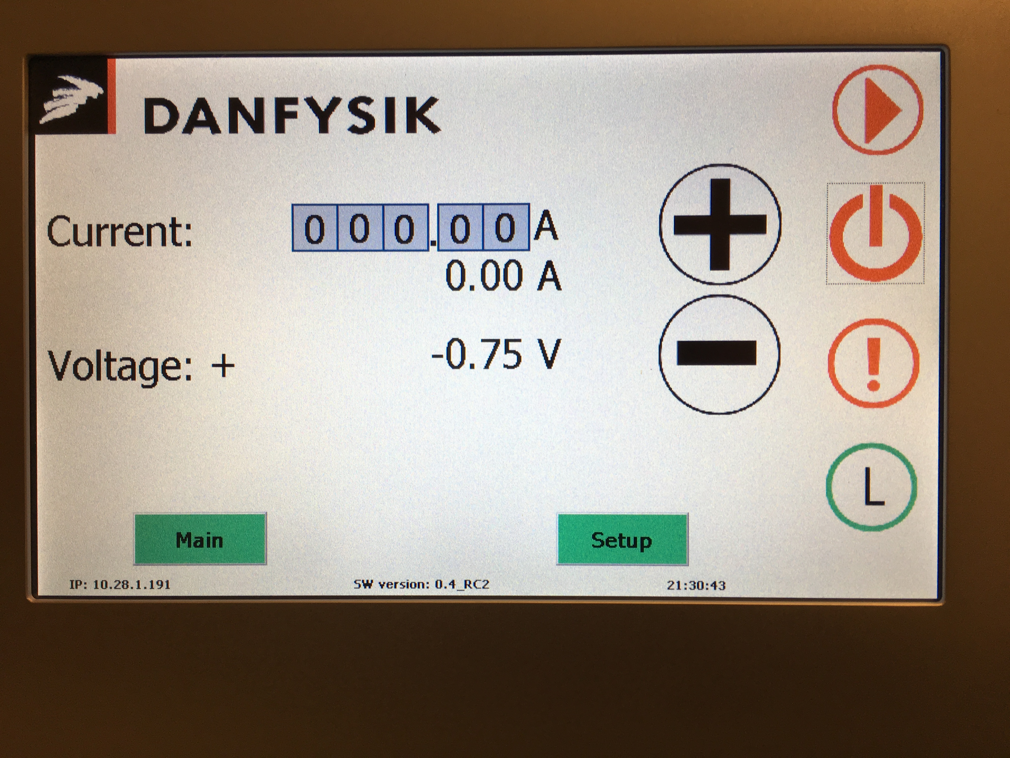
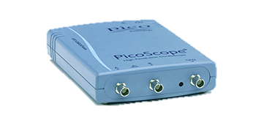
AU Test Lab
PLC
RSM2 RSM1
PicoScope
Power cables
RSM2 RSM1
Girder
EVR
Termination box
Bdot, Interlock
Local PC

Slide 31
RSM Power Supply (RSMPS)

Slide 32

RSMS-PS Block Diagram: 4 crates/magnet
Notes:
Remote line
ISOx

Slide 33
RSMPS Block Diagram

Slide 34
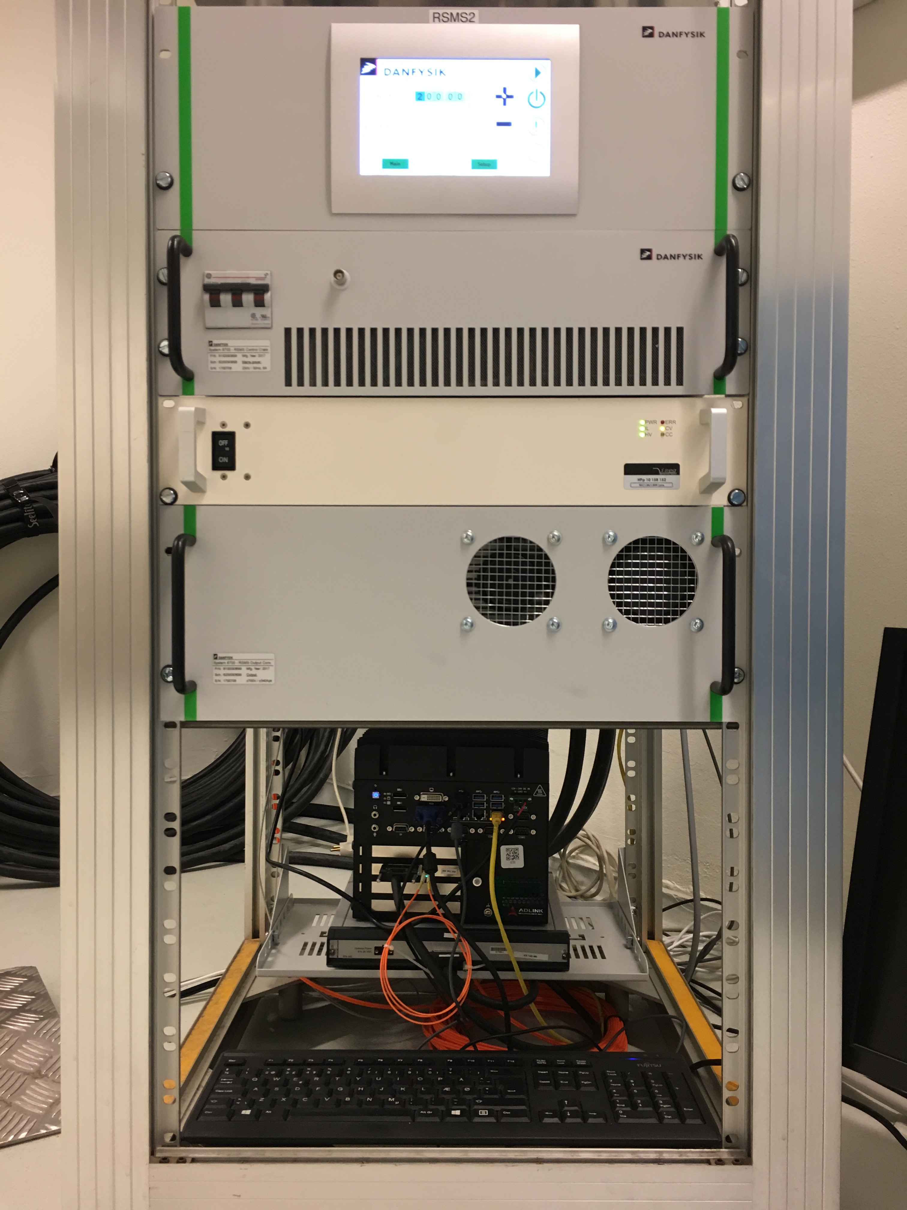
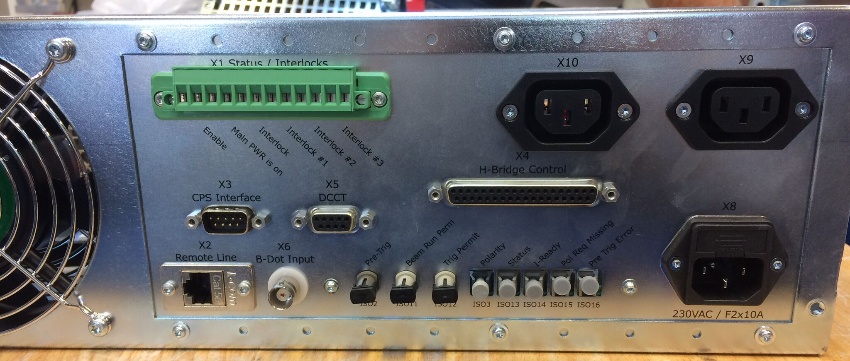
IPC
CC
CCPS
OC
IOC+EVR
Iñigo Alonso
Notes:
Enable+Interlock

Slide 35
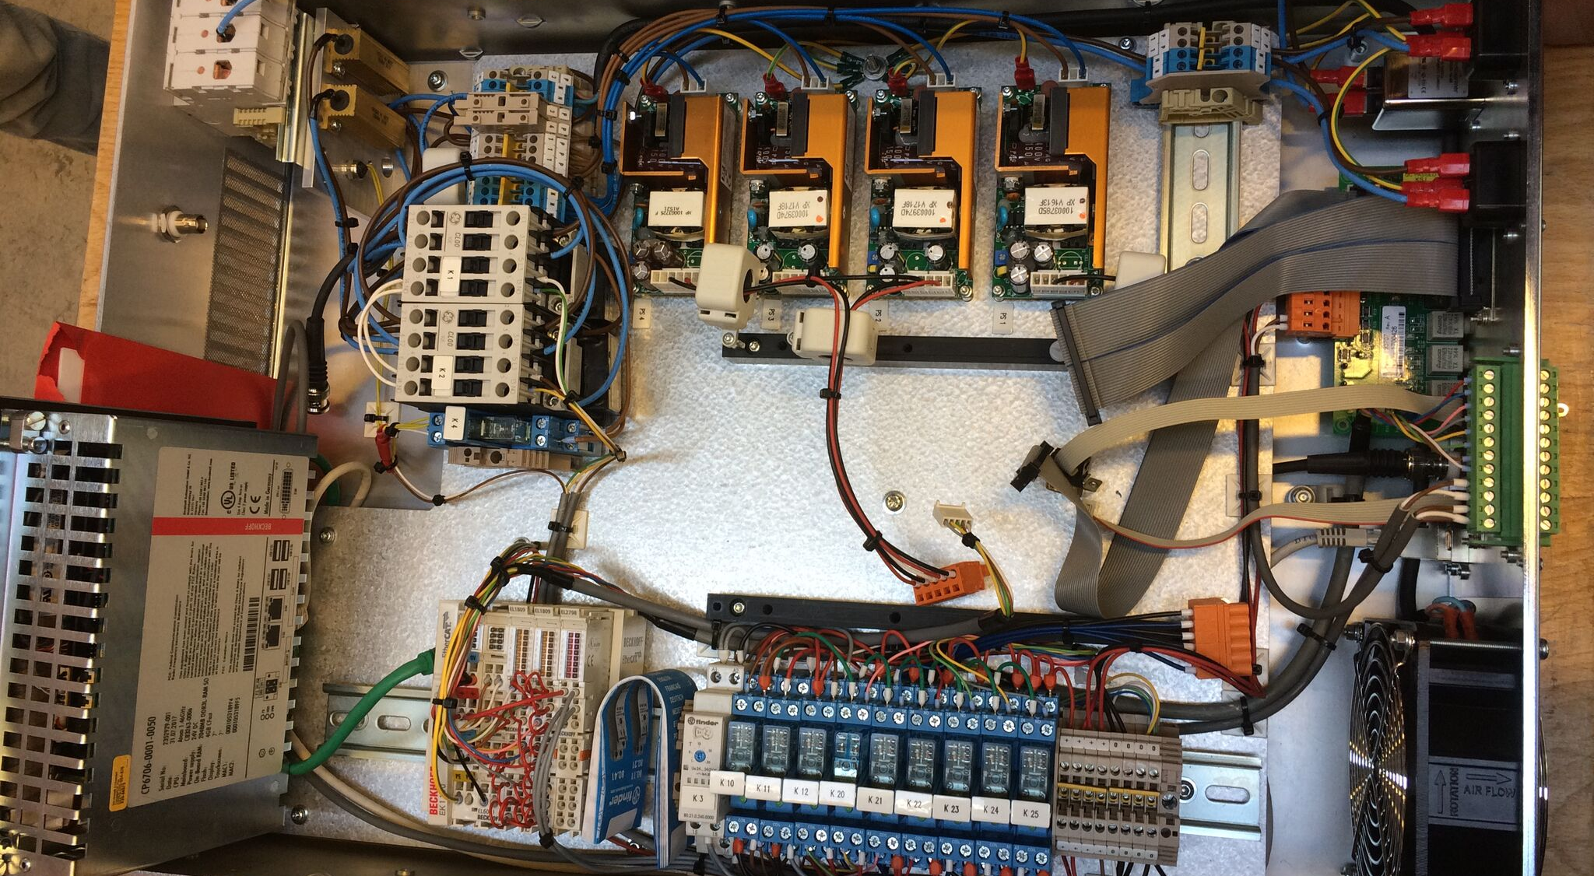
Control Crate, 19” 3U + IPC

Slide 36
Control Crate, 19” 3U + IPC
Bechoff CP6706 IPC
Communication to local and remote control
Interlock supervision
ON/OFF control
Analogue measurements
Motherboard for regulation and DCCT module
Signal interface module (including light guides)
  Timing EVR
Remote line, RJ-45
  SCPI protocol
DCCT interface
Auxiliary power supplies for all electronics

Slide 37
Output Converter, 19” 4U
Cap. bank (and bleeder circuit)
2 x half-bridge modules: SiC MOSFET, 1.2 kV, 3.6 mΩ (CAS325M12HM2)
Gate drivers
Output current transducer (for regulation)
Heat sink with NC thermal switches (supply interlock)
Short to ground on output: soft earth connection
Notes:
Integrator

Slide 38
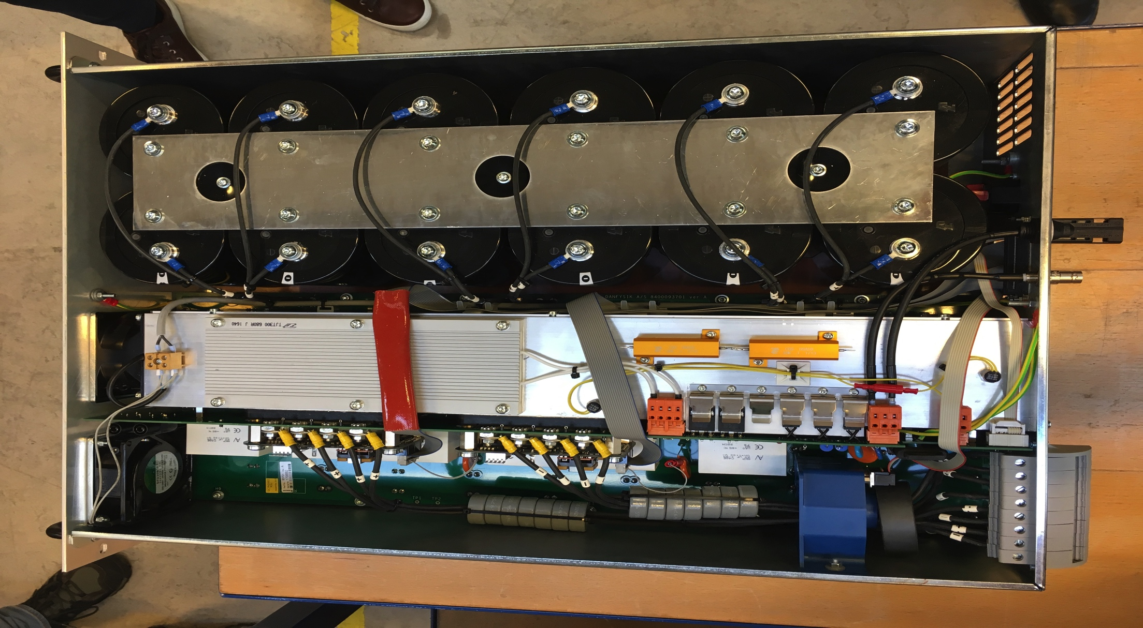
Output Converter, 19” 4U
Load
cables
DCCT
From
CCPS

Slide 39
Regulation
Intra-Burst (“fast”)
Inter-Burst (“slow”)
Pos. and neg. current peak levels are compared for every “pulse”, e.g. every 1/40 kHz
A waveform DC offset can be neutralized in time domain: by introducing a timing skew in the H-bridge
Pos. and neg. peak levels are averaged over a burst
Levels are compared to amplitude setpoints
  Predicted DC Link value is reconfigured in the post-processing phase.
SPICE sim. of current
@Magnet
@Supply output
350A / 340A = 1.03
Notes:
Current output peaks are detected and sampled (ADC)
Simulations show that offset regulation can be very efficient
Cable distortion and filter effects + slight overshoot (350/340 = 1.03)

Slide 40
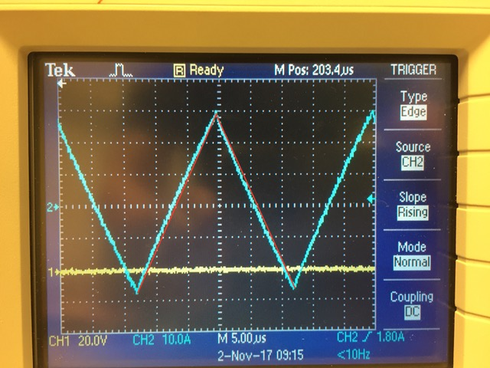
Between CDR-2 to assembled hardware…
Ext. master oscillator discontinued
Studies:
  Cable parameters
  Early testing of SiC MOSFETs
    No snubbers: only 60V overshoot at max. 600V (V_{DS} = 1200V)
  Regulation module, proof of principle
System 8700 (Beckhoff IPC)
Coil impregnation testing
LLI delays:
  Ceramic chamber
  Ferrites
Early current waveforms: 30 A @ 40 kHz

Slide 41
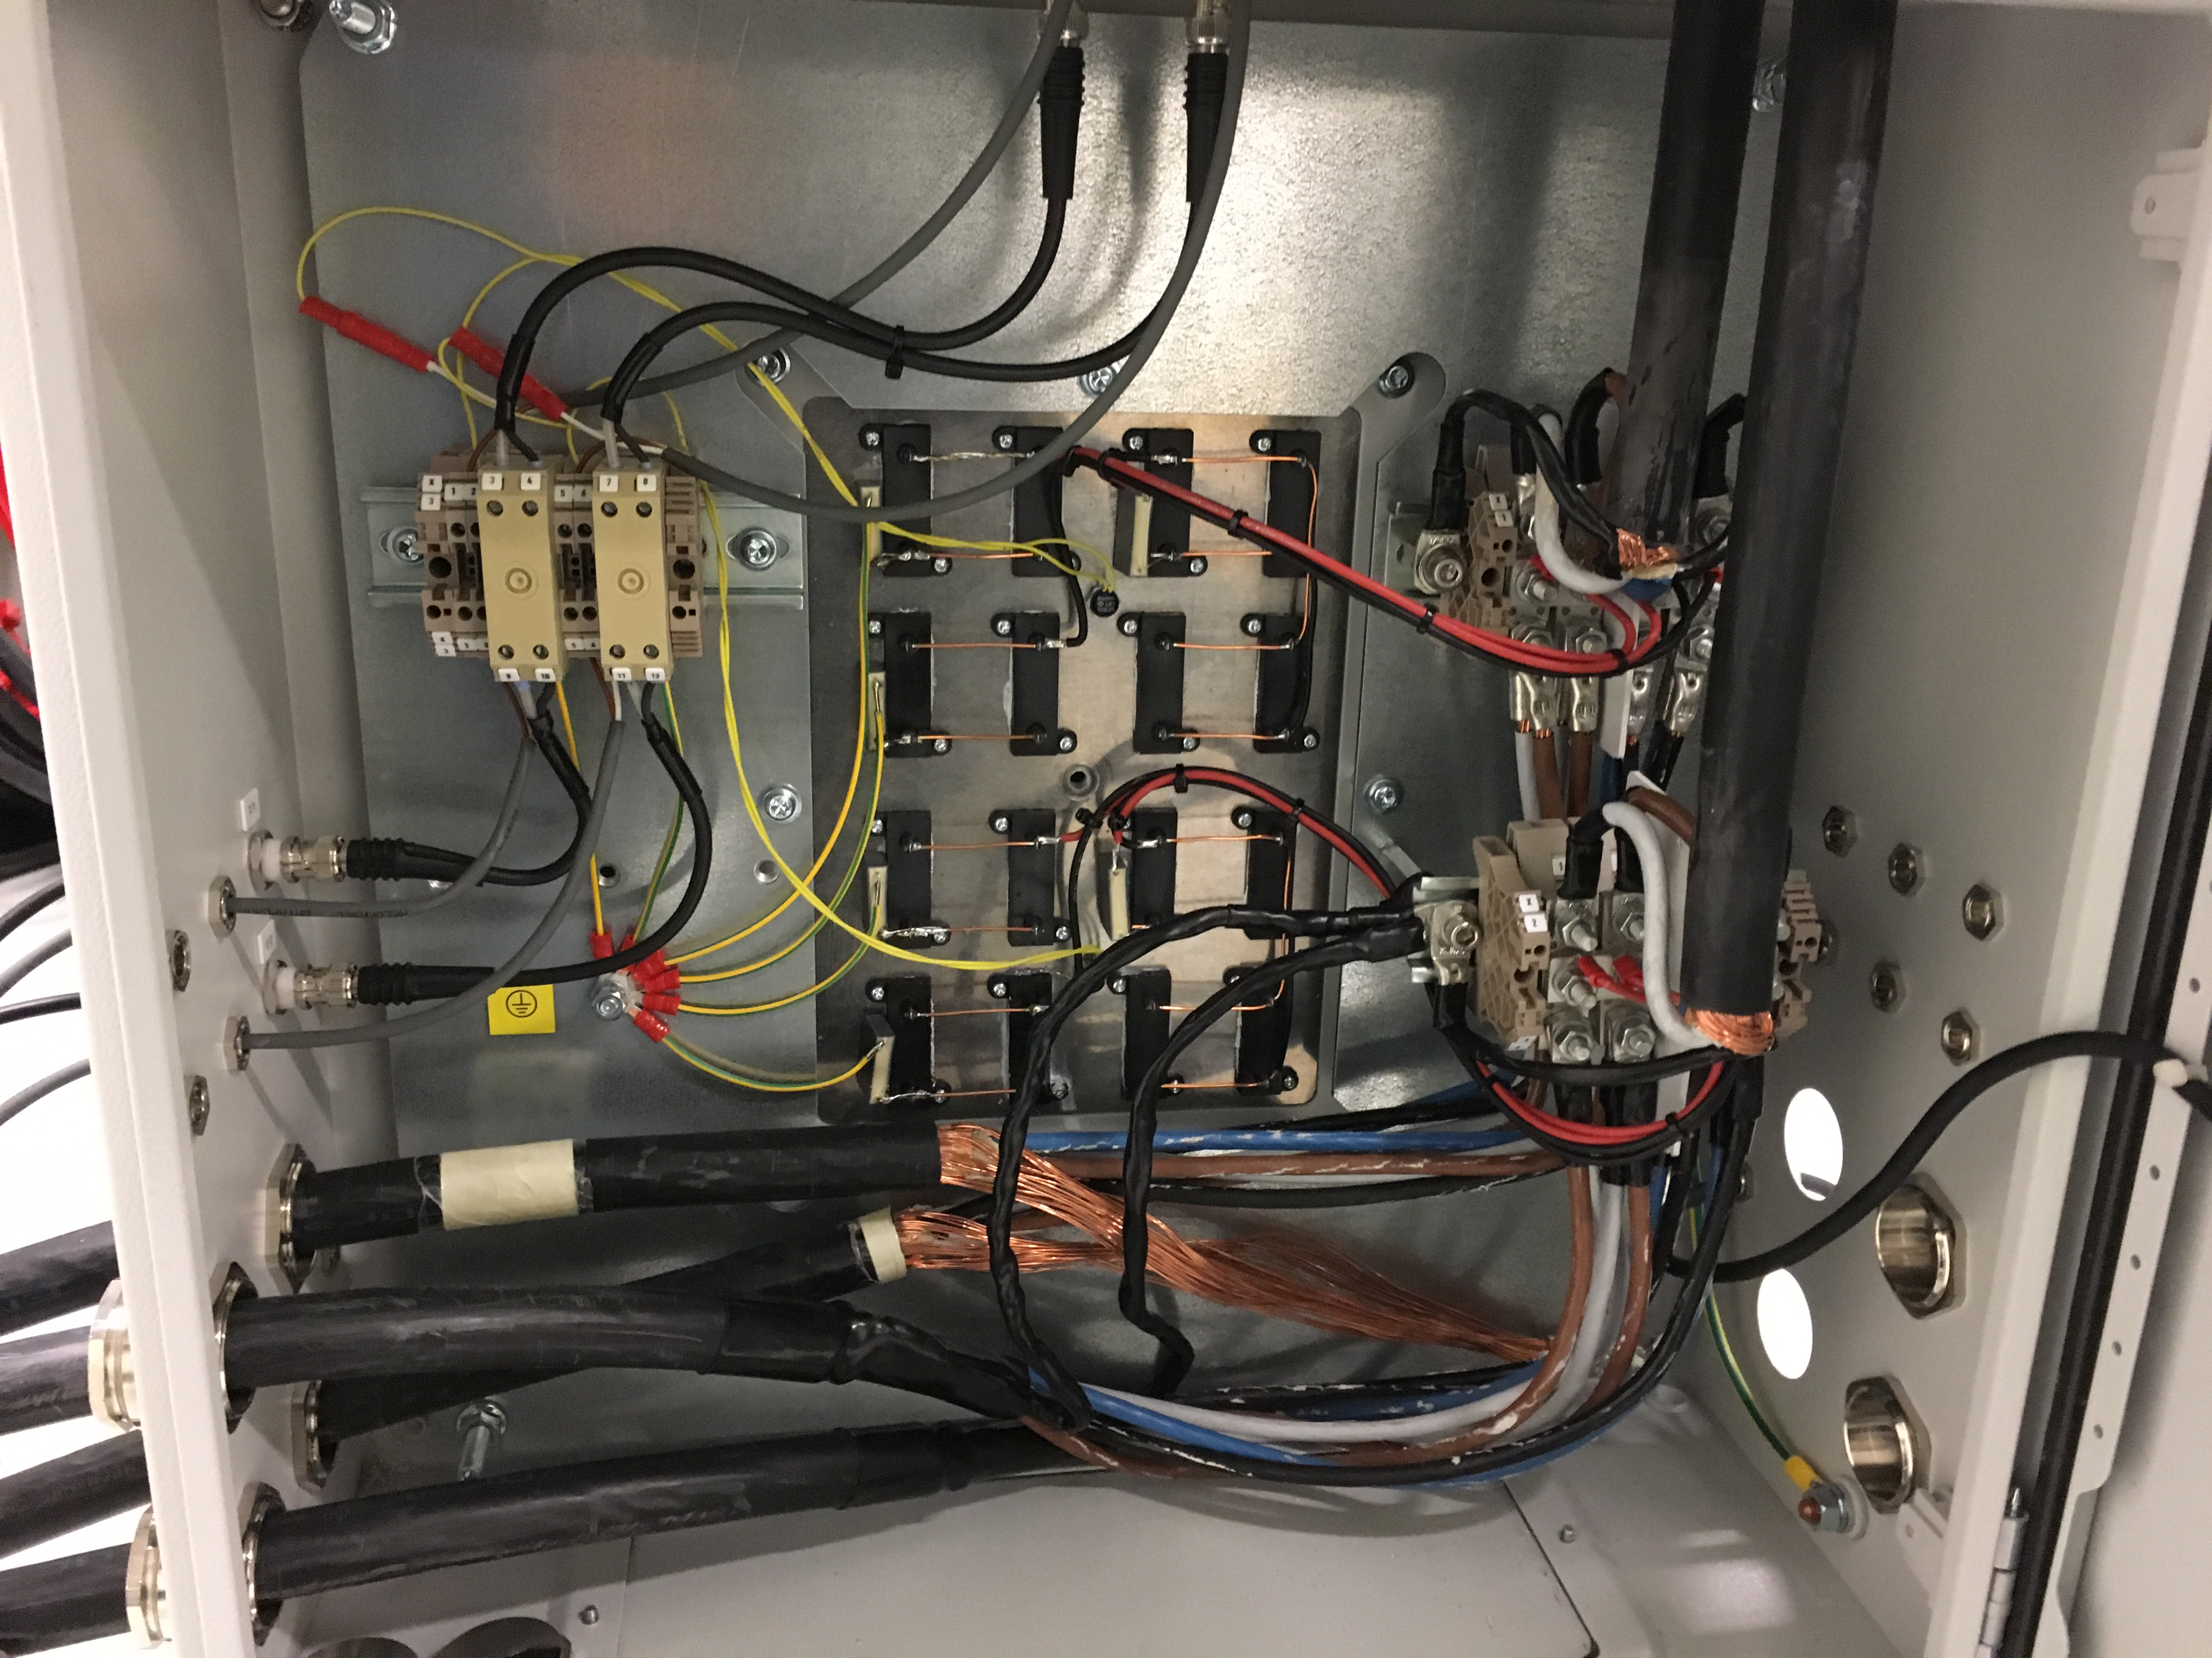
Termination Box
Bdot and thermal breakers (from RSMs)
Termination Box
RSM1
RSM2
Matching filter
RSM1
Bdot and thermal breakers (to supplies)
Matching filter
RSM2
Power cables, 2 / RSM

Slide 42
Verification of Pre-Series

Slide 43
FAT-I: November 2017
Programme (CDR-2)
Visit to Danfysik, Nov 29-30
Performance validation at several setpoint combinations
Stability tests (~8 h)
Safety: high-voltage isolation
System self-protection: short to ground, excessive parameter setpoints, frequency
Inspection of hardware (limited assembly)
Review of FAT results
Training
Inspection and confirmation of interfaces
AU: Søren Pape Møller, Heine
ESS: Iñigo Alonso, Kent Wigren, Javier Cereijo Garcia

Slide 44
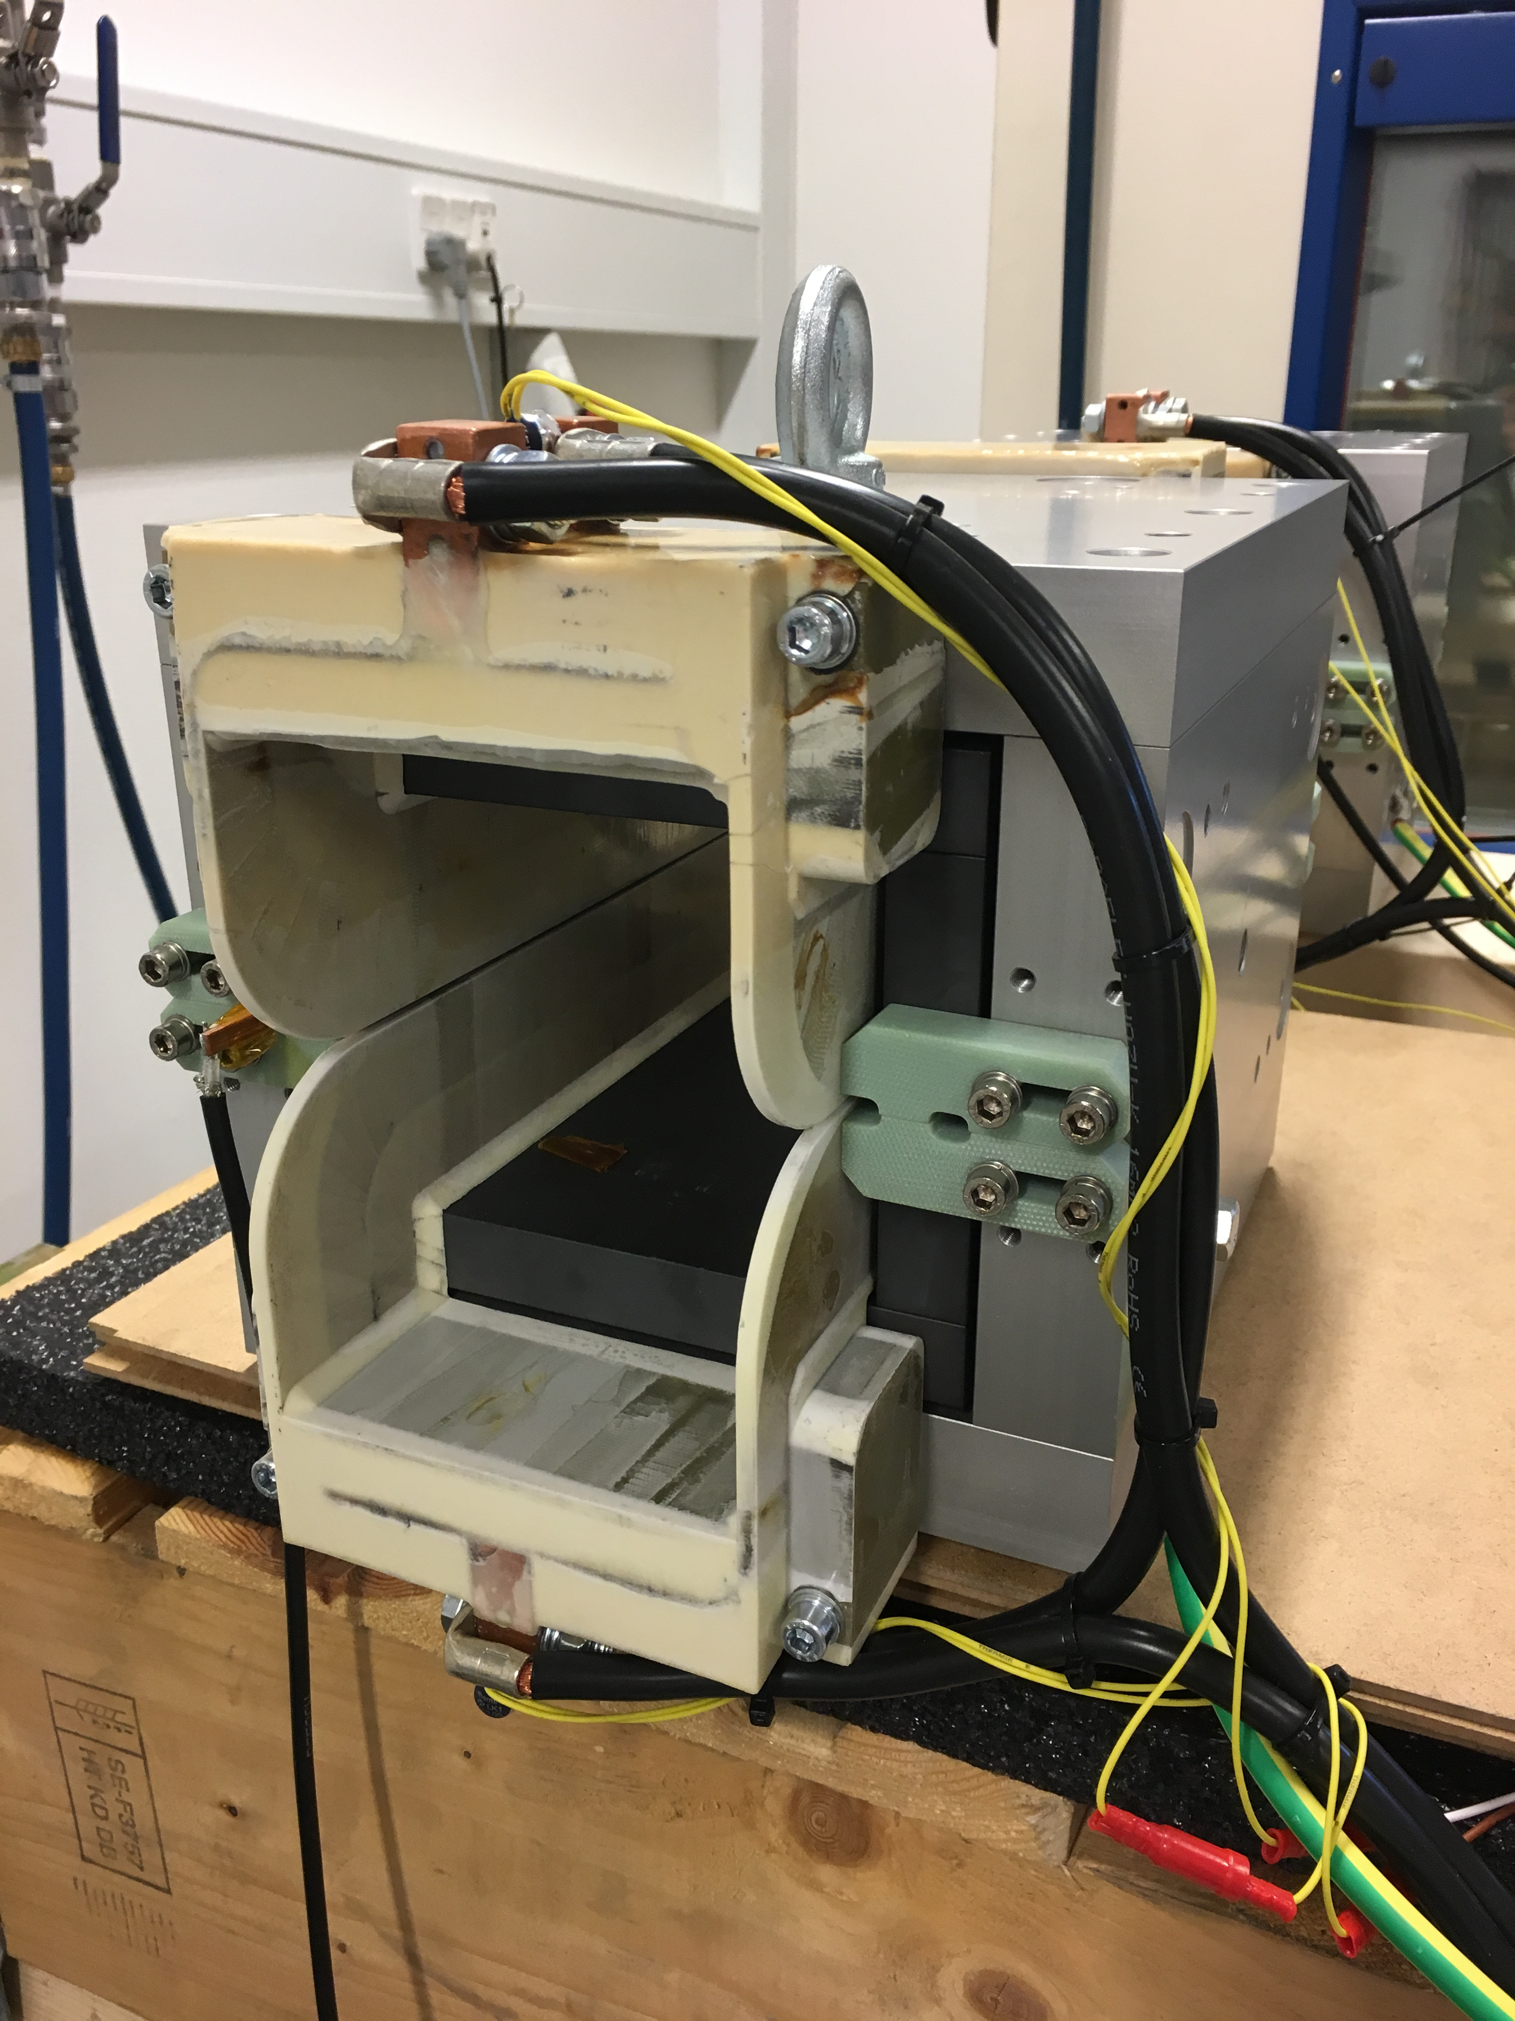
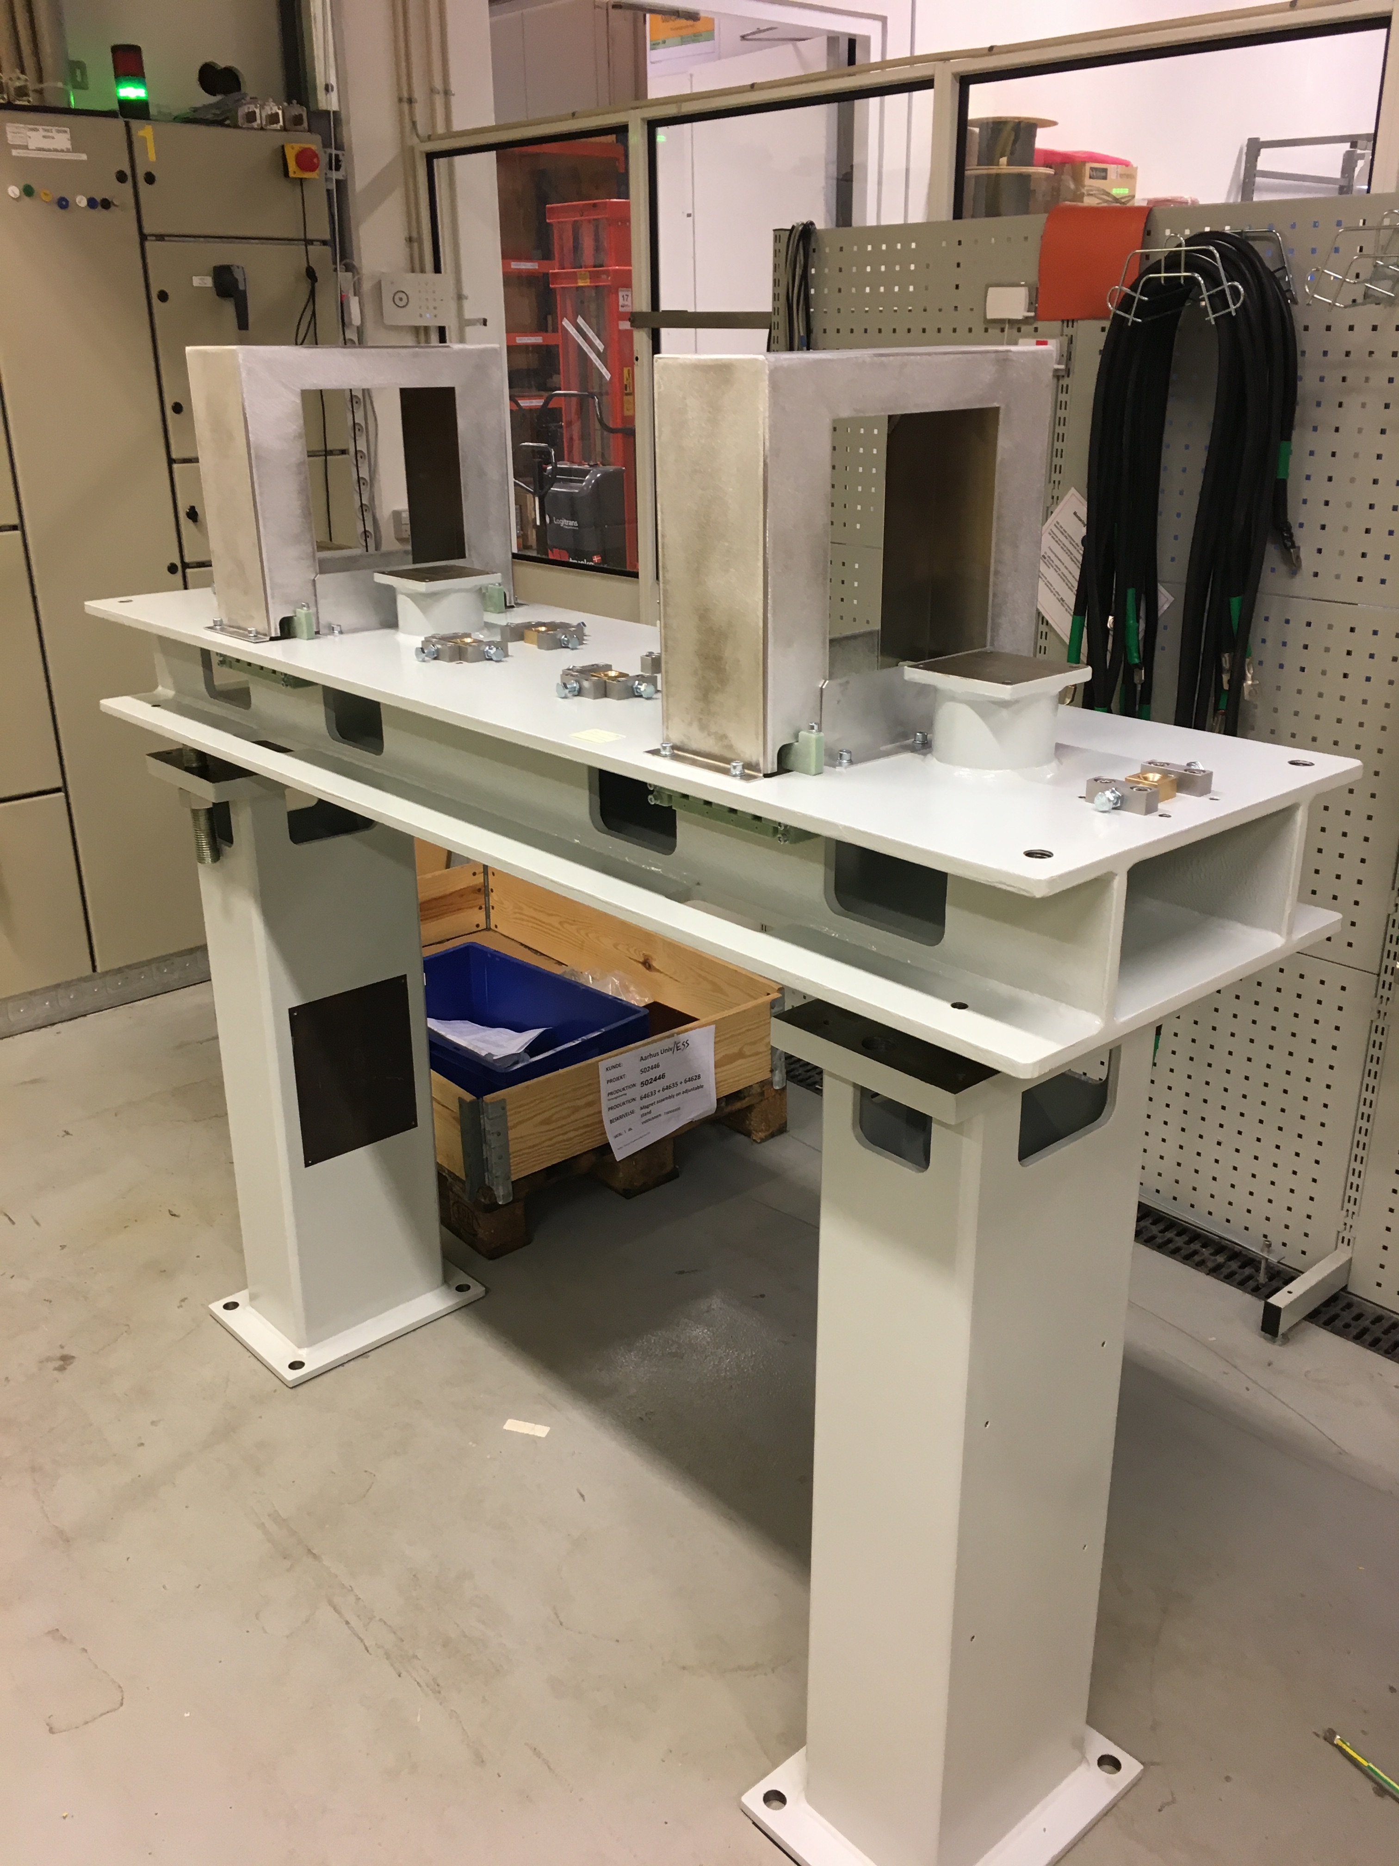
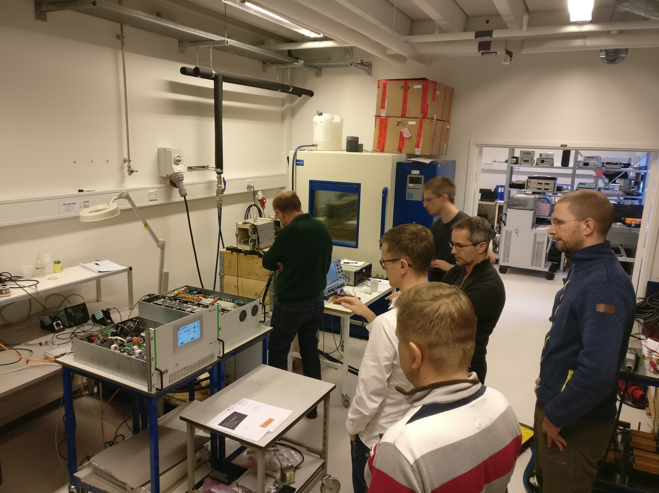

Slide 45
FAT: Parameters > Acceptance Criteria
Absolute amplitude accuracy, TS 2.10. 3.0%-3.2% (1%)
  Power cable discharge: the power cables will continue to discharge energy in the magnet a bit longer than the supply actually does
  Peak detection: the inter-burst regulation loop relies on peak detection in the current waveform (slight frequency dependence)
  Decision: Accepted. Can be remedied with a calibration (beam response)
Stability, TS 2.12. 1.1%-1.2% (±0.5%)
  Specification is only very marginally exceeded, and is to be compared with the relative beam size (~20%)
  Decision: Accepted
Offset, TS 2.13. 1.3% of full current (<1%)
  The measured offset concerns a specific, single period of the burst. On average the offset is expected to be smaller due to regulation loop.
  1% DC offset would correspond to a beam displacement of ~0.6 mm at the target
  Decision: Accepted, tolerance exceedance has only minuscule effect
Notes:
Amplitude accuracy: no regulation at load, remote sense wires
Beam position stability at target

Slide 46
Site Acceptance Test Results

Slide 47
SAT Test Steps
System installation
System IO
Bdot characterization
EVR from ESS
  Synchronization
  Polarity
Temperature stability
Long-term testing: stability, reliability
(Stress test of supply): not typical application
Notes:
Focus on tests not already conducted at vendor

Slide 48
System Installation in Aarhus Test Lab
2017.12.13: System received
RSMs mounted on girder
Cables coiled on pallet
Supply crates in boxes
Chamber: delayed!
Support stand columns on pallet
Installation experiences:
Straightforward
Power cables are indeed stiff, 2 man.days / 2 RSMs
OCs are heavy (cap. banks): rack trays
2017.12.22:
System installed
Wfm.gen for pre-triggers
2018.01.22: EVR operational
2 x Pre-triggers
2 x Polarity (constant)
2018.03.14
Ceramic chamber
RSM1 coil replacement (v2 -> v3)

Slide 49
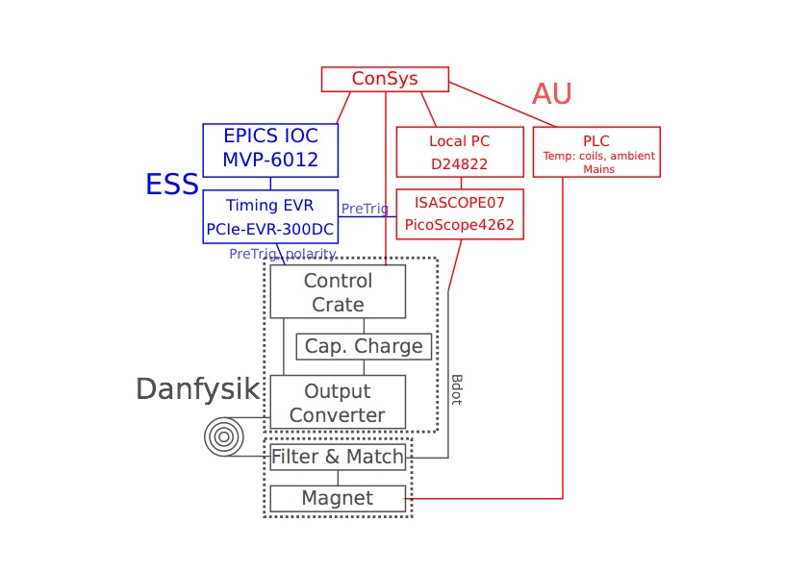
SAT Setup: Block Diagram
Notes:
PicoScope 4262, 2ch, 16 bit, 5 MHz, 10 MS/s, will sample both waveforms.

Slide 50
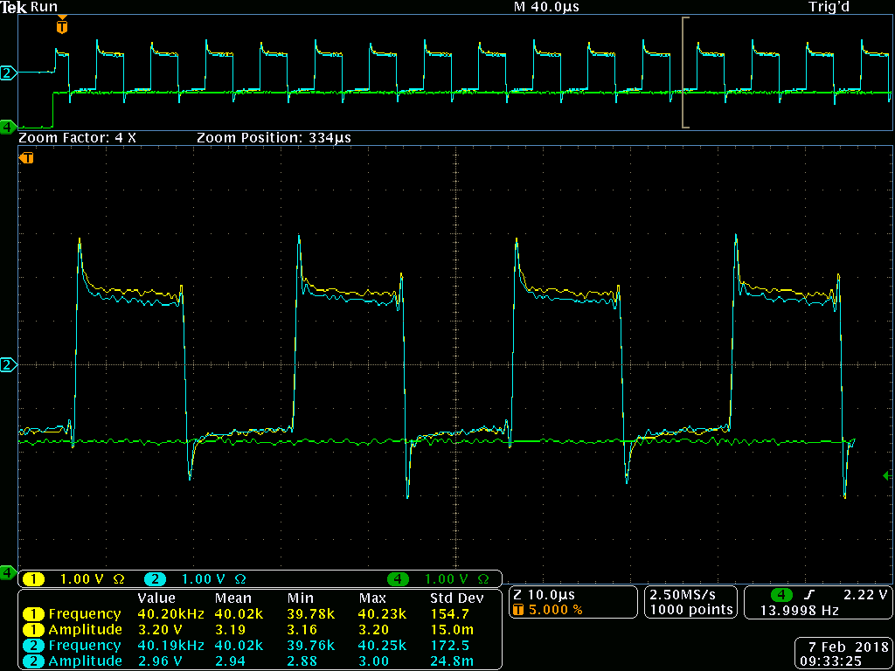

Slide 51
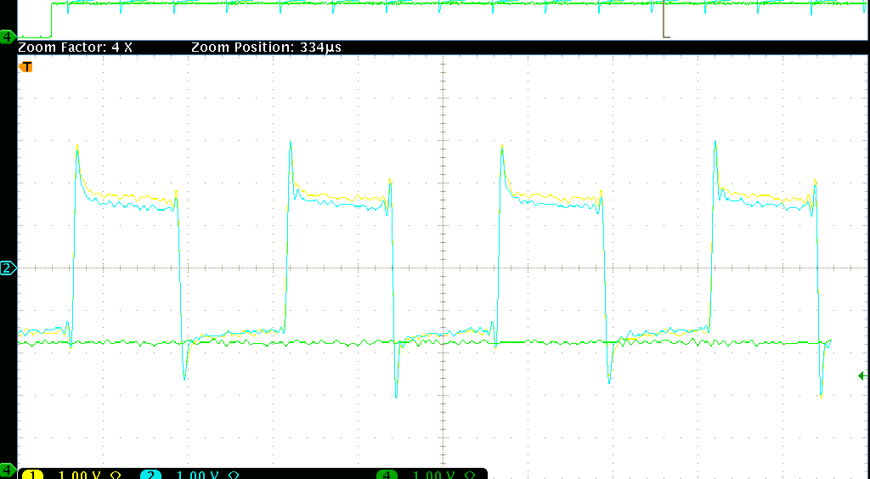
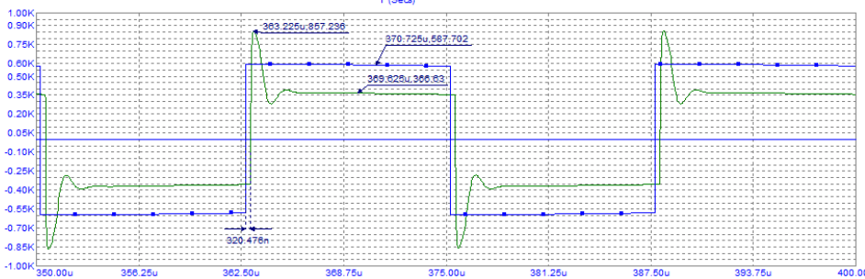
Bdot Waveform Shape: Scope vs. SPICE (DDR)

Slide 52
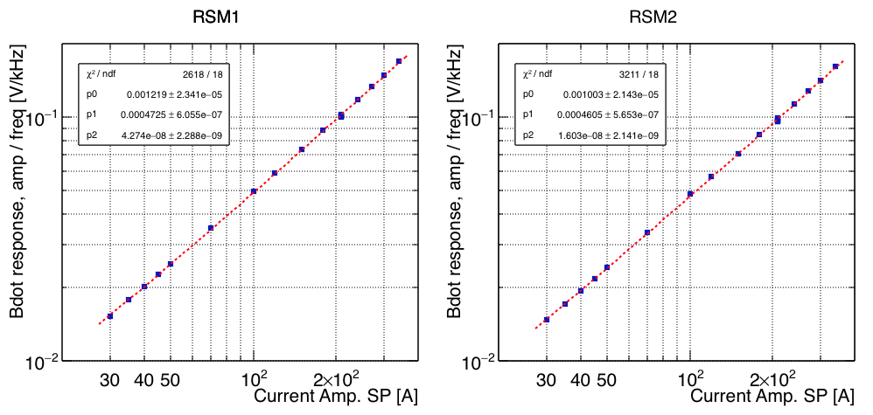
Bdot Linearity -> Reconstructed Current Amp.
Normalized Bdot signal = Bdot amplitude / frequency
Norm. Bdot linear function of current amplitude setpoint (NB: log-log).

Slide 53
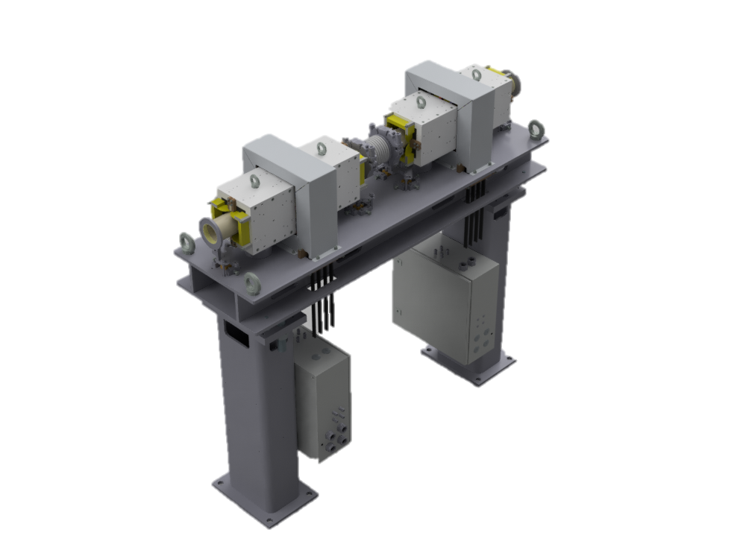
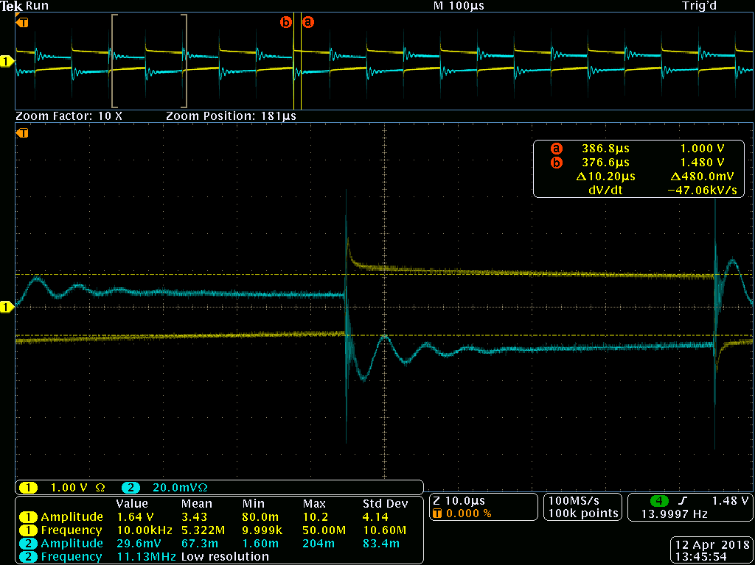
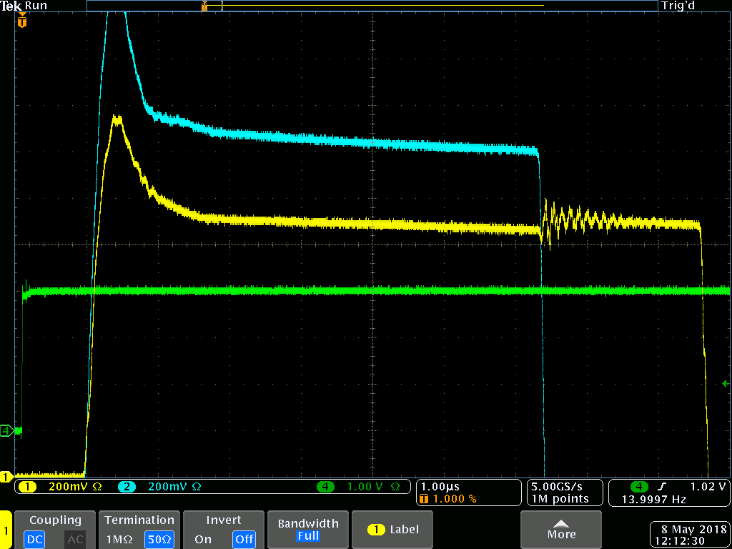
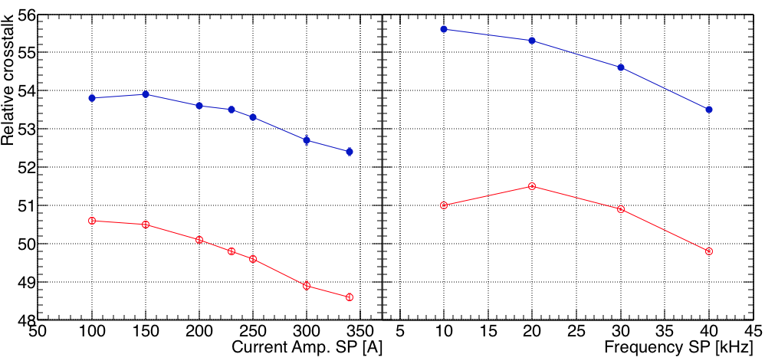
Bdot Signal Crosstalk - ~50:1
Notes:
Only measured for a RSM pair!

Slide 54
SAT: Thermal Testing

Slide 55
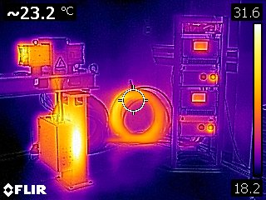
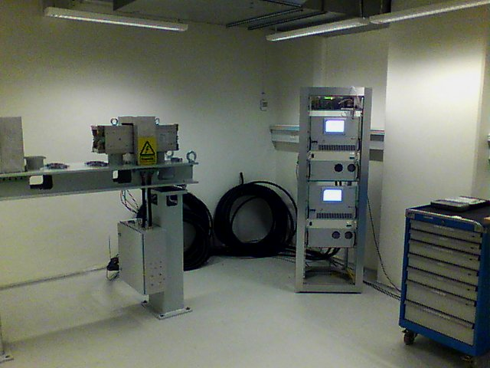
Thermal Testing
Thermal imaging: pinpoint hotspots due to inadequate heat dissipation (thermal contact) or excessive resistance (electrical contact).
PT1000 sensors are placed accordingly: termination box backplate, coils, cables, etc.

Slide 56
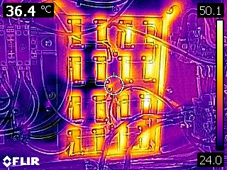
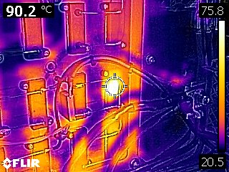
Thermal Testing
At 230 A the matching filter resistors run hot and close to thermal breaker temperature (60 deg C).
Bad thermal connection detected and remedied.

Slide 57
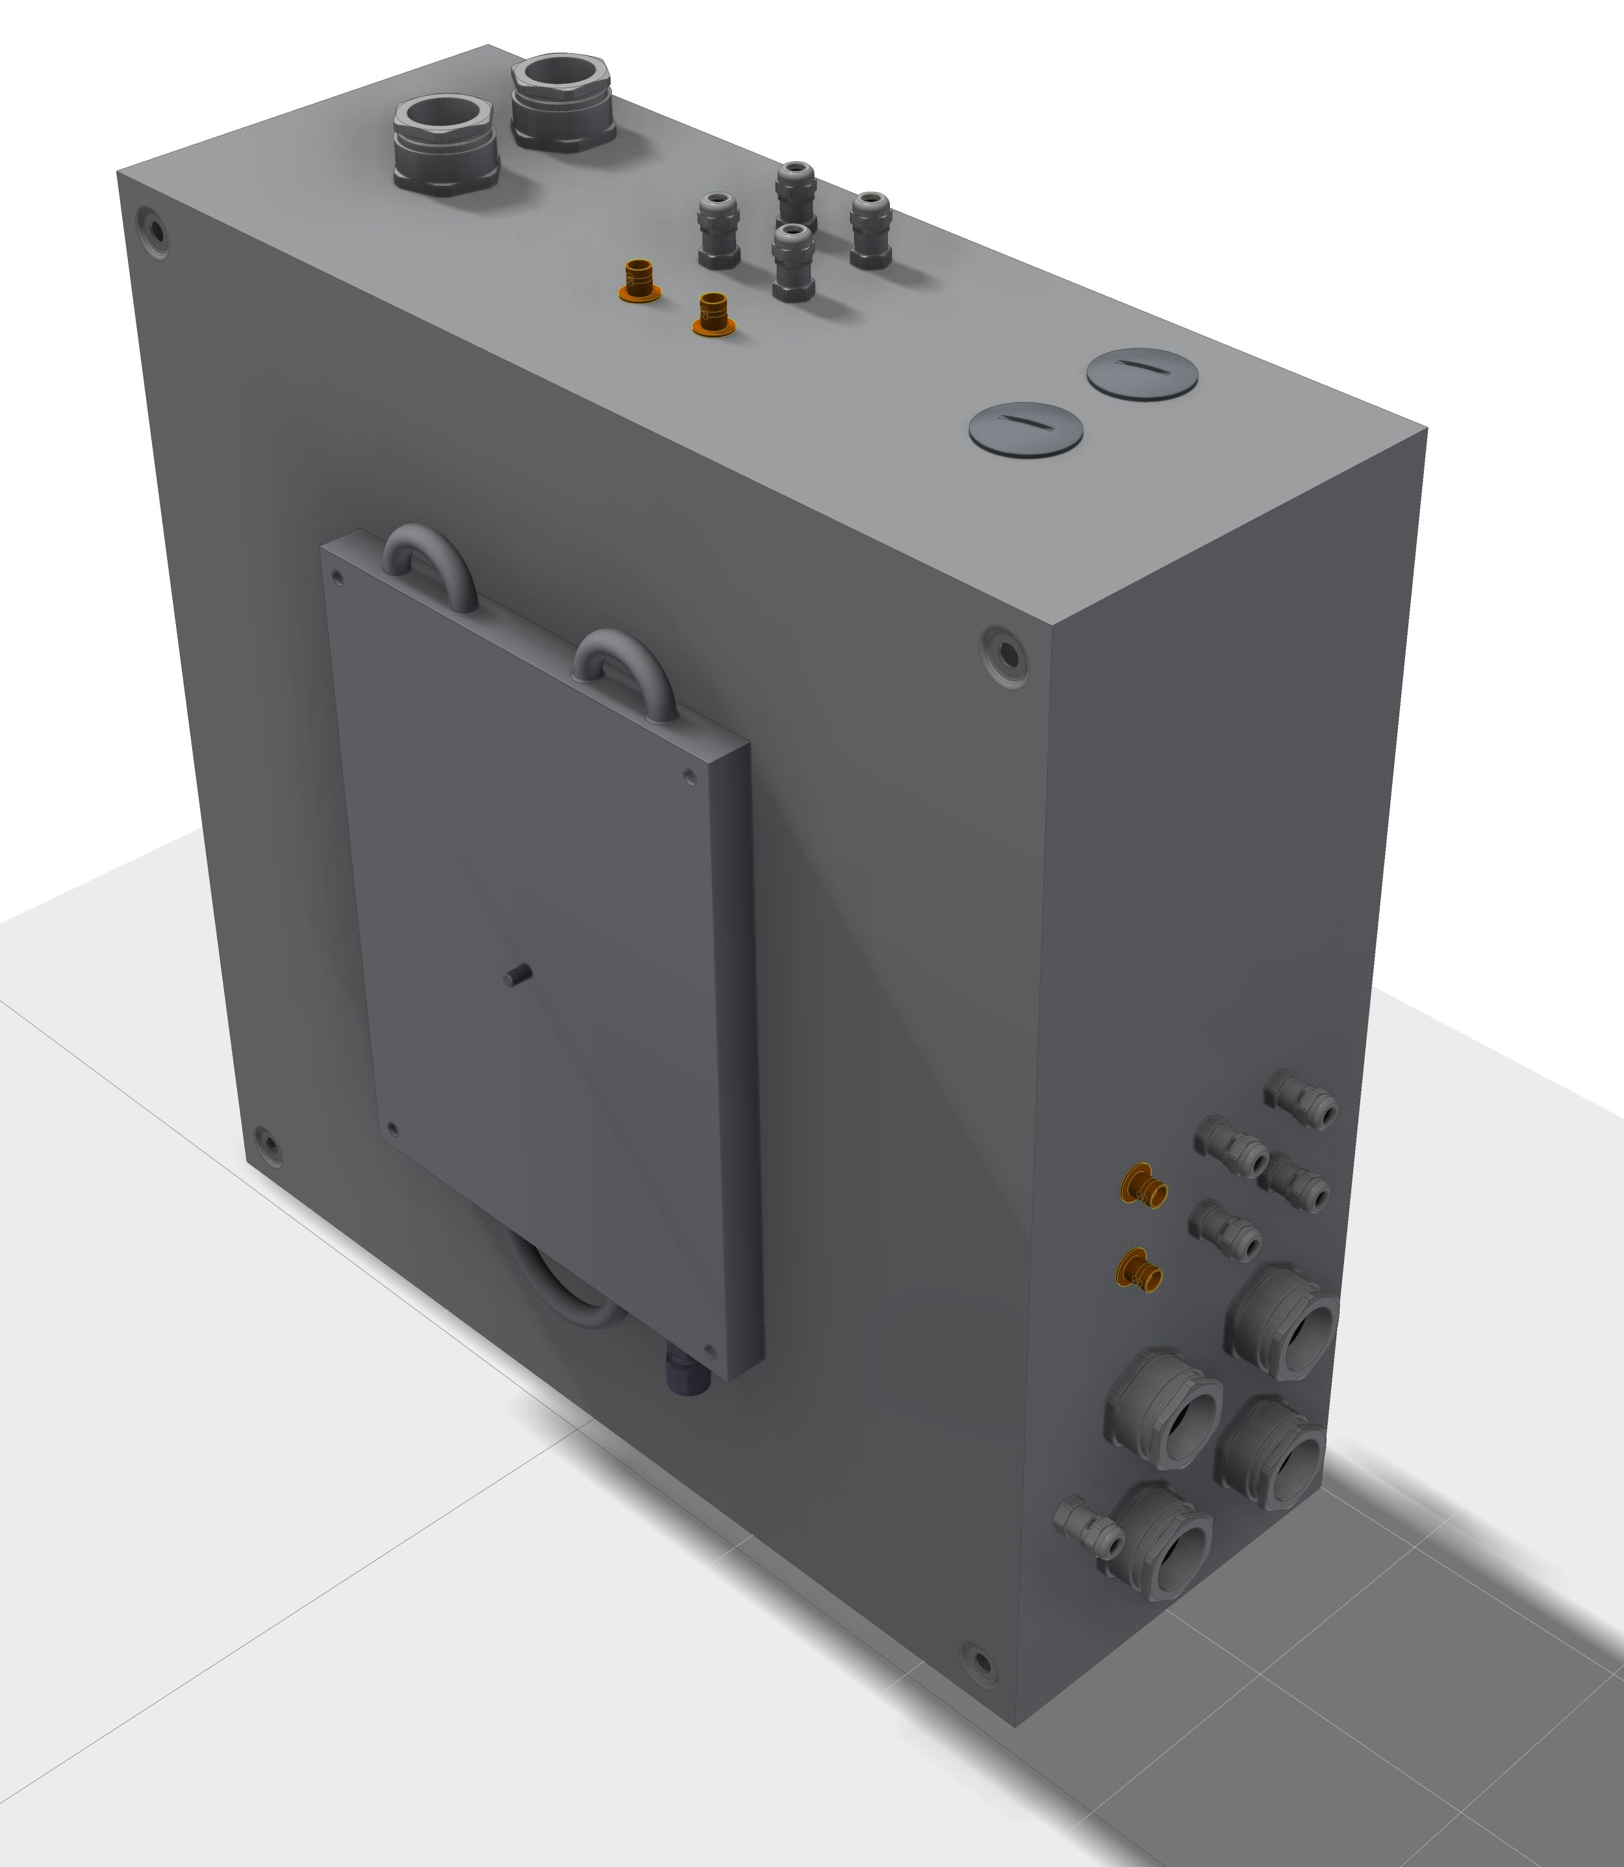
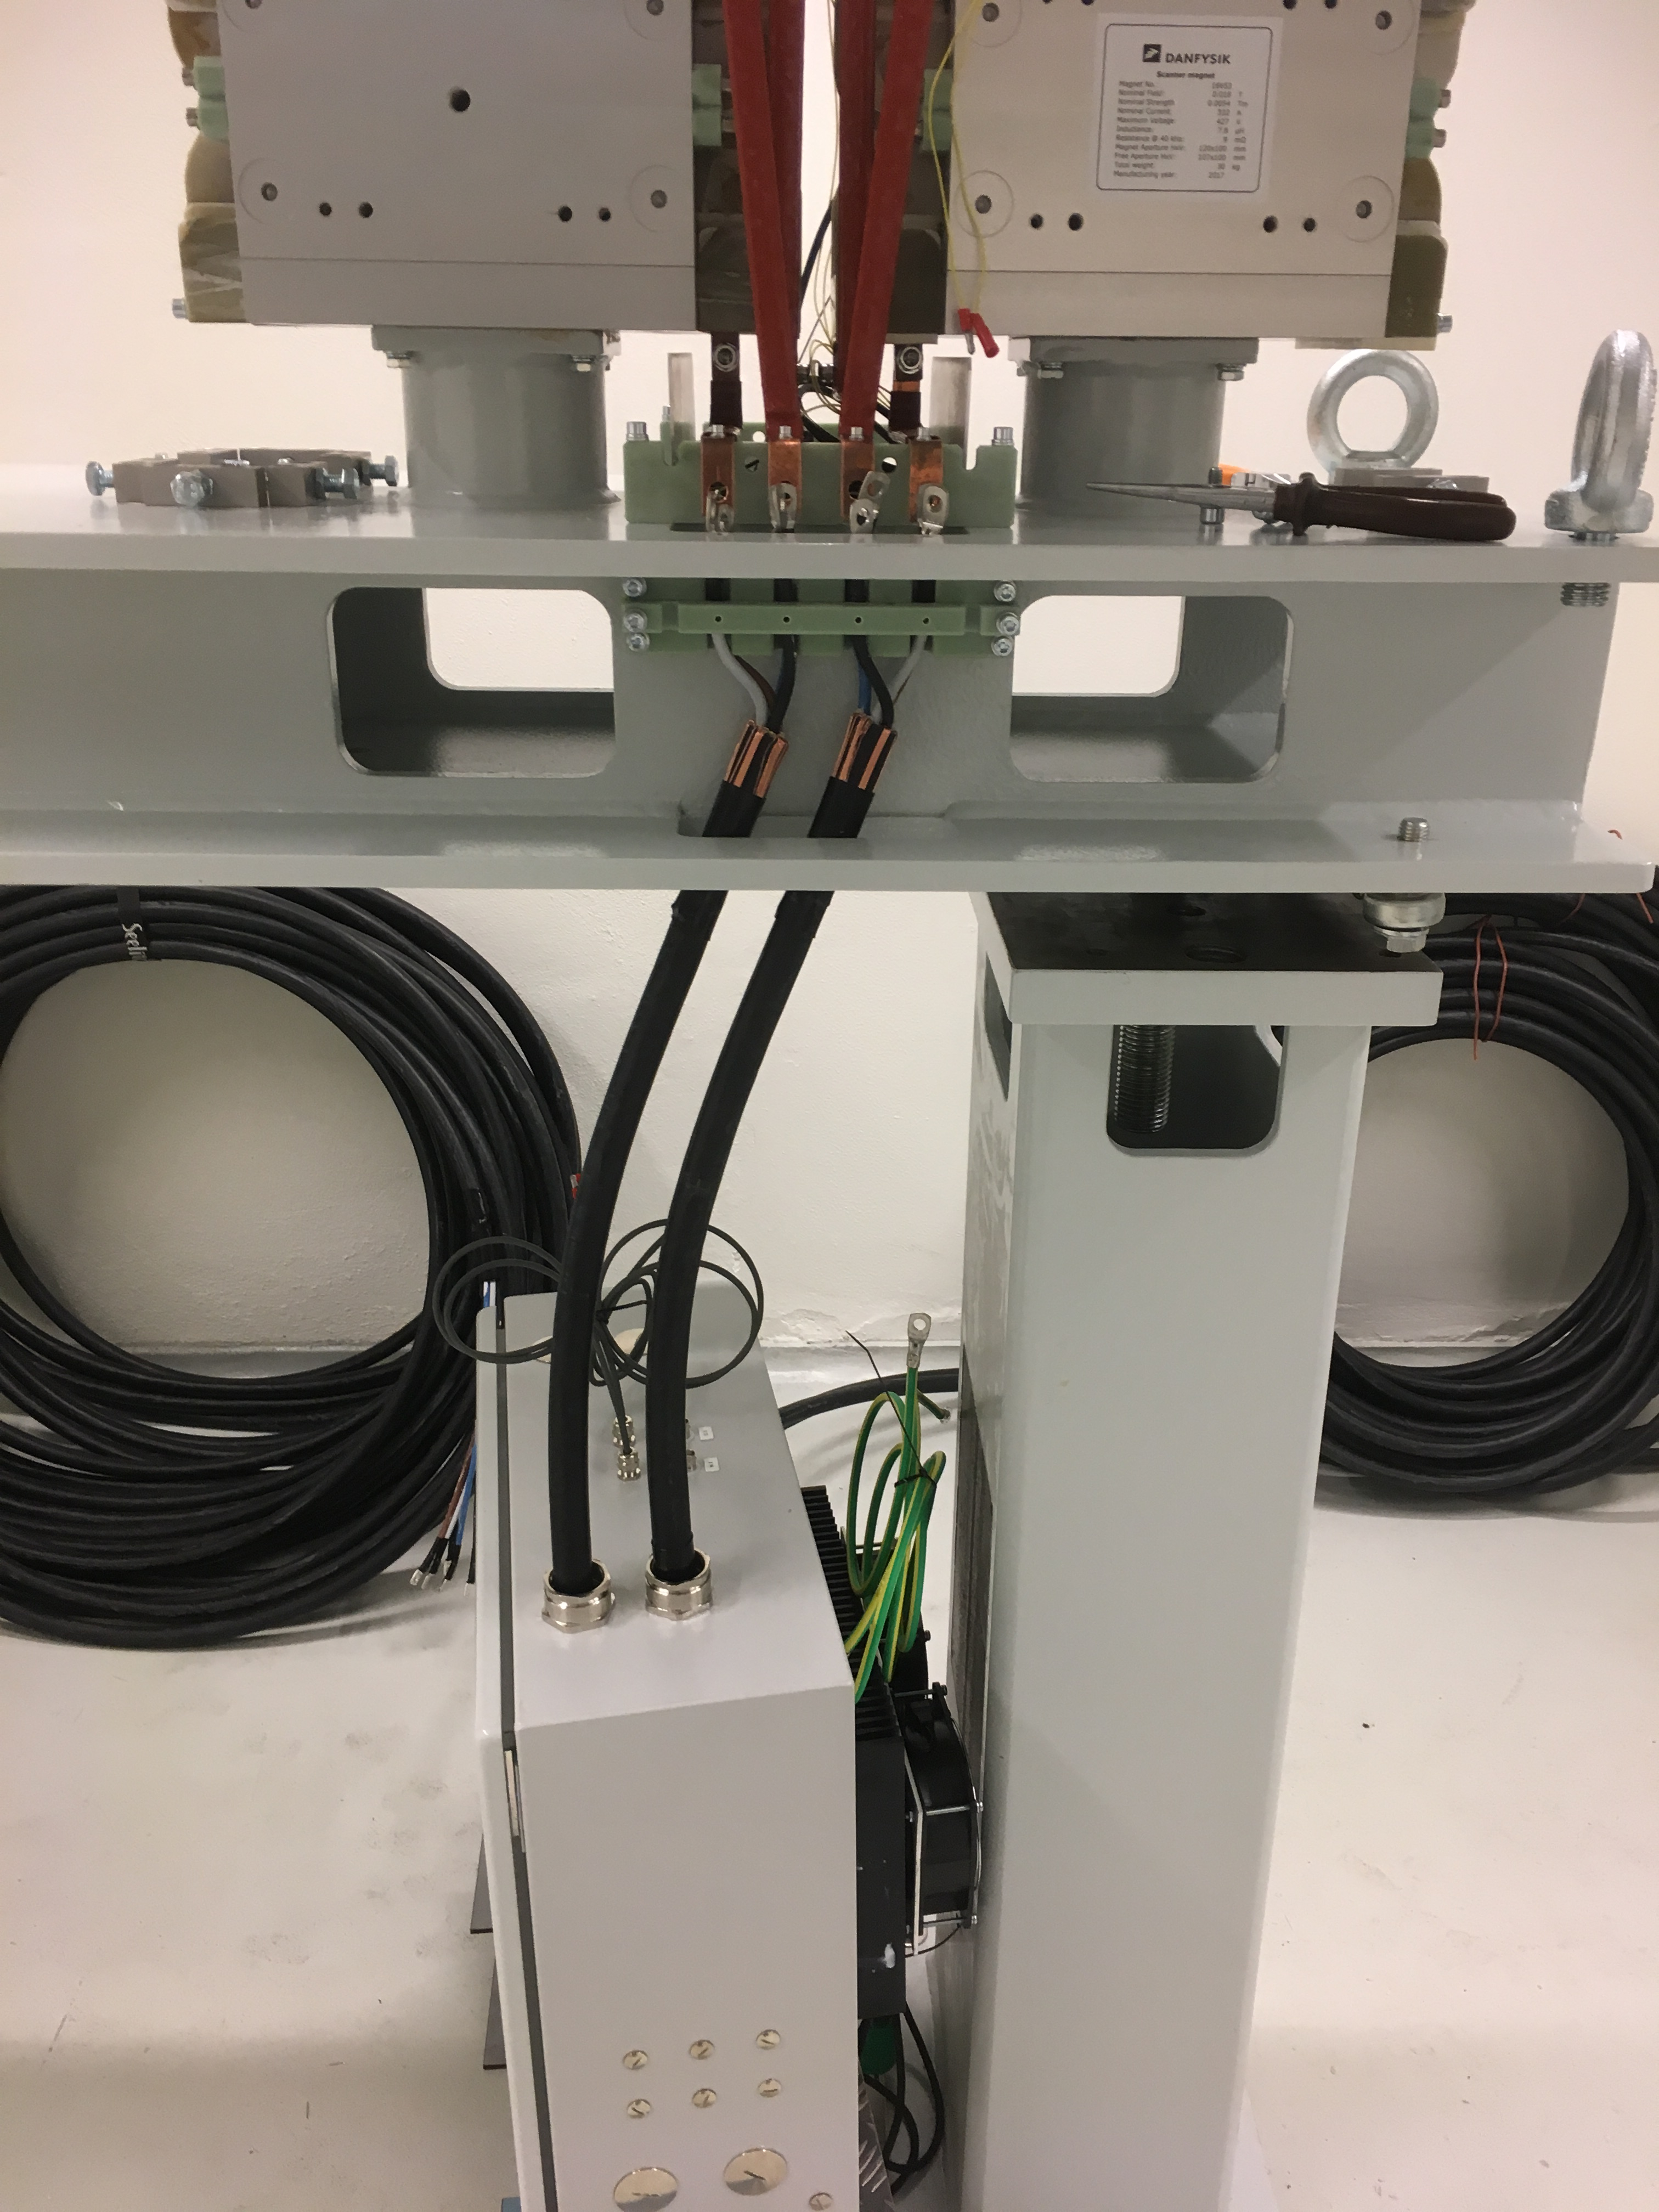
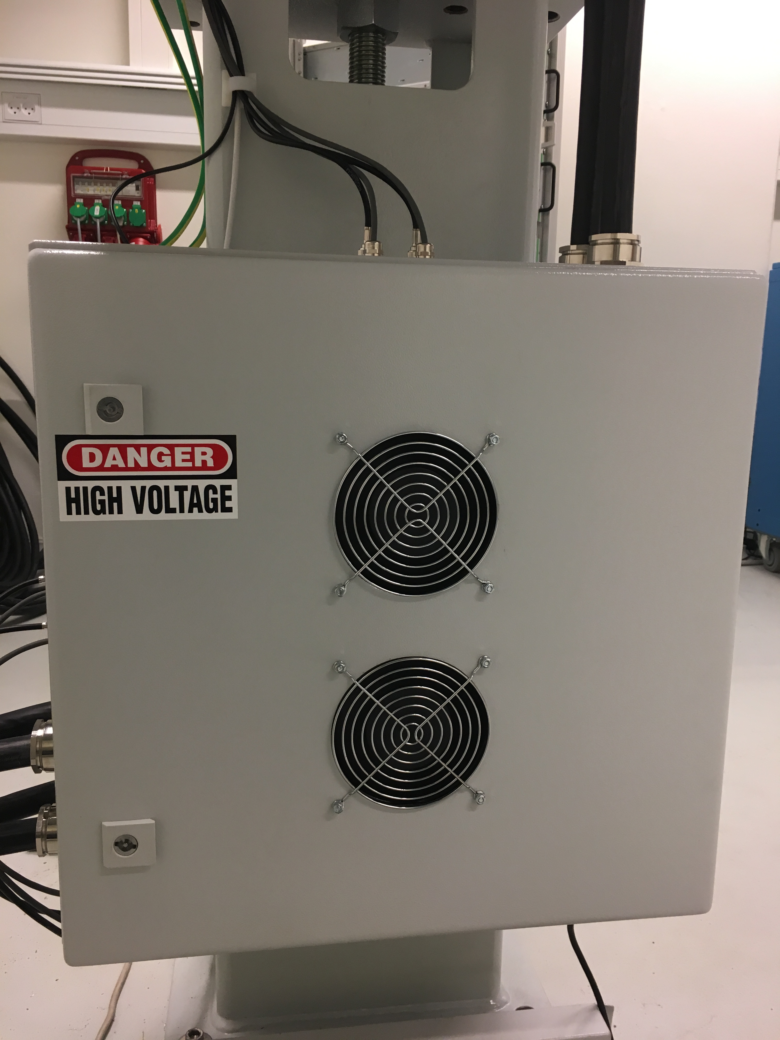
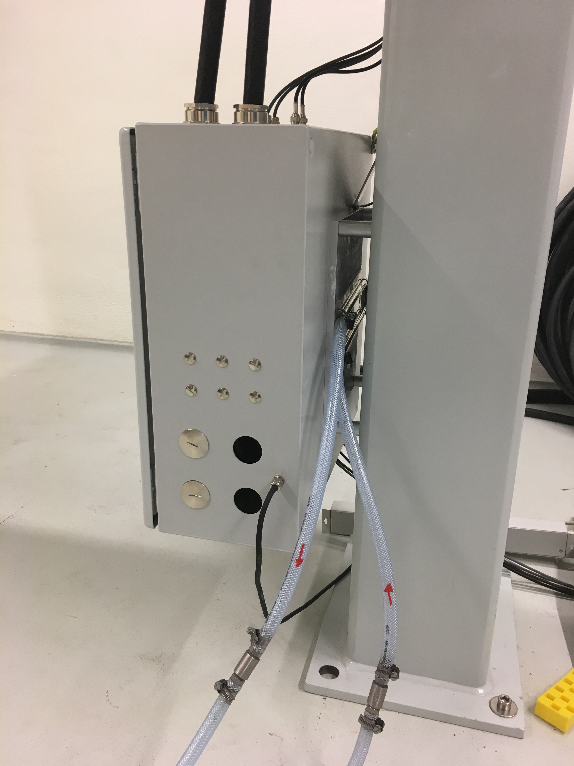
Active Cooling of Termination Box
As delivered
Heatsink + fans
Not expected: active cooling required to operate > 200 A (340 A maximum).
The production-series will feature water-cooling
Notes:
Bushings
Does not meet requirements / expectations

Slide 58
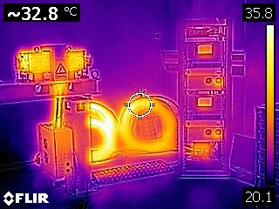
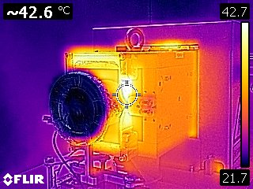
Thermal Testing @ 340 A + WC
Notice termination box!
Coils are now hottest: 43 deg C.
  30 – 40 deg C predicted in DDR

Slide 59
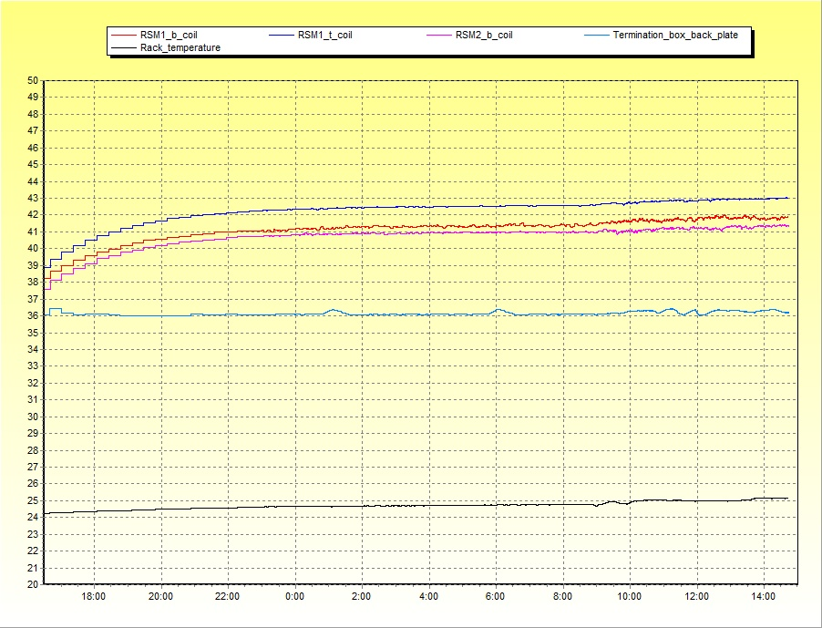
Thermal Testing @ 340 A + WC
RSM coils
Termination box backplate (edge)
Ambient temperature
Run started at 13:44: > 6 h to reach steady coil temperatures

Slide 60
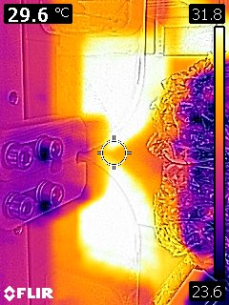
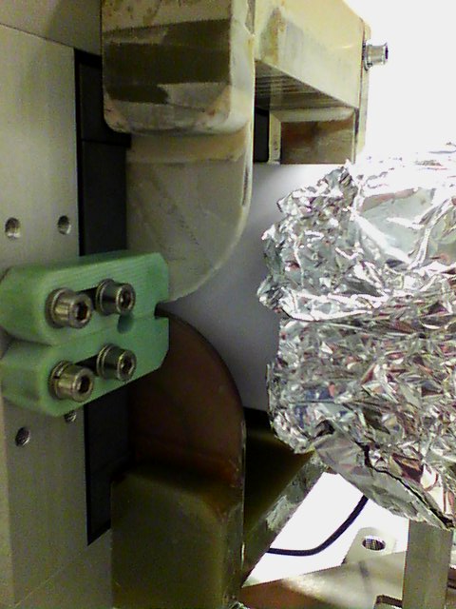
Thermal Testing: Coil Impregnation?
v2
v3
No difference in thermal performance can be observed between the two coil designs
Recommendation: accept coil design v.3 for the production-series

Slide 61
Pre-Series Performance Testing @ AU
Objectives
Tests
To test what Danfysik cannot…
Operation similar to application at ESS
Long-term stability (months).
  Nature and frequency of faults?
  Provide knowledge of how to improve and monitor system performance. Mitigate faults?
Typical operational modes
Bdot waveform “quality” will be used as measure of performance
Both supplies at 230 A, 40.000 kHz, 14 Hz
Random and wear-out failures will take a large accumulated system operation time to probe
Notes:
Unfamiliar design: Assess system availability on actual hardware
Bottom-up MTBF estimation can be inaccurate
Failure types
Interruptions

Slide 62
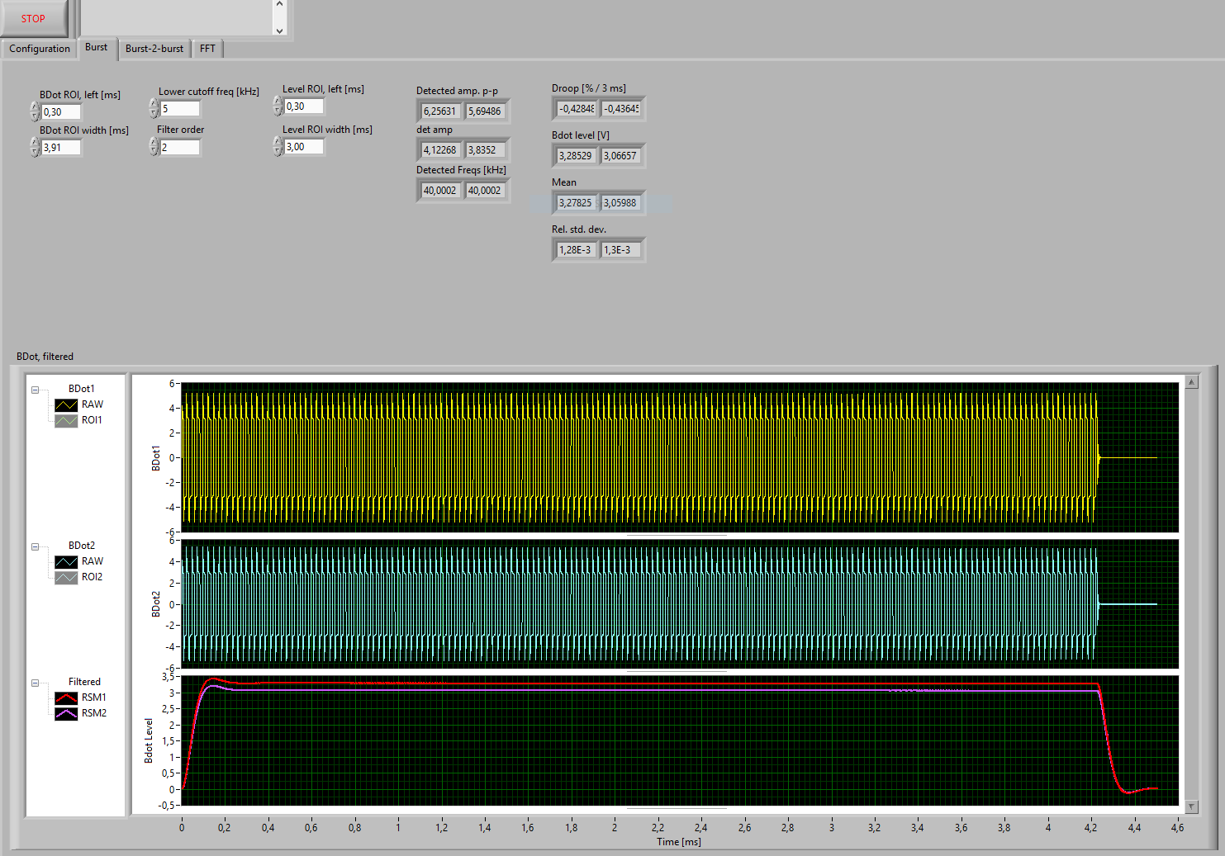
LabVIEW Code
5 Figures of Merit (FoMs) devised:
Reconstructed peak current: cf. calibration
Raster frequency: robust
RMS of filtered Bdot waveform: rectifier + a 5 kHz low-pass filter (“raster speed”)
Relative burst DC offset
Phase: relative to ext. trigger (TTL from EVR)
Notes:
Robust
LabVIEW code – signal generator
Droop = 0.3% / 3 ms

Slide 63
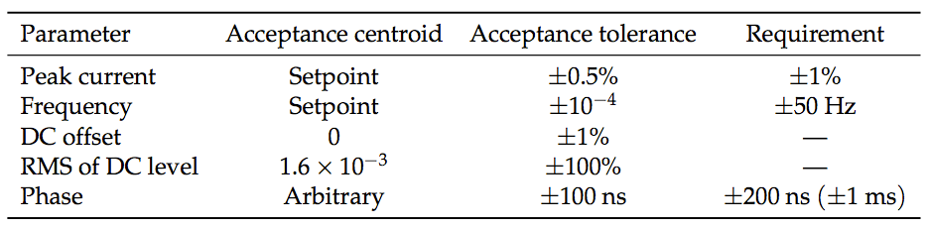
LabVIEW Code: Burst & Supply Errors
Bdot burst data acquisition, reduction, validation
  FIFO structure containing events of 2-ch raw burst data
  Reduce to FoMs
  Event classification (accepted / not accepted):
Supply error status: regulation loop error, rejecting pre-trigger, interlocks (overheating)
Notes:
Errors are logged and counted

Slide 64

Long-Term Testing (LTT)
Notes:
50 x 24 hours

Slide 65

LTT: Run Durations

Slide 66
System Error Candidate Events
2018.03.20. 12:05: RMS of filtered Bdot > 50% of mean value. Tolerance was empirically set, and Bdot waveform contains no significant artifacts.
  Tolerance is increased to ±100%
2018.04.03. 9:27: Bdot amp. 0.72% below expected value. Tolerance: <±0.5% (ESS spec: <±1%).
2018.04.06. 9:24: Bdot amp. 0.99% below expected value. Tolerance: <±0.5% (ESS spec: <±1%).
  Detected amplitude error is small (within spec)
  Both events occurred during PC login: bad BNC connector + desk movement

Slide 67
Bdot Signal Integrity?
The Bdot signal has caveats:
  Inherently derivative only
  Detector + cable response?
  Temperature-dependent, ~1% / 10 K?
Bdot response should ideally be evaluated with a reference signal
Depending on Bdot amp. acceptance tolerance, pre-heating system may be relevant
Bdot signal has been used to examine the RSMS to the level of system performance requirements, i.e. very closely
Depending on the application of the Bdot signal at ESS, acceptance tolerances could be much larger.
Additional (redundant) sensors? Beam, Hall probe, DCCT, Idot, …
Notes:
Specifically amplitude, waveform shape

Slide 68
SAT Evaluation
All SAT test steps are passed with expected (or better) performance
Valuable experience is gained
Untested items
  Alternating polarity (not implemented in EVR)
  Crosstalk between H-V RSMs
  Testing with beam
  Actual alignment
Notes:
Close to

Slide 69
Integrated Control System (ICS)

Slide 70
RSM Supply Algorithm
Notes:
Predictive formula for VDCL
Capacitor charging time constant

Slide 72

ICS
Apart from mechanical interfaces, RSMS has interfaces with
  Timing system EVR: Pre-Trigger, polarity (light guides)
  IOC: configuration, status readback (Ethernet)
  FDU: Bdot (BNC), ISO11-16, etc.
Several hardware signals are readily available for monitoring the system state on a fast time scale
Control Crate

Slide 73
Control Crate ISOx
ISO Name | ISO Label | RX / TX | Type |  | Description | Interfacing equip.
2 | Pre-Trig | RX | HFBR-2412TZ | RX 1652 | Initiates raster burst | EVR
3 | Polarity | RX | R-2521Z | 640 | H: positive, L: negative + warning (ISO15), freq > 10 kHz: negative | EVR
11 | Beam Run Permit | TX | HFBR-1414TZ | TX 1644 | Current wfm is within specs: beam may be issued | FDU?
12 | Trig Permit | TX | HFBR-1414TZ | TX 1644 | PS ready to start a pulse burst | FDU?
13 | Status | TX | T-1528Z | 1652 | Status available on serial line | FDU?
14 | I-Ready | TX | T-1528Z | 1652 | Output current of previous burst was within 1% of set point | FDU?
15 | Pol Req Missing | TX | T-1528Z | 1652 | Input for ISO3 not accepted | FDU?
16 | Pre Trig Error | TX | T-1528Z | 1652 | Input for ISO2 not accepted | FDU?

Slide 74

ICS
Timing EVR has been provided to trigger and control polarity of power supplies
  Allowed an early direct verification of potentially most important interface
  Alternating polarity feature is currently not implemented in EVR
Fault-Detection Unit (FDU)
    Multiple hardware signals are made available at the RSMPS to the FDU
    Dec 2017: Visit by Stephane Gabourin (ESS Machine Interlocks Engineer)
    A FDU mockup is being made: aim is to test with pre-series hardware
Notes:
RSMPS + FPGA DevKit ~ FDU

Slide 75
Synchronization

Slide 76
Synchronization: Burst Timing
Pre-Trig will be used to synchronize the respective wfms by the assumption that
  the 8 x Pre-Trig signals are received synchronous
  the specified usable 3.57 ms raster burst is deterministic in terms of start and end relative to the Pre-Trig signals, independent of raster wfm frequency or other parameters.
  THE(!) potential source of common mode failures
Internal oscillators (only):
  Free-running, not phase-locked
    may result in phase errors ~1/f.IClk, 200 ns is tolerable on combined wfm
  The 8x oscillators are bought to have very similar absolute frequencies.

Slide 77

Synchronization: Burst Polarity
The wfm polarity is to alternate with burst (beam pulse) number (neutron quality issue)
Critical to sync. polarity within e.g. 4x H RSMs
  Could lead to wfm cancellation
  Implementation of polarity sync. could determine impact of faults

Slide 78
Polarity Sync. of Waveforms: Implementation?
Parallel: all power supplies are similar
  External polarity master (EVR)
  High signal = Start positive
  Frequency above 10kHz = Start negative
  Low/No signal = Start negative, set the warning signal
Design Change Request (CR)?
  ISO15 of CC currently states polarity input (ISO3) = OK/NOK
  Even better implementation: ISO15 indicates the interpreted polarity requested (Stephane Gabourin)
  Would require consultancy hours (VHDL prog.), 37.5 kDKK, paid by AU
Pol?
IN
OUT
IN
OUT
IN
OUT
IN
OUT

Slide 79
Safety, Quality & RAMI

Slide 80

Conventional Hazards
High voltage cables: ±340 A, ±650 V (pulsed)
  Clear labeling and distinction between HV and signal cables
  Enclosing covers, only removable by tools
  Power supply Enable / Interlock (NC) to prevent operation during access
  CR: reduce cover openings significantly!
Mechanical hazards:
  Topple dangers should be avoided if possible
  Girder should be secured in place once aligned (turnbuckles)
Operation and service manual available
  Includes evaluation of installation and maintenance risks and mitigating precautions.

Slide 81






RSM Failure?
Figure of merit:
Peak current density (J_{max}) on target
Beam outside nominal footprint regions
Nominal
No rastering
f_{x} = f_{y}
Loss of 1 H RSM
50% smaller beam size
50% larger beam size

Slide 82
RAMI
Incident | Type | Occurence | Impact | Time to recover | Preventive measures
1 x power supply failure | Random | < 1 / y | Not harmful for short periods | < 10 min. by adjusting the remaining 3 RSMs. | Monitor internal operating temperatures
8 x power supply failure | Random, common mode (central system failure, configuration) | ? | Single pulse: not harmful | < 10 min. depending on cause | High degree of parallel redundancy, monitor beam (PBI) and magnets (FDU) closely
 |  |  | Multiple pulses: PBW / target failure | 1-6 months?
Cable, coil insulation deterioration | Lifetime | 1 / 5-10 y? | Not harmful, assuming a localized sudden event | Tunnel access + 1h – 1day | Regular inspection for embrittlement
Vacuum leak | Random (following replacements, alignment) | ? | Could prevent operation (beam loss on res. gas) | 1-2 days depending on cool-down time and preparation | Monitor pressure near raster section
Water-cooling | Random, wear-out | 1 / 3 - 5 y | Could prevent operation | Tunnel access + 1h – 1day | Rad.hard hoses, regular inspections
Redundant system of raster magnets with strength contingency allows for a quick recovery
The design aims at using rad-resistant materials, where possible. Additionally components, like cables, are placed far away from the beam center and prepared for swift exchange
Notes:
Degraded mode
Cooling water!

Slide 83
Suggested Spare Components
Part | Quantity | Comment
Cable between connection box and bus bars | 32 | Cables may be exposed to radiation causing degradation. The cables are easily exchangeable causing minimum down time.
Coils | 2 | May be exchanged in case of long term degradation of insulation
Ferrites, horizontal | 2 | Ferrites do not degrade. Ferrites are fragile and could potentially be damaged during exchange of a coil
Ferrites, vertical | 2 | As above
Vacuum chambers | 2 | Ceramic chambers are brittle

Slide 84
Verification
FAT I (pre-series), Supplier
Mechanical, electrical, vacuum
Magnetics: Performance (B(t) waveforms, field quality, synchronization) of magnets + cable + supplies
Validation program suggested by supplier – to be approved by Aarhus University (and ESS)
SAT I (pre-series), Aarhus University
Visual inspection for potential shipping damage
System installation + nominal performance testing
Operation will be assessed in detail and long-term stability tests will be made (<4+6 months)
Typical operation modes + stress tests. Temperature readings (thermocouples + thermography)
FAT II (production series), Supplier
As FAT I + additional points based on findings from pre-series SAT?
SAT II (production series), ESS + Aarhus University
System installation + nominal performance testing
FAT II description pending (CW24)
Notes:
Danfysik ISO9000, provides monthly status reports reports that are shared with ESS

Slide 85
Top risks @ CDR-2
Top risks
  Late changes in design parameters: max f (neutronics), etc.
  Unexpected effects and parameters not included in simulations:
    cable, stray fields inducing eddy currents, etc.
    Beam losses, activation due to backstreaming radiation from target
  System not performing well under long-term tests (true & false trips)
Planned risk treatment activities:
  Perform cable tests before design phase is finalized
  Pre-series: testing and maturing design
  MPS discussions: Include designer as early as possible

Slide 86
Conclusions
The pre-series equipment has passed the FAT and SAT test verification procedures (approved at CDR-2)
  Only negligible deviations from expectations
The pre-series has offered an opportunity to verify and mature the design significantly.
  Production procedures refined
  Experience gained from installation, operation, monitoring, etc.
  Lab visits by system stakeholders
Experience:
  Output signal shape
  Supply behavior
Notes:
Caught early

Slide 87
Pre-Series: DDR vs. Hardware?
Feature / Parameter | DDR | Pre-series
External ref. oscillator | ESS Master Oscillator | No ext. reference
Ceramic chamber ID / mm | 80 | 78.0 ± 2.5
PSU Controller | Danfysik System 8500 | Danfysik System 8700
Control Crate optical IO | As described in DDR | As described in Danfysik Interface Specification
Notes:
Coil design

Slide 88
Pre-Series Endgame?
Maximize benefit of Pre-Series test lab at AU
  Additional verification and interface testing?
  Verify system performance after ceramic chamber test coating
  FDU mockup
Decommissioning proposal
  All equipment is sent to Danfysik, where the system will be refurbished to include the production series amendments
  ESS receives 1 pre-series line (1 RSM, 1 power supply, 1 ceramic vacuum chamber, cables, etc.) to be used as complete spare unit
  Danfysik gets to reuse remaining parts in production-series and holds all refurbishing costs

Slide 89

Thank you for your preparation, attention, and valuable comments!

Slide 90
Extra Slides

Slide 91
Bdot Waveforms
Bdot wfms: Square voltage wfms, 10-40 kHz
  14 Hz x ~3.5 ms bursts, >400 kS/s
PicoScope 4262, 2ch, 16 bit, 5 MHz will sample both waveforms.
  (2ch + time) x 16 bit
  Using Pre-Trig as Ext Trig would enable detection of timing jitter
Data reduction on local PC (LabVIEW):
  FFT: fundamental freq. and its amplitude
  Statistical values: mean, (RMS), …
  Polarity (sign of first edge of waveform)?
Buffer containing history of previous N wfms (shift register)
  In case of fault, write buffer to disk
  Fault = wfms pars outside operational window

Slide 92
Raster Pulse: Alternating Pattern Parity
Shea et al, ICANS’15
Notes:
Amplitude spectra of neutron intensity fluctuations induced by raster scanning the
proton beam (0.8 Å neutron pulses from the thermal moderator)

