Slide 1
RF Split Box
Anders Svensson, ESS
www.europeanspallationsource.se
23 April, 2018

Slide 2
Introduction – Split Box
RF Split Box provides RF signals to LLRF and LPS
  Single coax cable from each RF signal source
  Cavity pickup, Phase ref, Power Couplers
Also contains a Low Pass filter to suppress VM harmonics
Two variants, 352 MHz (45pcs) and 704 MHz (86pcs), covering both NC and SC needs
All passive device with SMA inputs and outputs
Mechanical enclosure 19” and 1U

Slide 3
RF cell power sensing concept

Slide 4
Block diagram

Slide 5
Main RF specification
Item
Inputs | 10 channels | SMA
Outputs | 21 outputs | SMA
Maximum input level | < +30 dBm < +33 dBm | From SSPA (TBA)
Minimum input level | TBD
Insertion loss, VM | < 2 dB | Vector Modulator
Insertion loss, 2-way | < 4 dB
Insertion loss, 3-way | < 8 dB
Input/ Output return loss | > 10 dB
Isolation, same input | > 10 dB
Isolation, different inputs | > 70 dB
LPF harmonic rejection | > 30 dB | VM output

Slide 6
Critical performance - temperature drift
Thermal drift between Cavity signal and Reference is critical
Significantly better than the overall stability requirement:
-Split Box drift requirement 0.02 degree over temperature range 22 - 27 °C, between paths in red

Slide 7
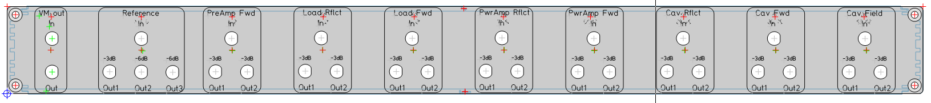
Front panel layout - examples
Example from TS2
Proposed Layout

Slide 8
Attenuator values - Preliminary
To be confirmed from TS2 experience
LLRF activities planned to ramp up in June (2018)
Would like to delay planned delivery by June from PEG

Slide 9
RF Split Box
Last slide
next
Patch Panel

Slide 10
RF Patch panel - purpose
For all RF signals going to the LLRF rack
  Also DC signals from modulator
Clean coaxial interface between outside and inside rack cabling
  Outside cables will be 3/8” and inside 0.24”
  N type connectors outside and SMA (TBD) type inside (all?)
Short circuit of ground currents from outside before going into rack
Improved RF shielding for EMC racks version
Placed in the rack ceiling close to the rack rows cable trays

Slide 11
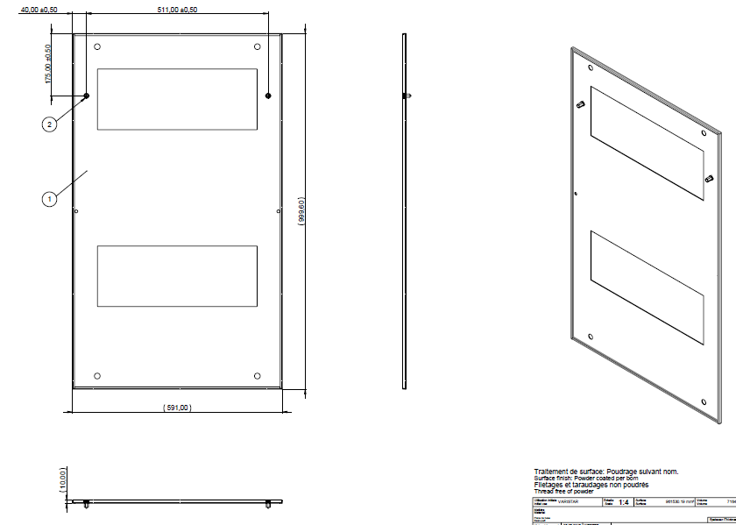
Rack top cover layout
Schroff top cover (two variants) could be replaced with patch panel

Slide 12
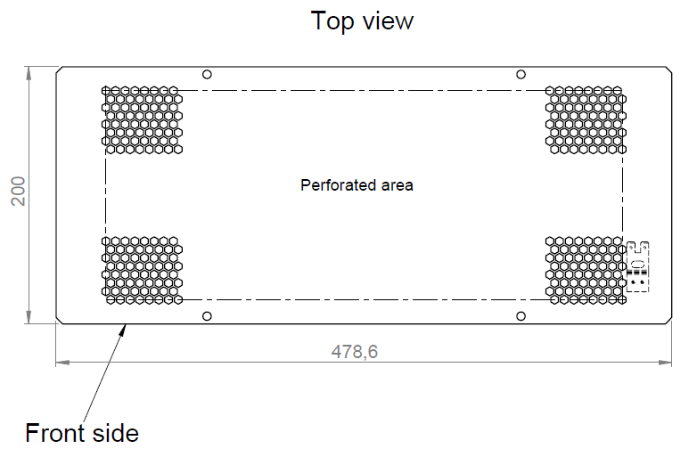
Cable entry plate
Custom made plate replacing cable entry, 200x450 mm

Slide 13
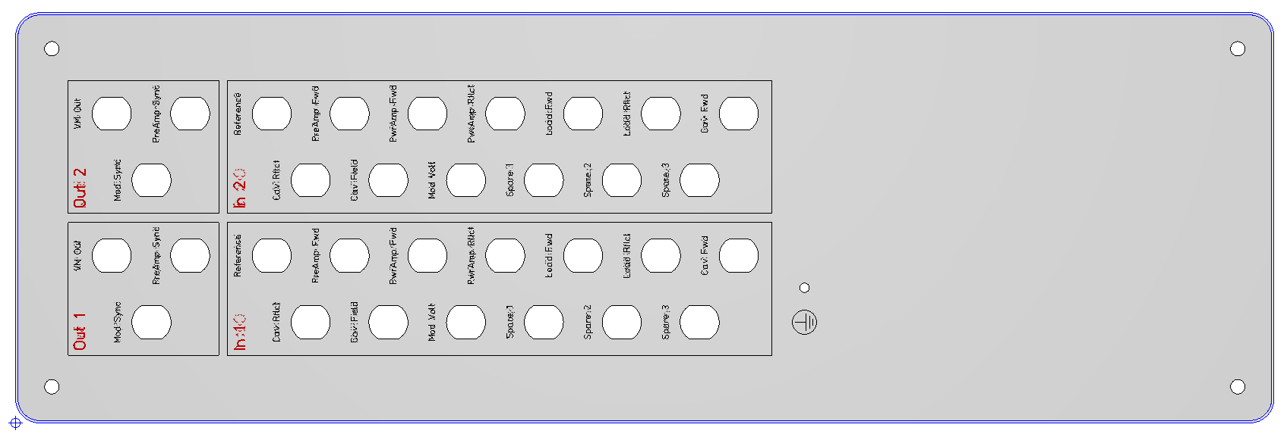
Patch panel - example
Test stand 2 panel for Rittal rack:
  Dimensions 520 x 170 mm

Slide 14
Signals
Common:
Cavity pickup
Reference
PreAmp Fwd
PwrAmp Fwd
PwrAmp Rflct
Load Fwd (LPS)
Load Rflct (LPS)
Cavity Fwd
Cavity Rflct
Additional:
RFQ cavity mon. 20 pcs
DTL field distribution 8 pcs
Second Reference
Modulator voltage
Modulator current
Spares ?

Slide 15
THE END

