Slide 1
CDR e ̄Pick Up
www.europeanspallationsource.se
18-04-26

Slide 2
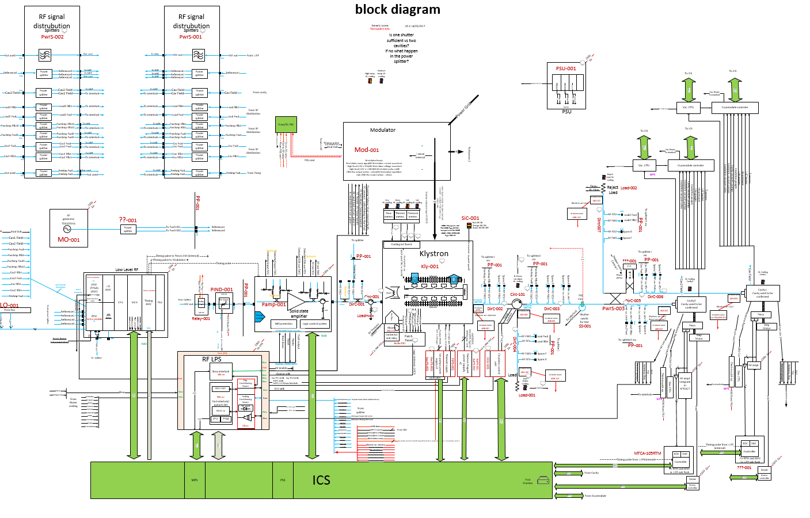
Block diagram of Medium beta RF chain
e ̄ Pick Up: protect the power coupler of the cavity from multipacking

Slide 3
e ̄ Pick Up in ESS LINAC
RFQ x 2
Spokes x 26
HB x 44
MB x 36
In total:
108 for cold and warm linac

Slide 4
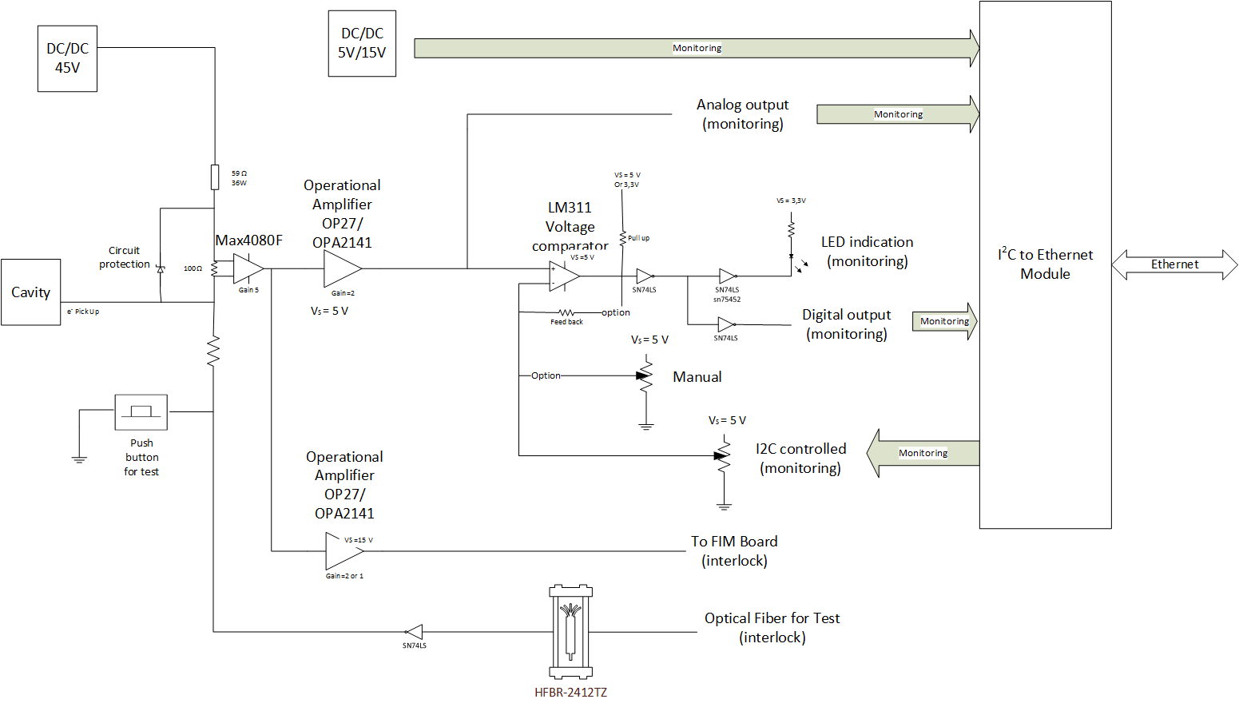
Block diagram of the e ̄ Pick Up
Functionalities
Measure and convert the curent into voltage
Provide this voltage image of the current to LPS
Monitoring functions independant of the main function
Test functions
Interfaces
Cavity input (SMA connector)
Main single Power supply input: 24V
Analog output to LPS (SMA) Integration with LPS to do.
Fiber in from LPS (for Test)
Ethernet (RJ45) for monitoring (ICS)

Slide 5
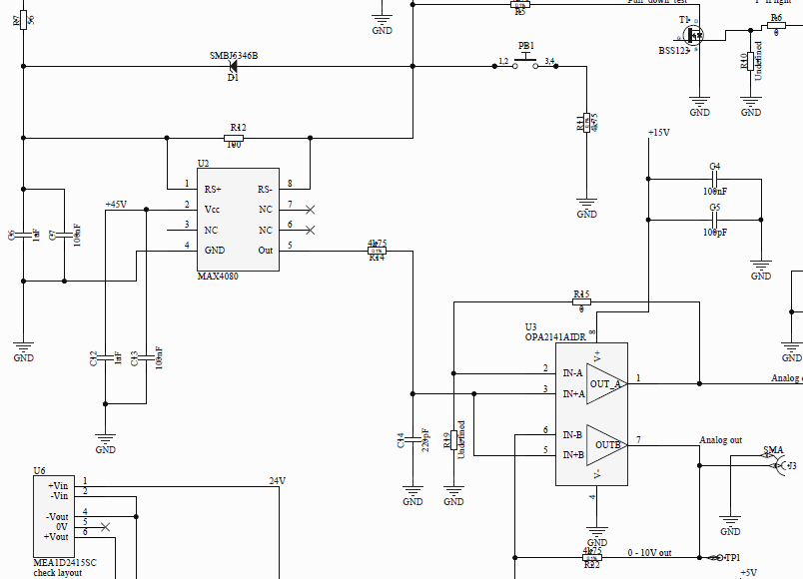
How does it work?
Max 4080 current to voltage converter: current sense amplifier. Gain = 5
OP Amplifier Gain = 2
Total Gain = 10

Slide 6
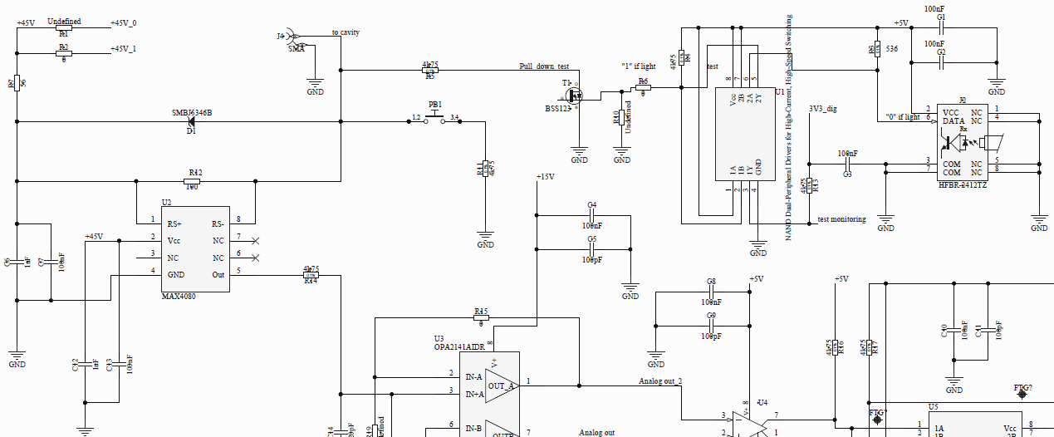
Test of the e ̄ Pick Up
Press button for manual test (do we remove it for production?)
Test controlled remotly by LPS (fiber) (active=light)
Value of the leakage test current to be confirmed. (10mA now)
Indication on LED or on Monitoring

Slide 7
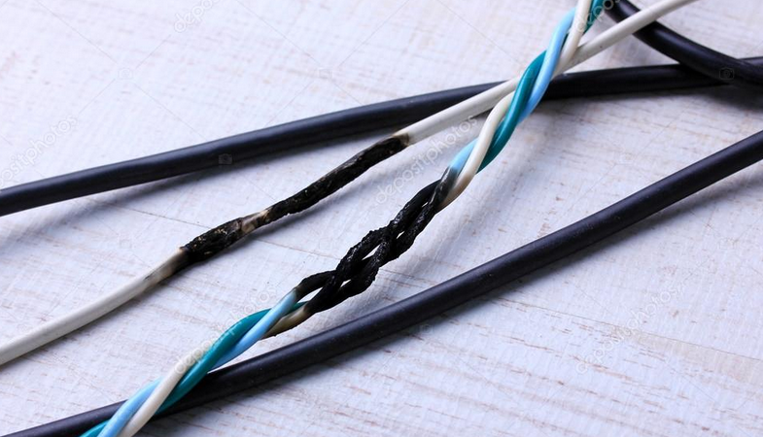
Protection in case of CC
In case the user make a CC -> interlock and not destructive
  Resistor 56 Ω 25W
  SMBJ5346B: diode zener 10V
  Max 4080 support 80V
  In addition the DC/DC converter has limited current: 33mA

Slide 8
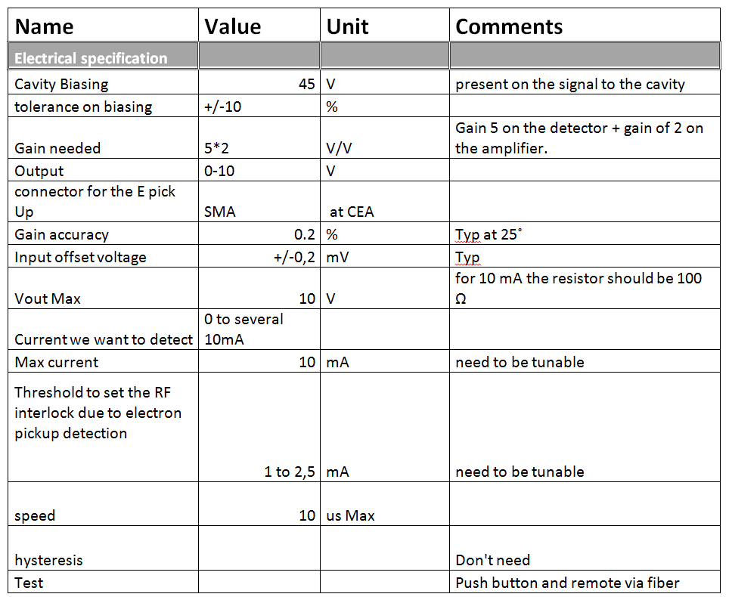
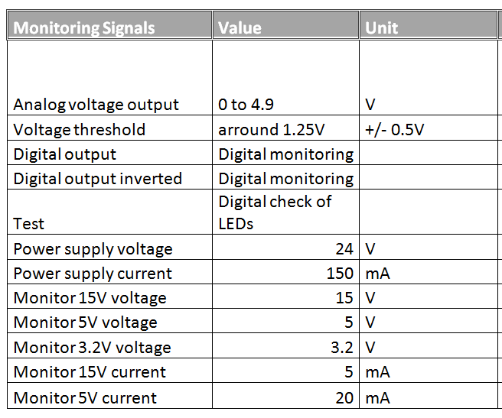
Specification

Slide 9
Design to optimise the MTBF
Minimize the junction temperature of the ICs by limiting the consumption
Over specify the rate voltage of the capacitor
Reliabilty oriented design rules:
  Voltage-limiting suppressor diodes,
  Thermal monitoring
  Filters, rise-time reducers: resistors, inductors, coils, ferrite beads, and capacitors, all of which slow the rise time of a transient and spread the impulse over time. Each of these networks is reciprocal; they protect a system from the outside world (EMS) and protect the outside world from any unintentional signal (EMI) that a device might radiate.
  Cool down the board
  No Manual button on main function (to be discussed).
  Current-limiting and switching devices: fuses.

Slide 10
MTTF calculation
Part number | Description | Qty/ board | MTTF (hours) | Failure rate (1/hours) | Failure rate (1/hours)
Max 4080 | Current detector | 1 | 1.18E+10 | 8.47E-11 | 8.47E-11
ADL5611 (equivalkent OPA2141) | RF amplifier | 2 | 3502012625 | 2.86E-10 | 5.71E-10
LT1764 (or equivalent) | Voltage regulator | 1 | 1097535494 | 9.11E-10 | 9.11E-10
NPO capacitor | NPO capacitor | 9 | 1.97E+06 | 5.07E-07 | 4.56E-06
X5R capacitor | X5R capacitor | 2 | 5.26E+05 | 1.90E-06 | 3.80E-06
 |  |  |  | MTTF system (Hours) | 1.20E+05
 |  |  |  | MTTF system (Years) | 13.64736666

Slide 11
Reliability (1/4)
LPS can test the functionality of the E- pick up
By fiber the RF – LPS can activate a leakage current simulating a multipaking issue
As return the analog signal can be tested by LPS
E- pick Up
Fiber In
LPS
Analog out
Monitoring

Slide 12
Monitoring for E- Pick Up (connected to ICS)
Monitoring of different functions:
  Consumption of the board (in case an IC is broken the consumption is impacted)
  Interlock status with independant
  and parallel detector from LPS
  Test of the monitoring itself (need to be on site)
  Temperature monitoring
  Voltage monitoring (output of the regulators)
  We can more if you want ☺
E- pick Up
Monitoring
Ethernet
ICS

Slide 13
Quality plan. Because quality start from the specification and design
Quality: a key ingredient for reliability
  Accurate analysis carried out on the in-house developed HW modules
Quality starts at:
  Conceptual Design and Specifications by ESS
  Quality attitude by design
  Quality tested PCB manufacturing and supplier chain (Eurocircuit, Note: NOTE Lund was rewarded with “The ALICE Industrial Award” by producing PCBAs for CERN . Note Lund has a unique specialized production process for prototypes)
  Adoption of commercial rad-tolerant components from known manufacturers
  Adoption of high quality components for the Board

Slide 14
Quality plan
Specifically on electronics board manufacturing
Standard formats for PCB cards, standard size and component series (SMD min. 0804 resistances or capacitances).
Altium Designer™ software for the creation of schematics, gerber files, BoM standard copper thickness for PCB (1,55mm), and standard connectors for interfacing (aligned with other board “Ficher” chosen)
Standard proven procedures already used in the past
Choose electronic components easily available on the European market
Choose electronic components tested, but far from possible obsolescence.

Slide 15
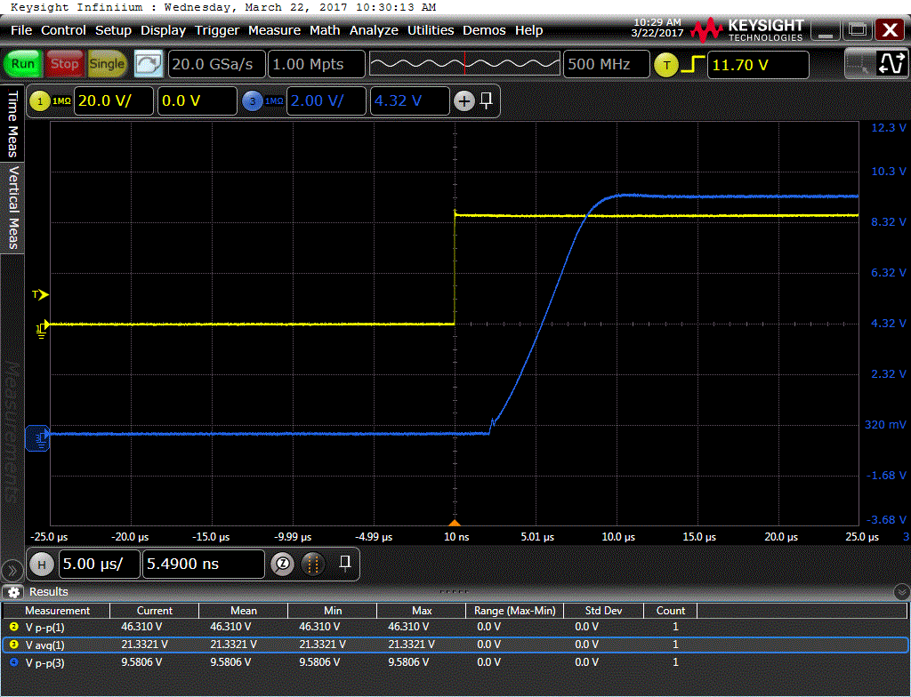
Measurements on prototype
In case of 10mA leakage
  Response time 8µs
Calibration of the system + FIM to be discussed
In case of 4,5mA leakage
  Response time 5µs
Output noise bellow 0,1V pp

Slide 16
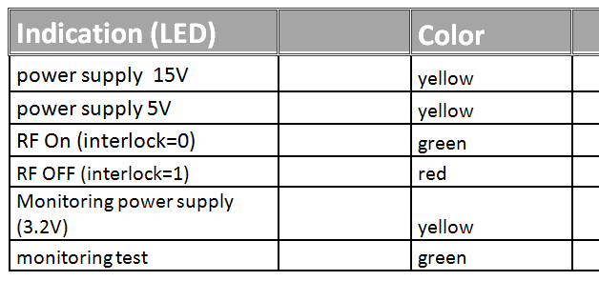
Indication and Monitoring
Indications LED
Monitoring using I2C bus and I2C to Ethernet module

Slide 17
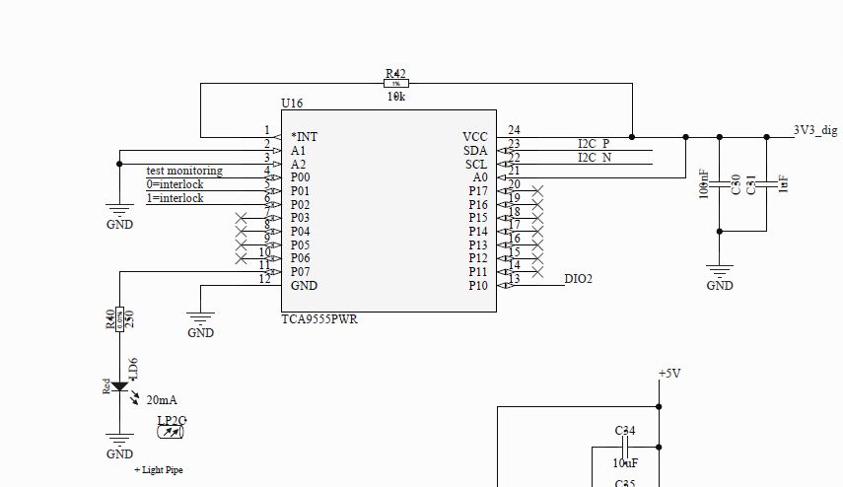
Port extender_tca9555
Adress chosen: 0x21
Digital input
  P0 test monitoring Low if test is on going
  P1 low if interlocking
  P2 high if interlocking
Digital output
  P7 test: high to
  activate the LED

Slide 18
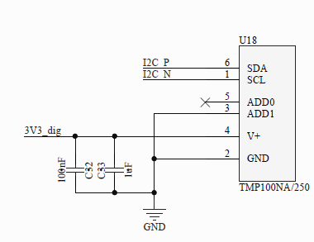
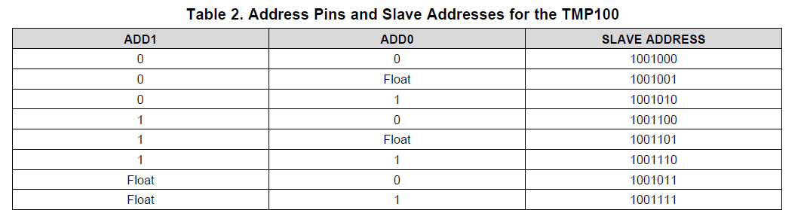
Temperature reader TMP100
Address: 0x49

Slide 19
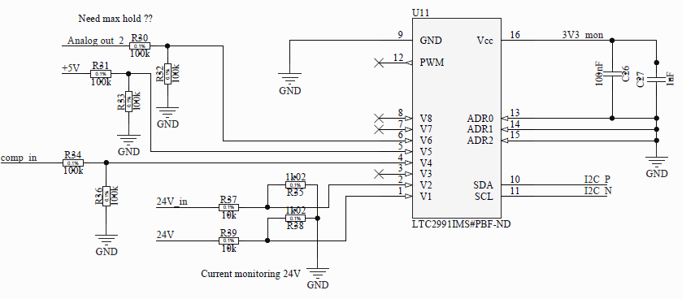
LTC2991IMS voltage current monitoring
Current monitoring onV1 and V2 by V2 – V1 on 24V
Voltage monitoring input
  5 V on V5
  Analog out on V6:
  Image of the current read but not max hold.
Voltage input
  V4
  to check the voltage
  threshold
  level of the comparator

Slide 20
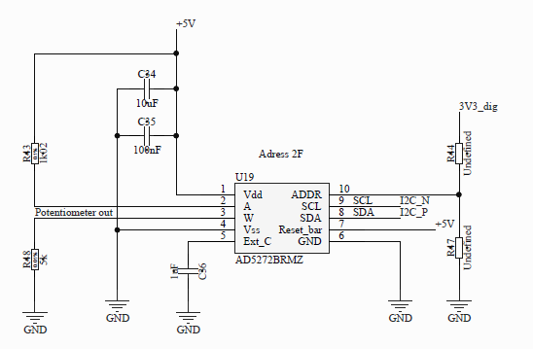
Potentiometer AD5272
Resolution 10 bits
Vakue: 20kΩ
Maximum ±1% nominal resistor tolerance error

Slide 21
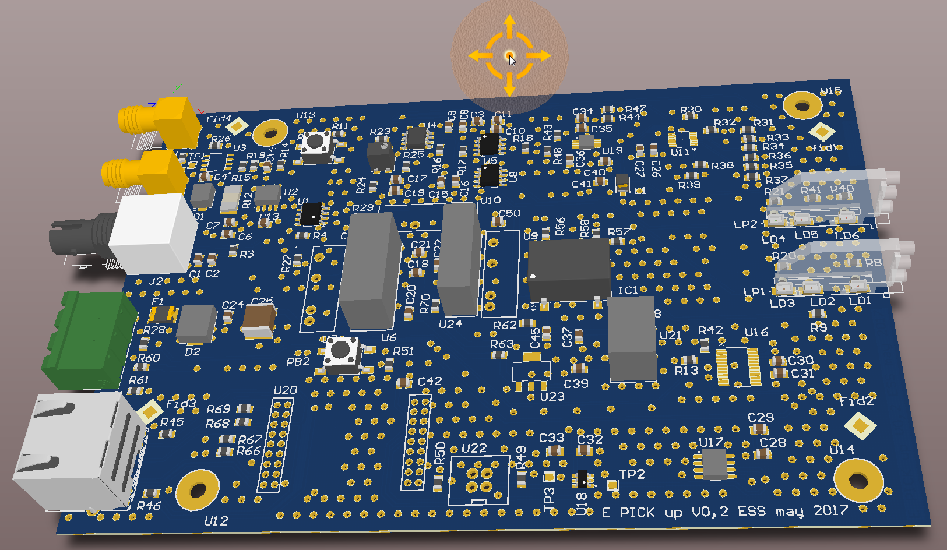
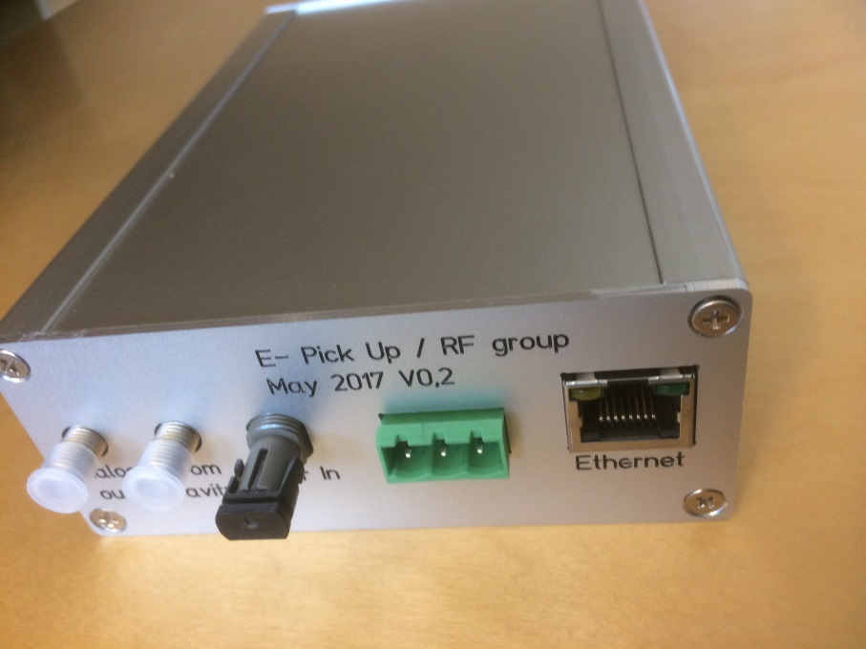
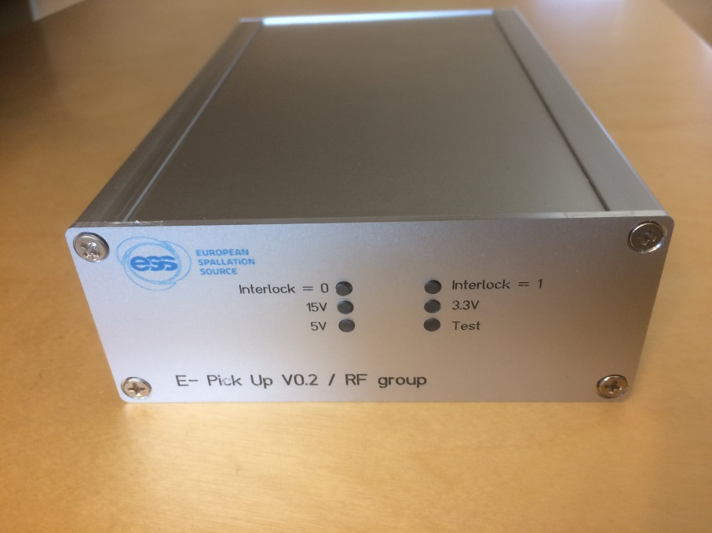
e ̄ Pick Up prototype Board and Box

Slide 22
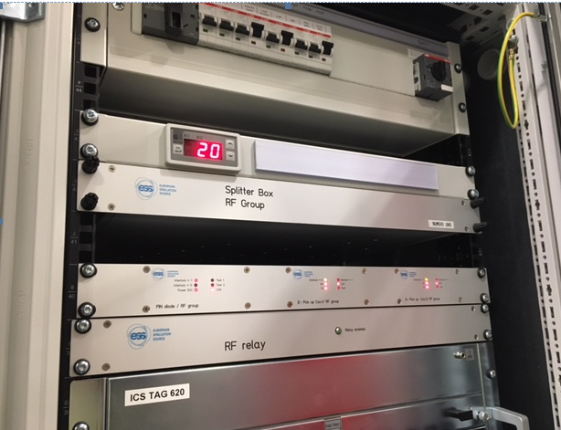
Mechanical for prototype
For TS2 we have grouped 2 e ̄ Pick Up and 1 Pin diode in a 1U rack box
Splitter box, pin diode and e- Pick up in TS2

