Slide 1
PSS relay CDR
www.europeanspallationsource.se
18-04-26

Slide 2
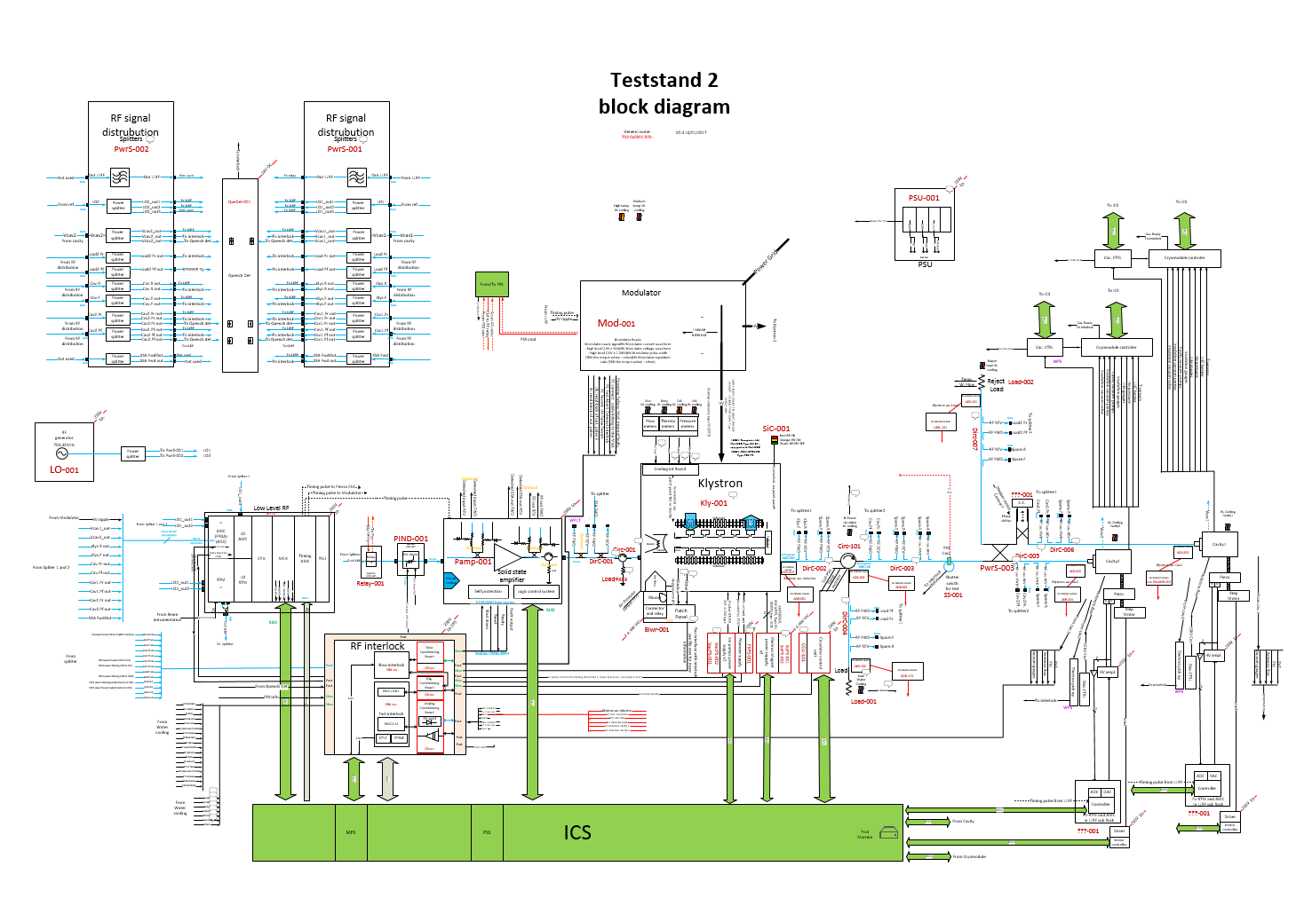
Cut OFF the RF in case of risk for personal
RF relay: drop the RF for personal safety

Slide 3
PSS relay in ESS LINAC
DTL x 5
RFQ x 1
Spokes x 26
HB x 44
MEBT x 3
MB x 36
In total:
115 for cold and warm linac

Slide 4
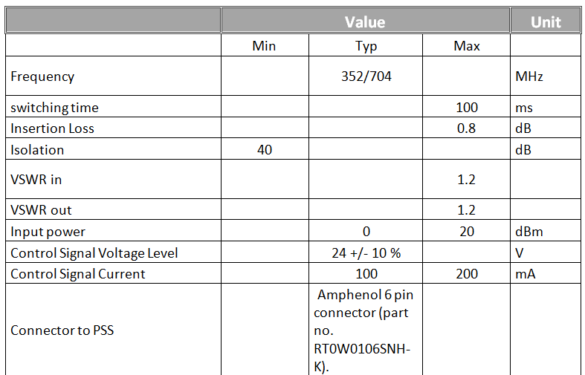
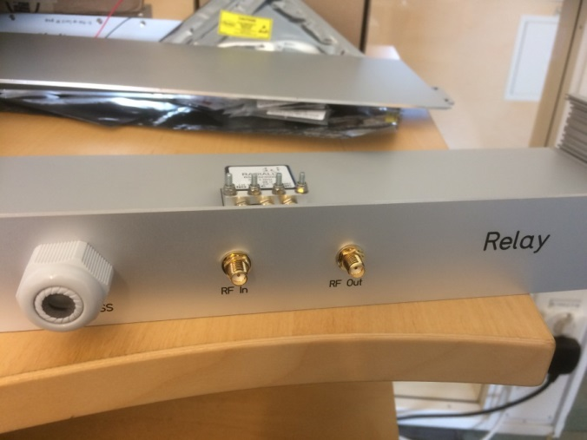
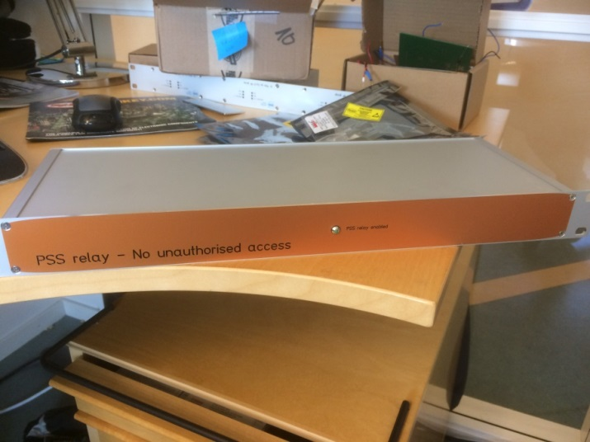
Relay PSS
specification

Slide 5
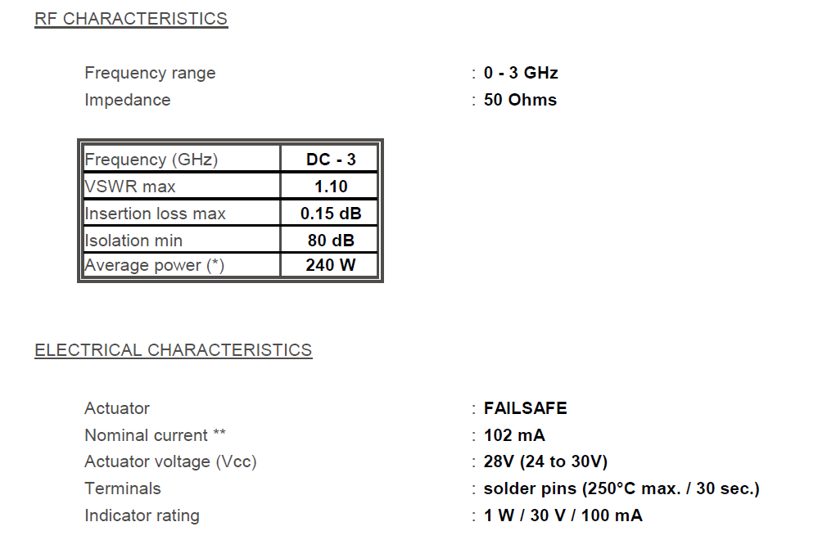
Based on Radial R570323000

Slide 6
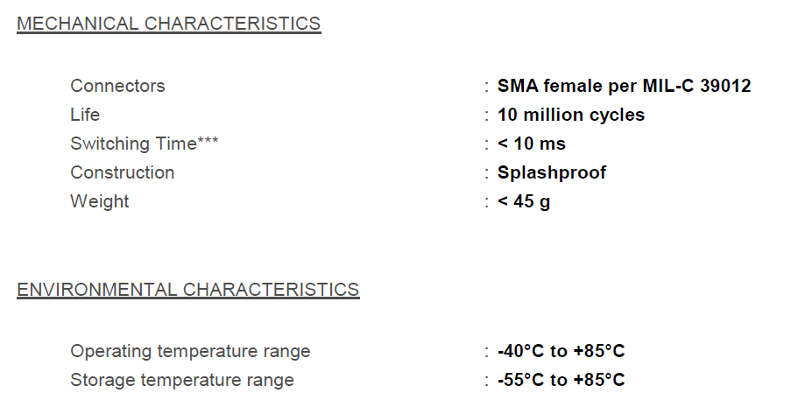
Data sheet and reliability

Slide 7
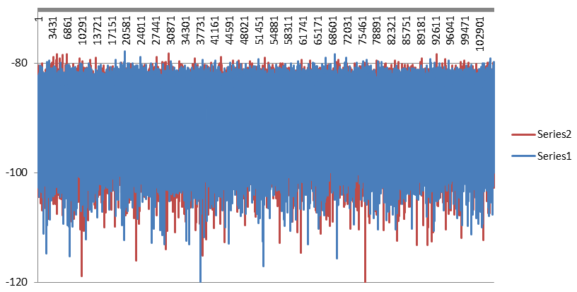
Reliability
Tested over 200 000 times without any failure

Slide 8
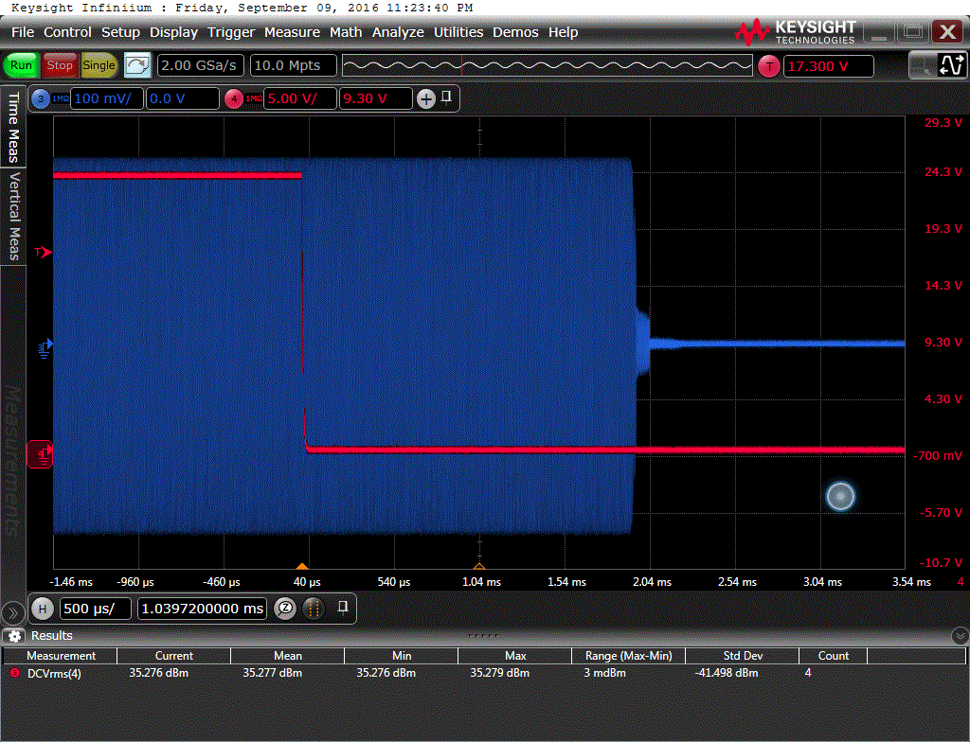
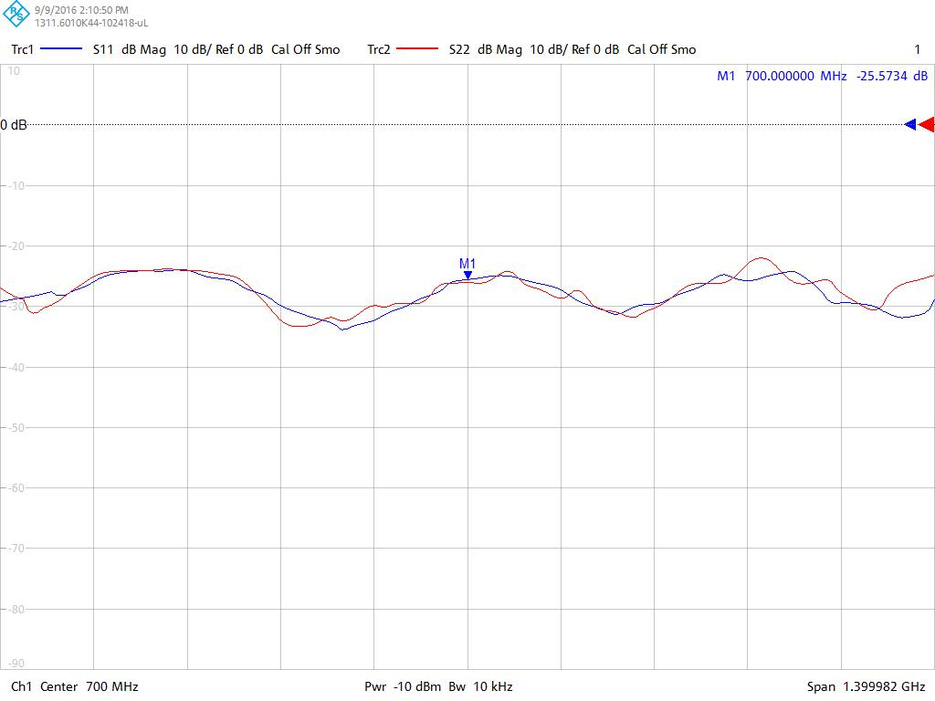
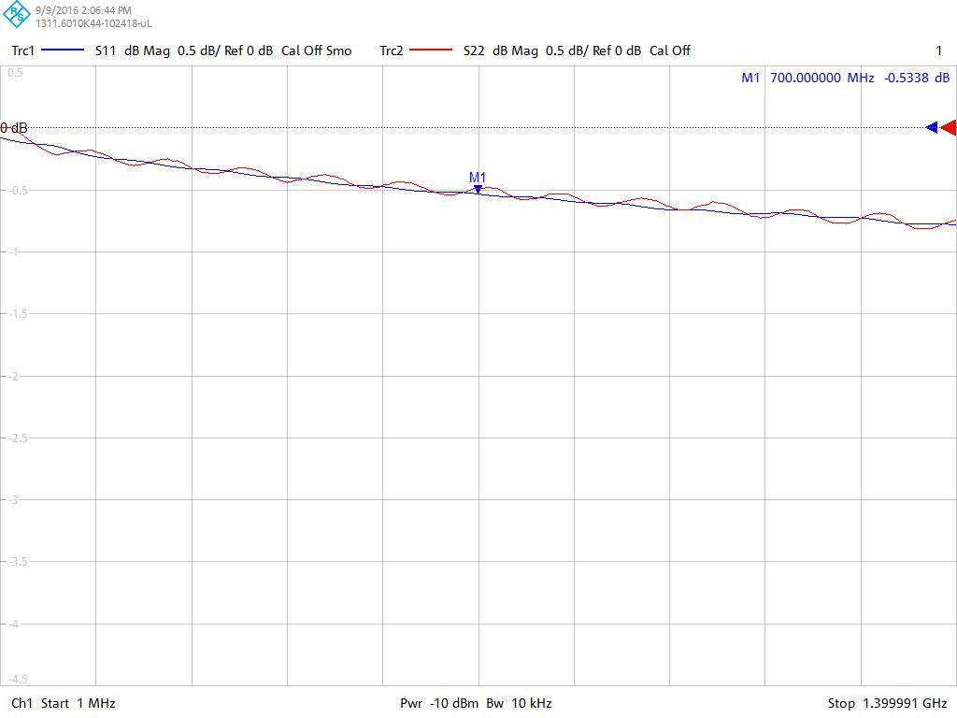
Measurements
In line with
Specification
Not matched OFF

Slide 9
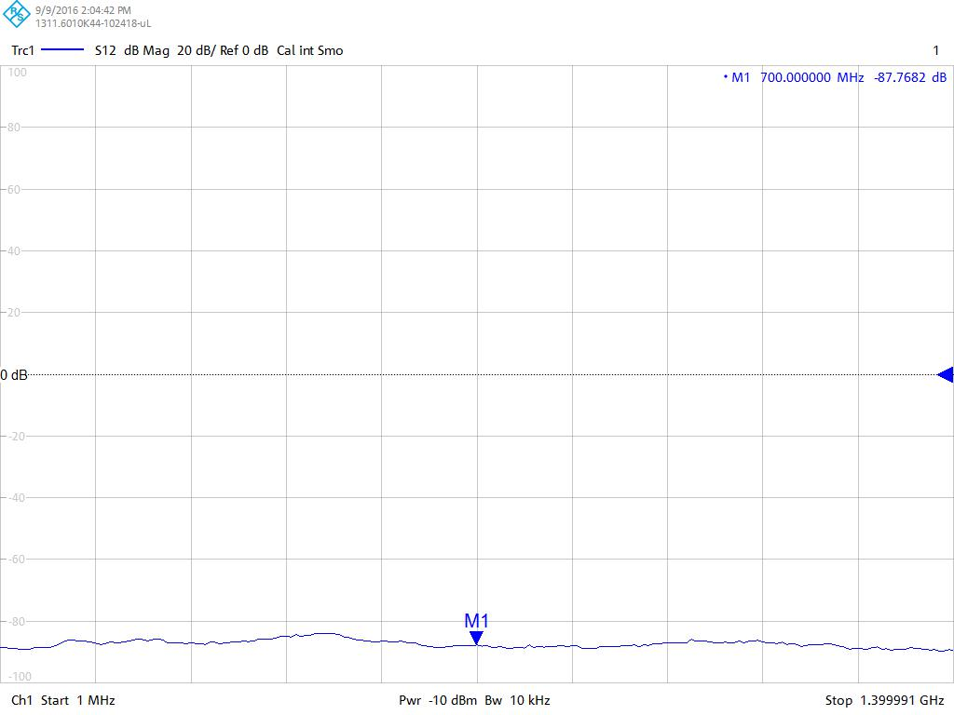
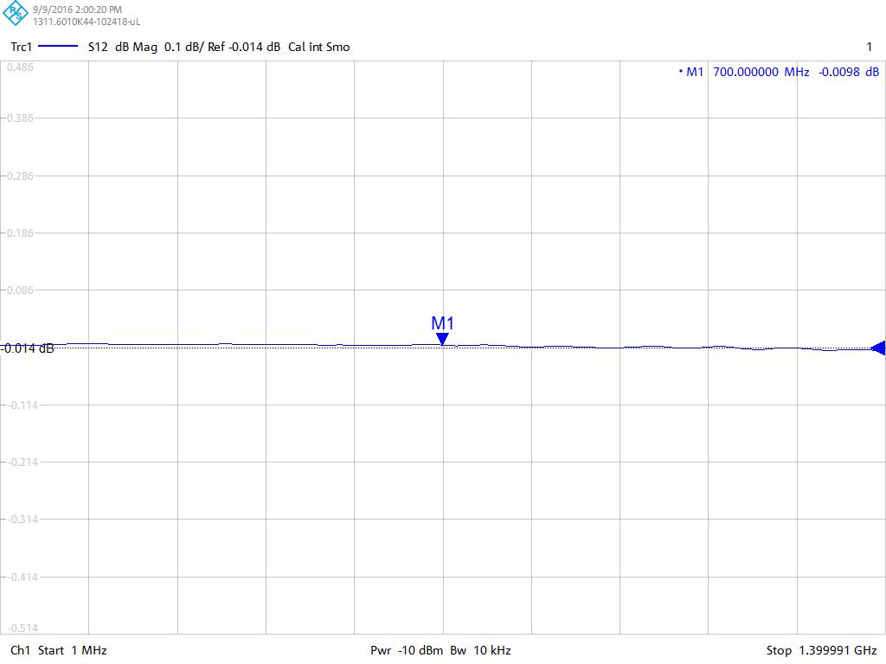
Measurements
IL and isolation

