Slide 1
CDR Pin diode
www.europeanspallationsource.se
18-04-26

Slide 2
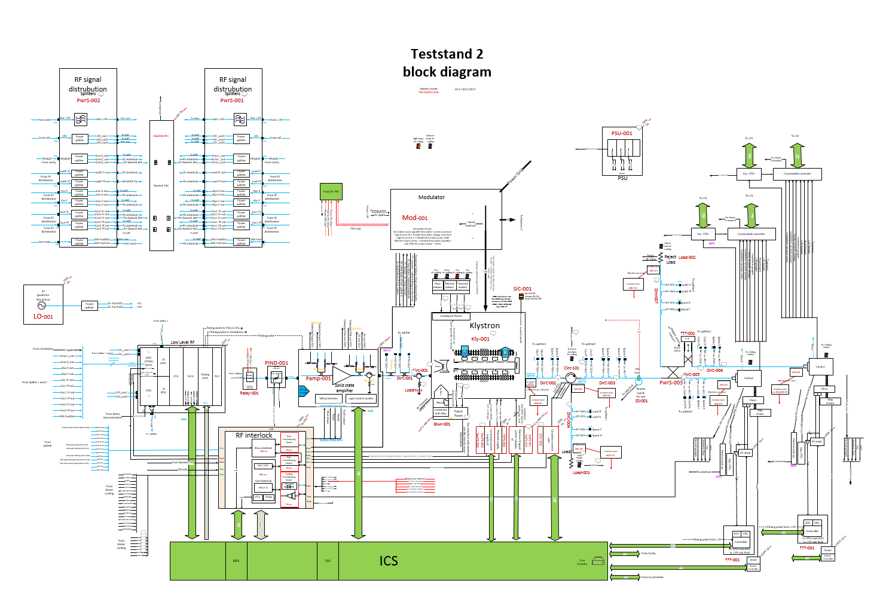
Two small boards in RF system (but key part of interlock)
Pin diode: to stop RF in less than 100ns

Slide 3
Pin diode in ESS LINAC
DTL x 5
RFQ x 1
Spokes x 26
HB x 44
MEBT x 3
MB x 36
In total:
115 for cold and warm linac

Slide 4
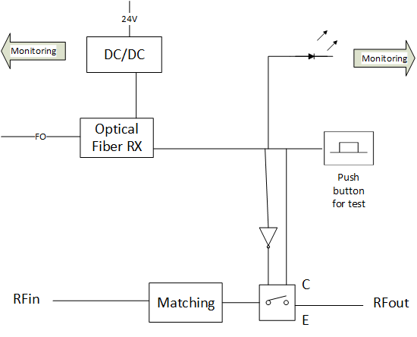
RF PIN diode Block diagram
Functionalities
Cut the RF power in less than 100ns on LPS request
Monitoring functions independant of the main function
Test function
Interfaces:
RF in / RF out: interface with RF path
Fiber in: control of the PIN diode (from LPS)
Unique Power supply (24V)
Ethernet connection (RJ45) monitoring

Slide 5
How does it work?
Based on SKY13348
  SPDT high power switch with 50 Ω terminated outputs
Switch controlled by optical fiber connected to LPS
Monitoring functions independant of the main function
  Voltage monitoring 24V, 3,3V dig, 5V for main function
  Current consumption
  Interlock status
  Temperature of the board

Slide 6
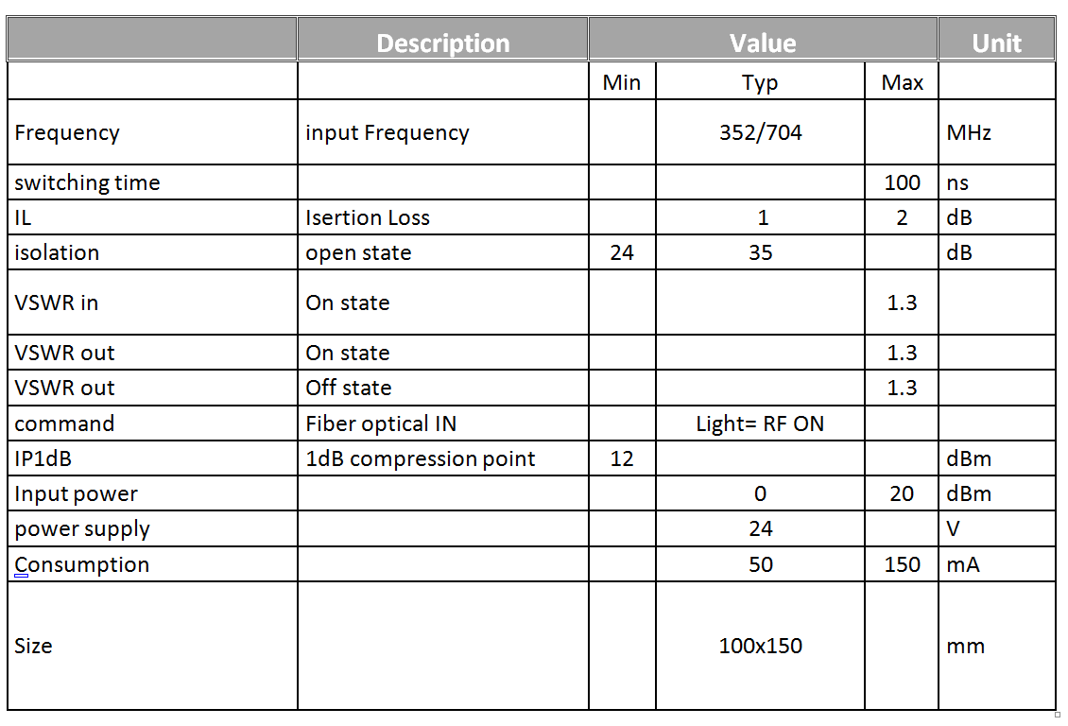
Specification
Specification

Slide 7
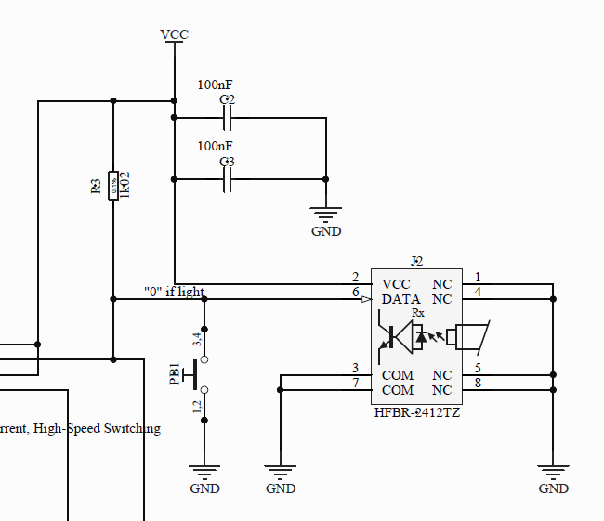
Test of the Pin Diode
Press button for manual test (do we remove it for production?)
Test controlled remotly by LPS (fiber) (active=light)
Return on LED and monitoring (control of the SPDT)

Slide 8
Reliability (1/4)
LPS can test the functionality of the Pin Diode with return on ICS
Pin diode
LPS
Fiber In
Monitoring
ICS
Digital out /2

Slide 9
Monitoring for E- Pick Up (connected to ICS)
Monitoring of different functions:
  Consumption of the board (in case an IC is broken the consumption is impacted)
  Interlock status with independant
  and parallel detector from LPS
  Test of the monitoring itself (need to be on site)
  Temperature monitoring
  Voltage monitoring (output of the regulators)
Pin Diode
Monitoring
Ethernet
ICS

Slide 10
Optimise the MTBF
Minimize the junction temperature of the ICs by limiting the consumption
Over specify the rate voltage of the capacitor
Reliabilty oriented design rules:
  Voltage-limiting suppressor diodes,
  Thermal monitoring
  Filters, rise-time reducers: resistors, inductors, coils, ferrite beads, and capacitors, all of which slow the rise time of a transient and spread the impulse over time. Each of these networks is reciprocal; they protect a system from the outside world (EMS) and protect the outside world from any unintentional signal (EMI) that a device might radiate.
  Metal box connected to ground
  Cool down the board as much as possible using via 4 layers PCB.
  No manual button on main functions (to be discussed).
  Current-limiting and switching devices: fuses (to be discussed)

Slide 11
MTTF calculation
Part number | Description | Qty/ board | MTTF (hours) | Failure rate (1/hours) | Failure rate (1/hours)
Sky 13348 | SPDT | 1 | 8.00E+08 | 1.25E-09 | 1.25E-09
HFBR-2412TZ | Fiber receiver | 1 | 3000000000 | 3.33E-10 | 3.33E-10
MEV1D2405SC | Voltage regulator | 1 | 1500000000 | 6.67E-10 | 6.67E-10
NPO capacitor | NPO capacitor | 6 | 1.97E+06 | 5.08E-07 | 3.05E-06
X5R capacitor | X5R capacitor | 2 | 5.26E+05 | 1.90E-06 | 3.80E-06
 |  |  |  | MTTF system (Hours) | 1.46E+05
 |  |  |  | MTTF system (Years) | 1.67E+01

Slide 12
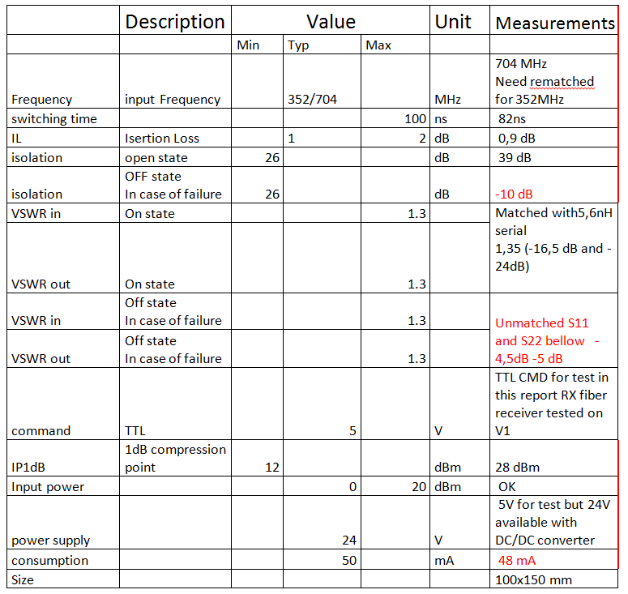
Measurements on prototype

Slide 13
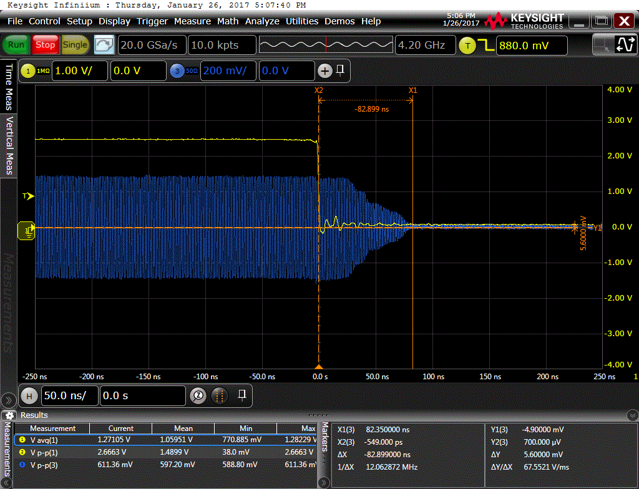
Measurements on prototype
Switching time (Off)

Slide 14
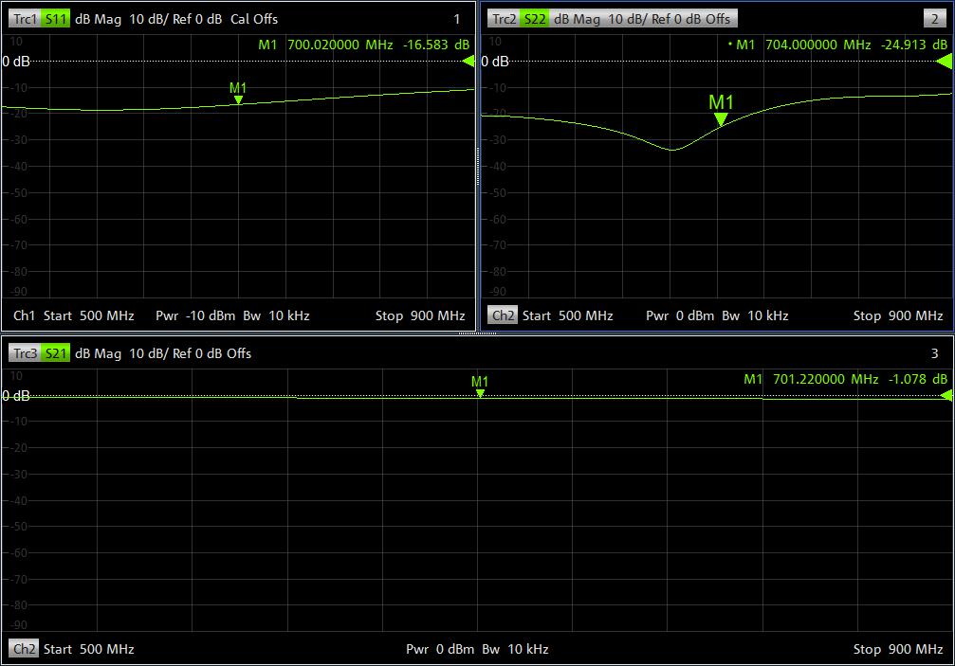
Measurements on prototype
IL switch On

Slide 15
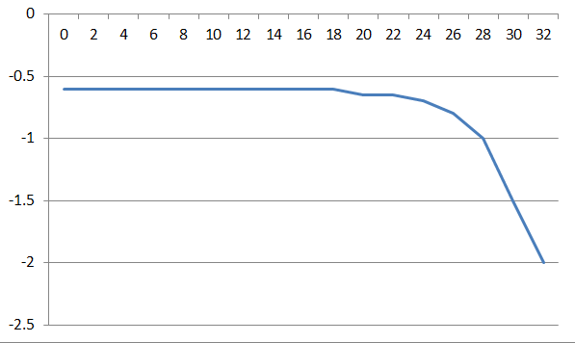
IL vs Pin

Slide 16
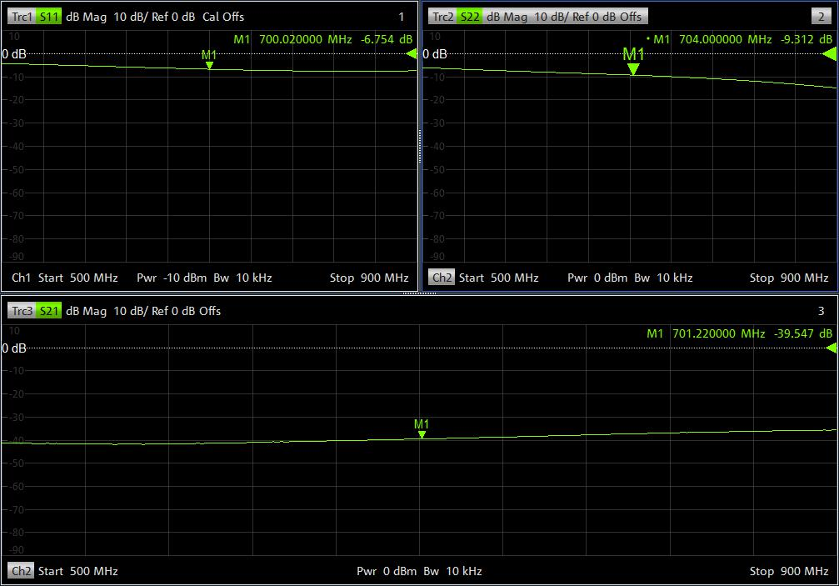
Measurements on prototype
IL switch OFF

Slide 17
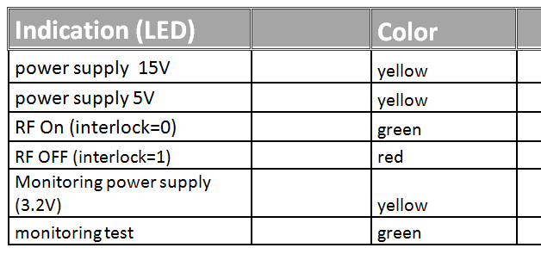
Indication and Monitoring
Indications LED
Monitoring using I2C bus and I2C to Ethernet module

Slide 18
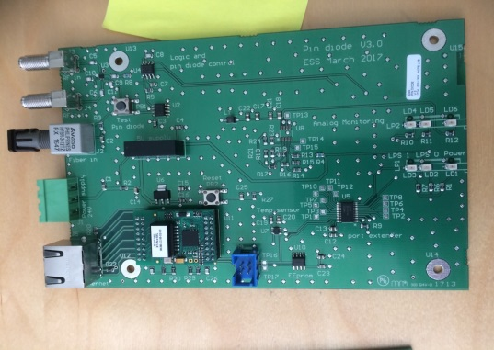
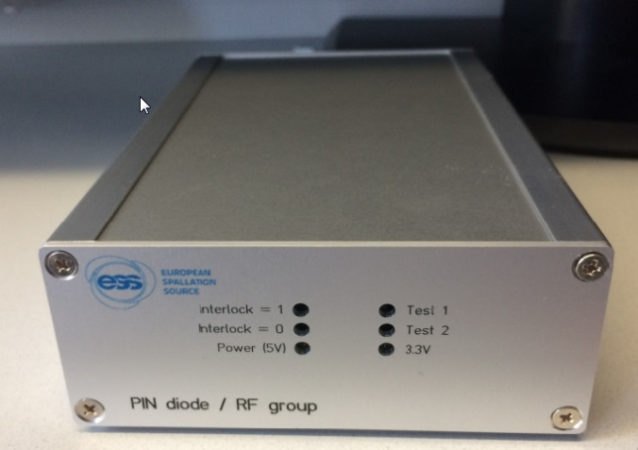
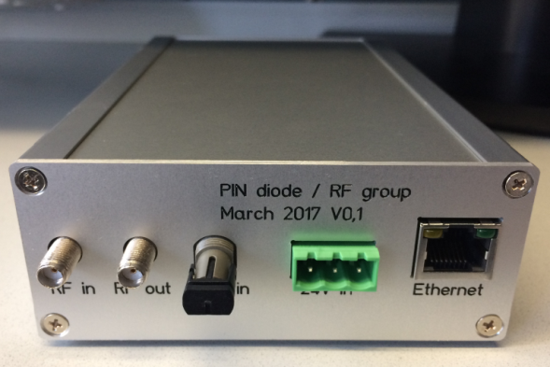
Mechanical for prototype
For TS2 we have grouped 2 e ̄ Pick Up and 1 Pin diode in a 1U rack box

Slide 19
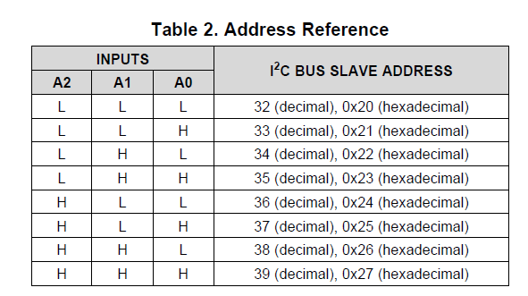
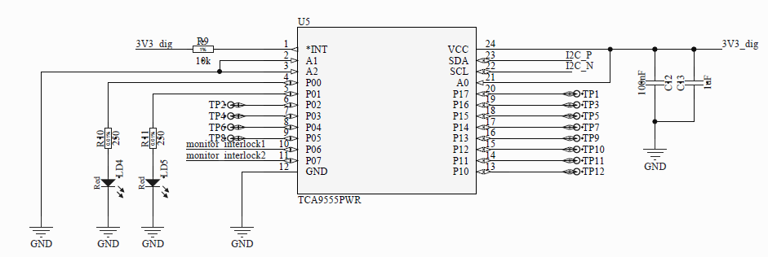
Port extender_tca9555
Adress chosen: 0x21
Digital input
  P6: high if the switch is open
  P7: High if the switch is closed
Digital output
  P0 for test1
  P1 for test 2
Parameters we would like to see:
  P6: high if the switch is open
  P7: High if the switch is closed
Parameters we would like to control
  P0 for test1
  P1 for test 2

Slide 20
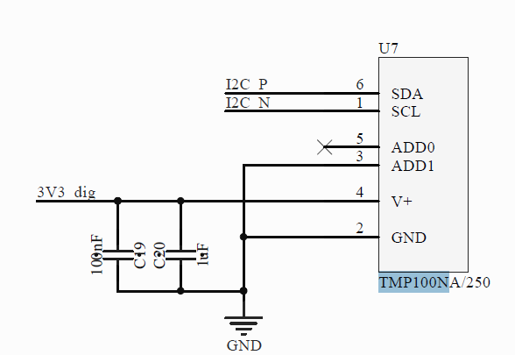
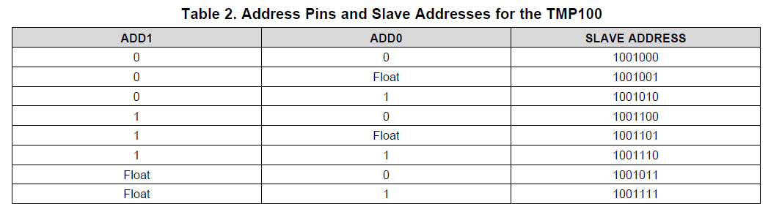
Temperature reader TMP100
Address: 0x49
Parameters we would like to see
  Temperature

Slide 21
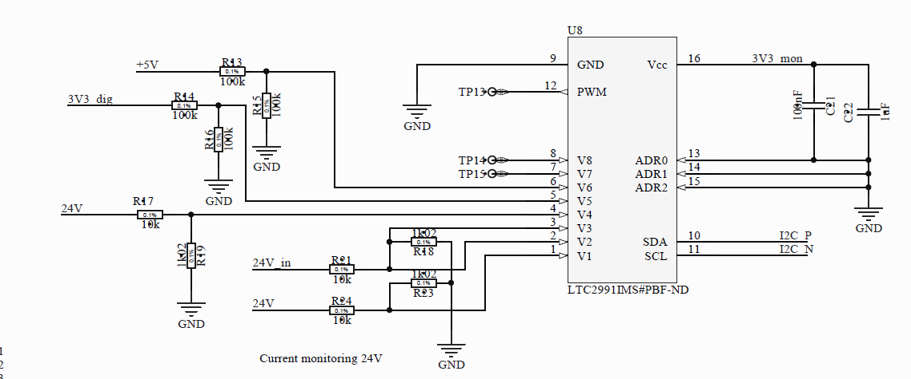
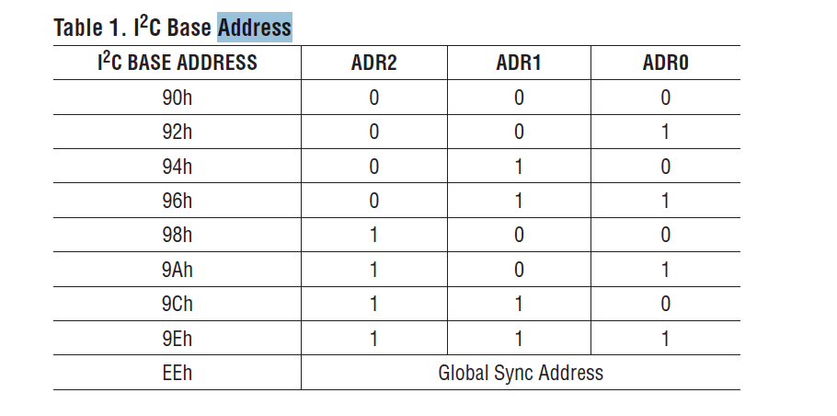
LTC2991IMS voltage current monitoring
Current monitoring onV1 and V2 by V2 – V1 on 24V
Voltage monitoring
  24V on V4
  3.3 V on V5
  5V on V6
  Test on V7 and V8
Address 0x90
Parameters we would like to see:
  Current consumption (V2-V1) x TBD
  24V monitoring: V4
  Digital Volt. 3.3V : V5
  Analog voltage 5V: V6

Slide 22
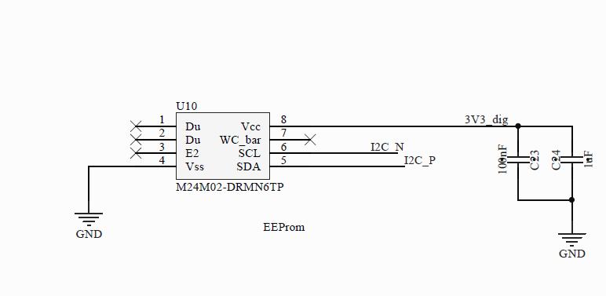
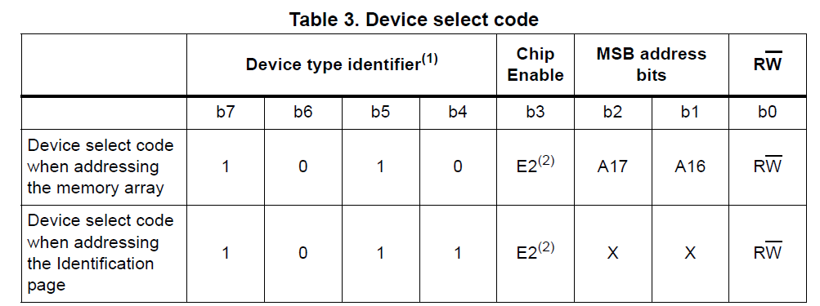
Eeprom M24M02
Address: see table
Below (bin: 101xxxx)

