Slide 1
Vacuum System for the HEBT area
Ferreira, Marcelo J.
Vacuum System Section Leader
www.europeanspallationsource.se
18-04-19

Slide 2
Outline
Introduction,
DCM baseline documents,
Vacuum standardization,
Technical Annex STFC,
Scheduling,

Slide 3
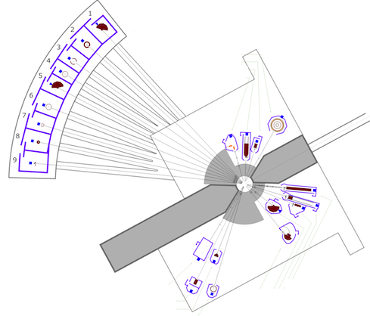
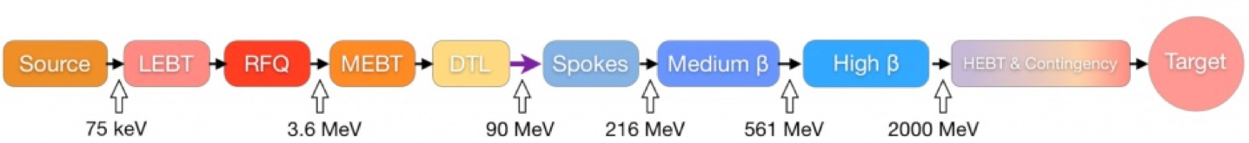
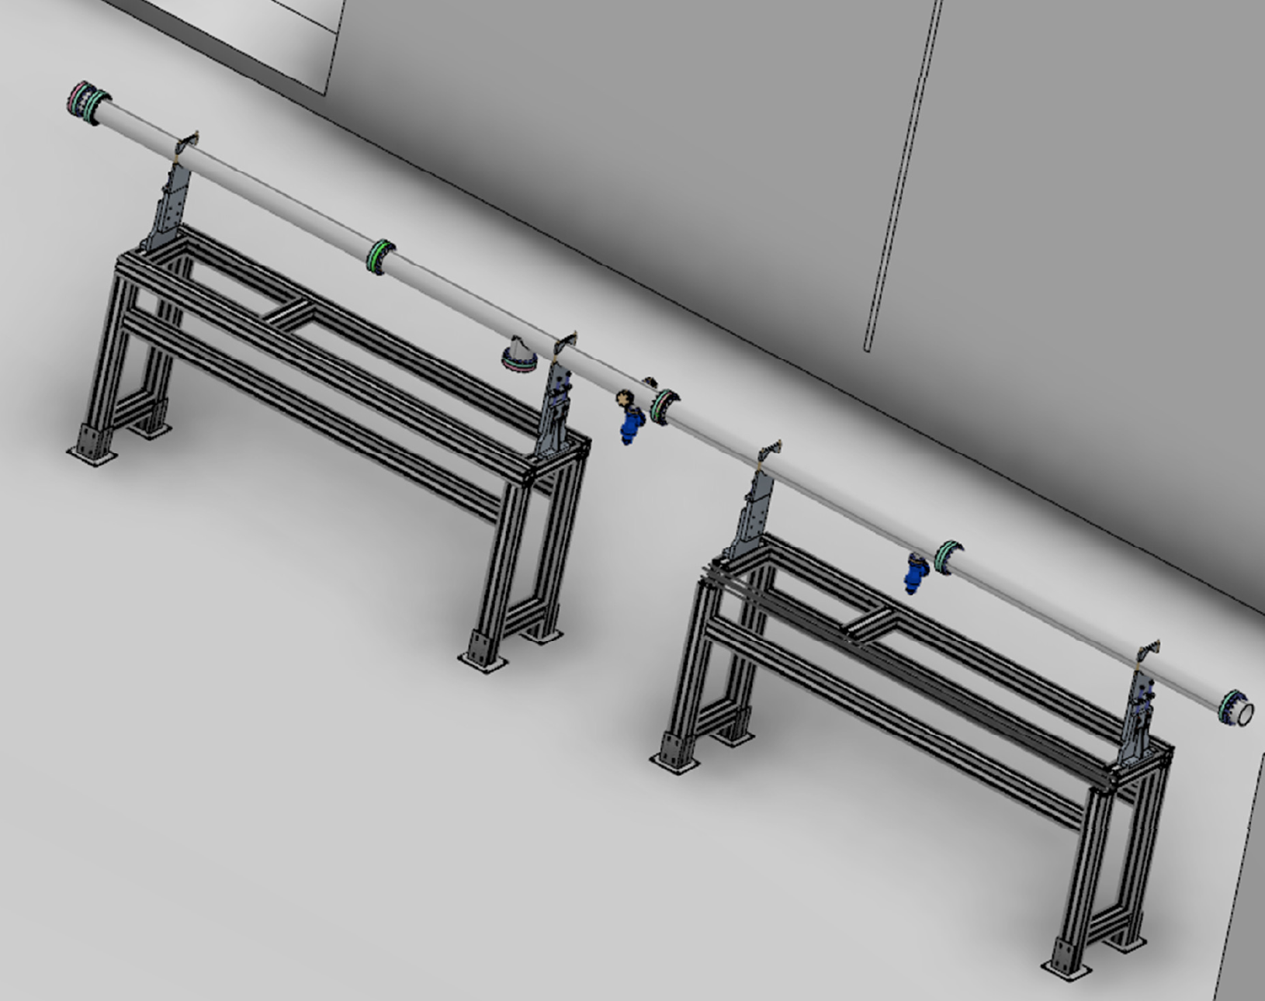
Introduction
Warm LINAC
Cold LINAC
High Energy Beam Transport (HEBT) area:
Transport the proton beam from the end of the HB to the A2T area,
Contingency area for future use, instead of Cryo Modules (CM), will have Dummy Cryo Modules (DCM), connecting the LWUs,
Some instrumentation will be installed (EX: Fast Wire Scanner) on the DCM,
Standard UHV area,
Chambers inside the STFC/Daresbury in kind,
No vacuum instrumentation included.
3

Slide 4
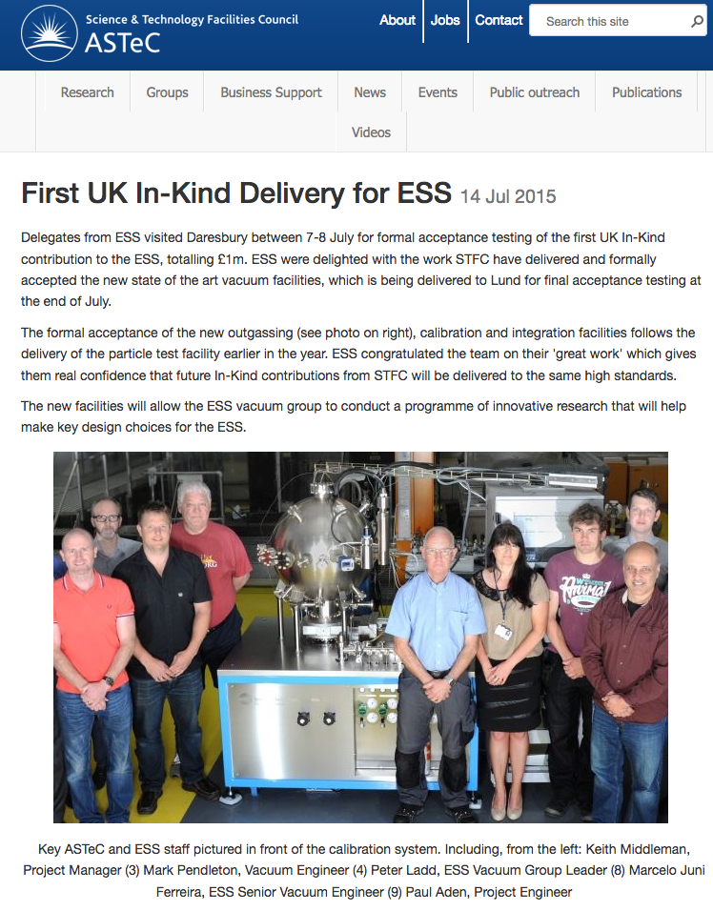
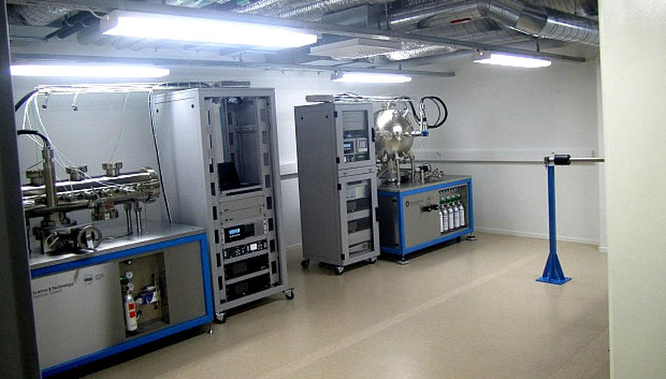
ESS – STFC/Daresbury collaboration time line
April 2014 First meeting to ask STFC/Daresbury to participate as ESS Vacuum in kind for WP 12.
Jul 2014 STFC/Daresbury accepted to delivery full packed for all WP 12 (Cold LINAC, portable clean rooms and test Facilities),
Dec 2014 Test Facilities and clean room specifications agreed,
Mar 2015 Initial discussions on delivery schedule and technical specification for the LWUs cold LINAC. Clean room specifications finished,
May 2015 Acceptance meeting at STFC/Daresbury for the test facilities,
Jul 2015 Test facilities delivery at ESS/Lund, acceptance test approved,
Oct 2015 PDR LWUs cold LINAC,
Jun 2016 CDR for LWUs at STFC/Daresbury,
XXX 2017 First delivery of DCM to ESS,

Slide 5
DCM baseline documents
From ESS:
ESS main time schedule,
DOORS requirements (top-down and interfaces),
ESS Vacuum Handbook – ESS 0012894, 0012895, 0012896, 0012897,
Technical detail spreadsheet,
From STFC/Daresbury and ESS
Technical Annex,
3D drawings,
From STFC/Daresbury:
Vacuum standards (ASTeC Vacuum documents equivalent to ESS Vacuum Handbook),
Clean room documentations,

Slide 6

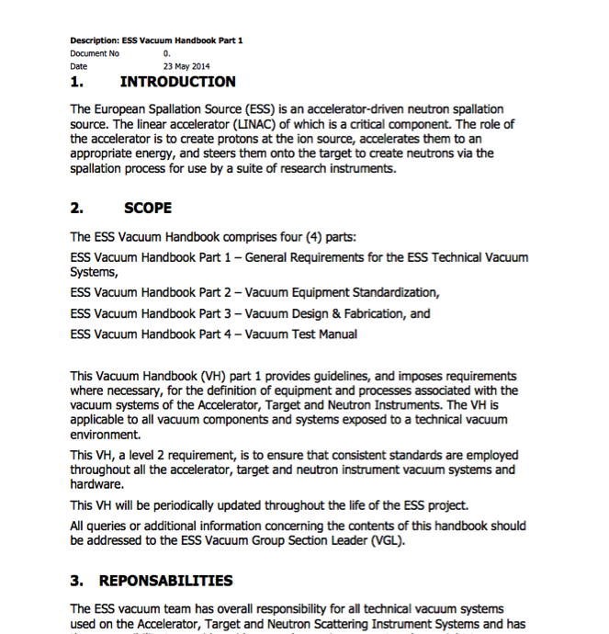
Vacuum Standardization, an Integrated Approach
Working closely with our partners across the project one of our primary goals was to promote the use of common vacuum equipment and standards. As a result a Vacuum Standardization meeting was held in February 2014 where equipment suitable for Standardization was agreed and reflected in the ESS Vacuum Handbook.
An important element of this Standardization is the Procurement Policy applied for the procurement of all “major” vacuum equipment. The primary objective of the program is to develop a list of standard vacuum equipment for use project wide to minimize project costs, reduce spares holdings, training and achieve other benefits of standardization.
STFC joined the ESS Vacuum Frame-Work Agreement (FA) procurement following the ESS Vacuum standardization policy
http://europeanspallationsource.se/accelerator-documents

Slide 7
Document status
ESS Vacuum Handbook => OK! (following ASTeC documents ) Aug 2014
DOORS => OK! May 2016
Technical Specifications (LWU + DCM cold LINAC) => OK! Mar 2016
ESS main time schedule => OK! May 2016
TA in kind from STFC/Daresbury => May 2016=> signed March 2018
Date | Pipes Ready to Ship* | % | LWU Ready to Ship* | %
31/01/2018 | 20 | 50% | 0 | N/A
30/07/2018 | 40 | 10% | 0 | N/A
26/01/2019 | 48 | 0% | 1 | 25%
25/07/2019 | 52 | 0% | 31 | 25%
21/01/2020 | 0 | 0% | 58 | 0%
19/07/2020 | 0 | 0% | 74 | 0%
Key Milestones: updated from the TA as is Feb/2018

Slide 8
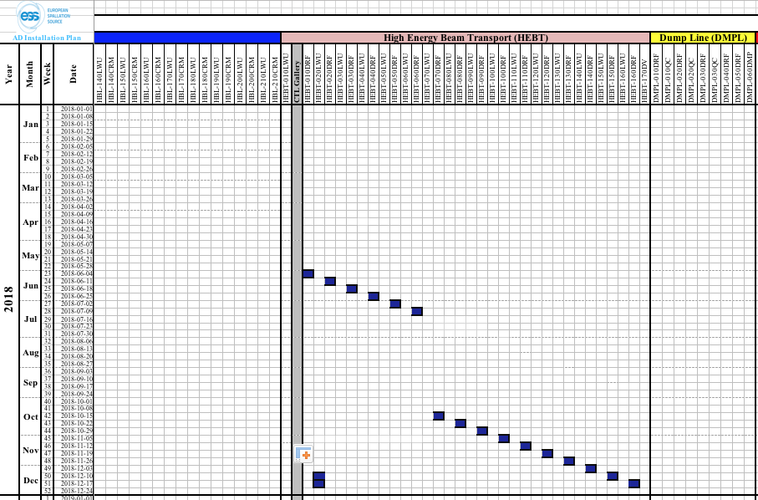
Schedule
-Last update from the TAC review on the installation of the HEBT DCM starting in June from the end of the HB to the A2T area.

Slide 9


Thank you!

