Slide 1
Beamline Controls Group (BCG)
Tobias Richter & Matt Clarke
DMSC

Slide 2
May 2018:
Beamline Controls Group proposal
Create an NSS neutron beam-line controls group.
  In line with other facilities
  Consolidate planning, prioritisation & development
  Improve performance and integration with ICS
DMSC STAP suggest this is a sensible structure

Slide 3
Organisation
Existing line structure remains in place.
New project structure will allow a common prioritisation of tasks and ensure better visibility of progress and bottlenecks across NSS.
Enabling staff to work on tasks currently deemed inside the NSS scope, should empower people to make progress where it is limited due to resources, training or expertise.
It will also facilitate better knowledge sharing in core areas.
Authority to prioritise controls tasks on behalf of NSS
Authority to work on ICS bits of scope and make technical progress in agreement with ICS and NSS stakeholders
No immediate budget implications.
Scope creep from ICS to NSS is a risk.
However, we have better control of the ICS delivery in the proposed structure and we benefit from synergies by pooling resources and reducing bottlenecks.

Slide 4
Targeted BCG Scope
NICOS (Scientific User Interface)
Expert Interfaces
Timing system
IOCs for NSS devices
  detector slow control
  area detector interfaces
  choppers
  sample environment
  motion control
EPICS Infrastructure
  PVaccess
  IOC factory
  configuration control
  network infrastructure
  archiver integration
  alarms, logging
  deployment
Support of operations at V20, ESSIIP, Embla, BNC, construction site, etc

Slide 5
Communications
No attempts to disrupt collaboration that is currently working well.
Steering Board for the Experiment Control Programme already has stakeholders from all groups involved – scope should be expanded to cover all of BCG
Idea was to have staff closely located together in the Lund site offices with desk space for the DMSC staff
Meetings (for the moment – TBD)
  Weekly BCG – ICS update and prioritisation meeting
  Bi-weekly BCG project meeting with knowledge exchange
  Monthly ECP Steering Board Meetings
Common prioritisation using new or existing Jira projects
Set of relevant milestones tied to instrument delivery

Slide 6
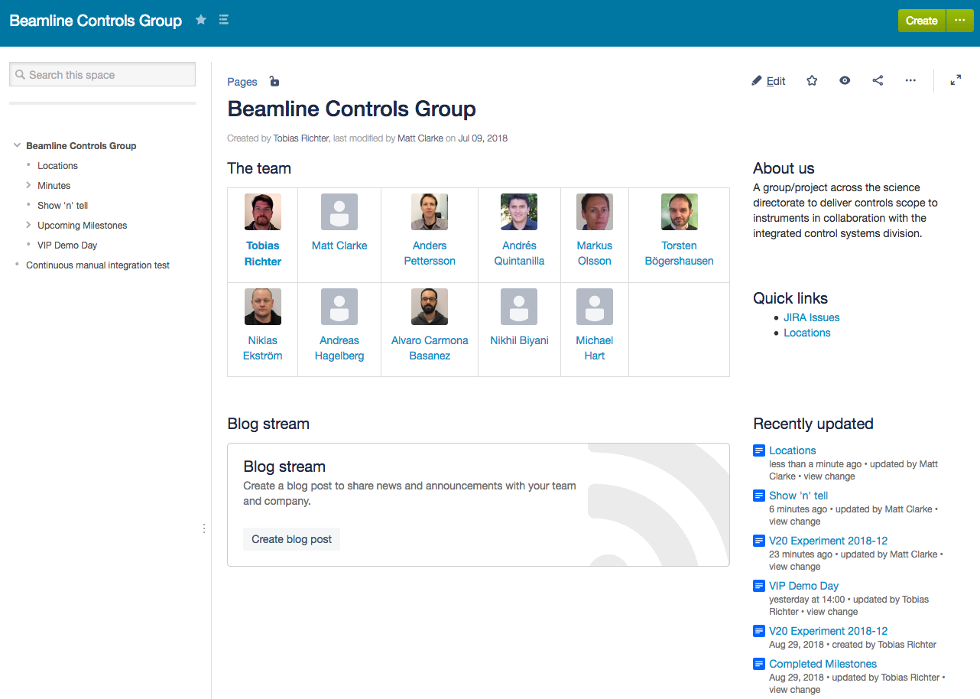
Confluence page
https://confluence.esss.lu.se/display/BCG
Notes:
BCG has its own confluence page

Slide 7
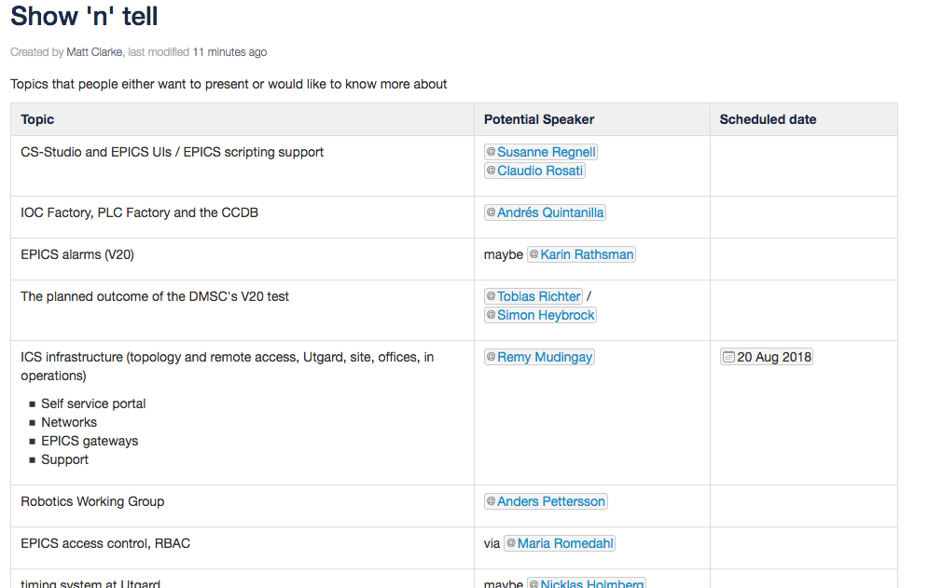
Show ‘n’ tell
Notes:
A place to list things we don’t know or would like understand better
Can be from within the BCG or from external parties, e.g. ICS

Slide 8
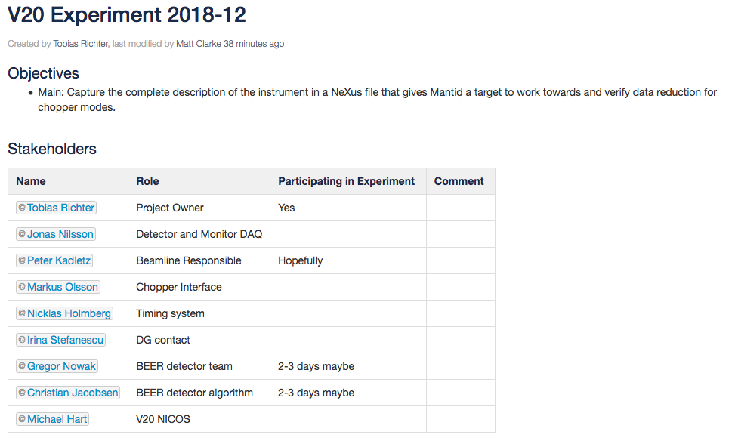
Integration milestones
Notes:
Used to list past, current and future milestones at the BCG level – stuff that may span multiple areas in NSS or need outside support, e.g. from ICS.
For example:
the next V20 visit
Chopper factory tests

Slide 9
VIP demo days
Notes:
Every now and again we have an important visitor or visitors to Utgård, for example: recently the German minister and a delegation from South Africa.
For these visits, the DMSC have run a streaming demo with event data from a detector being send from the EFU into Kafka and into DAQUIRI.
The intention is to repeat these demos every six to eight weeks.
Firstly to make sure the demo is ready to go for the next visit, and secondly we want to start adding new functionality into the demo. For example: we may want to start including TDC data from the mini-chopper.

Slide 10
JIRA
https://jira.esss.lu.se/secure/RapidBoard.jspa
ICSHWI JIRA
BCG JIRA
SAD JIRA
DM (ECDC) JIRA
Choppers JIRA
Notes:
BCG Jira for higher level tickets.
Can be linked to more specific tickets in other JIRAs, e.g. in the ICS JIRA

Slide 11
JIRA – what is it for?
Create a ticket
Need something done
Notes:
If you need something doing put a ticket in

Slide 12
JIRA – what is it for?
Create a ticket
Need something done
Have an idea
Notes:
Perhaps you have had an idea and you want to discuss it or just record it

Slide 13
JIRA – what is it for?
Create a ticket
Need something done
Have an idea
Worried about something
Notes:
Perhaps you are worried about something
If it relates to a lack of information then the alternative may be to add something to the Show ‘n’ tell

Slide 14
JIRA – what is it for?
Create a ticket
Need something done
Have an idea
Worried about something
Need a decision
Notes:
Finally, if you need a decision made: create a ticket.
Not sure where we will record decision at the moment. At the very least it will be recorded in the ticket.
By putting all these things into JIRA means we only have to look in one place for stuff and we can use this to create an agenda for the regular meetings.
Do we need separate labels for the different types of issue? Currently we just have tasks.

Slide 15
Farewell Nikhil!
Good luck in your new job

Slide 16
Welcome Michele!
Good luck in your new job

