Slide 1
Sample Environment Mechatronics and System Integration - Update
Anders Pettersson
Scientific Activities Division
ECP Sept 03 ESS

Slide 2
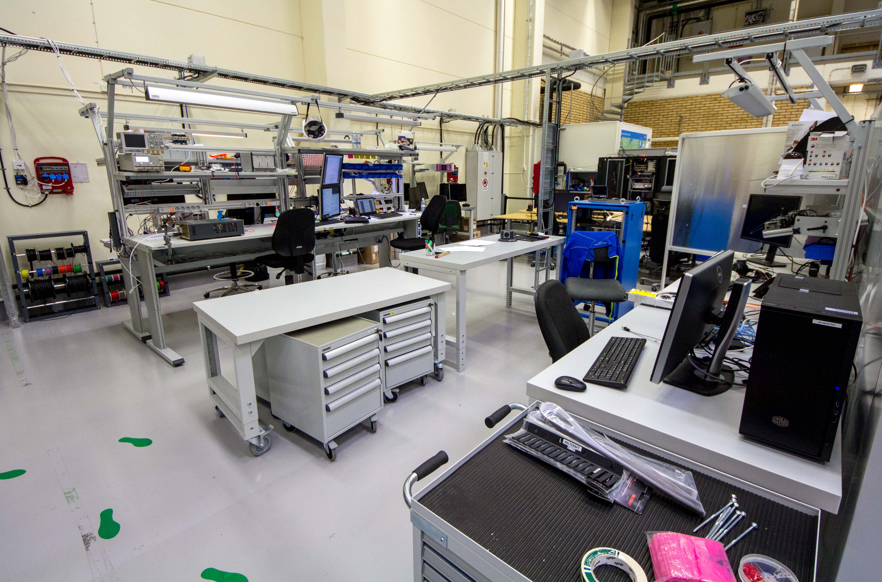
Utgård – Now even cooler

Slide 3
ESS Sample Environment Control
Beamline Controls Group
Coordinate technology groups
Focus control competence
SE provide
Requirements
Control hardware PLC, IPC
Algorithms/Logic/Sequences
Coordinating integration
SECoP
SINE2020
Providing a standard protocol
Experiment Control System
Sample Environment System
EPICS
SECoP
EPICS
Integrated Control Systems Division
EPICS infrastructure
Engineering UI
Archiver
Network booting
Data Management and Software
Centre
ECS NICOS integration
User interface and Scripting
Data collection
Plug and Play
Network Infrastructure
Timestamp
3

Slide 4
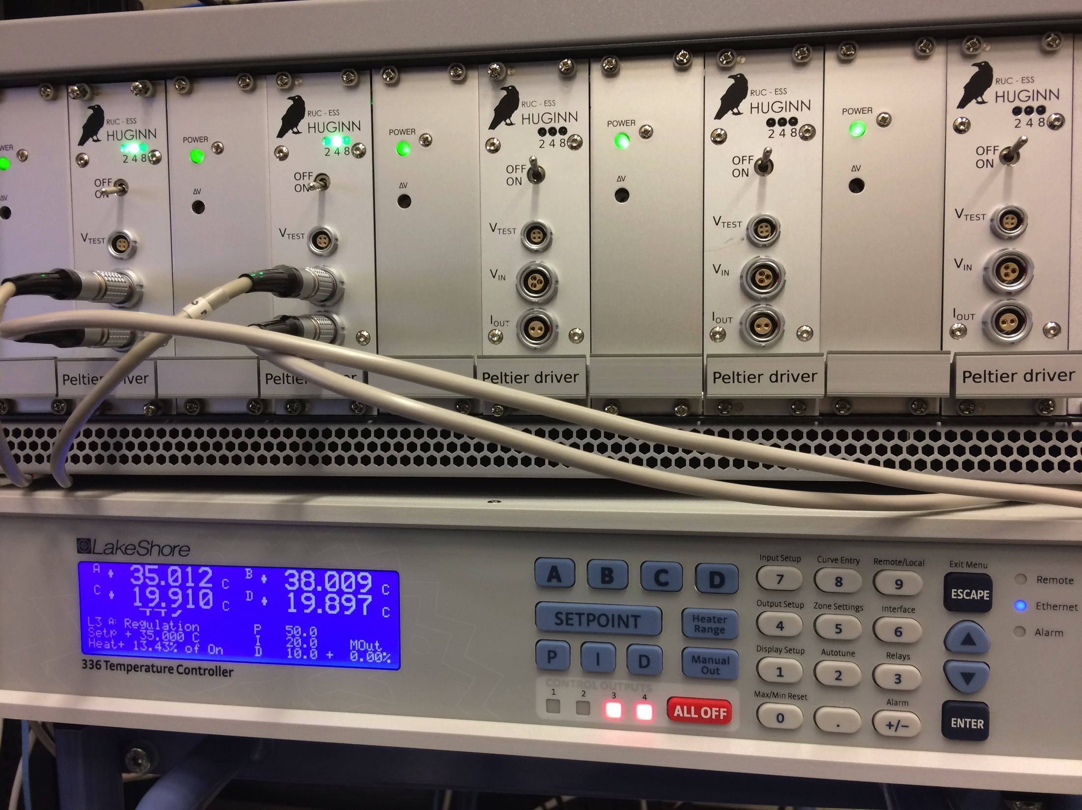
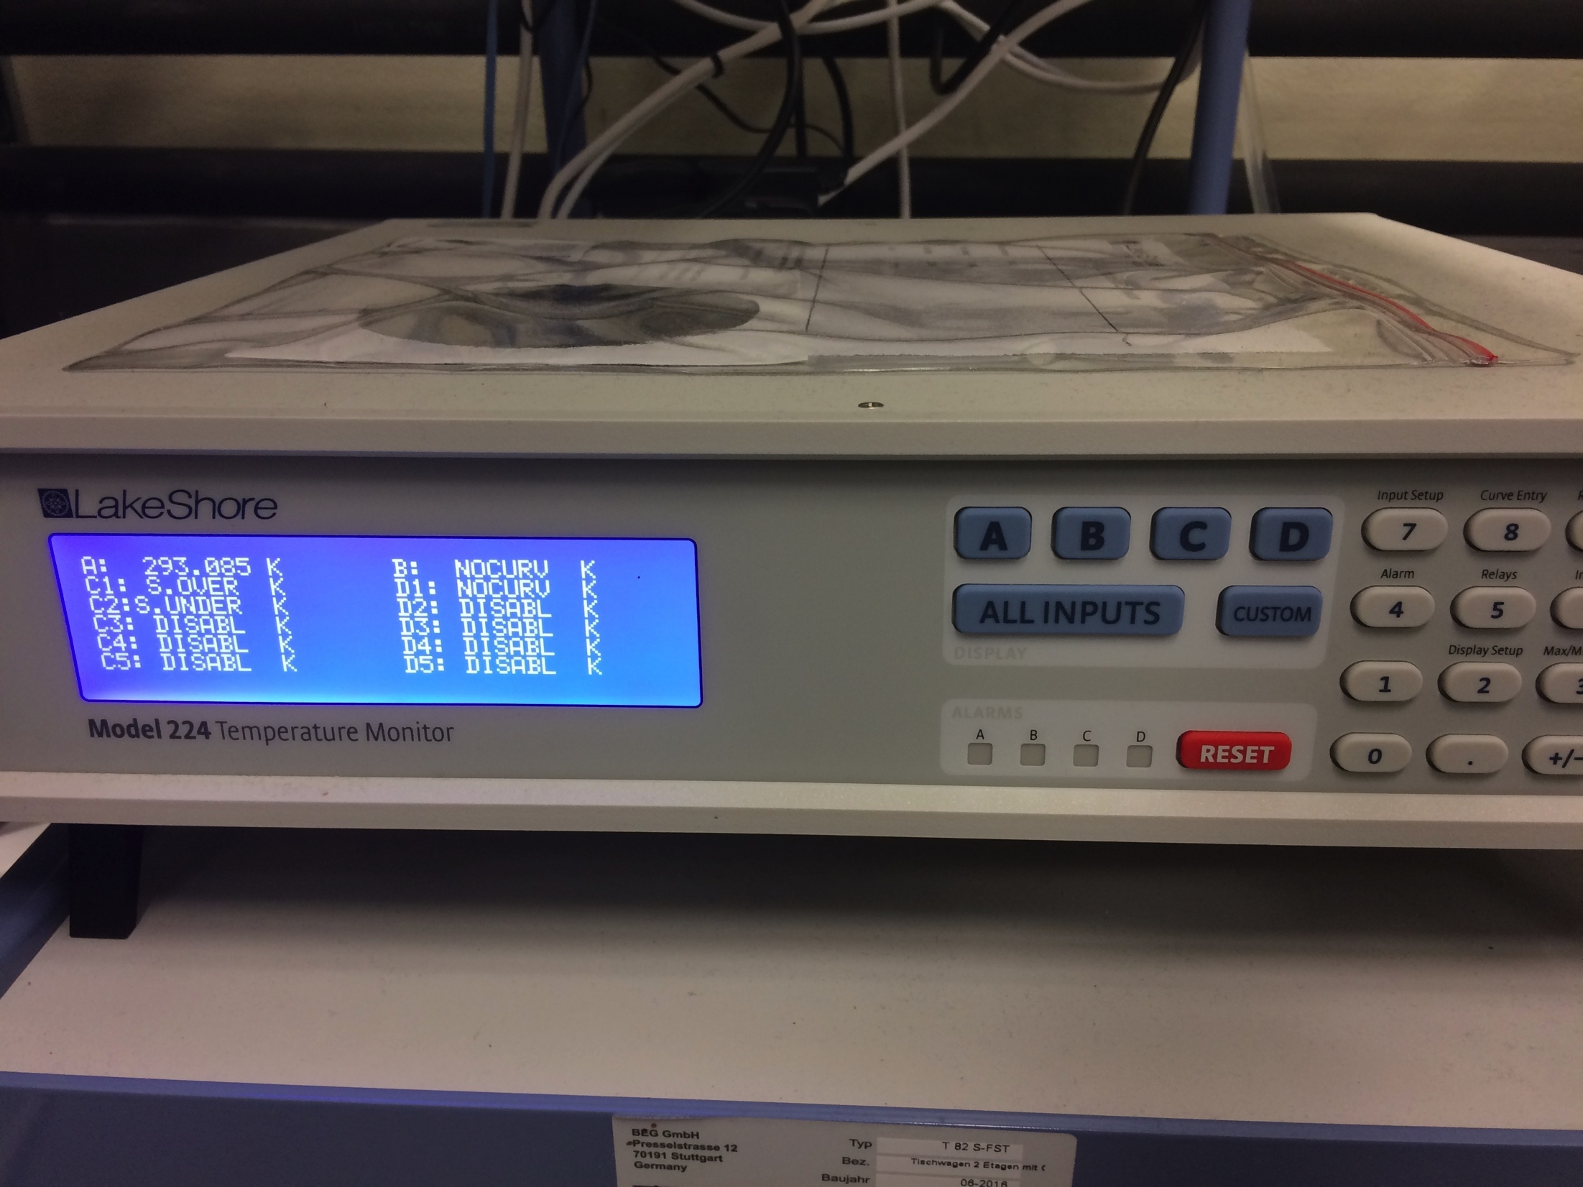
STATUS: EPICS (by Integrated Control Systems Division ICS)
Progress in 2017
Full network booting + IOC startup available/tested
2 systems running on test hardware (Fitlet mini-PC)
Managed to integrated spectrometer proprietary driver
More Sample Environment Equipment Integrated (later slide)
Plans for 2018
Plug and Play
Integration tools/code accessibility
save and restore
calibration/configuration handling
network booting (or not…)

Slide 5
Integration Projects: Overview
JULABO F25-HL Circulator
LakeShore 336 Temperature Controller
Lab CCR SES
LESKER KJLC 354 vacuum gauge
OceanOptics QEPro Spectrometer
LakeShore224 Temperature monitor
KEPCO BOP502D Bipolar Power Supply
NE 1600 6 channel syringe pump
NE 100X 1 channel syringe pump
NE9000G Peristhaltic pump
Utgård SE Utilities PLC
PACE5000 Pressure controller
Scanning system
LOKI (VR) inline system
HPLC Knauer AZURA P 6.1L
Anton-Paar Densitometer
Ocean Optics Spectrometer
Orange Cryostat
Cameras for Kinematic Mounting
Huginn SANS Temp Controller Integration (with PLC)
“Baseline” (2017)
“Baseline” (2017)
“Baseline” (2017)
“Baseline” (2017)
“Baseline”
Close to “Baseline”
Close to Baseline
Not started
Not started
“Baseline”
Just started
Just started
LOKI (VR) inline system
Not started
Started
Not started
In progress
“Baseline”
Not started
More on its way!
EA Power Supply
Function generator
Resistor decade
AC suceptability
Flexiprobe(?)
Pulse Probe laser..
…

Slide 6
SE Short term priority list
Platform | Device name/Id/type | Parent SES (from above) or Standalone | Equipment availability | Blocking after (yy Q1-Q4) | Description (very short) | status | Progress (to baseline)
FLUCO | NE 1600 6ch syringe pump |  | Available | 18Q1 | Can likely be fully based on 1 ch Syringe pump already started. | Integration draft available. Need to deploy on fitlet. Not tested | 75
TEFI | Lockin | AC susceptibility | Available | 18Q3 | lock-in detector for in-situ measurements | Final steps by Wayne L. | 80
TEFI | Vacuum guages | OC/Gas handling | Available | 18Q3 | Remote readout of pressure, suitable for PID control of needle valve or general diagnostics. | can readout | 50
TEFI | Convert MATLAB code to EPICS/Python | Huginn | Available | 18Q3 | Huginn |  | 90
TEFI | Auto vacuum valves | OC/Gas handling | Available | 18Q3 (open/close)/19Q1 (full integration) | Electric and pneumatically controlled vacuum valves. | can be opened closed | 50
MESI | Huginn NetBooting! |  | Available | 18Q4 | Make Huginn a SES with network booting. | Config in CCDB and IOC fact. LS336 snippet issue. | 50
PREMP | PACE gas controller | DAC | Available | 18Q4 | EPICS interface for controllable-pump | Initial control OK. | 70
PREMP | transducers | PES and DAC | on order | 18Q4 | Beckhoff to EPICS interface | Not started | 0
PREMP | actuated valves | PES and DAC | planned | 18Q4 | Beckhoff to EPICS interface |  | 0
PREMP | high level pressure control software | PES and DAC | From other. | 18Q4 | P display + logging, P set point, P ramp setup-control, safety features such as leak and blowout detection and response (including opening/closing valves) | Not started
PREMP | 1d linear scanning motor(prototype) | SCAN | available | 18Q4 | control of single axis linear motor | Started. | 25
PREMP | laser detector | SCAN | available | 18Q4 | read output laser diode, interface with motors to display as function of scan position | Started. Signal read in Beckhoff. | 50
PREMP | Integration of Cameras for Kinematic Mounting |  | available | 18Q4 | Added in above KinMSysy | Small but complex final issues. | 90
FLUCO | Gas-Process-Handling-System |  | Ordering/Descussion | 19Q1 | Gas handling for various setup's | Contact started with setaram | 2
FLUCO | Resistance Bridge, Model 1427 |  | Available | 19Q1 | Remote prcision resistance bridge | Not started
FLUCO | Model 1255 |  | Available | 19Q1 | Frequency Response analyzer | Not started
FLUCO | Model 1286A |  | Available | 19Q1 | Potentiostat | Not started
FLUCO | Prologix PL-GPIB-LAN |  | Available | 19Q1 | GPIB to Ethernet converter | Not started
PREMP | hydraulic pump | PES | planned | 19Q1 | EPICS interface for controllable-pump | Not started
PREMP | Ocean Optics Spectrometer | DAC | on order | 19Q1 | read output from ocean optics spectrometer, fit spectrum, extract peak position | Most can be based on HLab work !

Slide 7
From 2017 Dec
Topics:
Will there be a GUI for NICOS available?
How to handle a device scanning in the beam to find beam centre.?
Plotting Temperature vs Magnetic field?
Remote accsess/status check?
NICOS clients for “users” (colleagues)

Slide 8
Areas of Interest 2018
SECoP in ECS. (SECoP v1.0 available in Sept)
Promote SECoP for Loki inline project (NURF?) (ISIS)
Looking into Archiver and Channelfinder. Links to ECS?
Plug and Play. (ICS)(Vacuum)
Push “user PC” for Nicos (DMSC)
Local/Network booting with (ICS)
Naming. Always one name, Changing name after location, Both?
Network discussions (ICS)
Slow time timing discussion (ICS)
Clients conflicts? Philosophy on NICOS vs CSS etc
Alarm handling – Alarms.

Slide 9
Now what..
Need to get going !
Setup NICOS for a few systems
I do not sense the YEAHHH!!....

Slide 10
FIN
Thank YOU for your attention!

