Slide 1
ICS update 7th Experiment Control Workshop
Maria Romedahl
Neutron Instruments and Technologies Integration Manager
www.europeanspallationsource.se
3 September, 2018

Slide 2
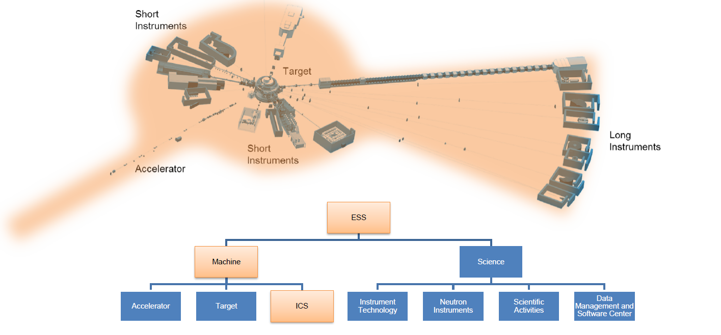
ESS - ICS Division
The Integrated Control System Division (ICS division) is the organizational group responsible for the control systems within ESS for the accelerator, target, neutron scattering systems and conventional facilities, including a machine protection system (MPS) and a personnel safety system (PSS).

Slide 3
ICS Organization
H Carling
K Vestin
R Mudingay
S Regnell
A Nordt

Slide 4
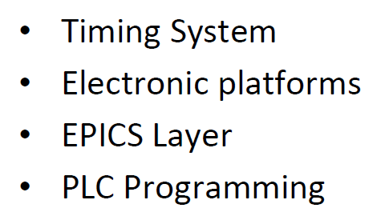
Hardware and Integration Group

Slide 5
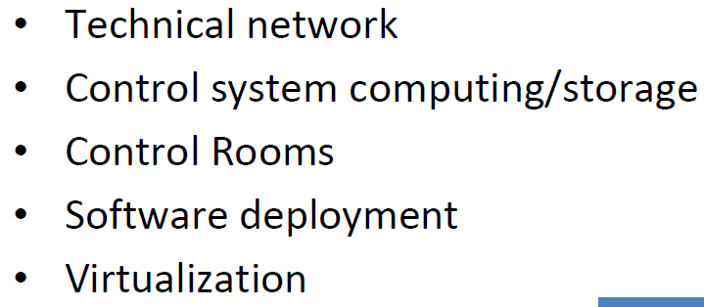
Infrastructure Group

Slide 6
Software Group

Slide 7
Protection Systems Group

Slide 8
Work Package 12 Interactions
ICS point of contact for NSS project
Intrument technology groups (MCA, NChG, DG)
Sample Environment
DMSC
NSS Project Division
Instrument teams
Parental leave
Work fr remote
Work fr remote
Support us ~5%

Slide 9
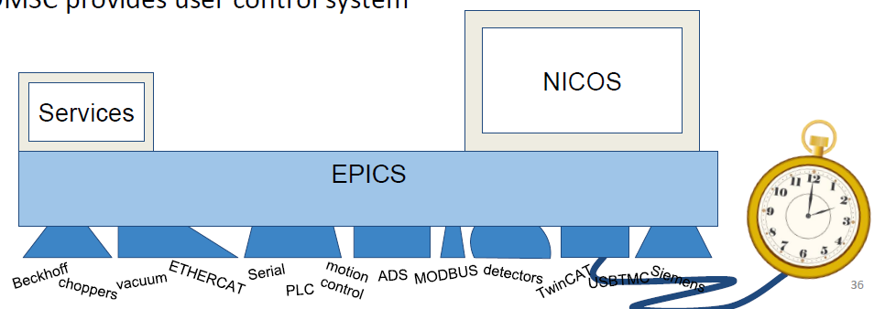
Work Package 12 Engineering Effort
EPICS and Timing System integration for
Generic instrument technologies
Sample environment
Instrument specific equipment (robots, cameras, ...)
Supply EPICS and Timing System controls hardware to ESS neutron instruments
Reviewer and contributor to the generic technologies documentation
Reviewer and contributor to the neutron instruments documentation
DMSC
ICS
ICS
ICS

Slide 10
Work Package 12 Documentation

Slide 11
WP12 - Vertical Integration Project (VIP)
Why VIP?
Continuation of ESS Instrument Integration Project (ESSIIP) in Utgård Lab
Create a local (in Lund) instrument beamline (without neutrons) in the lab in preparation for first neutron instrument installations
VIP Project idea
To integrate a device into the full control ecosystem
The device to be defined together with the intrument technology groups
The full control ecosystem needs to be defined
Define things like
how the network would be set up on an instrument
how ICS controls would be deployed
how ICS services would be deployed
how devices would be integrated into the DMSC's user control system

Slide 12
WP12 - Vertical Integration Project (VIP)
Create Lab Space
Deploy ICS Software Stack
Deploy Timing System
Chopper Integration
SW Tools Development
Set up better Lab Network / Instruments Network
Sample Environment Plug & Play
Sample Environment Integration
Detector Integration
MCA Integration
June 2018
About June 2019

Slide 13
VIP Results
Create Lab Space
Done
Deploy ICS Software Stack
Deploy Timing System
Chopper Integration
SW Tools Development
Set up better Lab Network / Instruments Network
Sample Environment Plug & Play
Sample Environment Integration
Detector Integration
MCA Integration

Slide 14
VIP Results
Create Lab Space
Done
ChannelFinder
Archiver Appliance
Alarm Server
EPICS to Kafka Forwarder
Channel Access Put Log
CA gateway
Full stack redeployment demo
Deploy ICS Software Stack
Ongoing, >50% done
Deploy Timing System
Chopper Integration
SW Tools Development
Set up better Lab Network / Instruments Network
Sample Environment Plug & Play
Sample Environment Integration
Detector Integration
MCA Integration

Slide 15
VIP Results
Create Lab Space
Done
Deploy ICS Software Stack
Ongoing, >50% done
HW specified
Components installed
EVG running with single EVR
EVG running with two EVRs
Timestamping (Rb Oscillator)
Deploy Timing System
Ongoing, >50% done
Chopper Integration
SW Tools Development
Set up better Lab Network / Instruments Network
Sample Environment Plug & Play
Sample Environment Integration
Detector Integration
MCA Integration

Slide 16
VIP Results
Create Lab Space
Done
Deploy ICS Software Stack
Ongoing, >50% done
Deploy Timing System
Ongoing, >50% done
Mini-chopper rotating at 14 Hz
Implement timestamping
-> -> -> DMSC application
Chopper Integration
Ongoing, >50% done
ICS SW Development
Set up better Lab Network / Instruments Network
Sample Environment Plug & Play
Sample Environment Integration
Detector Integration
MCA Integration

Slide 17
VIP Results
Create Lab Space
Done
Deploy ICS Software Stack
Ongoing, >50% done
Deploy Timing System
Ongoing, >50% done
Chopper Integration
Ongoing, >50% done
SW Tools Development
Ongoing
Set up better Lab Network / Instruments Network
Sample Environment Plug & Play
Sample Environment Integration
Detector Integration
MCA Integration

Slide 18
VIP Results
Create Lab Space
Done
Deploy ICS Software Stack
Ongoing, >50% done
Deploy Timing System
Ongoing, >50% done
Chopper Integration
Ongoing, >50% done
SW Tools Development
Ongoing
Set up better Lab Network / Instruments Network
Just Started
Sample Environment Plug & Play
Just Started
Sample Environment Integration
Detector Integration
Just Started
-> -> -> DMSC application
MCA Integration

Slide 19
VIP Results
Create Lab Space
Done
Deploy ICS Software Stack
Ongoing, >50% done
Deploy Timing System
Ongoing, >50% done
Chopper Integration
Ongoing, >50% done
SW Tools Development
Ongoing
Set up better Lab Network / Instruments Network
Just Started
Sample Environment Plug & Play
Just Started
Sample Environment Integration
Not Started
Detector Integration
Just Started
MCA Integration
Not Started

Slide 20
VIP Results
Create Lab Space
Done
Deploy ICS Software Stack
Ongoing, >50% done
Deploy Timing System
Ongoing, >50% done
Chopper Integration
Ongoing, >50% done
SW Tools Development
Ongoing
Set up better Lab Network / Instruments Network
Just Started
Sample Environment Plug & Play
Just Started
Sample Environment Integration
Not Started
Detector Integration
Just Started
MCA Integration
Not Started
Documentation: See Jira ICSHWI-864 and https://confluence.esss.lu.se/display/IS/VIP
Always Ongoing

Slide 21
ICS Update
Thank You!
Questions?

