Slide 1
Chopper control update 7th ECP workshop
Markus Olsson
Control system engineer
www.europeanspallationsource.se
3 September, 2018

Slide 2
Choppers
Rotating discs 700-1400mm 14-350Hz
100 choppers in 15 instruments
About 40 chopper racks

Slide 3
Chopper control concept
DMSC
User interface
Data analysis
EPICS
Timing System
Software interface modules
Engineering HMI
(CS-Studio)
CHIC IOC
Time stamping
(TDC pulse)
CHIC Standard Comm. template
Kollmorgen
Timing IOC
Synchronization signal (7-406Hz)
SKF
Jülich
Other DCU
EPICS IOC
CHIC
Control Interface
Diagnostics
Chopper MPS
Monitoring
Chopper Package _{(1..N)}
Motor & Bearing Control
Ref input
Sensors
TDC output

Slide 4
EPICS Layer
EPICS layer
Message layers (ESS+Airbus)
Control interface
Interlock
Outputs
GUI
Data logging
CHIC Layer
Monitoring
Supplier 1
Supplier 2
Supplier n
Supplier 1
Supplier 2
Supplier n
Chopper Controller 1
External Sensors 1
Chopper Layer
Chopper Controller 2
External Sensors 2
Chopper Controller n
External Sensors 3

Slide 5
DMSC Chopper user interface
DMSCLayer
Data Base
All data from the CHIC and timing system is stored in a data base and/or sent to DMSC
Configuration data base (CCDB) (PLC config files)
Monitoring system
Real time diagnostics
Condition monitoring
GUI
EPICS Layer
CHIC PVs
Control
Alarms
Status
Sensor data
FFT Vibration monitoring
Timing PVs
Frequencies
Phase delays
TDC pulses
Reference pulses
Interface to CHIC
CHIC Layer

Slide 6
EPICS – Beckhoff interface overview
Modbus TCP/IP to PLC
TCP/IP to EPICS
Two ”message layers” one in ST (owned by ESS) one in C++ owned by Airbus.
Full implementation of all layers scheduled to fall 2018.
EPICS
TCP/IP
Modbus TCP/IP
ESS Message layer
(In ST)
CHIC Beckhoff
TcCOM
Airbus Message layer (C++)

Slide 7
Automated script – PLC Factory
Developed by Miklós Boros and Andrés Quintanilla
Variables for control and monitoring.
The script will create two sets of code, one to PLC and one to an EPICS module
Will save a lot of time and reduce the risk of human errors.
Variables for control and monitoring
Config file
PLC Factory
(python script)
EPICS
module
ST code
PLC
EPICS IOC

Slide 8
Automated script – PLC Factory
Developed by Miklós Boros and Andrés Quintanilla
Variables for control and monitoring.
The script will create two sets of code, one to PLC and one to an EPICS module
Will save a lot of time and reduce the risk of human errors.
Variables for control and monitoring
Config file
PLC Factory
(python script)
EPICS
module
ST code
EPICS
PLC

Slide 9
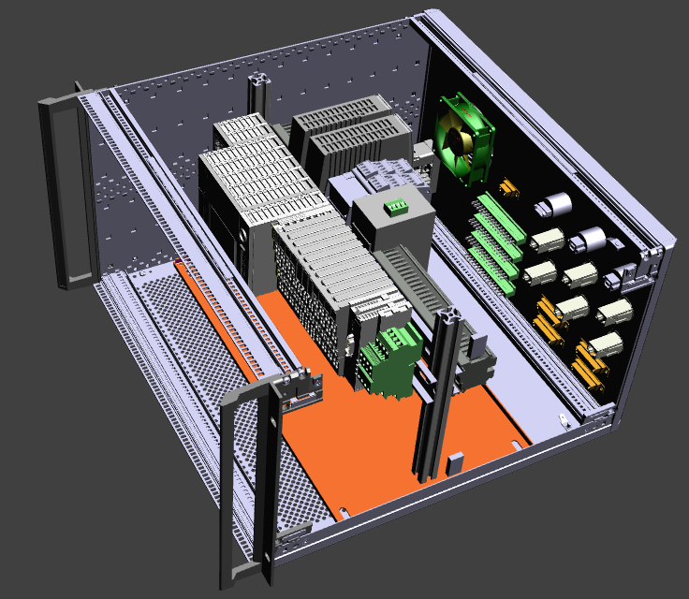
Hardware design
Crate 4U or 6U
PLC (Beckhoff)
VSE100 (Vibration Monitoring)
2 x Power supply
Remote controlled Switch
Analog I/Os
Digital I/Os
Fieldbuses (Ethernet ports)
External hard drive

Slide 10
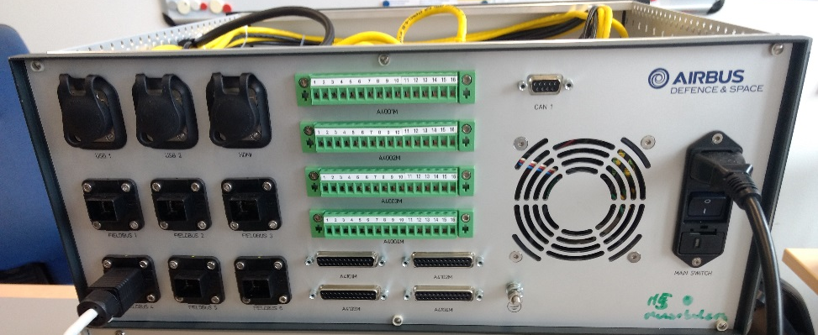
CHIC prototype
First prototype crate made by Airbus spring 2018
Second prototype in design stage. To be built fall 2018.
Third version delivered spring 2019

Slide 11
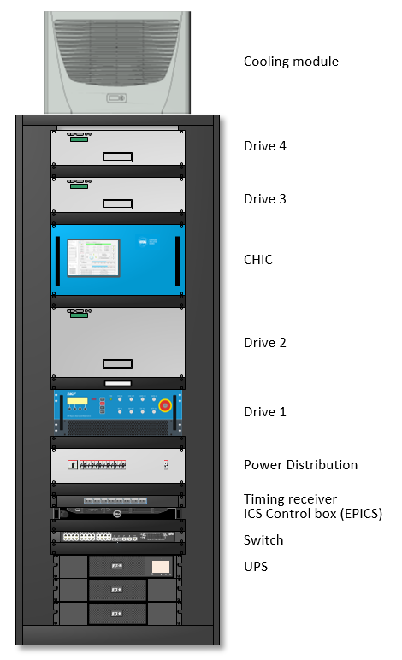
Chopper control rack
Variant of the ESS standard instrument rack
Designed according to ESS standards and SE legislation.
The rack is discussed together with suppliers
Part of the control system in-kind with Jülich.
Prototype delivered spring 2019
Prototype chopper control rack

Slide 12
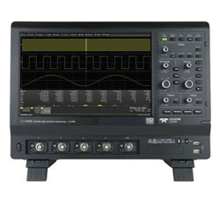
Verification and validation
New 300 MHz oscilloscope for verification of timing and chopper accuracy
Jitter and chopper phase error can be plotted directly in a histogram with 2 ns resolution
Possible to connect accelerometers for additional vibration analysis.

Slide 13
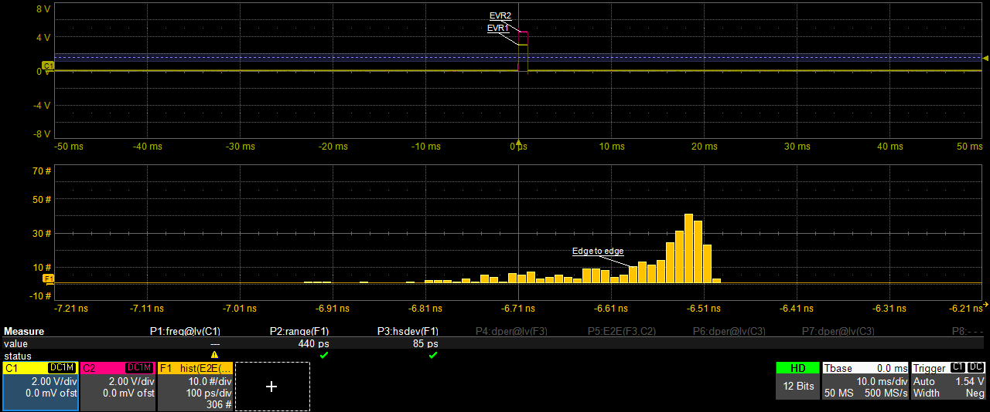
Timing update
Frequencies 14-350Hz generated with the EVR
Two EVRs connected to one EVG
Tested at utgård August 2018.
440 ps jitter, resolution limited by our oscilloscope
440 ps

Slide 14
Planned tests - fall 2018
Atomic clock ordered to improve time stamping in the EVR (for test purposes)
Test with laser to determine the angular offset between the TDC and a specific window in the disk.
Test timing system with high speed chopper (pre FAT)

Slide 15
Chopper control timeline 2018/2019
Today
2019
CDR CHIC
75 days
✓
Timing test on Airbus chopper?
2 days
CHIC integrated in EPICS
Rack delivered
CHIC delivered
CHIC Software ready
for tests
55 days
FAT
SAT
CHIC ready for deployment
2018
Sept
Oct
Nov
Dec
Jan
Feb
Mar
Apr
May
June
July
Aug
2019

Slide 16
Rack locations
LOKI, FREIA,
SLEIPNIR, NNBAR
MIRACLES, MAGIC
T-REX, HEIMDAL
C-SPEC, BIFROST
NMX, BEER
ESTIA?
ODIN, DREAM
ESTIA?
ANNI, SKADI
VESPA

Slide 17
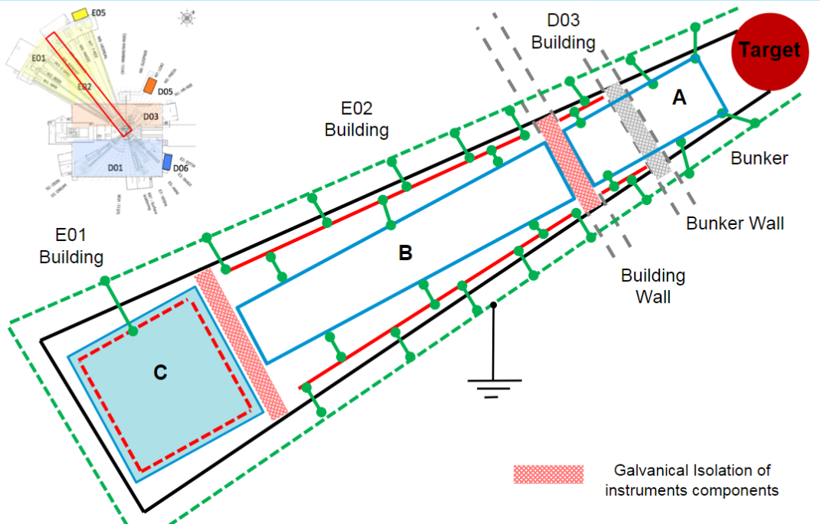
Simple grounding rules
The chopper control rack shall always be in the same grounding zone as the chopper.
Mixing grounding zones can cause damage on equipment or in worst case cause injuries.
A rack shall never be shared between instruments.
To ensure the reliability of the instrument

Slide 18
News
Finished critical design of the CHIC and the Control rack.

Slide 19
Chopper timing
Markus Olsson
Control system engineer
www.europeanspallationsource.se
3 September, 2018

Slide 20
ESS Timing
RF Master Oscillator
88 MHz
Master Event Generator
fanout
Event
receiver
Event
receiver
fanout
Event
receiver
Event
receiver
Event
receiver
Event
receiver
Event
receiver
Event
receiver
The 14 Hz operating frequency will be generated by down conversion from RF in the event generator (divide 88.0525 MHz by 6289464 to get 14.00000064 Hz)
All timing sequences, events, etc., generated in hardware
One or two event generators for NSS

Slide 21
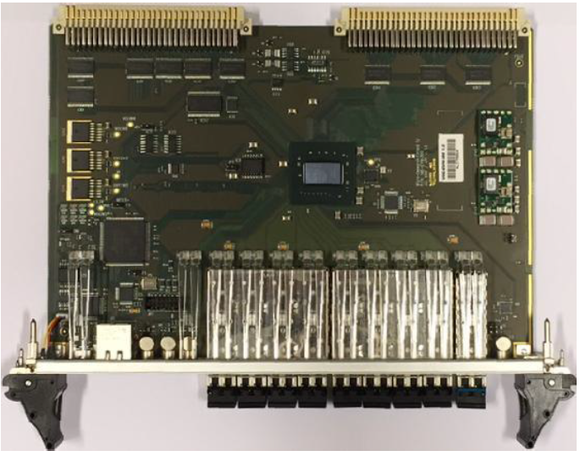
Timing (Bifrost example)
Every rack will have an event receiver (EVR) that will provide ref frequencies to the choppers.
Frequencies from 3.5Hz to at least 406Hz will be created. (14Hz-350Hz tested)
EVG 88MHz
EVR 14Hz
EVR 14Hz
210 Hz
14 Hz
14 Hz
210 Hz
14 Hz
Time stamp
14 Hz
Time stamp
Time stamp
Time stamp
Time stamp
Time stamp

Slide 22
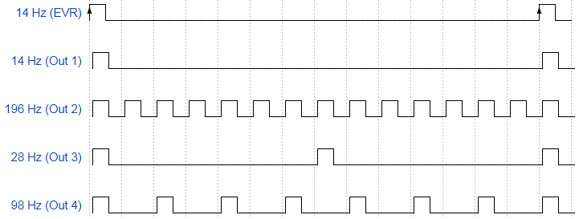
Chopper timing
Different “pulse trains” are triggered by the rising edge of the 14 Hz event.

Slide 23
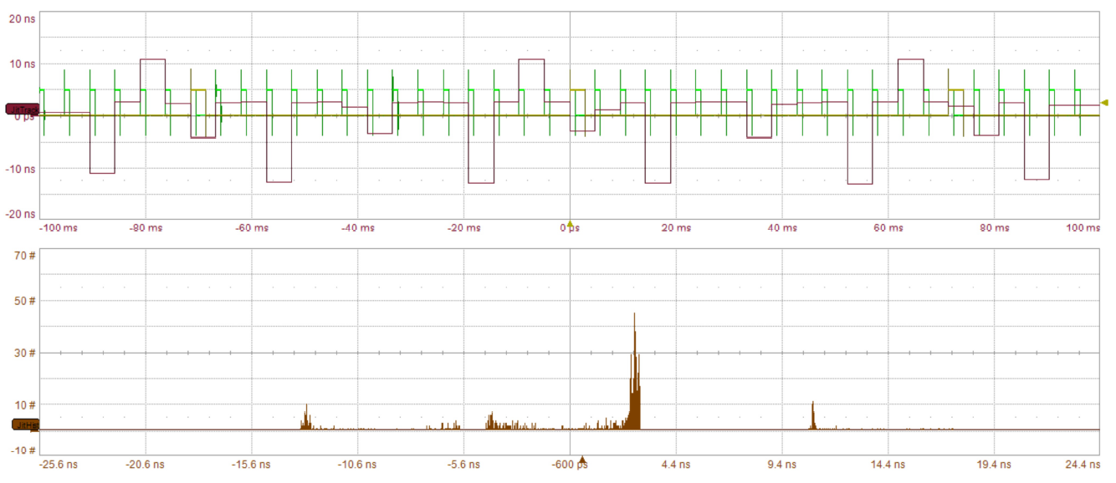
Experiment 210Hz
JitTrack ctc jitter
Histogram ctc jitter

Slide 24
Chopper timing
The maximum cycle to cycle jitter will be 11.3 ns for any frequency.
Every pulse can be adjusted back and forth in time with a resolution of 11,3 ns.
The jitter between the last pulse of the pulse train and the new 14 Hz pulse will not be more than 11.3 ns
Cycle to cycle jitter max 25 ns

Slide 25
TDC offset determination
The TDC can be a magnet on the disc or a position on the shaft
The offset angle is predetermined with laser
Verified once when installed in beam
Window edge
ɸ
TDC

Slide 26
Phase error and error propagation
Reference signal jitter: < 1ns precision
Chopper mechanical error: unknown but static at constant speed
TDC sensor error: unknown
Time stamping error: 11,3 ns precision
$Error=\sqrt{{Ref}^{2}+{Mech}^{2}+{Ctrl}^{2}+{TDC}^{2}+{Tstamp}^{2}}$
$Total error=\sqrt{{BW1}^{2}+{BW1}^{2}+…^{2}}$
Determined with neutrons
Sent to DMSC

Slide 27
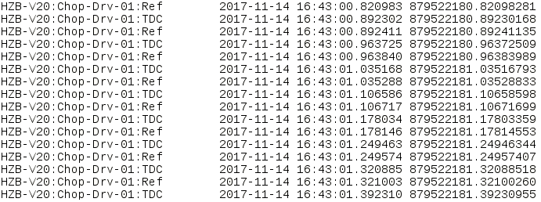
Example of a timestamp
EPICS epoch since Jan 1st 1990
11,3 ns resolution
Absolute time us precision

Slide 28
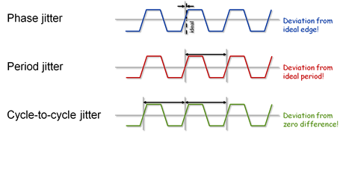
Chopper phase error
Talking directly to suppliers (Airbus, Jülich, SKF, Mirrotron)
Phase error = rising edge TDC – rising edge Ref
Can be measured easily with an oscilloscope (persistence on) for about 10 min.
Max phase error should be ±0.025° (± 5µs @ 14 Hz)

Slide 29
Phase error experiment 14Hz

Slide 30
Interface - Chopper Group/Instruments
What drives will be used? SKF communication module will be implemented into the CHIC fall 2018.
What communication protocol will be used between CHIC and drives. (Modbus preferred)
The drives can be used in “stand alone” mode during commissioning if needed.
Specific variables in the drive that will be monitored in the CHIC?

