Slide 1

BrightnESS Wrap-up
Afonso Mukai
Scientific Software Engineer
www.europeanspallationsource.se
31 August, 2018

Slide 2
Outline
The tasks in BrightnESS WP5
Aggregation and streaming software architecture
Event formation and fast sample environment
EPICS forwarding
NeXus file writing
Development status
Performance tests

Slide 3
The tasks in BrightnESS WP5
WP5: Real-Time Management of ESS Data
  Task 5.1: Creating a standard neutron event data stream for different detector types
  Task 5.2: Creating a standard method for streaming meta-data for fast applied fields
  Task 5.3: Software to aggregate and make available the neutron event data and sample meta-data

Slide 4
Aggregation and streaming software architecture

Slide 5
Aggregation and streaming software architecture
Apache Kafka-based, using Google FlatBuffers for serialisation
C++ in-house development: Event Formation Unit, EPICS to Kafka Forwarder, NeXus File Writer, in collaboration with ISIS, PSI and Elettra
Command and status messages sent through Kafka using JSON
Using Graphite/Grafana for metrics, Graylog for logging

Slide 6
Event mode data acquisition

Slide 7
Event formation and fast sample environment
Event Formation Unit receives raw data and sends events to Kafka
One topic per detector, with partitioning for scalability
Fast sample environment solution based on the same software

Slide 8
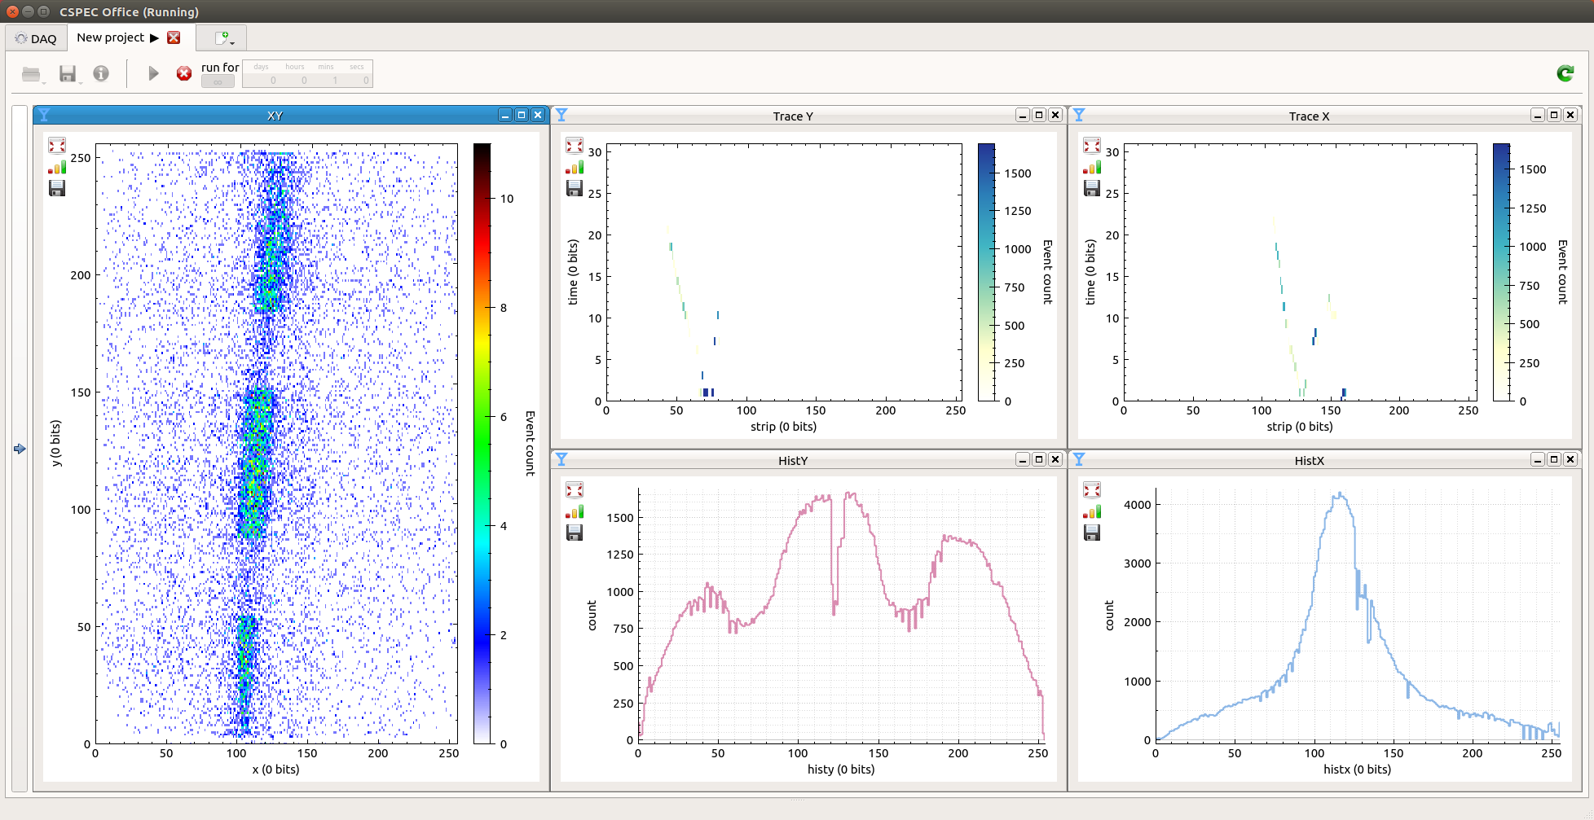
Event formation and fast sample environment

Slide 9
EPICS forwarding
Forwarding application subscribes to EPICS process variables (PVs) and writes data to Kafka
Data for multiple PVs in an instrument are multiplexed over the same topic

Slide 10
NeXus file writing
NeXus is an HDF5-based data format for neutron, X-rays and muon science
The NeXus file writer subscribes to a configurable list of Kafka topics and writes experiment data to files
NeXus file structure and topic names are described in a JSON configuration file or command message

Slide 11
Development status
Continuous integration on DMSC computing infrastructure
Performance and scaling tests run at PSI
System used at the BER-II reactor at HZB for acquiring data from an ESS test chopper
Demonstrations of the Event Formation Unit at the ESS Utgård laboratory
EPICS forwarder and Kafka deployed at three ISIS instruments

Slide 12
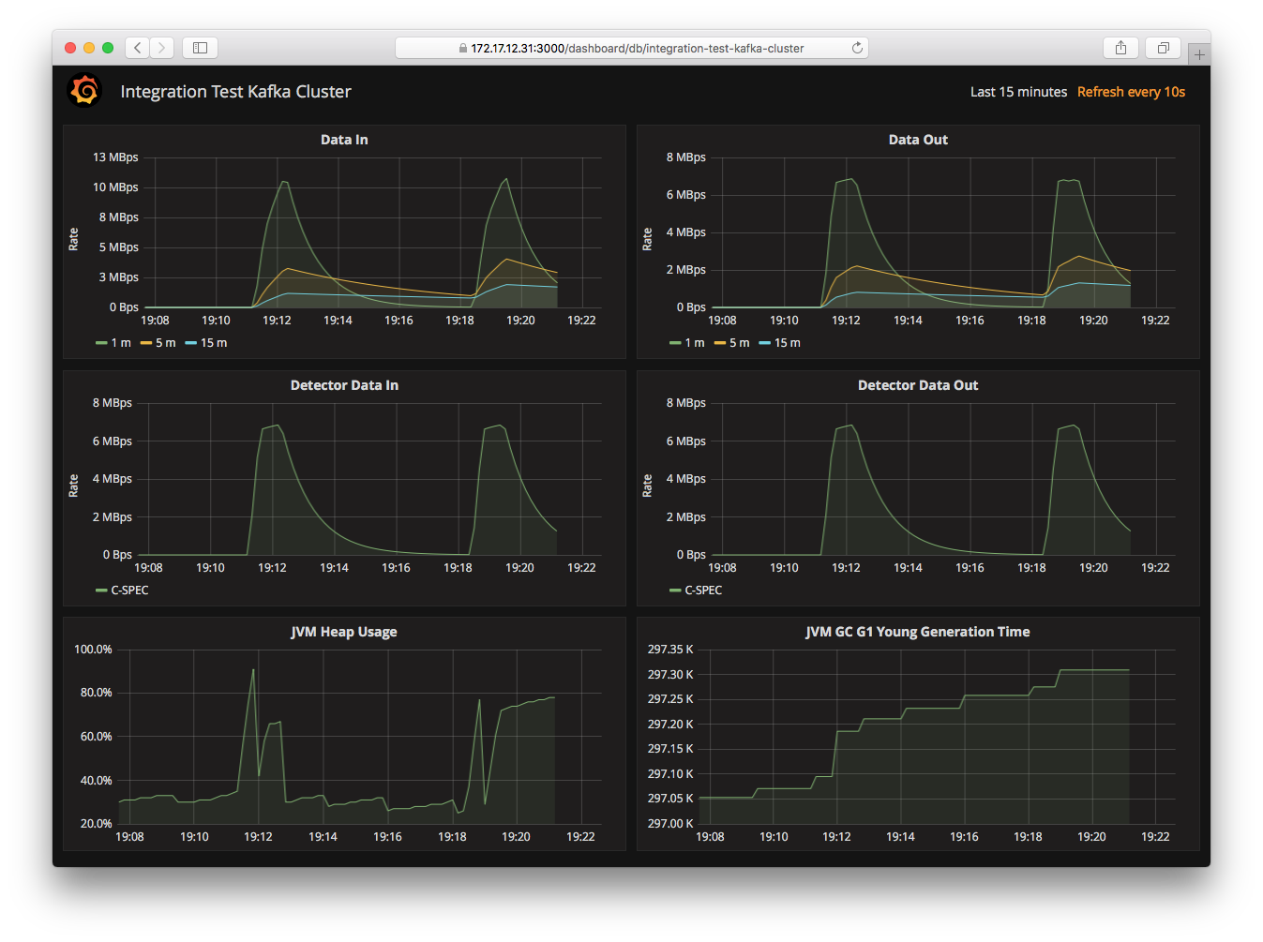
Development status

Slide 13
Performance tests
Scalability measurements: throughput as a function of the number of Kafka brokers with an event producer and a file writer, using one partition per broker.

Slide 14
Performance tests
Kafka throughput as a function of message size and number of partitions. Two servers run the brokers, while a third runs the event producer.

