Slide 1
ECP Visualisation

Slide 2
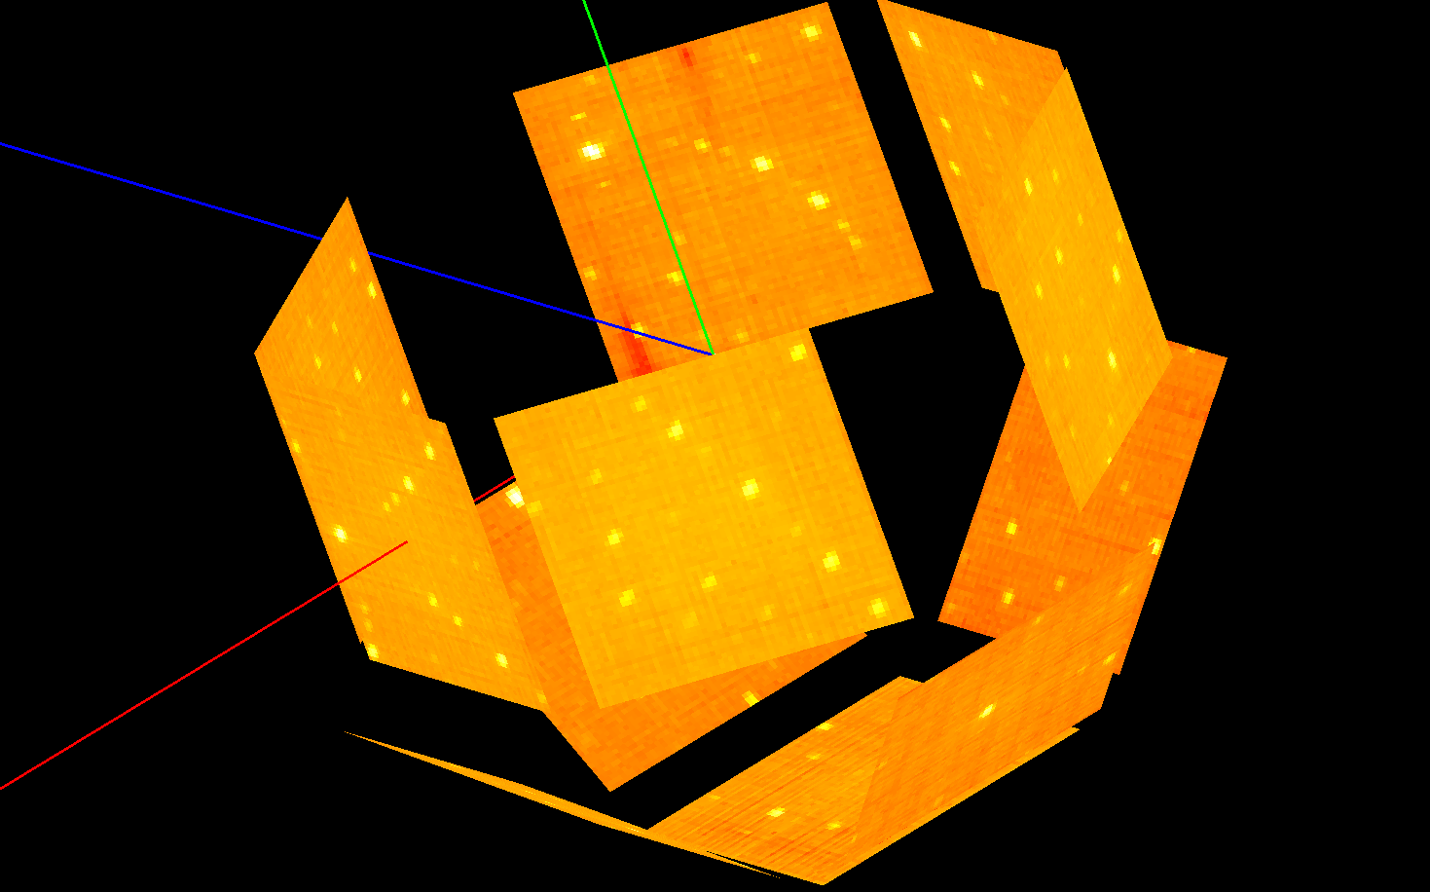

Slide 3
What is the Instrument View?
Beamline visualization 3D with data overlays
Interactive and auto-updates
Supports unwrapped 2D modes
Tools
Masking and ROI
SXD peak inspection and editing
Tree navigation
Historically tied to ManidPlot but no longer

Slide 4
What is it used for?
Commissioning beamlines
Diagnosis
Live data visualization
Masking data
Overlaying and editing peaks lists
User statistics - the 2nd most used interface in MantidPlot

Slide 5
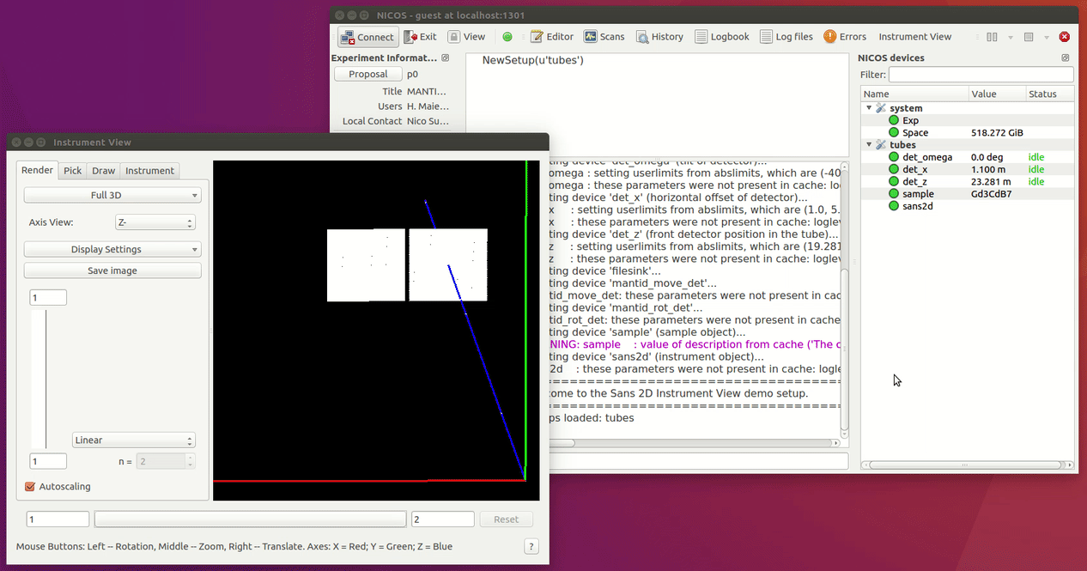

Slide 6
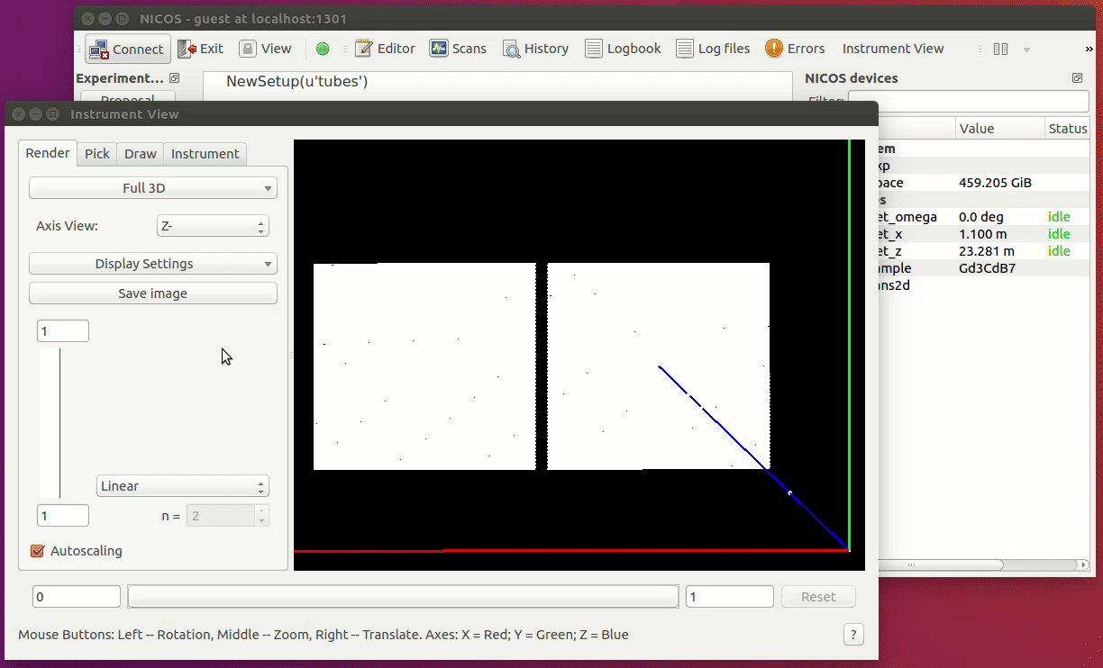

Slide 7
Recent Changes
v3.14 (Released July 2018) , contains an almost complete rewrite of back-end. Big performance improvements and scanning capabilities added. No official front-end for scanning yet.
v3.14 (Release planned Dec 2018)
NeXus Geometry compatibility. Optimisations for 2D Meshes
v3.x Volumetric Detectors
Instrument | Speedup
WISH | 5x
BASIS | 5x
GEM | 4x
SANS2D | 3x
POLARIS | 3x
CNCS | 2x

Slide 9
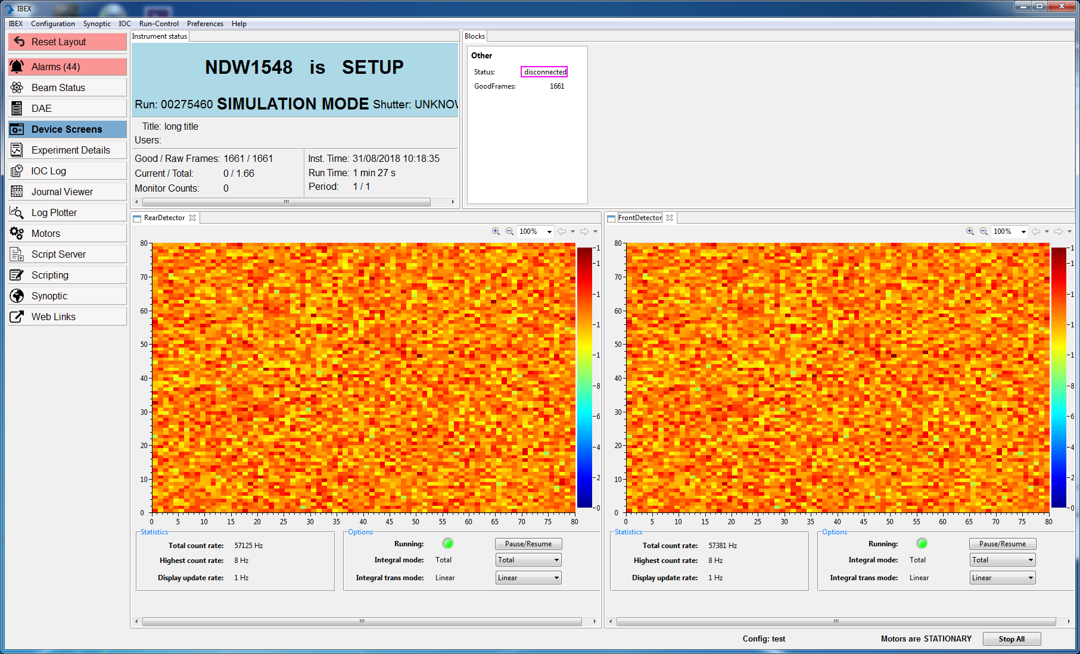
Ibex Live View

Slide 10
Discussion Points
Instrument View
Gives consistent instrument visualization across tools
Well tested, steered and adopted by community – Feature complete?
More powerful that necessary for ECP
No light-weight deployment yet
User confusion between running versions of Mantid

