Slide 1
IRR for Ion Source Safety Fence - Introduction
Øystein Midttun
Ion source and LEBT system leader
www.europeanspallationsource.se
3 April 2018

Slide 2
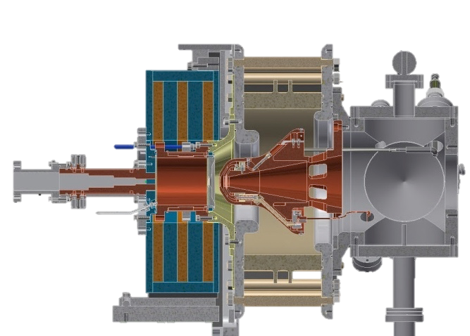
The ESS proton source is a microwave discharge ion source
High voltage insulator
Extraction aperture
Extraction electrodes
Plasma chamber
Waveguide
Pumping ports
H₂ gas injection
Solenoid magnets
50 cm
2

Slide 3
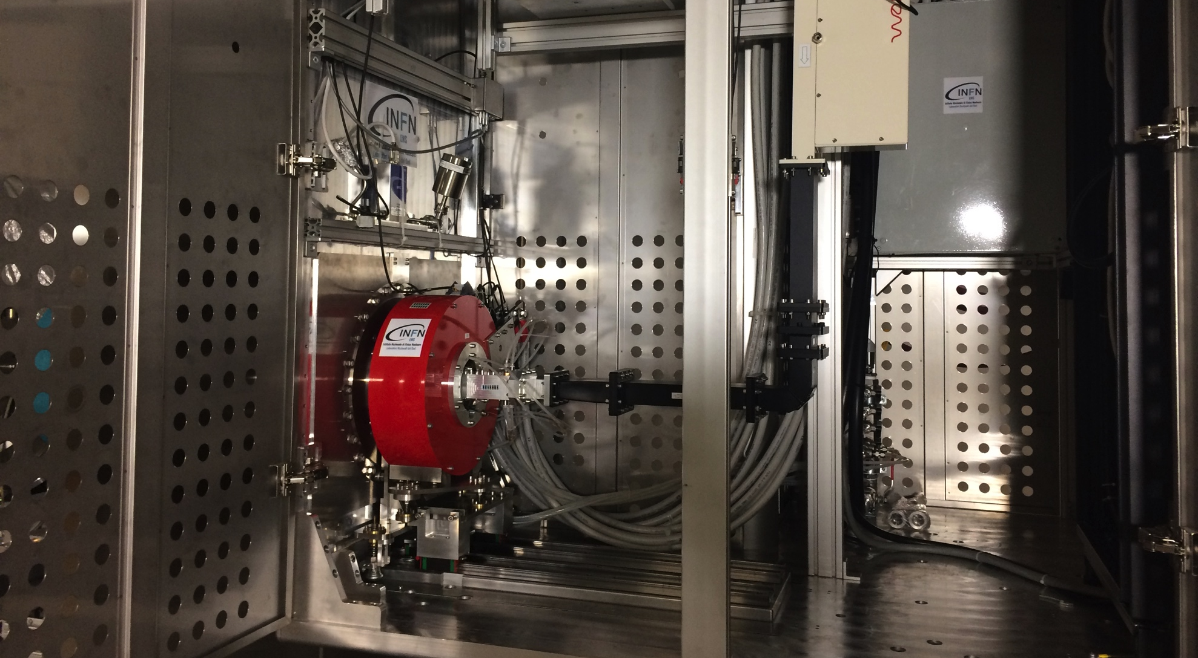
The plasma generator sits inside a high voltage platform

Slide 4
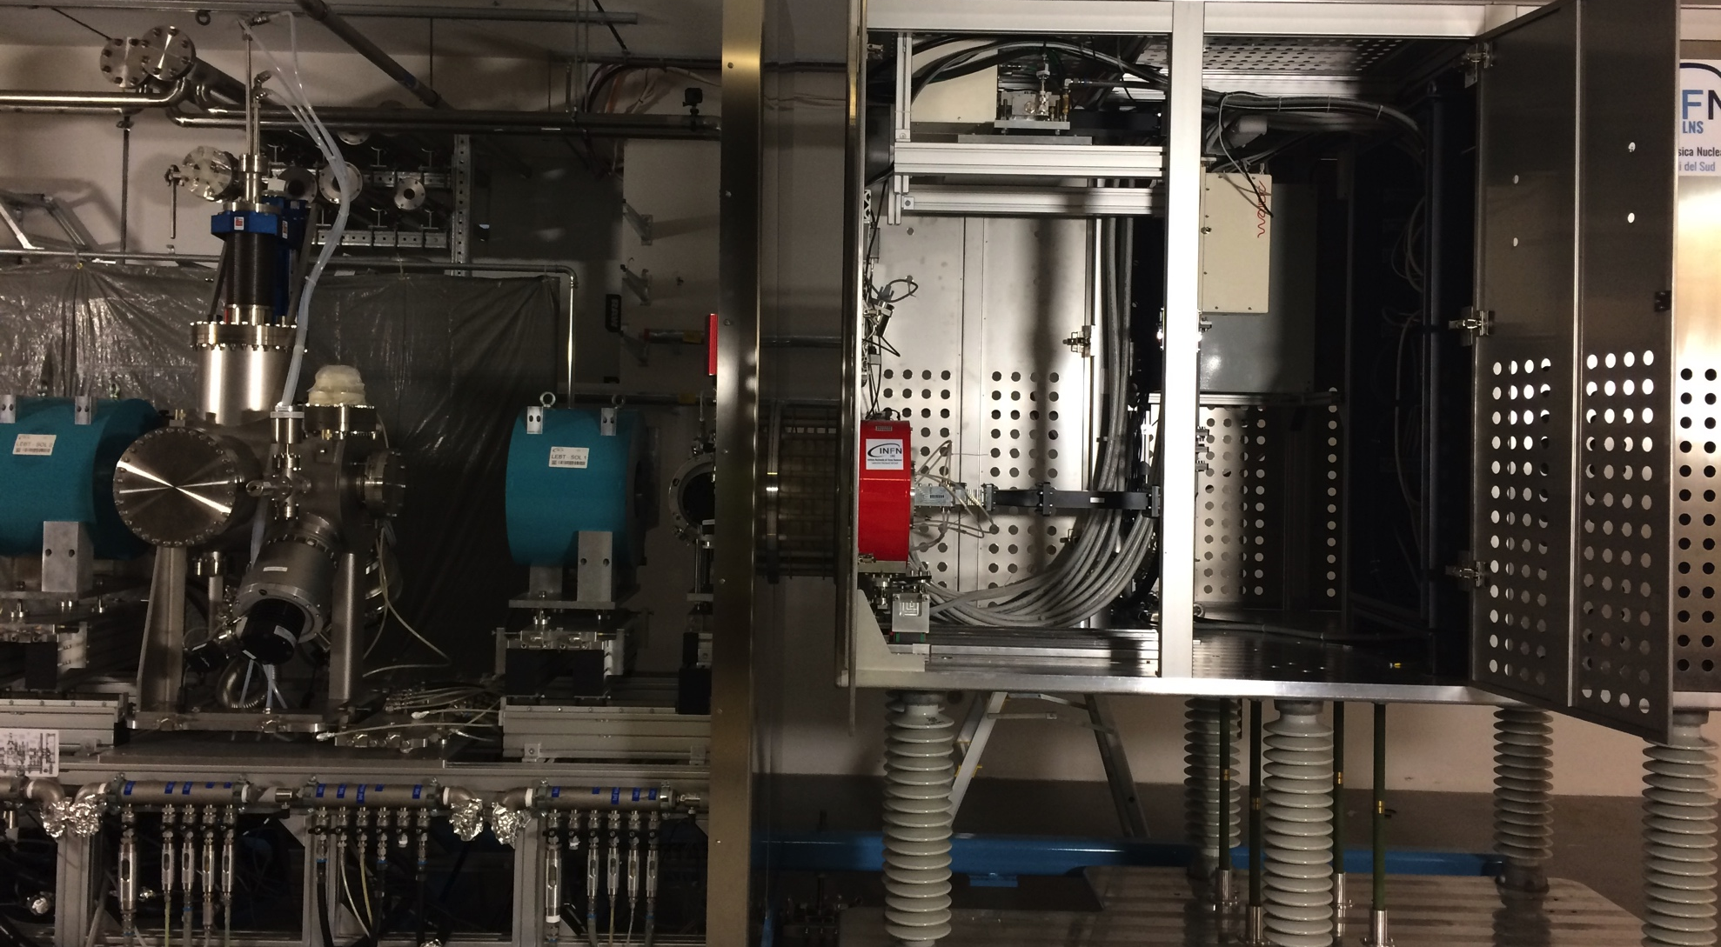
Ion source at high voltage and low energy beam transport at ground potential

Slide 5
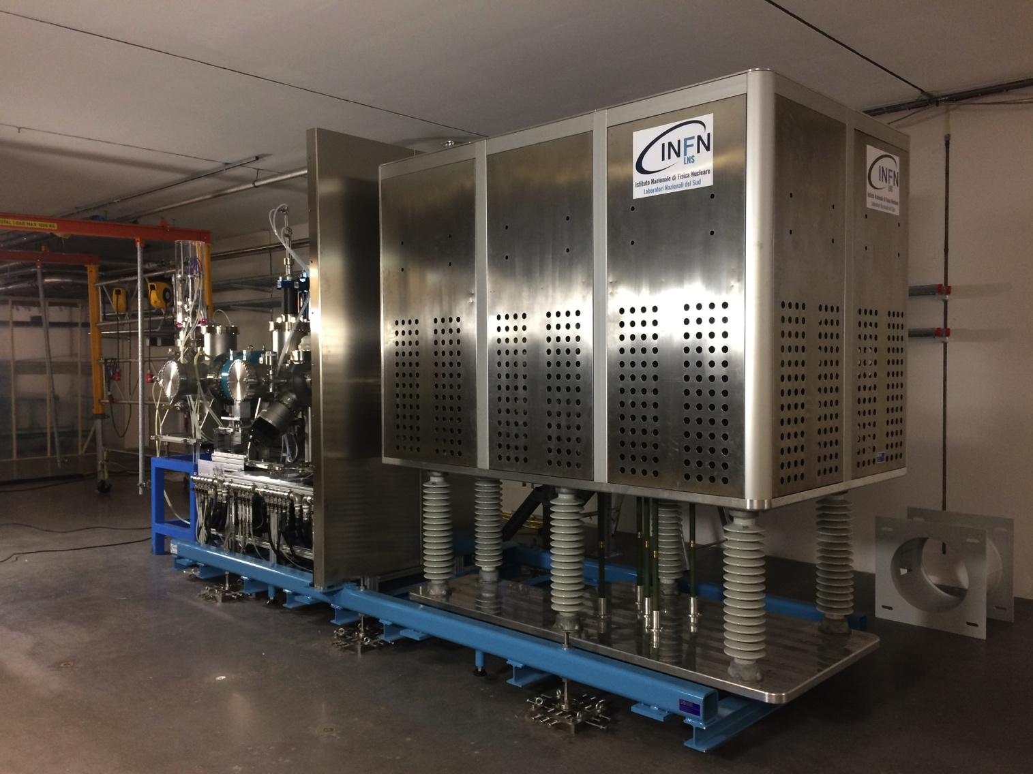
We have designed a safety fence with two main functions
1: protect against the 75 kV of the high voltage platform
75 kV

Slide 6
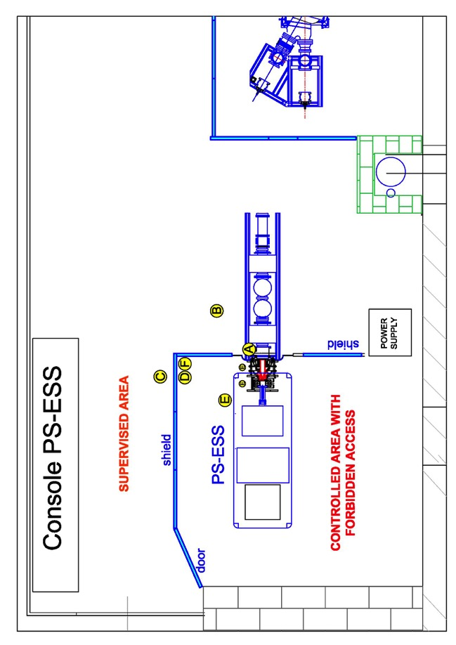
We have designed a safety fence with two main functions
2: protect against x-ray coming from the ion source when HV is on
Measurements at ion source test stand, INFN-LNS
2 mm lead shielding around the ion source
Radiation level below
natural background
Normal operation:
< 15 µSv/h
Maximum observed:
380 µSv/h
Measured dose rate levels
above natural background
Report: PS-ESS radioprotection report 30.03.17, ESS-0114736
fig 5

Slide 7
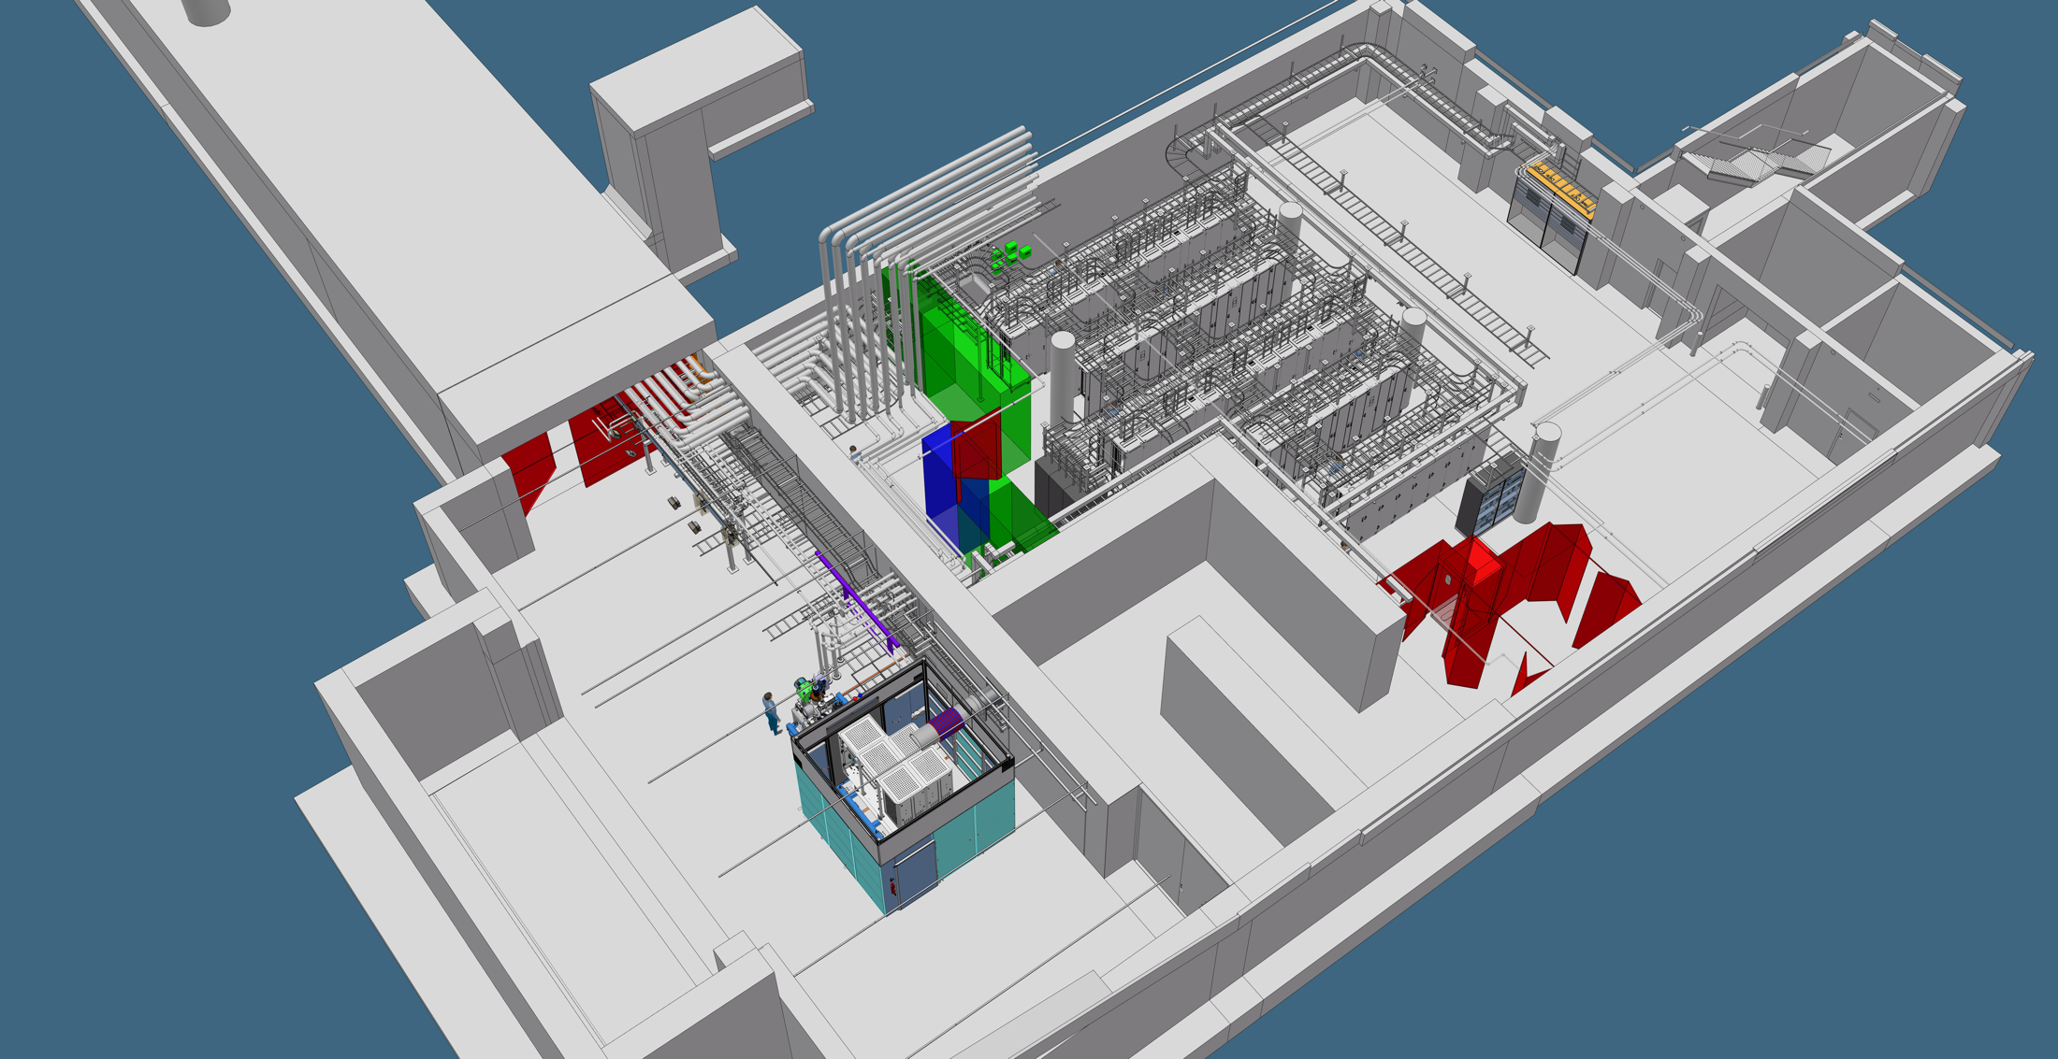
Our goal is to safely run the ion source while there is access to the accelerator tunnel
Ion source commissioning can take place at the same time as installation (of other stuff)
No access control to the tunnel needed
PSS0 will ensure that there no one can approach the HV platform while it’s on
By lead shielding the HV safety fence, the area outside can be classified as a public radiation zone

Slide 8
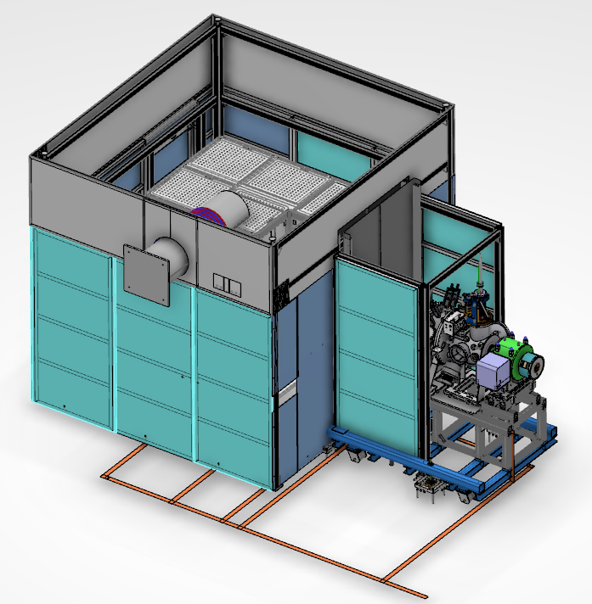
3D model of high voltage safety fence
1 m high stainless steel mesh (2 mm spacing, IP3x)
Floor-to-ceiling walls
Additional lead shielding
around the LEBT
2.5 m high, 2 mm thick
lead shielding
Cooling water inlet
for the ion source

Slide 9
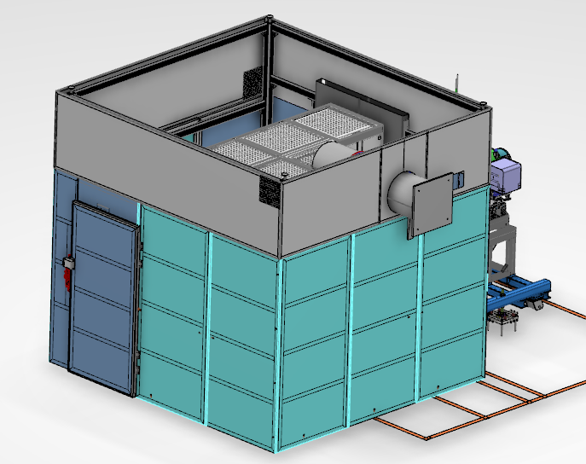
3D model of high voltage safety fence
Isolated 400 VAC
Fibre optic control cables
Safety door
PSS0

Slide 10
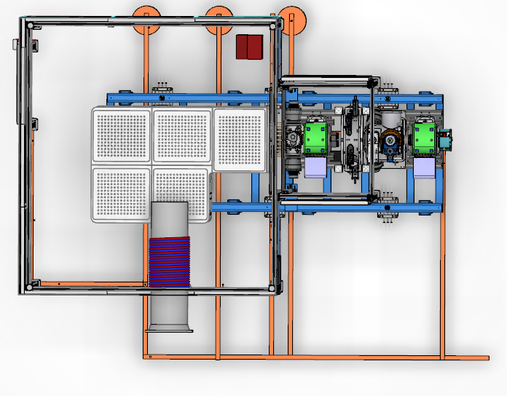
Top view of high voltage safety fence
Entrance
Connection to grounding
mesh in the floor
Ion source
water cooling
Grounding system is not updated; we will connect
to one point in the grounding mesh of the tunnel floor

Slide 11
Ion Source and fence designed for it
Description of the HV protection cage: ESS-0122281

