Slide 1
Accelerator R&D in Sweden
Roger Ruber
Uppsala University
On behalf of
Accelerator Groups in Sweden
Thanks to all colleagues for materials
TIARA Collaboration Council
ESS, 25 June 2018

Slide 2





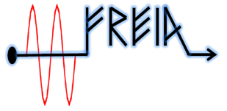

Sweden: 10.2 million (population, April 2018)
  450'000 km² (→ 23 pp/km²)
  520 GEur (BNP, 2018 est.)
  15 universities, 15 colleges, 3 private univ./coll.
Main universities/institutes
  Uppsala: UU, SLU
  Lund: LU, ESS
  Gothenburg:
  Chalmers, GU
  Stockholm:
  KTH, SU, KI, Handels

Slide 3
European spallation source
Mats Lindroos
Accelerator Division
ESS ERIC

Slide 4
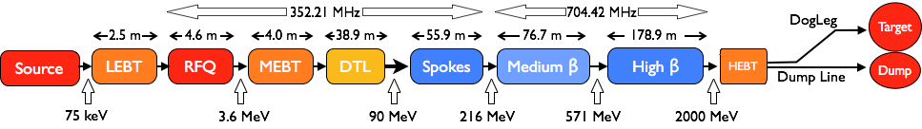
Accelerator – Scope
Accelerator Technical performances
Key parameters:
    -2.86 ms pulses
    -2 GeV
    -62.5 mA peak
    -14 Hz
    -Protons (H+)
    -Low losses
    -Minimize energy use
    -Flexible design for mitigation and future upgrades
Design Drivers:
High Average Beam Power
5 MW
High Peak Beam Power
125 MW
High Availability
95%
18 IK partners in 8 countries and 5 collaboration partners
1.3 GeV capacity with 2 MW on target for 2025 with remaining RF sources (40) to be installed after 2026

Slide 5






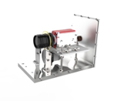
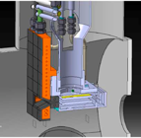
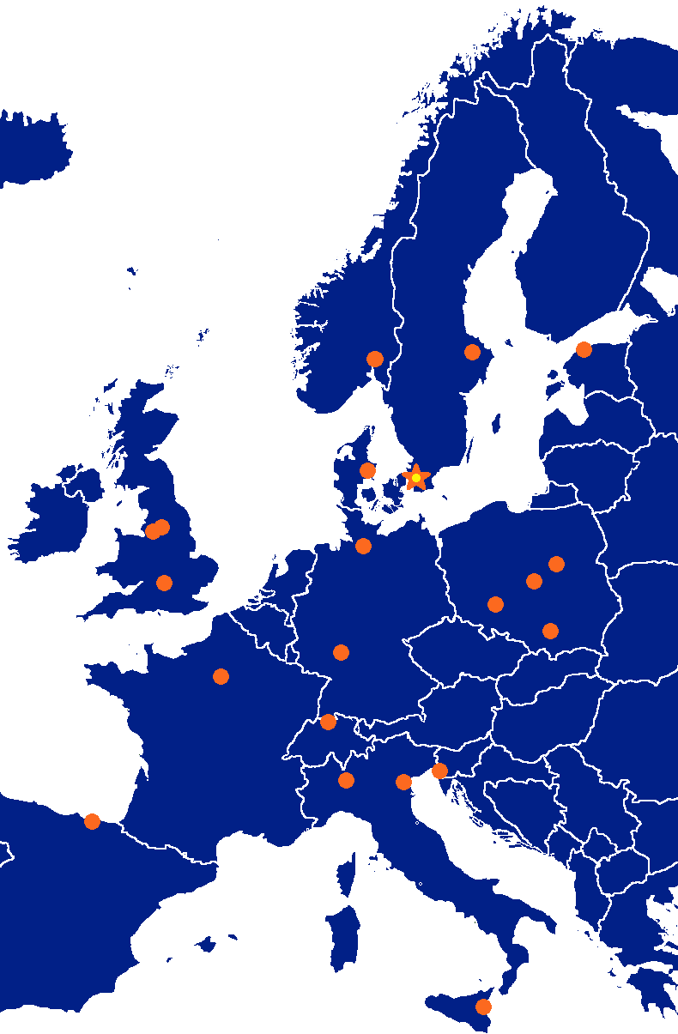




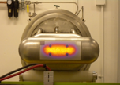






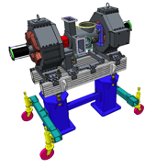









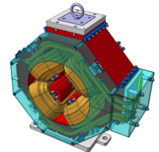

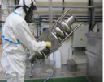

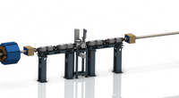













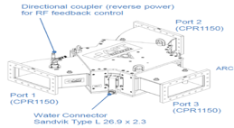
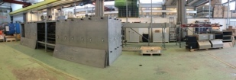
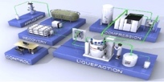











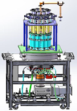
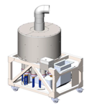



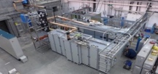
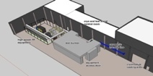
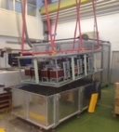
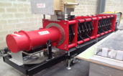
Accelerator Collaboration
The accelerator R&D at ESS has predominantly been done by IK partners as ESS was a start-up with very few staff in 2009 (after the site decision)
5

Slide 6
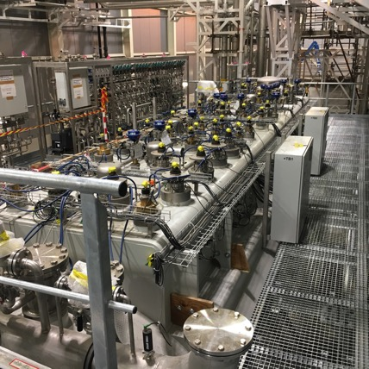
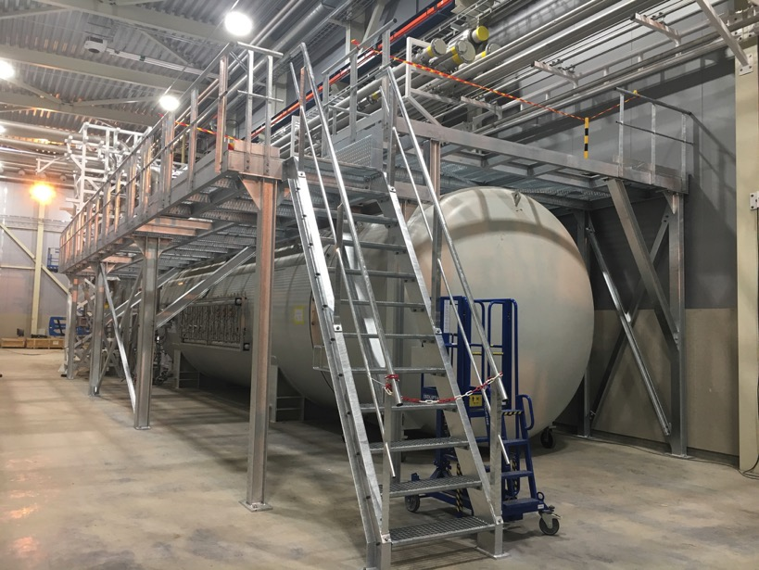
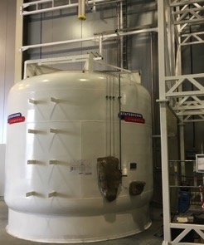
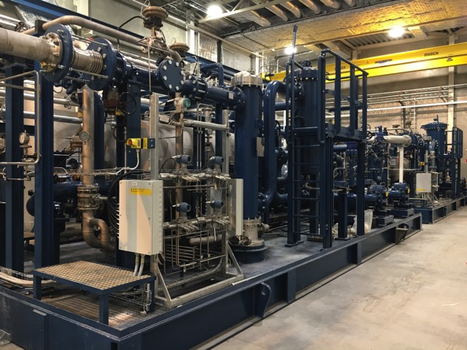
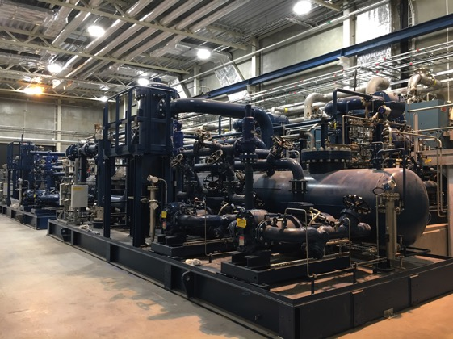
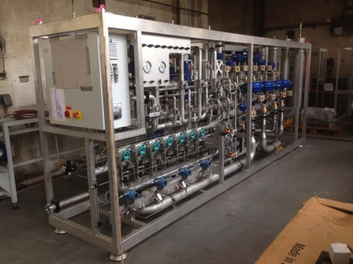
Accelerator Cryoplant (ACCP)
The cryogenics systems are commercial developments with IK contributions in which the ESS team has played a central role for design requirements and installation

Slide 7
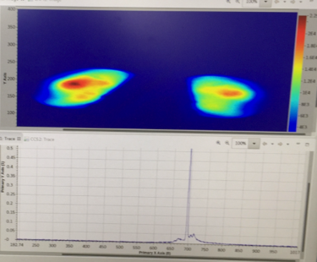
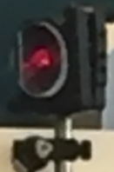
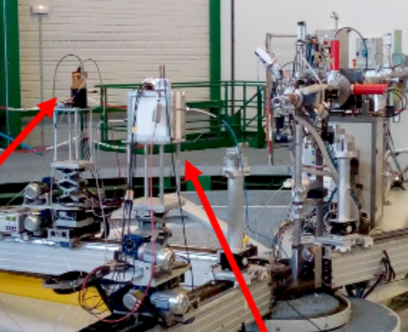
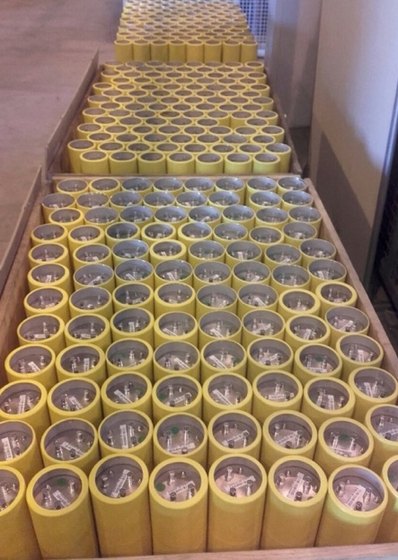
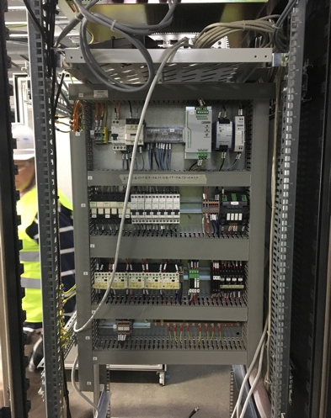
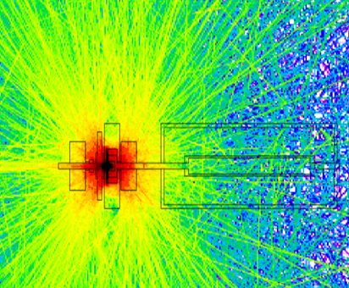
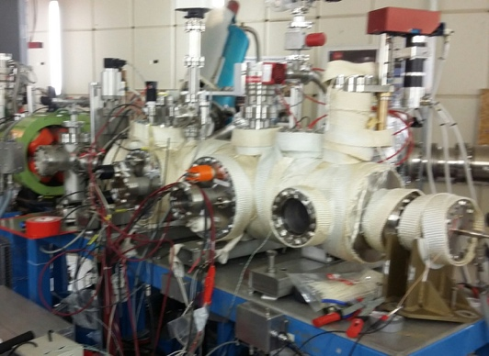
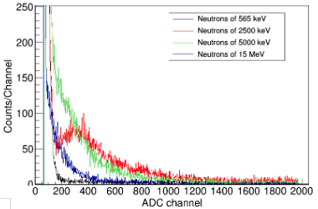
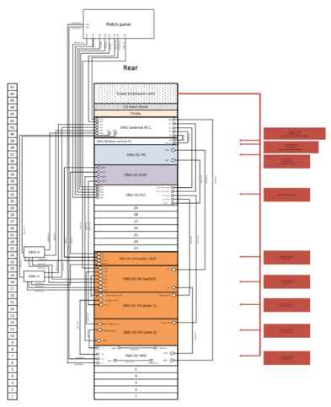
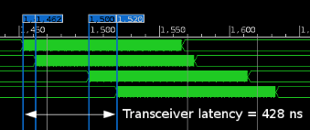
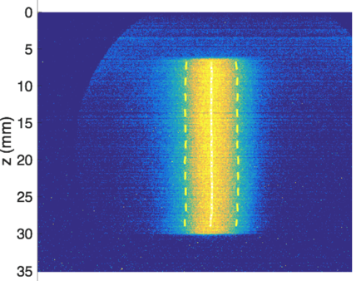
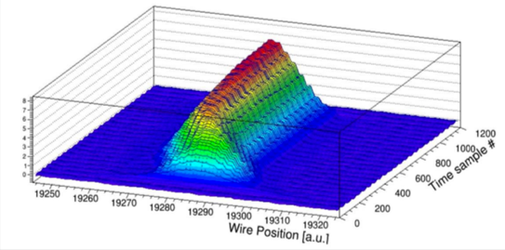
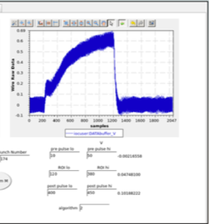
Beam Diagnostics
Development of beam instrumentation has been done jointly by ESS and IK partners as it initially was planned as an ESS activity
ESS Lund, with 7 in-kind partners, building 514 systems of 22 types
Design
Verification in proton beam
Production
Installation
Most systems through CDR
Imaging @DTU
Beam stop simulations
Neutron detectors
@AMANDE
All ion chambers
received
(+ receiving BPM,
BCM, WS, …)
Giga-scale processing, EPICS integration
Emittance
rack,
as-built docs
Profile monitors
@IPHI
Wire scanners @Linac4

Slide 8
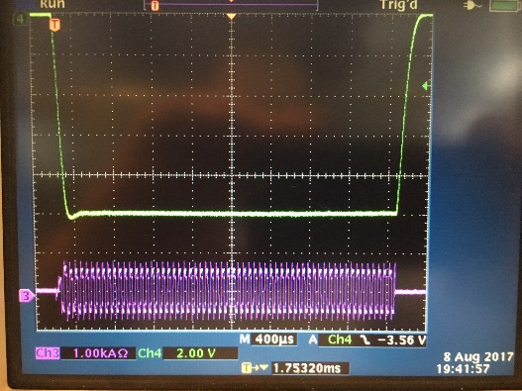
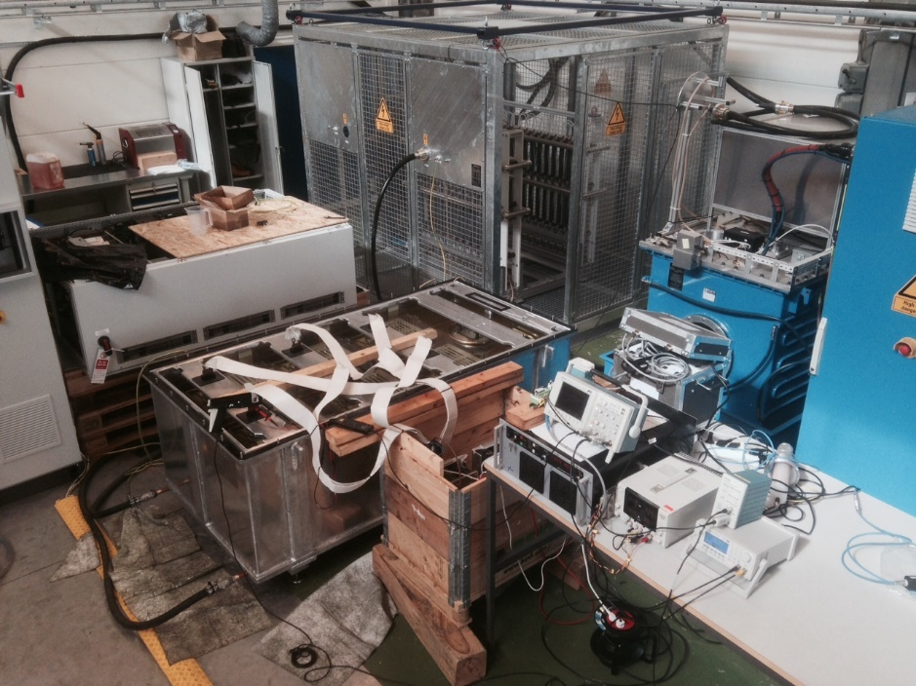
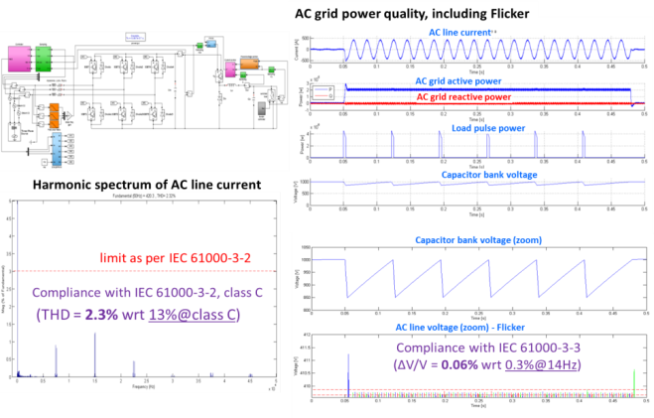
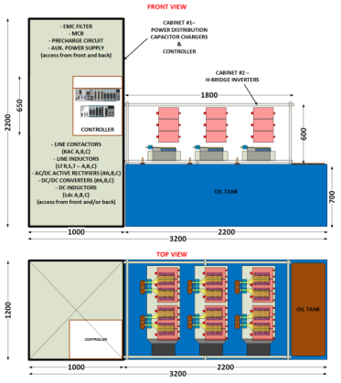
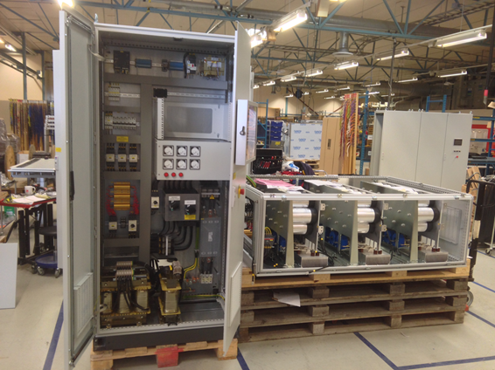
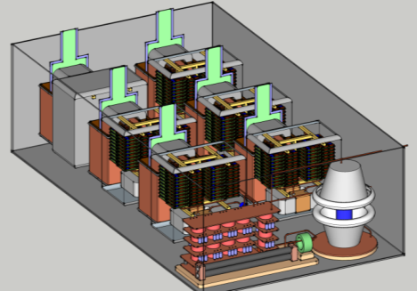
Stacked Multi-Level (SML) modulator
The most notable ESS development has been the SML modulator topology
Significant savings for the full ESS project compared to traditional modulators.
2017
Mid 2013
2016
2013-2014
2014
8
2014
2014
8

Slide 9
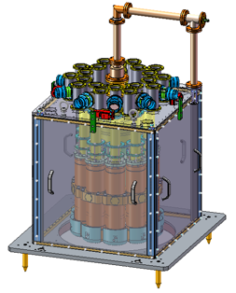

The ESS MB-IOTs
ESS has lead and financed a successful commercial development of IOTs
But the development is not yet mature for series production (at a competitive price)
so ESS will use klystrons up to at least 1.3 GeV
10 Electron guns placed in a circle
Cavity with 10 separate interaction gaps/single output
Magnetic focusing (PPM or solenoid)
Output windows based on high power klystron designs
Extensive modelling and simulation (beam optics, mode analysis, thermal and structural analysis, innovative manufacturing, …
Single beam prototypes, sub-assembly prototypes, …
Design driven by reliability and efficiency
105.6 kV
96 kV
75.2 kV

Slide 10
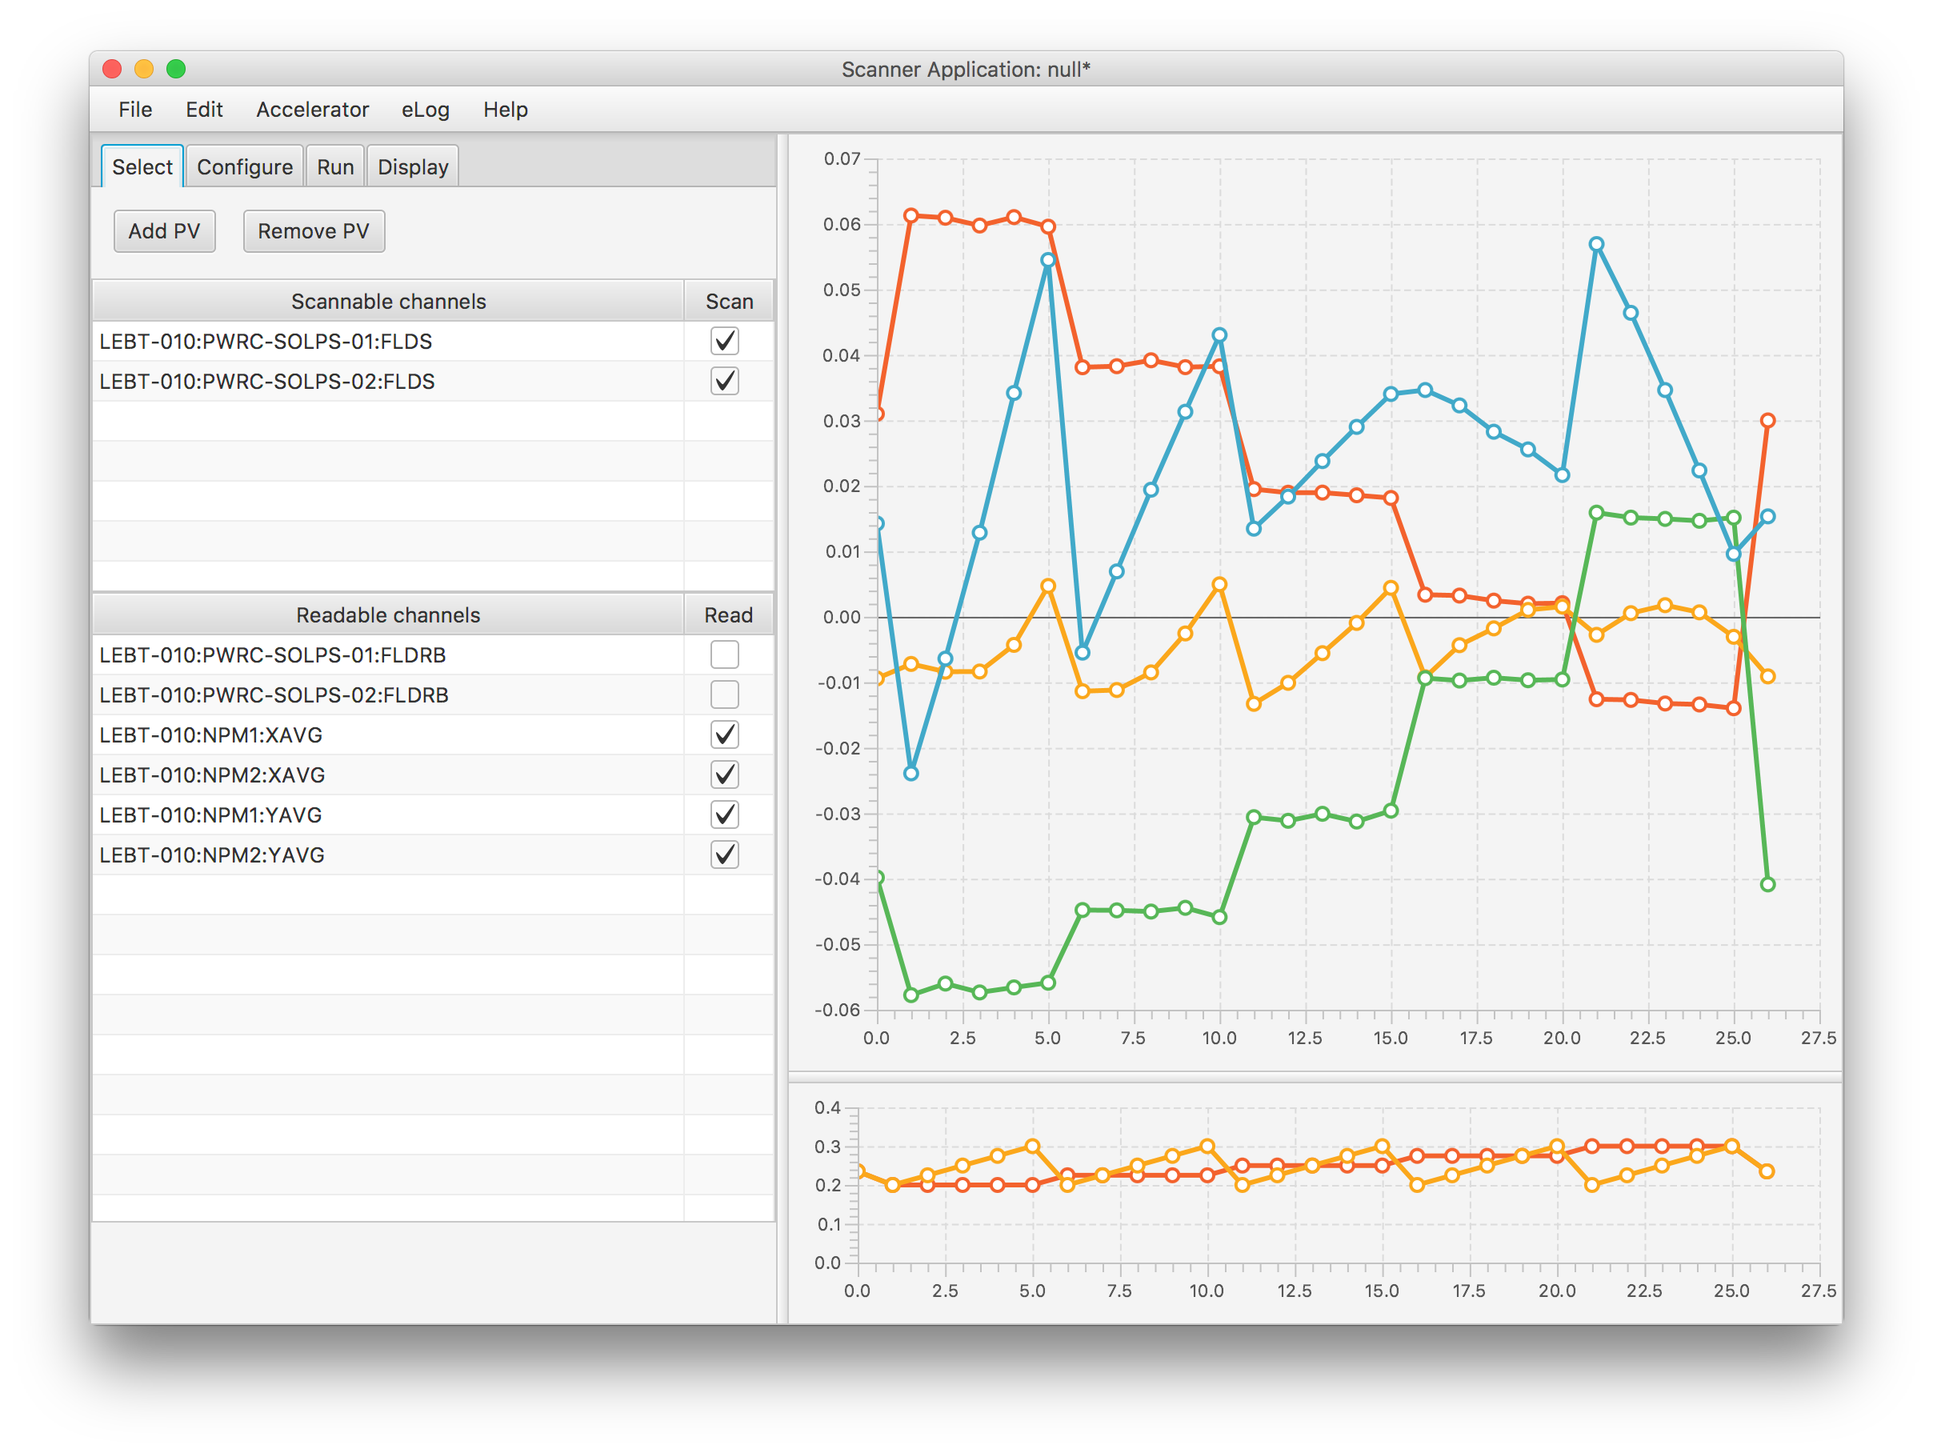
Beam physics high level applications
The beam physics design has been done at ESS. This includes high level application programs developed in EPICS for efficient beam commissioning and operation
A multi-dimensional scanning application is developed to be used in the control room during commissioning, and operations.
The following example shows a 2D scan of the solenoid fields and looks at the beam position (average) on the two NPMs downstream of the solenoids.
The success indicator for the RFQ commissioning is the transmission, via scanning the solenoid fields in the LEBT.
This process is simulated and the areas of high transmission result also in lower emittance.

Slide 11
Lund university
Sverker Werin
MAX IV Laboratory & Synchrotron Radiation Physics Division
Dept. of Physics

Slide 12
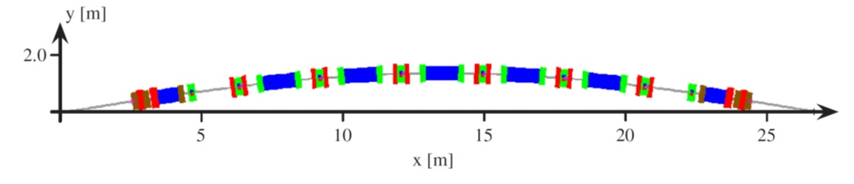
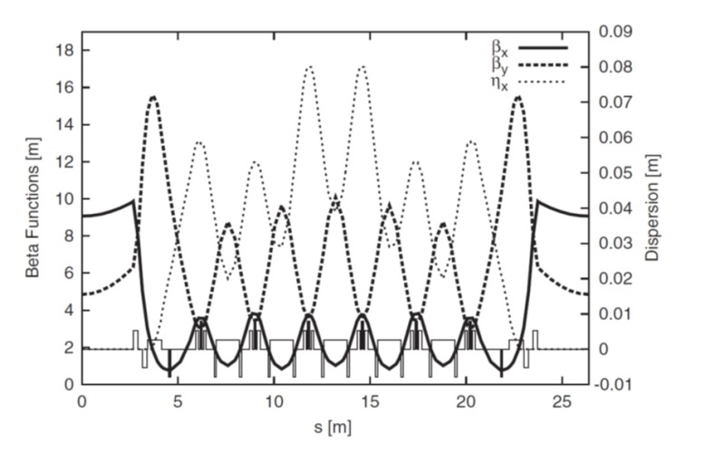
1. Ring development – MAX IV
Ultra low emittance
Diffraction limit
7 Bend Achromat
330 pm horisontal emittance
100 MHz RF + Harmonic cavities
Compact magnet design
Fully NEG coated vacuum system
Layout of one achromat
Energy [GeV] | 3.0
Harmonic number | 176
Circumference [m] | 528
Natural chromaticities (horizontal/vertical) | -49.8/-43.9
Horizontal emittance (bare lattice) [nm rad] | 0.326
Main radio frequency [MHz] | 99.931
Circulating current [mA] | 500
Number of achromats | 20
Betatron tunes (horizontal/vertical) | 42.20/14.28
Corrected chromaticities (horizontal/vertical) | +1.0/+1.0
Lattice functions
Compact magnets

Slide 13
1. Ring development – future MAX IV
  Brightness Improvements: current lattice and Ids (150 pm rad)
  Brightness Improvements: additional focussing (100 pm rad)
  Completely new lattice (diffraction limit at 10 keV)
Exchanging the 7 BA ring with a 19 BA within the same tunnel.

Slide 14
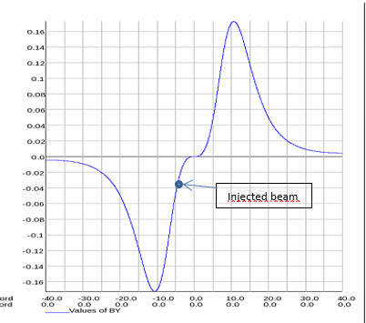
Multipole Injection Kicker (MIK)
1. Ring development - sample
Objective: achieve near transparent top-up injection.
Joint project with SOLEIL based on original concept from BESSY.
First prototype installed in the 2017 shutdown.
Injection with MIK (up to 300 mA) demonstrated.
Perturbation to the stored beam reduced by a factor ~60.
Injection with the MIK
Drawings by SOLEIL
P.Lebasque
P.Alexandre

Slide 15
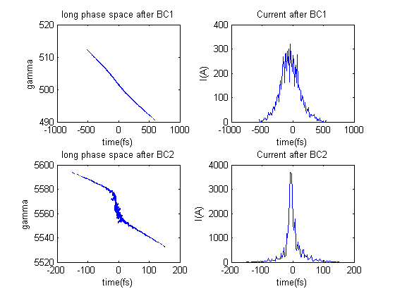
2. Linac -Bunch compression and linearization
Extraction
1.5 GeV
Extraction
3 GeV
Thermionic RF gun*
Short Pulse Facility
L2A
L2B
L3A
L9B
Kicker & septum*
L19B
L0
L1B
BC1 @ 260 MeV
BC2 @ 3 GeV
PC RF gun
Linearisation with sextupoles
economy
reliability
simplicity
Compression in double achromats
positive R56 (fixed)
compression varied with RF phase
utilise the natural T566 for linearisation
“weak” sextupoles for tuning linearisation
symmetry keeps the second order energy dependent matrix elements small
Sextupoles
Sara Thorin, MAX IV

Slide 16

Testing and optimizing gun and laser performance
(Sara Thorin)
3. Guns – Test Facility
First experiments (Q3 2018)
100 Hz Gun
<0.5 nm emittance gun
Pulse shaping
Injector optimisation
Emittance evolution measurements with the emittance meter (M. Ferrario, INFN)

Slide 17








4. Transverse Deflecting Cavity
Erik Mansten
Switchable polarization
3 GHz
~ 1 fs resolution
http://ipac2018.vrws.de/papers/thpal027.pdf
FemtoMAX
TDC line
Possible SXL placement
Horizontal Deflection
Vertical Deflection

Slide 18

4. SXL – Soft X-ray FEL
Francesca Curbis, Sverker Werin
Design study 2018-2020
Funded by Knut and Alice Wallenberg Foundation
Collaboration MAX IV, Lund University, Stockholm University, KTH and Uppsala University
SPF
FemtoMAX
Extraction
1.5 GeV
Extraction
3 GeV
BC1 @ 250 MeV
SXL
Linac 1250 Mev
Linac 1500 Mev
Linac 250 MeV
BC2 @ 3 GeV

Slide 19



4. SXL – Soft X-ray FEL
Francesca Curbis, Sverker Werin
Wavelength 1-5 nm
Photon energy 0.25-1 keV
Pulse length 10-100 fs
Rep rate 100 Hz
Power (peak) ~ 1 GW
Ph/pulse 10¹¹⁻¹²
Gain length ~ 1m
e- energy - 3 GeV
ε_{Ν} < 1 um
Output performance:
Saturation length ≈30m
Saturation power ≈few GW
FODO lattice,
beta average 10 m
Lambda_u=36mm
Lambda= 1.25nm
To be optimised
rms transv. size
2.6 10⁻⁵ m
3 m
0.75 m
Electron bunch:
10 fs sigma
(5fs sigma)
(flat top)
Other relevant parameters:
Energy spread 1%
Emittance 0.4 mm mrad (projected)
Peak current 2.5 kA

Slide 20
stockholm university
Anders Källberg
Instrumentation Physics Division
Dept. of Physics

Slide 21

Studies and Development of DESIREE
Two electrostatic storage rings,
8.6 m circumference, cooled to 14 K, with beam lifetimes of 300+ s

Slide 22

Studies and Development of DESIREE
Beams of opposite charges (here C⁻ and N⁺) interact in the midsection.
Two neutral particles are created
Their distance in 3D at the detector is measured
  which gives a value of the kinetic energy released in the mutual neutralization,
  which in turn depends on which atomic states of the resulting atoms are formed in as indicated in the figure.

Slide 23



Studies and Development of DESIREE
Development of the beam diagnostic systems,
  measurements of beam current, beam position and momentum spread.
  figure shows the system used to simultaneously measure the properties of two beams circulating in the two rings.
Investigations of stochastic cooling
  Studies ongoing of the possibility to implement stochastic cooling longitudinal momentum spread in a new low-energy regime in DESIREE.

Slide 24

Supporting CRYRING@ESR
CRYRING, formerly installed at MSL, has been transferred to GSI and is now reconstructed to become the first operating part of FAIR.
During the ongoing commissioning phase, beams from a local ion source have been injected, stored, accelerated and cooled.
We are contributing to the project with our experience from 20 years of running CRYRING.
from ESR @ 0.7 Tm

Slide 25
Uppsala university
Hermann Dürr, Tord Ekelöf, Vitaliy Goryashko, Lars Hermansson,
Roger Ruber, Volker Ziemann
FREIA Laboratory
Dept. of Physics and Astronomy
FEL Centrum KTH/SU/UU

Slide 26





Horizontal SRF Test Stand
RF Power Source
Cryogenics
Implementation
SRF Cavity
Horizontal Cryostat

Slide 27



FREIA
Facility for Research Instrumentation and Accelerator Development
Funded by
KAWS, Government, Uppsala Univ.
State-of-the-art Equipment
cryogenics
- liquid helium
- liquid nitrogen
control room
- equipment controls
- data acquisition
Competent and motivated staff
collaboration of physics (IFA)
and engineering (Teknikum).
vertical cryostat
3 bunkers
with test stands
horizontal cryostat
radio-frequency (RF) power sources

Slide 28

Test Cryostats
"HNOSS" Horizontal Cryostat
"Gersemi" Vertical Cryostat
test of SRF cavities
  3240 x ø1200mm inner volume
  up to two cavities simultaneously,
  each equipped with helium tank,
low or high power RF testing
  power coupler (top, bottom, side)
  (cold) tuning system
operation range 1.8 to 4.5K.
test of SC magnets or SRF cavities
  3.2m x ø1.1m total volume
  2.65m x ø1.1m below lambda plate
  design includes joint for lambda plate
operation modes 1.8 to 4.5 K
  vacuum
  saturated bath
  pressurized bath (2K heat exchanger)
Available as ARIES
Trans National Access Facility

Slide 29



SRF Test Activities
Hélène single spoke cavity (IPNO)
  antenna, low power
  self-excited loop (SEL)
  RF calibration procedures
Germaine double spoke (IPNO)
  antenna and cold tuner, low power
  cryogenics: cooling, heat load
  LLRF, SEL
  Q₀, gradient, microphonics
Romea cavity package (IPNO)
  power coupler and tuner,
  nominal gradient
  Q₀ and gradient,
  microphonics, fill time,
  Lorentz force detuning
  tuner operation
High-β elliptical cavity package (CEA)
  FPC conditioning ok
  under test
ESS Cryomodules
  1 prototype, August 2018
  13 series during 2019 - 2020

Slide 30






RF and Controls
High Power RF
LLRF and Controls
Prototyping high power RF for ESS
  352 MHz for spoke linac
    dual tetrode: 2x400 kW, 3.5 ms, 14-28 Hz
  704 MHz for elliptical cavities
    modulator, klystron, RF distribution
Development solid-state RF
  single transistor
    1250 W and 70% efficiency
  8 transistor demonstrator
    10 kW with ~70% efficiency
  compact low-loss combiners
    200 kW 12-to-1 cavity combiner
    10 kW 8-to-1 planar gysel combiner
    20 kW 2-to-1 planar gysel combiner
LLRF
  for test stand
    Self excited loop, pulsed or CW
    digital phase control
    extended RF measurements
  Lund Univ. / ESS LLRF
    test of prototypes
Controls and Safety Interlock
  Siemens PLC, NI cRIO
  development EPICS & data archiver
    to be copied to ESS test stand/linac

Slide 31







Recent PhD Thesis
Beam Diagnostics and Dynamics in Nonlinear Fields (J.Ögren)
From Macroscopic to Microscopic Microscopic Dynamics of Super-conducting Cavities
(A. Bhattacharyya)

Slide 32

ESS Upgrade Studies
Upgrade ESS with short-pulse target
  produce ~300 MeV neutrinos for ESSnuSB
  neutron program must not be affected
Accelerator modifications
  double rep. rate: 14 Hz → 28 Hz (4% to 8% df)
  add accumulator ring (circ.~400 m)
    compress proton pulses to few μs, affordable
    by the magnetic horn (350 kA → heating)
  H⁻ source (instead of protons)
    space charge problems to be solved.
2nd Target
  study alternatives for magnetic horn
EU Design Study for ESSnuSB approved by EU in December 2017
for 2018-2021

Slide 33
Soft X-ray FEL Studies
MAX IV Soft X-ray FEL
CompactLight
Baseline SXL design with state-of-the-art undulator technology
  generation of short pulses (<1 fs)
  double pulses for pump-probe experiments
  strong-field single-cycle THz source
  microbunching instability
Impact of undulator technology on FEL performance:
  analytical computation of FEL performance parameters
  dependence on 𝜆_𝑢 & 𝐾 of undulator
Simulation studies of soft x-ray FEL
  baseline design – SASE operation
  production of attosecond light pulses
  Harmonic-lasing self-seeding (HLSS)
Large undulator strength for short period gives a huge improvement in FEL brightness.
Peak pulse energy at undulator end
Peak brilliance at ~16m along undulator length

Slide 34



Ultrashort Light Pulse Generation
High-Harmonic Generation (HHG)
sources are facing saturation
  Undulator light source is a promising way to the attosecond region
LUSIA Collaboration
  Attosecond SIngle-Cycle Undulator Light
  explore novel concepts for generation of attosecond pulses with on a µJ energy scale
  coherent few-cycle light pulses down to a single-cycle by tailoring light wavefronts in an undulator

Slide 35

Ultra-fast Electron Diffraction
X-ray FELs generate laser-like x-ray pulses
  with wavelengths from 10's nm to sub-Å region
Ultra-short electron pulse
  offer much higher elastic scattering cross sections
  an ideal tool to probe structural dynamics
Science case
  chemical reactions in water and liquid environments
  structural dynamics in biological systems
  controlling the non-equilibrium pathways toward materials’ functionality
Proposed FREIA-UED
  variable pulse lengths (0.1-10 ps),
  high electron flux (CW/1 MHz),
  excellent coherence,
  electron energy 250 keV - 2 MeV,
  collaboration with Stanford

Slide 36


the end
Thanks for your attention!
http://blog.qatestlab.com/2011/04/01/how-to-involve-non-functional-testing-in-your-project/

