Slide 1
TIARA Website v. 1.0
An update on TIARA Website
D. Sertore & S. Reda

Slide 2
Site URL and access
The new website www.eu-tiara.org is hosted on the INFN - LNF servers. It is now public and accessible!!
Old site www.eu-tiara.eu maintained for future reference (site registered by CEA)

Slide 3
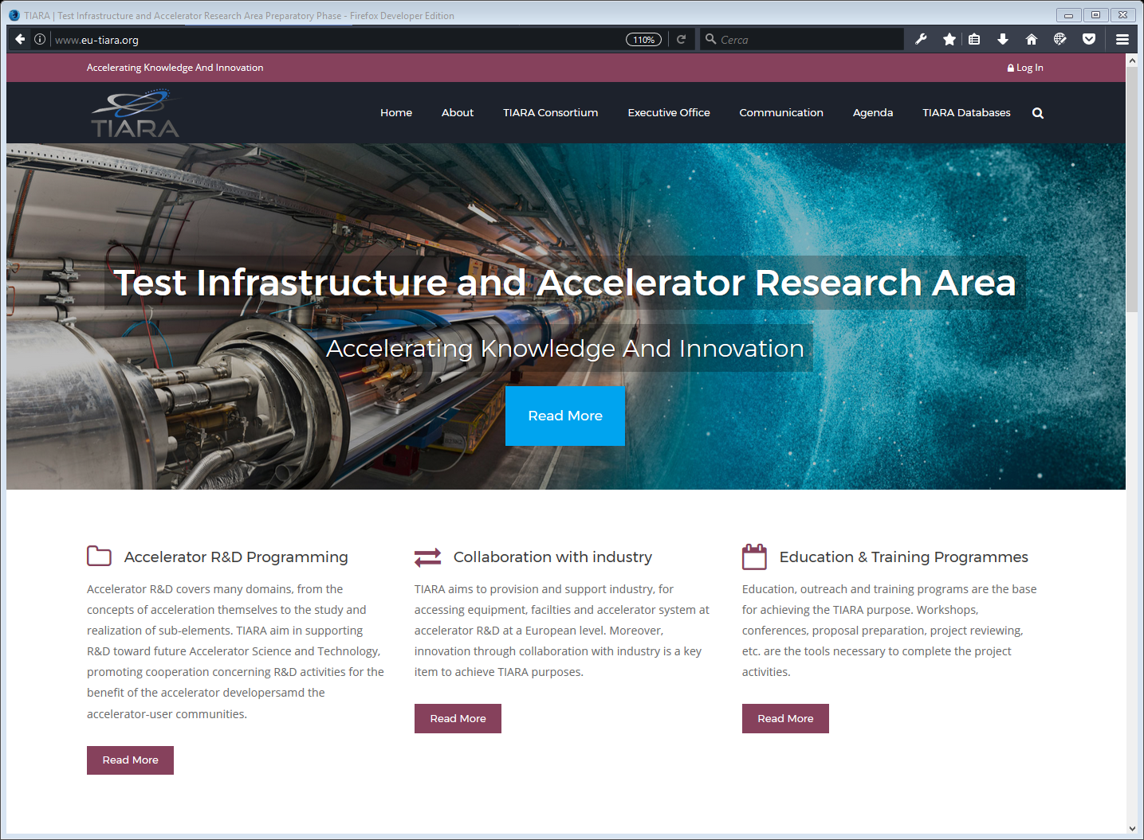
The «Home Page» …

Slide 4
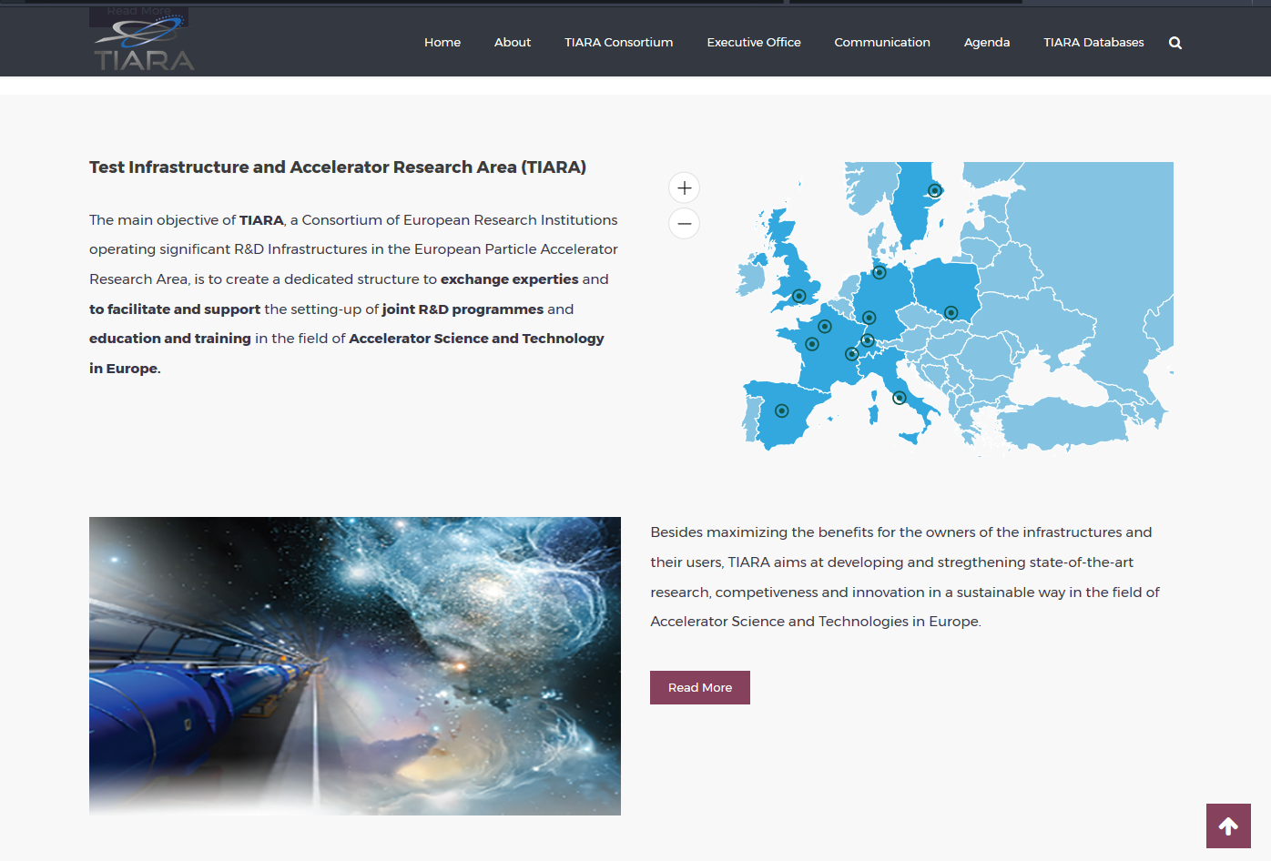
… scrolling down …
Responsive map

Slide 5
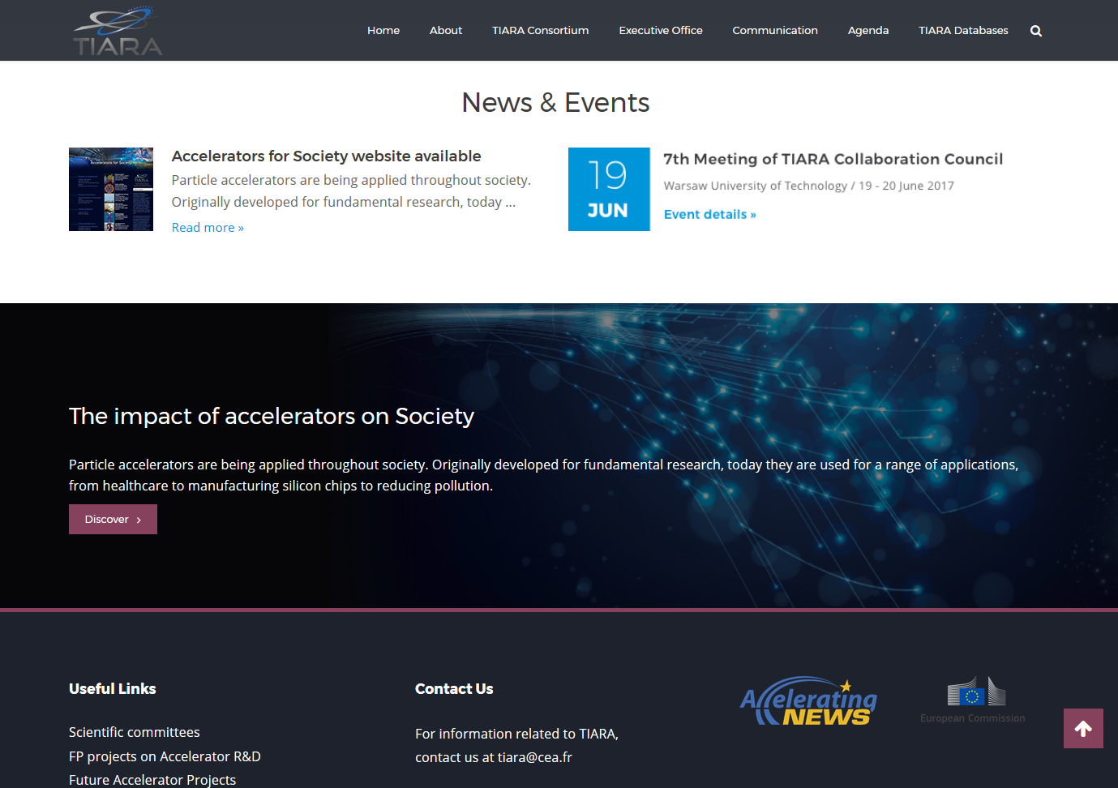
… till the end.

Slide 6
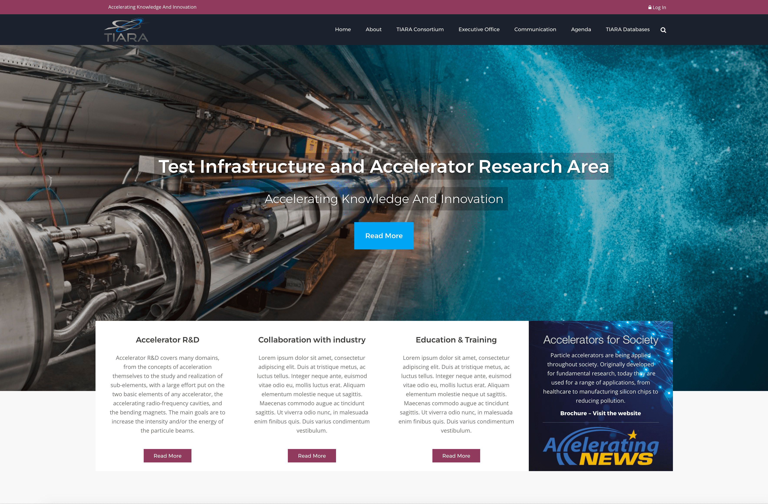
The «Home Page» … a proposal …

Slide 7
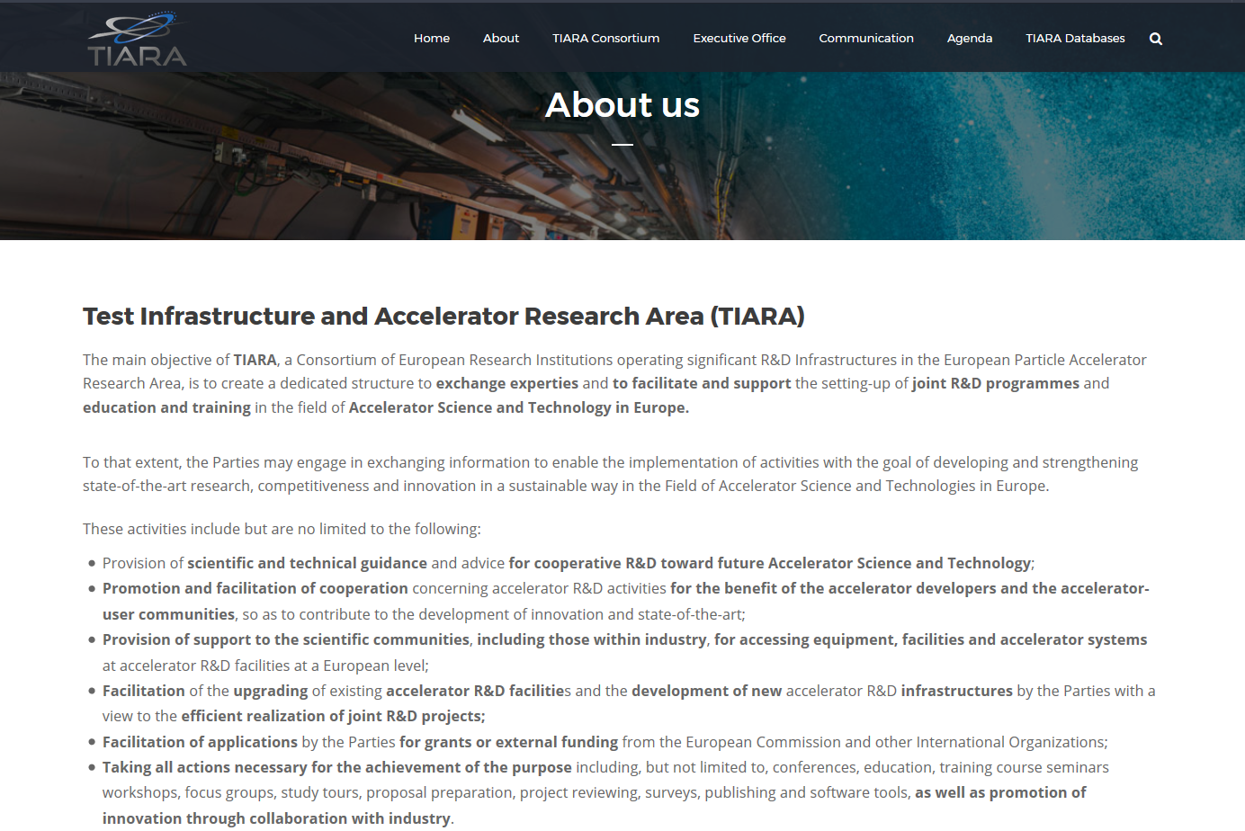
«About»

Slide 8
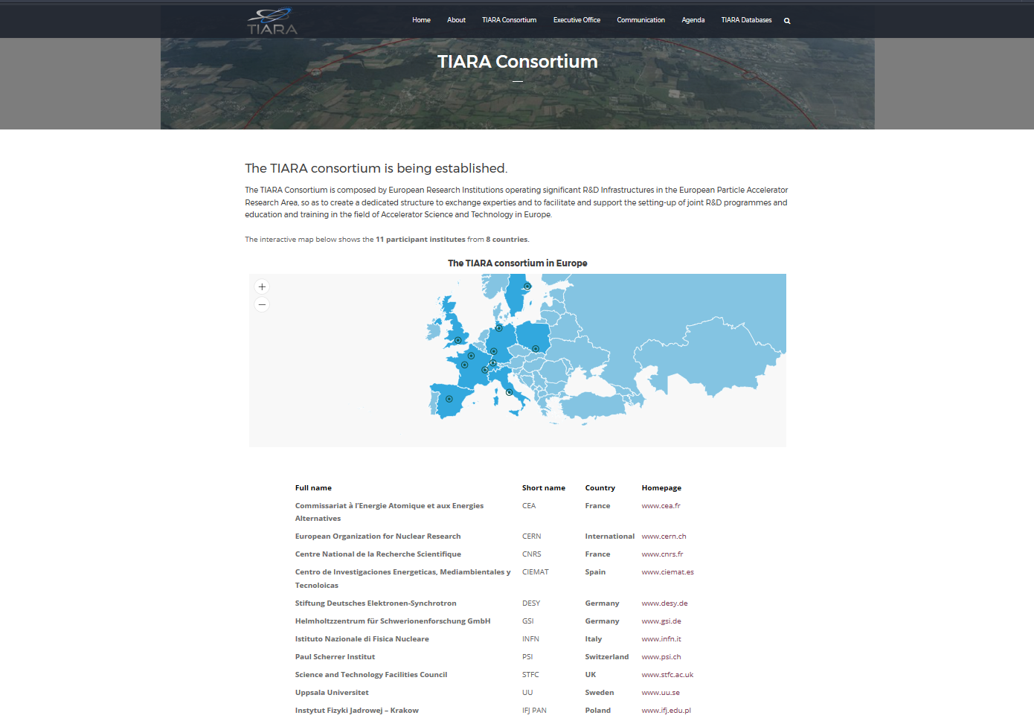
«TIARA Consortium»

Slide 9
«Projects»

Slide 10
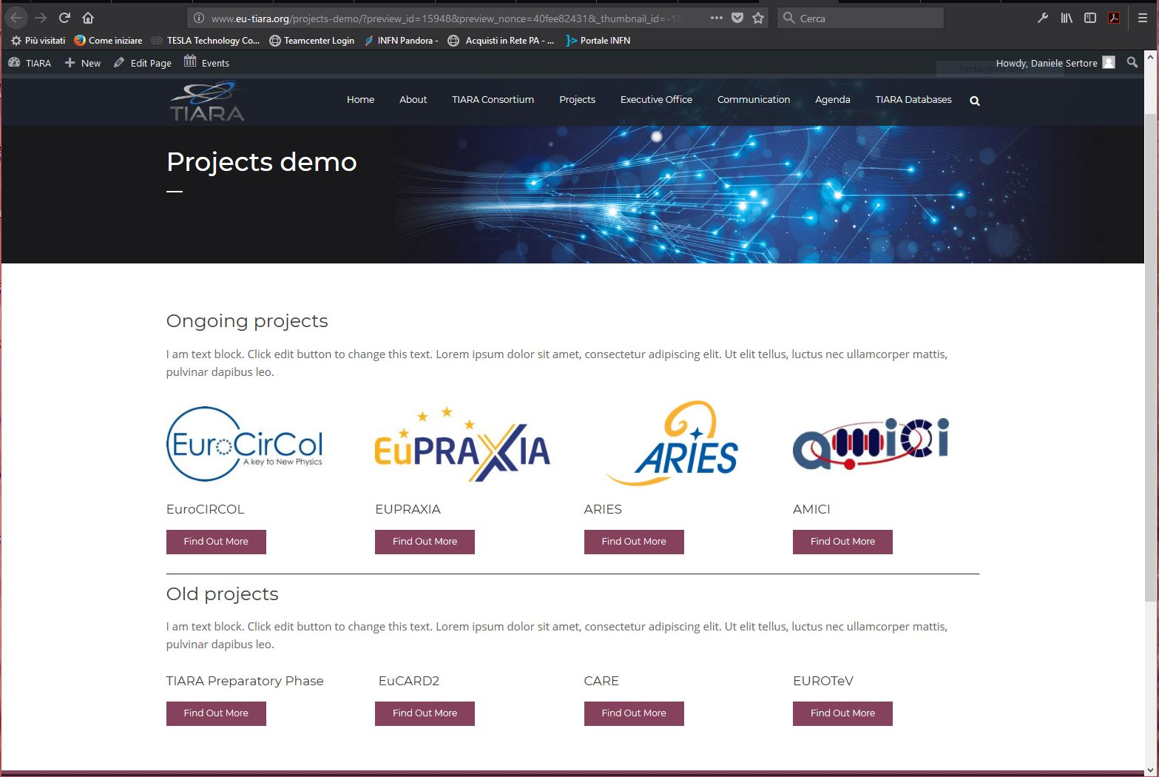
«Projects»

Slide 11
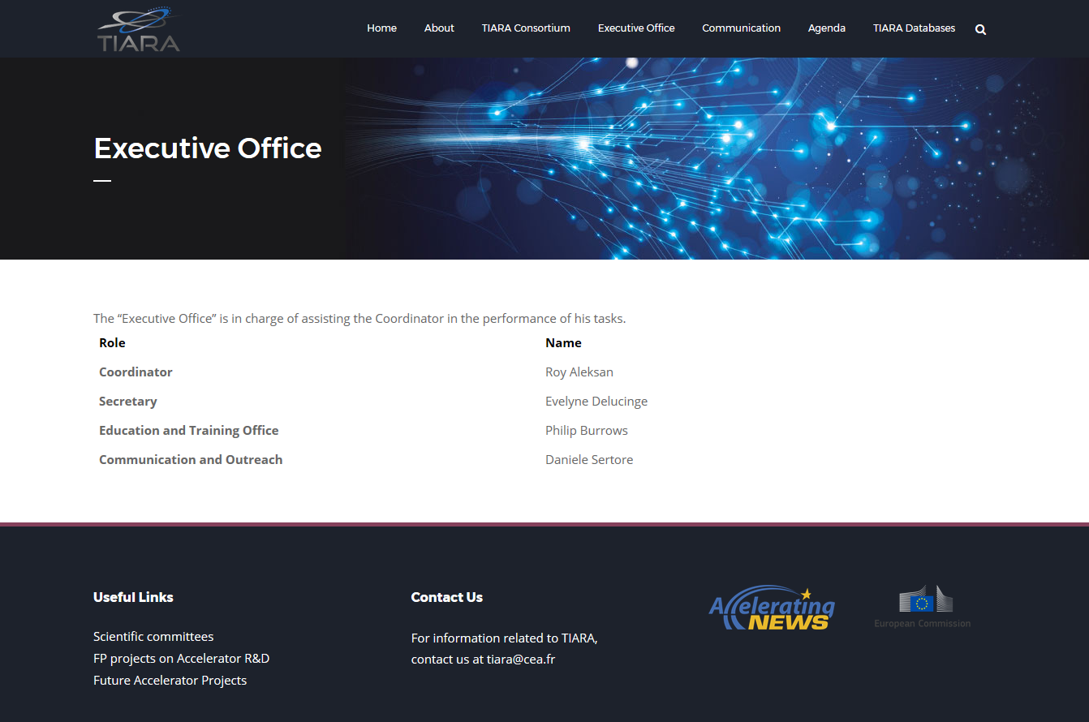
«Executive Office»

Slide 12
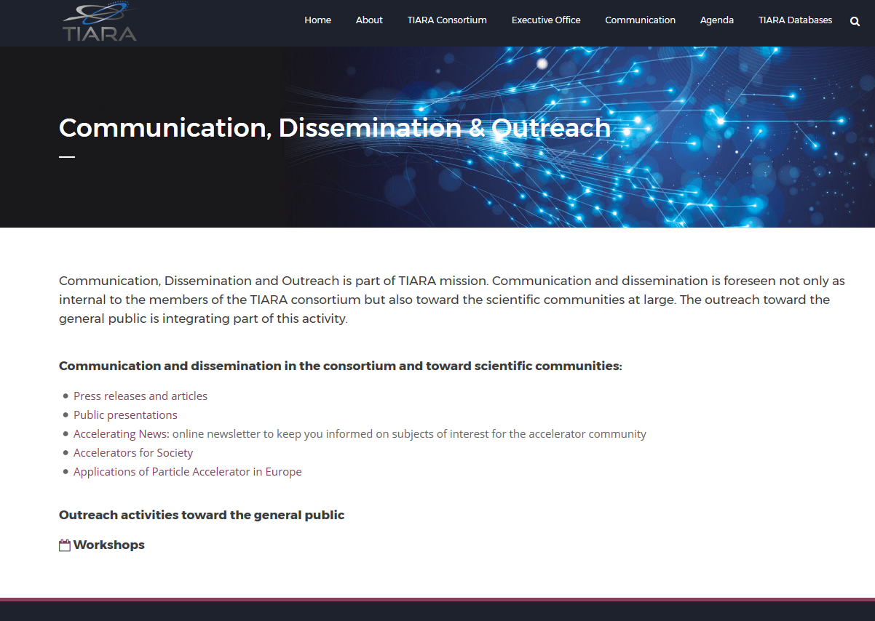
«Communication»

Slide 13
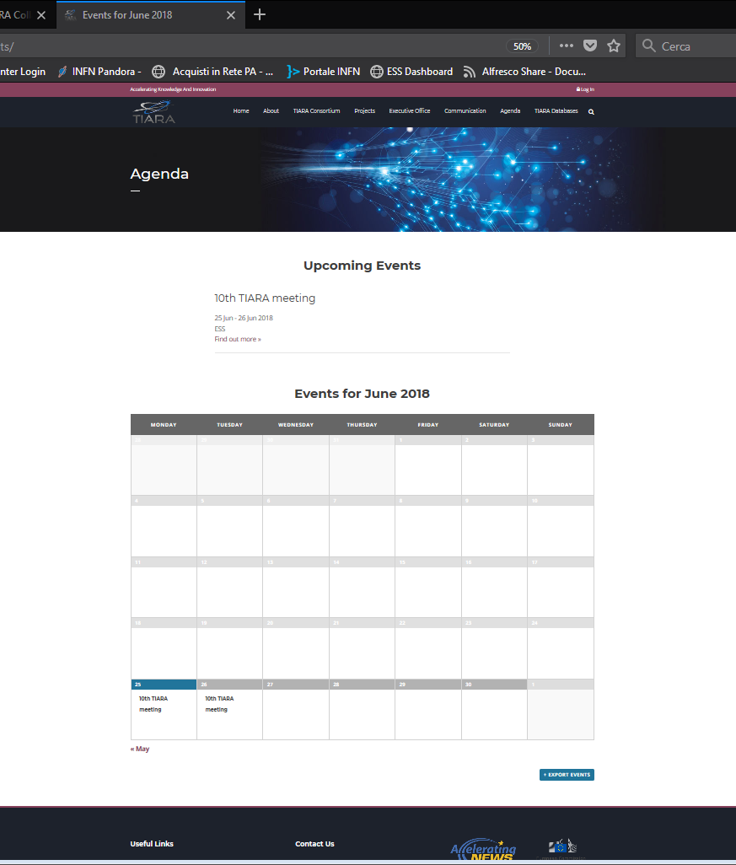
«Agenda»
Next event in the TIARA calendar
Calendar including also event of projects related to TIARA?

Slide 14
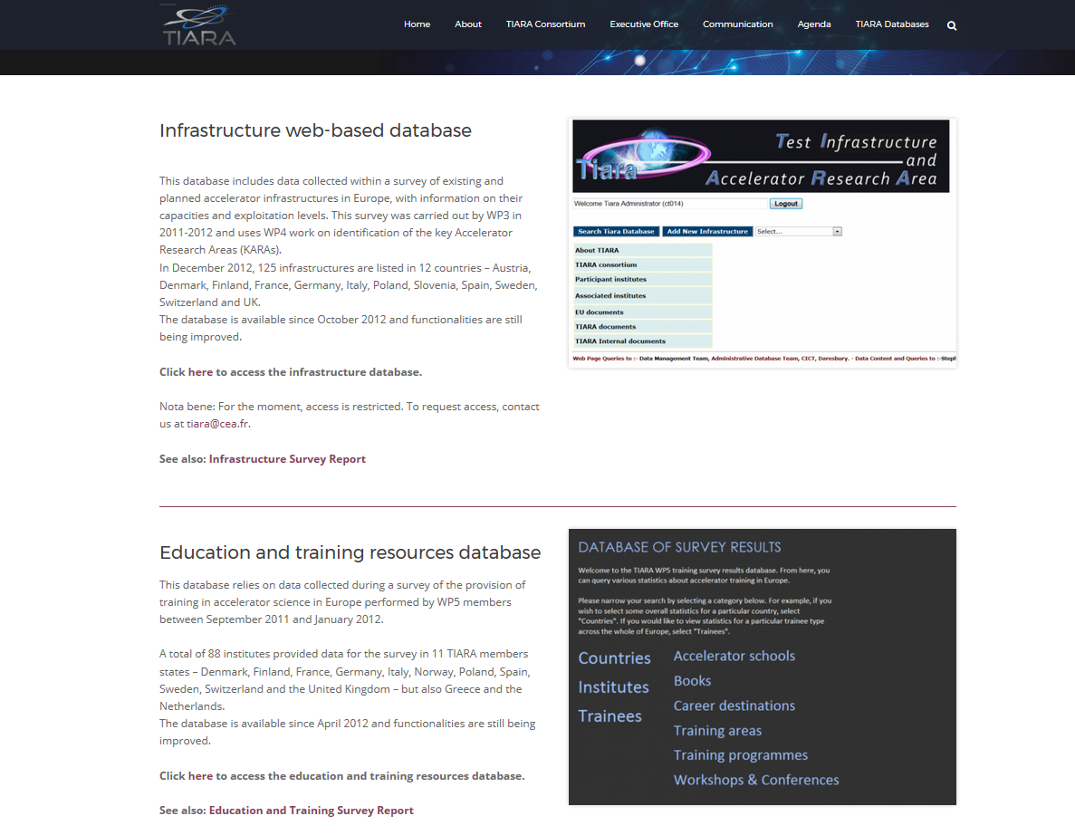
«TIARA Databases»

Slide 15
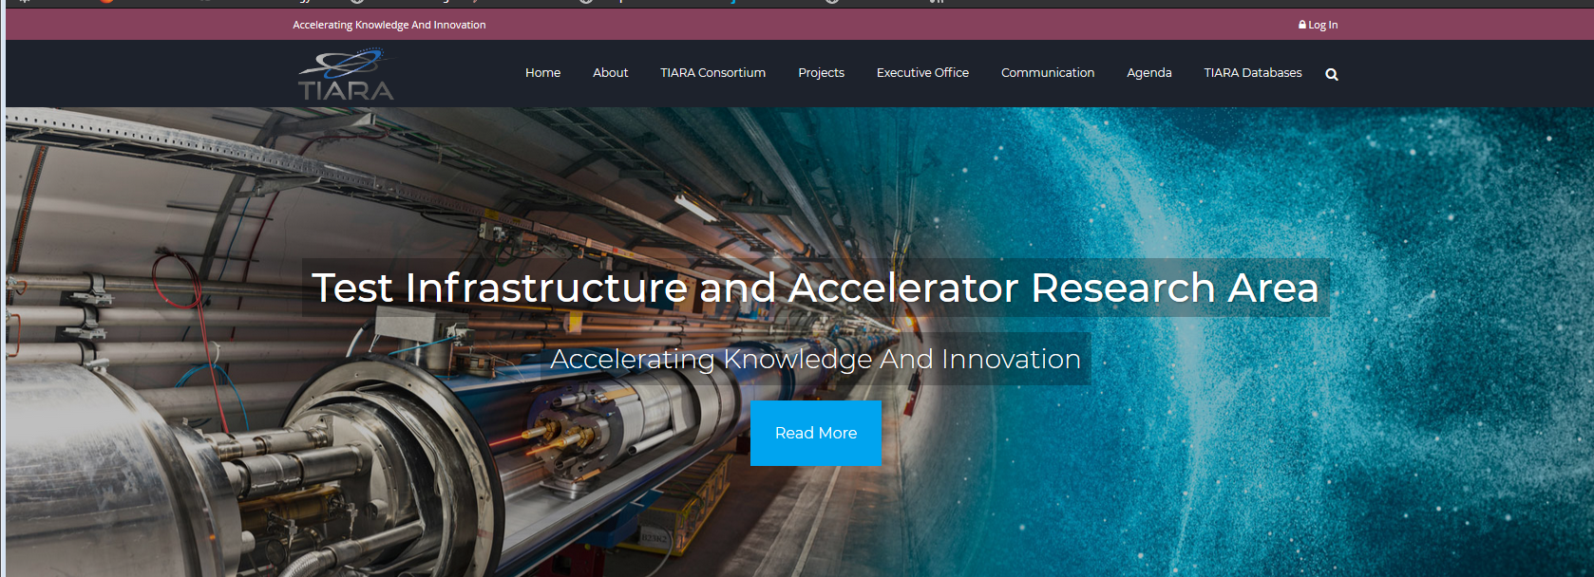
«Restricted Area»
We plan to provide a single username and password to each member
We use it for sharing common interest documents
Mou
Minutes?
….

Slide 16
On going actvities
Agenda
We would like to include also event from projects “supported” by TIARA.
We should define a way of doing this. Any suggestion is welcome. Contact each project communication and outreach responsible?
Any idea and/or suggestion and/or comments is warmly welcome!

Slide 17
Thank your for your attention!!!

