Slide 1

TIARA inputs to European Strategy
for Particle Physics
R. Aleksan
26/6/2018
ES 2013
TIARA input for ES 2013
Update for ES 2020

Slide 2
ES 2013: 4 main priorities
Europe’s top priority should be the exploitation of the full potential of the LHC, including the high-luminosity upgrade of the machine and detectors with a view to collecting ten times more data than in the initial design, by around 2030. This upgrade programme will also provide further exciting opportunities for the study of flavour physics and the quark-gluon plasma.
CERN should undertake design studies for accelerator projects in a global context, with emphasis on proton-proton and electron positron high-energy frontier machines. These design studies should be coupled to a vigorous accelerator R&D programme, including high-field magnets and high-gradient accelerating structures, in collaboration with national institutes, laboratories and universities worldwide.
The initiative from the Japanese particle physics community to host the ILC in Japan is most welcome, and European groups are eager to participate. Europe looks forward to a proposal from Japan to discuss a possible participation.
CERN should develop a neutrino programme to pave the way for a substantial European role in future long-baseline experiments. Europe should explore the possibility of major participation in leading long-baseline neutrino projects in the US and Japan.

Slide 3
ES 2013: TIARA inputs
Preliminary comments:
TIARA deals with R&D and thus is not mandated to do recommendation for specific accelerator projects

Slide 4
ES 2013: TIARA inputs
Key Area Identification
Analysis of needs of future large accelerator projects and of emerging ideas/technologies
Critical
Key Accelerator Research Areas (KARA)/
Key Technical
R&D Issues (KTI)
R&D
Program
D4.1 KARA/KTI

Slide 5
List Key Accelerator Research Areas (KARA)
and Key Technology Issues (KTI)
ESGARD survey in 2010 among the 37 EuCARD partners
Extended within WP4 members (assisted by colleagues from our home institutions)
Collected broad areas needing R&D, with potential impact on community
technical requirements for accelerators as drivers of “analytical” facilities (Neutron Sources, FELs, Ultimate light sources, …)
HEP/Nuclear

Slide 6

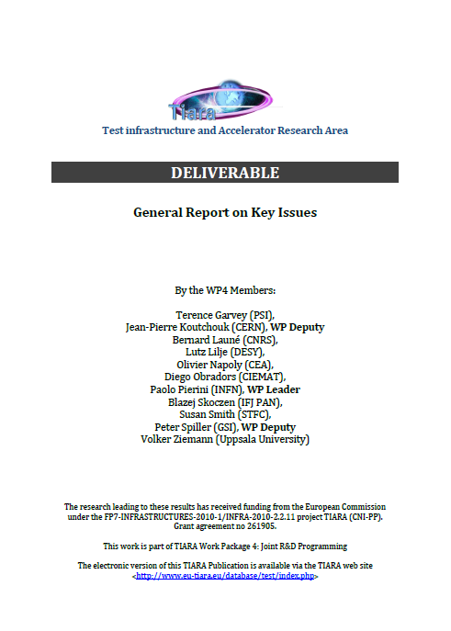
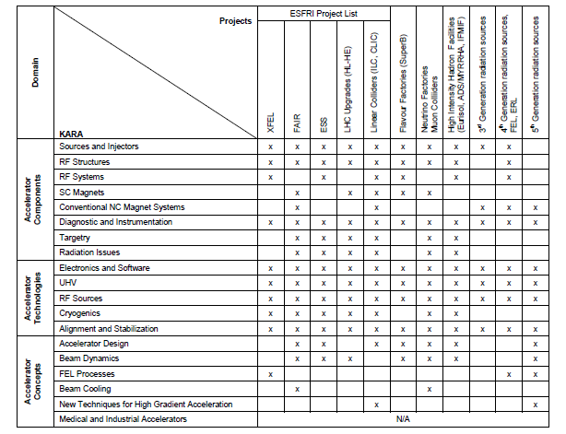
D4.1: 46 pages
Issued December 2011, after approval of GC
  Base for WP4 Joint R&D Programme
  Mapping R&D items/Projects
Difficult to condense all in 20 m! Outline...

Slide 7
Main areas of R&D needs
1. Accelerator Components
2. Accelerator Technologies
3. Accelerator Concepts
19 KARAs
~130 KTIs

Slide 8
1. Accelerator Components (8 KARA)
Sources and Injectors
RF structures
RF systems
SC magnets
Conventional NC magnets
Diagnostics and instrumentation
Targetry
Radiation issues
For each of these Key Areas, a further level (Key Technical Issues) is provided, with a ½-1 page description

Slide 9
Sources and injectors | High Brighness Photo Injectors
 | High intensity Heavy Ion Injectors
 | High intensity Proton H-/d Injectors
 | High-polarization electron/positron source
 | Hollow beams for proton beam collimation
 | RFQ development
 | Beam funneling
RF structures | Overcoming the Limits of Bulk Nb
 | Consolidation of the Nb Technology for Maximum Yield at Higher Gradients
 | High Gradient Acceleration at Low RF Breakdown Rates
 | Improvements of the “Low Beta” Cavity Technology
 | Continuous-Wave Superconducting Radiofrequency
 | Variable Frequency Resonators for Synchrotrons or FFAGs
 | Couplers for SRF Cavities at High Average Power
 | RF Structures for 6D Muon Beam Cooling
 | Crab cavity Developments
 | Development and engineering of C-Band and X-Band RF structures
RF systems | Optimization of RF Systems for high brilliance damping rings
 | X-Band and C-Band RF systems
 | Precision LLRF control
Components: KTI 1/3

Slide 10
SC magnets | Materials and technologies for the 20 T Range and Beyond
 | Fast cycling sc magnets
 | Engineering Challenges for High Field SC Magnets
 | Cryogen-free Magnet systems
 | Short-period undulators
 | High Field small magnets using rare-earth ferromagnets
Conventional NC magnet systems | Compact magnets
 | Radiation resistant magnet
 | Insertion devices for damping and X-Ray production
 | Pulsed Magnets and Kickers
 | Transparent Injection in Top-Up Schemes
 | Fast pulsed quadrupole magnets for beam lines
Diagnostics and instrumentation | Beam Intensity and Loss Detectors
 | Beam Position Monitor Development
 | Beam Size and Emittance Monitor Devices Development
 | Synchronization, fs or sub-fs
Components: KTI 2/3

Slide 11
Targetry | Challenges for High Power Targets for Secondary Particle Production
 | Radiation Damage Phenomena in Target Materials
 | Monte Carlo Transport Codes Validation
 | Collimation Systems
 | Bent Crystal channelling
Radiation issues | Determination of Prompt Radiation Levels
 | Component Activation Handling
 | Compact Radiation Shielding
 | Radiation-hard diagnostic devices
Components: KTI 3/3

Slide 12
2. Accelerator Technologies (5 KARA)
There is more than just components, facilities need complex technologies for operation. R&D is needed and beneficial, e.g.:
Electronics/Software
UH Vacuum
RF power sources
Cryogenics
Alignment/stabilization schemes

Slide 13
Electronics and Software | LLRF cost, performance
 | xTCA Standards
UHV | Radiation Induced Outgassing and Secondary Particle Generation
 | Low Outgassing Rates to Limit Pumping Time
 | Wall Chamber Conductivity and Eddy Currents
 | Large Pumping Power
RF sources | Energy efficiency
 | Solid State Technology RF Souces
 | High Frequency Sources
Cryogenics | Cryoplant Efficiency Improvements
 | Cryogenic Distribution and Cryostat Insulation
Alignment and Stabilization | Laser and Wire Positioning Systems
 | Nanometer Level Stabilization
Technology: KTI

Slide 14
3. Accelerator Concepts (6 KARA)
Last group of Key Accelerator Research Areas, covering design issues for future facilities or promising technologies, not yet implemented in facilities
Accelerator Design
Beam Dynamics
FEL processes
Beam cooling
New techniques for high gradient acceleration
Medical/Industrial accelerators

Slide 15
Accelerator Design | Design for reliability and availability
 | Beam Losses and Machine protection at High Beam Power
 | Compactness And Simplicity
 | Energy Efficiency and storage
Beam Dynamics | Enhanced Beam Modeling Tools and Experimental Validation Tools
 | High Luminosity and High Energy Hadron and Lepton Colliders
 | Beam Stability and Lifetimes in Circular Accelerators
 | Small Emittance Beam Generation and Transport
 | Transport of electrons in plasma accelerating structures
 | Low Losses in High Intensity Linacs
 | High Reliability Operation
 | Laser-Beam Interaction for Acceleration and X-Ray Production
 | Fast Acceleration for Unstable Particles
FEL processes | Develop new seeding techniques for FELs
 | Attosecond pulse generation
 | Circularly Polarized X-Ray FELs
Beam cooling | Electron and stochastic cooling for heavy ion beams
 | Ionization cooling
Concepts: KTI 1/2

Slide 16
New techniques for high gradient acceleration | Self Injection Laser Wake-Field Acceleration
 | External Injection in Laser Plasma Waves Below Wave Breaking
 | External Injection in Particle Wake-Field Acceleration
 | Development of 5th Generation Light Sources: Compact Hard X-Ray Sources
 | Proton and light Ion Generation with Laser Driven Plasmas
Medical and Industrial Accelerators | Improvement in Dose Delivery for Hadrotherapy
 | Image Guided Radiation Therapy
 | Cost and Complexity Reduction of Medical Accelerators
 | Boron Neutron Capture Therapy
 | Production of PET Isotopes and Tracers
 | Acceleration Driven Systems for Nuclear Waste Transmutation
 | Accelerators for Fusion
 | Industrial and Societal Applications
 | Environmental Applications
 | Accelerators for Detection of Illegal Nuclear Material
Concepts: KTI 2/2

Slide 17
ES 2013: TIARA inputs
In order to allow one to develop a programme enabling the realization of future accelerators for particles physics on the medium and long term, it is essential that
accelerator science and technology, and the corresponding R&D, be acknowledged as a vital need with the highest priority within the update of the European Strategy of Particle Physics,
this message be widely conveyed to the European Commission and national funding authorities with a recommendation to amplify their investment effort in the area of accelerator R&D across all relevant fields of research,
the education and training in the field of accelerator science and technology be strengthened
a strong support be given to TIARA (Test Infrastructure and Accelerator Research Area, www.eu-tiara.eu), the aim of which is to develop further and support state-of-the art research, competitiveness and innovation in a sustainable way in the field of accelerator Science and Technologies in Europe in close coordination with CERN, other relevant international bodies and national R&D activities and infrastructures.

Slide 18
ES 2020: TIARA possible input update (Discussion)
Update KARA/KTI list (if needed)
  Is there missing important topics?
Possible TIARA recommendations:
Reiterate previous recommendations, i.e.
  Emphasize the importance of accelerator R&D
  Emphasize the importance of education and Training
Be specific of main Accelerator R&D General Areas, i.e.
  High field magnets (including LTS and HTS)
  High gradient acceleration systems (warm, cold & novel techniques)
  High intensity acceleration systems (including also RF efficiency)

