Slide 1
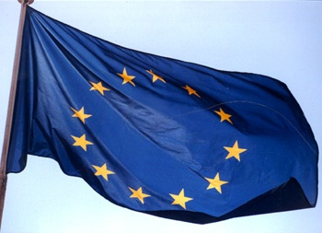

TIARA Collaboration Council
R. Aleksan
TCC meeting
June 25-26, 2018
General information
H2020 IA call
Preparation WP2018-2020

Slide 2
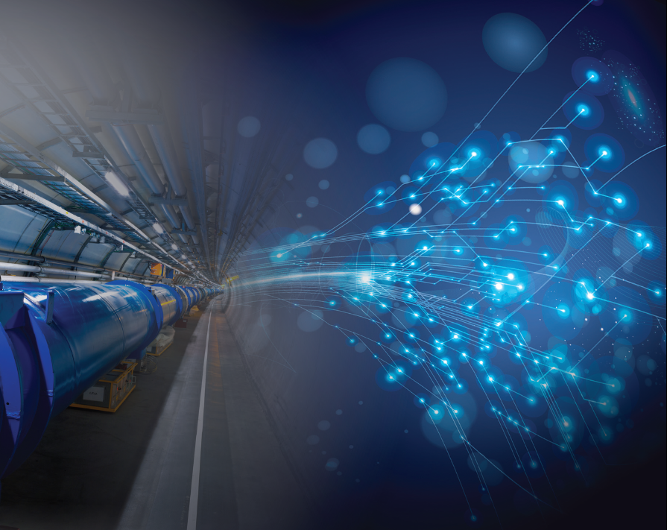
Summary of on going calls and projects
INFRA: WP 2016-17-INFRAINNOV
New type of calls
ATTRACT has been approved
Not dedicated to Accelerator but could be used for diagnostics and instrumentation :
ATTRACT call in July 2018
Deadline in September 2018
Action :
ARIES WP8 should prepare bids

Slide 3
Summary of Past and on-going activities (History)
 | 03 | 04 | 05 | 06 |  |  | 07 |  |  |  | 08 |  | 09 |  |  |  |  |  |  |  |  | 10 |  |  | 11 |  |  |  | 12 |  | 13 | 14 |  |  |  |  | 15 |  |  | 16 | 17 |  |  |  |  | 18 |  |  |  | 19 |  | 20 | 21
Accelerator R&D
CARE (IA)
EuCARD (IA)
EuCARD2 (IA)
ARIES (IA)
EUROTEV (DS)
EURISOL (DS)
EUROnu (DS)
HiLumi (DS)
EuroCIRCOL (DS)
EuPRAXIA (DS)
ESSnuSB (DS)
CompactLight (DS)
SLHC-PP (PP)
ILC-HiGrad (PP)
TIARA (PP)
EUROLEAP
AMICI (INNOV)
EASYTrain (MSC)
Fusumatech (FET)
P6
P7
P7
H20
P6
P6
P7
P7
H20
H20
H20
H20
P7
P7
P7
P6
H20
H20
H20
ESGARD/TIARA has set up a successful strategy for developing a coordinated collaborative long term (>15 years) programme in accelerator R&D!
a 19 projects supported: Total cost >305M€ (EC contribution 105M€)
More than 100 partners (labs, Uni., industry) in 21 countries involved
LINAC4, ELBE, FLASH, XFEL, ESS, HL-LHC, FAIR,…

Slide 4
Summary of Past and on-going activities (History)
In 2018, the total funding received from EC for on-going projects reaches 7.7 M€.

Slide 5
Discussions with the EC for H2020
Development and Long Term Sustainability
Topics (Type of Action) | Budgets (EUR million) |  |  | Deadlines
 | 2018 | 2019 | 2020
Opening: 05 Dec 2017
INFRADEV-03-2018-2019 (RIA) | 15.00 |  |  | 22 Mar 2018
Opening: 16 Oct 2018
INFRADEV-02-2019-2020 (CSA) |  | 20.00 |  | 29 Jan 2019
INFRADEV-04-2019 (RIA) |  | 20.00
Opening: 14 Nov 2018
INFRADEV-03-2018-2019 (RIA) |  | 40.00 |  | 20 Mar 2019
Opening: 25 Jul 2019
INFRADEV-01-2019-2020 (RIA) |  | 20.00 | 10.00 | 12 Nov 2019
Overall indicative budget | 15.00 | 100.00 | 10.00
INFRADEV
Impl. for ESFRI/OWCRI
PP for ESFRI RM18
Fast Track operation ELI
Impl. for ESFRI/OWCRI
DS
Action : TIARA reviews and oversees the preparation of bids
(See discussion later)
Indicative budget for 2020: EUR 28 million ?
INFRADEV-02-2020: Preparatory Phase of new ESFRI projects

Slide 6
Discussion with the EC for H2020
Integrating/opening European Infrastructures
Topics (Type of Action) | Budgets (EUR million) |  | Deadlines
 | 2018 | 2019
Opening: 05 Dec 2017
INFRAIA-01-2018-2019 (RIA) | 101.50 |  | 22 Mar 2018
Opening: 14 Nov 2018
INFRAIA-01-2018-2019 (RIA) |  | 125.00 | 20 Mar 2019
Overall indicative budget | 101.50 | 125.00
INFRAIA
IA advanced commu.
(NA,TNA, JRA)
Targeted call :
2018: 23 topics
2019: 20 topics
Indicative budget for 2020: EUR 155 million ?
INFRAIA-02-2020: Integrating Activities for Starting Communities
INFRAIA-03-2020: Pilot for a new model of Integrating Activities

Slide 7
Discussion with the EC for H2020
Innovation
Topics (Type of Action) | Budgets (EUR million) | Deadlines
 | 2019
Opening: 10 Oct 2018
INFRAINNOV-01-2019 (RIA) | 8.00 | 29 Jan 2019
Opening: 14 Nov 2018
INFRAINNOV-02-2019 (CSA) | 1.50 | 20 Mar 2019
Overall indicative budget | 9.50
INFRAINNOV
HPC use for SMEs
Network of RI-ILO
Indicative budget for 2020: ?
INFRAINNOV-03-2020: Co-Innovation platform for research infrastructure technologies
INFRAINNOV-04-2020: Innovation pilots (accelerators considered)
Total amount for the call : 60M€ (under discussion)

Slide 8
Discussions with the EC for H2020
Policy and international actions
Topics (Type of Action) | Budgets (EUR million) |  | Deadlines
 | 2018 | 2019
Opening: 05 Dec 2017
INFRASUPP-01-2018-2019 (RIA) | 6.00 |  | 22 Mar 2018
INFRASUPP-01-2018-2019 (CSA) | 6.00
Opening: 14 Nov 2018
INFRASUPP-01-2018-2019 (CSA) INFRASUPP-01-2018-2019 (RIA) |  | 27.00 | 20 Mar 2019
Overall indicative budget | 12.00 | 27.00
INFRASUPP
SESAME….
ERIC network….

Slide 10
Meetings
TCC-IRC: TIARA Collaboration Council – Implementation Review Committee
Reminder of next meeting : Thursday Nov. 15, 2018 at CERN
  Talks FCC/EuroCirCol TDR, ESSnuSB and CompactLight
  Extended discussion on European Strategy and FP9 (cont’d)
  Status SEEIIST (Balkan) project
  …
Proposal for following meeting : CERN,
doodle for the period Feb./March 2019 ?
Reminder of other project general meetings
January 29-30, 2019 : FCC/EuroCirCol TDR delivery meeting in Paris
June 2019 : 6th FCC/EuroCirCol annual meeting in Brussels
April 9-12, 2019 : ARIES Yearly meeting in Budapest

Slide 11

Additional Slides

Slide 12
TIARA Collaboration Council meetings
Institute | Representative | Substitute | « IRC » (ESGARD functions)
CEA | P. Vedrine | A. Chancé | A. Chancé
CERN | F. Bordry | M. Vretenar | M. Vretenar
CNRS | J.-L. Biarrotte |  | J.-L. Biarrotte
CIEMAT | J. Perez | L. Garcia-Tabares | L. Garcia-Tabares
DESY | R. Brinkmann | R. Assmann | R. Assmann
GSI | P. Spiller | J. Stadlmann | P. Spiller
INFN | E. Nappi |  | S. Guiducci
PSI | L. Rivkin | T. Garvey | T. Garvey
STFC | G. Blair | C. Jamieson | P. MacIntosh
UU | T. Ekelof |  | T. Ekelof
IFJ-PAN | M. Jezabek | P. Malecki | P. Malecki
Members

