Slide 1
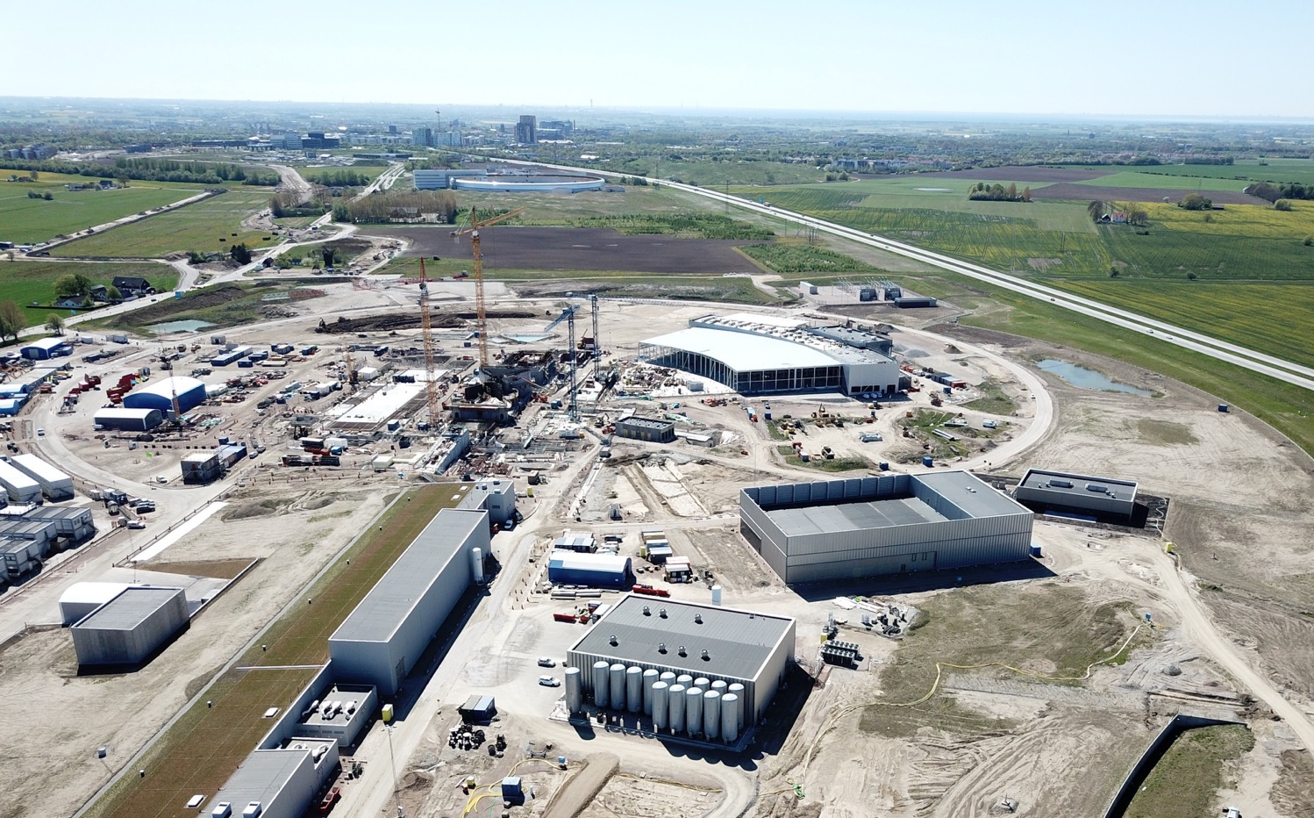
The European Spallation Source
John Womersley, Director General
June 2018

Slide 2
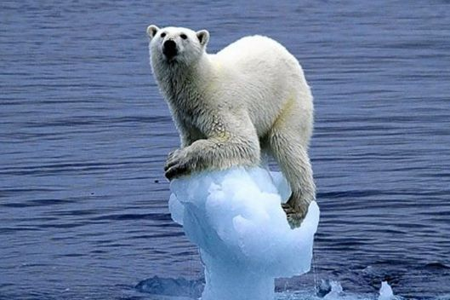
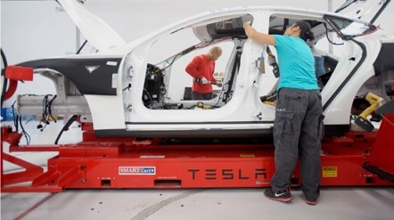
Scientific and technological innovation is essential
global challenges of energy, climate, environment, healthcare
economic and societal challenges of stalled productivity and long term wage stagnation

Slide 3
Materials and molecules
Where are the atoms and what do they do?
New materials, new drugs, new processes, new energy technologies

Slide 4
HEALTH
With neutrons, we are able to study the building blocks of the human body by understanding how proteins, enzymes and other biological material work on the molecular and atomic level.
This includes research on DNA molecules and proteins that control aging and cancer, organs like muscles and teeth, and constructing better medical implants.

Slide 5
ENERGY
Neutrons enable the potential for developing more environmentally friendly products and processes.
Fuel cells driven by hydrogen, materials used for solar power, and telephone batteries are some of the areas that benefit from neutron technology.

Slide 6
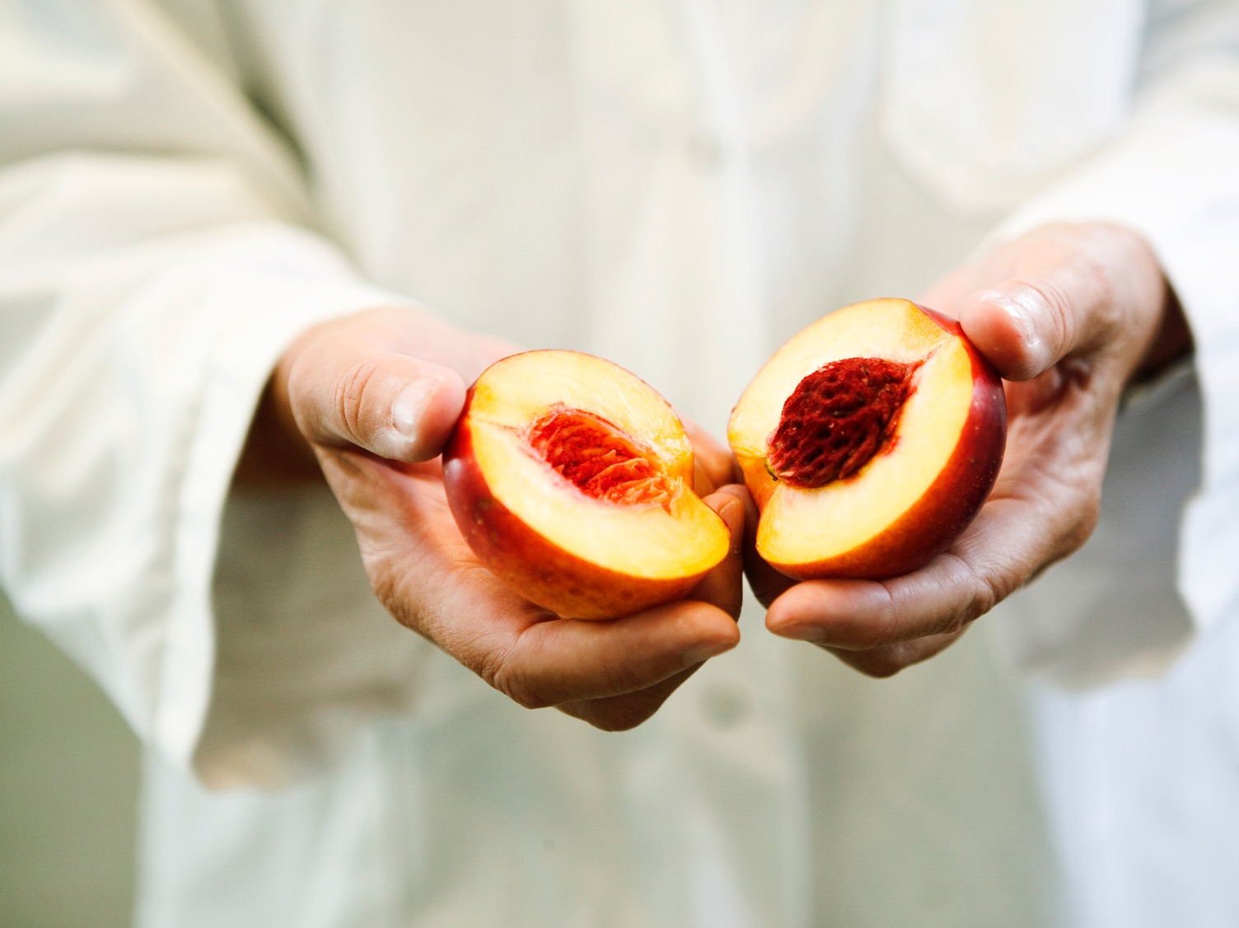
FOOD
Consumers demand safe and healthy food, creating a need for companies to understand the complex structure of food and ingredients.
Neutrons are used to study enzyme structures and what happens during chemical processes. The non-destructive analysis techniques can reveal protein and emulsion structures and reduce energy consumption in food production.

Slide 7
NEW MATERIALS
Mobile phone and computer technology are developing fast while new technologies like LED lighting are emerging. New products full of advanced materials surround us in our everyday life.
Today's materials must be lighter, stronger, cheaper and sustainable. Neutrons help us not only understand the atomic structure of materials, but also their behavior.

Slide 8
Vision, Mission and Values
ESS Vision
Our vision is to build and operate the world’s most powerful neutron source, enabling scientific breakthroughs in research related to materials, energy, health and the environment, and addressing some of the most important societal challenges of our time.
Mission
To do this, we commit to deliver ESS as a facility that:
Is built safely, on time and on budget
Produces research outputs that are best-in-class both in terms of scientific quality and in terms of socioeconomic impact
Supports and develops its user community, fosters a scientific culture of excellence and acts as an international scientific hub
Operates safely, efficiently and economically, and responds to the needs of its stakeholders, its host states and member states
Develops innovative ways of working, new technologies, and upgrades to capabilities needed to remain at the cutting edge
Core Values
Excellence • Collaboration • Openness • Sustainability

Slide 9
Neutron Facilities
10²⁰
Reactor Sources
Spallation Sources
J-PARC
ESS
HFIR
ILL
LANSCE
ISIS
CSNS
10¹⁵
MTR
HIFAR
MARIA
ORPHEE
IPNS
SALAM
HANARO
SNS
NRX
HFBR
NIST
ZING-P’
Dhruva
CARR
PIK
NRU
SAFARI-1
JRR-3
ETERR-2
FRM-II
OPAL
LVR
RSG
SINQ
IBR-II
HOR
JEEP II
KENS
X-10
WNR
Effective thermal neutron flux n/cm²-s
ZING-P
10¹⁰
CP-2
CP-1
10⁵
Berkeley 37-inch cyclotron
Particle driven pulsed
350 mCi Ra-Be source
Particle driven steady state
Pulsed reactor
Fission reactors
1
Chadwick
1930
1940
1950
1960
1970
1980
1990
2000
2010
2020
2030
Year
(Updated from Neutron Scattering, K. Skold and D. L. Price, eds., Academic Press, 1986)
Notes:
CP-1 Chicago USA
CP-2 Chicago USA
X-10: Oak Ridge, USA
NRX: Chalk River, USA
MTR: Idaho, USA
LVR: Rez, Czech Republic
HIFAR: Sydney Australia
NRU: Chalk River, USA
HOR Delft Netherlands
SAFARI-1 Pretoria South Africa
HFBR: Brookhaven, USA
HFIR: ORNL, Oak Ridge, USA
NIST: National Inst. for Stds and Tech. Gaithersburg, USA
ILL: Grenoble, France
JEEP II Kjeller Norway
MARIA Swierk Poland
ORPHEE LLB Saclay France
Dhruva: Mumbai, India
RSG: serpong, Indonesia
SINQ: PSI, Switzerland
JRR-3: Tokai, Japan
ES-Salam Algiers Algeria
HANARO: Daejon KAERI, South Chorea
ETERR-2 Cairo Egypt
FRM-II: Munich, Germany
OPAL: Sydney, Australia
CARR: Beijing China
PIK: Gatchina, Russia
ZING-P Argonne USA
WNR Los Alamos USA
KENS Tsukuba Japan
IPNS Argonne USA
IBR-II Dubna Russia
LANSCE Los Alamos USA
ISIS Oxfordshire UK
SNS Oak Ridge USA
JPARC Tokai Japan
CSNS Beijing China
ESS Lund Sweden
More reactor sources exist across the world….

Slide 10
ESS Vision: Build and operate the world’s most powerful neutron source
Reactor sources
Accelerator-driven sources
ESS
Effective thermal neutron flux 10¹⁵ n/cm²-s
J-PARC
NIST
ILL
LANSCE
ISIS
FRM-II
SNS
CSNS
Year

Slide 11
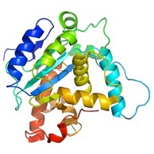
How a spallation source works
instrument
neutrons
moderator
sample
proton accelerator
target
“spallation” is the process that releases neutrons from the target nuclei

Slide 12
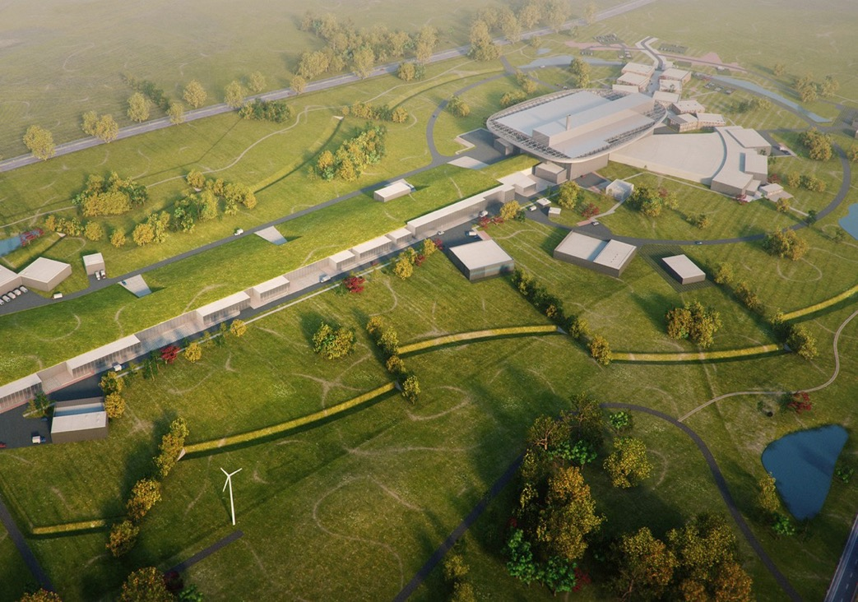
Neutron Production Target
Experiments
Superconducting Proton Accelerator

Slide 13
Some numbers
1843 M€ construction cost
5 MW world’s most powerful particle accelerator
15 experimental stations
20 ⨉ more sensitive on average than today’s best
800 experiments per year
2023 first science for users
13 ERIC member nations

Slide 14
Journey to deliver the world’s leading facility for research using neutrons
2025
ESS Construction Phase Complete
2014
Construction Starts on Green Field Site
2023
ESS Starts
User Program
2009
Decision to Site ESS in Lund
2019
Start of Initial Operations Phase
2012
ESS Design Update Phase Complete
2003
European Design of ESS Completed

Slide 15
Financing includes cash and deliverables
The European Spallation Source ERIC established in 2015
Host Countries Sweden and Denmark
Construction 47.5% Cash Investment ~ 97%
Operations 15%
Non Host Member Countries
Construction 52.5% In-kind Deliverables ~ 70%
Operations 85%
13 European Member Countries

Slide 16
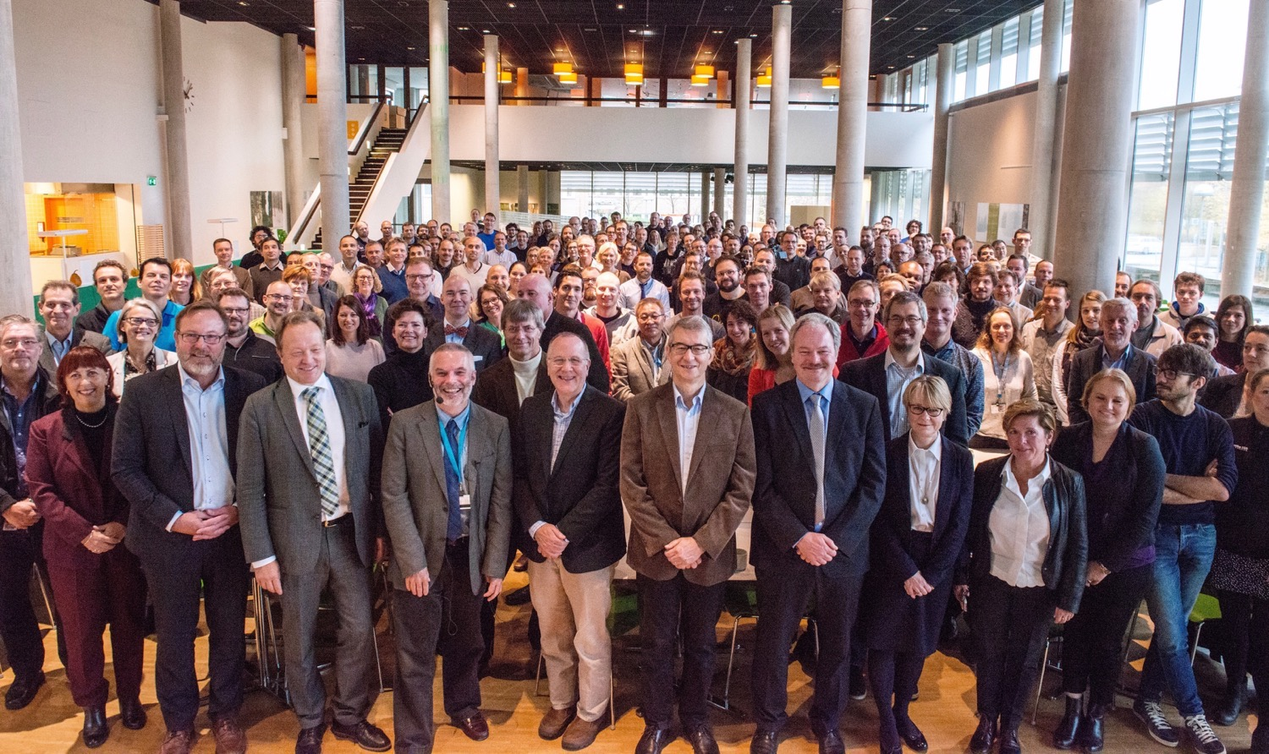
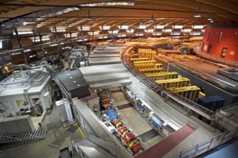
Organisation and People
447
Employees
50
Nationalities
~ 100
Collaborating Institutions
Notes:
Updated September 2017

Slide 17
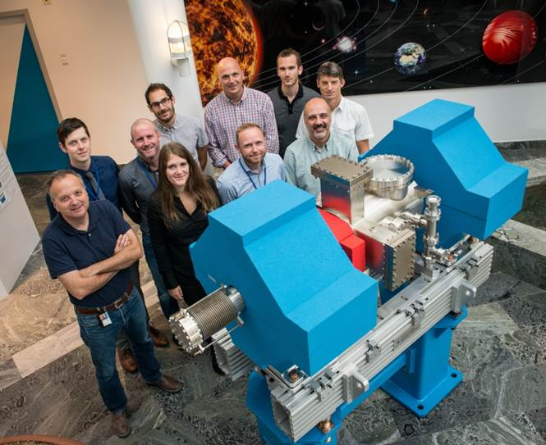
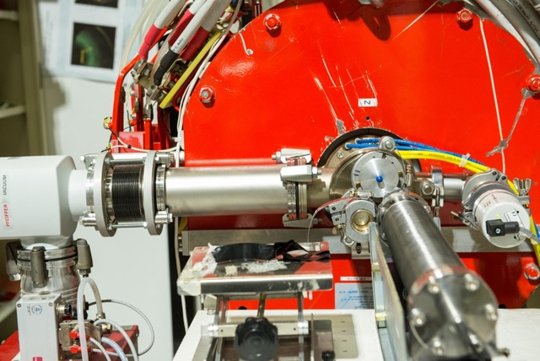
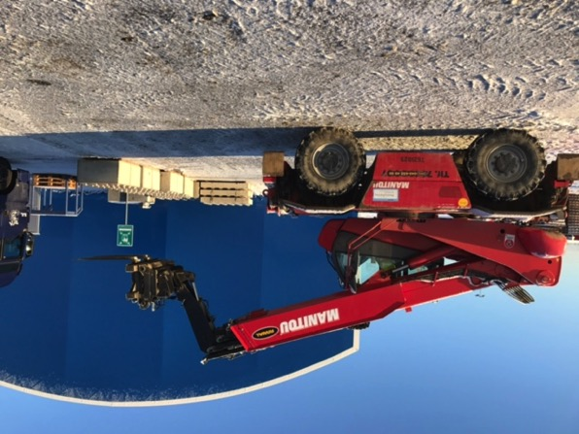
ESS In-kind Partners
Aarhus University
Atomki - Institute for Nuclear Research
Bergen University
CEA Saclay, Paris
Centre for Energy Research, Budapest
Centre for Nuclear Research, Poland, (NCBJ)
CNR, Rome
CNRS Orsay, Paris
Cockcroft Institute, Daresbury
Elettra – Sincrotrone Trieste
ESS Bilbao
Forschungszentrum Jülich
Helmholtz-Zentrum Geesthacht
Huddersfield University
IFJ PAN, Krakow
INFN, Catania
INFN, Legnaro
INFN, Milan
Institute for Energy Research (IFE)
ISIS - Rutherford-Appleton Laboratory, Oxford
Laboratoire Léon Brilouin (LLB)
Lund University
Nuclear Physics Institute of the ASCR
Oslo University
Paul Scherrer Institute (PSI)
Polish Electronic Group (PEG)
Roskilde University
Tallinn Technical University
Technical University of Denmark (DTU)
Technical University Munich (TUM)
Science and Technology Facilities Council
University of Copenhagen (KU)
University of Tartu
Uppsala University
Wigner Research Centre for Physics
Wroclaw University of Technology
Warsaw University of Technology
Zurich University of Applied Sciences (ZHAW)

Slide 18
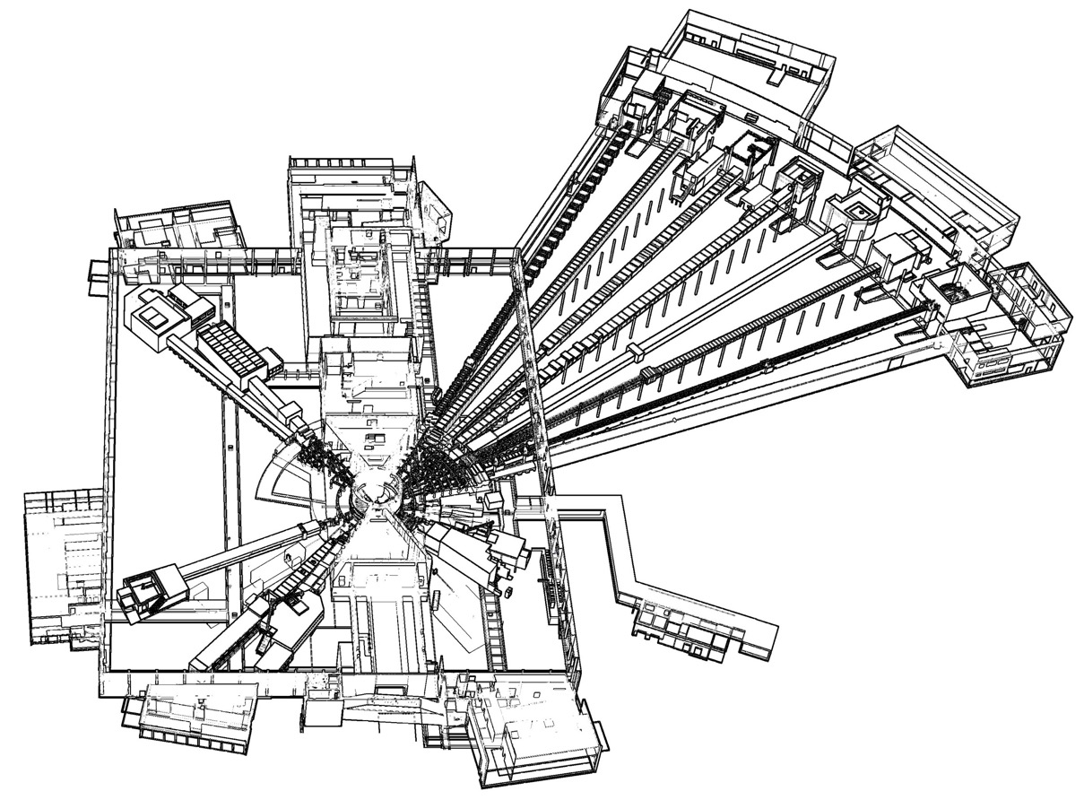
Instrument Suite
NMX
BEER
CSPEC
BIFROST
MIRACLES
MAGIC
ODIN
T-REX
HEIMDAL
DREAM
SANS | LOKI, SKADI
Reflectometry | ESTIA, FREIA
Powder Diffraction | DREAM, HEIMDAL
Single-Crystal Diffraction | MAGIC, NMX
Imaging & Engineering | ODIN, BEER
Direct-Geometry Spectroscopy | CSPEC, T-REX
Indirect-Geometry Spectroscopy | BIFROST, MIRACLES, VESPA
LoKI
VESPA
SKADI
FREIA
ESTIA
ESS Instrument Layout (September 2017)

Slide 19
The 15 NSS Project Instruments All are funded to be world leading in 2023
Instrument Class | Instrument | Costbook Value (M€) | Performance targets (@ 2MW)
Large Scale Structures | LOKI (Broad band SANS) | 12.19 | 5 x D22 & 20 x SANS2D
 | SKADI (General Purpose SANS) (+SONDE funds) | 11.50 | 4 x D22
 | ESTIA (Focusing Reflectometer) | 11.80 | Conventional mode: ~ 100 x D17 High intensity mode: 1cm² samples = seconds
 | FREIA (Liquids Reflectometer) | 13.2 | 30 x FIGARO, INTER
Diffraction | DREAM (Bispectral powder diffractometer) | 13.66 | > 10 x POWGEN or WISH
 | HEIMDAL (Hybrid diffractometer) | 13.55 | ~ 50 x GEM, ~ 8 x new POLARIS
 | MAGIC (magnetism single crystal diffractometer) | 13.10 | Cold: > 100 x worlds best, Thermal: 1mm³ crystals = 10 min
 | NMX (Macromolecular crystallography) | 11.67 | > 10 x LADI & Biodiff
Engineering & Industrial | BEER (Engineering diffractometer) | 14.99 | world leading in strain scanning, unique flexibility
 | ODIN (multi-purpose imaging) | 11.60 | world leading for high resolution, > 10 x best for TOF methods
Spectroscopy | BIFROST (extreme environment spectrometer) | 13.45 | > 10 x THALES & MACS
 | C-SPEC (cold chopper spectrometer) | 16.50 | 100 x IN5 (w RRM)
 | T-REX (bispectral chopper spectrometer) | 16.85 | 3 x 4-SEASONS, 3 x IN5
 | VESPA (vibrational spectroscopy) | 12.0 | 10 x VISION (ΔE = 130 meV)
 | MIRACLES (backscattering spectrometer) | 13.53 | 2 x BASIS and DNA
Total cost book value |  | 199.59

Slide 20
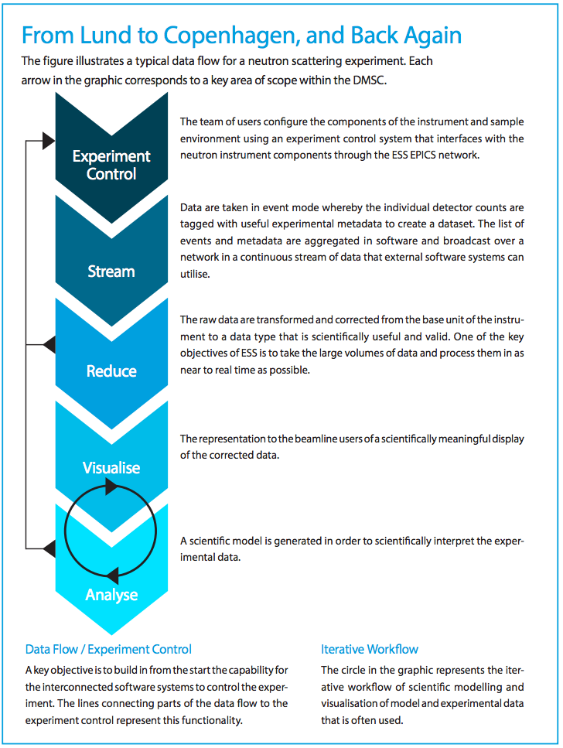
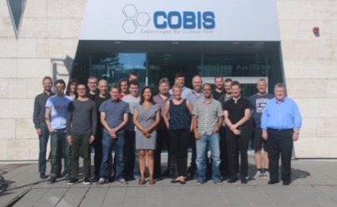
Data Management and Software Centre COBIS, Copenhagen University North Campus
Provide world leading scientific software and scientific computing support for neutron scattering at ESS
Scientific Software
ESS experiment control system, Data acquisition, Data correction software, visualization, and software to model and analyze experimental data sets.
Data center operations
Store and catalogue ESS datasets, provide ESS users remote access to their data, computing for live data correction, and analysis software during and after experiments.
User support
Support ESS users with data treatment and analysis.
20

Slide 21
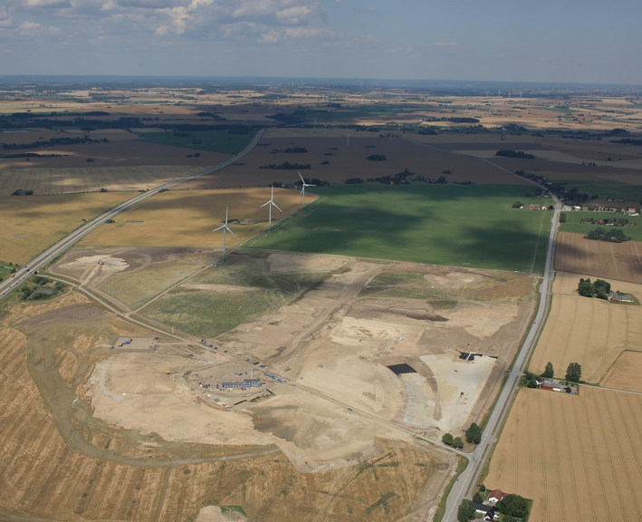
Civil Construction Groundbreaking
September 2014

Slide 22
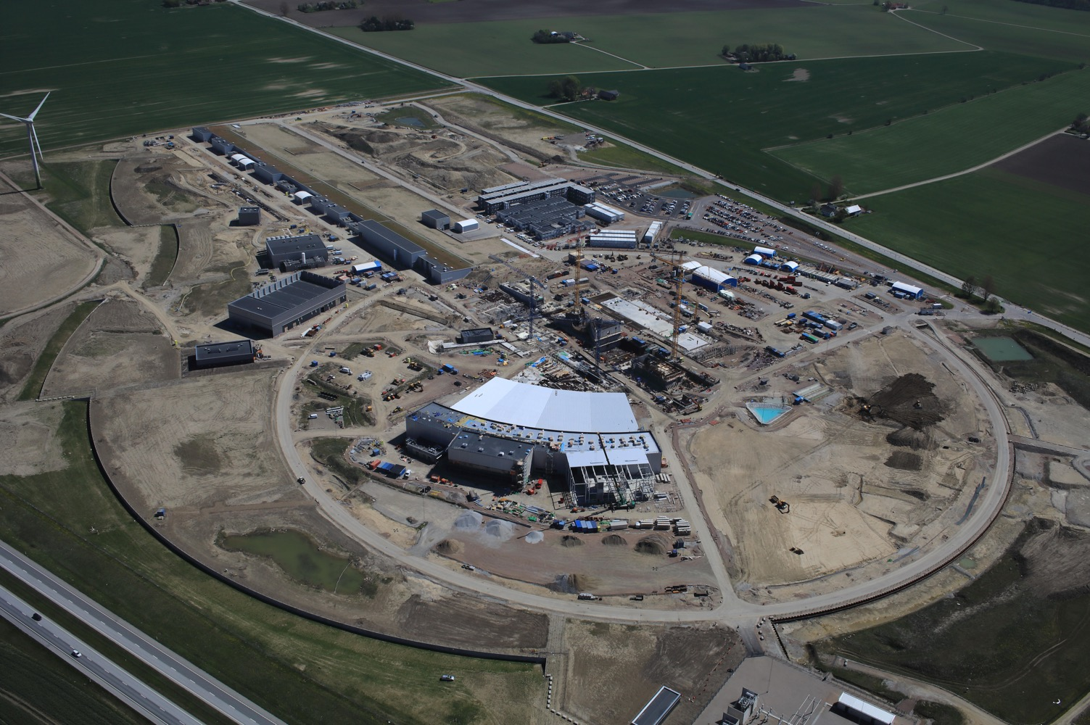
May 2018

Slide 23
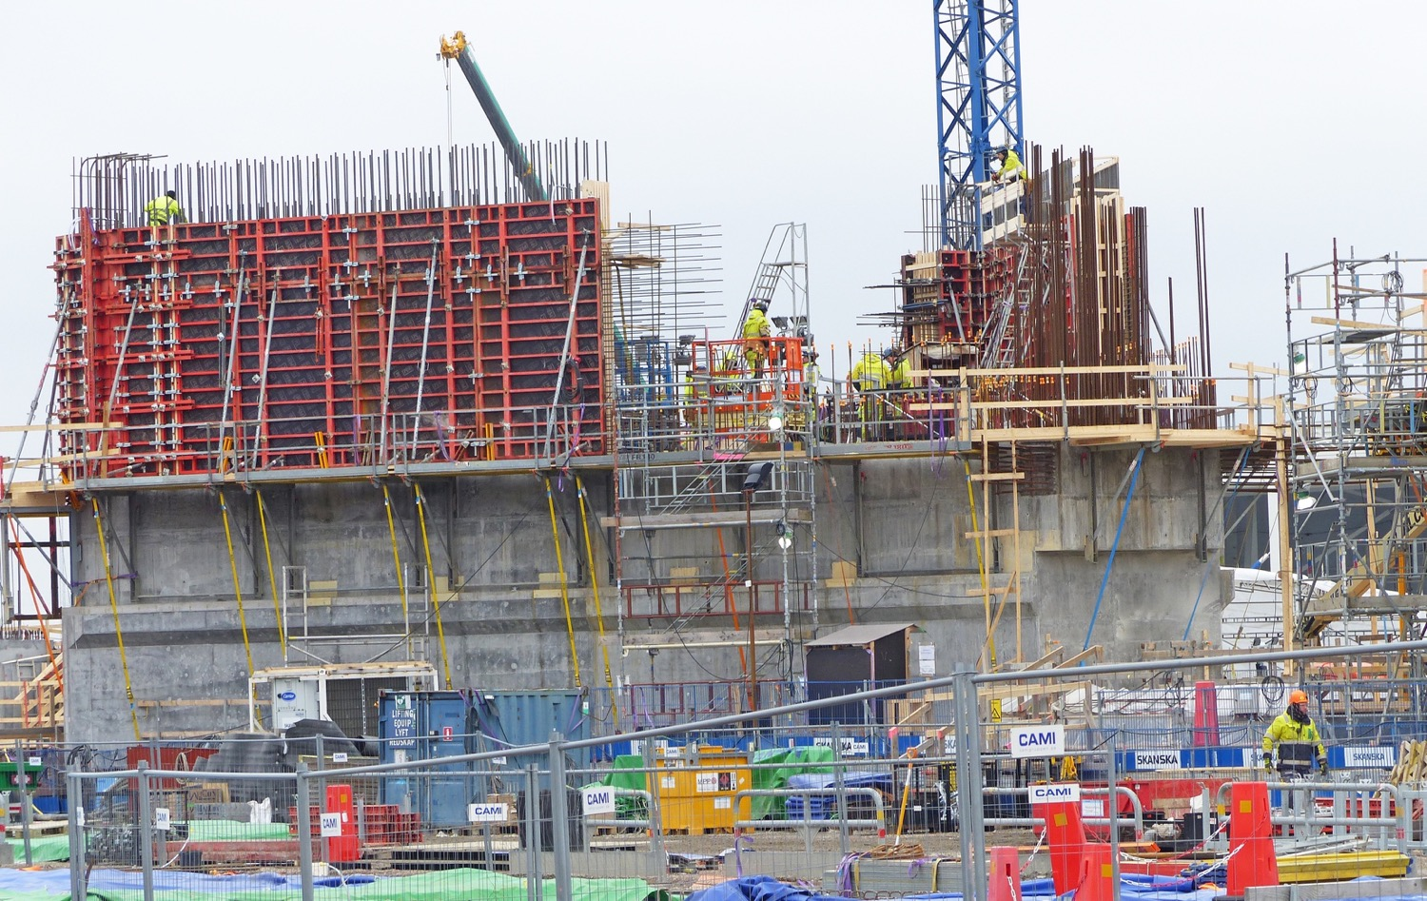
Target Monolith – concrete & reinforcement

Slide 24
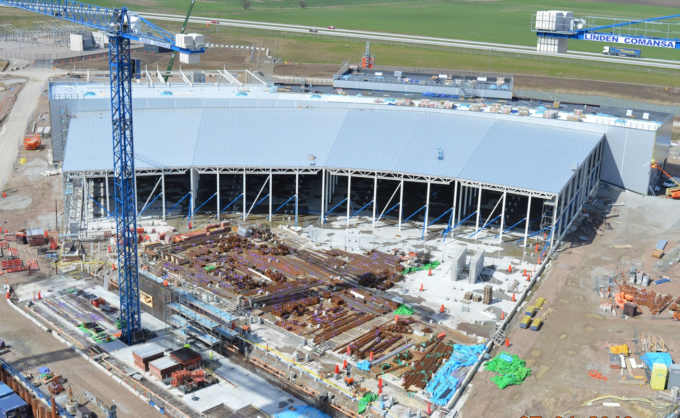
E-buildings

Slide 25
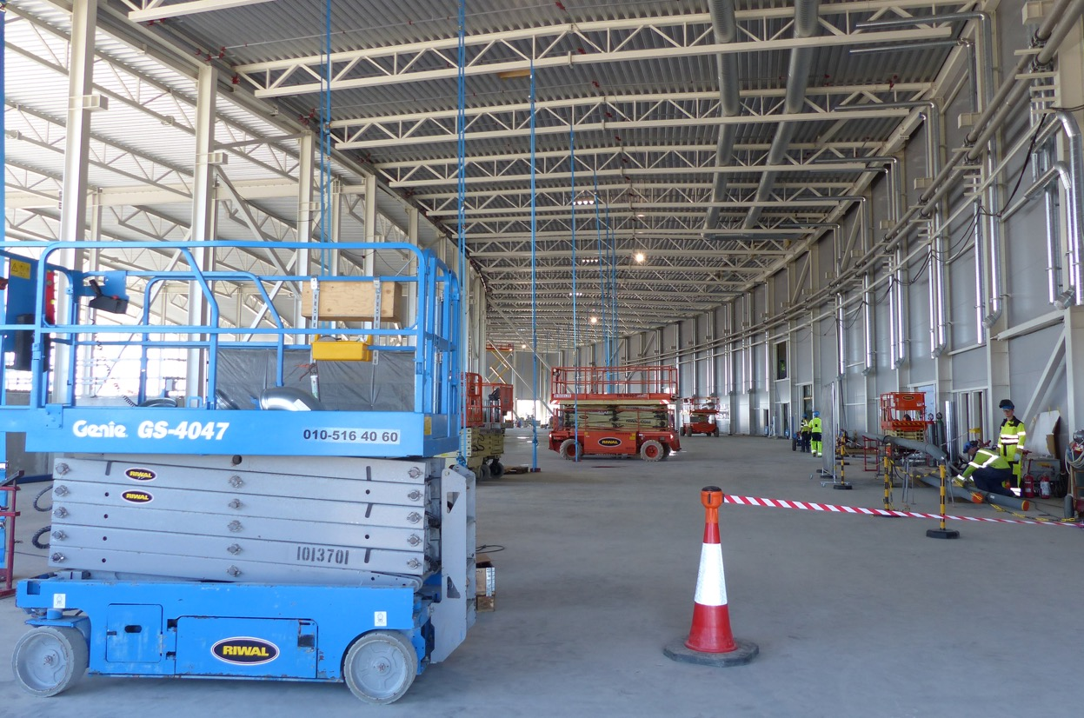
E-buildings E01 MEP installation works

Slide 26
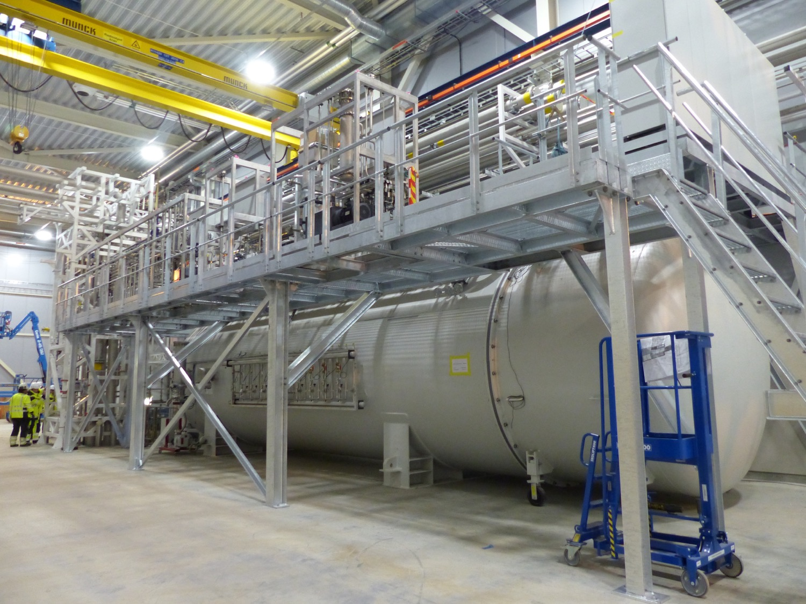
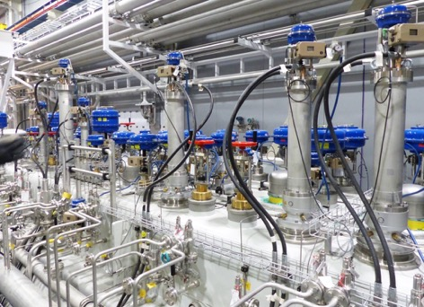
Klystron Gallery Coldbox

Slide 27
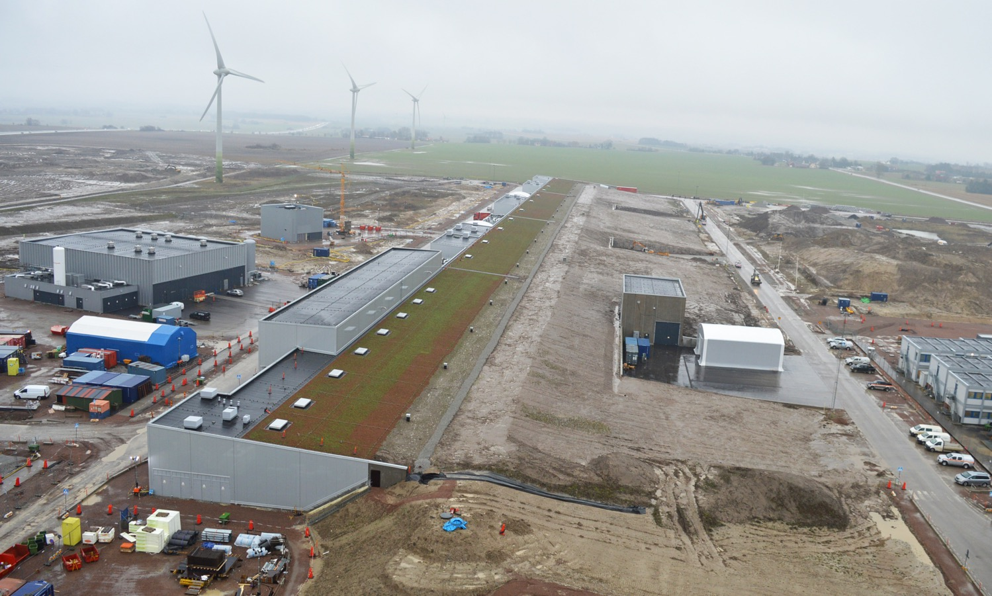
Accelerator & Klystron Gallery

Slide 28
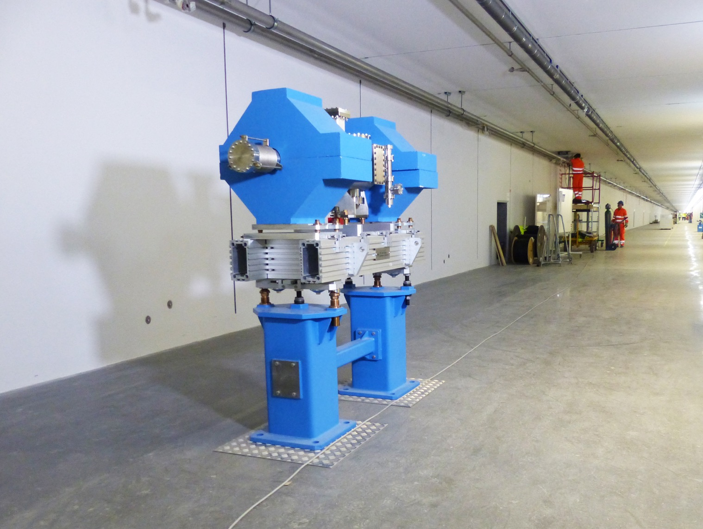
Accelerator Warm Linac Unit Prototype

Slide 29
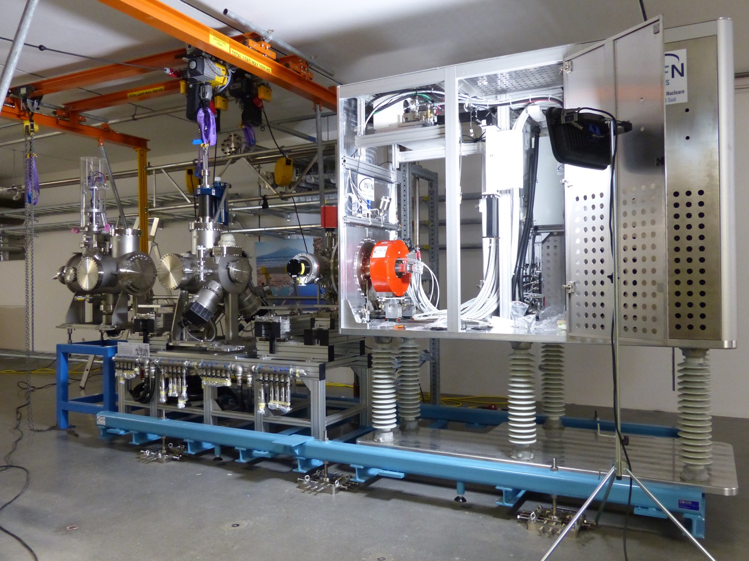
Ion source & LEBT installation

Slide 30
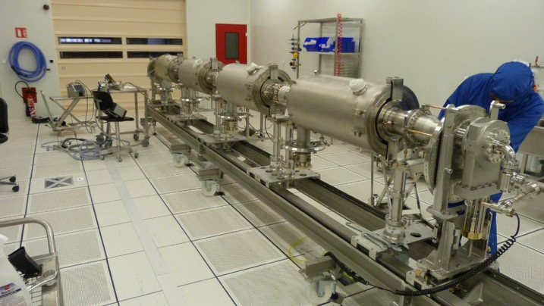
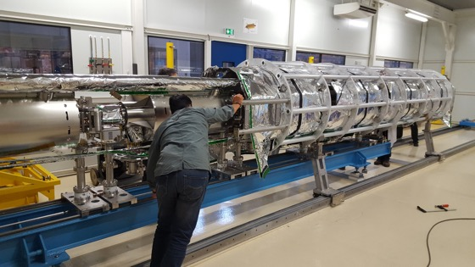
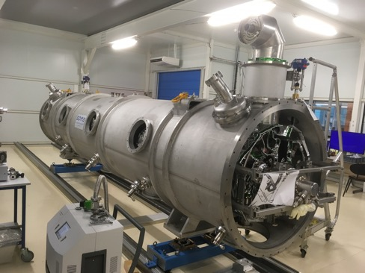
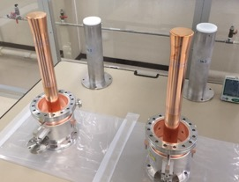
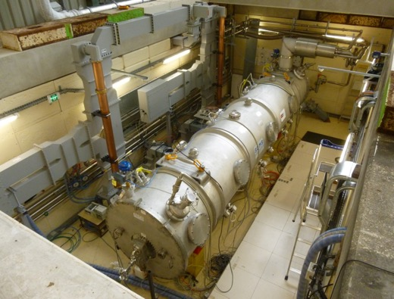
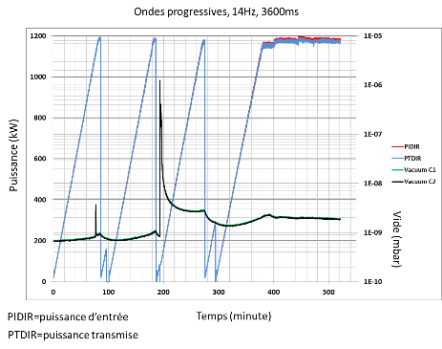
CEA – MB Prototype Cryomodule
March 2017
May 2017
July 2017
Assembly in ISO4 CEA CR
4 medium β 6 cell elliptical SRF cavities (1 LASA/3 CEA)
Cooldown at CEA test stand in Sept 2017
No RF operation due to accidental rupture of coupler ceramic
10 couplers at nominal specs

Slide 31
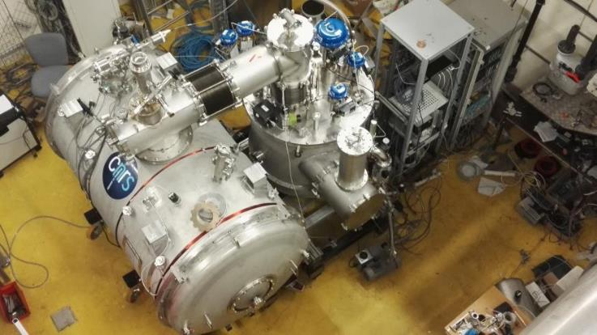
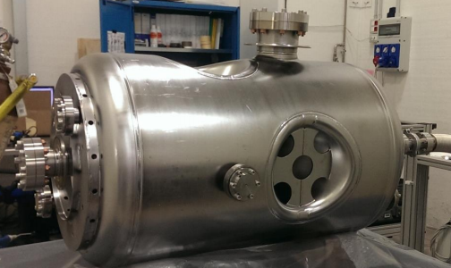
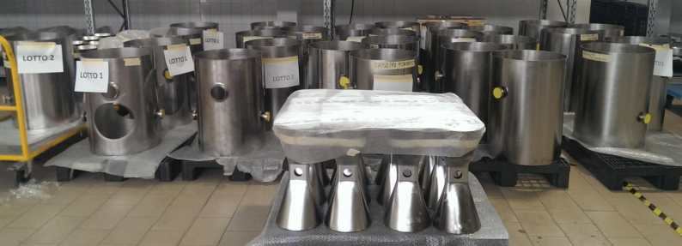
Spoke components (CNRS – IPNO)
C.13.05.b
Proto Cryomodule and Valve Box in final cryo validation stages at IPNO
Assemble with 2 cavities
@ FREIA in May RF High Power
Series cavities fabrication
In full swing (but power coupler and vacuum vessels in critical path)
First 4 cavities at IPNO May, then test and release of full series

Slide 32
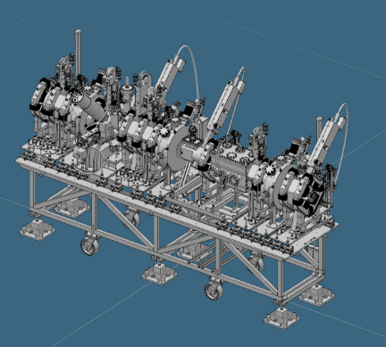
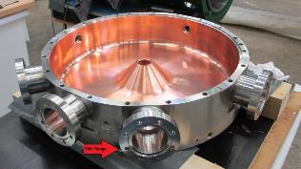
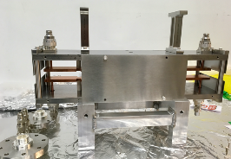
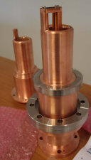
MEBT (ESS-Bilbao)
C.13.05.b
Quadrupoles 11
Buncher cavities 3
Scrapers 2 (+2)
Choppers 1
Total length 3.8 m
Several types of beam instrumentation
Quadrupole #1 under FAT at Danfysik, front view
Side view
Buncher cavity copper-plated at GSI
Chopper
3D model of MEBT
Power couplers for buncher cavity

Slide 33
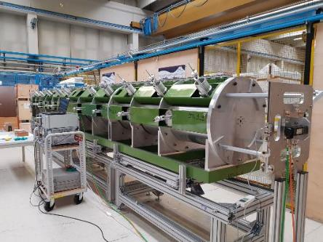
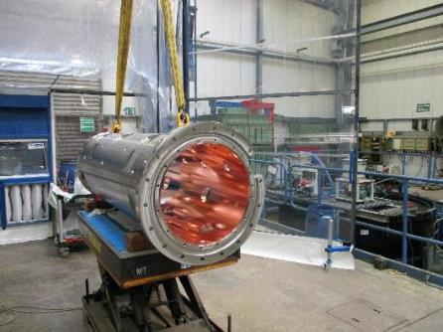
DTL (INFN – Legnaro)
C.13.05.b
Main parameters
Input energy 3.6 MeV
Output energy 90 MeV
Number of tanks 5
Sections per tank 4
Length 39 m
Weight 34 tons
Mock-up of tank, for bead-pull tests etc.
DTL schedule
Tank # | BPM's ready | DT EB welded (except BPM) | DT RFI (BPM's included) | RFI (forecast)
T4 | 2018-09-30 | 2018-06-30 | 2018-11-30 | 2019-01-01
T1 | 2018-09-30 | 2018-07-31 | 2018-11-30 | 2019-02-10
T3 | 2018-09-30 | 2018-09-30 | 2019-01-10 | 2019-03-15
T2 | 2018-09-30 | 2019-05-30 | 2019-05-30 | 2019-06-05
T5 | 2018-09-30 | 2019-05-30 | 2019-05-30 | 2019-09-30
Copper plated tank section #4-1 at GSI

Slide 34
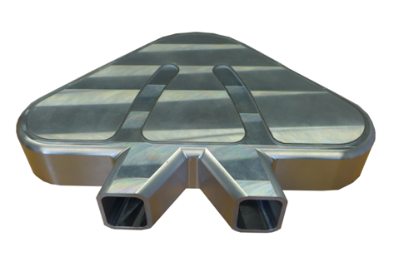
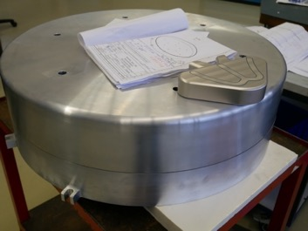
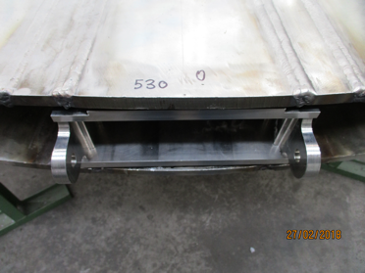
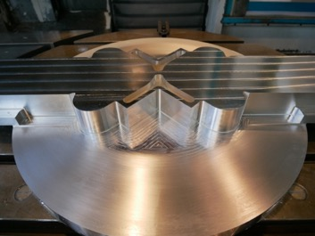
Target components are in construction
C.13.05.b
Cryogenic moderator prototype
Target moderator cryoplant coldbox
Reflector Vessel & Cold Moderator
Tungsten cassette in target wheel prototype
34
Thermal Moderator

Slide 35
Rebaselined ESS schedule
2018
2019
2020
2021
2022
2023
2024
2025
BOT
SOUP
Warm LINAC Commissioning Steps
EOC
1.3 GeV Capability Installed
Accelerator + ICS
Hi-Beta Install
Beam on Dump
(570 MeV)
Accelerator RBOT
Accelerator Schedule Float to BOT
CF + Target + NSS (Bunker+TBL) + ICS
Bunker and Test Beam Line RBOT
Access for Monolith Installation
Target RBOT
15th Instrument Complete (Ready for hot commissioning)
NSS Instruments + ICS
Instrument Hall Access for Start of Installation
Start beam commissioning for 1st Instruments
SOUP

Slide 36
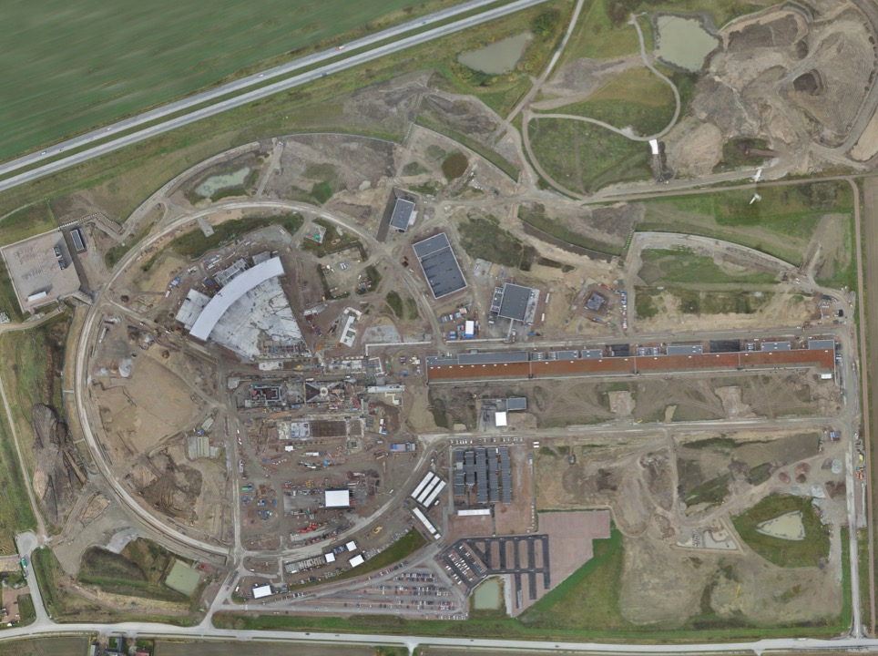
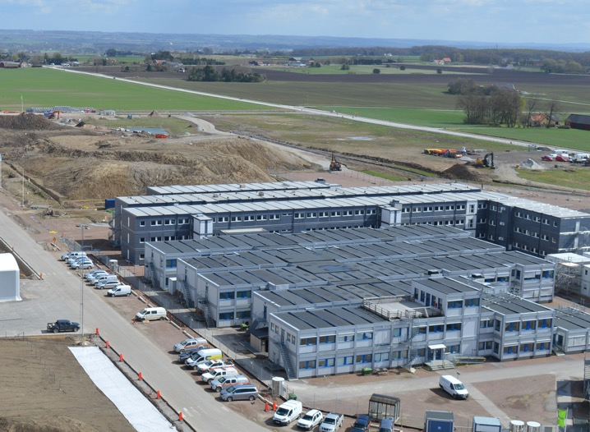
Permanent
Office Campus
2021
New 2018 ESS offices for all staff
New Bus Stop
Lund Tramway Depot

Slide 37
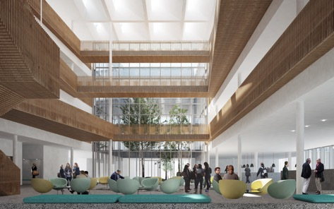
Campus
Offices, auditorium canteen
Labs and Workshops
Signed construction and financing agreements in February
Now in detailed design before target cost is agreed
Cost of the lease is included in the operations costs
Entrance Building

Slide 38
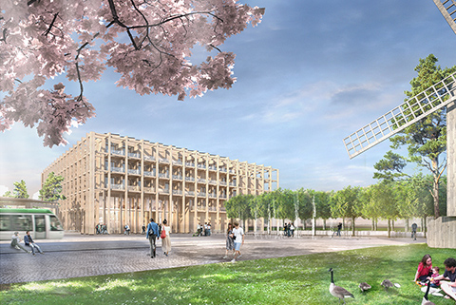
SPACE Building: Reception, exhibition space, guest house for MAX IV and ESS (~100 rooms), office and meeting space, restaurant
Tramway to Lund C station

Slide 39
Funding decisions in 2018
AFC.07
Budget Plan 19/20 (R)
Indicative Plan 21-25 (I)
Construction Budget 2019 (I)
Schedule Review
8 Feb
10-11 Apr
Focus on re-baselining
Will mostly impact indicative plan 21-25
Council.12
Workshop
Budget plan 19/20 (I)
Indicative plan 21-25 (I)
High-Level Document (D)
Sharing Policy (D)
22-24 May
Council.14
Constr. budget 2019 (A)
Init ops budget 2019 (A)
Indicative plan 2021-2025 (A)
Commitments from Members for 2021-2025
Commitments from Members to completion of construction
Council.13
4-5 June
Budget Plan 19/20 (A)
Indicative Plan 21-25 (I)
Commitments from Members for 2019/20 initial ops funding
AFC.08
Constr. budget 2019 (R)
Init ops budget 2019 (R)
Indicative planning 2021-2025 (R)
Annual Review
Sep
Project review
30-31 Oct
3-4 Dec

Slide 40
ESS shows how European nations can work together to invest in scientific and technical innovation
ESS is on track to deliver first science in 2023
Research at ESS will address pressing issues for energy, healthcare, the economy and the environment

Slide 41
Thank you!
@johnwomersley europeanspallationsource.se

