Slide 1

ARiES Progress Report
for the TIARA Meeting
M. Vretenar, CERN
Lund, 25 May 2018
Notes:
Why do we need ARIES

Slide 2
Scientific Advisory Committee
 | First choice | Status | Comments
Europe | Pantaleo Raimondi (ESRF) | Accepted, 11.10.2017 | Cannot be present to the 1st Annual Meeting
Asia | Akira Yamamoto (KEK) | Accepted, May 17
America | Lia Merminga (SLAC – now FNAL) | Accepted, 25.8.2017 | Moved to FNAL - announced at last moment that cannot be present at Annual Meeting – considering stepping down
 | Tor Raubenheimer (SLAC) | Accepted, 12.05.2018 | Nominated by GB at 2018 Meeting

Slide 3
Industry Advisory Board
Country | Company | Person
France | SigmaPhi/PIGES | J.L. Lancelot
Spain | Elytt | J. Lucas
UK | Elekta | J. Allen
Scandinavia | GE | T. Eriksson
Germany | Research Instruments | M. Peiniger
(int.) | Int. Irradiation Ass. | F. Martin

Slide 4
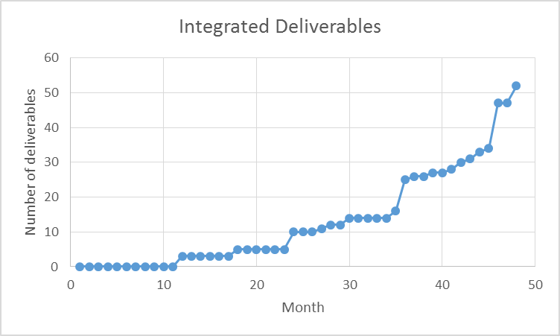
Status of Deliverables
3 Deliverables due at end Y1 (M12, end April 2018)
2 submitted on schedule,
1 delayed by 2 months to write the report after the end of data collection at M12.
D14.1 | Set-up of the Proof-of-Concept innovation-funding scheme | WP14 | Submitted
D15.1 | Evaluation of cleaning process | WP15 | Received, will be submitted end June
D17.1 | Material characterization | WP17 | Submitted
The delay was agreed with the EC Scientific Officer (max. 2 months!)
52 Deliverables over the project duration

Slide 5
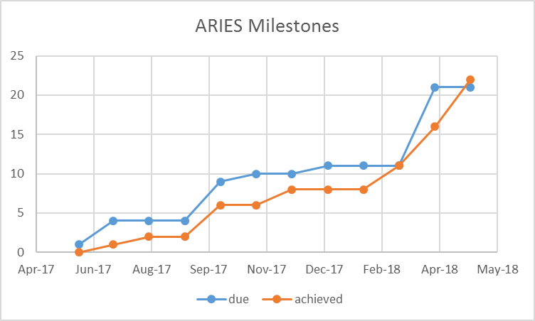
Status of Milestones
MS1 | Kick-off meeting | WP1 | 1.1 | M2 | Jun-17 | 03/07/2017
MS2 | Kick-off Meeting of ARIES-TIARA working-group | WP1 | 1.3 | M3 | Jul-17 | 28/03/2018
MS22 | EuroNNAC3 Kick-Off Meeting | WP5 | 5.1 | M3 | Jul-17 | 22/12/2017
MS49 | Organisation of WP-15 kick-off meeting | WP15 | 15.1 | M3 | Jul-17 | 30/08/2017
MS3 | Forming all official bodies required by the governance | WP1 | 1.1 | M6 | Oct-17 | 29/03/2018
MS10 | Project website launched | WP2 | 2.2 | M6 | Oct-17 | 20/10/2017
MS50 | First sample substrates cleaned at INFN for depositing at partners | WP15 | 15.2 | M6 | Oct-17 | 20/10/2017
MS58 | Organisation of PowerMat kick-off meeting | WP17 | 17.1 | M6 | Oct-17 | 20/10/2017
MS63 | Setup simulation framework for acceleration and radiation generation in wakefields driven by lasers with orbital angular momentum | WP18 | 18.3 | M6 | Oct-17 | 20/10/2017
MS17 | Contribute to Workshop on Energy for Sustainable Science | WP4 | 4.1 | M7 | Nov-17 | 22/12/2017
MS33 | First general workshop of the RULE network | WP7 | 7.1 | M9 | Jan-18 | 28/03/2018
MS4 | 1st Annual Meeting | WP1 | 1.1 | M12 | Apr-18
MS11 | Meeting to agree MOOC platform and academic structure and content of e-learning course | WP2 | 2.4 | M12 | Apr-18 | 08/05/2018
MS13 | Current applications of e-beam accelerators up to 10 MeV | WP3 | 3.2 | M12 | Apr-18 | 26/04/2018
MS23 | EAAC and Yearly Meeting EuroNNAc3 I | WP5 | 5.4 | M12 | Apr-18 | 26/04/2018
MS26 | Report on 1st Annual workshops of all tasks | WP6 | 6.1 | M12 | Apr-18 | 16/05/2018
MS34 | First topical meeting of the RULE network: injector | WP7 | 7.2 | M12 | Apr-18 | 16/05/2018
MS39 | Report on 1st Annual workshops of all tasks | WP8 | 8.1 | M12 | Apr-18 | 18/05/2018
MS42 | Appointing of an Industrial Advisory Board, (IAB) | WP14 | 14.3 | M12 | Apr-18 | 09/04/2018
MS47 | Reviewed requirements document | WP14 | 14.6 | M12 | Apr-18 | 18/04/2018
MS64 | Setup of experimental facilities for laser wakefield acceleration experiments using laser drivers with orbital angular momentum | WP18 | 18.3 | M12 | Apr-18 | 30/04/2018
21 Milestones due in Year 1
All achieved
One milestone of Y2 already delivered, two months in advance.
Some intial delays but all contributors made an effort to complete the April milestones in time for the Annual Meeting.
66 Milestones in total, 44 left.

Slide 6
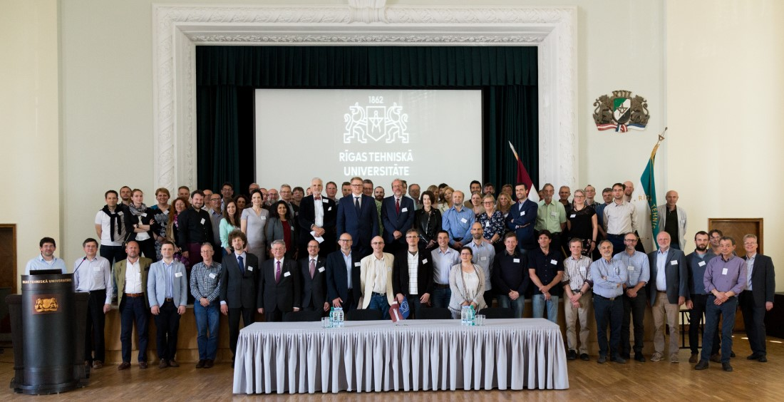
Meetings
Kick-off meeting at CERN, 4-5 May 2017
4 Steering Committee Meetings (May-September-December-March), 2 by video and 2 face-to-face at CERN.
2018 Annual Meeting in Riga, 23-25 May, organised by Riga Technical University.
2019 Annual Meeting: will be organised by the Wigner Institute in Budapest, 8-12 April

Slide 7

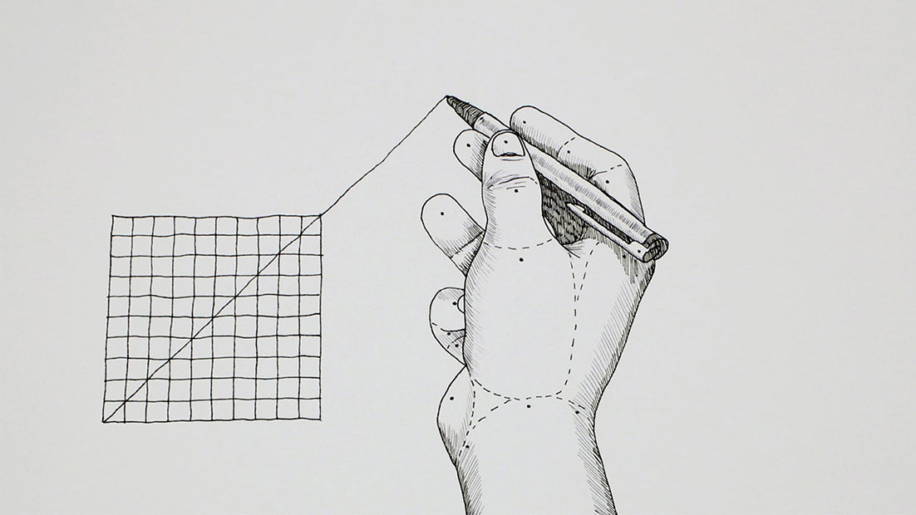
Highlights from 1st Annual Meeting
Usual blend of summary talks from Workpackages and highlight talks on specific subjects
Administrative issues were presented at the Governing Board meeting before the plenary sessions – this leaves time to concentrate WP presentations on science.
External presentations: SEEIIST initiative (N. Sammut), BELA at ITEP Moscow (T. Kulevoy)
Special session on Friday 25th morning:
The gamma factory, Mieczyslaw Krasny
The muon collider, Manuela Boscolo
The advanced linear collider study group, Patric Muggli
extrapolation
versus

Slide 8

Proof-of-Concept Fund
Call for projets to study, develop and establish the commercial feasibility of novel concepts within accelerator science.
10 excellent proposals submitted at the end of March deadline.
An Evaluation Committee organised by M. Losasso (7 members from ARIES industries or IAB) analysed the 9 proposals submitted on time and selected for funding (50 kEUR each the following projects (with score):
1 2 3 Tot.
RTU
RHP
CEA
U.Liv.
Extremely successful in terms of quality of proposals and of selection procedure

Slide 9
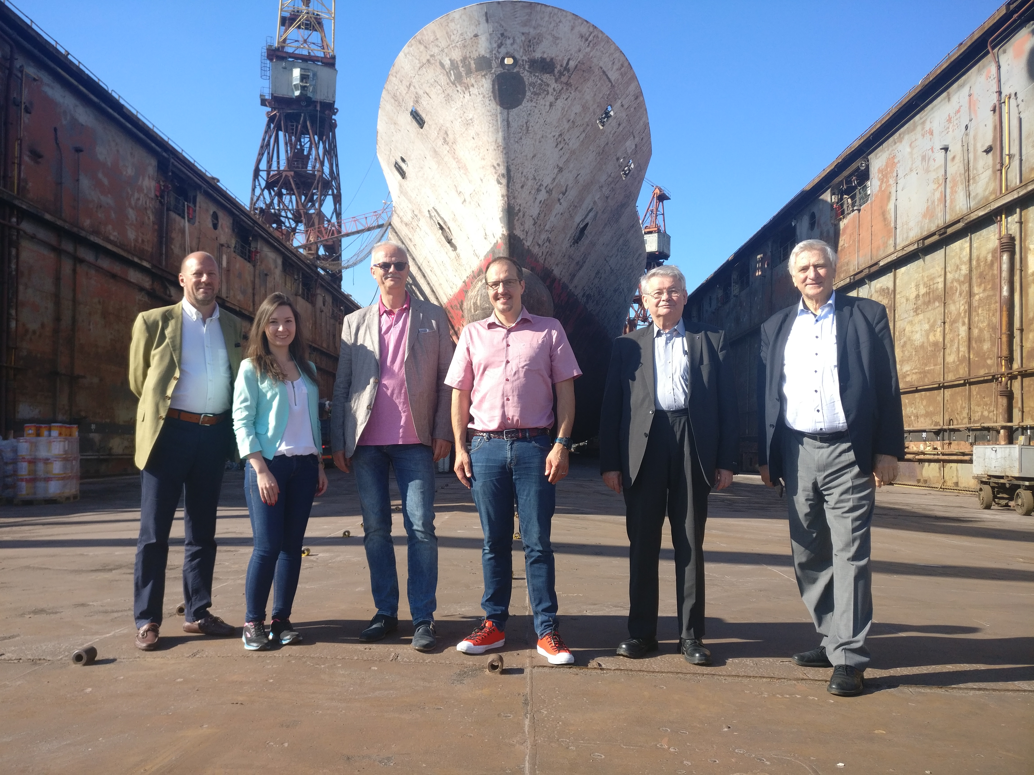
Hybrid electron accelerator system for treatment of marine diesel exhaust gas
1. Institute of Nuclear Chemistry and Technology - INCT (Warsaw, Poland)
2. CERN (Geneva, Switzerland)
3. Fraunhofer Institute - FEP (Dresden, Germany)
4. Univ. Huddersfield, Accelerator Applications Group – UH (Huddersfield, UK).
5. ebeam Technologies Europe – ebeam (Flamatt, Switzerland)
6. Remontowa Marine Design – Remontowa (Gdansk, Poland)
7. Milgravja Tehnoloģiskais Parks - Riga Ship Yard - RKB (Riga, Latvia)
8. BIOPOLINEX Sp. z o.o.(Lublin, Poland)
The Sulphur Day is on 1 January 2020
MARPOL Annex VI - the global sulphur cap will be reduced from current 3.50% to 0.50%
Economically viable solution is still not there
There is no working technology which can effectively deal with SOx and NOx at the same time
Goal: test and validate the system on a real diesel engine at the Riga shipyard, with an accelerator on loan from Ebeam Tech.
3

Slide 10
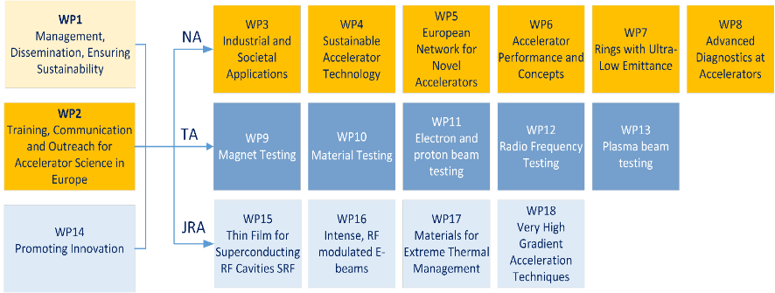
ARIES Structure - reminder
18 Workpackages:
8 Networks 5 Transnational Access, 5 Joint Research Activities.

Slide 11
Transnational Access after 1 year (/4)
WP9 – Magnet Testing CERN well in the forecasts, FREIA under construction
MagNet - CERN | User-projects |  |  | Users supported | Units of access (1 h)
 | Submitted | Selected | Supported
Year 1 (M1-M12) | 3 | 3 | 2 | 8 | 464
Foreseen for project (M1-M48) | 8 |  |  | 40 | 1,920
Gersemi – Uppsala Univ. | User-projects |  |  | Users supported | Units of access (1 h)
 | Submitted | Selected | Supported
Year 1 (M1-M12) | 0 | 0 | 0 | 0 | 0
Foreseen for project (M1-M48) | 8 |  |  | 56 | 2880
WP10 (TA) – Material Testing HiRadMat will stop end 2019, GSI is just restarting
HiRadMat - CERN | User-projects |  |  | Users supported | Units of access (1 h)
 | Submitted | Selected | Supported
Year 1 (M1-M12) | 6 | 6 | 5 | 36 (13*) | 600
Foreseen for project (M1-M48) | 5 |  |  | 20 | 200
* With financial support
M-branch - GSI | User-projects |  |  | Users supported | Units of access (1 h)
 | Submitted | Selected | Supported
Year 1 (M1-M12) | 0 | 0 | 0 | 0 | 0
Foreseen for project (M1-M48) | 8 |  |  | 48 | 480

Slide 12
Status of WP11 - elec. and proton beam testing
ANKA/KARA @ KIT: in operation and ready for TNA User requests
FLUTE @ KIT: in commissioning. First TNA Proposal in preparation
IPHI @ CEA: beam restarted as expected end of 2017. Two requests are being discussed (proton beam in September, neutrons beg. 2019)
SINBAD @ DESY: under installation, availability Spring 2019 confirmed
VELA @ STFC: delay in commissioning, beam will be available Q4 2018. Two groups preparing requests.
No access provided within ARIES yet
Open issues:
Delay in commissioning (FLUTE, VELA)
Difficulties to match requests and beam characteristics (IPHI)
Misunderstanding with KIT on the TNA management
Actions:
Advertisement at Conferences (Beam Instrumentation, Linac) and on web sites.
Contacts with KIT to solve the problem retroactively
Dynamic TNA access could help reduce pressure on WP11
Will revise situation at September SC meeting

Slide 13
WP11 – Beam Testing
ANKA – KIT** |  |  |  | Users supported | Units of access (1 h)
 | Submitted | Selected | Supported
Year 1 (M1-M12) | 0 | 0 | 0 | 0 | 0
Foreseen for project (M1-M48) | 8 |  |  | 64 | 480
FLUTE – KIT** |  |  |  | Users supported | Units of access (1 h)
 | Submitted | Selected | Supported
Year 1 (M1-M12) | 0 | 0 | 0 | 0 | 0
Foreseen for project (M1-M48) | 8 |  |  | 40 | 320
IPHI - CEA |  |  |  | Users supported | Units of access (1 h)
 | Submitted | Selected | Supported
Year 1 (M1-M12) | 0 | 0 | 0 | 0 | 0
Foreseen for project (M1-M48) | 12 |  |  | 72 | 1440
SINBAD - DESY |  |  |  | Users supported | Units of access (1 h)
 | Submitted | Selected | Supported
Year 1 (M1-M12) | 0 | 0 | 0 | 0 | 0
Foreseen for project (M1-M48) | 9 |  |  | 36 | 630
VELA – STFC** |  |  |  | Users supported | Units of access (1 h)
 | Submitted | Selected | Supported
Year 1 (M1-M12) | 0 | 0 | 0 | 0 | 0
Foreseen for project (M1-M48) | 14 |  |  | 56 | 336

Slide 14
WP12 – RF testing
HNOSS – Uppsala Univ. | User-projects |  |  | Users supported | Units of access (1 h)
 | Submitted | Selected | Supported
Year 1 (M1-M12) | 1 | 1 | 1 | 5 | 136
Foreseen for project (M1-M48) | 4 |  |  | 44 | 2880
Xbox - CERN | User-projects |  |  | Users supported | Units of access (1 h)
 | Submitted | Selected | Supported
Year 1 (M1-M12) | 1 | 1 | 1 | 6 (1*) | 80
Foreseen for project (M1-M48) | 4 |  |  | 64 | 6000
Still far from objectives for both facilities

Slide 15
WP13 – Plasma beam testing
One experiment campaign performed at UHI100 facility (CEA LIDYL)
Lund LULAL facility upgraded in 2017, ready to welcome users – but no news!
APOLLON facility has started commissioning process
Agreement: participation to commissioning of APOLLON will count as TNA experiment (machine experiments!).
APOLLON - CNRS | User-projects |  |  | Users supported | Units of access (1 h)
 | Submitted | Selected | Supported
Year 1 (M1-M12) | 0 | 0 | 0 | 0 | 0
Foreseen for project (M1-M48) | 6 |  |  | 48 | 180
LIDYL - CEA | User-projects |  |  | Users supported | Units of access (1 h)
 | Submitted | Selected | Supported
Year 1 (M1-M12) | 1 | 1 | 1 | 5 | 152
Foreseen for project (M1-M48) | 4 |  |  | 40 | 640
LULAL – ULUND** | User-projects |  |  | Users supported | Units of access (1 h)
 | Submitted | Selected | Supported
Year 1 (M1-M12) | 0 | 0 | 0 | 0 | 0
Foreseen for project (M1-M48) | 6 |  |  | 36 | 480

Slide 16
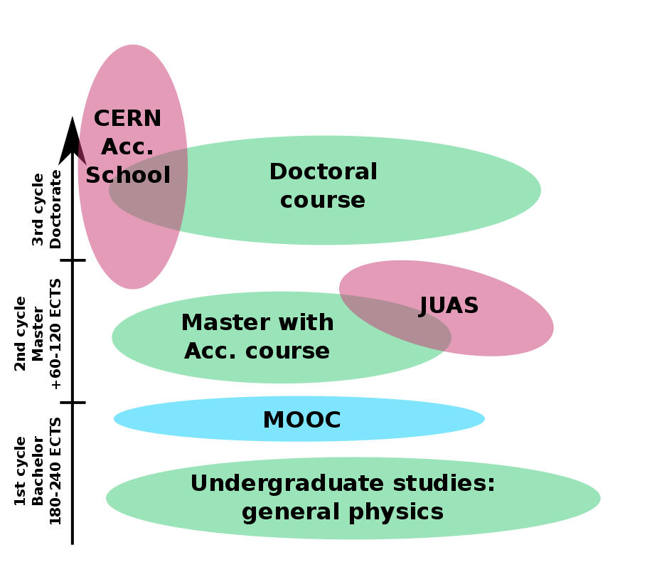
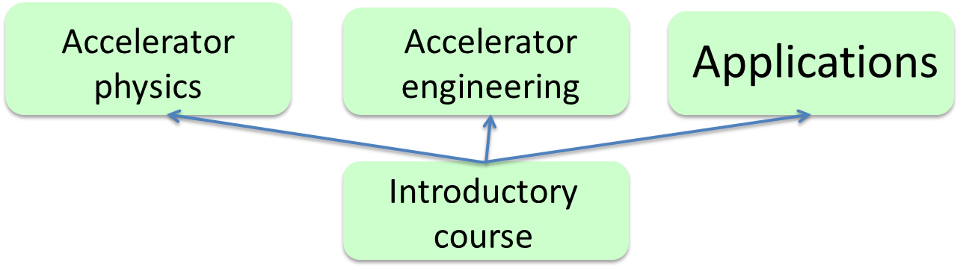
Highlights: Massive Online Open Course on Accelerator Science and Technology (N. Delerue)
Target: students at end of 1st cycle, before they go to JUAS or CAS (+outreach?)
Note: A MOOC is not a normal lecture. It can be watched “concept by concept” when students have time. Optimum duration of a “concept” 6-9 min, can be replayed several times.
4 modules for 10 hrs. total
will address the main recommendation from the TIARA education report.
The syllabus is defined.
Topics coordinators identified for the introductory courses.
Lecturers are being identified for the introductory courses.
Finding topics coordinators was more difficult than expected => if you know people who might be interested in coordinating one of the topics of the advanced modules, email (delerue@lal.in2p3.fr).
Strong interest at IPAC’18.
Project on schedule for a delivery before May 2020 (probably autumn 2019).

Slide 17
Highlights WP6 – Accelerator Performance & Concepts
Coordinator: F. Zimmermann (deputy: G. Franchetti)
In year 1, organized 11 workshops (T6.2: 5, T6.3: 2, T6.4: 1, T6.5: 2, T6.6:1);
total number of participants: 1046 (including the FCC week…);
7 refereed journal publications: 7 (PRL: 1, PRAB: 2, NIM A: 2, EPJ: 1, IOP: 1);
another 5 workshops already scheduled (T6.2: 1, T6.2/T6.3/6.4(joint): 1, T6.5: 1, T6.6: 2) ;
in addition outreach articles (e.g. Accelerating News: 2), seminars, and public events;
recruitments of postdocs/ESR underway (T6.3, T6.4, T6.6); other T6.3 work contracted (AIT);
focus on students and gender diversity;
Upcoming events:
ECLOUD’18, La Biodola, Italy, June (6.2, 6.4)
LHeC, FCC-eh, and PERLE Workshop, LAL Orsay, France, 27-29 June, 2018 (6.5)
Muon Collider workshop, Padova, 2-3 July 2018 (6.6)
Channeling Conference 2018, Ischia, 23-28 September 2018 (6.6)
eeFACT2018, Hong Kong 24-29 September 2018 (6.4)
ARIES ERL collaboration, Mainz, September 2018 (6.5)
Beam Quality Control, Impedances and Reliability in Hadron Storage Rings and Synchrotrons, Goethe University Frankfurt, December 2018 (6.2/6.3/6.4)
Gamma Factory mini-workshop, CERN, December 2018 (6.6)
Accelerator applications of crystals and nanotubes, jointly with ARIES WP17 (?), 2019 (6.6)
Gravitational waves and accelerators, 2020 (6.6)

Slide 18
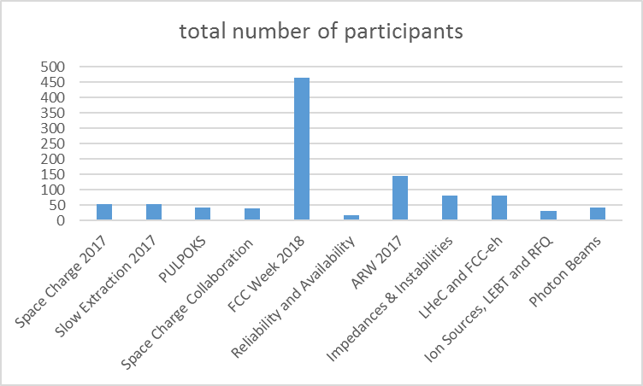
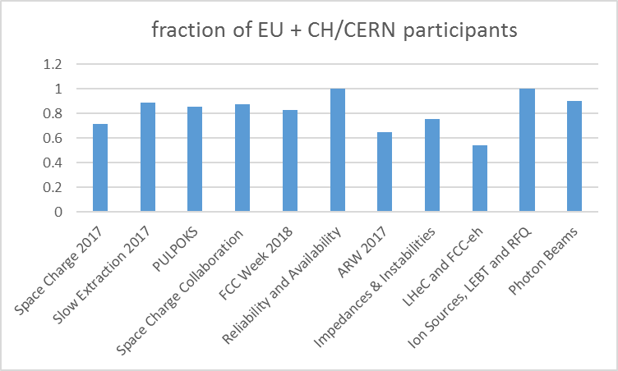
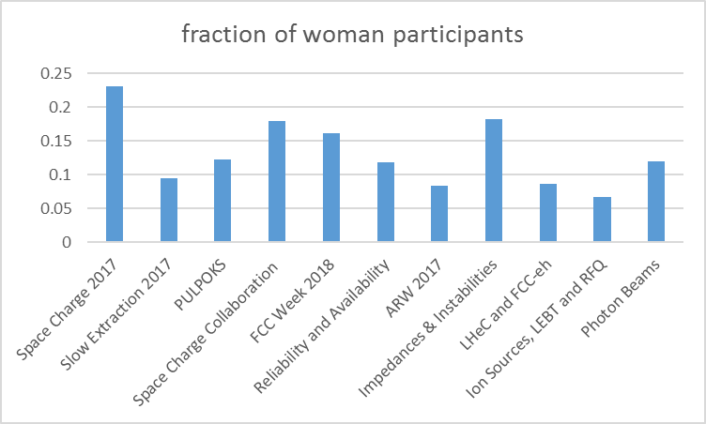
WP6 workshop statistics

Slide 19
Highlights WP7 – Ring for Ultra-Low Emittance
Three workshop have been organised in the first year
7th general workshop on low emittance rings
15-17 January 2018, at CERN
1st Topical Workshop on Injection and Injection Systems (TWIIS)
  27-30 August 2017, at Bessy, Berlin
Topical workshop on Diagnostics for Ultra Low Emittance Rings (TW-DULER)
  17-18 April, at Diamond, Oxford

Slide 20
Highlight WP8 – ADA (Advanced Diagnostics at Accelerators)
Organization of three dedicated Topical Workshops
Intense discussion on actual topics, about 35 participants each workshop
Exchange of personnel: 2 x 2 weeks to GSI and ALBA, one visit shifted due to visa problems
Further event in preparation concerning ‘Longitudinal Diagnostics at FELs’,
‘BPM technology and orbit feedback’ and ‘Commissioning of LINACs’
Date | Location | Title of workshop
22.-24.05.2017 | GSI Darmstadt | ARIES Topical Workshop on ‘Simulation, Design & Operation of Ionization Profile Monitors’
29-30.01.2018 | ALBA Barcelona | ARIES Topical Workshop on ‘Emittance Measurements for Light Sources and FELs’
14-16.05.2018 | CERN Geneva | ARIES Topical Workshop on ‘Extracting Information from electro-magnetic monitors in Hadron Accelerators’

Slide 21
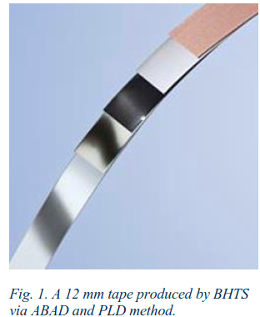
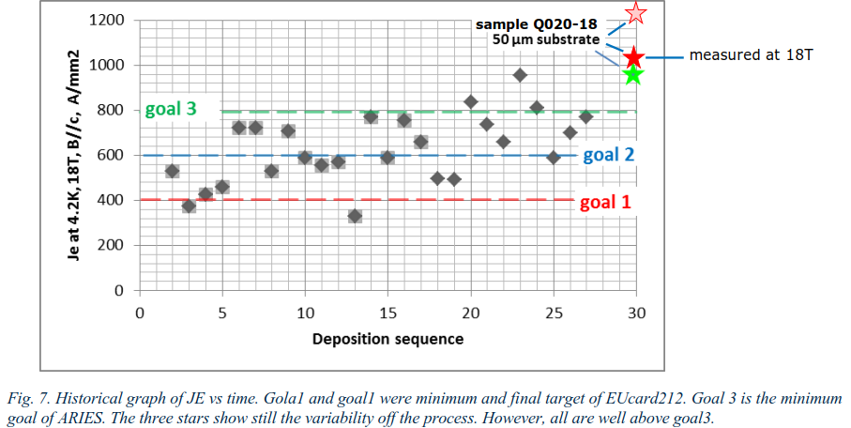
Highligths – HTS cable
First short HTS cable lengths produced with the new deposition technique and tested
System developed for EuCARD2 reviewed and adapted to manufacture HTS coated conductor depositing REBCO on a 50 μm thick substrate, half the previous thickness of 100 μm. Thin stainless tape is an absolute novelty in the panorama of coated conductor. BHTS has adopted the equipment and the process and has obtained tapes with record current density. Issue of the bi-directional bending (bi-stable effect) has been solved.
In more than one short length values of 900-1200 A/mm2 at 4.2 K , 18-20 T have been obtained, well above the ARIES minimum target value of 800 A/mm2.

Slide 22
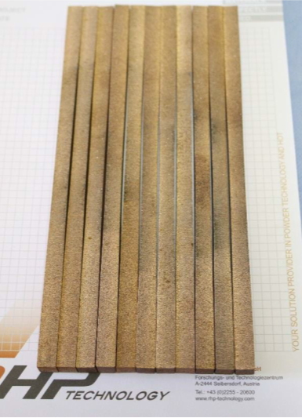
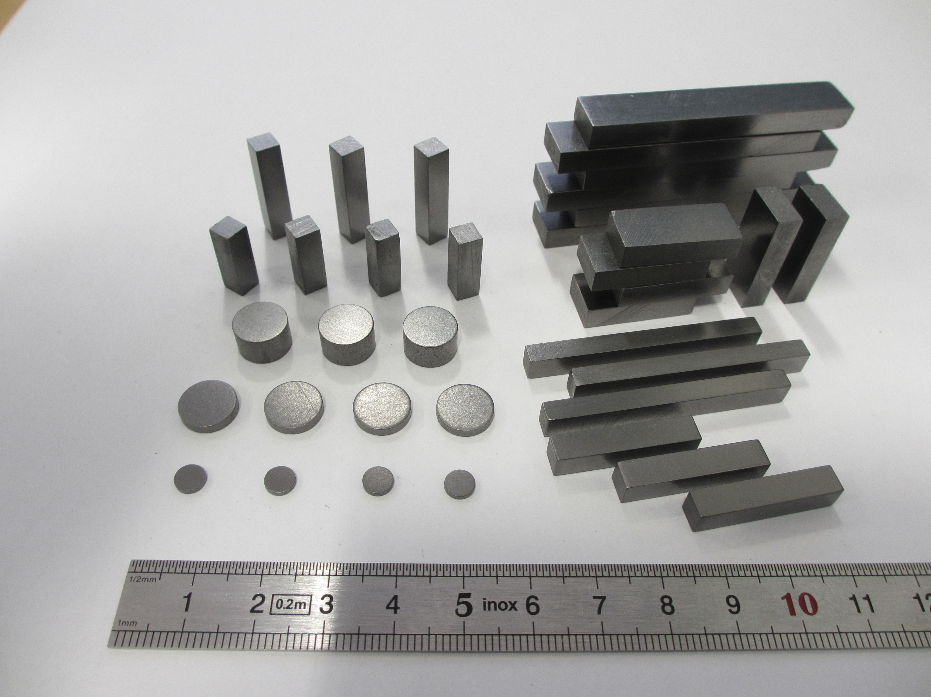
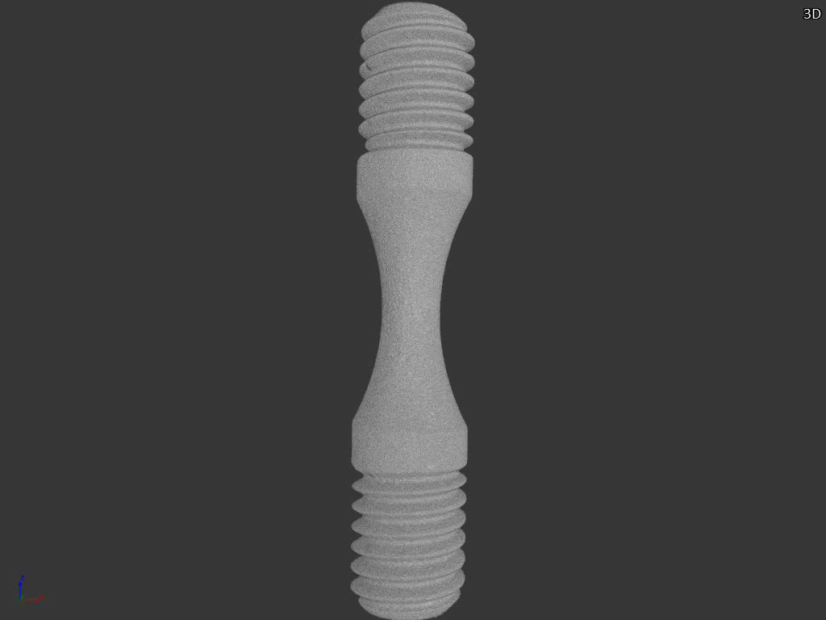
WP14.4 highlights
1st year dedicated to the production of components for D14.3 (due by M24, but anticipated by 1 year to match WP17 milestones and deliverables)
Production at RHP and Brevetti Bizz included:
  25 threaded MoGr samples for dynamic tests at Politecnico di Torino
  35 CrGr specimens for characterization at CERN MechLab
  10 CuCD rods installed in HiRadMat (HRMT36 – Multimat)
  10 CuCD specimens for characterization at CERN MechLab
  10 metal-diamond samples for luminescence studies at GSI and CERN
CuCD rods for tests in HiRadMat
Also, start of the R&D at RHP for the MgB₂ deposition on metallic substrate
CrGr specimens for characterization at CERN

Slide 23
Highlights WP17 - PowerMat
Very good progress during Year 1.
Material characterization of a large palette of material completed, paving the way for future optimizations and improvements.
Successful 2-day workshop held in Turin, Italy, in November 2017, with participation of 30 people from a number of laboratories, universities and industries.
Comprehensive experiment (Multimat) successfully completed at CERN HiRadMat facility, also relying on Transnational Access.

Slide 24
WP18 – Very High Gradient Acceleration Techniques
Task 2 (2 stage injection):
Conceptual design of electron transport line completed, preferred version identified
Task 3 (exotic laser beams):
PIC simulations started. First test of creating Laguerre-Gaussian doughnut beams
Task4 (dielectric laser acceleration):
Hiring completed, simulation efforts continuing, design of experiment started
Task5 (spectral charge frontier):
theoretical study and benchmarking of injection schemes ongoing.

Slide 25

The ARIES word cloud
Wordcloud of the ARIES Proposal, 2015

