Slide 1
Update EuPRAXIA & ATHENA.
R. Brinkmann, DESY – TIARA meeting Lund, June 25/26
(brief summary, more comprehensive report can be given by Ralph Assmann at next meeting)

Slide 2
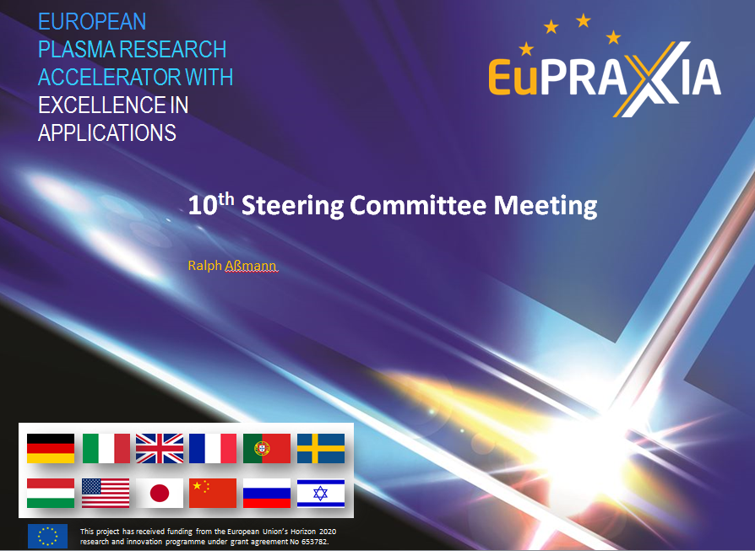
Selected slides from:
11 June 2018
Here: towards site proposal & task sharing

Slide 3
EuPRAXIA Concept: Competence View
Consortia address the relevant topics in design, construction and commissioning. Budget defined by responsibility...
Laser
Pisa, CNRS, CLF, ELI, FBI, ...
RF Tech
DESY, INFN, CERN, Daresbury, ...
FEL
SOLEIL, Roma, DESY, Daresbury, ...
Applica-tions
Oxford, CNRS, UB, Strathclyde, ...
Plasma
U. Paris, DESY, Oxford, ...
Theory/Sim
CEA, IST, DESY, INFN, HZDR, ...
Instrumen-tation
INFN, KIT, SOLEIL, DESY, ...
xxx
...
Not complete, just examples...
Insert author and occasion via slide master
3

Slide 4
EuPRAXIA Concept: Alternative Site View?
(Instead of several competing sites)
Define future approach now, reflecting national approaches?
CERN
X Band RF Technology (Compact Driver)
Italy
EuPRAXIA Site for beam-driven plasma acc.
Germany
EuPRAXIA Site for laser-driven plasma acc.
ELI
EuPRAXIA Turn Key User Technology
France
EuPRAXIA Center for Technology
Portugal
EuPRAXIA Center
for Theory & Plasma Simulation
Industry
European laser and accelerator Industry
UK
EuPRAXIA Center
for Industrial Applications
Possible?
Better ideas?
Insert author and occasion via slide master
4

Slide 5
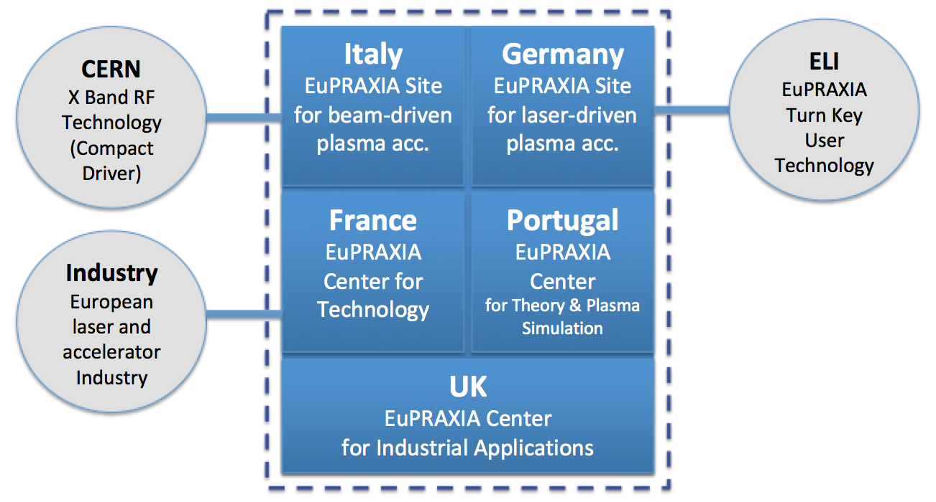
EuPRAXIA Concept: Alternative Site View?
Reflects ambitions known to us but integrates all into a common project.
Two sites reflect two driver technologies – minimal duplications due to common project work!
Use of existing sites use pre-invest and make sure OP costs are covered.
Very visible roles to France, Portugal and UK without the need to propose a site.
Connects to European industry, ELI and CERN.
Simplifies discussion of radiation protection, safety, ...: labs take care of it through existing structures.
Easy to explain to people not interested in technical details.
For discussion...
Insert author and occasion via slide master
5

Slide 6

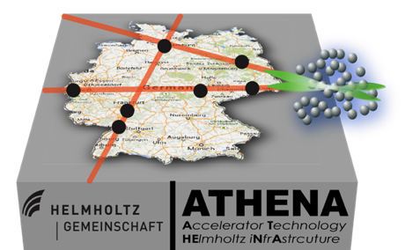
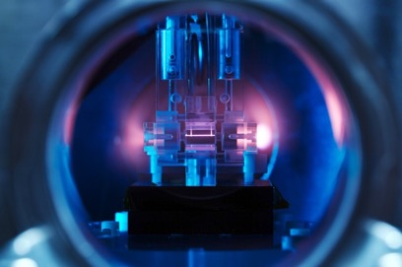
ATHENA project in Helmholtz Association
Accelerator Technology
HElmholtz INfrAstructure
On Helmholtz Roadmap since 2011 (DESY initiative), proposal by six Helmholtz centers (DESY, FZJ, GSI+HI-Jena, HZB, HZDR, KIT) submitted in 2015
Received “Outstanding” rating in evaluation
Some delay due to funding boundary conditions, but final approval (& start of funding) now confirmed by Helmholtz Senate on 12 June, 2018
30M€ total from Helmholtz investment programme 2018-21 (~11M€ → DESY)

Slide 7






30 M€ all ARD centers, 2 future technologies for the Helmholtz strategy
@DESY
@HZDR

Slide 8
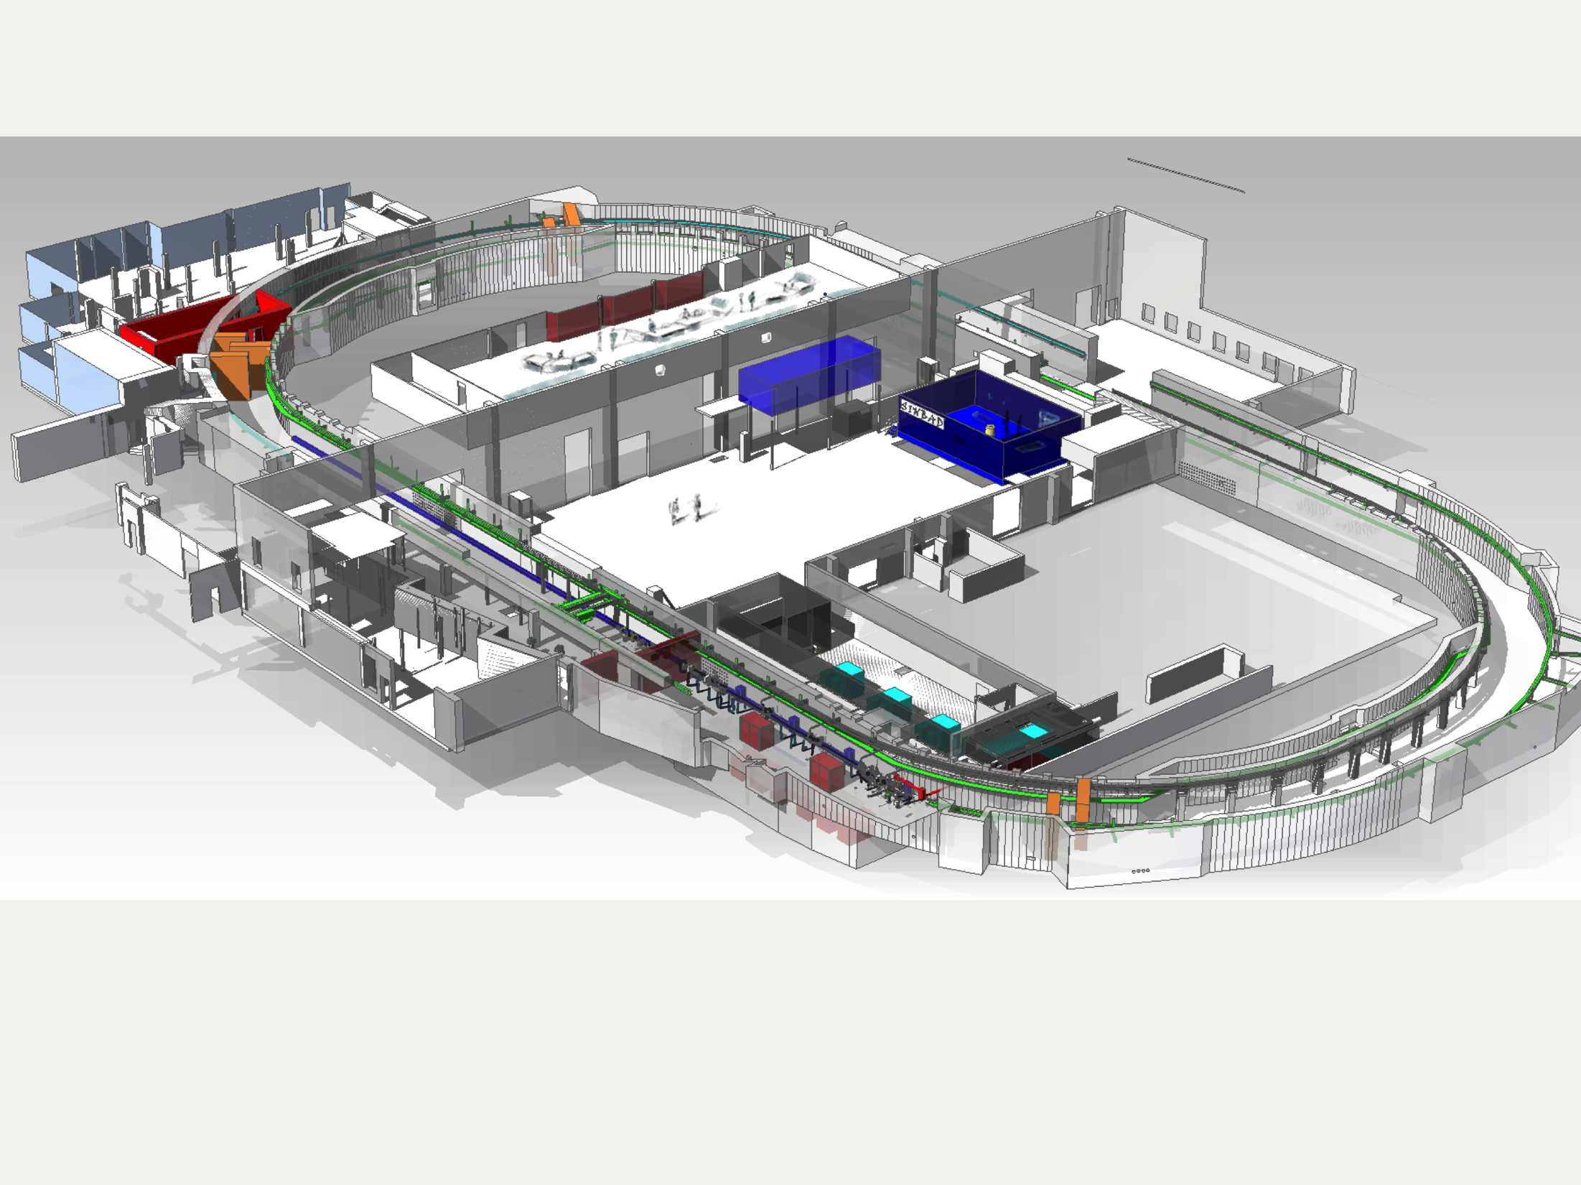

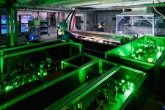
ATHENAe/DESY: integrated with SINBAD infrastructure
Short INnovative Bunches and Accelerators at DESY
Plasma accelerator with internal injection (LUX)
Undulators
Pilot user area
Plasma accelerator with external injection
Angus high power laser
ARES linac energy upgrade
Dogleg to 2nd experimental area
X-band TDS

Slide 9
Thank you for your attention!

