Slide 1
ESS RF SYSTEMS AND SPECIALISED POWER CONVERTERS
Anders Sunesson RF group leader
Contributions from the RF group (WP 8, Morten Jensen; WP 17, Carlos Martins)
Contributions from IK partners
TAC #17, April 12, 2018
www.europeanspallationsource.se

Slide 2

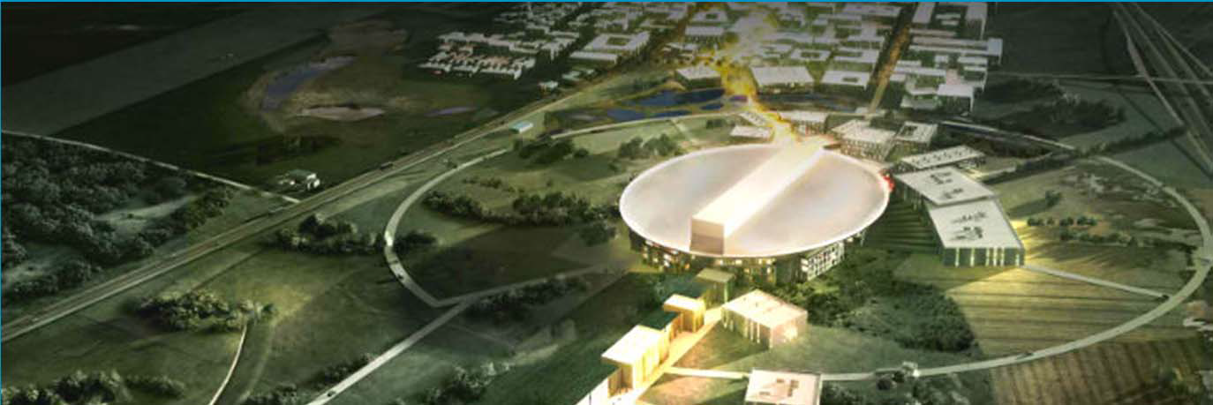



An artists impression of ESS

Slide 3
RF systems
Power to 155 cavities, one RF station/cavity
  High Voltage development: SML modulator topology (see presentation Carlos Martins after lunch)
  High Power RF Amplifier development: MB-IOT, aimed at high beta linac (see presentation Morten Jensen after lunch)
A large part of the RF systems is provided in collaboration with partners
      RF NC linac (ESS Bilbao, Spain)
      Spoke RF stations (Elettra, Italy)
      Interlock systems (ESS Bilbao, Spain; Elettra, Italy; ATM Atomki, Hungary)
      LLRF (ESS Bilbao, Spain and Polish Electronic Group, Poland)
      RF high power distribution (STFC and Huddersfield University, UK)
      Phase ref distribution (Warsaw University of Technology, Poland)
      Installation (IFJ PAN, Krakow, Poland)
Collaboration Lund Univ (test stand, LLRF) and Uppsala Univ (FREIA facility)

Slide 4
Rebaselining for accelerator
ESS is re-baselining the full project.
An internal review of the accelerator sub-project was held 16 March and the comments from this review are now being implemented for the external review in the end of May.
The proposed Ready for Beam On Target (RBOT) date is 24 May 2021 with Beam On Dump (BOD) at 570 MeV 8 February 2021.

Slide 5
Critical-Path for sub-project
The ACCSYS Critical Path to RBOT goes through four intermediate milestones.
The Ion Source to LEBT beam commissioning (June 2018) is not on the critical path, but an important transition to initial operations milestone.
ISrc to Beam Dump (BOD)
8/2/2021
ISrc to DTL1
ISrc to DTL4
RBOT
4/11/2019
27/4/2020
24/5/2021
2018
2019
2020
2021

Slide 6
ISrc to Beam Dump (BOD)
ISrc to DTL1
ISrc to DTL4
8/2/2021
RBOT
4/11/2019
27/4/2020
24/5/2021
2018
2019
2020
2021
2018
2021
17/12/18 - 12/07/19
RFQ + DTL 1 RF System
75 days
Today
15/07/19 - 26/07/19
PSS1 Validation
29/07/19 - 18/10/19
RFQ, MEBT, DTL1 RF Conditioning
10 days
21/10/19 - 01/11/19
SRR2
15 days
04/11/19 - 31/01/20
ISrc to DTL1 Beam Commissioning
150 days
27/05/19 - 31/01/20
Full NC Linac RF System
10 days
03/02/20 - 14/02/20
PSS1 Re-Validation
60 days
17/02/20 - 10/04/20
DTL2, 3, 4 RF Conditioning
10 days
13/04/20 - 24/04/20
SRR3
65 days
27/04/20 - 17/07/20
ISrc to DTL4 Beam Commissioning
180 days
20/07/20 - 21/08/20
DTL5 Installation
03/12/18 - 15/11/19
Elliptical CDS Installation
10 days
19/08/19 - 15/11/19
SPK CDS Installation
40 days
18/11/19 - 07/08/20
SPK CM Installation
10 days
18/11/19 - 01/06/20
MBL CM Installation
60 days
01/06/20 - 07/08/20
HBL CM Installation
25 days
12/08/19 - 13/12/19
HBL1 LWU Installation
65 days
16/12/19 - 27/03/20
A2T LWU Installation
120 days
30/03/20 - 19/06/20
MBL/HBL2 LWU Installation
290 days
22/06/20 - 14/08/20
SPK LWU Installation
290 days
17/08/20 - 25/09/20
Final HBL/SPK LWU Installation
250 days
12/08/19 - 25/09/20
SPK RF Power Stations
- PSS/SRR
28/09/20 - 16/10/20
Full PSS Validation
141 days
19/10/20 - 13/11/20
DTL5 and SC Linac - Warm RF Conditioning
50 days
- NC Linac
16/11/20 - 11/12/20
CDS and CMs Cooldown and Tests
15 days
- SC Linac, HEBT, A2T
14/12/20 - 22/01/21
SC Linac - Cold RF Conditioning
20 days
25/01/21 - 05/02/21
SRR4
20 days
- Beam Commissioning
08/02/21 - 07/05/21
ISrc to DMPL Beam Comm.
10 days
10/05/21 - 21/05/21
SRR5
75 days
20 days

Slide 7
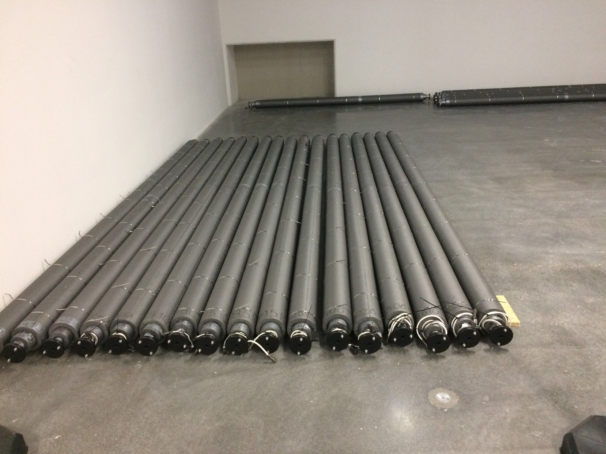
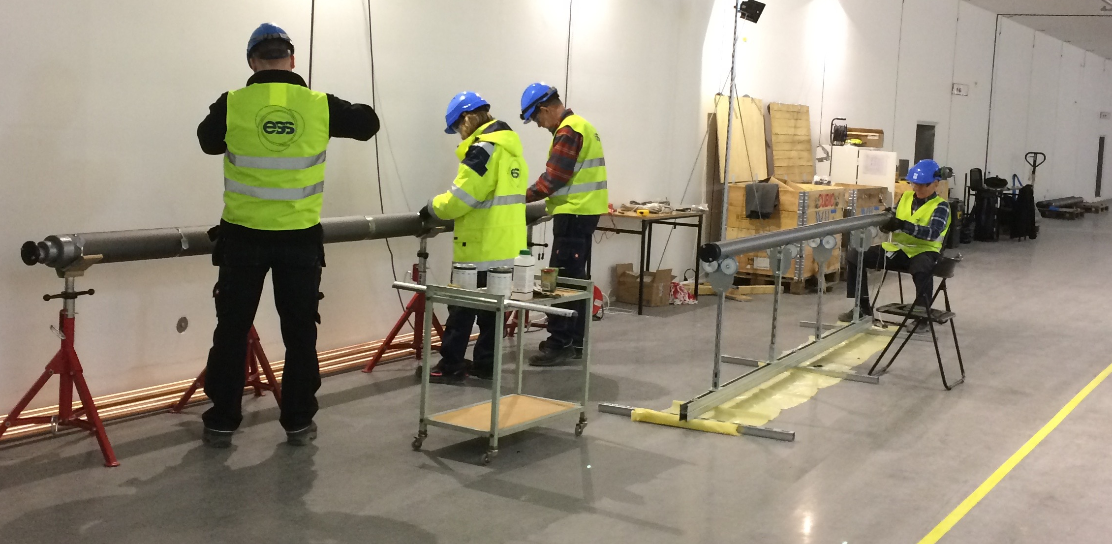
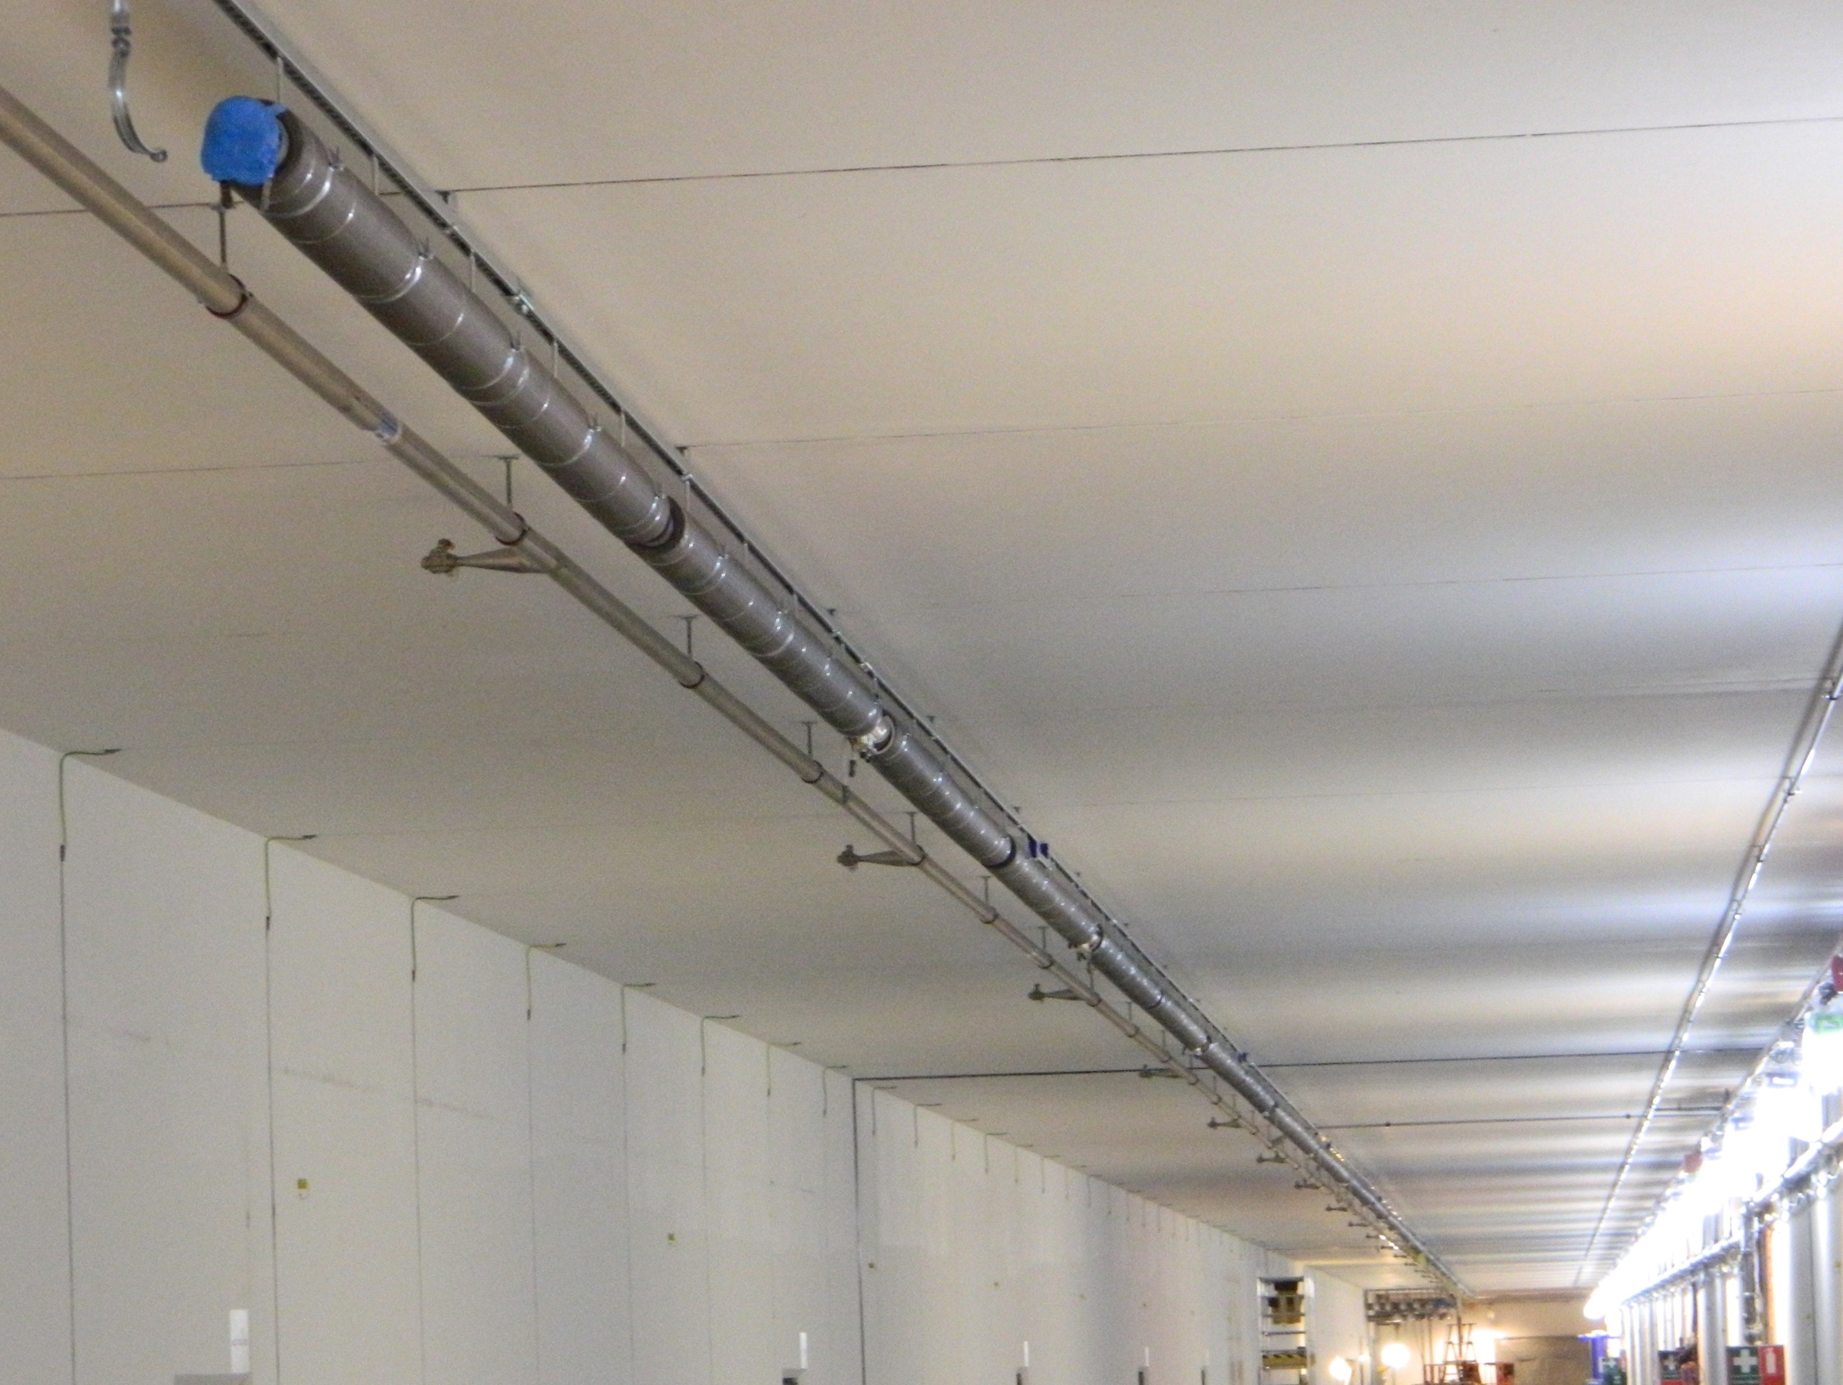
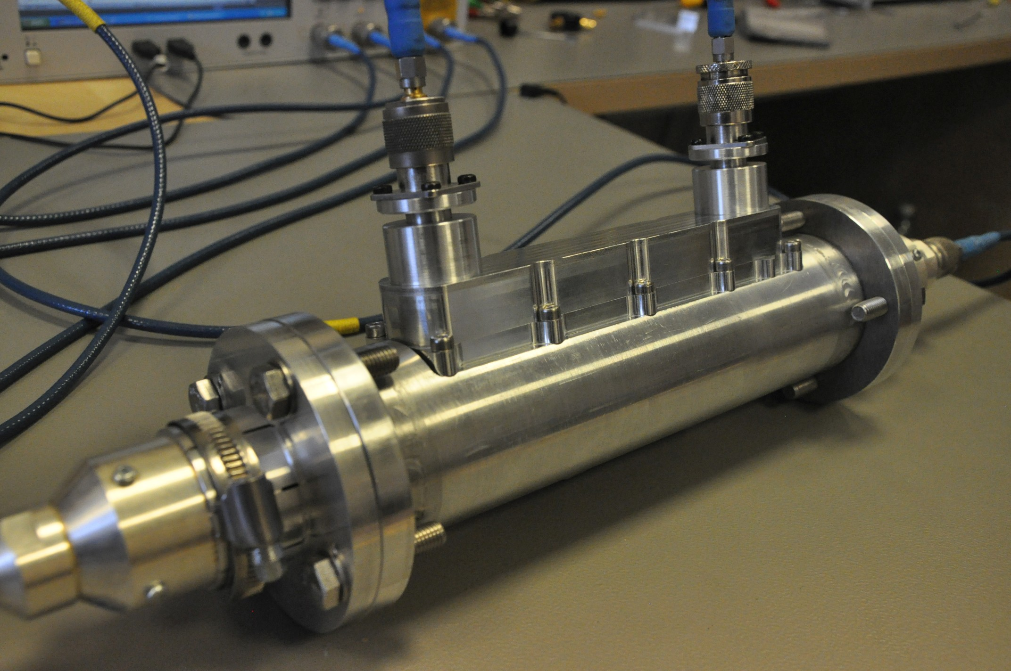
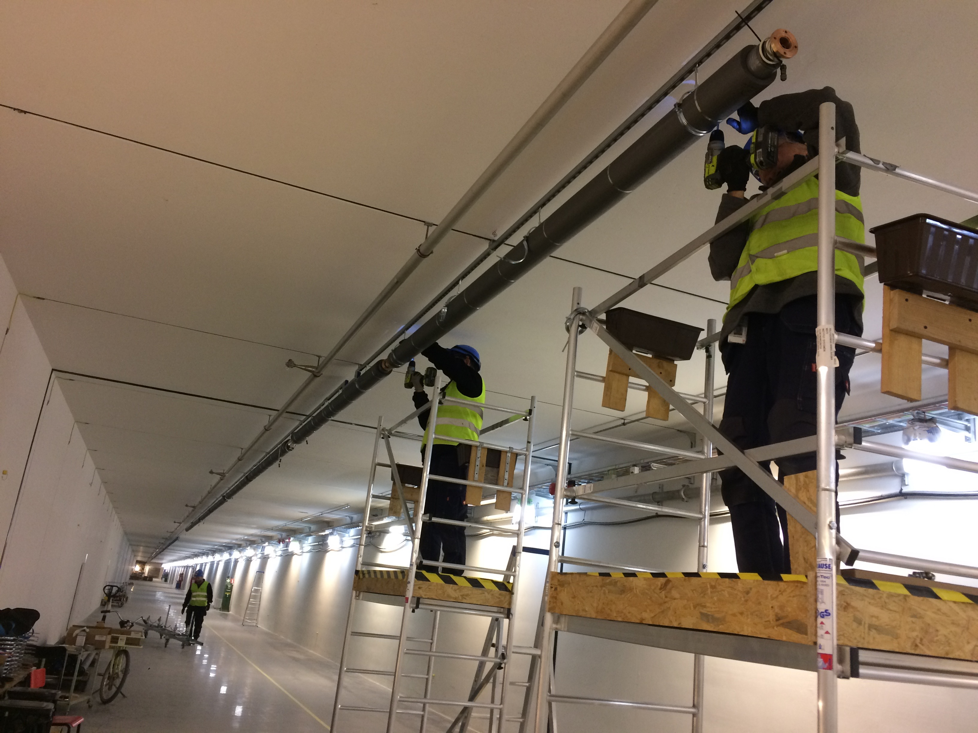
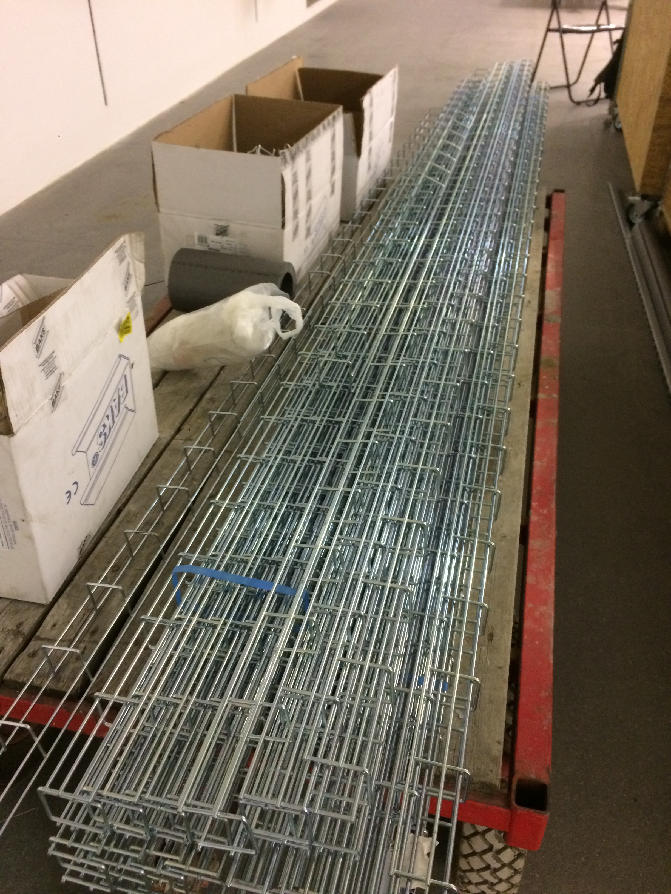
Highlights phase reference distribution
119 rigid line sections
heating cables,
Temperature sensors
thermal insulation jacket
Installation in Tunnel
Install hanging system
Assembly heating cables, temperature sensors, thermal insulation
Install rigid line sections and couplers
Install cable tray
Status today in tunnel
~500m PRL line installed from ion source to Dogleg
~100m PRL line remain to install this year from Dogleg to A2T
53 directional couplers
~500m-long cable tray

Slide 8
Thank you

