Slide 1
Tap Point story
Mateusz Żukociński
CDR meeting
Lund, 27.04.2018
Notes:
Hello everyone! My name is Tomasz Leśniak. I am working

Slide 2
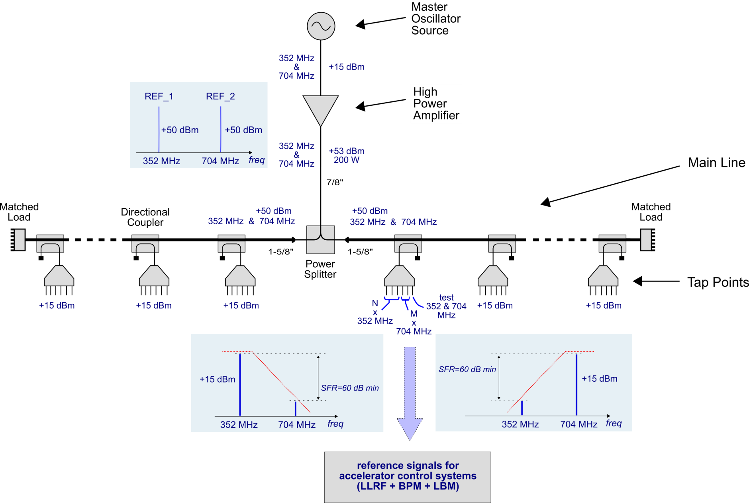
PRL RF system concept

Slide 3
PRL RF system concept
Tap Point

Slide 4
PRL RF system concept
Basic functionality of Tap Point:
RF signal end distribution & filtering
multichannel RF output module for reference signal selection

Slide 5
PRL RF system concept
Tap Point from system point of view:
local node for RF and temperature control system interconnection
thermal boundary conditioning
cabling and maintenance node

Slide 6
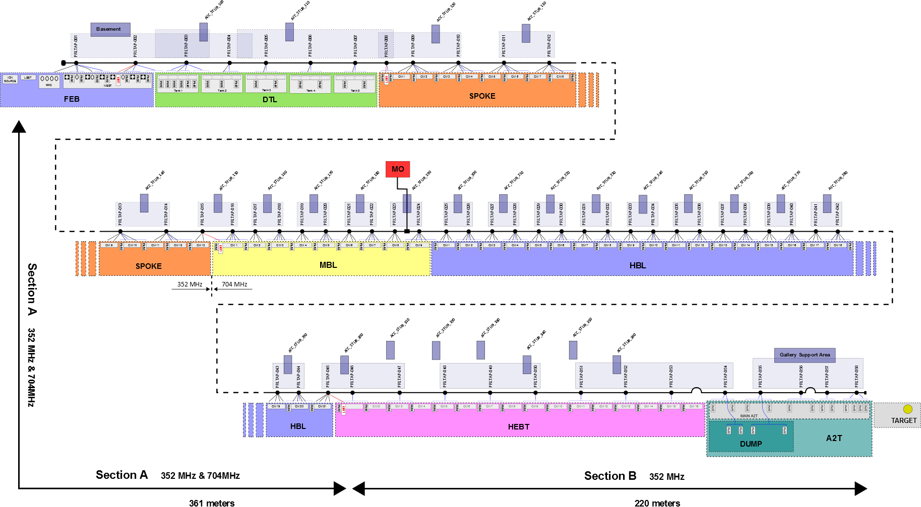
PRL layout

Slide 7
PRL layout

Slide 8
PRL layout
2 x versions of Tap Points:
          3-way Tap Point
          6-way Tap Point
many output configurations (requires modular design)

Slide 9
Tap Point requirements
Total number of Tap Points | x 58
Two frequency Tap Points | x 30
Single frequency Tap Points | x 28 (14 x 352 MHz & 14 x 704 MHz)
6-way Tap Points | x 36
3-way Tap Points | x 22
Total input power | ~+30 dBm (+27 dBm @ 352 MHz and +27 dBm @ 704 MHz) (with option to increase by 2-3 dB total depending on MO amplifier and final power budged of the PRL => up tp 33 dBm total)
Output power | ~+16 dBm @ 352 MHz and 704 MHz * (* providing as much power as possible (+16 dBm minimum) )
Unwanted signal suppression | > 60 dBc between 352 MHz and 704 MHz at each output

Slide 10
Tap Point configuration list
Tap Points | LLRF outputs | BPM outputs | LBM outputs | # 352MHz outputs | # 704MHz outputs | 2 x freq. | 1 x freq. | only 352MHz | only 704MHz | # total outputs used | version
PRLTAP-001 | 3 | 2 | 0 | 3 | 2 | 1 |  |  |  | 5 | 6-way
PRLTAP-002 | 1 | 2 | 1 | 2 | 2 | 1 |  |  |  | 4 | 6-way
PRLTAP-003 | 1 | 3 | 0 | 1 | 3 | 1 |  |  |  | 4 | 6-way
PRLTAP-004 | 1 | 1 | 0 | 1 | 1 | 1 |  |  |  | 2 | 3-way
PRLTAP-005 | 1 | 1 | 0 | 1 | 1 | 1 |  |  |  | 2 | 3-way
PRLTAP-006 | 1 | 1 | 0 | 1 | 1 | 1 |  |  |  | 2 | 3-way
PRLTAP-007 | 1 | 1 | 0 | 1 | 1 | 1 |  |  |  | 2 | 3-way
PRLTAP-008 | 0 | 1 | 1 | 1 | 1 | 1 |  |  |  | 2 | 3-way
PRLTAP-009 | 4 | 1 | 0 | 4 | 1 | 1 |  |  |  | 5 | 6-way
PRLTAP-010 | 4 | 1 | 0 | 4 | 1 | 1 |  |  |  | 5 | 6-way
PRLTAP-011 | 4 | 1 | 0 | 4 | 1 | 1 |  |  |  | 5 | 6-way
PRLTAP-012 | 4 | 1 | 0 | 4 | 1 | 1 |  |  |  | 5 | 6-way
PRLTAP-013 | 4 | 1 | 0 | 4 | 1 | 1 |  |  |  | 5 | 6-way
PRLTAP-014 | 4 | 1 | 0 | 4 | 1 | 1 |  |  |  | 5 | 6-way
PRLTAP-015 | 2 | 0 | 1 | 3 | 0 |  | 1 | 1 |  | 3 | 3-way
PRLTAP-016 | 4 | 1 | 0 | 1 | 4 | 1 |  |  |  | 5 | 6-way
PRLTAP-017 | 4 | 0 | 0 | 0 | 4 |  | 1 |  | 1 | 4 | 6-way
PRLTAP-018 | 4 | 1 | 0 | 1 | 4 | 1 |  |  |  | 5 | 6-way
PRLTAP-019 | 4 | 0 | 0 | 0 | 4 |  | 1 |  | 1 | 4 | 6-way
PRLTAP-056 | 0 | 1 | 0 | 1 | 0 |  | 1 | 1 |  | 1 | 3-way
PRLTAP-057 | 0 | 1 | 0 | 1 | 0 |  | 1 | 1 |  | 1 | 3-way
PRLTAP-058 | 0 | 2 | 0 | 2 | 0 |  | 1 | 1 |  | 2 | 3-way
total | 155 | 49 | 4 | 70 | 138 | 30 | 28 | 14 | 14 | 208

Slide 11
Tap Point configuration list
Tap Points | LLRF outputs | BPM outputs | LBM outputs | # 352MHz outputs | # 704MHz outputs | 2 x freq. | 1 x freq. | only 352MHz | only 704MHz | # total outputs used | version
PRLTAP-001 | 3 | 2 | 0 | 3 | 2 | 1 |  |  |  | 5 | 6-way
PRLTAP-002 | 1 | 2 | 1 | 2 | 2 | 1 |  |  |  | 4 | 6-way
PRLTAP-003 | 1 | 3 | 0 | 1 | 3 | 1 |  |  |  | 4 | 6-way
PRLTAP-004 | 1 | 1 | 0 | 1 | 1 | 1 |  |  |  | 2 | 3-way
PRLTAP-005 | 1 | 1 | 0 | 1 | 1 | 1 |  |  |  | 2 | 3-way
PRLTAP-006 | 1 | 1 | 0 | 1 | 1 | 1 |  |  |  | 2 | 3-way
PRLTAP-007 | 1 | 1 | 0 | 1 | 1 | 1 |  |  |  | 2 | 3-way
PRLTAP-008 | 0 | 1 | 1 | 1 | 1 | 1 |  |  |  | 2 | 3-way
PRLTAP-009 | 4 | 1 | 0 | 4 | 1 | 1 |  |  |  | 5 | 6-way
PRLTAP-010 | 4 | 1 | 0 | 4 | 1 | 1 |  |  |  | 5 | 6-way
PRLTAP-011 | 4 | 1 | 0 | 4 | 1 | 1 |  |  |  | 5 | 6-way
PRLTAP-012 | 4 | 1 | 0 | 4 | 1 | 1 |  |  |  | 5 | 6-way
PRLTAP-013 | 4 | 1 | 0 | 4 | 1 | 1 |  |  |  | 5 | 6-way
PRLTAP-014 | 4 | 1 | 0 | 4 | 1 | 1 |  |  |  | 5 | 6-way
PRLTAP-015 | 2 | 0 | 1 | 3 | 0 |  | 1 | 1 |  | 3 | 3-way
PRLTAP-016 | 4 | 1 | 0 | 1 | 4 | 1 |  |  |  | 5 | 6-way
PRLTAP-017 | 4 | 0 | 0 | 0 | 4 |  | 1 |  | 1 | 4 | 6-way
PRLTAP-018 | 4 | 1 | 0 | 1 | 4 | 1 |  |  |  | 5 | 6-way
PRLTAP-019 | 4 | 0 | 0 | 0 | 4 |  | 1 |  | 1 | 4 | 6-way
352 MHz outputs | 70
704 MHz outputs | 138
Test/spare outputs | 88
TOTAL 296
PRLTAP-056 | 0 | 1 | 0 | 1 | 0 |  | 1 | 1 |  | 1 | 3-way
PRLTAP-057 | 0 | 1 | 0 | 1 | 0 |  | 1 | 1 |  | 1 | 3-way
PRLTAP-058 | 0 | 2 | 0 | 2 | 0 |  | 1 | 1 |  | 2 | 3-way
total | 155 | 49 | 4 | 70 | 138 | 30 | 28 | 14 | 14 | 208

Slide 12
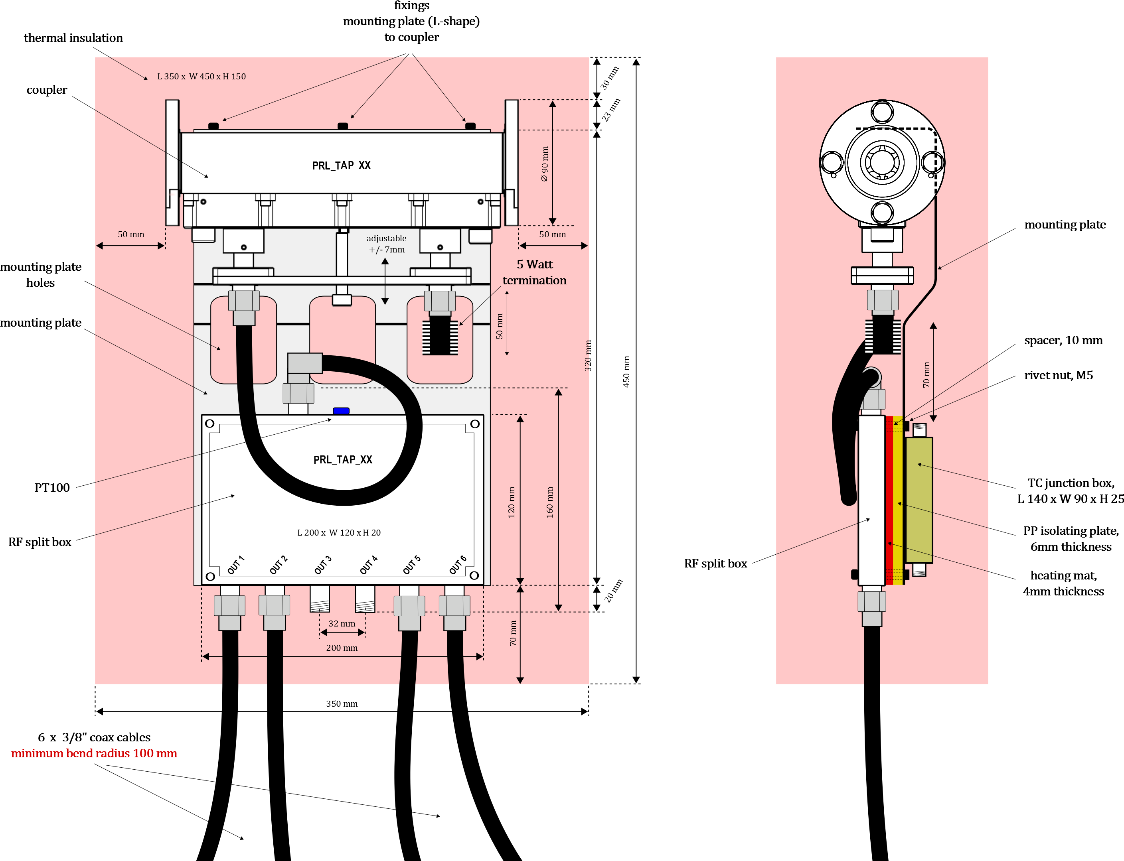
Tap Point mechanical design

Slide 13
Tap Point mechanical design
Not only RF !!
RF performance
temperature stability -> heat transfers
space limitations
mechanical restrictions
ergonomics (assembly + cabling)
assembling & servicing

Slide 14
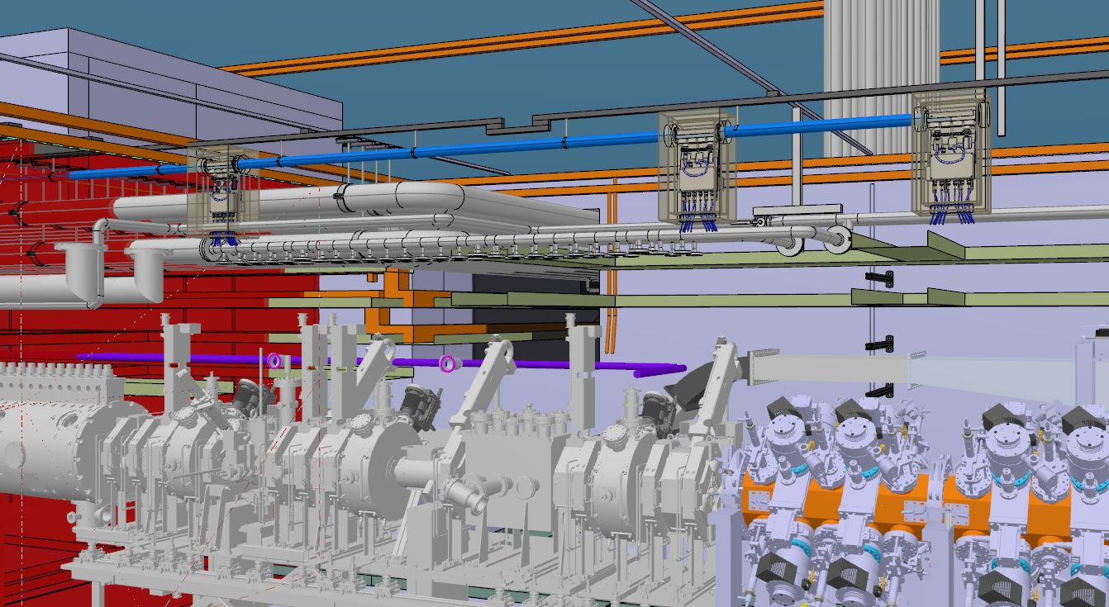
Tap Point 3D implementation
Insulated Rigid line
Tap Points
Coupler

Slide 15
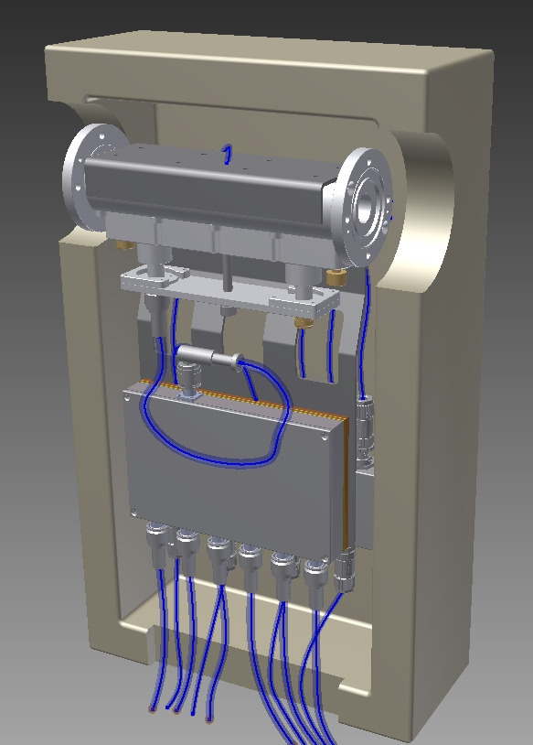
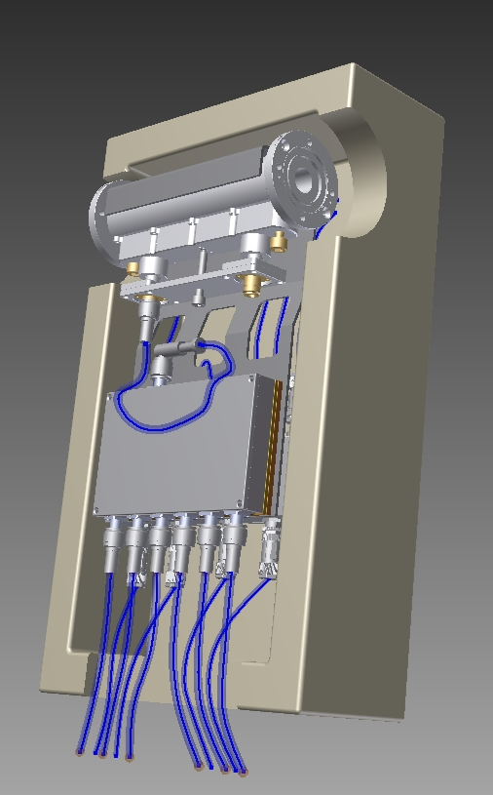
Tap Point 3D implementation
PE or PP
foam insulation
directional
coupler
mounting plate
jumper cable
RF Split Box
(ex tap point)
cables to Stubs

Slide 16
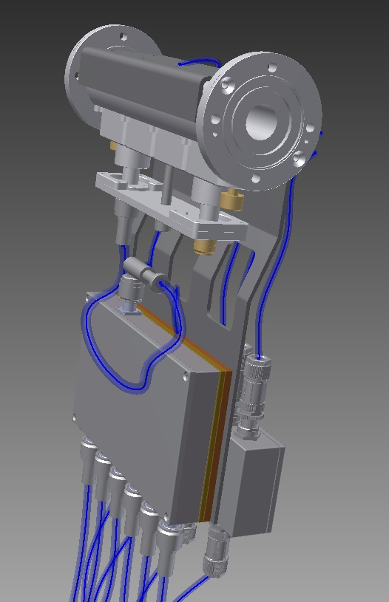
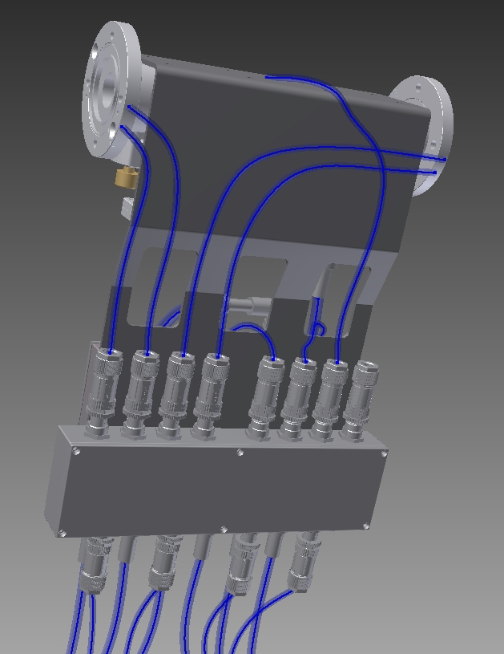
Tap Point 3D implementation
mounting plate
RF Split Box
(ex tap point)
heating mat
thermal insulation
Junction Box
(temperature control)

Slide 17
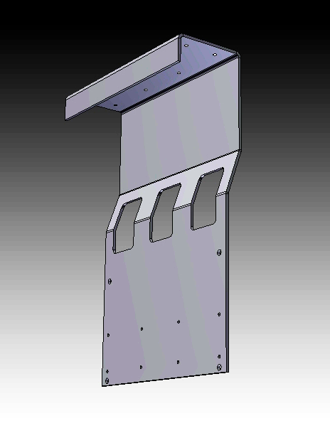
Tap Point -> mounting plate
Mounting plate:
aluminium plate 3 mm thick
plate bended to keep symmetry
(center of gravity)
cutouts in the plate to minimize heat transfer

Slide 18
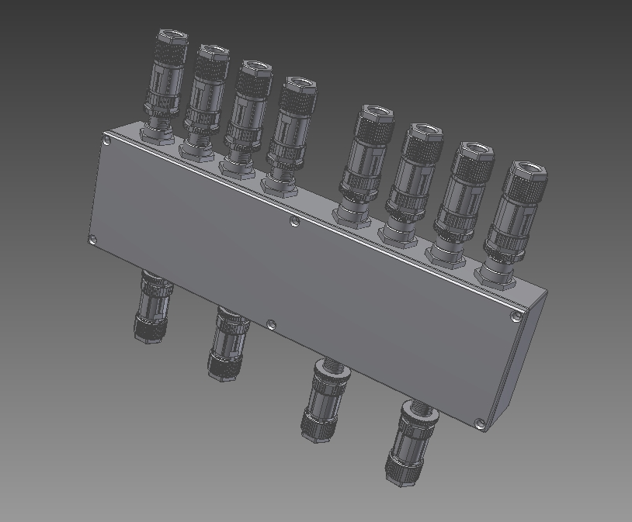
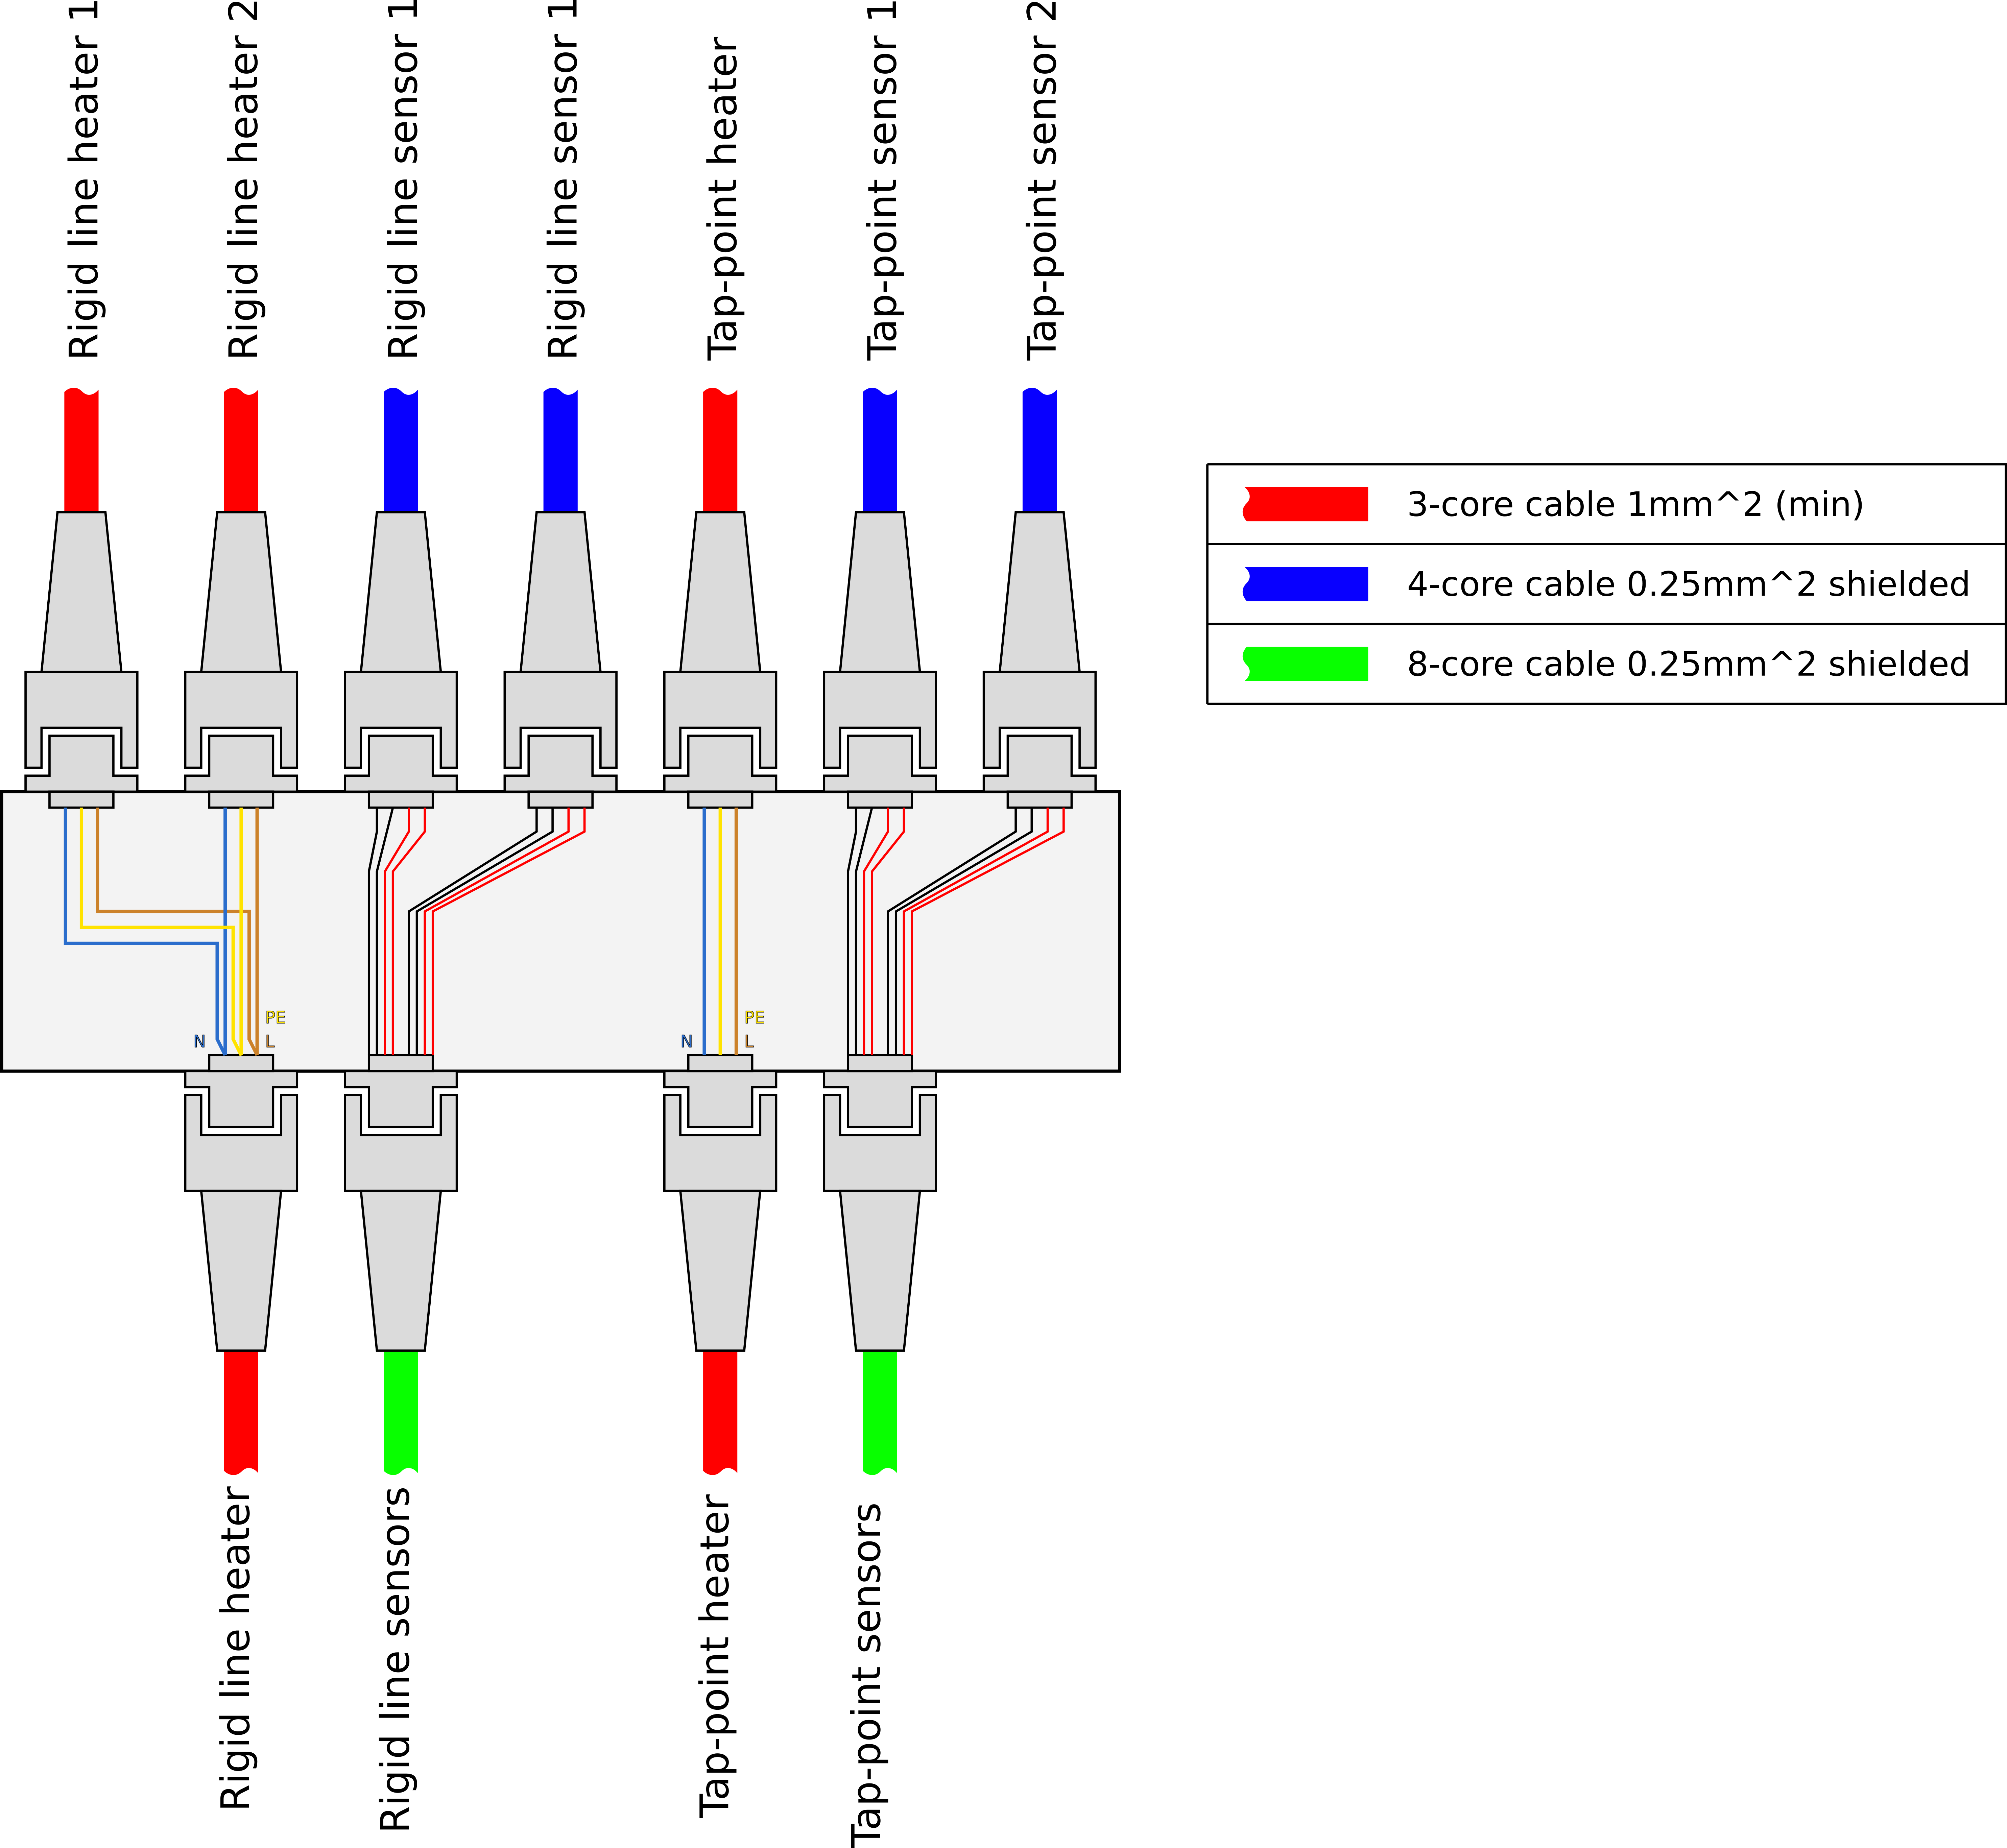
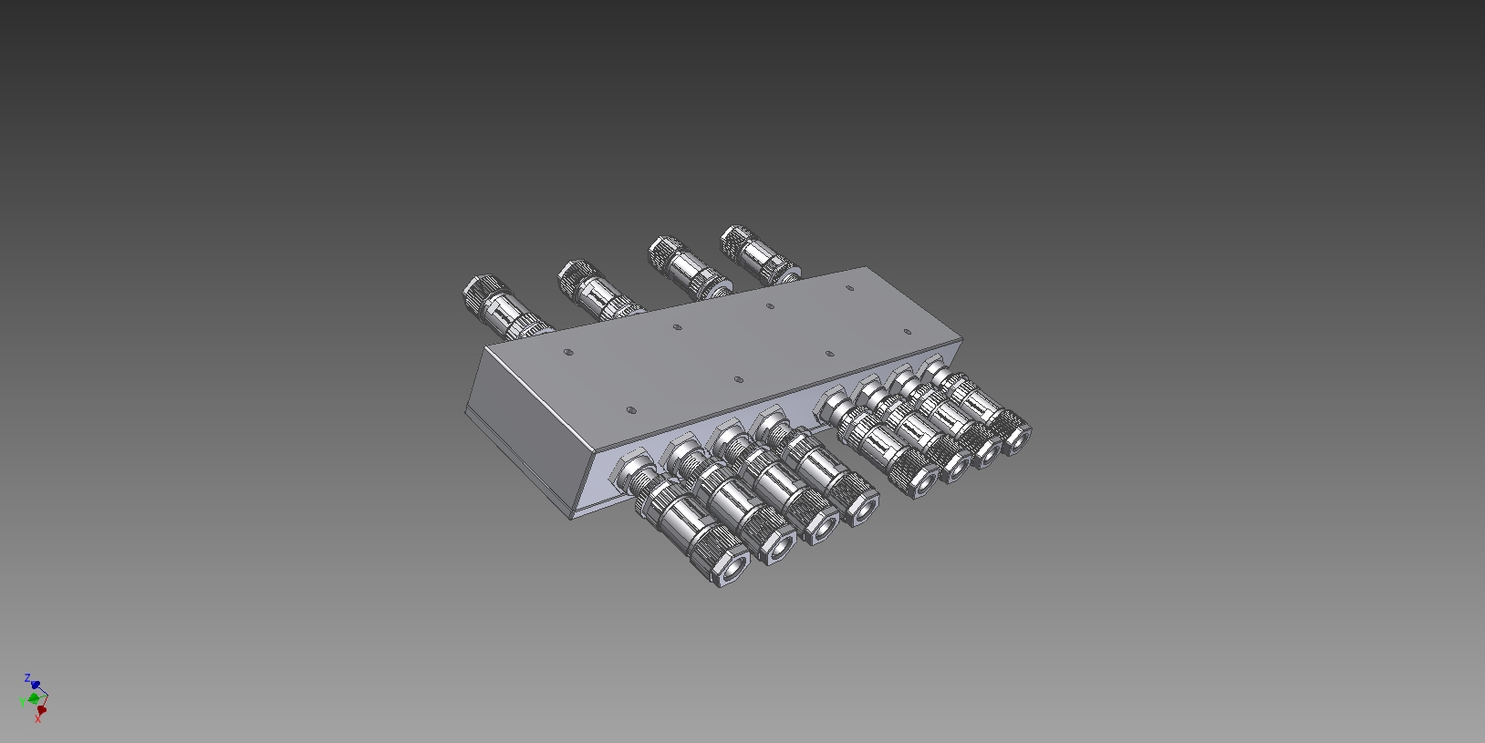
Tap Point -> Junction Box
Junction Box functionality:
  combining Temperature CTRL cables in one place
  modularity of design
  ease of connecting/cabling & servicing

Slide 19
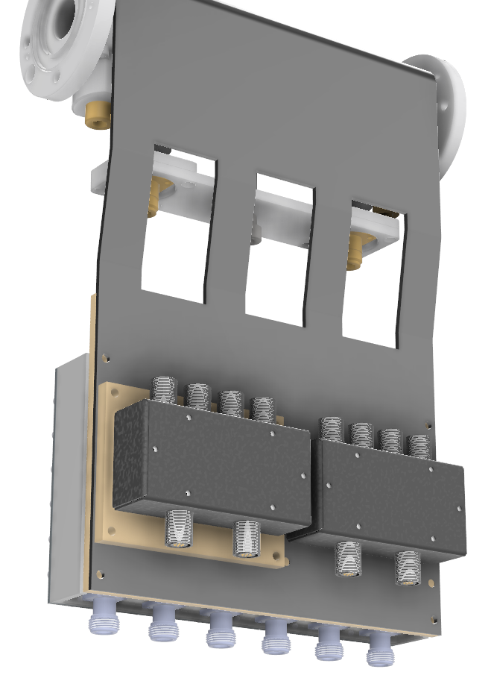
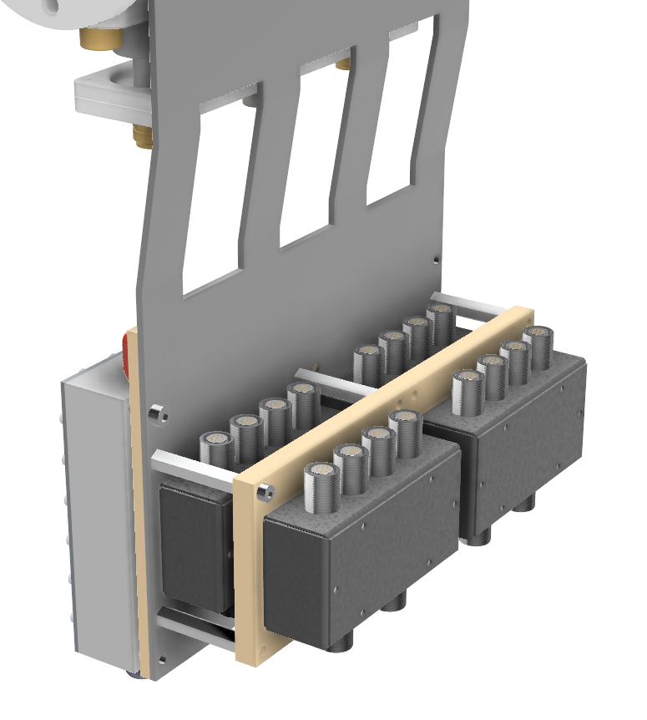
Tap Point -> Junction Box
Junction Box functionality:
  combining Temperature CTRL cables in one place
  modularity of design
  ease of connecting/cabling & servicing
dielectric pad => isolation of signal ground
=> presentation by Radek Papis

Slide 20
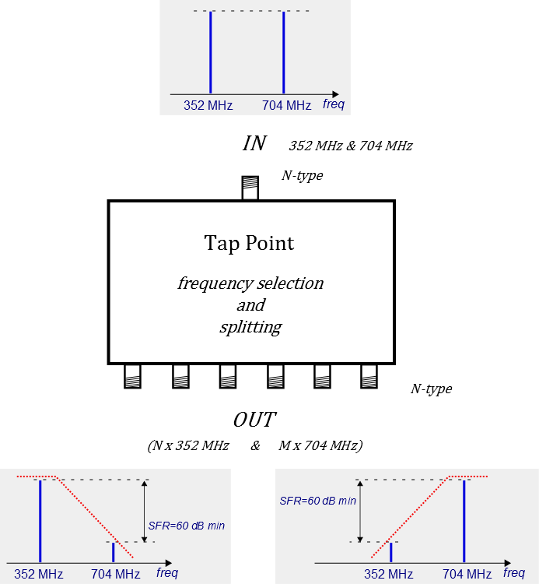
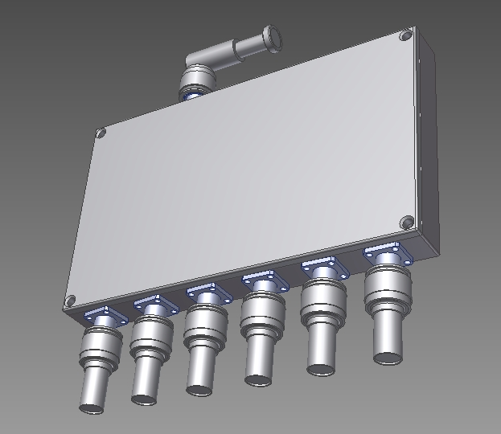
Tap Point -> PRL Split Box
RF Distribution Module functionality:
  spliting & filtering phase ref. signals
  minimize temp. drifts due to heat leak through RF cables -> separate temp. control loop
  ease of assembly
  ease of connecting/cabling & servicing

Slide 21
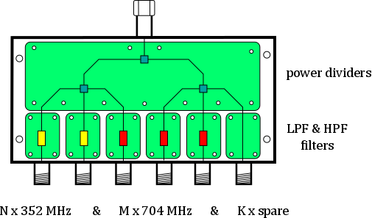
Tap Point -> PRL Split Box
Internal structure:
  2 versions of RF Distribution Module
  - 6-way power splitter (30 pcs)
  - 3-way power splitter (28 pcs)
  diplexer in the input to select reference frequency
  hermetic metal enclosure
Design approach:
  PCB based solution (FR408 epoxy based laminate)
  COTS components
  modularity
Notes:
is going to be realized as development

Slide 22
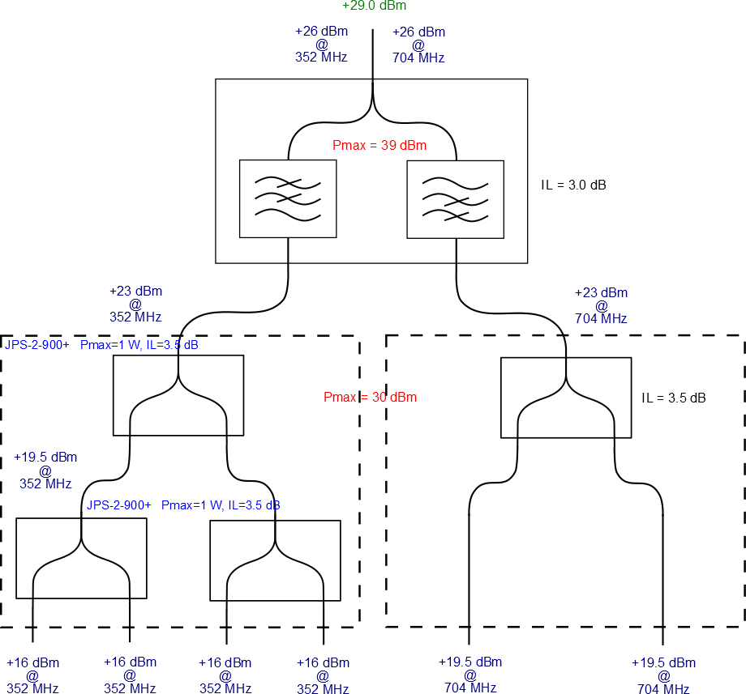
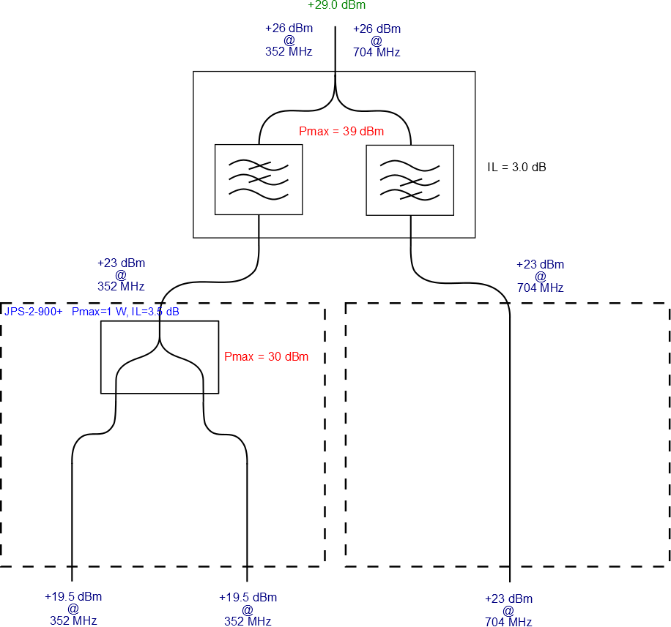
Tap Point -> PRL Split Box - concept
Tap point with “diplexer + power dividers”
6-way Split Box
(“4+2” configuration)
3-way Split Box
(“2+1” configuration)

Slide 23
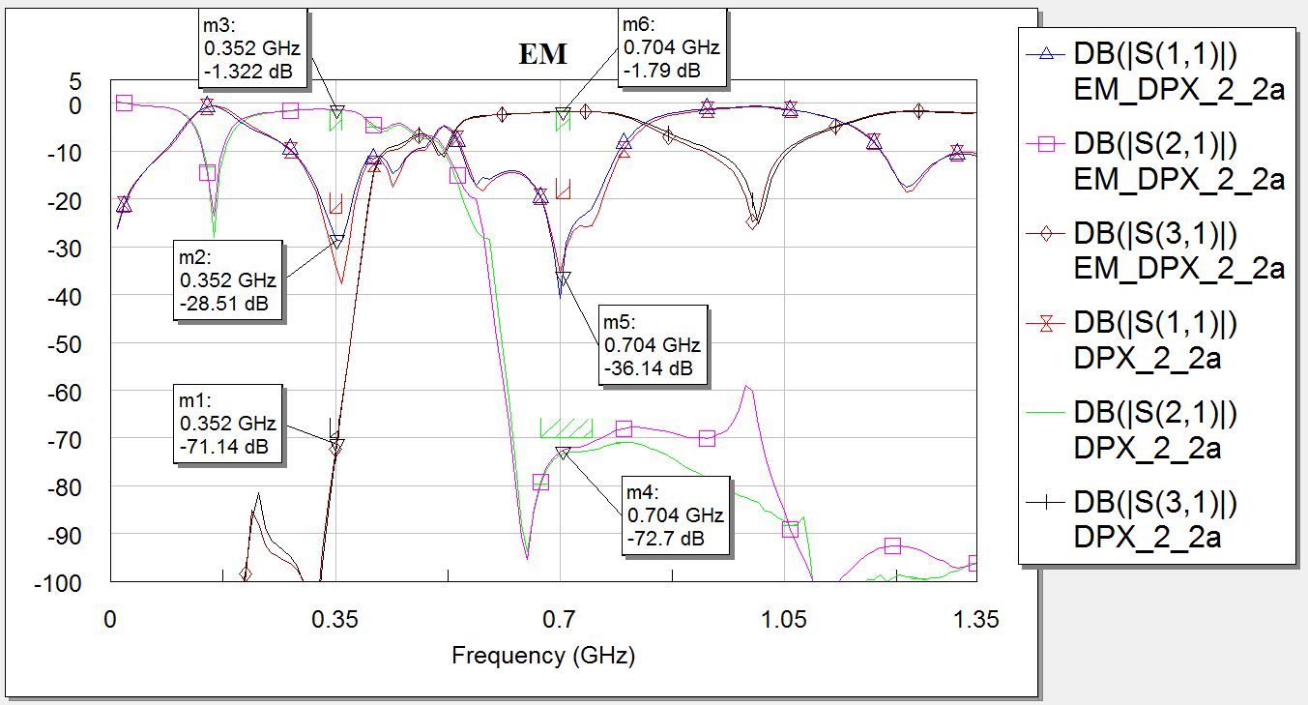
Tap Point -> PRL Split Box - concept
Diplexer itself
Insertion Loss < 2 dB
Return Loss > 28 dB
signal separation ~70 dB

Slide 24
Tap Point -> PRL Split Box - concept
8-way Tap Point
Insertion Loss < 10 dB
Return Loss > 17 dB
signal separation ~70 dB

Slide 25
Tap Point -> PRL Split Box - concept
6-way Tap Point with diplexer
(equal output power)
6-way Tap Point with diplexer
(unequal output power)
Meeting on 29.11.2017 (attendees: Anders Svenson, Stephen Molloy, Rihua Zeng, Mateusz Zukocinski)
do we need spare/test output with both frequencies (not filtered output)? → it is not necessary, we do not need spare/test outputs with both frequencies
shall we provide equal power to all Tap Point outputs (~+16 dBm) or shall we provide as much power as possible (e.g. +16…+19 dBm depending on configuration) – the second scenario (provide as much power as possible) seems to be better in terms of system power budget vs noise performance of reference signals receivers: DWC, VM, LOGM but may cause trouble if some modules are build only for specific fixed input power, e.g. Split Box??) → providing as much power as possible (+16 dBm minimum) is recommended – front-end circuits at BPM and LLRF cards have adjustable attenuators to level reference signal power

Slide 26
Tap Point -> PRL Split Box - concept
6-way Tap Point with diplexer
(equal output power)
6-way Tap Point with diplexer
(unequal output power)
Meeting on 29.11.2017 (attendees: Anders Svenson, Stephen Molloy, Rihua Zeng, Mateusz Zukocinski)
do we need spare/test output with both frequencies (not filtered output)? → it is not necessary, we do not need spare/test outputs with both frequencies
shall we provide equal power to all Tap Point outputs (~+16 dBm) or shall we provide as much power as possible (e.g. +16…+19 dBm depending on configuration) – the second scenario (provide as much power as possible) seems to be better in terms of system power budget vs noise performance of reference signals receivers: DWC, VM, LOGM but may cause trouble if some modules are build only for specific fixed input power, e.g. Split Box??) → providing as much power as possible (+16 dBm minimum) is recommended – front-end circuits at BPM and LLRF cards have adjustable attenuators to level reference signal power

Slide 27
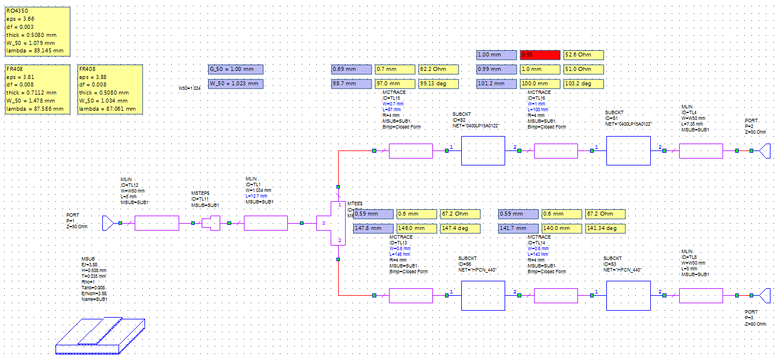
Tap Point -> PRL Split Box - design
Diplexer design
SMD components used to buid Tap Point PCB modules
Component | Model | Manufacturer
2-way power divider | JPS-2-900+ | Minicircuits
LPF filter - reflective | 0400LP15A0122 | Johanson
HPF filter - reflective | HFCN-440+ | Minicircuits
Circuit modeling/simulation
Electromagnetic modeling/simulation

Slide 28
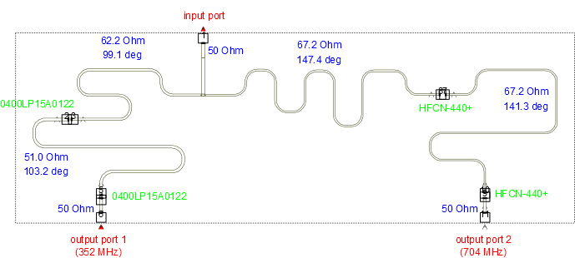
Tap Point -> PRL Split Box - design
Diplexer design - PCB layout for EM simulations

Slide 29
Tap Point -> PRL Split Box - design
Diplexer design – modeling results (circuit vs EM)
diplexer is reflectionless in 352 MHz and 704 MHz bands
low insertion loss < 2 dB
very good matching > 25 dB
signals sepration ~70 dBc

Slide 30
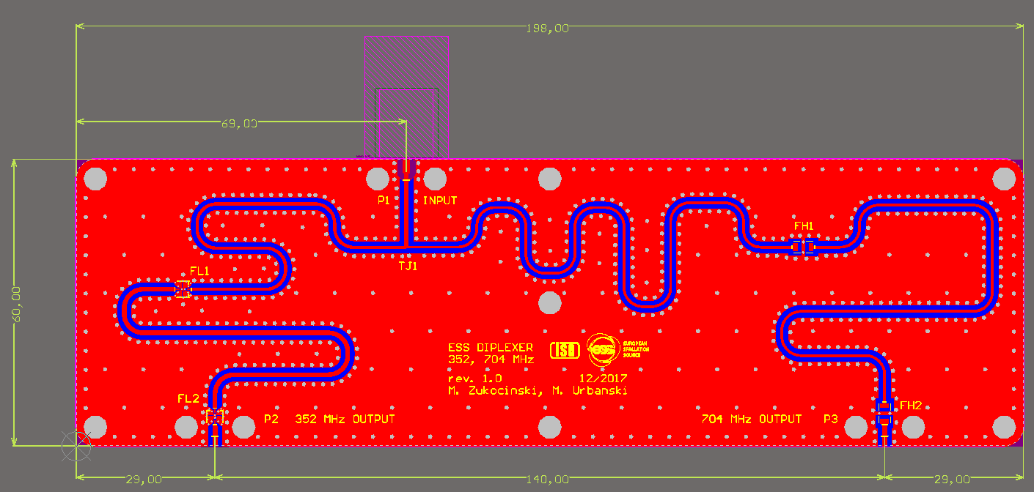
Tap Point -> PRL Split Box - design
Diplexer design – PCB layout

Slide 31
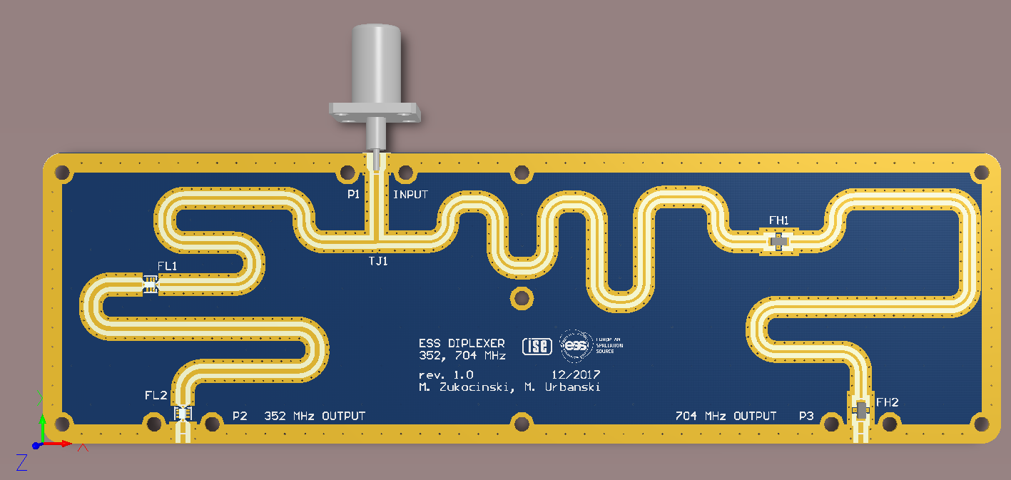
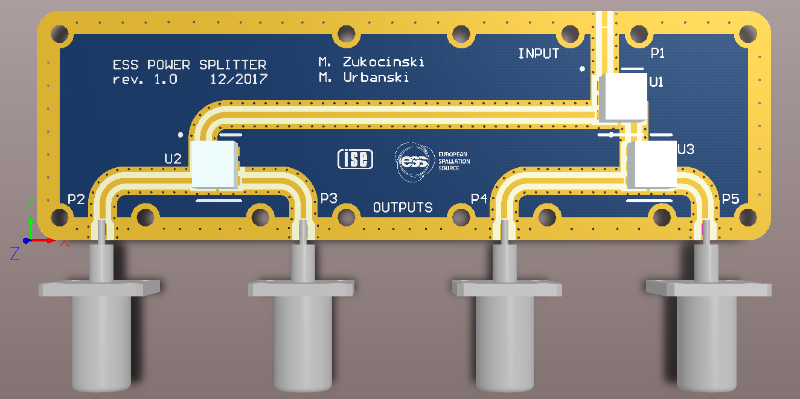
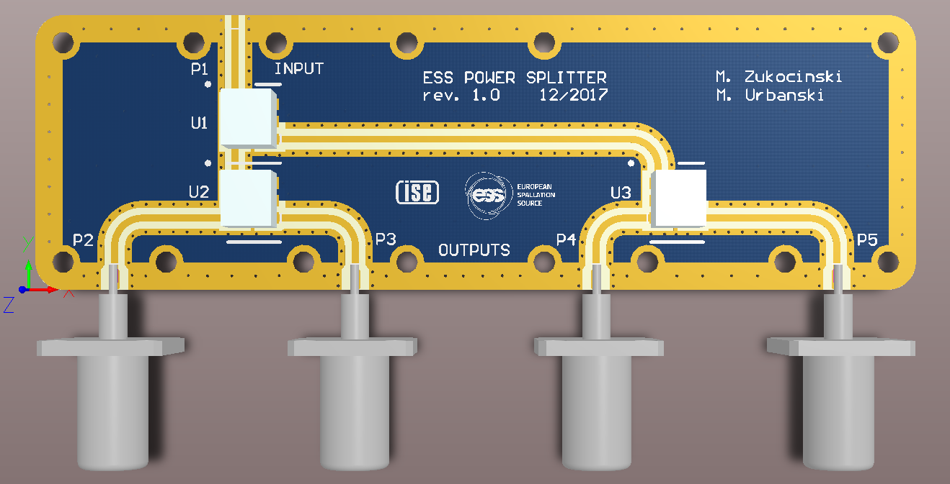
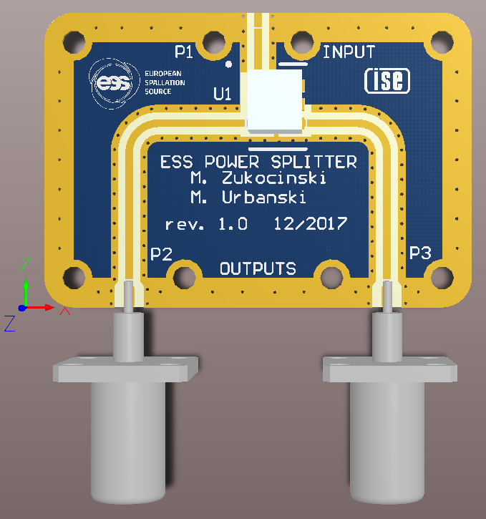
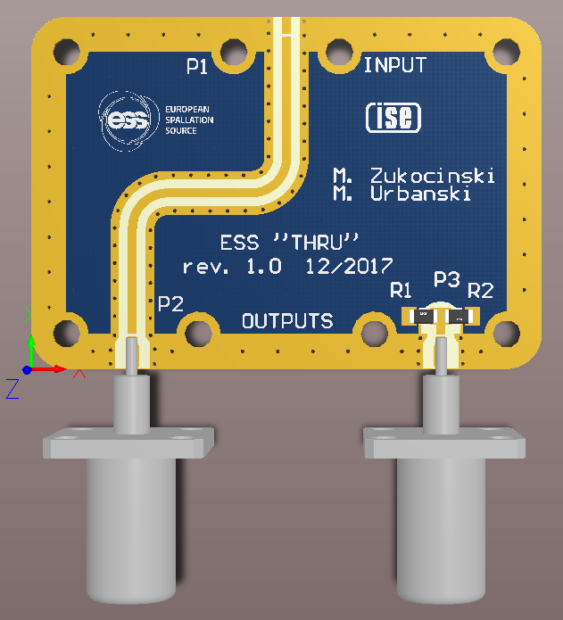
Tap Point -> PRL Split Box - design
To build the Split Boxes for the PRL
the 5 different boards are needed:
diplexer
4-way power divider, right version
4-way power divider, left version
2-way power divider
1-way bypass

Slide 32
Tap Point -> PRL Split Box - design
Diplexer design – PCB layout 3D

Slide 33
Tap Point -> PRL Split Box - design
Power splitters design – PCB layout 3D
4-way power splitter, input on the left
4-way power splitter, input on the right

Slide 34
Tap Point -> PRL Split Box - design
Power splitters design – PCB layout 3D
1-way bypass (through)
2-way power splitter

Slide 35
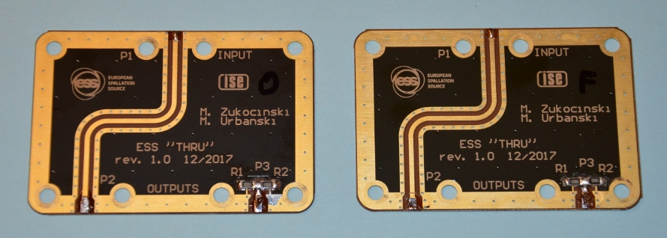
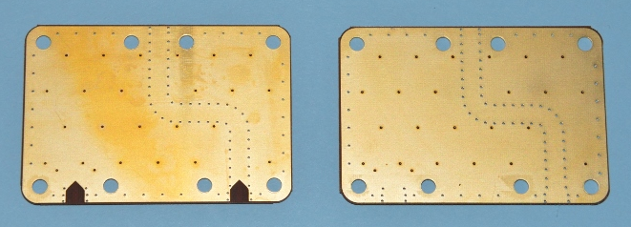
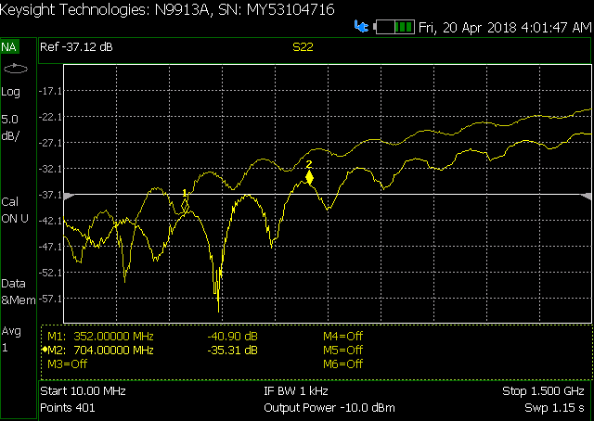
Tap Point -> PRL Split Box - design
coax-to-microstrip transition - optimization
1-way bypass (through)

Slide 36

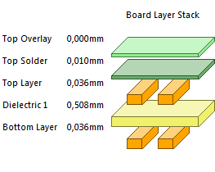
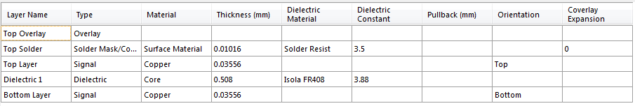
Tap Point -> PRL Split Box - design
PCB manufacturing
Stack-up Information:
2 layer Isola FR408
thickness of the dielectric (glass/epoxy core) = 0.508 mm
1 oz copper both sides
no Solder Mask on bottom layer

Slide 37
Tap Point -> PRL Split Box - design
Radiation hardness
Example of material declaration for highpass filter HFCN-440+ (MiniCircuits)
Model: HFCN-440+ | Weight: 18.893 mg
HI PASS FLTR / SURF MT / RoHS
RoHS Compliant : Yes
Constituent | Description | CAS No. | Weight in mg | % by component
PC BOARD |  |  | 18,893
ALUMINA - CERAMIC |  | 1344-28-1 | 8,162 | 43,20
SILICON DIOXIDE |  | 7631-86-9 | 4,459 | 23,60
LEAD OXIDE - EXEMPT |  | 1317-36-8 | 3,363 | 17,80
CALCIUM OXIDE |  | 1305-78-8 | 2,173 | 11,50
SILVER |  | 7440-22-4 | 0,659 | 3,49
NICKEL | BARRIER | 7440-02-0 | 0,021 | 0,11
TIN-100 | PLATING | 7440-31-5 | 0,057 | 0,30

Slide 38
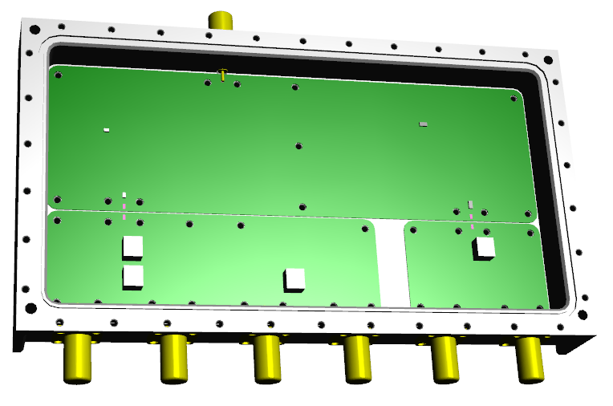
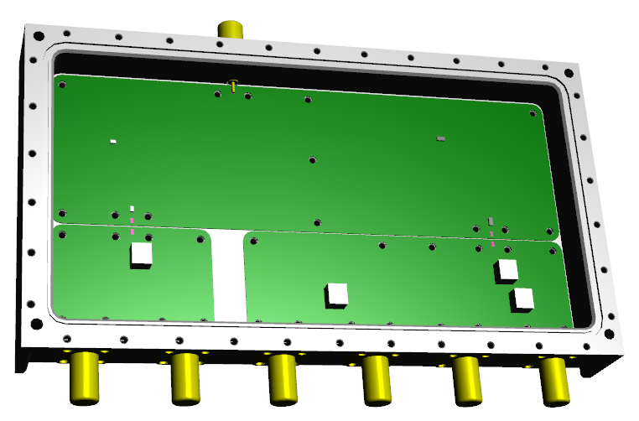
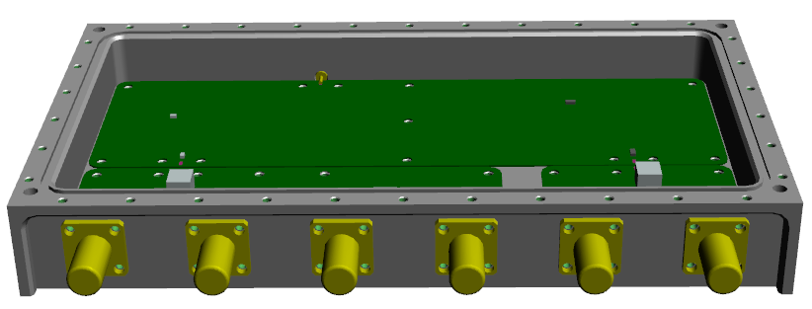
Tap Point -> PRL Split Box - design
Module enclosure
universal design for 6…3-way modules
dimensions: 210 mm x 100 mm x 25 mm
hermetic: gasket under top cover & o-rings under N-type connectors

Slide 39
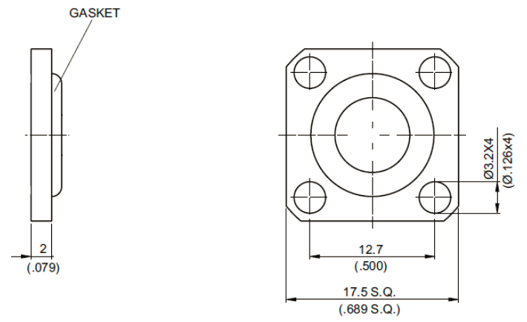
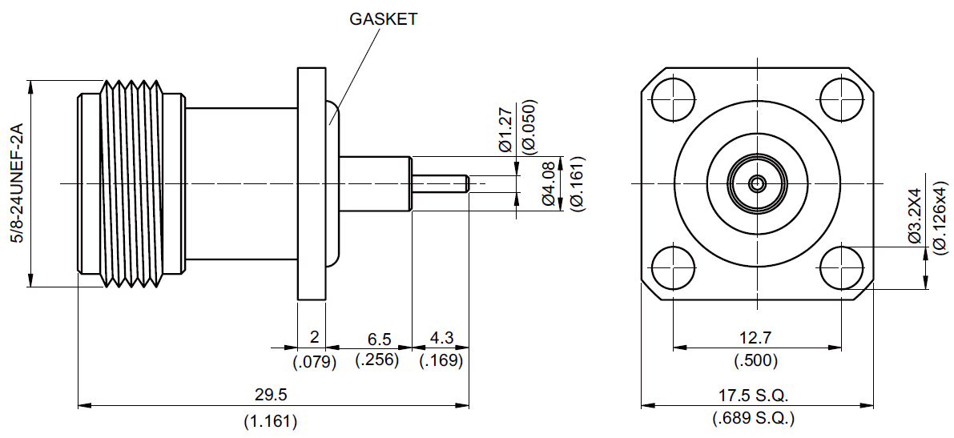
Tap Point -> PRL Split Box - design
Module enclosure
radiation hard N-type connectors with Rexolite dielectric & o-rings & gasket material
N-type bulkhead connector
cup for covering unused N-type holes

Slide 40
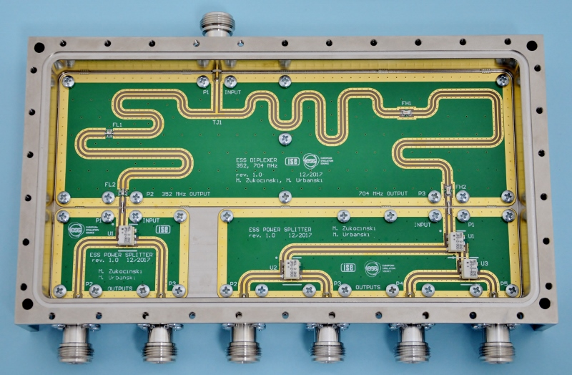
Tap Point -> prototype
6-way Split Box (“2+4” configuration)
INPUT
352 MHz & 704 MHz
diplexer
352 MHz
704 MHz
2-way divider
OUTPUTS
4-way divider

Slide 41
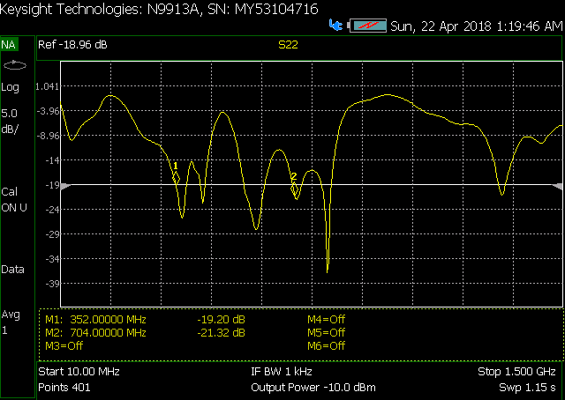
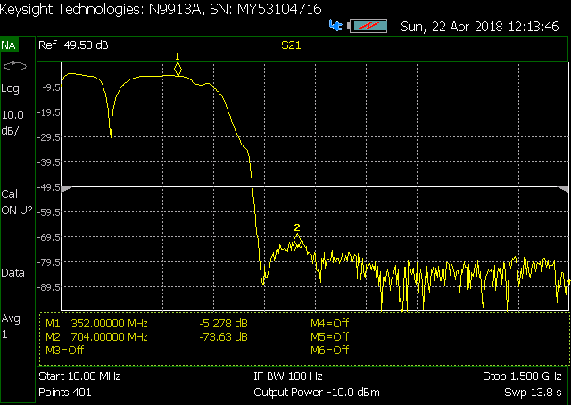
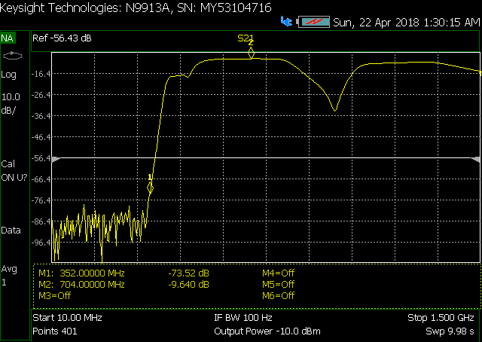
Tap Point -> prototype
6-way Split Box (“2+4” configuration)
input reflections
RL@352 MHz = 19.2dB, RL@704 MHz = 21.3dB
transmission to 352 MHz outputs
IL@352 MHz = 5.3dB
IL@704 MHz = 73.6dB
transmission to 704 MHz outputs
IL@352 MHz = 73.5dB,
IL@704 MHz = 9.6dB

Slide 42
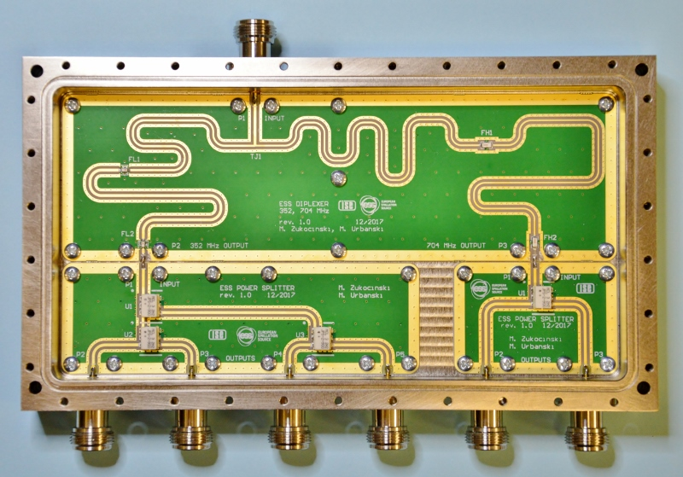
Tap Point -> prototype
6-way Split Box (“4+2” configuration)
INPUT
352 MHz & 704 MHz
diplexer
352 MHz
704 MHz
4-way divider
OUTPUTS
2-way divider

Slide 43
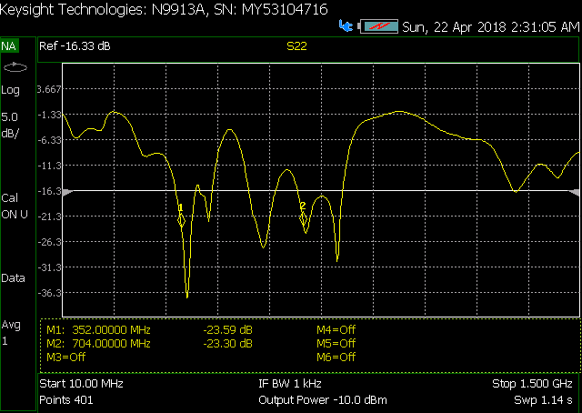
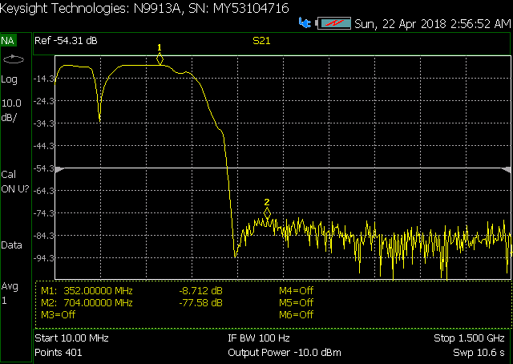
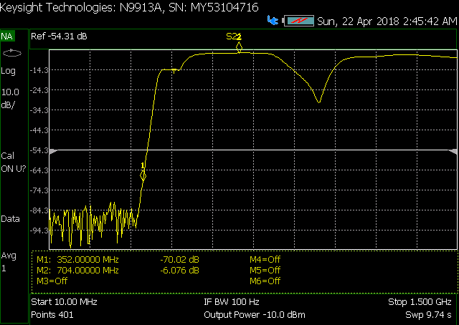
Tap Point -> prototype
6-way Split Box (“4+2” configuration)
input reflections
RL@352 MHz = 23.6dB, RL@704 MHz = 23.3dB
transmission to 352 MHz outputs
IL@352 MHz = 8.7dB
IL@704 MHz = 77.6dB
transmission to 704 MHz outputs
IL@352 MHz = 70.0dB,
IL@704 MHz = 6.1dB

Slide 44
Tap Point -> status
RF Split Box
  diplexer boards design √
  spliter boards design √
  enclosure design √
  N-type connectors with Rexolite -> available from 2 companies (Jyebao & xxx) -> to be ordered…
  prototyping and testing (RF performance)
  minor design modifications
  full production documentation + ordering formalities
  production (64 pcs) & testing (FAT)
Junction Box
  design √
  prototyping in progress
Mounting bracket
  design √
  prototyping √
  production
Heating mats + sensors + isolating pads -> to be ordered…
Thermal insulating shell -> manufactureres selected (final 3D model of Tap Point needed to design the shell)
5/10 Watt dummy loads for dir. couplers (Rexolite) -> bought from JFW Industries Inc., USA)
short coaxial cable -> manufactureres selected -> to be ordered…
Costs are estimated

Slide 45
Tap Point -> status
RF Split Box
  diplexer boards design √
  spliter boards design √
  enclosure design √
  N-type connectors with Rexolite -> available from 2 companies (Jyebao & xxx) -> to be ordered…
  prototyping and testing (RF performance)
  minor design modifications
  full production documentation + ordering formalities
  production (64 pcs) & testing (FAT)
Junction Box
  design √
  prototyping in progress
Mounting bracket
  design √
  prototyping √
  production
Heating mats + sensors + isolating pads -> to be ordered…
Thermal insulating shell -> manufactureres selected (final 3D model of Tap Point needed to design the shell)
5/10 Watt dummy loads for dir. couplers (Rexolite) -> bought from JFW Industries Inc., USA)
short coaxial cable -> manufactureres selected -> to be ordered…
Costs are estimated
Thank you!

