Slide 1
PRL MO to Tunnel Distribution
Dominik Sikora
Critical Design Review
27.04.2018, Lund

Slide 2
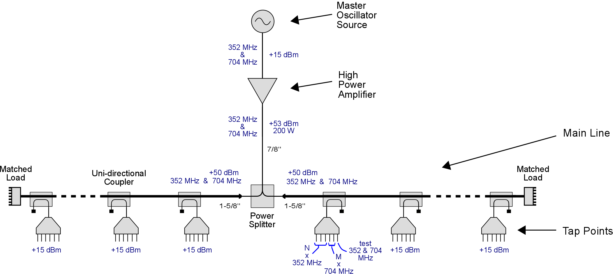
MO to Tunnel Distribution

Slide 3
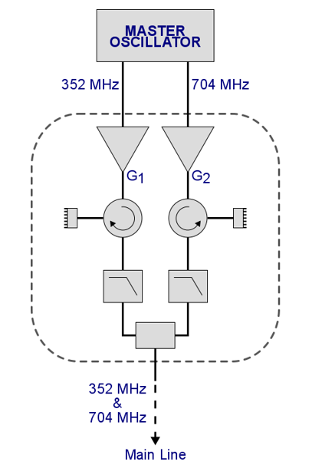
High Power Amplifier Stage (1)
PRL Main Line needs:
  48-51 dBm @352.21 MHz,
  49-52 dBm @704.42 MHz
Two narrowband high power amplifiers
  Advantages compared to one wideband amplifier: better phase noise, no MO reference intermodulation effects, cost
  Bandpass combiner design can pose difficulties but we want it from the company with the amplifiers
  Phase drifts can be different, so active compensation needed
  Diagnostics: output power level and output VSWR monitoring
Several companies asked for the amplifier stage system (R&S, HBH, Popek, Microwave Amps …)

Slide 4
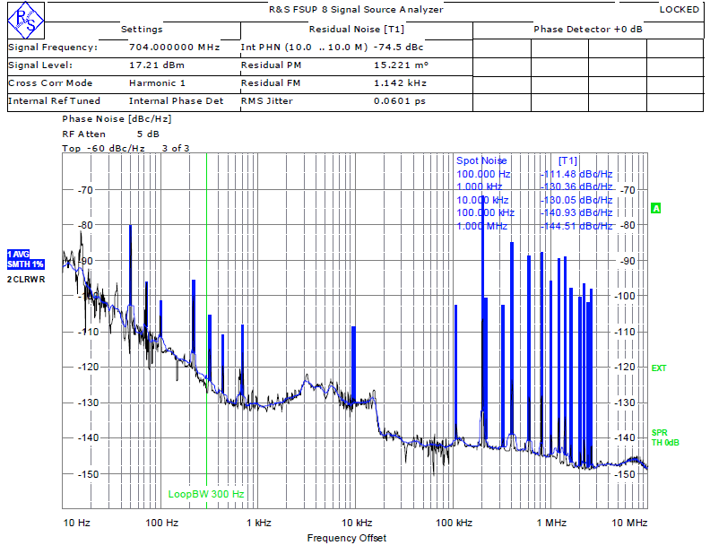
High Power Amplifier Stage (2)
Phase noise measurements of R&S SSA BBA150 wideband amplifier done by Anders Svensson
  60 fs of jitter already met the requirements (100 fs of output signal) but spikes and high phase noise floor could be better
Amplifier stage requirements:
  Additive phase noise: 40 fs of jitter (MO signals jitter: 60 fs from spec)
  Main output power: 51 dBm @352.21 MHz, 52 dBm @704.42 MHz at the main output
  Amplifiers power: 52 dBm @352.21 MHz, 53 dBm @704.42 MHz due to bandpass combiner

Slide 5
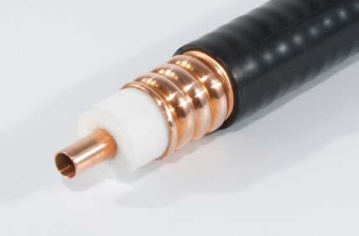
Distribution Media
Length from MO to the main line: 30m
Cable type: 7/8” LCF78-50JA (3 cables with one spare)
  Power loss: 0.95 dB @704 MHz and 0.65 dB @352 MHz
  Phase drift: 0.18 deg/K @704 MHz and 0.09 deg/K @352 MHz (~23 fs/K/m)
Cable and amplifiers are sources of phase drifts
Active compensation needed
Phase drift requirements for MO to tunnel distribution:
  0.1 degree between MO references (due to frequency change of reference along the machine)

Slide 6
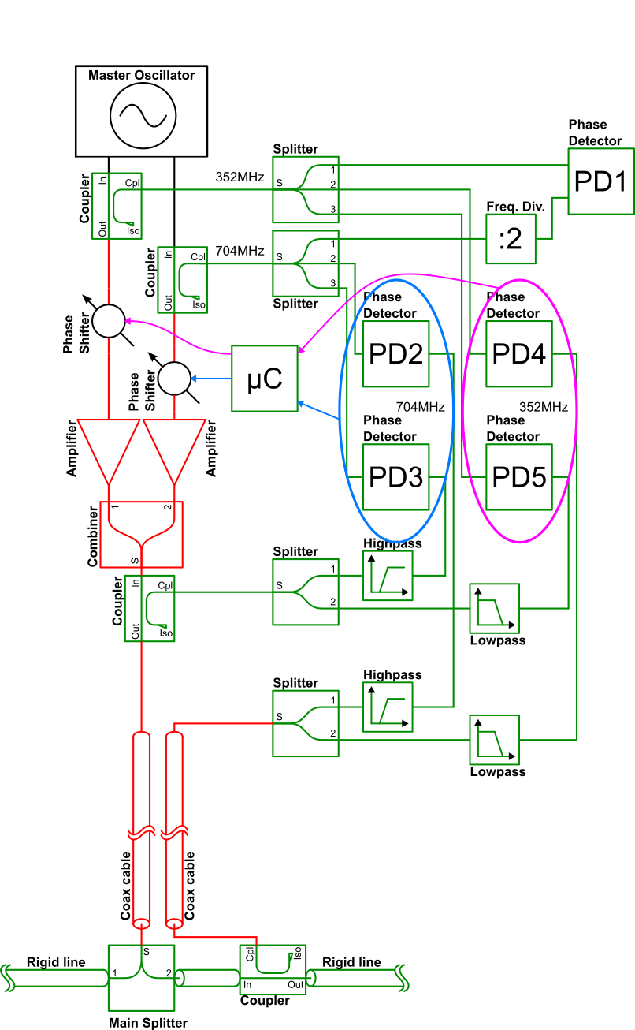
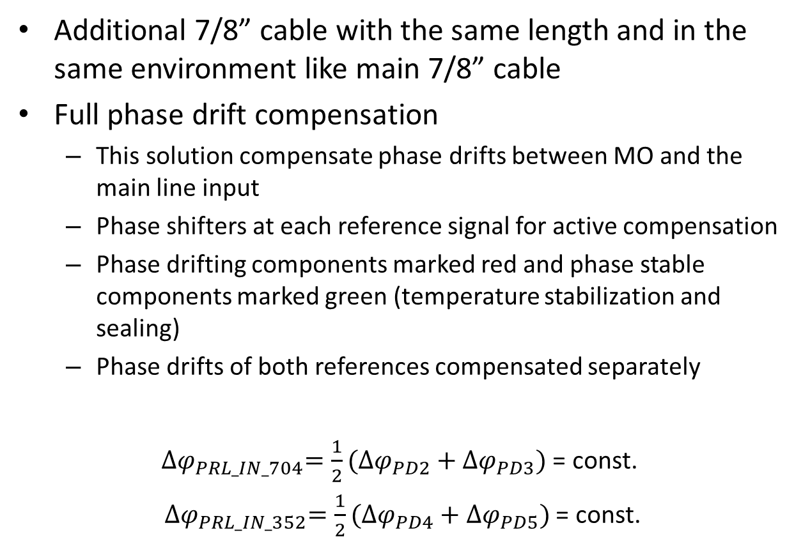
Phase Drift Compensation (1)
Additional 7/8” cable with the same length and in the same environment like main 7/8” cable
Full phase drift compensation
  This solution compensate phase drifts between MO and the main line input
  Phase shifters at each reference signal for active compensation
  Phase drifting components marked red and phase stable components marked green (temperature stabilization and sealing)
  Phase drifts of both references compensated separately
${∆φ}_{PRL_IN_704}=\frac{1}{2}(∆φ_{PD2}+∆φ_{PD3})$ = const.
${∆φ}_{PRL_IN_352}=\frac{1}{2}(∆φ_{PD4}+∆φ_{PD5})$ = const.

Slide 7
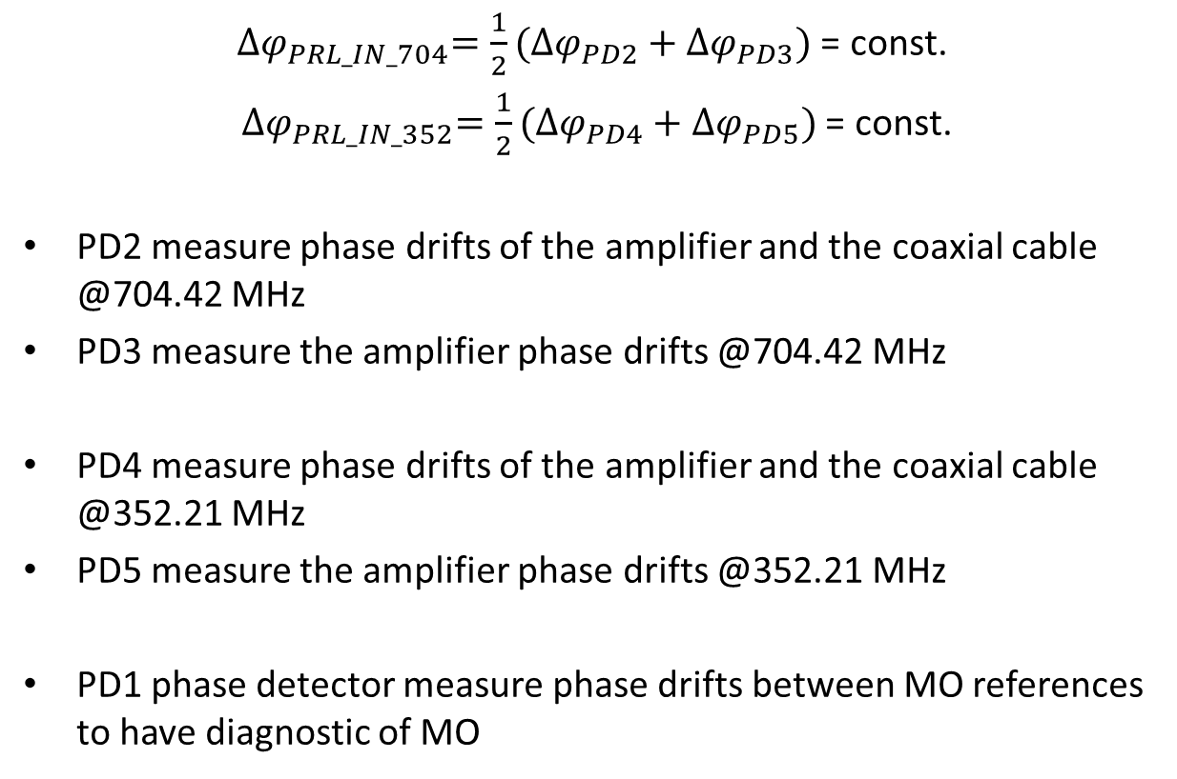
Phase Drift Compensation (2)
${∆φ}_{PRL_IN_704}=\frac{1}{2}(∆φ_{PD2}+∆φ_{PD3})$ = const.
${∆φ}_{PRL_IN_352}=\frac{1}{2}(∆φ_{PD4}+∆φ_{PD5})$ = const.
PD2 measure phase drifts of the amplifier and the coaxial cable @704.42 MHz
PD3 measure the amplifier phase drifts @704.42 MHz
PD4 measure phase drifts of the amplifier and the coaxial cable @352.21 MHz
PD5 measure the amplifier phase drifts @352.21 MHz
PD1 phase detector measure phase drifts between MO references to have diagnostic of MO

Slide 8
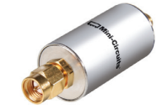
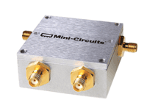
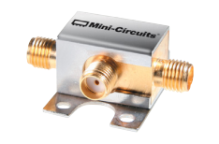
Phase Drift Compensation (3)
Prototype:
  Conectorized RF sub-components (directional couplers, power splitters, low- and highpass filters, combiner) ordered
  Phase drifts compensation is being preparing
  Final prototype results to proof the concept – July/August
Final version:
  PCB and housing design of compact sub-modules – July/August
  Sub-modules production – September
  Assembly and tests – October/November
  Temperature stabilized electronics in 19” box
  Diagnostics

Slide 9
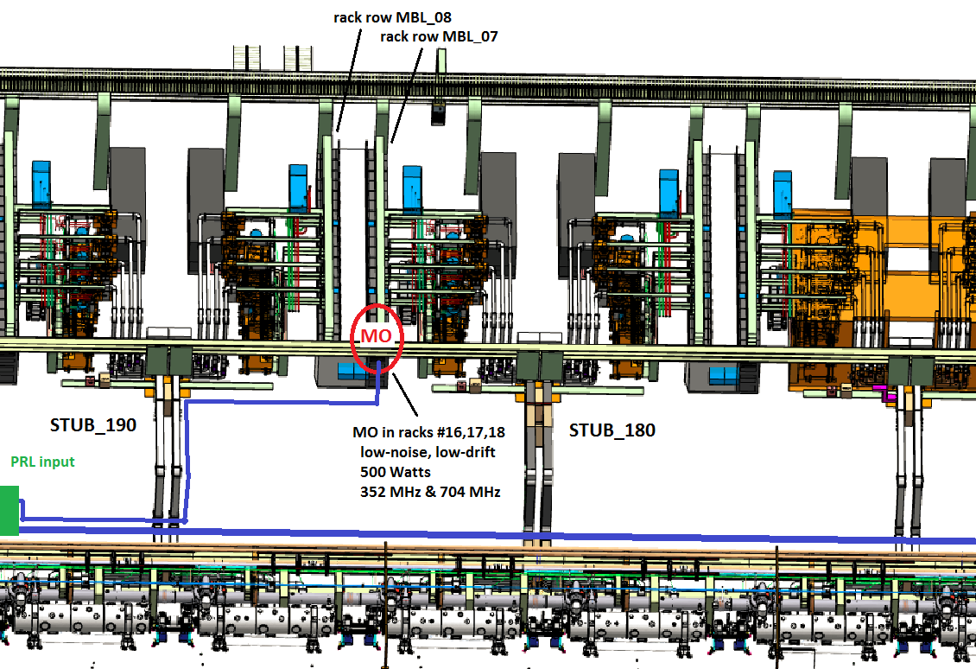
MO and High Power Amplifier Racks (1)
MBL-070ROW, MO racks #16, #17, #18 (from tunnel side)

Slide 10
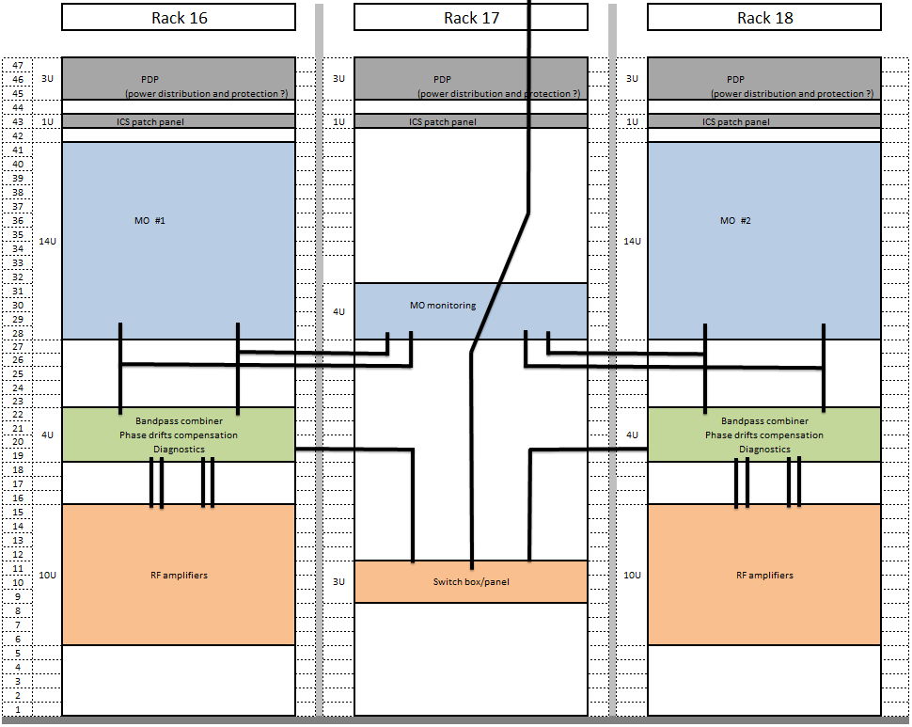
MO and High Power Amplifier Racks (2)
Layout proposal:
  19” box with band-pass combiner, phase drifts compensation system and diagnostics in the MO channel rack
  10U of high for RF amplifier that can be in the MO channel rack or in the middle rack

Slide 11
Remaining Tasks
High power amplifiers selection
Eventually bandpass combiner design
MO racks arrangement
Interface with ICS for monitoring

Slide 12
Thank you for your attention.

