Slide 1
DTL 2 & 4 FC PDR
Requirements and conceptual design
Clement Derrez
www.europeanspallationsource.se
14 May, 2018

Slide 2
Outline
Design specifications
Interface requirements
Conceptual design
Electronics
Usage during commissioning & Planning

Slide 3
Design specifications
Beam characteristics | Beam modes | 5 uS, 14 Hz 50 uS, 1 Hz
 | Current | 6.3 to 62.5 mA
 | Beam sizes | FC2: 1.16 x 1.24 mm FC4: 1.35 x 1.32 mm
 | Peak power | FC2: 2.43 MW FC4: 4.62 MW
 | Average power | FC2: 170 W FC4: 324 W
* Beam parameters and modes described as well in the thermo mechanical simulations talk by Thommy

Slide 4
Design specifications
Measurement 74 MeV beam: 90% charge collection efficiency → Specs relaxed compared to lower energy FC | Accuracy | Better than 10%
 | Resolution | Better than 1%
 | Sampling frequency | At least 2 MHz
 | Bandwidth | At least 300 KHz
 | HV power supply | 1 KV
Mechanical | Internal radius | At least 30 mm
 | Actuation, Limit switches | Pneumatic actuator 2 sets of switches, IN & OUT (MPS and Pos)
 | Water cooling | Compliance with WP16
 | Vacuum | Compliance with ESS-0012894

Slide 5
Interfaces requirements
Mechanical: Detailed in Thommy’s talk
  Mechanical design, vacuum, manufacturing and assembly
    Note: we use the WS flange
  Compressed air intake for pneumatic actuator
Acquisition
  Analog stage, digitizer
Controls
  Control design and integration: one mTCA system used for all LINAC FCs, deployed in FEB for LEBT FC control. ECAT integration covered in Julen’s talk
  MPS: switches, connectors, wiring defined in ICD ESS-0110223
Cooling:
  Water intake
  Pressure and flow
  Temperature measurements

Slide 6
Conceptual design
HV bias, motion control, signal, cooling status
Local protection status
MPS
MPS Limit switches
FC2
FC4
mTCA
AFE
ECAT
HVPS
DTL2, DTL4
FEB-030ROW:CNPW-U-007

Slide 7
Electronics
Migrated from VME to mTCA following commissioning in Catania
One mTCA crate equipped with:
  MRF EVR
  CPU
  PS
  MCH
  Signal acquisition: Struck SIS8300 AMC and SIS8900 RTM
  Front End: Consists of a resistor and surge protector (added after Catania experience) at rack patch panel level
Lab tests results:
  Bandwidth: ~ 4 MHz
  Resolution at max current: better than 0.1 %
  300Khz noise issue to solve, prob. coming from mTCA PSU
  Surge protector tests ongoing in Bilbao, TODO in Lund

Slide 8
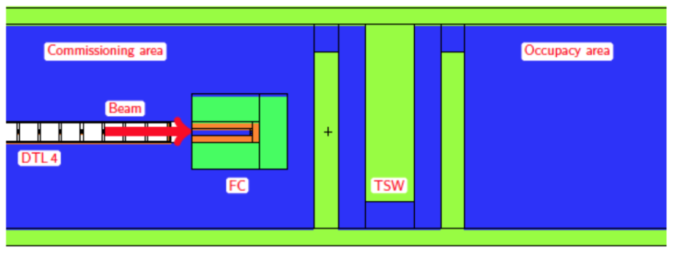
DTL FCs usage during commissioning
ISrc – DTL1 commissioning
  ~3 months
  DTL2 FC at nominal location
  DTL4 FC in temporary housing and placed after DTL4 with shielding
  Limits in mean current
    DTL2 FC prompt dose (DTL1 energy): 8.0 nA
ISrc – DTL4 commissioning
  ~3 months
  DTL2 FC at nominal location
  DTL4 FC in temporary housing and placed after DTL4 with shielding
  Limits in mean current
    DTL2 FC prompt dose (DTL2 energy): 3.0 nA
    DTL4 FC prompt dose (DTL4 energy): 1.2 µA
    FC (5 µs, 14 Hz): 4.4 µA
  DTL4 FC contact dose after 100 days with 4 hrs cooling: 150 mSv/(h µA)
Temporary shield wall is now a single wall with no hole and radiation calculations, e.g., in ESS-0136227 and ESS-0118232, must be revised.

Slide 9
ISrc to Beam Dump (BOD)
ISrc to LEBT
ISrc to DTL1
ISrc to DTL4
8/2/2021
RBOT
4/6/2018
4/11/2019
27/4/2020
24/5/2021
2018
2019
2020
2021
2018
03/09/18 - 09/11/18
RFQ Installation
2021
07/01/19 - 01/02/19
DTL4 Installation
50 days
Today
04/02/19 - 01/03/19
MEBT Installation
20 days
11/03/19 - 05/04/19
DTL1 Installation
20 days
08/04/19 - 03/05/19
DTL3 Installation
10/06/19 - 05/07/19
DTL2 Installation
20 days
27/07/20 - 21/08/20
DTL5 Installation
20 days
17/12/18 - 05/04/19
Stubs Installation
20 days
17/12/18 - 11/01/19
RFDS Support Structure
20 days
14/01/19 - 25/01/19
Water Cooling for RF
From a TAC17 presentation by C. Plostinar
28/01/19 - 01/02/19
Trays and Cables RF
80 days
04/02/19 - 08/02/19
Power to Modulators
20 days
11/02/19 - 22/02/19
RFQ Klystron
10 days
25/02/19 - 08/03/19
DTL1 Klystron
5 days
11/03/19 - 12/04/19
Modulator 1
11/03/19 - 03/05/19
Waveguides
5 days
06/05/19 - 12/07/19
Loads and Circulators
10 days
25/02/19 - 12/07/19
RF System Commissioning (RFQ and DTL1)
10 days
15/07/19 - 26/07/19
PSS1 Validation
25 days
29/07/19 - 18/10/19
RF Conditioning (RFQ and DTL1)
21/10/19 - 01/11/19
SRR2
89 days
40 days
04/11/19 - 31/01/20
Beam Commissioning (ISrc to DTL1)
50 days
29/07/19 - 09/08/19
Modulator 2
100 days
12/08/19 - 23/08/19
Modulator 3
10 days
02/09/19 - 13/09/19
DTL2 Klystron
07/10/19 - 18/10/19
DTL3 Klystron
60 days
Tunnel
04/11/19 - 15/11/19
DTL4 Klystron
10 days
02/12/19 - 13/12/19
DTL5 Klystron
65 days
Gallery
23/09/19 - 31/01/20
Full NC RF System Commissioning
10 days
Stubs
03/02/20 - 14/02/20
PSS1 Re-Validation
17/02/20 - 10/04/20
RF Conditioning (DTL2, 3, 4)
10 days
SRR/PSS/Commissioning/Conditioning
13/04/20 - 24/04/20
SRR3
91 days
10 days
27/04/20 - 24/07/20
Beam Commissioning (ISrc to DTL4)
10 days
10 days
10 days
95 days
10 days
40 days
10 days
65 days

Slide 10
Thanks!
Questions?

Slide 11
Backup: Requirements L4
ID | Name | Requirement | Clarification | Verificaiton | units | Min | Nom. | Max
15202 | DTL beam current measurement | The beam current shall be measured at the end of each DTL tank. |  | inspection, demonstration | location |  | 5
15203 | DTL beam current measurement range | The beam current shall be measured in the range 0 - 80 mA. |  | inspection, measurement | mA | 0 |  | 80
15204 | DTL beam current measurement error | The beam current, averaged over 1 µs, shall be measured with a total measurement error of less than ±0.8 mA. |  | inspection, analysis | mA | -0.8 |  | 0.8
15205 | DTL beam current measurement precision | The beam current shall be measured with a precision of sigma ≤ 1% of the measured value. | This refers to the individual samples, not the time-averaged value. | inspection, measurement | % |  |  | 1
15206 | DTL beam current measurement bandwidth | The beam current shall be measured with a bandwidth of at least 300 kHz. | The bandwidth will be limited by the cable length. | inspection, measurement | kHz | 300
15207 | DTL beam current measurement time resolution | The beam current measurement time resolution, defined as the interval between independent reported measurement readouts, shall be ≤ 91 ns. | This corresponds to a sampling rate of 11 MHz. | inspection, measurement | ns |  |  | 91

Slide 12
Backup: Requirements L4
ID | Name | Requirement | Clarification | Verificaiton | units | Min | Nom. | Max
15208 | DTL beam current invasive calibration measurement | There shall be a possibility to measure beam current with higher accuracy for calibration purposes in at least two places in the DTL section. This measurement can be invasive. |  | inspection, demonstration | location | 2
15209 | DTL beam current invasive calibration measurement error | The high accuracy beam current measurement shall have a total measurement error of less than ±0.1 mA. | This refers to the individual samples, not the time-averaged value. | inspection, analysis | mA | -0.1 |  | +0.1
15210 | DTL beam current invasive calibration measurement precision | The high accuracy beam current measurement shall have a precision of sigma ≤ 0.01 mA. | This refers to the individual samples, not the time-averaged value. | inspection, measurement | mA |  |  | 0.01
15211 | DTL beam current invasive calibration measurement integration time | The high accuracy beam current measurement time resolution, defined as the interval between independent reported measurement readouts, shall be ≤ 1 µs. |  | inspection, measurement | µs |  |  | 1
15212 | DTL beam stop | The DTL shall be equipped with an insertable beam stop. | Requirements for invasive measurements shall apply for the beam stop. The beam stop shall be able to function as a beam dump during calibration and tuning. | inspection, demonstration | location | 1

