Slide 1
DTL Faraday Cups
Mechanical Design
Thomas Grandsaert
Development Engineer
www.europeanspallationsource.se
8 May, 2018

Slide 2
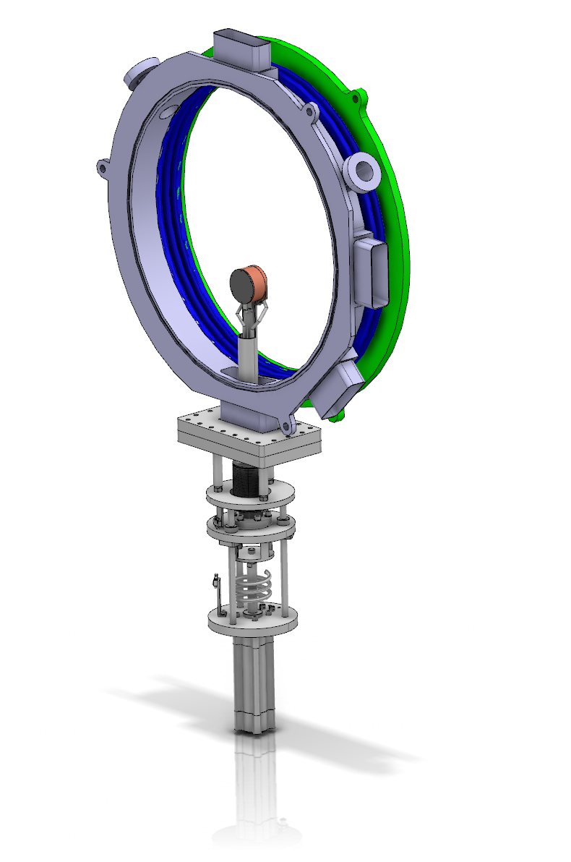
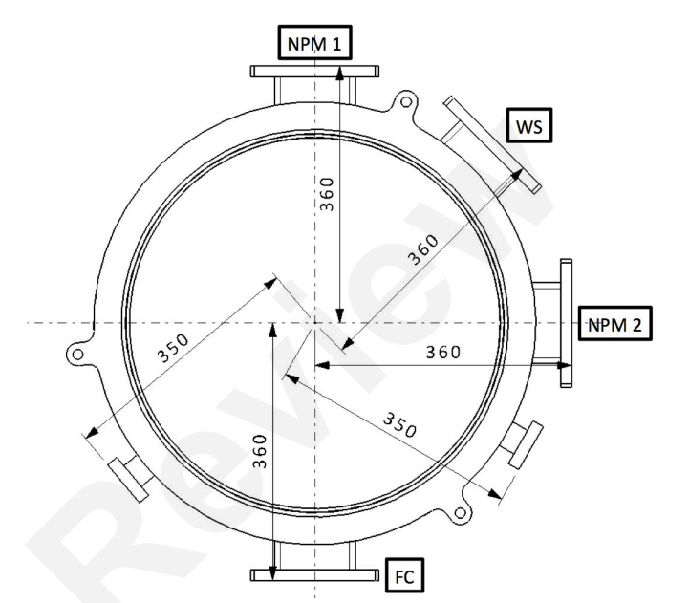
DTL Faraday Cups
Intertank integration

Slide 3
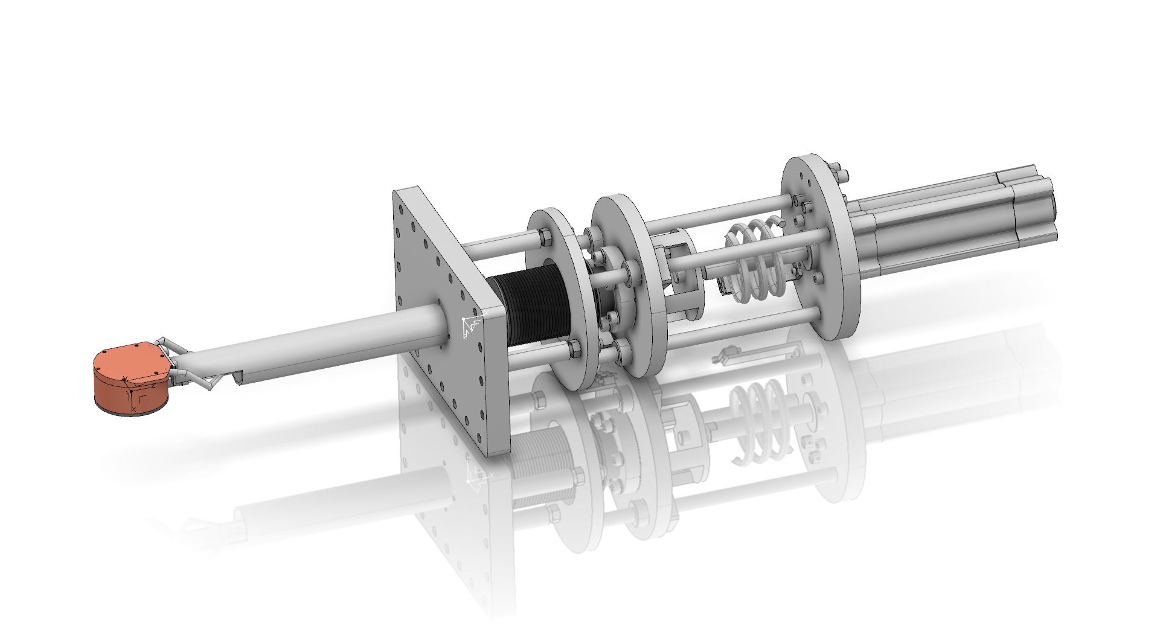
DTL Faraday Cups
Full system
Bellows
Pneumatic actuator with at
least 100mm stroke
ComVAT WS flange
FC

Slide 4
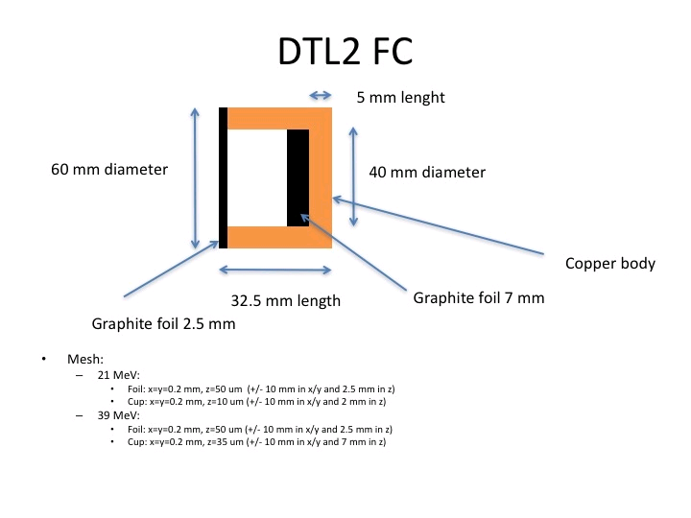
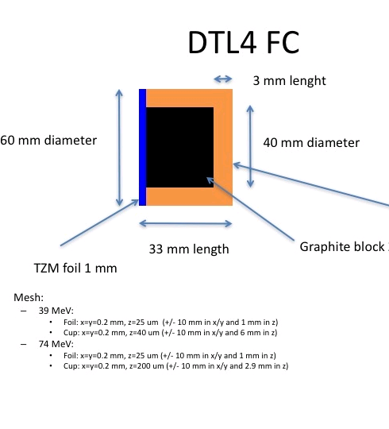
Fluka >> ANSYS
Geometry

Slide 5
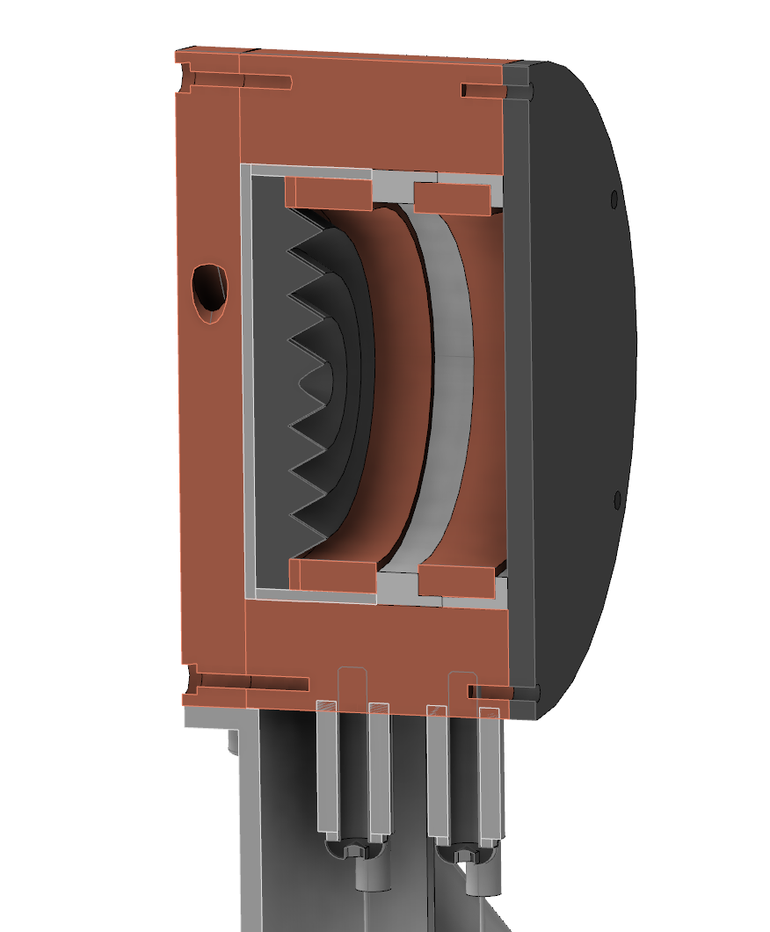
DTL Faraday Cups
DTL2 Design
Copper wall and spring wafer
Repeller
Cooling plate
Graphite collector
Graphite foil
degrader
Alumina insulator
Macor insulator

Slide 6
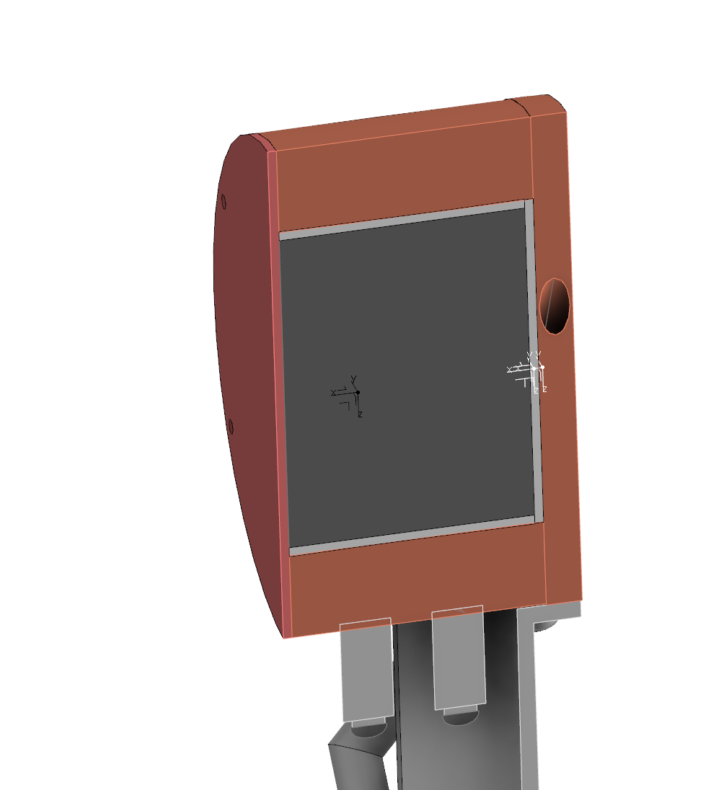
DTL Faraday Cups
DTL4 Design
Copper wall
Cooling plate
Graphite collector
TZM foil
degrader
Alumina insulator
Macor insulator

Slide 7
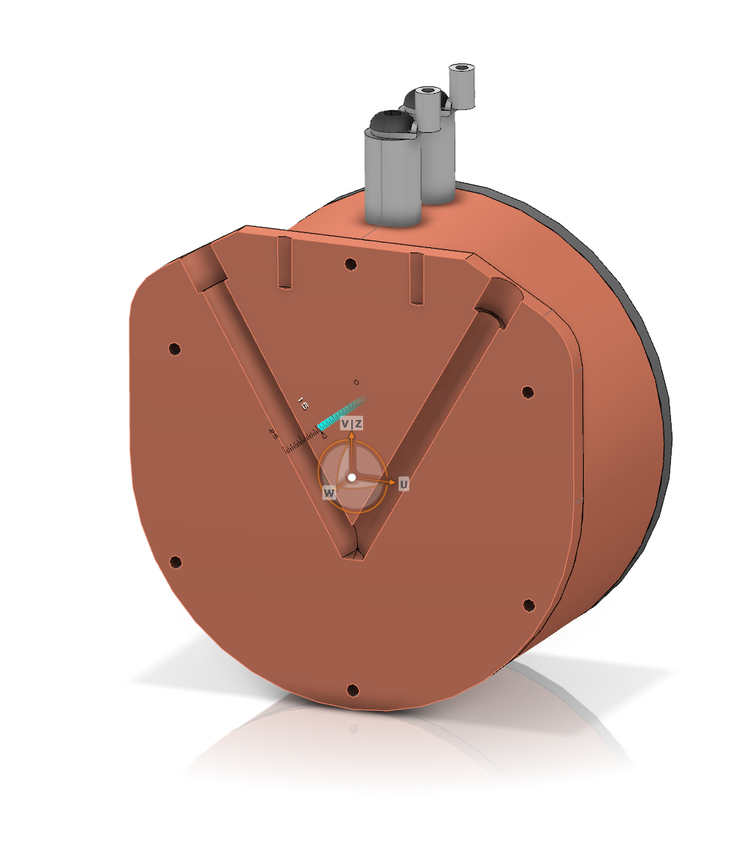
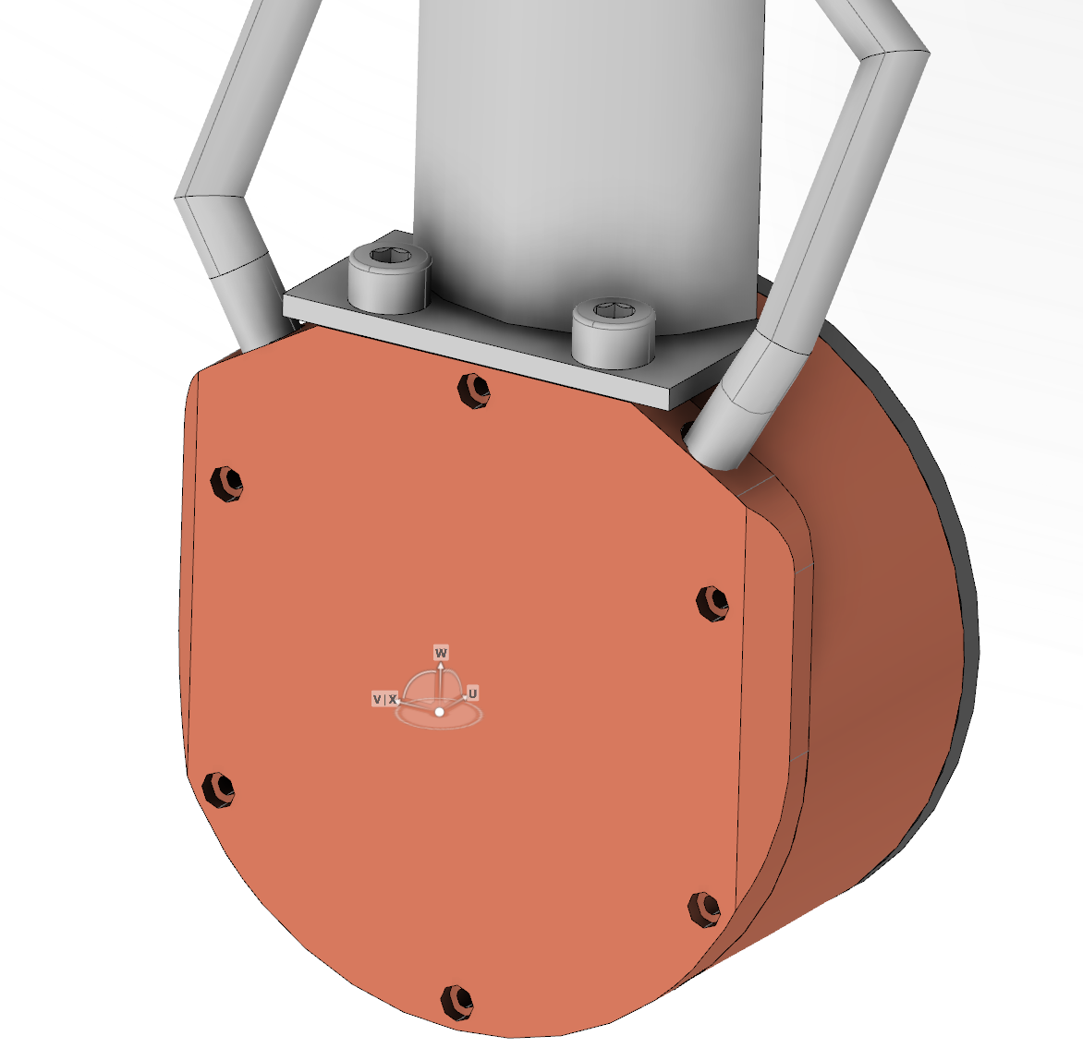
Mechanical Design
Cooling
V-shaped cooling channels

