Slide 1
DTL Faraday Cups
Fluka >> ANSYS
Thomas Grandsaert
Development Engineer
www.europeanspallationsource.se
13 May, 2018

Slide 2
Fluka >> ANSYS
Beam Parameters and Modes
The beam parameters at the DTL FC location can be found at: BPWP-475
Current: 62.5 mA (65mA simulated)
Pulse length: 5/50 µs
Pulse frequency: 14/1 Hz
 | DTL2 | DTL4
21 MeV | sigx: 1.241 +/- 0.043 sigy: 1.161 +/- 0.043 | sigx: 1.392 +/- 0.044 * sigy: 1.317 +/- 0.046 *
39 MeV | sigx: 1.655 +/- 0.048 sigy: 1.751 +/- 0.056 | sigx: 1.107 +/- 0.024 * sigy: 1.175 +/- 0.031 *
57 MeV |  | sigx: 1.351 +/- 0.034 sigy: 1.326 +/- 0.030
74 MeV |  | sigx: 1.801 +/- 0.049 sigy: 1.854 +/- 0.053
*special case

Slide 3
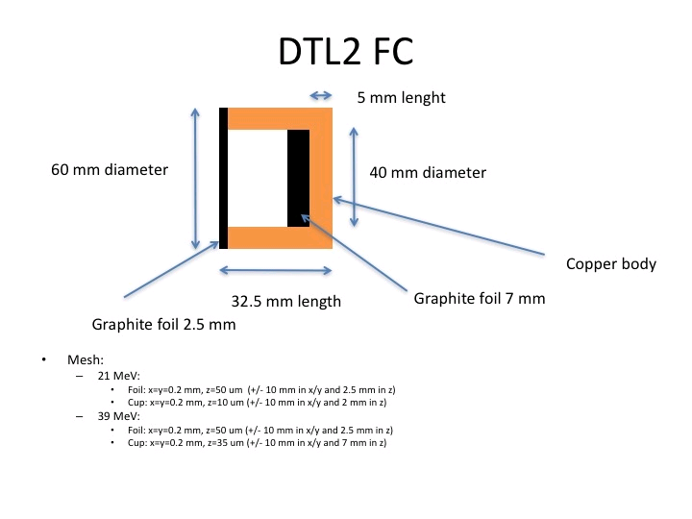
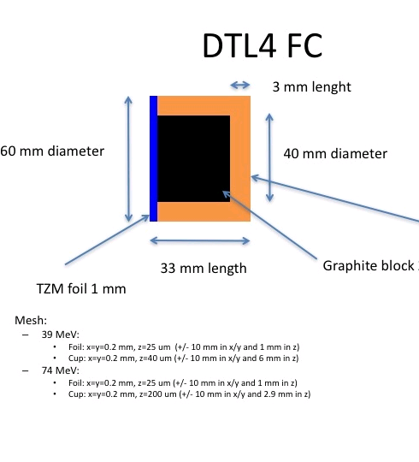
Fluka >> ANSYS
Geometry

Slide 4
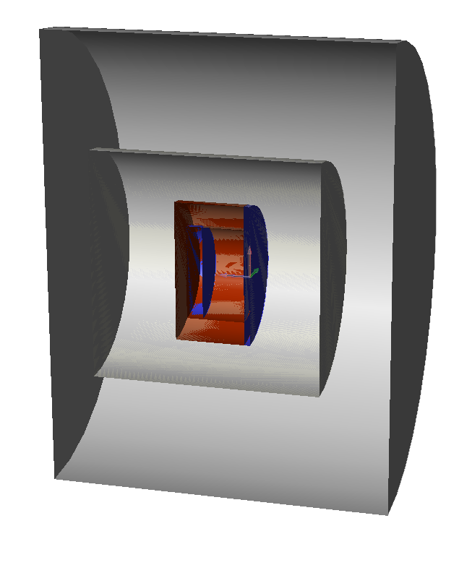
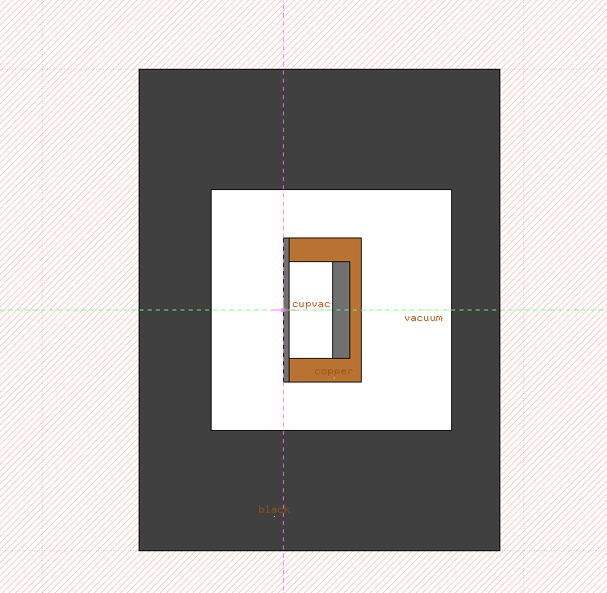
Fluka >> ANSYS
Geometry
Modeled using SimpleGeo
Fluka import

Slide 5
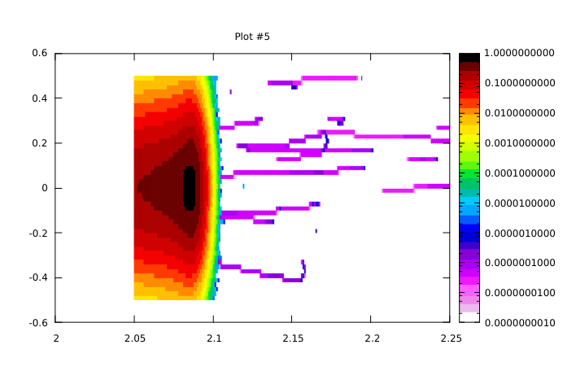
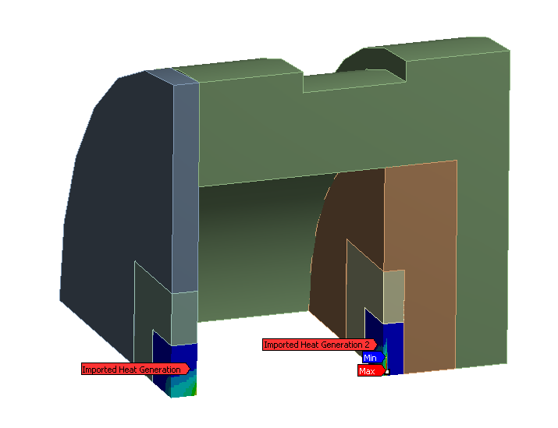
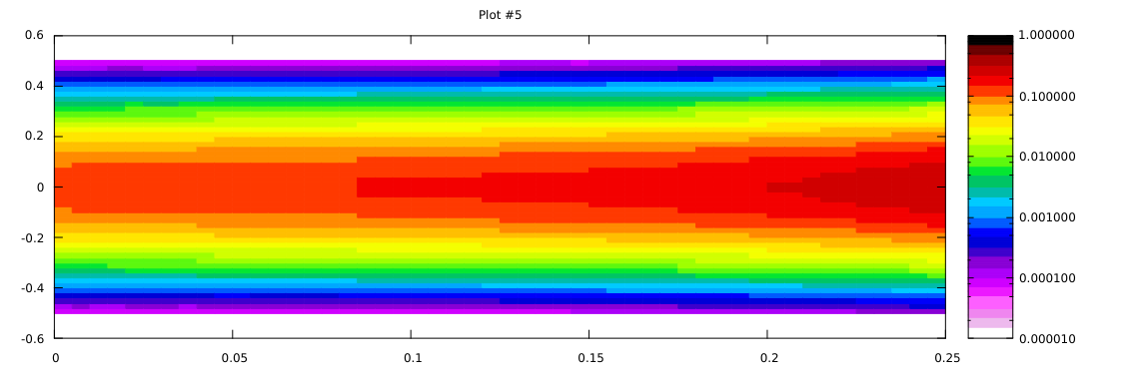
Fluka >> ANSYS
DTL2: Data transfer
DTL2
Normalized Fluka plots in GeV/cm³ per primary
Cup
Fluka ASCII outputs re-normalized (using python)
to W/m³ and mapped to ANSYS coordinate
system (symmetry exploited)
Foil

Slide 6
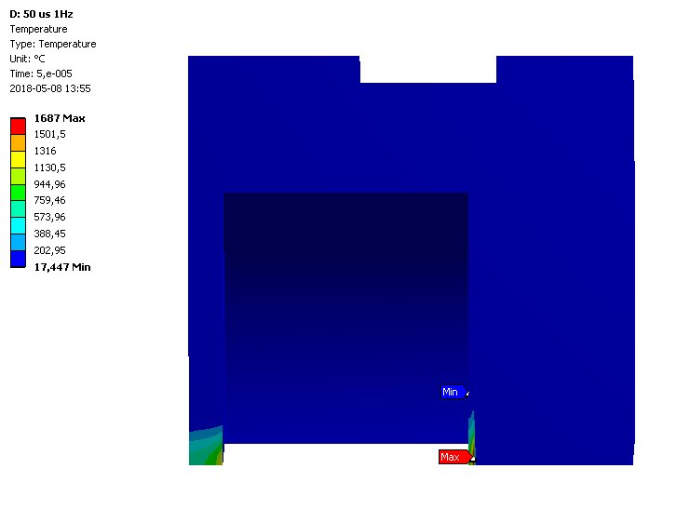
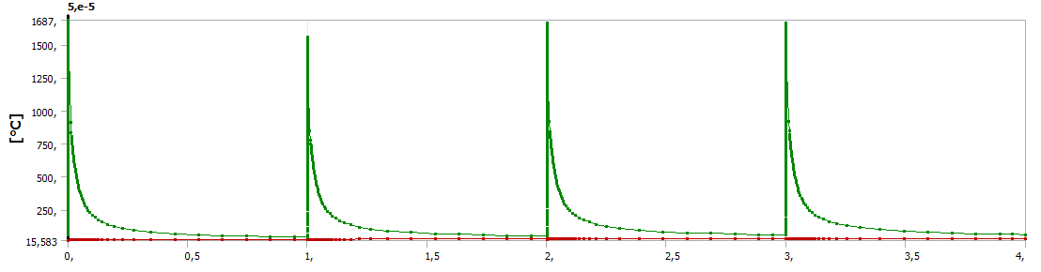
Fluka >> ANSYS
DTL2: Thermal simulations
DTL2 : 21MeV :
50 µs beam at 1 Hz (worst case)
Fluka Graphite density: 1.8 g/m³
Peak ANSYS temp: 1687°C
Graphite evaporation temp: approx. 2400°C
Conclusion:
We can say that it is very unlikely that the FC could withstand full 4% duty cycle at 14Hz (2857 µs pulse)

Slide 7
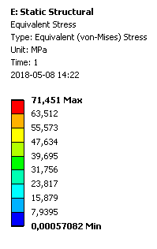
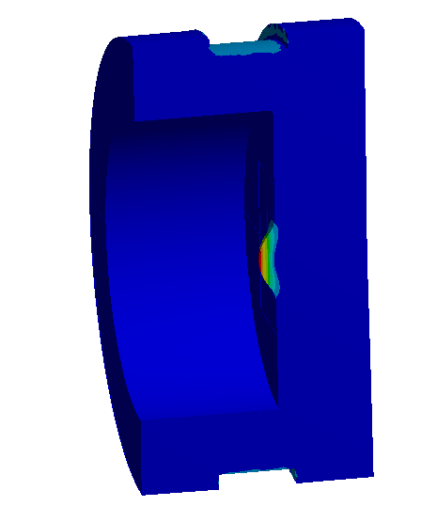
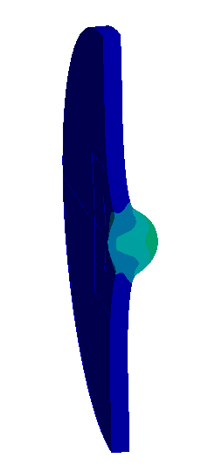
Fluka >> ANSYS
DTL2: Structural simulations
DTL2 : 21MeV :
50 µs beam at 1 Hz (worst case)
Peak von-Mises stress:
foil (graphite): <47 MPa
cup (graphite): 71,451 Mpa
Conclusion:
As the ultimate tensile strength of graphite is approx. 60 MPa, and as such it is required that the cup have a conventional 45° cone shape design, as to increase the surface area by a factor of √2, and decrease the temperature by 70%.
A further Fluka and ANSYS study should be performed to confirm this.
Foil
Cup

Slide 8
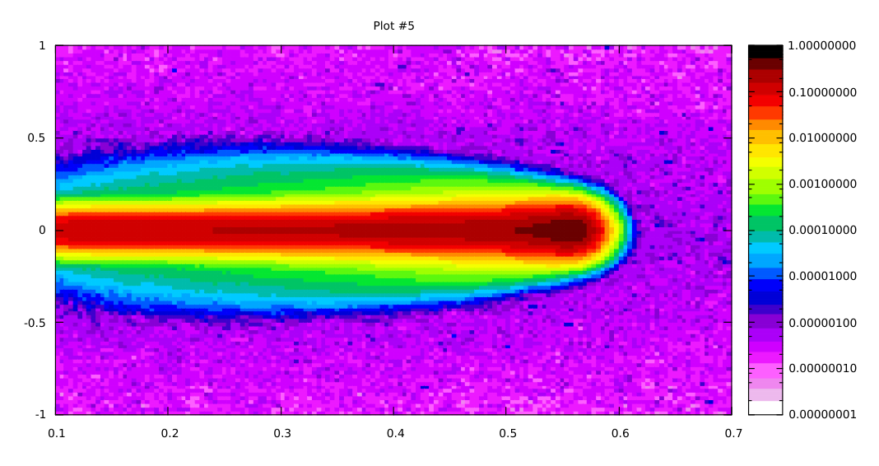
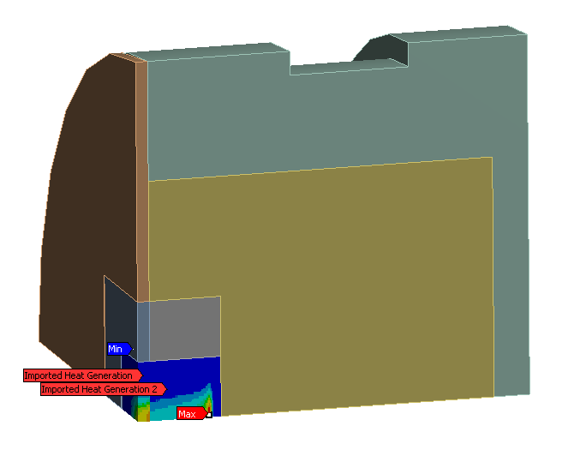
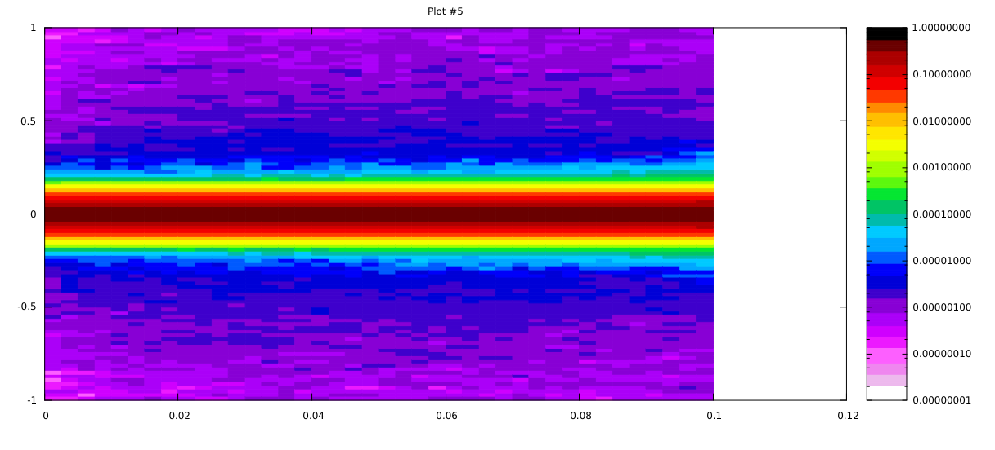
Fluka >> ANSYS
DTL4: Data transfer
Normalized Fluka plots in GeV/cm³ per primary
DTL4
Cup
Fluka ASCII outputs re-normalized (using python)
to W/m³ and mapped to ANSYS coordinate
system (symmetry exploited)
Foil

Slide 9
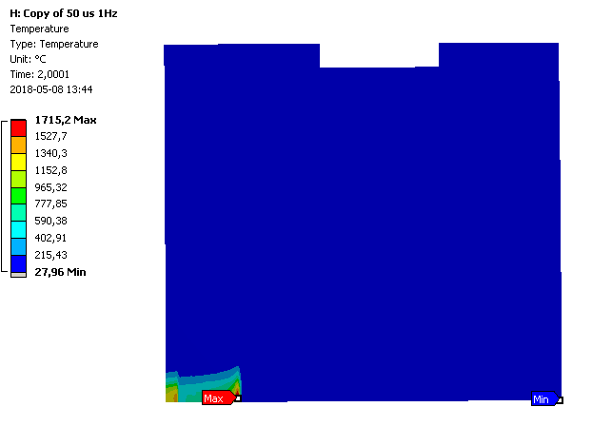
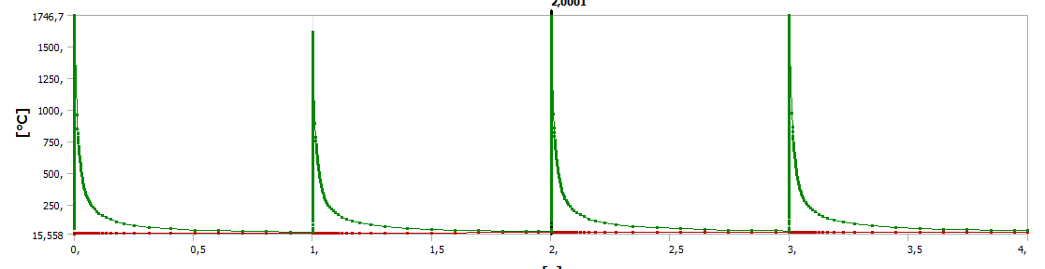
Fluka >> ANSYS
DTL4: Thermal simulations
DTL4 : 39MeV :
50 µs beam at 1 Hz (worst case)
Peak ANSYS temp: 1715,2°C

Slide 10
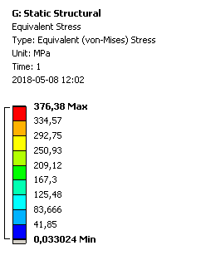
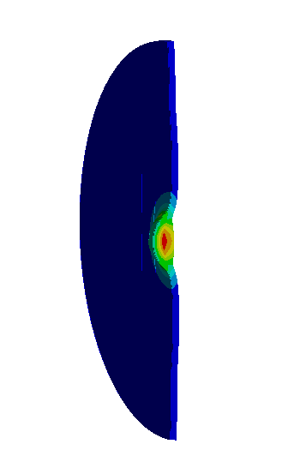
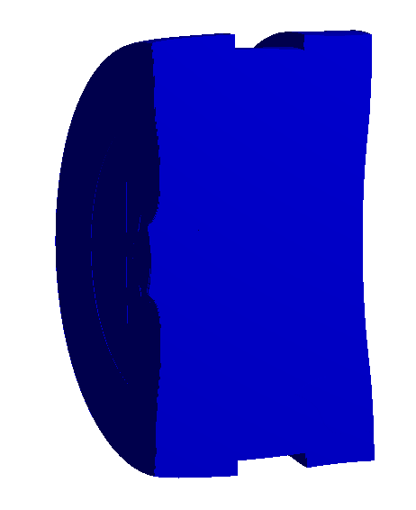
Fluka >> ANSYS
DTL4: Structural simulations
DTL4 : 39MeV :
50 µs beam at 1 Hz (worst case)
Peak von-Mises stress:
foil (TZM): 376 MPa
cup (graphite): <41,85 Mpa
Conclusion:
Must be careful to select the type of TZM because recrystallization (loss of subgrains) cause a steep drop in the yield strength, especially at high temperatures (150-600 MPa)¹
Foil
Cup
¹ T Mrotzek et al 2010 J. Phys.: Conf. Ser. 240 012079

Slide 11
To be done…
DTL2
  Cone shape (45° simulation) should be performed to confirm compliance with graphite material limitations
DTL4
  TZM material properties need to be strictly defined in technical spec. to avoid problems with material limitations, or the FC design needs to be changed
Activation studies are still to be performed, but should be moving forward soon with support from new colleagues (Elena).
Full pulse will likely (99.999%) vaporize the graphite

