Slide 1
ICS contribution
EtherCAT based Control
Julen Etxeberria
Entry-level Controls Engineer
www.europeanspallationsource.se
May 14, 2018

Slide 2
Common Hardware Infrastructure (EtherCAT)
EtherCAT is the technology chosen by ICS
to meet real-time requirements (kHz DAQ system)
open protocol with an available Linux open source master.
high performance and it is faster that the most other fieldbuses.
It is a real-time Ethernet-based fieldbus
flexible topology
high synchronization between nodes
For instance, EtherCAT will be used when the I/O system needs to be beam-synchronous; needs to acquire signals in the kHz range; or needs to be spread across locations that are far from each other and would need cumbersome cabling, but still belong to one system.
Moreover Motion Control and Automation Group (MCAG) has chosen open source EtherCAT technology to cover motion control systems.

Slide 3
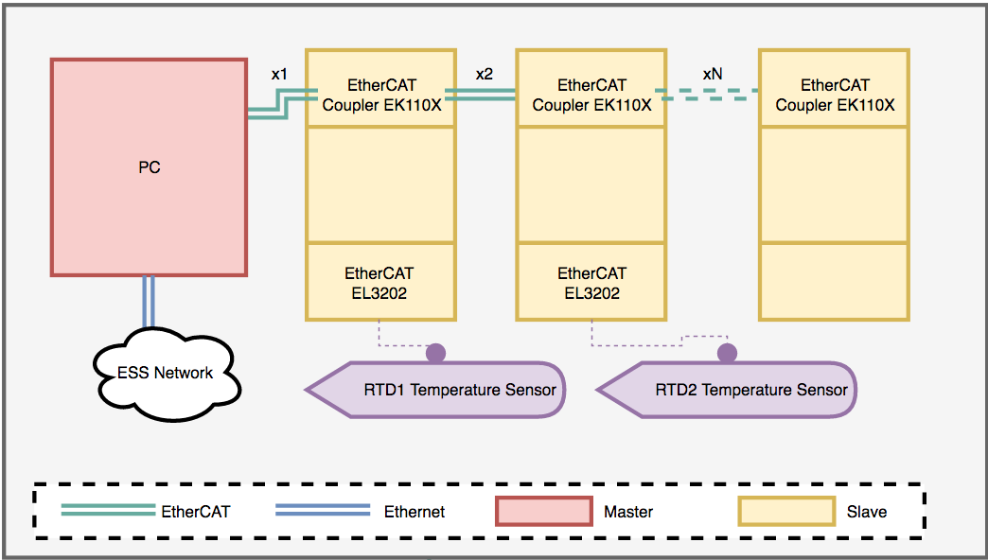
EtherCAC chain example

Slide 4
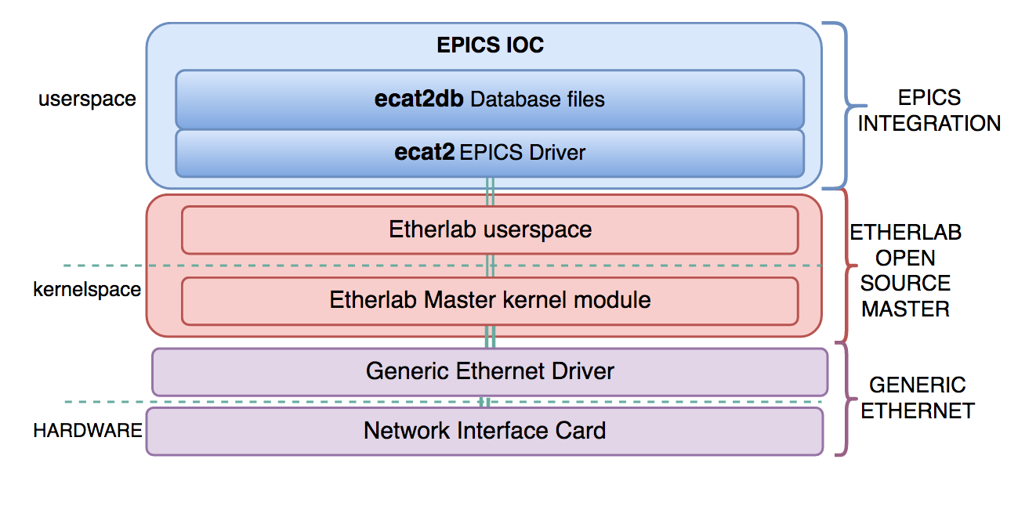
Integration support into EEE

Slide 5
Current set up for LEBT Farady Cup
We currently have in the lab an EtherCAT crate with these modules for the faraday cup (LEBT) control.
ES3602: analog input, bias current and voltage read back from ISEG (2 channels module)
ES4134: analog output, ISEG bias current and voltage setpoints (4 channels module)
ES2124: digital output 5V, ISEG bias output control (4 channels module)
ES2004: digital output 24V, move FC (4 channels module)
ES1014: digital input 24V, in and out switches readout (4 channels module)

Slide 6
MPS development and Beam Interlock System
Prevent Device to exit/enter the beam pipe when Device is the requested, by locking all Device motion controller actions.
Stop beam operation if Device is not fully extracted when Device is upstream of the requested beam destination, by monitoring the Device OUT position switch.
Stop beam operation if Device is the requested beam destination and Device water cooling flow is below/above acceptable limits.
https://chess.esss.lu.se/enovia/link/ESS-0145199/21308.51166.36608.57100/valid
https://chess.esss.lu.se/enovia/link/ESS-0151691/21308.51166.33792.60924/valid

Slide 7
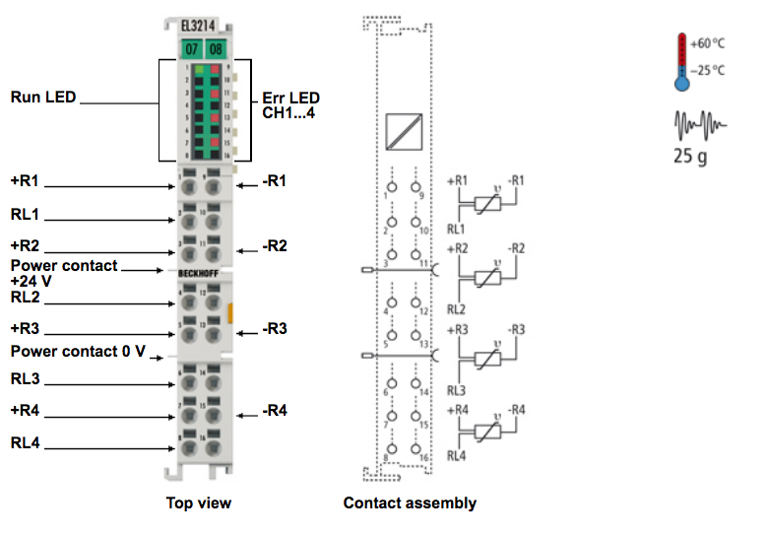
EL3214 | 4-channel input terminal PT100 (RTD) for 3-wire connection

Slide 8
Questions?

