Slide 1
Status of ACCSYS
ESSI-ESS governance meeting
Mats Lindroos, Sub-Project Manager
www.europeanspallationsource.se
May 2018

Slide 2
Summary
Accelerator scope and organisation
  23 Partners representing 50% of the budget
Accelerator earned value status
  40% complete and 85% committed
New critical path and delays since 2013
  19-24 months driven by IK delivery delays
Overview of budget and request for additional funds for installation
5 top risks

Slide 3
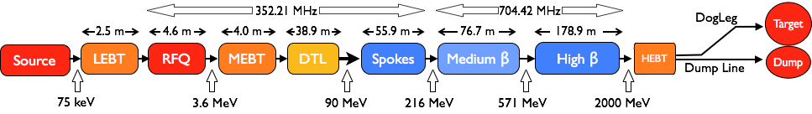
Accelerator – Scope
Accelerator Technical performances
Key parameters:
    -2.86 ms pulses
    -2 GeV
    -62.5 mA peak
    -14 Hz
    -Protons (H+)
    -Low losses
    -Minimize energy use
    -Flexible design for mitigation and future upgrades
Design Drivers:
High Average Beam Power
5 MW
High Peak Beam Power
125 MW
High Availability
95%
18 IK partners in 8 countries and 5 collaboration partners
1.3 GeV capacity with 2 MW on target for 2023 with remaining RF sources (40) to be installed after 2026

Slide 4






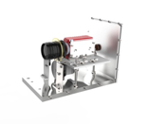
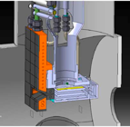
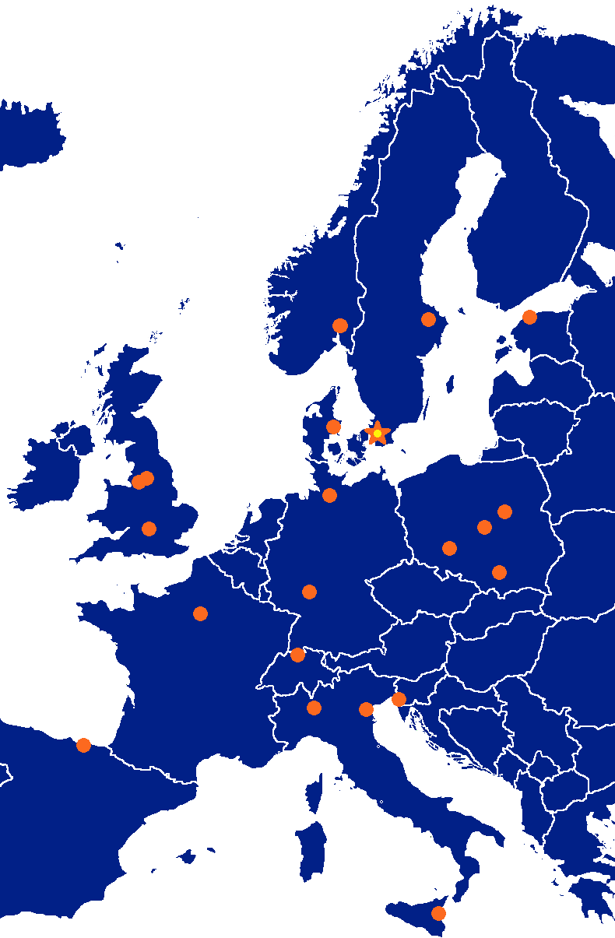




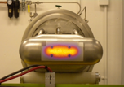






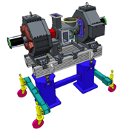









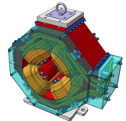

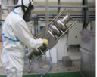

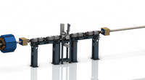













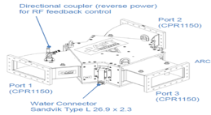
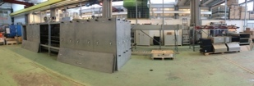
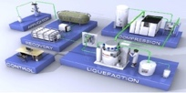











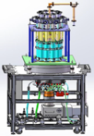
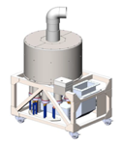



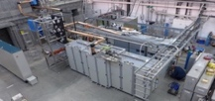
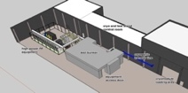
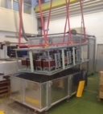
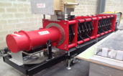
Accelerator Collaboration
4

Slide 5
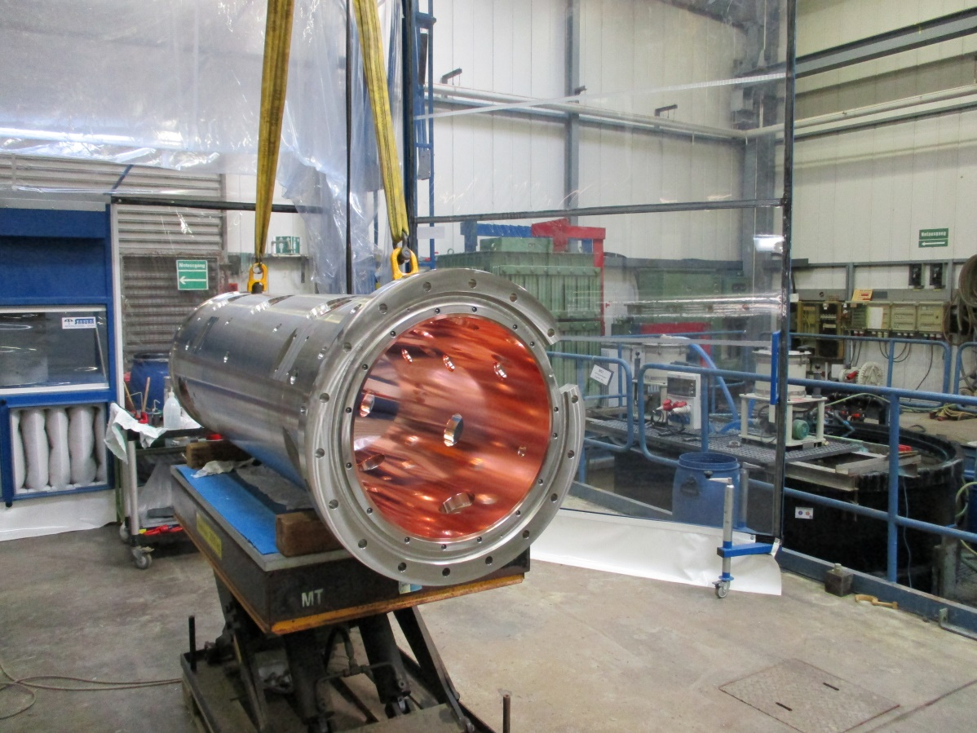
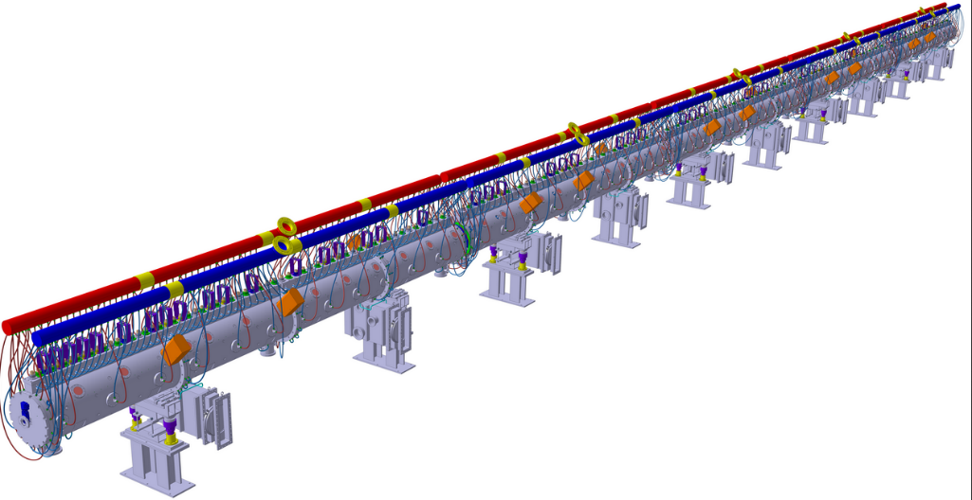
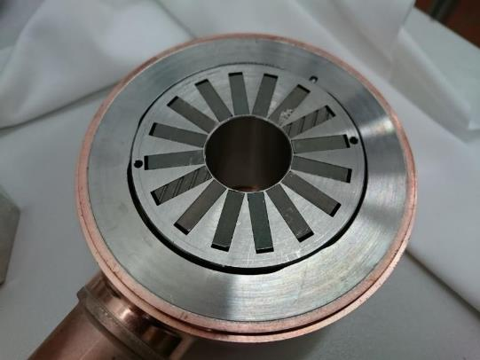
Drift Tube Linac (DTL) Mechanical assembly (40 m long)
The largest normal conducting part
The drift tubes equipped with permanent magnet quadrupoles are centered with 0.1 mm precision

Slide 6
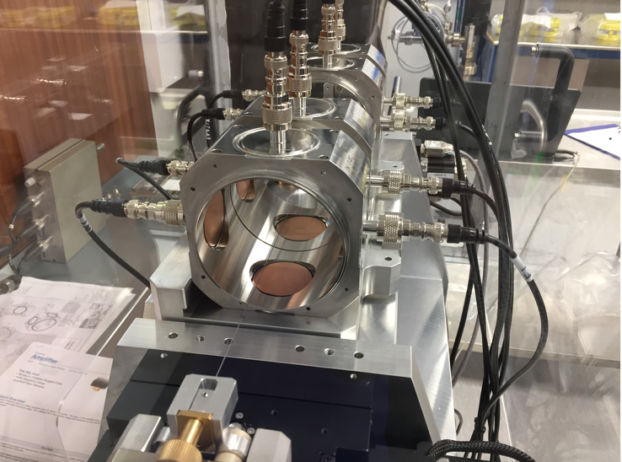
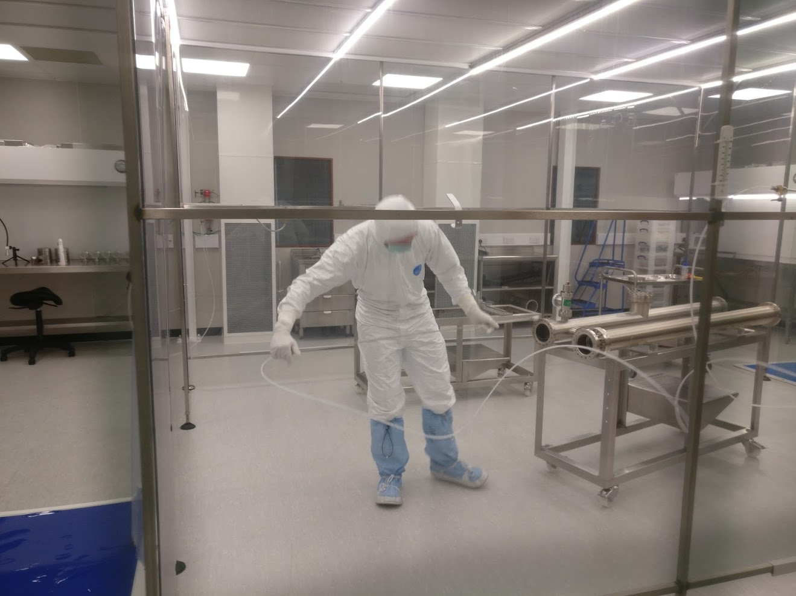
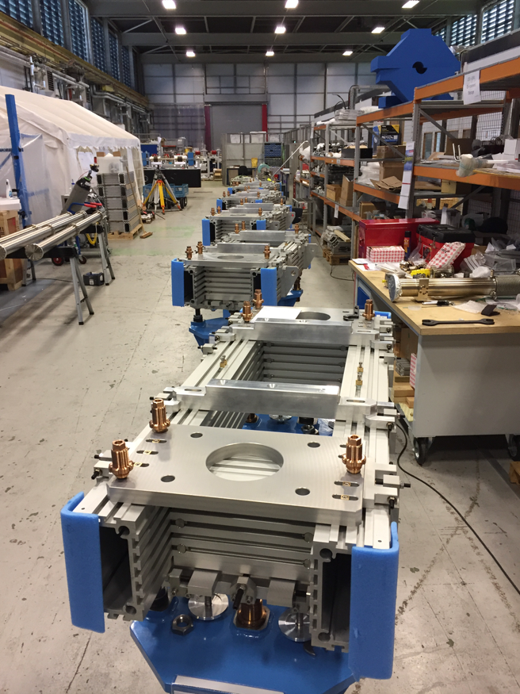
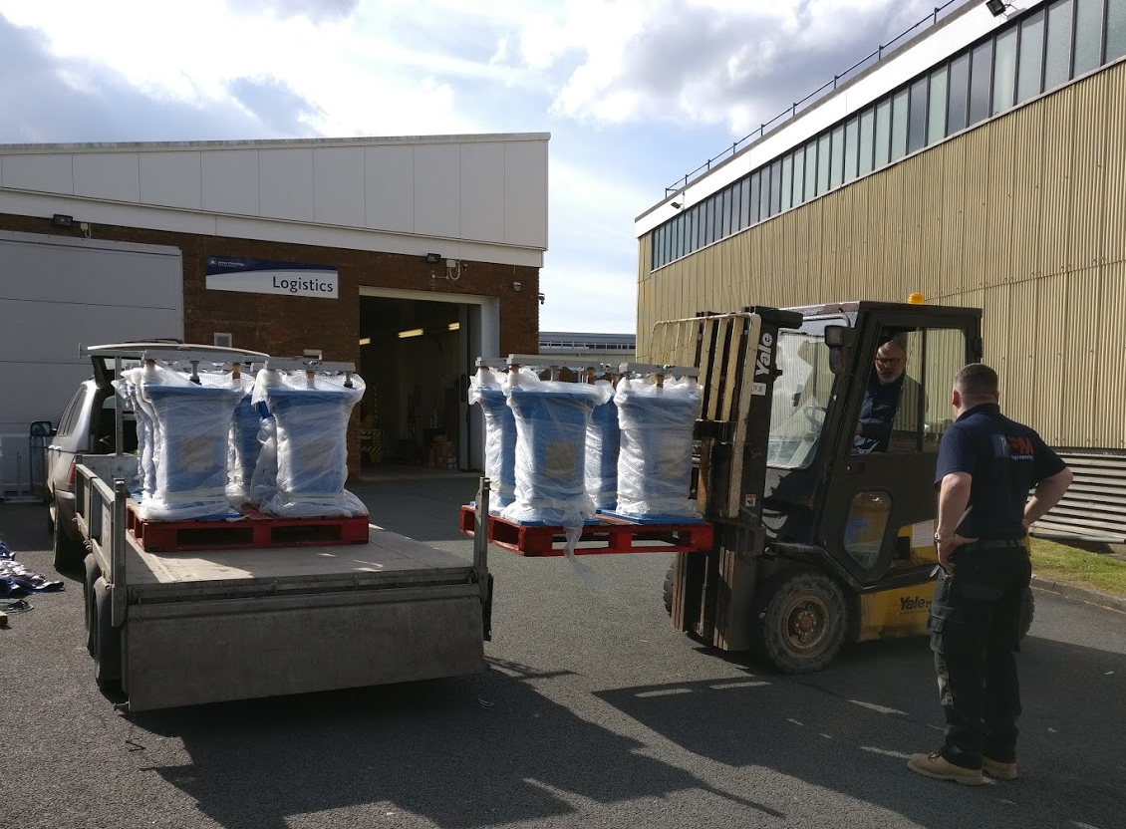
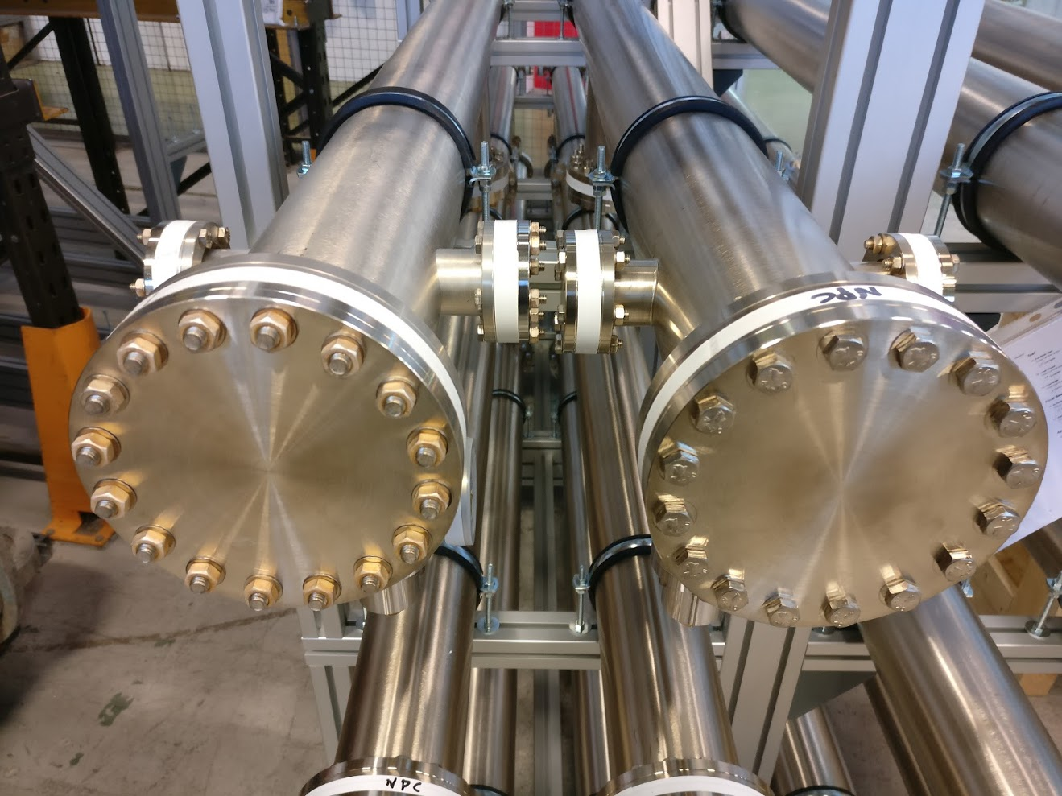
High-light STFC – Linac Warm Units (LWU)
LWU builds on going.
All BPMs for Elliptical sections now at Daresbury
Next Delivery of Dummy Cryo Modules in May

Slide 7

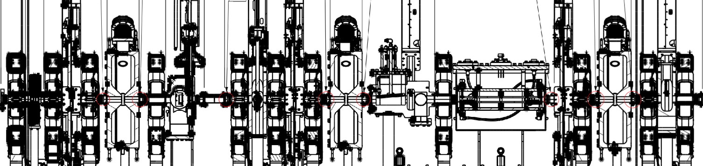
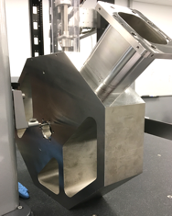
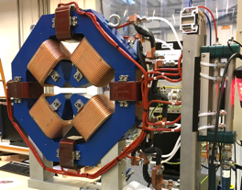
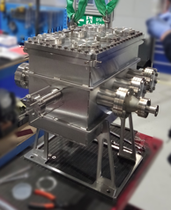
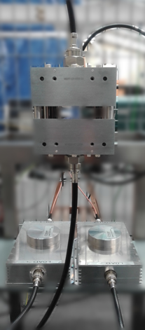
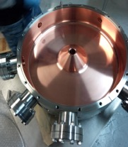
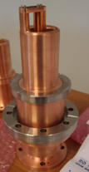
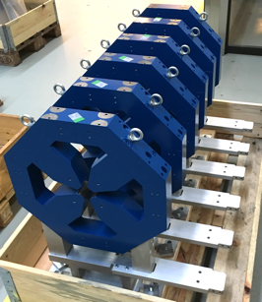
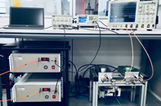

ESS Bilbao: Medium Eneregy Beam Transport (MEBT)
DIAGNOSTIC
VESSELS
BUNCHERS &
RF COUPLER
ProtonBeam
Instrumentation
FAST CHOPPER
QUADRUPOLES

Slide 8
Accelerator Systems (sub-) Project (ACCSYS) – organization
WBS/WP# | TITLE | LEADER | EXT. WP | DEPUTY WP LEADER for EXTERNAL WPS | PCC
11 11.01 | ACCSYS MANAGEMENT | M. LINDROOS J.G. WEISEND II | NO |  | 110100001 & 110100002
11.02 | ACCELERATOR PHYSICS | M. ESHRAQI | NO |  | 110200001
11.03 | NORMAL CONDUCTING FRONT END | S. GAMMINO | YES | E. SARGSYAN | 110300001
11.04 | SPOKE CRYOMODULES | G. OLRY | YES | C. DARVE | 110400001
11.05 | ELLIPTICAL CRYOMODULES | P. BOSLAND | YES | C. DARVE | 110500001
11.06 | BEAM DELIVERY SYSTEMS | S. MØLLER | YES | I. ALONSO | 110600001
11.07 | BEAM DIAGNOSTICS | T. SHEA | MIX |  | 110700001
11.08 | RF SYSTEMS | M. JENSEN | MIX |  | 110800001
11.09 | Not used
11.10 | TEST STANDS | W. HEES | MIX |  | 111000001
11.11 | CRYOGENICS | P. ARNOLD | MIX |  | 111100001
11.12 | VACUUM | M. JUNI-FERRERA | MIX |  | 111200001
11.13 | SAFETY & OPS | L. TCHELIDZE | NO |  | 111300001
11.14 | LINAC | H. DANARED | NO |  | 111400001
11.15 | ELECTRICAL SUPPORT | F. JENSEN | NO |  | 111500001
11.16 | COOLING SUPPORT | A. LUNDMARK | NO |  | 111600001
11.17 | POWER CONVERTERS | C. MARTINS | MIX |  | 111700001
11.18 | ENGINEERING RESOURCES |  | NO |  | 119900001
11.98 | GENERAL INSTALLATION SUPPORT | H. DANARED | NO |  | 119800001
11.99 | INSTALLATION | H. DANARED | NO |  | -
Accelerator Collaboration Board (ACB) – meets twice annually:
Reps from each IKC & collaborating institute (one elected as chair)
ESS Technical Director
ACCSYS Sub-Project leader
Accelerator Technical Board (ATB) – meets quarterly:
AccMT & all WP leaders and deputies
Reps of all contracted institutes if not already a WP leader
ESS Machine Management Team members invited
Accelerator (Project) Management Team (AccMT) – meets weekly:
Mats Lindroos: Project Leader
Caroline Prabert: Administration
John Weisend II: Dep. Proj Leader (WP 1) & STS (WPs 11,12,15,16)
Lena Gunnarsson & Magnus Israelsson: Project Planners
Lali Tchelidze: Invited in 2018 for licensing
Peo Gustafsson: IKC coordination manager and infrastructure sub-project leader
Håkan Danared: Linac systems leader (WPs 3,4,5,6,14) and Installation coordinator (WPs 98,99)
Andreas Jansson: Beam Physics, Diagnostics, Init ops planning mgr (WPs 2,7)
Anders Sunesson: RF power systems leader (WPs 8,17)
Note: Section Leaders (AD line) can be called to participate in AccMT meetings
IKC coordination, IKC liaisons & BrightNESS IKC ‘field coordination’:
Peo Gustafsson: IKC coord mgr Ebbe Malmstedt (C): assists overall IKC coord and risk manager at AD
Georg Hulla: for WP 3 IKC Felix Schlander: for WP 4 & WP 5
Frank Hellström (C): for WP 3 IKC Nuno Elias: for WP 4 & WP 5 IKC
Fredrik Håkansson (C): for WP 4 & 5

Slide 9
Accelerator Division– organigram for line org and In-kinds
Head Count: 135 (2018-05-15)
87 employees
38 from Eng & Integr Support, Consultants, Students, Planners
13 In-kind
Mats Lindroos – Head of Division
Håkan Danared – Deputy Head of Division
John Weisend II – Deputy (sub) Project Leader
Administration
Caroline Prabert
Inga Tejedor
WeiYing Li
Planning and Project Control
Lena Gunnarsson
Magnus Israelsson
Nicholas Evans
Diana Bergenholtz
Installation
Håkan Danared
Olle Lagerblad
Marcus Green (C)
Dennis de Wit (C)
Emmanouil Trachanas (C)
Christoforos Kourkoutis (C)
Carl-Johan Hårdh (C)
Mats Pålsson (C)
Pontus Jönsson (C)
Jenny Cerne (C)
Rasmus Johansson (C)
Nicolas Eke (C)
IKC Coordination
Peo Gustafsson
Ebbe Malmstedt (C)
IN-KIND from IFJ PAN Poland
Leszek Hajduk
Krzysztof Myalski
Michal Sienkiewicz
Tadeusz Ostrowicz
Edward Gornicki
Wawrzyniec Gaj
Jan Zbroja
Marek Skiba
Karol Kasprzak
IN-KIND from Warsaw University of Technology
Krystian Bec
Quality
Kent Wigren (C)
Beam Physics, Operations & Beam Diagnostics
Andreas Jansson - GL
Beam Physics
Mamad Eshraqi – SL
Renato de Prisco
Ryoichi Miyamoto
Yngve Levinsen
Ciprian Plostinar
Natalia Milas
YuanShuai Qin (S)
ZhiJun Wang (C)
IN-KIND from Norway
Øystein Midttun, Bergen
Greyson Christoforo, Oslo
Linac
Håkan Danared- GL
Cecilia Maiano
Radio Frequency Systems
Anders Sunesson- GL
Specialized Technical Services
John Weisend II – GL
Gunilla Jacobsson
Power Converters
Carlos Martins – SL
Göran Göransson
Marko Kalafatic
Rutambhara Yogi
Petro Pohorilo
Dana McKenzie
Anders Andersson (C)
Cryogenics
Philipp Arnold – SL
Jaroslaw Fydrych
John Jurns
Xilong Wang
Xiaotao Su
Johnny Råström
Mattias Olsson
Per Nilsson
Romain Goncalves (2018-05-23)
Ila Sjöholm (C)
Piotr Tereszkowski (C)
Fredrik Nilsson (C)
IN-KIND from INFN, Italy
Gianluigi Cibinetto
Beam Diagnostic
Tom Shea– SL
Cyrille Thomas
Hooman Hassanzadegan
Hinko Kocevar
Irena Dolenc Kittelmann
Rafael Baron
Edvard Bergman
Clement Derrez
Slava Grishin
Dmitri Gudkov
Elena Donegani
Thomas Grandsaert (EIS)
Johan Norin (C)
Mehdi Mohammadnezhad (C)
Accelerator Integration
Vacant– SL
Iñigo Alonso
Front End & Magnets
Edgar Sargsyan – SL
Georg Hulla
Janet Schmidt
Richard Bebb
Frank Hellström (C)
Saverio Ardovino (C)
RF Sources
Morten Jensen – SL
Rihua Zeng
Rafael Montano
Bruno Lagoguez
Chiara Marrelli
Staffan Ekström
Stevo Calic
Iñigo de la Fuente
Anders Svensson
Christian Amstutz
Walther Borg
Anirban Krishna Bhattachanyya
Linus Ternelius Svensson (2018-06-18)
Utilities and Test Stand Wolfgang Hees - SL
Anton Lundmark
Evangelia Vaena
Frithiof Jensen
Emilio Asensi
Owen Buchan
Steven McGlasson
Lars Rosberg
Jörgen Jönsson (EIS)
Akif Coku (C)
Andreas Olenmark (C)
Fredrik Persson (C)
Susanna Sjöström (C)
Weiming Yue (S) (2018-06-01)
Superconducting RF
Paolo Pierini – SL
Christine Darve
Felix Schlander
Saeid Pirani
Nuno Elias (EIS)
Fredrik Håkansson (C)
Younguk Sohn (visitor until June 2018)
Vacuum
Marcelo Juni Ferreira – SL
Hilko Spoelstra
Simone Scolari
Christophe Jarrige
Fabio Ravelli
Kristell Barthélemy
Ralf Huber
Laurence Page
Fredrik Svensson
Henric Gunnarsson
Peter Ladd (C 50%)
Operations
Lali Tchelidze – SL
Marc Munoz
Aurélien Ponton
Frank Kornegay (C 15%)
Notes:
§

Slide 10
Accelerator scope - linac
System | IK/ESS | Scope | Status | Comments
Ion source and LEBT | IK - INFN | Design (D), Procurement, Manufacturing and assembly (PMA), testing (T) and Installation (I) | Ready for C and I for infrastructure | Installed in February 2018
MEBT | IK- Bilbao | D, PMA, T, I | PMA
RFQ | IK- CEA | D, PMA, T, I | PMA | All couplers conditioned
DTL | IK - INFN | D, PMA, T, I | PMA
Spoke SRF (13 CM) | IK- CNRS | D, PMA | PMA | Prototype testing now
M-beta SRF (9 CM) | IK- CEA, INFN, CNRS | D, PMA, T (3 CM at CEA) | PMA | Prototype testing now
H-beta SRF (21 CM) | IK - CEA, STFC, CNRS | D, PMA | PMA | To 1.3 GeV, first 11 CMs
Linac Warm Units (73 units) | IK – STFC, Elettra | D, PMA | PMA | Magntes and power supplies, Elettra
Raster system | IK - Aarhus | D, PMA, T, I | PMA | First unit testing now
Beam instrumentation (514 devices) | IK and ESS | D, PMA, T, I | PMA | Several systems completed

Slide 11
Accelerator major systems – RF, cryo, testing, installation and commissioning
System | IK or ESS | Scope | Status | Comments
RF NC linac 352 MHz | IK- Bilbao | D, PMA, T, I | PMA | 5 klystrons, 3 modulators, RFdis and LLRF
LLRF Elliptical linac | IK - PEG, Atomki | D, PMA, T, I | PMA | First series klystron now at ESS
RF klystrons 704 MHz (80 klystrons) | ESS | D, PMA, T, I | PMA for 36 klystrons | 44 klystrons still to be ordered for H-beta
Modulators (20) | ESS | D, PMA, T, I | PMA for 9 Modulators | 11 Modulators still to be ordered for H-beta
Cryoplants (2) | ESS | D, PMA, T, I, C | T: TICP, I: ACCP
Cryodstribution | IK - Wroclaw, IPNO | D, PMA, I | PMA
Testing Spoke | Collab - Uppsala | T | T
Testing elliptical | ESS | T |  | Test stand under construction
Integration | ESS | D | D | Several ESS divisions
Installation RF | IK – IFJPAN and ESS | I | I
Installation linac | IK and ESS | I | I
Testing and commissioning | ESS | T, C | T | Support from IK partners

Slide 12
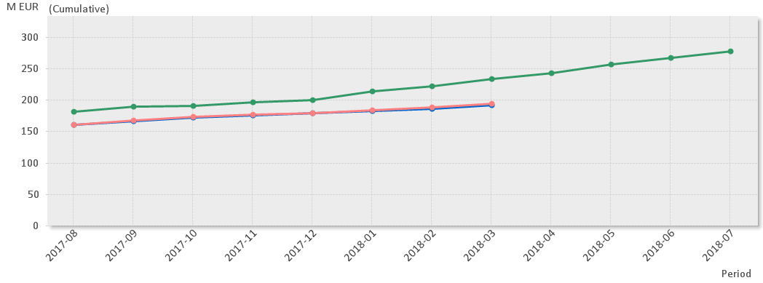
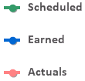

Before re-baseline: Earned Value Graph for baseline with beam in June 2019 with 40% complete
(* No InKind included)
Current Status
Cumulative Cost Variance is by end of Mar -2.1 M€ out of which at least 1.6 M€ is recoverable
Main contributors to the CV are: Cooling Support, Electrical Support and Beam Delivery Systems.
Cumulative Schedule variance is by end of Mar -40.9 M€.
Main contributors to the SV are: Elliptical SRF incl cryomodules, Vacuum and NCFE. 31 M€ of the Schedule variance is In-Kind work.

Slide 13
CRITICAL PATH MAY 2019
ISrc to Beam Dump (BOD)
ISrc to DTL1
ISrc to DTL4
8/2/2021
RBOT
4/11/2019
27/4/2020
24/5/2021
2018
2019
2020
2021
2018
2021
17/12/18 - 12/07/19
RFQ + DTL 1 RF System
75 days
Today
15/07/19 - 26/07/19
PSS1 Validation
29/07/19 - 18/10/19
RFQ, MEBT, DTL1 RF Conditioning
10 days
21/10/19 - 01/11/19
SRR2
15 days
04/11/19 - 31/01/20
ISrc to DTL1 Beam Commissioning
150 days
27/05/19 - 31/01/20
Full NC Linac RF System
10 days
03/02/20 - 14/02/20
PSS1 Re-Validation
60 days
17/02/20 - 10/04/20
DTL2, 3, 4 RF Conditioning
10 days
13/04/20 - 24/04/20
SRR3
65 days
27/04/20 - 17/07/20
ISrc to DTL4 Beam Commissioning
180 days
20/07/20 - 21/08/20
DTL5 Installation
03/12/18 - 15/11/19
Elliptical CDS Installation
10 days
19/08/19 - 15/11/19
SPK CDS Installation
40 days
18/11/19 - 07/08/20
SPK CM Installation
10 days
18/11/19 - 01/06/20
MBL CM Installation
60 days
01/06/20 - 07/08/20
HBL CM Installation
25 days
12/08/19 - 13/12/19
HBL1 LWU Installation
65 days
16/12/19 - 27/03/20
A2T LWU Installation
120 days
30/03/20 - 19/06/20
MBL/HBL2 LWU Installation
290 days
22/06/20 - 07/08/20
SPK LWU Installation
290 days
10/08/20 - 25/09/20
Final HBL/SPK LWU Installation
250 days
12/08/19 - 25/09/20
SPK RF Power Stations
- PSS/SRR
28/09/20 - 16/10/20
Full PSS Validation
141 days
19/10/20 - 13/11/20
DTL5 and SC Linac - Warm RF Conditioning
50 days
- NC Linac
16/11/20 - 11/12/20
CDS and CMs Cooldown and Tests
15 days
- SC Linac, HEBT, A2T
14/12/20 - 22/01/21
SC Linac - Cold RF Conditioning
20 days
25/01/21 - 05/02/21
SRR4
20 days
- Beam Commissioning
08/02/21 - 07/05/21
ISrc to DMPL Beam Comm.
10 days
10/05/21 - 21/05/21
SRR5
75 days
20 days

Slide 14
Accelerator In-Kind contracts
More details on each delivery in Ciprian Plostinar’s talk
ACCSYS | France | CEA | IKC | AIK 3.4 | Radio-frequency Quadrupole | 8 710 000
ACCSYS | France | CEA | IKC | AIK 5.1 | Elliptical Linac H-ECCTD, High Beta Elliptical cavities and cryomodule demonstrator | 4 294 000
ACCSYS | France | CEA | IKC | AIK 5.2 | Elliptical Cryomodules Components Supply | 38 618 000
ACCSYS | France | CEA | IKC | AIK 5.3 | Elliptical Cryomodules Engineering and Assembly | 19 395 000
ACCSYS | France | CEA | IKC | AIK 5.5 | Technical assistance in installation and commissioning of the medium and high beta cryomodules | 600 000
ACCSYS | France | CEA | IKC | AIK 7.1 | Emittance Measurement Unit for the low energy beam transport | 311 000
ACCSYS | France | CEA | IKC | AIK 7.2 | Beam Diagnostics (Doppler Shift Measurement for Low-Energy Beam Transport) | 78 000
ACCSYS | France | CEA | IKC | AIK 7.3 | Non-invasive profile monitor | 1 549 386
ACCSYS | France | CEA | IKC | AIK 7.9 | Neutron beam loss monitor | 1 180 000

Slide 15
Comments on possible further delays
The In-Kind deliverables that presently are on the critical path are:
  ESS-Bilbao (cash flow issues and procurement issues)
  IPNO (procurement issues)
  Elettra (VAT issues)
  STFC (delay from Elettra for magnets)
  Wroclaw (Cashflow and procurement issues)
  LASA (Procurement issues) and CEA (Technical and delay with cavities)
  STFC and CEA (first two on CP, remaining after RBOT)
On the near critical path:
  INFN (procurement issues)
Many IK partners have several competing activities running in parallel, priorities are often set by IK lab management at higher level
If ESS services such as ICS, Infrastructure, Electrical safety and licensing is later than planned it would also cause delays
Delays could also be caused by failure by AD:
  to coordinate and set priorities with other ESS divisions and services
  to deliver as planned for component installation and structuring of documentation for e.g. Safety Readiness Reviews

Slide 16
Comments on (further) schedule mitigation
We have incorporated a large number of changes in the installation sequence compared to the original sequence but we can still work on the sequence to mitigate delays on individual components
It is still possible to optimize the LINAC warm unit installation sequence once we have the final magnet delivery schedule.
If the spoke cryomodules are further delayed, we could possibly bring in some spoke Cryo Modules (CM) to the tunnel through the front end (once the shielding wall is removed).
Commission the Elliptical Cryo Distribution System earlier with additional hardware (0.5 M€) allowing earlier connection of elliptical CMs.
The late access to Accelerator to Target (A2T) can be mitigated with some additional shielding at the end of the dog-leg
We are asking IK partners and collaborators for additional help with installation work

Slide 17
This slide shows the beam commissioning delays compared to one of the very first plans from 2013 (before transition milestones were defined)
ISrc to RFQ/MEBT/DTL1
ISrc to Beam Dump (BOD)
4 Nov '19
8 Feb '21
ISrc to LEBT
ISrc to DTL4
RBOT
25 Jun '18
27 Apr '20
24 May '21
New Baseline
2019
2020
2021
18.8 months
Beam to RFQ/MEBT Delay
21.8 months
Beam to DTL4 Delay
21.2 months
BOD Delay
23.9 months
RBOT Delay
Old Baseline
2019
2020
2021
5 Jul '18
28 May '19
ISrc to DTL4
RBOT
11 Apr '18
30 Apr '19
ISrc to RFQ/MEBT
ISrc to Beam Dump (BOD)

Slide 18
Schedule Delays: Lessons Learned
Charge 6
Many lessons learnt for future projects – will be collected and documented in due time at ESS
For the continuation of the accelerator project:
  Assure that infrastructure design and construction has the right requirements and organisation. They have to be ahead of component installation to not slow installation!
  Assure that the appropriate tooling for installation is purchased early and available at the ESS site
  Assure that there is enough space available for storage off-site where also quality control and sorting can be done
  Assure that ESS central tools and processes for installation are available in time
  Continue to push for early preparations at IK partners for work at the ESS site e.g. Swedish building site formalities, safety training, accreditation of labour etc.
  Support IK partners for the CE marking process to avoid that money is spent on (not required) third part accreditation
  Recruit sufficient numbers of ESS staff which can assume ownership and offer longer term support for installation work

Slide 19
Some Features of the Accelerator Project that affect Cost Changes
The Accelerator Project is 40% complete
The Accelerator Project is almost 50% in kind contributions which includes almost 100% of the beamline components
The majority of major cash procurements for the project have been completed - cryoplants came in under budget and the 36 first 704 MHz klystrons were purchased at the budgeted price.
Primary remaining cost risks for the project are associated with utility systems (electrical, cooling water)

Slide 20
Status Before Re-baselining
(2nd of March 2018)
Approved budget: 490 073 390 €
Actual cost: 188 959 380 €
Remaining budget¹: 301 114 010 €
Forecast²: 28.7 M€
Risk exposure: 9 900 000 €
Schedule Variance: -35 348 816 €
Cost Variance: -2 624 365 €
¹ Remaining budget = Approved budget - Actual cost
² Forecast = Cost expected to be incurred but not yet approved as a budget change

Slide 21
If proposed re-baseline is approved
New approved budget: 496 809 941 €
Total contingency call: 6 736 551 €
New Forecast: 31 472 727 €
New Risk exposure: 14 732 000 €
Schedule Variance: 0 (per definition)
Cost Variance: 0 (per definition)

Slide 22
Accelerator 5 top risk
Charge 9
Insufficient accelerator and ICS coordination; Schedule risk
  Mitigations: Develop strategy, Follow-up meetings/review
Installation complexity underestimated; Cost and Schedule risk
  Mitigations: Develop new organisation, develop detailed installation plan
Lack of spares when needed; Cost and schedule
  Mitigations: Decision on SRF facility, Identify critical systems
CE marking has to be implemented; Cost and schedule
  Mitigations: Define ESS strategy, Inform IK, Discuss and agree with IK
Lack of staff to install, support, maintain and consolidate installed equipment; Cost and Schedule
  Mitigations: Seek additional funding for construction and initial operations, Detailed staff plan with fully resourced activities
The total value of cost risk is: 14.7 M€

Slide 23
Concluding Remarks
The accelerator project is making good progress at 40% complete with 85% committed e.g.
  The ACCP is being installed and the TICP cryoplant is being commissioned.
  The ion source and LEBT are installed in the ESS tunnel and infrastructure installation is now being completed so that commissioning can start this summer.
There is good progress with manufacturing of the accelerator systems at IK partners and major contracts have been placed at ESS as planned and on budget e.g.
  For 36 Klystrons and 9 modulators with first series klystrons are being received in the coming month.
The delay for IK partners and for some ESS work has made it necessary to re-baseline the project.
  The major drivers for delays at IK partners are cash-flow issues, VAT issues, procurement issues and other competing high-priority activities at the IK partner lab.
We feel confident that the new baseline shows a realistic path s to reach BOD (Feb 2021) and RBOT at 570 MeV (May 2021).
The float between RBOT and BOT will be used for beam commissioning to dump and the the installation of the full HB linac with RF sources (RF to 1.3 GeV) and is part of the accelerator construction sub-project.
We estimate that 9-12 months of additional float is needed to assure successful completion of the accelerator construction sub-project, this is consistent with the P6 plan.

Slide 24
Total staff in construction and initial operations - Preliminary
114 staff in steady-state operation

Slide 25
Metric ACCSYS
Item | Actual Value | Desired Value
Number of Resource Loaded Activities (RLAs) in remaining work plan | 2070 | -
% of activities that are RLAs | 36% | -
Average duration of RLAs in the remaining work plan (days) | 209 | < 20
Average duration of RLAs in the installation work plan (days) | 78 | < 20
% of RLAs that are Level-of-Effort (LOE) | 54% | < 5%
% of non-LOE RLAs with more than 6 months duration -(Live/Installation) | 24% /18% | 0
% of non-LOE RLAs with more than 3 months duration -(Live/Installation) | 34% / 19% | < 5%
Number of MS that link across WPs within your sub-project | 97 | many
Number of MS that link across WPs across another sub-project | 18 | many
Number and % or RLAs that are on the critical path | 203 / 9,9% | > 20 / < 10%
Number and % or RLAs that are on the near critical path, i.e. <60 days | 302 / 14,6% | > 20 / < 20%
Number of LOE or time constrained activities on the critical path | 62 | 0
% of RLAs dependent on others vs time constrained - NO LOE -(Live/Installation) | 48% / 1% | > 95%
% of RLAs with dead-end (no successor activity) - NO LOE -(Live/Installation) | 51% / 42% | < 5%

Slide 26
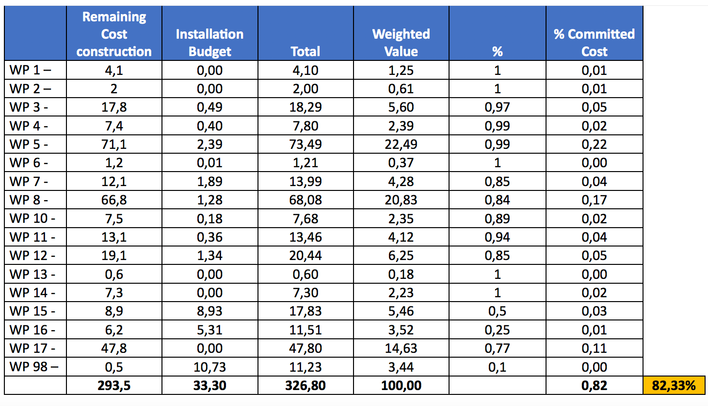
Committed cost ACCSYS

