Slide 1
ESS Project Status
Roland Garoby
Technical Director
www.europeanspallationsource.se
18 May 2018

Slide 2
Outline
Status of construction:
  Civil construction
  Accelerator
  Target
  Controls
“New” baseline schedule
Summary

Slide 3
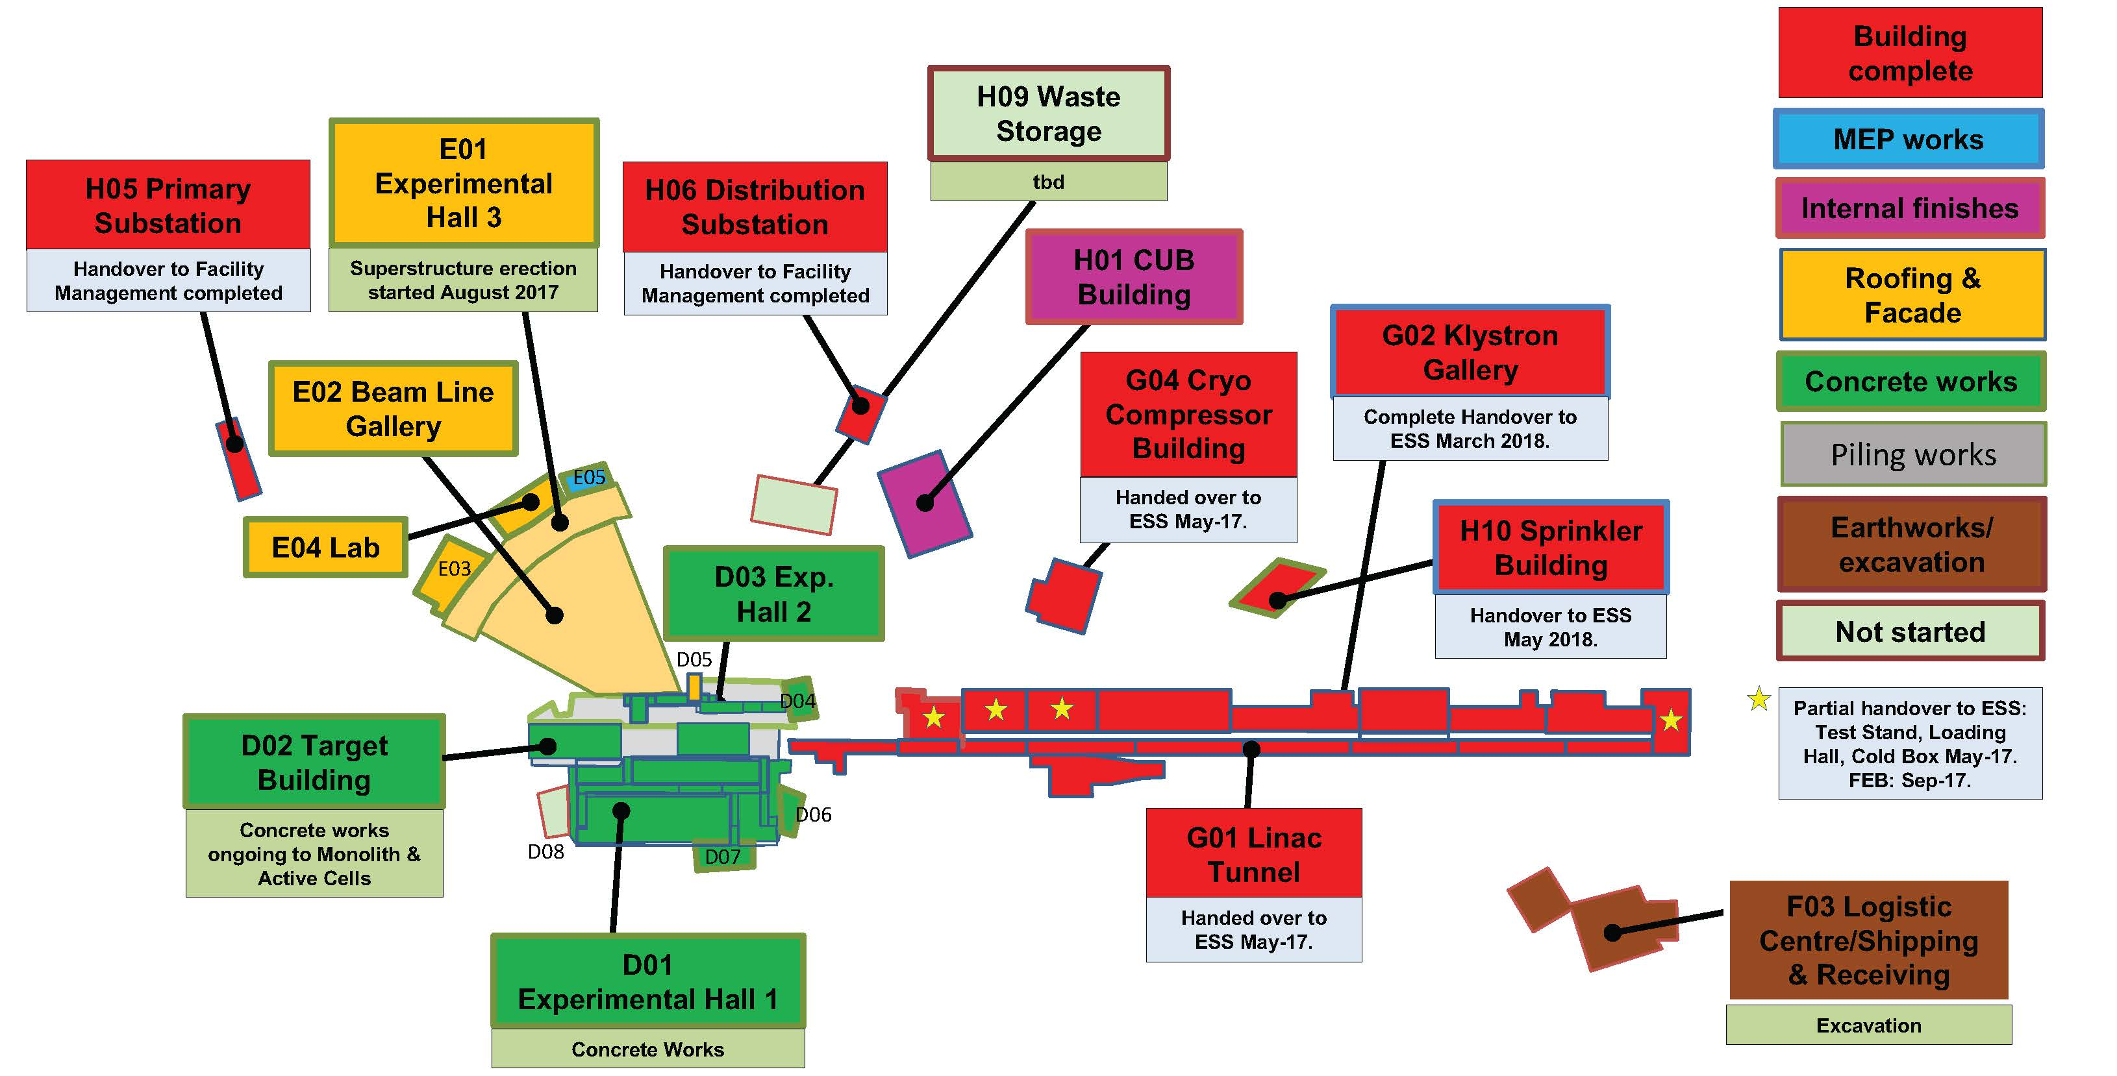
Civil construction status

Slide 4
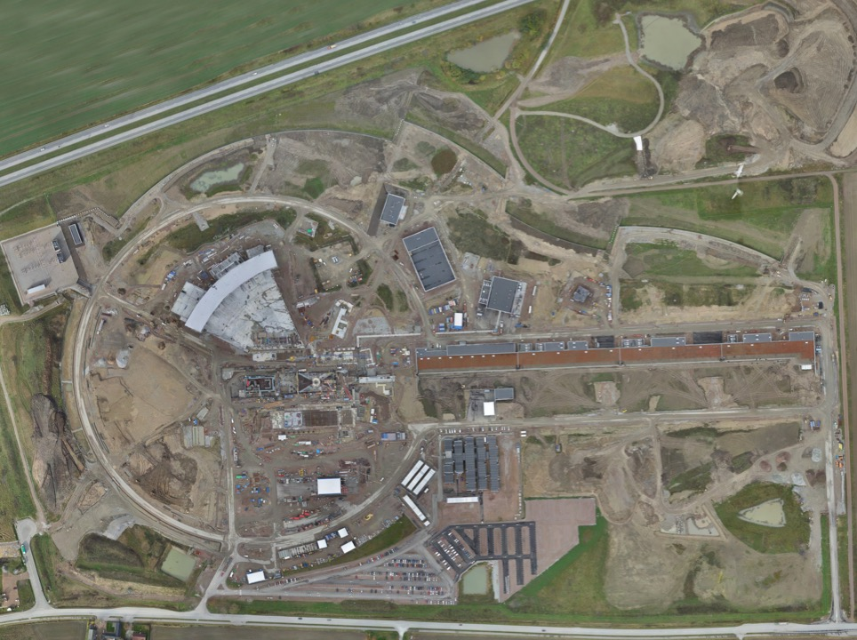
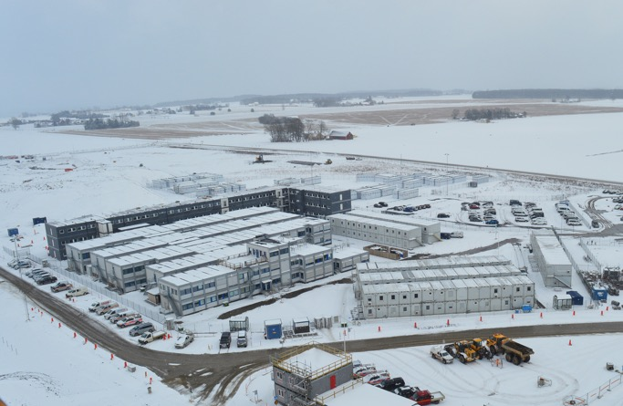
Permanent
Office Campus
2021
New 2018 ESS offices for all staff
New Bus Stop
Lund Tramway Depot

Slide 5
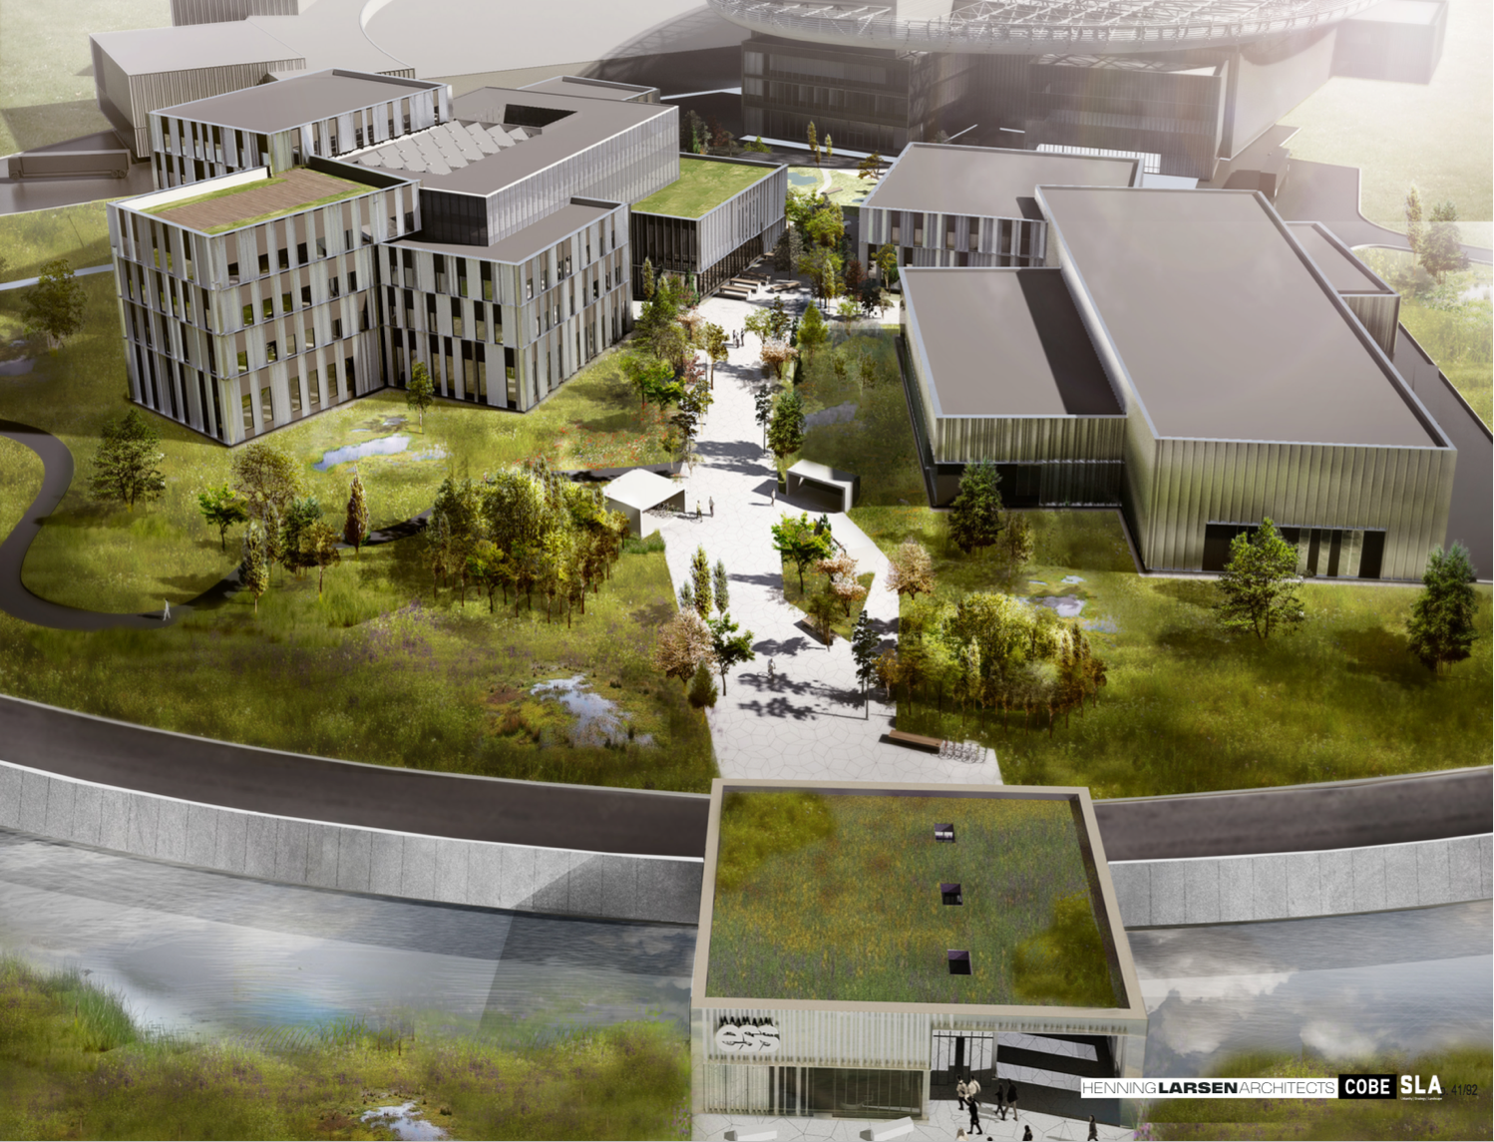
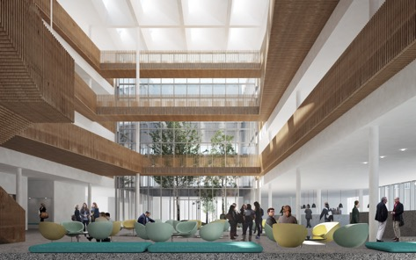
Campus
Offices, auditorium canteen
Labs and Workshops
Signed construction and financing agreements in February
Now in detailed design before target cost is agreed
Cost of the lease is included in the operations costs
Entrance Building

Slide 6
Status of construction:
  Civil construction
  Accelerator
  Target
  Controls
“New” baseline schedule
Summary

Slide 7
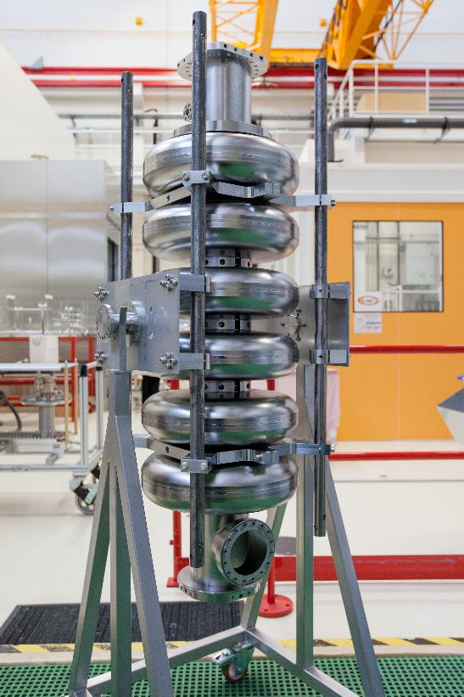
Equipment construction is progressing at in-kind partners (e.g. CEA & INFN)…
Medium β elliptical cavities (CEA-Saclay and INFN-Milano)

Slide 8
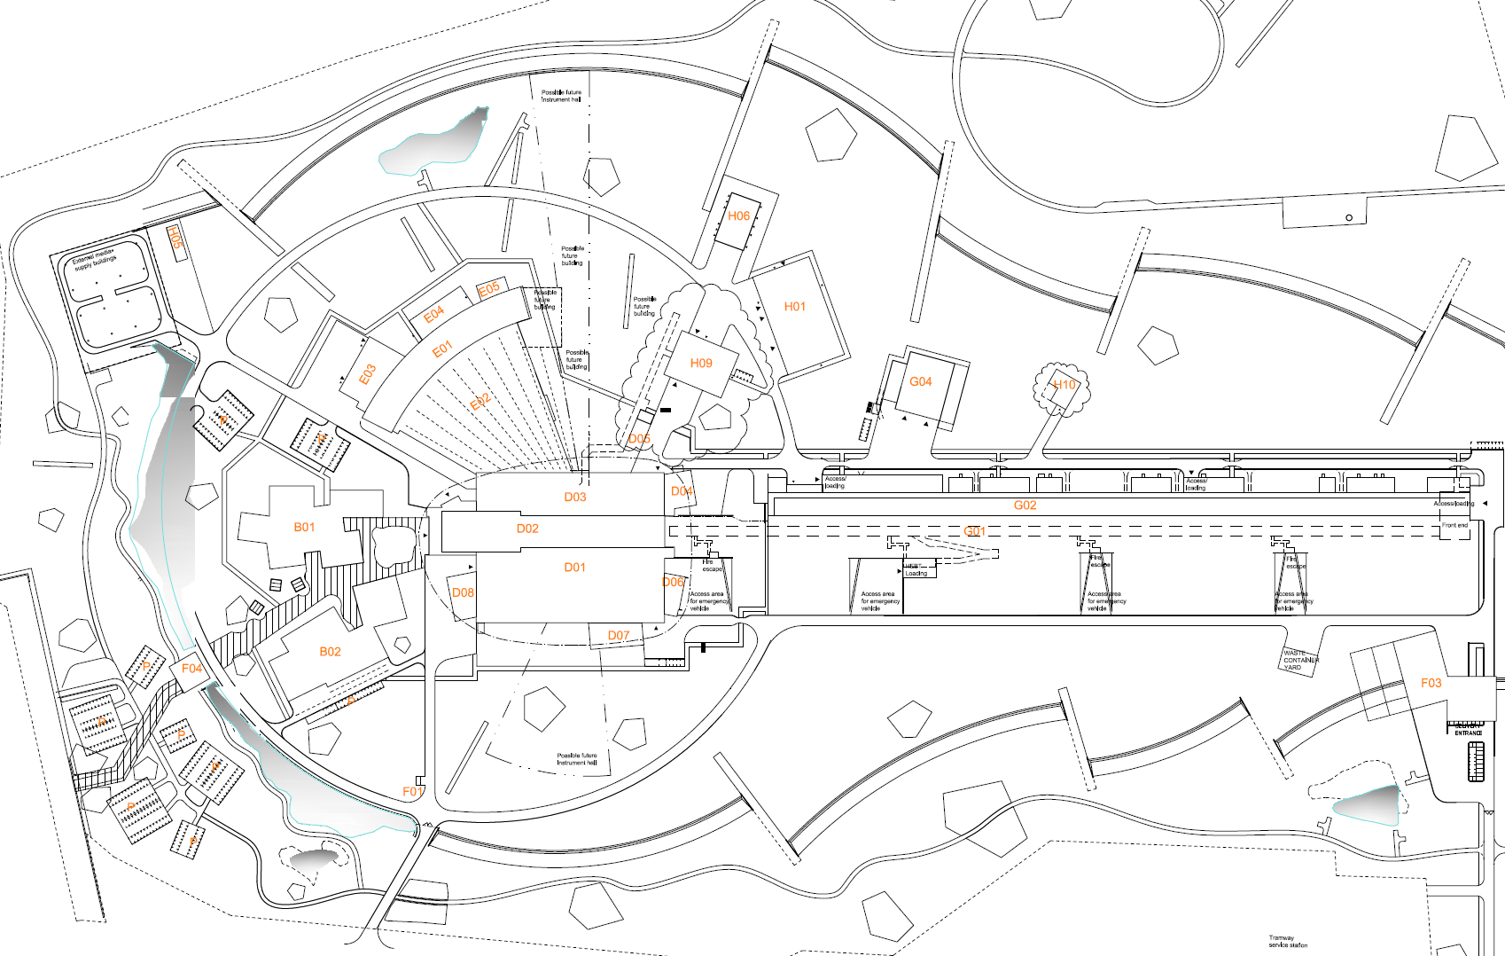
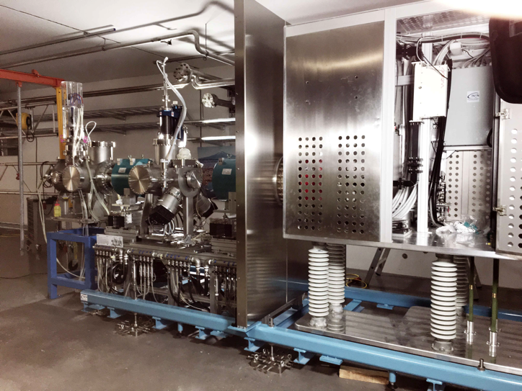
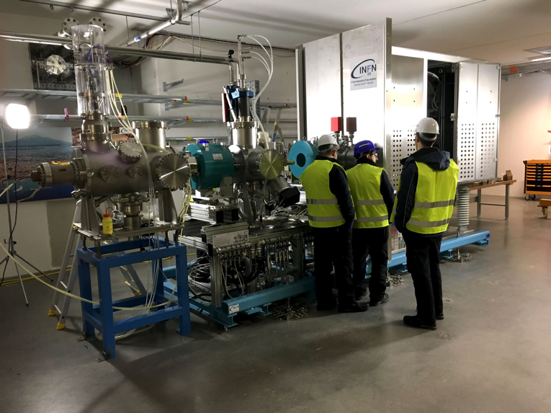
some in-kind equipment is already being installed in Lund [e.g ion source from INFN (+ CEA)]…
Accelerator Front End
(Ion Source and LEBT)
… an opportunity for lessons that led to a new
organization for the installation of the infrastructure…

Slide 9


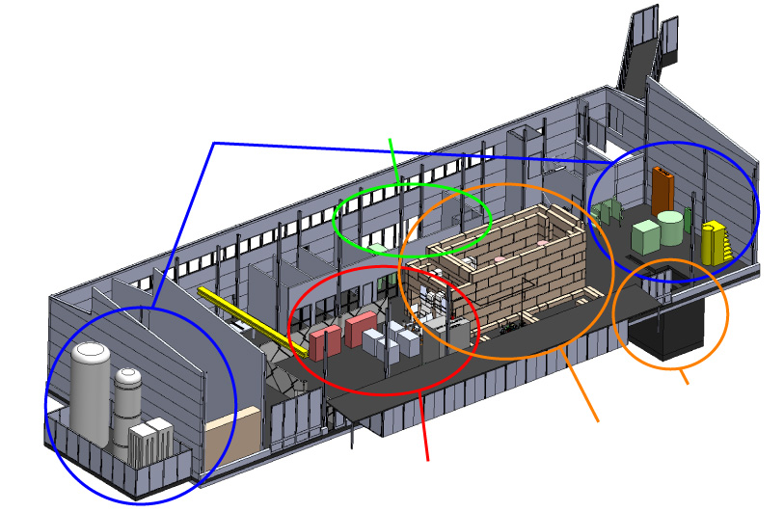

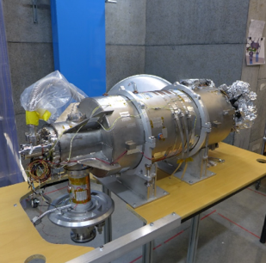
… and Test infrastructure is operational at some partners’ premises (e.g. Uppsala)
Several Spoke prototypes tested in HNOSS
Preparation of HB validation test (>March)
Preparation of Spoke Prototype test (>May)
State-of-the-art Equipment
cryogenics
- liquid helium
- liquid nitrogen
control room
- equipment controls
- data acquisition
Romea in HNOSS
HB package at FREIA
vertical cryostat
3 bunkers
with test stands
horizontal cryostat
radio-frequency (RF) power sources

Slide 10
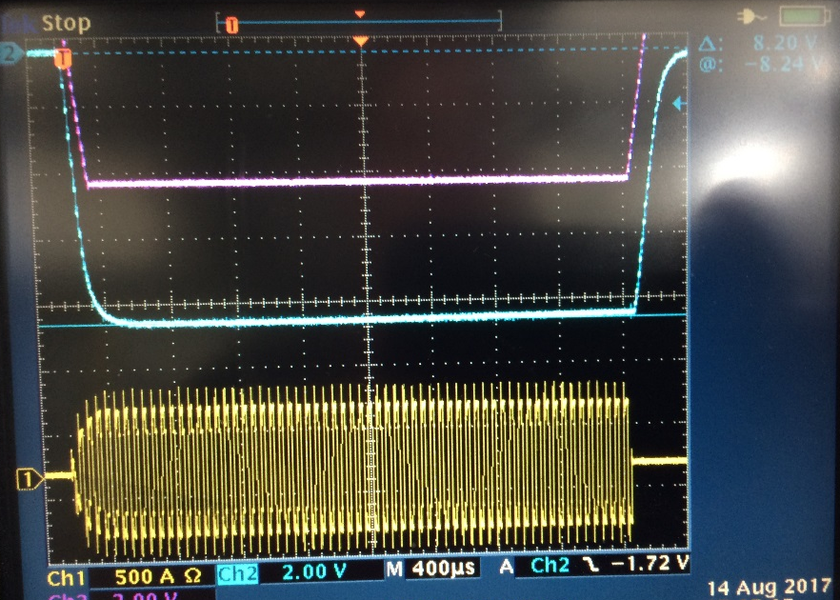
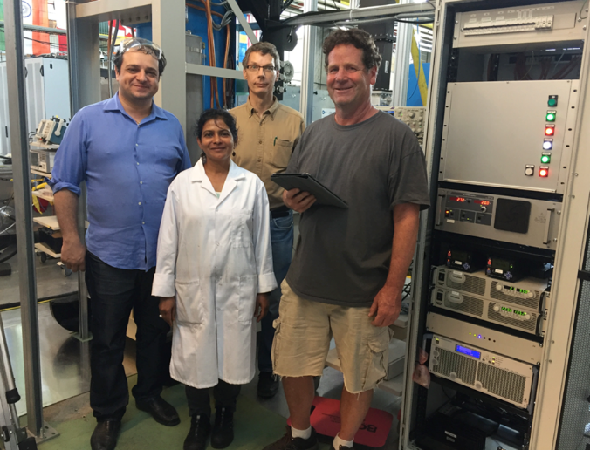
ESS development of high power/ compact/ high efficiency modulator is successful
Electrical schematic of Stacked Multi-Level (SML) modulator
12 modulators are in construction in industry
(build-to-print)
SML prototype
modulator
successfully powered
a Toshiba Klystron
up to 1 MW RF
Happy
Engineers!

Slide 11
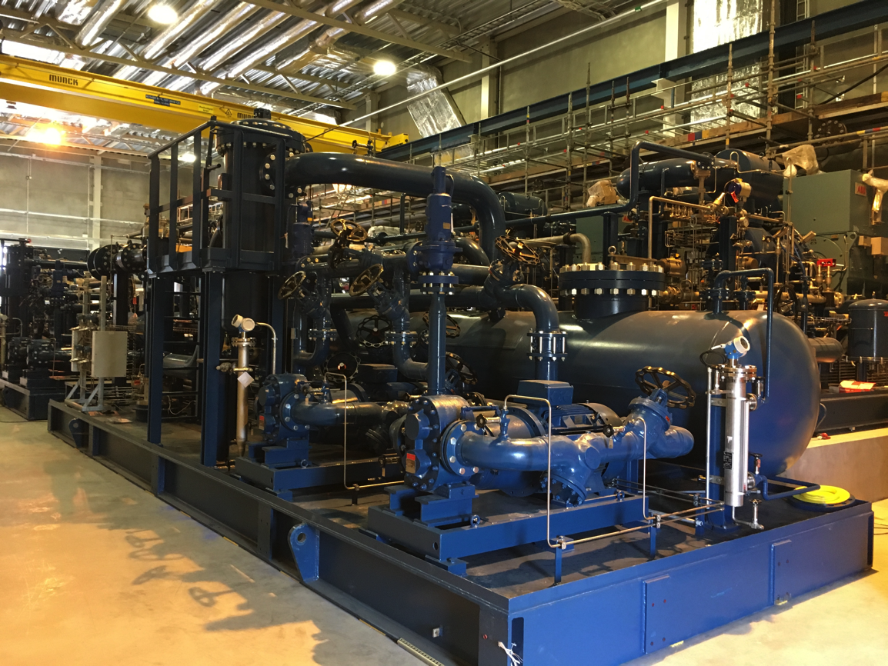
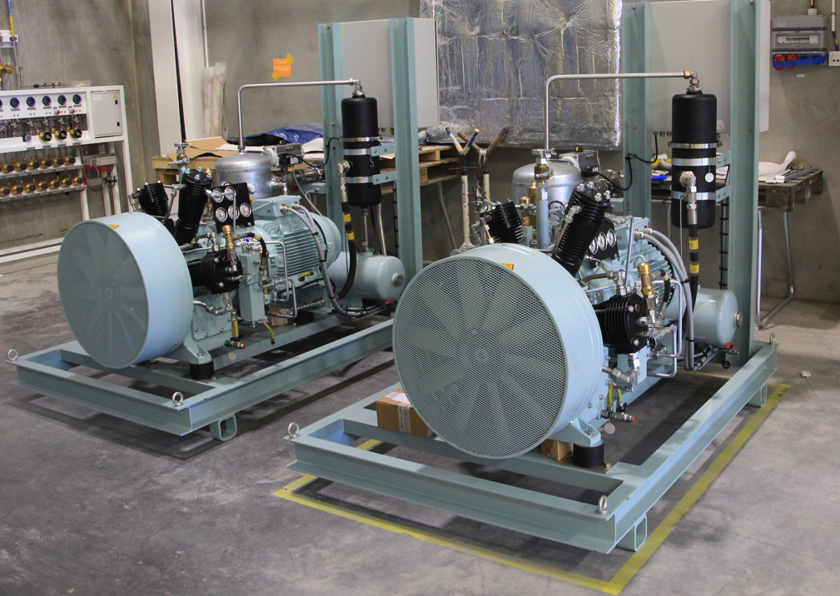
Helium Systems procured by ESS are in commissioning
Helium Recovery System Compressors
Helium compressors
and recovery system
ACCP compressors and oil removal system

Slide 12
Status of construction:
  Civil construction
  Accelerator
  Target
  Controls
“New” baseline schedule
Summary

Slide 13

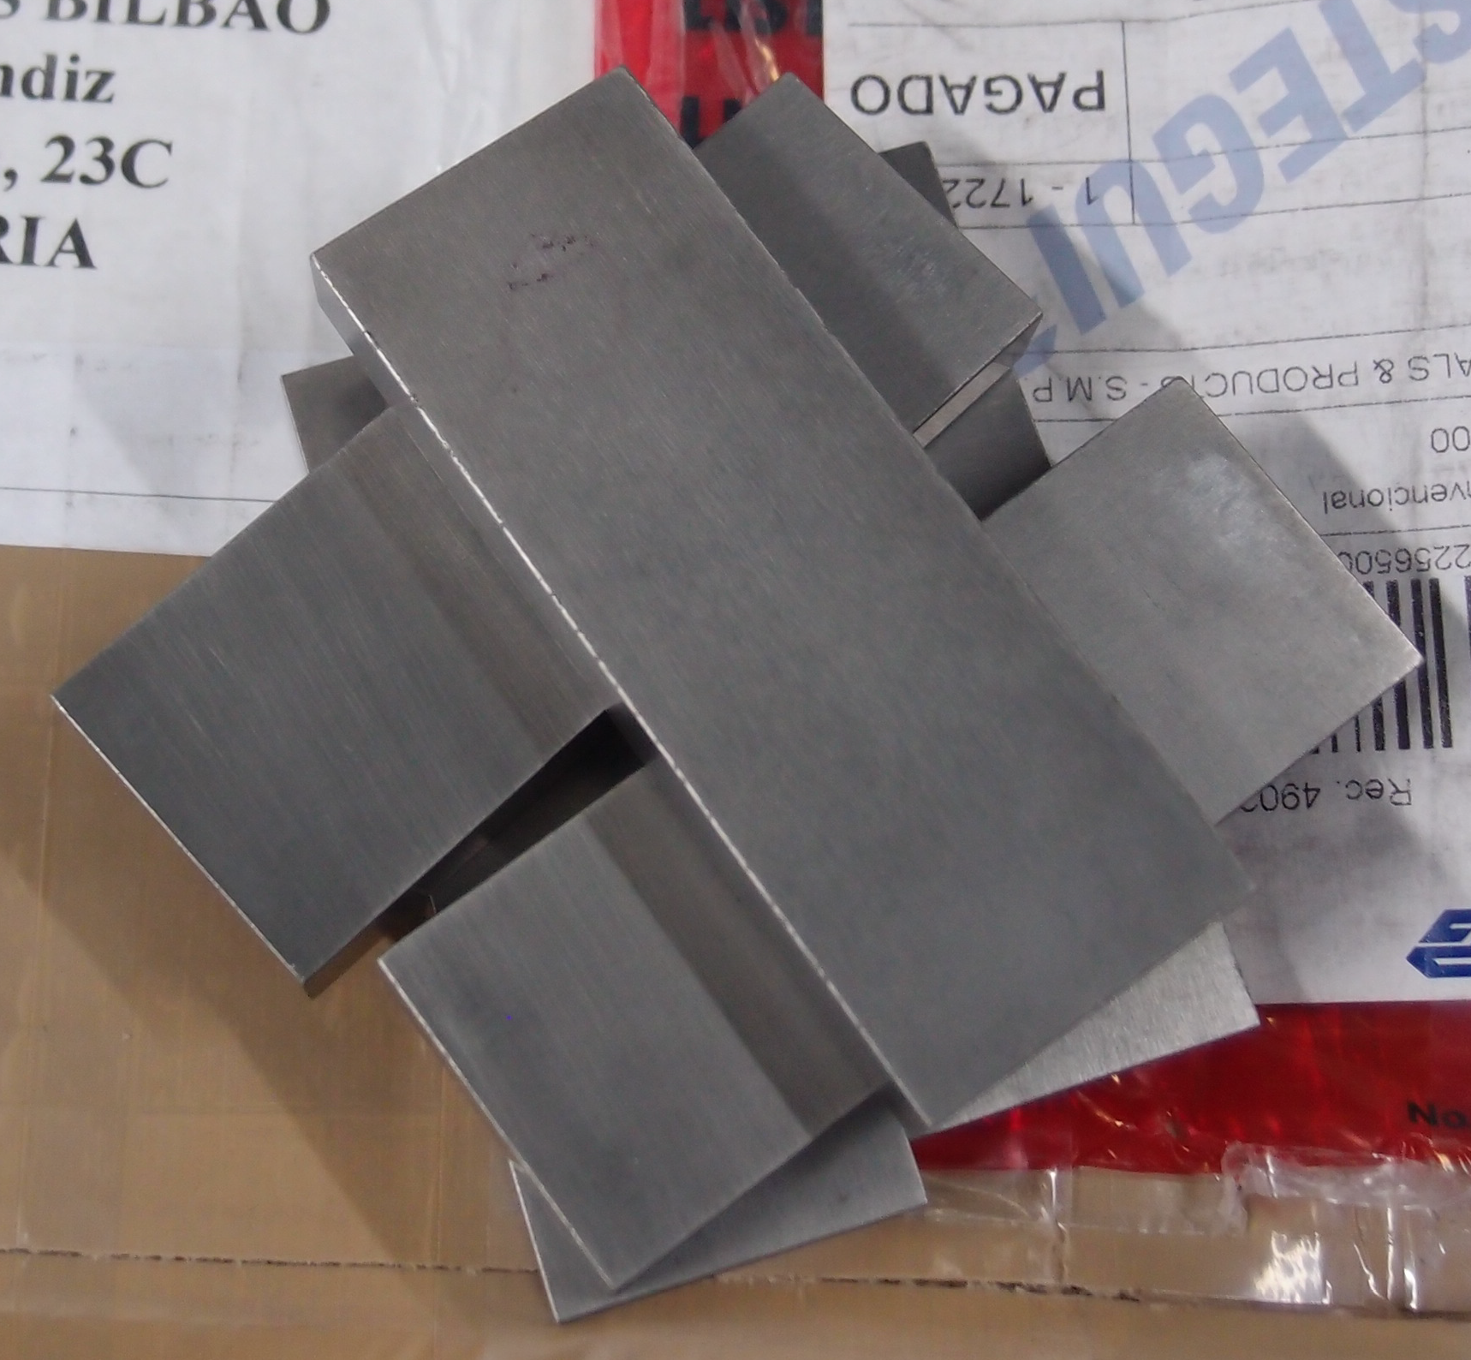
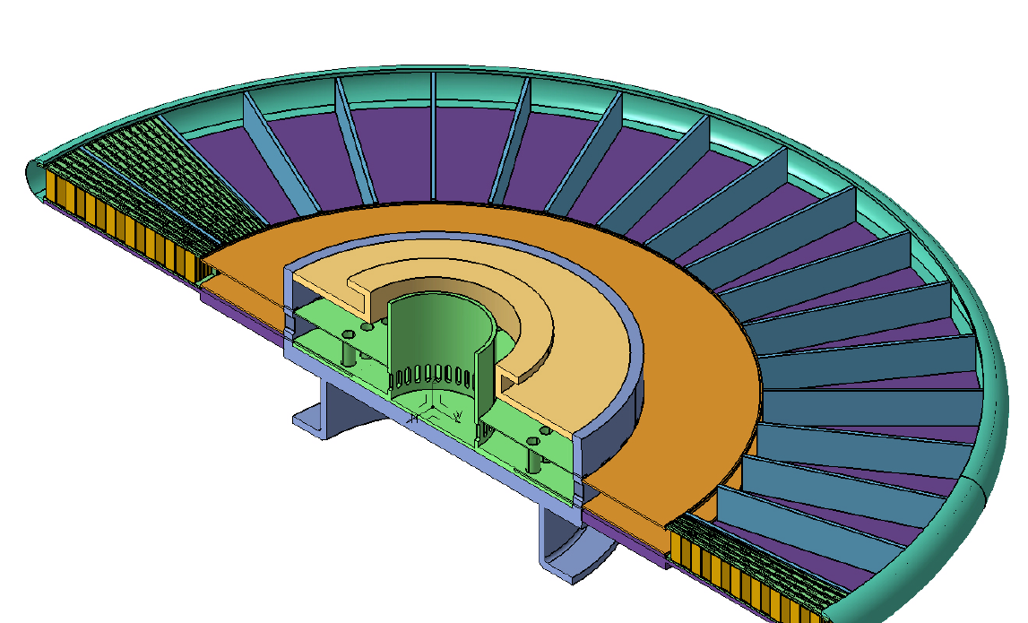
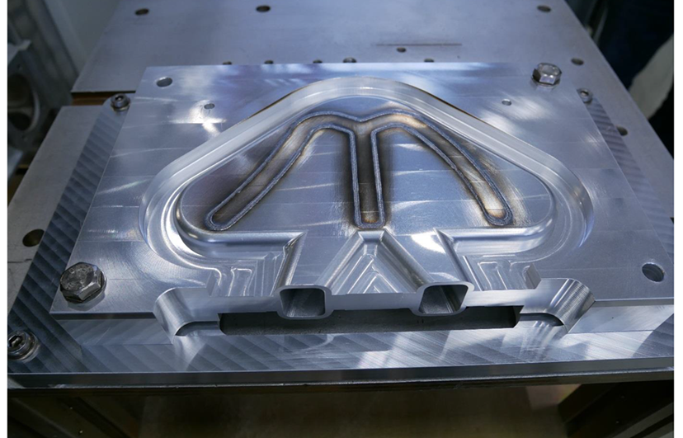
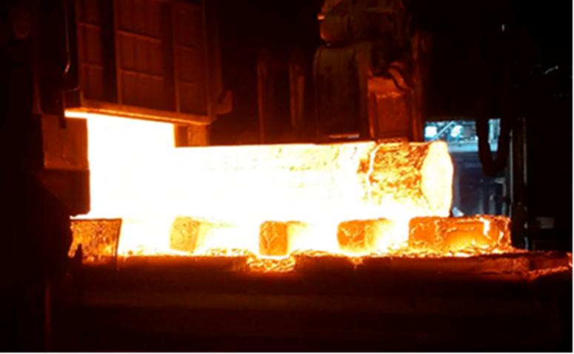
Equipment construction is progressing at in-kind partners (e.g. ESS-Bilbao, FZJ)…
proton
beam
Cold moderator vessel (FZJ)
48 cm
Tungsten bricks
Forging of moderator shaft (FZJ)
Cassette

Slide 14
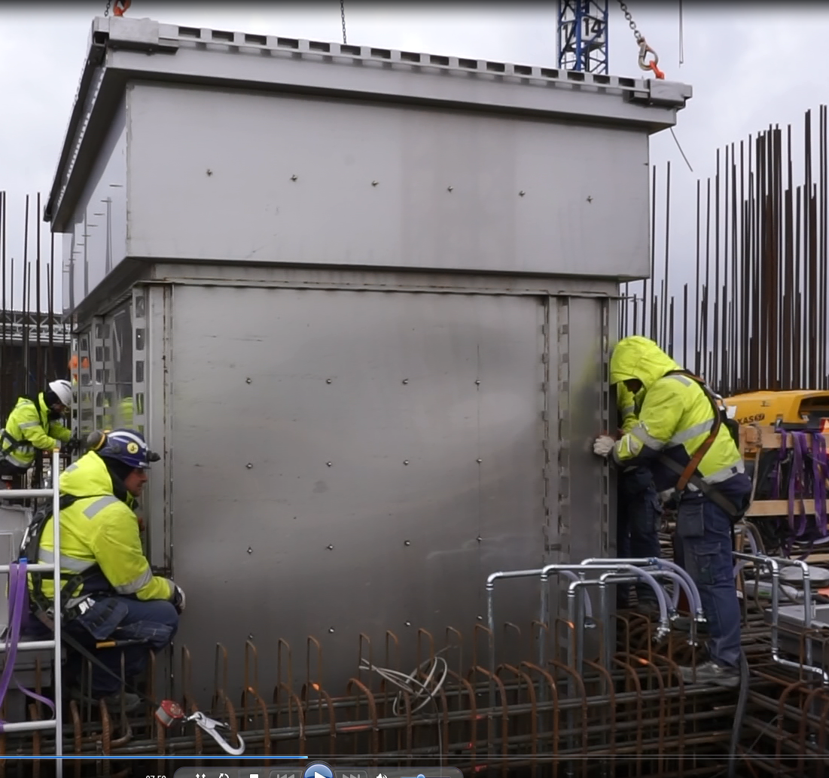
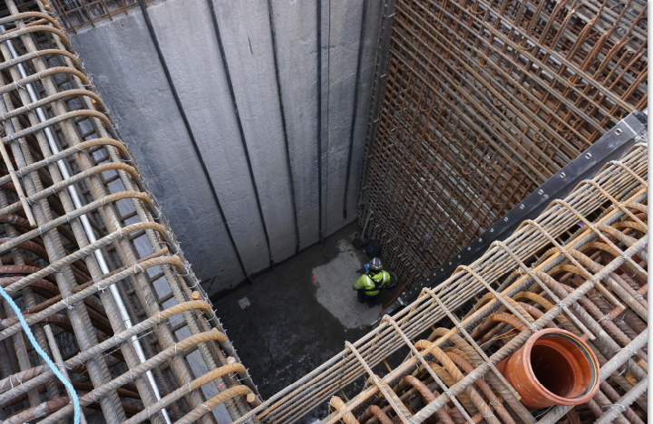
ESS procured equipment is being installed (e.g. storage pits in Active cell)
Active cell
Hole before storage pit installation
Lowering of pit A3 into place

Slide 15
Status of construction:
  Civil construction
  Accelerator
  Target
  Controls
“New” baseline schedule
Summary

Slide 16



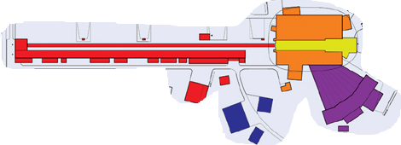


ESS Control System network
Red: Accelerator + Cryogenics zone
Yellow: Target zone
Orange/Violet: 1 zone/instrument
Blue: CF zone
PVGW: EPICS Process Value Gateway
CA Network: Channel Access (EPICS protocol)
ESS Network
~ 1.6 10⁶ control points!
DMZ
PVGW
PVGW
PVGW
PVGW
PVGW
PVGW
PVGW
PVGW
PVGW
PVGW
Core Network
CA network
CA network
CA network
CA network
CA network
CA network
CA network
CA network
CA network
Main Control Room

Slide 17
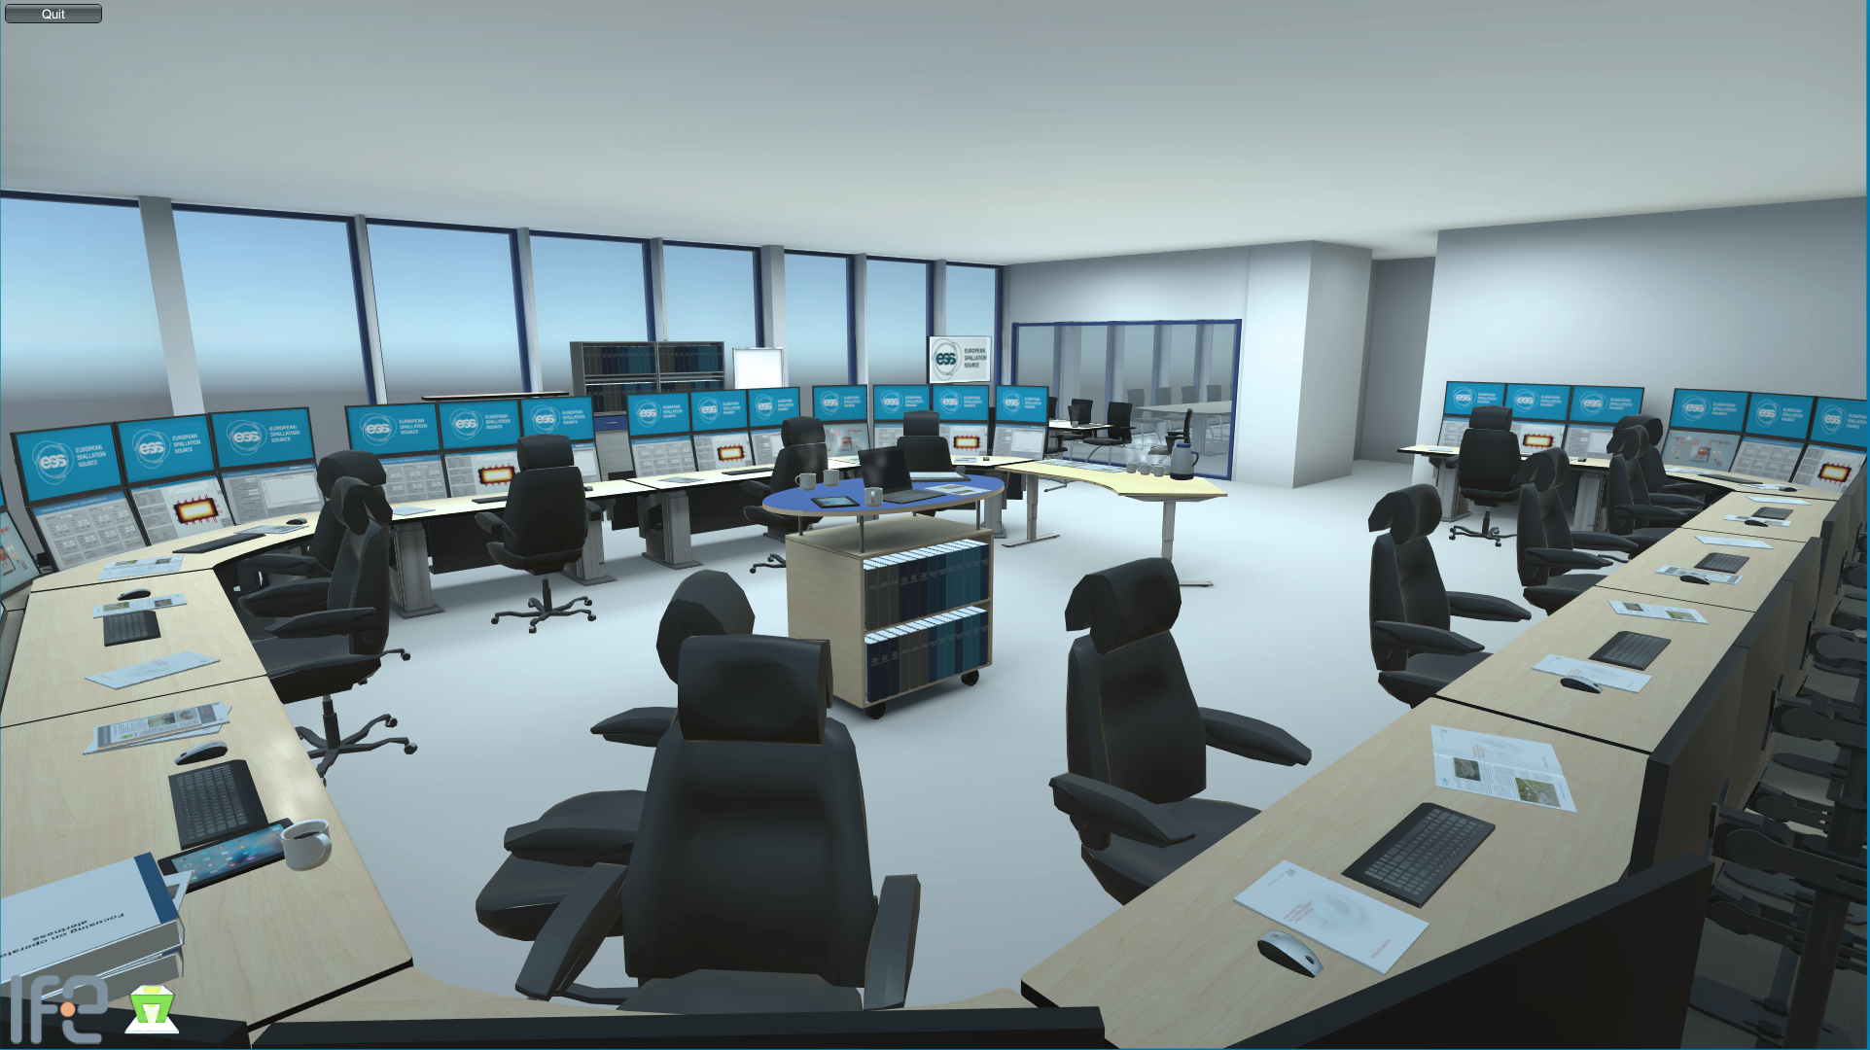
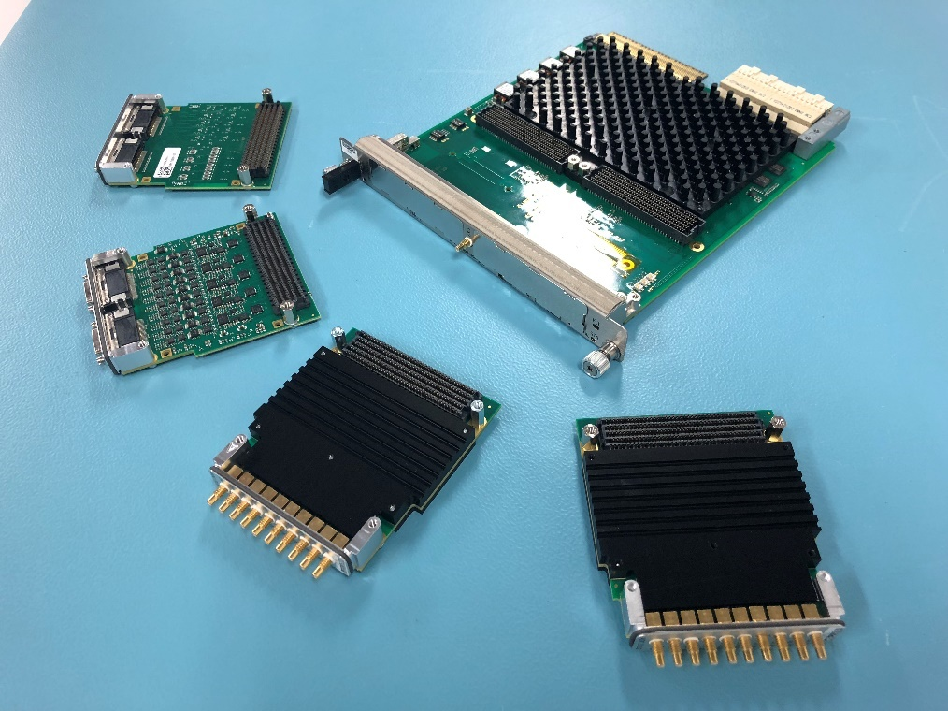
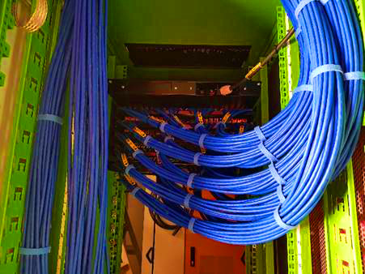
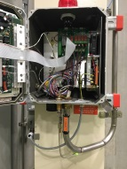
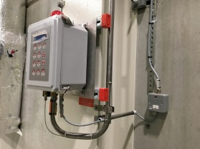
In-kind contributions are materializing and installation has started
IFE control room contribution
PSI IFC card family contribution
Cabling on site
Oxygen Deficiency Hazard system

Slide 18
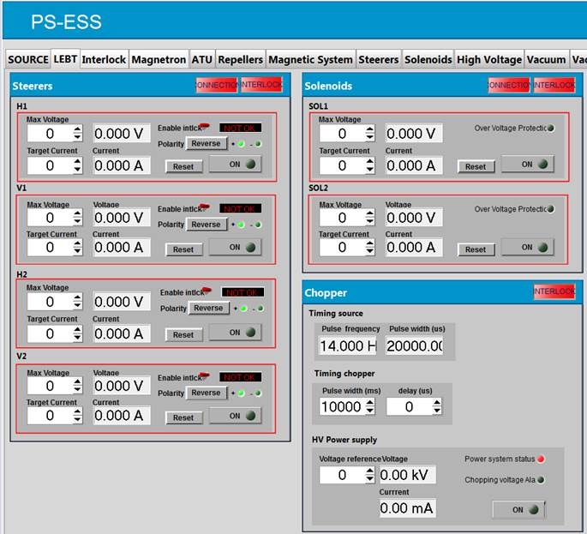
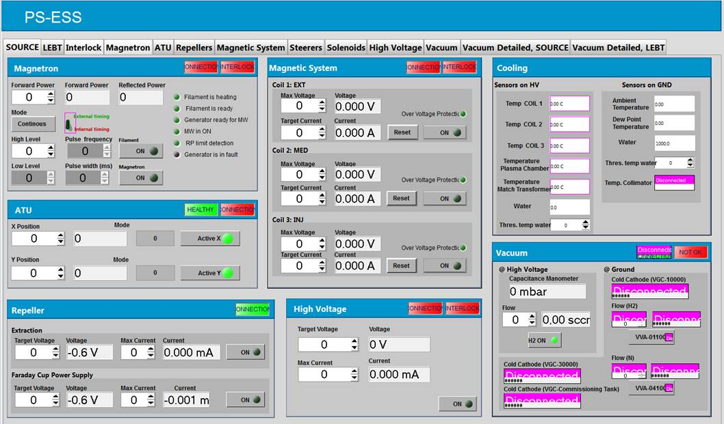
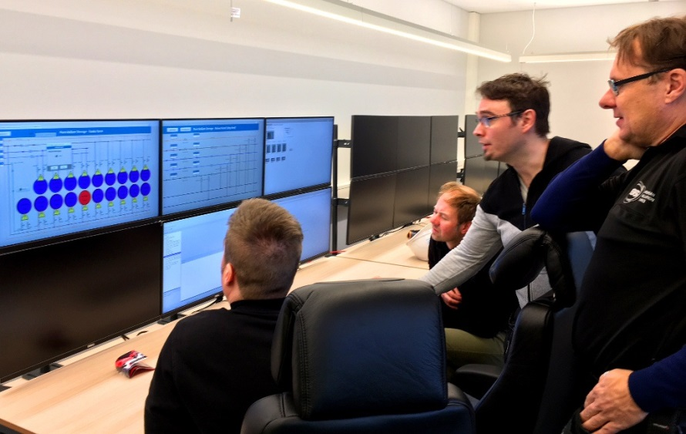
First steps of commissioning from the local control room
Recent achievements include controlling the pure Helium storage and parts of the ion source and LEBT from the local control room

Slide 19
Status of construction:
  Civil construction
  Accelerator
  Target
  Controls
“New” baseline schedule
Summary

Slide 20
Construction is 45% complete relative to the current baseline plan
Schedule performance: Few months delay shown in schedule variance and some delay incorporated in baseline changes (total of ~ 12 months); anticipate further large delays - main subject of this review
Cost performance: Good CPI, but already captured significant cost growth in the baseline (58 M€ since 2013) and foresee large cost increases for future work (ref. Completion of Construction Report reviewed at last Annual Review)

Slide 21
Background
Since establishing the baseline in 2013, we encountered large cost and schedule impacts from ratcheting of radiation safety requirements in aftermath of the Fukushima seismic event and concern over antagonistic threats
  145 M€ cost increase (baseline + forecast changes) identified in ‘Report to European Spallation Source ERIC Council on Completion of Construction’
ESS management is working closely with the ESS Council to secure adequate budget
We have also focused attention on completing the construction project scope with minimal delay in early science

Slide 22
Addressing the Schedule
Original baseline was established in 2013
  Well before completing preliminary design for most systems
  Only a few In-Kind partnerships in place
  Unaware of eventual ratcheting of requirements for Target Building
We have now reached a point where:
  the detailed scope, requirements, and method of accomplishment are better understood
  in-kind partnerships are established
  contracts with many of our key commercially supplied scope elements are in-place, and
  the uncertainty related to designing the buildings to meet regulatory requirements is nearly behind us
Therefore, we are proposing a new baseline plan to help us manage and track the work going forward
  Reviewing the proposed re-baseline is the purpose of next week review

Slide 23
Re-baselined Schedule
(under review next week)
2018
2019
2020
2021
2022
2023
2024
2025
BOT
SOUP
Warm LINAC Commissioning Steps
EOC
1.3 GeV Capability Installed
Will propose reasonable float to establish external milestone commitment
Accelerator + ICS
Hi-Beta Install
Beam on Dump
(570 MeV)
Accelerator RBOT
Accelerator Schedule Float to BOT
CF + Target + NSS (Bunker+TBL) + ICS
Bunker and Test Beam Line RBOT
Access for Monolith Installation
Target RBOT
15th Instrument Complete (Ready for hot commissioning)
NSS Instruments + ICS
Instrument Hall Access for Start of Installation
Start beam commissioning for 1st Instruments
RSOUP

Slide 24
Main delays for the Accelerator are due to in-kind partners…
ISrc to RFQ/MEBT/DTL1
ISrc to Beam Dump (BOD)
4 Nov '19
8 Feb '21
ISrc to LEBT
ISrc to DTL4
RBOT
25 Jun '18
27 Apr '20
24 May '21
New Baseline
2019
2020
2021
18.8 months
Beam to RFQ/MEBT Delay
21.8 months
Beam to DTL4 Delay
21.2 months
BOD Delay
23.9 months
RBOT Delay
Old Baseline
2019
2020
2021
5 Jul '18
28 May '19
ISrc to DTL4
RBOT
11 Apr '18
30 Apr '19
ISrc to RFQ/MEBT
ISrc to Beam Dump (BOD)

Slide 25
Main delays for the Target are due to the Target Building, but in-kind contributions are critical…
2018
2019
2020
2021
2022
Monolith Area Superstructure
Monolith and A2T Concrete
High Bay Infrastructure Installation
BOT
Target Building (D02) Access for Monolith Installation
Testing and Readiness Review
Monolith Installation & Testing
Ready for parallel bunker and monolith works
Target Wheel & MR Installed
Target RBOT
CF D01/D03 Build-out to weather tight
3 months float
Parallel Works
Target Integrated Bunker Scope
Final testing and Readiness Review
Bunker Construction and Installation
Monolith inserts & shutters installed
NSS RBOT

Slide 26
Estimate At Completion (EAC) of the neutron source increases with the new baseline
 | Costs in M€
Sub-Project | Current BL | Forecast (Feb-18) | Current EAC | Proposed BL | Proposed Forecast | Proposed EAC | Change in EAC
Accelerator | 490.0 | 28.7 | 518.7 | 496.7 | 31.5 | 528.2 | 9.5
Target | 183.6 | 18.7 | 202.3 | 189.7 | 30.5 | 220.2 | 17.9
ICS | 77.4 | 8.2 | 85.6 | 79.3 | 10.0 | 89.3 | 3.7
Total | 751.0 | 55.6 | 806.6 | 765.7 | 72.0 | 837.7 | 31.1
Mitigation actions will be taken to meet our commitment to manage within budget constraint aiming at costs related to:
Installation,
Delays,
Additional items.

Slide 27

Funding decisions in 2018
AFC.07
Budget Plan 19/20 (R)
Indicative Plan 21-25 (I)
Construction Budget 2019 (I)
Political decision-making
Minister level
Schedule Review
8 Feb
10-11 Apr
Focus on re-baselining
Will mostly impact indicative plan 21-25
Council.12
Workshop
Budget plan 19/20 (I)
Indicative plan 21-25 (I)
High-Level Document (D)
Sharing Policy (D)
22-24 May
Council.14
Constr. budget 2019 (A)
Init ops budget 2019 (A)
Indicative plan 2021-2025 (A)
Commitments from Members for 2021-2025
Commitments from Members to completion of construction
Council.13
4-5 June
Budget Plan 19/20 (A)
Indicative Plan 21-25 (I)
Commitments from Members for 2019/20
initial ops funding
AFC.08
Constr. budget 2019 (R)
Init ops budget 2019 (R)
Indicative planning 2021-2025 (R)
Annual Review
Sep
Project review
30-31 Oct
3-4 Dec

Slide 28
Status of construction:
  Civil construction
  Accelerator
  Target
  Controls
“New” baseline schedule
Summary

Slide 29
Summary
Multiple deliveries from in-kind partners are on critical path…
IKRC will now follow-up.
ESS construction advances regularly, both at the in-kind partners and in Lund. Progress in testing and fabrication confirm that the planned performance will be met.
Realistic delivery dates from in-kind contributions and delay in the construction of the Target building led to the new baseline schedule.
Budget includes our improved knowledge of costs and the impact of delays.
We look forward to the feedback from next week’s review…

