Slide 1
Integrated Control System
Status Report 2018-05
ESS/CEA-ESSI Coordination Committee meeting #5
Hector Novella
ICS Deputy Project Manager
www.europeanspallationsource.se
2018-05-18

Slide 2
Summary
The Integrated Control System Division (ICS division) is responsible for the control systems within the ESS facility including controls for
  Accelerator
  Target
  Neutron Scattering Systems
  Conventional Facilities
The project is 43% complete
  The organization hosts 52 employees and ~15 contractors
ICS has strong dependencies to stakeholders’ schedules

Slide 3
Outline
ICS goals and scope
ICS organization
ICS in-kind contributions
ICS project status
ICS project status illustrated

Slide 4
Outline
ICS goals and scope
ICS organization
ICS in-kind contributions
ICS project status
ICS project status illustrated

Slide 5
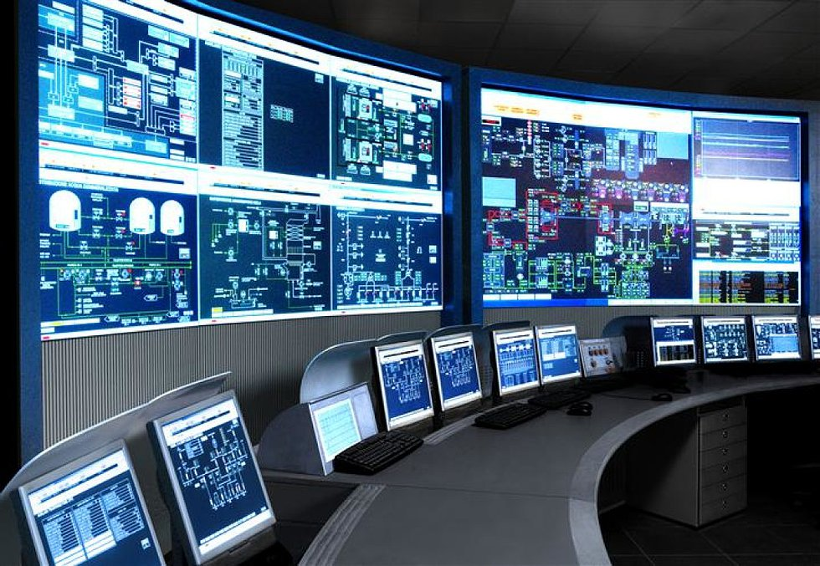
The ESS integrated control system
The ESS facility is a large and complex machine with very much and diverse equipment that needs to work in synchronization and with well-known configurations
The Integrated Control System Division (ICS division) is responsible for the control systems within the ESS facility including controls for
  Linear Accelerator
  Target Station
  Neutron Scattering Systems
  Conventional Facilities
In addition, ICS will implement
  Machine Protection System
  Personnel Safety System
To build a distributed control
system of this size is a major
undertaking

Slide 6


ESS/ICS challenges
The ESS control system complexity is very high
  About 1 600 000 “process values”
  Ambitious approach to automation of control system configuration
Facility availability goals are very high
  ICS plays a key role for the availability of the facility (95% availability goal)
  High performance, reliability and availability requirements on equipment and software deployed
Some new approaches will be implemented at ESS/ICS
  Full scale deployment of EPICS 7
    ESS is committed to contributing to the EPICS community
  Full scale deployment of MicroTCA.4
    ESS is involved in a public procurement for innovation initiative

Slide 7
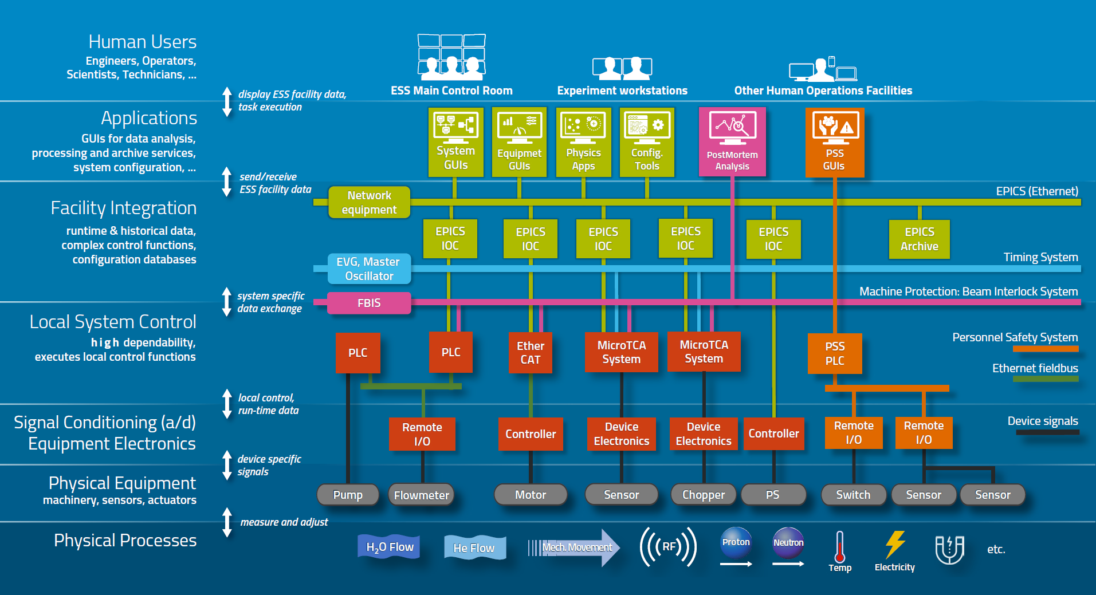
Control system architecture
Layered architecture based on EPICS

Slide 8





ICS project breakdown
Work package 01 Management and administration
Work package 03 Software core
Work package 04 Hardware core
Work package 05 Machine protection
Work package 06 Equipment
Work package 07 Control system infrastructure
Work package 08 Physics
Work package 09 Personnel safety systems
Work package 10 Integration - Accelerator
Work package 11 Integration - Target
Work package 12 Integration - Instruments
Work package 13 Integration - Conventional facilities
Work package 14 Test Stands
Work package 20 Installation
Software
Electronics
Infrastructure
Safety & protection

Slide 9
Outline
ICS goals and scope
ICS organization
ICS in-kind contributions
ICS project status
ICS project status illustrated

Slide 10
ICS Organization
2018-05
Henrik Carling
Head of Division
Controls infrastructure
Remy Mudingay
Controls Software
Susanne Regnell
Hardware & Integration
Karl Vestin
Safety and protection
Annika Nordt
Anna Gillberg
Team assistant
Benjamin Bertrand
Software engineer
Emanuele Laface
Accelerator physicist
Angel Monera
FPGA Engineer
François Bellorini
Integrator
Riccard Andersson
Technical Project Coordinator
Anni Frönell
PMO
Johan Christensson
Infrastructure technology eng
Juan Esteban Müller
Software scientist
Jeong Han Lee
Integrator
Tomasz Brys
Integrator
Enric Bargalló
Lead analyst
Alessio Curri
ICS administrator
Ben Folsom
PhD student
Simone Farina
Embedded systems engineer
Faye Chicken
Controls Technician
Stuart Birch
Senior PSS engineer
Hector Novella
Deputy project manager
Susann Skarin
Sys Admin
Thomas Fay
Integrator
Benedetto Gallese
Integrator
Fdo. Carrasco Martín
Technician
Thilo Friedrich
Systems Engineer
Claudio Rosati
Software engineer
Anders Harrisson
SW configuration manager
Saeed Haghtalab
Integrator
Joao Paulo Martins
Integrator
Mattias Eriksson
Technician
Dirk Nord
Software engineer
Viktor Fred
Lead eng electrical install
Timo Korhonen
Chief engineer
Peter Holgersson
Electrical Engineer
Julen Etxeberria
Junior controls engineer
John Sparger
Integrator
Fredrik Luthander
Software engineer
Ricardo Fernandes
Control system SW architect
Peter van Velze
Controls Technician
Stephane Gabourin
Lead engineer fast interlocks
Wojtek Fabianowski
in-kind manager
Javier Cereijo
PhD Student
Banafsheh Hajinasabi
Software engineer
Szandra Kövecses
Lead integrator MP
Oliver Talevski
Embedded engineer
Krisztián Löki
Integrator
Morteza Mansouri
Lead integrator PSS
Jan-Åke Persson
Senior software engineer
Mehdi
Mohammednezhad
Wayne Lewis
EPICS integrator
Denis Paulic
Deputy GL, PLC engineer
Karin Rathsman
Accelerator scientist
Miklós Boros
Integrator
Maria Romedahl
Technical coordinator
David Sánchez Automation Engineer
Fredrik Söderberg
Software engineer
Johannes Kazantzidis
Automation Engineer
Nour Akel
Installation cordinator
Yong Kian Sin
IEC61508 controls engineer
4 Positions opened or under consideration
ESS-0081625
Georg Weiss
Software engineer
Marino Vojneski
Automation Engineer
Philippe Rabis
WP Leader -AccSys
Alberto Toral Diez
Technician
47 Employees
18 Consultants
Lars Johansson
Software engineer
Nicklas Holmberg
Integrator
Michael Beck
WP Leader – Target, CF
Manuel Zaera-Sanz
Senior MP engineer
Consultants
Open positions (4)
Paulina Skog
Document Specialist
5 Temporary employees
4 Consultants
off-site
Meike Rönn
Document Specialist

Slide 11
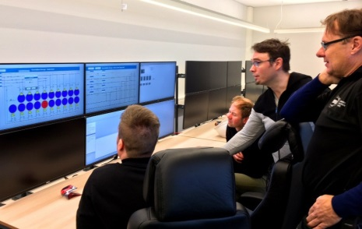
Hardware and integration scope
The scope of the hardware and integration group covers 5 big control systems, which are composed of a big number of subsystems:
    Hardware and Embedded software Systems
    Timing System
    Accelerator Control Systems
    Target Control Systems
    Instrument Control Systems
    Site infrastructure Control Systems
The Hardware & Integration Group shall provide control system integration to all relevant ESS stakeholders (Accelerator, Target, Site Infrastructure, Neutron Instruments).
Integration Support is defined as: the effort provided by ICS that is required for deploying the control system components, which provide monitoring and control functionality to the stakeholder systems.
The integration support includes among others:
    Design of the different control systems and integration in the overall ICS
    Development, upkeep and maintenance of (~500+) IOCs software in the plant
    Development and standardization of hardware technologies: mTCA infrastructure, DAQ systems, PLCs, etc.
    Troubleshooting and support to operators (on-call) service
    Providing ESS with necessary infrastructure for management of EPICS modules, FPGA firmware, PLC Code, etc.
    Support other Divisions with EPICS, PLC programming and FPGA development know-how.

Slide 12
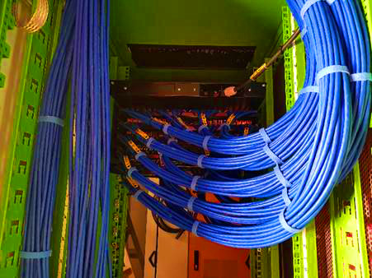
Control system infrastructure scope
The group’s responsibilities are to Design, Implement and Operate the IT Infrastructure needed to reliably run the Experimental Physics Industrial Control System (EPICS) eco-system. The main activities can be grouped into two parts:
Main Control Room, Data Centre and Networks - The activities include responsibility over the design, installation, configuration and maintenance where applicable:
Human factors analysis and ergonomic design of the ESS Main Control Room.
File and storage services for data produced by the machine for ‘on-line’ and ‘off-line’ analysis.
A secure Technical Network that interconnects the private machine networks for Accelerator, Cryogenics, Neutron Instruments, Target and Utilities (electrical substations and HVAC) to operation consoles located in Control rooms.
Control System Software authorisation tools and services.
Software Infrastructure – The activities include responsibility to design, install, configure and maintain the supporting applications for control specific software development.
Integration services for software development life-cycle for EPICS software.
Software Development environment.
Configuration management and software deployment.
Monitoring tools and services of Software applications used to configure the control system.

Slide 13
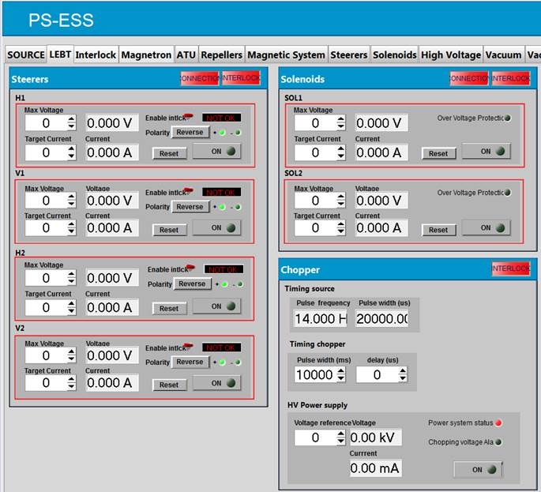
Control system software scope
Providing control system software applications, providing the following services:
EPICS Control System Studio:
  Operator screens
  Data browser
  Probe
  Archiver (Archiver Appliance)
  Alarms system (BEAST)
  Channel Finder functionality
  Save, Compare & Restore functionality (MASAR)
Post Mortem service/application
Calibration service/application
Diagnostics service/application
Generic information screens
Controls Configuration (ESS Named devices, cables)
Open XAL* framework with Physics online model

Slide 14
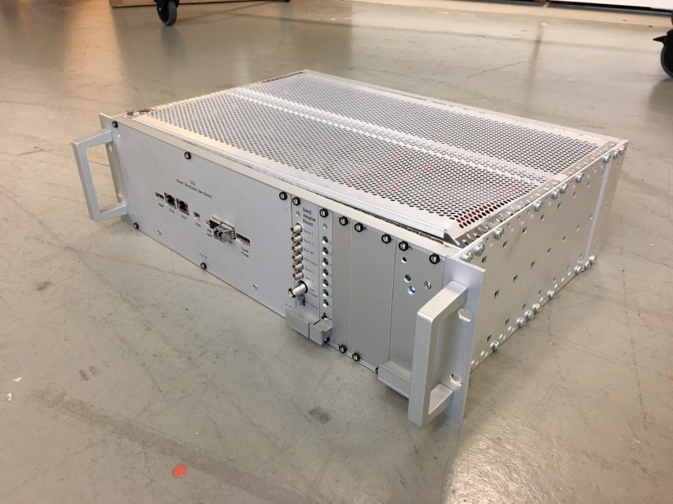
Machine protection scope
Machine Protection helps in achieving the operational availability requirements for ESS. High availability is achieved through high system reliability, through short preventive and corrective maintenance times and short recovery times after stopping beam operation.
The right strategy to avoid damage leading to long corrective maintenance times, will involve a mix of:
dedicated technical systems stopping operation (not only of beam) to prevent and mitigate damage,
dedicated operational and maintenance procedures to fix things before real damage can occur.
Machine Protection needs to reliably do the following:
protect the “machine” from damage, be it beam-induced or resulting from any other source,
protect the “machine” from unnecessary beam-induced activation.
Machine protection will be implemented in a way to:
minimize unnecessary down-time due to spurious trips,
provide optimal support for failure localization,
support all operational modes of the facility,
support operation in degraded mode.
Notes:
Text according to slide

Slide 15
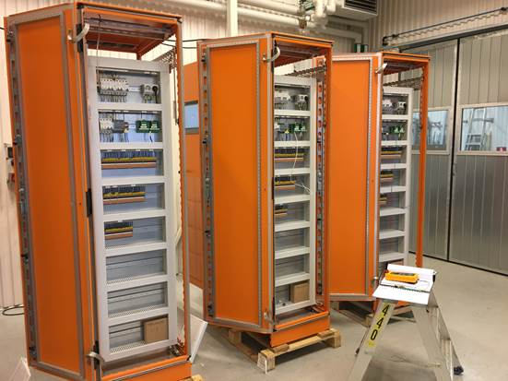
Scope of Personnel Safety Systems
The ESS Personnel Safety Systems are loosely divided into three major systems:
The Accelerator PSS,
The Target PSS,
The Neutron Instruments PSS (one system for each of the 22 Neutron Instruments).
The primary role of the ESS PSS is to prevent personnel from being harmed by exposure to ionizing radiation generated by the proton and neutron beams, under all operating modes.
The ESS PSS will also be used to control and mitigate against the following hazards inside pre-defined controlled areas:
Oxygen depletion (primarily from helium leak from the super conducting sections)
High voltage from assorted equipment
Radio frequency
X-Rays
Mitigation will be achieved by controlling access to the different areas when a potential hazard is present and switching off the equipment generating the hazards.
Notes:
Text according to slide

Slide 16
Outline
ICS goals and scope
ICS organization
ICS in-kind contributions
ICS project status
ICS project status illustrated

Slide 17
ICS In-kind partners
Partner Institutes
Atomki, Hungary
CEA, France
CNRS/IPNO, France
Elettra, Italy
ESS Bilbao, Spain
IFE, Norway
INFN Catania, Italy
INFN Legnaro, Italy
PSI, Switzerland
STFC, UK
Tallinn Technical University, Estonia
ÚJV Řež, Czech Republic
University of Łódź , Poland
Uppsala University, Sweden
ZHAW, Switzerland
Agreement signed
Agreement waiting for signature
Early discussions
Collaboration/other agreement

Slide 18
In-Kind partners deliver parts of our scope
In general, in-kind progress has been fairly good
Some projects have suffered in-kind-administrative delays
Many ICS projects are “piggy-backed” on stakeholder in-kind projects

Slide 19
Outline
ICS goals and scope
ICS organization
ICS in-kind contributions
ICS project status
  Scope completion and Earned Value
  Critical deliveries
  Key integration milestones
  Top project risks
ICS project status illustrated

Slide 20
Scope completion status
Overall progress of ICS scope is on par with progress for ESS construction project
Careful prioritization and adaptation is important to go forward

Slide 21
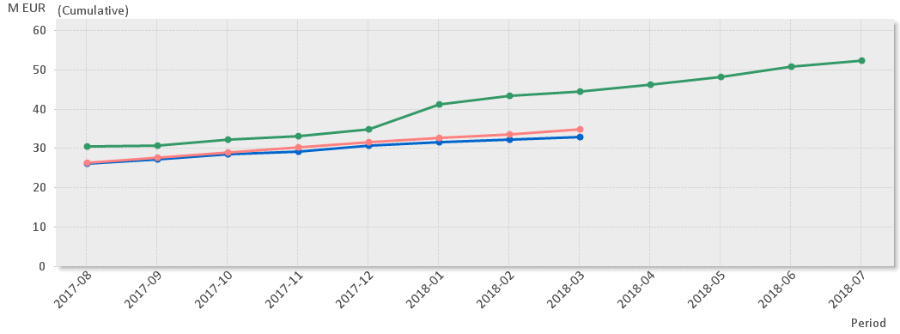
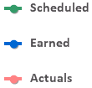

Earned value
(* No InKind included)
Current Status
The ICS project is 43% complete
Cumulative cost variance for ICS is within established variance reporting thresholds
Cumulative schedule variance exceeds reporting thresholds -11.5M€
  -4,6M€ is related to In-kind where the biggest contributions are
  -6.9 M€ is related to cash where the biggest contributors are
    -2.7M€ is related to delayed equipment purchases
    -1.6M€ for accelerator integration

Slide 22
Critical deliveries overview
MS L1: ICS ready for Accelerator ready for BoD
MS L1: ICS ready for Target ready for BoT
13/01/2022
30/11/2020
MS L1: ICS ready for Test beamline and Bunker ready for hot commissioning
MS L1: ICS components ready for initial operations independently
21/12/2018
31/05/2022
2018
2018
2019
2020
2021
2022
2022
Today
28 days
DI: MicroTCA systems 1 - 3 ready for installation
1/6/2018 - 29/6/2018
29 days
DI: EtherCAT system design completed
1/6/2018 - 29/6/2018
1 day
DI: MEBT controls integration completed
30/9/2018
1 day
DI: RFQ controls integration completed
30/11/2018
26 days
DI: Timing System sequencer and BIS programmed integrated for ISrc+LEBT
31/12/2018 - 25/1/2019
1 day
DI: DTL controls integration completed
1/4/2019
20 days
DI: D02 technical network in operation
31/5/2020 - 19/6/2020

Slide 23
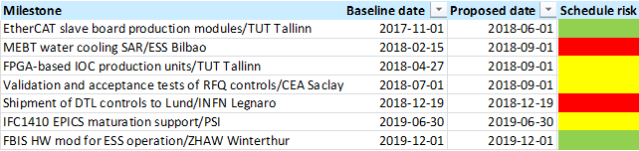
Critical/key In-Kind Deliveries

Slide 24
Key integration milestones (1)
MS L1: ICS ready for Accelerator ready for BoD
MS L1: ICS ready for Target ready for BoT
13/01/2022
30/11/2020
MS L1: ICS ready for Test beamline and Bunker ready for hot commissioning
MS L1: ICS components ready for initial operations independently
21/12/2018
31/05/2022
2018
2018
2019
2020
2021
2022
2022
Today
0 days
L1b: PSS-0 complete
1/6/2018
64 days
L1b: H01 CUB ready for ESS Server Hall installation start
2/7/2018 - 3/9/2018
51 days
L1b: Electrical power information from CF available for ICS (access to the power scada in H06 clarified)
1/11/2018 - 21/12/2018
120 days
L1b: IFC1410/IFC1420 test environment ready for stakeholders
2/1/2019 - 1/5/2019

Slide 25
Key integration milestones (2)
MS L1: ICS ready for Accelerator ready for BoD
MS L1: ICS ready for Target ready for BoT
13/01/2022
30/11/2020
MS L1: ICS ready for Test beamline and Bunker ready for hot commissioning
MS L1: ICS components ready for initial operations independently
21/12/2018
31/05/2022
2018
2018
2019
2020
2021
2022
2022
Today
56 days
L1b: RF Cell and LLRF Control ready
4/2/2019 - 1/4/2019
26 days
L1b: PSS-1 validation start
17/6/2019 - 12/7/2019
61 days
L1b: MP-SoS integration of design for Accelerator systems complete
3/6/2019 - 2/8/2019
68 days
L1b: Controls for Cryogenic Distribution System for super-conductive linac installed and ready for operation
29/7/2019 - 4/10/2019

Slide 26
Key integration milestones (3)
MS L1: ICS ready for Accelerator ready for BoD
MS L1: ICS ready for Target ready for BoT
13/01/2022
30/11/2020
MS L1: ICS ready for Test beamline and Bunker ready for hot commissioning
MS L1: ICS components ready for initial operations independently
21/12/2018
31/05/2022
2018
2018
2019
2020
2021
2022
2022
Today
53 days
L1b: SRR #2 - Beam through RFQ + MEBT (and DTL1)
19/8/2019 - 11/10/2019
47 days
L1b: PSS-1 re-validation start
16/12/2019 - 31/1/2020
55 days
L1b: SRR #3 - Beam through DTL1-4
1/3/2020 - 24/4/2020
33 days
L1b: PSS-Accelerator complete
7/9/2020 - 9/10/2020
40 days
L1b: SRR #4 - Beam through DTL5 to DMPL
2/11/2020 - 11/12/2020

Slide 27
Key integration milestones (4)
MS L1: ICS ready for Accelerator ready for BoD
MS L1: ICS ready for Target ready for BoT
13/01/2022
30/11/2020
MS L1: ICS ready for Test beamline and Bunker ready for hot commissioning
MS L1: ICS components ready for initial operations independently
21/12/2018
31/05/2022
2018
2018
2019
2020
2021
2022
2022
138 days
Today
L1b: Target cryoplant (Helium) installation complete and ready for ICS installation start
1/7/2018 - 16/11/2018
96 days
L1b: Target ready for ICS installation start - Target cabinets ready
7/10/2019 - 10/1/2020
45 days
L1b: Access to D02 building to start Technical network installation granted by Target
2/12/2019 - 15/1/2020
129 days
L1b: Access to D02 building to start Main control room installation granted by CF
9/9/2019 - 15/1/2020
152 days
L1b: PSS ODH for Target validated
4/5/2020 - 2/10/2020
60 days
L1b: Target Monolith systems WP4 - Functional/System Test -with ICS- start
1/2/2021 - 1/4/2021
47 days
L1b: Target wheel WP2 - Functional / System Test – with ICS – completed
13/9/2021 - 29/10/2021
93 days
L1b: Target cryogenic cooling (He+LH2) system tests with ICS completed
2/8/2021 - 2/11/2021
35 days
L1b: Target Station start integrated system test w/o beam with ICS
1/10/2021 - 4/11/2021

Slide 28
Key integration milestones (5)
MS L1: ICS ready for Accelerator ready for BoD
MS L1: ICS ready for Target ready for BoT
13/01/2022
30/11/2020
MS L1: ICS ready for Test beamline and Bunker ready for hot commissioning
MS L1: ICS components ready for initial operations independently
21/12/2018
31/05/2022
2018
2018
2019
2020
2021
2022
2022
Today
92 days
L1b: Test beamline ready for ICS controls installations
5/7/2021 - 5/10/2021
89 days
L1b: Test beamline ready for ICS PSS installations
19/7/2021 - 15/10/2021
78 days
L1b: Test beamline assembled and ready for ICS (PSS) commissioning test
13/12/2021 - 28/2/2022
1 day
L1b: Bunker ready for ICS controls installations
27/4/2022
1 day
L1b: Bunker ready for ICS PSS installations
27/4/2022

Slide 29
ICS – Top 5 Risk Mitigation Status (data from Exonaut)
Risk ID | Event | Potential Impact C – Cost S – Schedule Q – Quality and Function | Proba-bility | Mitigation measures | Treatment Due date
98 | ICS unable to support accelerator or target systems | C: 3.5 M€ S: 7-9 M Q: Several req. | 65% (4) | [Prevent by] Staff the integration packages according to plan (including forecast). Use FWA for integration services to bring in consultants | 181221
113 | Higher integration time needed for ICS local team (main potential issues with: ESS Bilbao, PSI, CEA Saclay) | C: 0,5 M€ S: 0-3 M Q: Several req. | 65% (4) | [Prevent by] Strengthen the collaboration between labs by increasing the contact events. | 190628
53 | Synergies with partners to grant success of MTCAv4 | C: 0,3 M€ S: - Q: - | 5,5% (2) | [Limit by] Procurement for MTCAv4 technologies involving several research facilities and industry. Partially financed by Brightness. | 190628
77 | Low level software (E3, drivers) is not enough or of the desired quality | C: 0,2 M€ S: 0-3 M Q: Several req. | 65% (4) | [Prevent by] Collaboration between groups within ICS for software processes and QA. E3 initiative tested and ready for deployment | 181214
96 | Entire planned budget from instruments integration gets forgotten with Value Engineering or Staged approach to End of Construction | C: 0 M€ S: - Q: One top-level req. | 35% (3) | [Avoid] Use of archiving in CHESS to keep trace of all this knowledge, and of sandboxes in Primavera to be able to refine it in the future. | 170616
Mitigation actions performed since last report |  | Revisited schedule related risks ICS procurement plan updated (ESS-0291029) [98, 113, 77] New work package managers appointed
Expected value of ICS cost risk = 6.5 M€ (5.9 M€ last month) (whole assignments and future)
Latest risk workshop: 2018-04-11; Next workshop scheduled for: 2018-09-26

Slide 30
Comments on Schedule - risks
[#112] Several stakeholder critical paths to manage adds complexity to schedule management
[#098] Overlap of integration activities (for example, between Accelerator, NSS and Target) due to the new schedule results in a challenge for ICS to secure the availability of skillful resources
[#113] Dependency on in-kind partners (main potential issues with: ESS Bilbao, PSI, CEA Saclay)
[#114] System testing time underestimated by stakeholders impacting ICS' assumptions
[#088] Uncertainty in the effort needed for commissioning support from ICS teams
[#100] Uncertainty in the coordination efforts for ICS installation teams due to cumbersome ESS site processes or involved organizations and suppliers
[from Exonaut; ESS risk management tool]

Slide 31
Outline
ICS goals and scope
ICS organization
ICS in-kind contributions
ICS project status
ICS project status illustrated

Slide 32
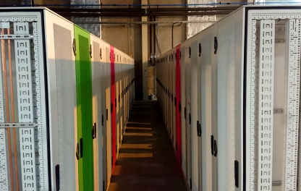
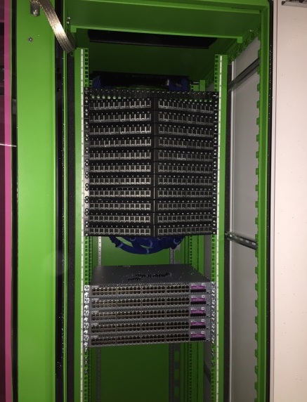
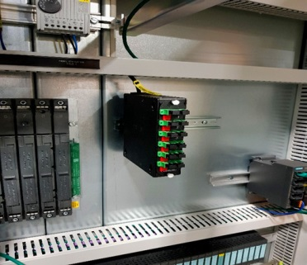
Installation of control system infrastructure
Installation and deployment of control system infrastructure is progressing according to plan
Fibre, cabling, switches, routers, patch panels etc. are installed and commissioned

Slide 33
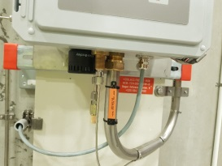
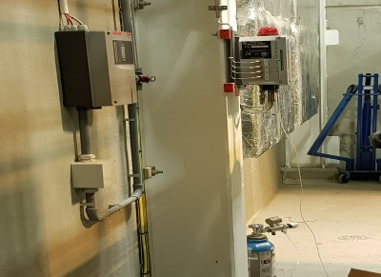
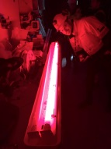
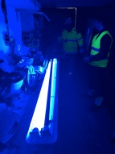
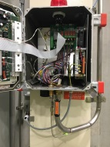
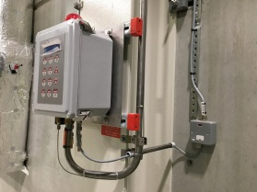
Installation of Personnel safety systems
ESS personnel safety
systems are among the
earliest systems that need to be in
place before operating equipment
A lot of installation is ongoing, in
particular for Oxygen deficiency hazard monitors

Slide 34
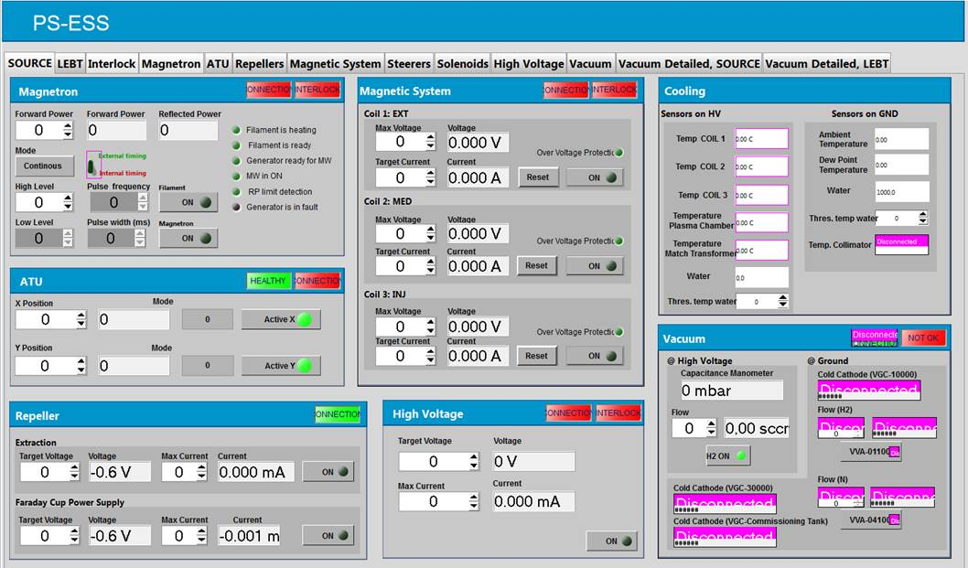
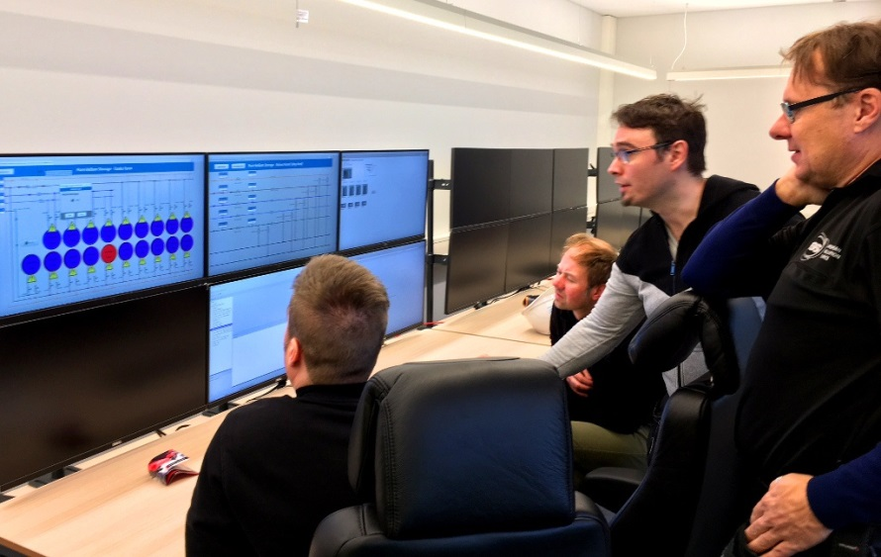
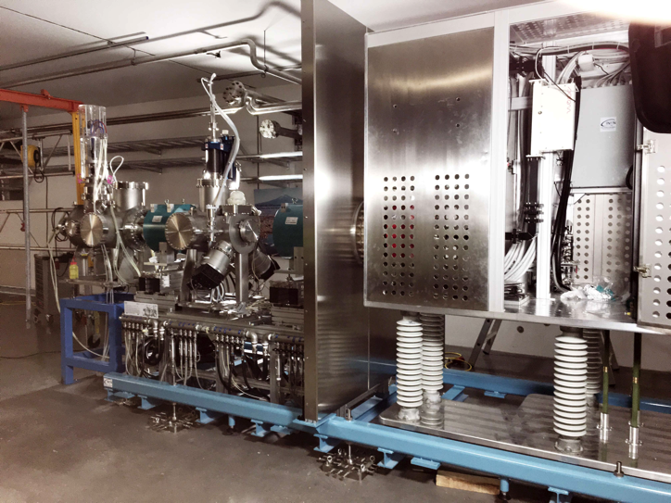
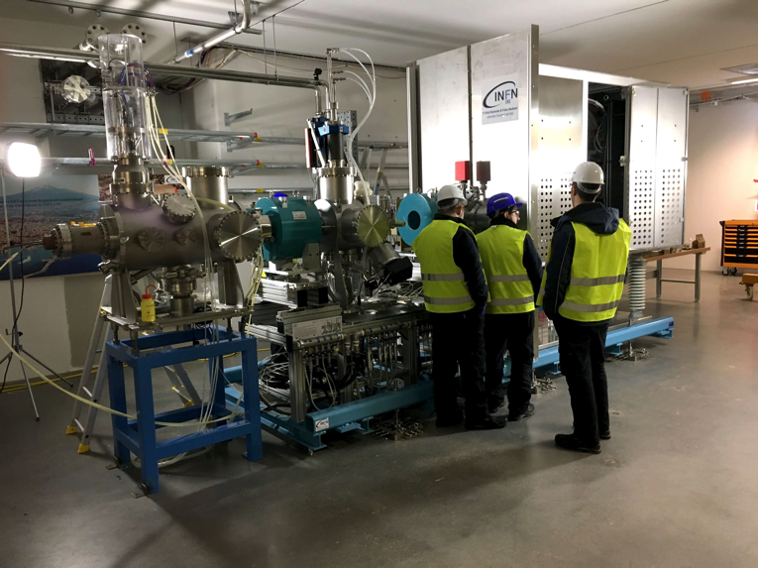
Controlling systems from the local control room
Recent achievements include controlling the pure Helium storage and parts of the ion source and LEBT from the local control room

Slide 35
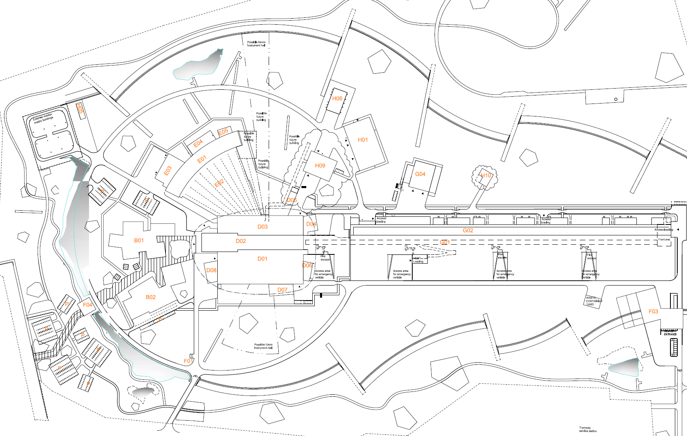
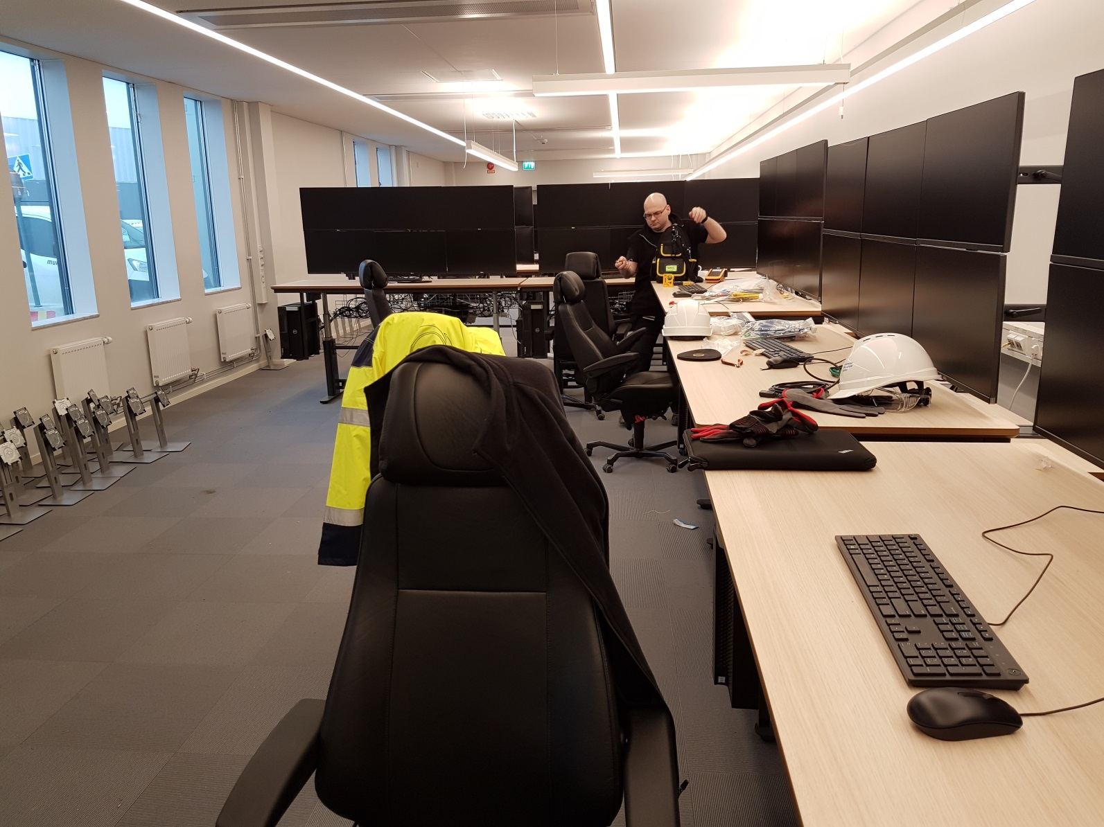
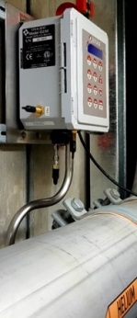
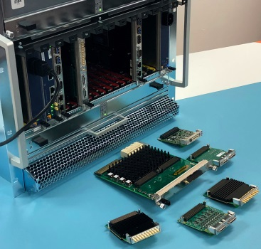
Temporary Control Room and controls hardware are materializing…
Local control room
Oxygen Deficency
Hazard System
High performance
platform (MTCA4)

Slide 36
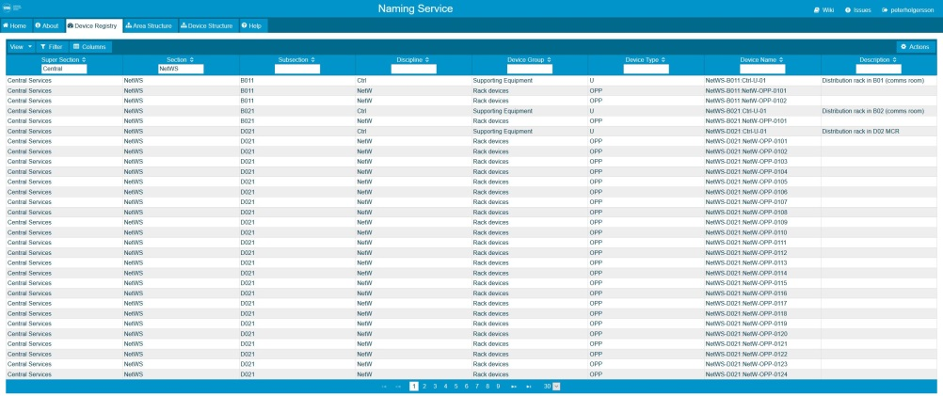
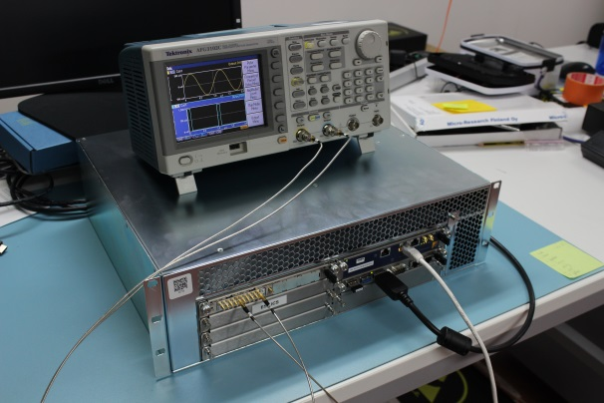
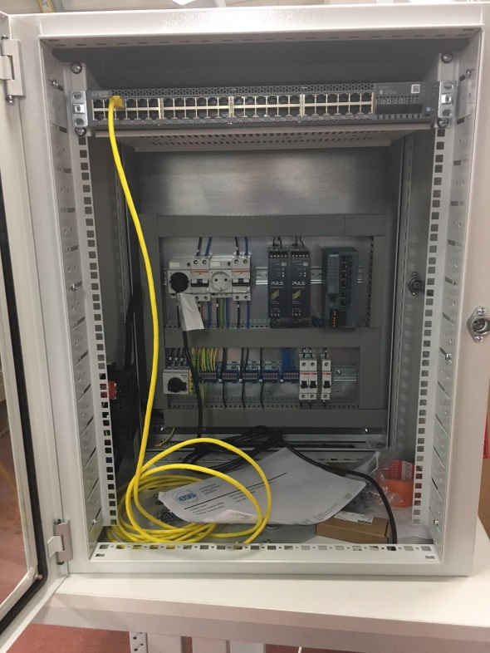
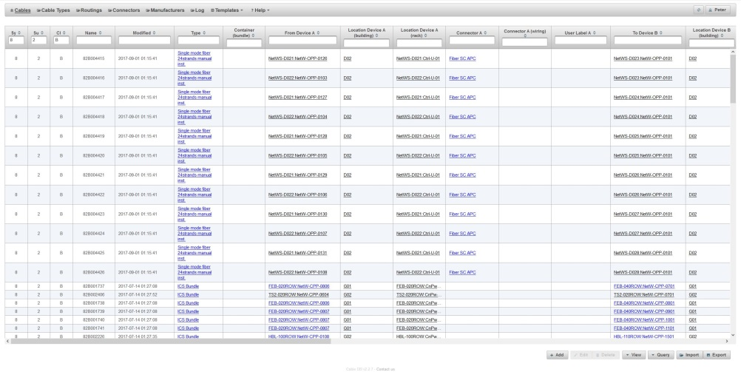
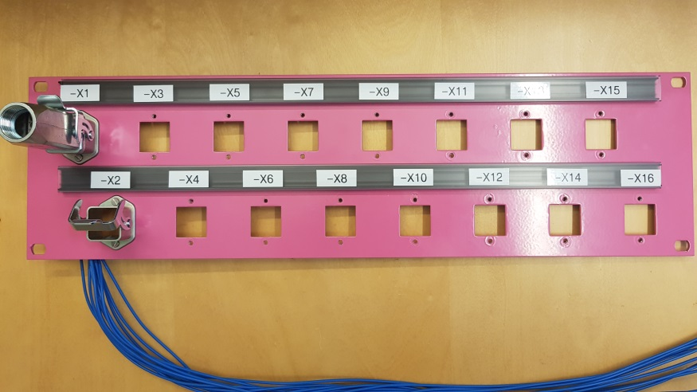
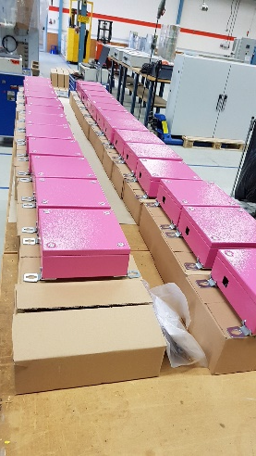
Building control systems
Many components are being assembled into ICS subsystems and readied for installation
Meanwhile, work is continuing with maintaining and developing the ICS and EPICS software solutions

Slide 37
Questions?
Thank you

