Slide 1
Data Reduction, Analysis & Modelling (DRAM) updates
Thomas Holm Rod
Group Leader Data Reduction, Analysis and Modelling
www.europeanspallationsource.se
19 September 2018

Slide 2
DRAM Time line and milestones (Fall 2018)
Plann. | Antici. | Description | Status
’18-07 | ’19-02 | SasView ready for SOUP (aka SasView 5 released). SasView compliant with non-functional and functional requirements. | Delayed. SasView 5 demonstrated and tested at codecamp at ESS in September. ⍺-version will be presented at SAS2018 in October at dedicated workshop. +75 persons signed up
’18-08 | ? | FullProf development begun. Collaboration with ILL kicked off | Uncertain
’18-Q3 | ’18-11 | Recruitment of 2 persons for Mantid, 1 for SpinW, and 1 for analysis in general. | Neil, Igor, and Simon W recruited. 2nd interview for last position Oct 1-5, 2018
’18-09 | ’18-09 | Office move. | ✅ Presumably completed
’18-09 | ’18-08 | Reduction on the fly. Data can be reduced on the fly for SANS2D for acceptance test but only low flux. | ✅ Demonstrated on local setup reading data from kafka stream.
’18-10 |  | Data reduction from NeXus. Data reduction of test workflow available from NeXus files. | ✅ have been possible for a long time
’18-11 | ’18-11 | Integration of reduction and analysis services. Data can be reduced and analyzed on the fly for limited flux for instrument(s) chosen for acceptance test. | Demonstrated for powder diffraction using a file for transfering histograms. Will be demonstrated for SANS using Kafka histogram streamer
Notes:
SasView:
Serious QA (Richard Heenan) at codecamp revealed several bugs. Thus, only alpha version will be used at codecamp.
Proper resolution function for ToF is not implemented (version 5.1)
Lessons-learned for next STAP meeting
Fullprof:
We do not get the feeling that the diffraction group at ILL is embracing the collaboration or open sourcing the software. We have not been able to setup a meeting so far, they have a lot of requirements for such a collaboration. Scientific computing group has not been involved.
Conclusion:
1) We should collaborate with ILL diffraction group but not rely on this collaboration

Slide 3
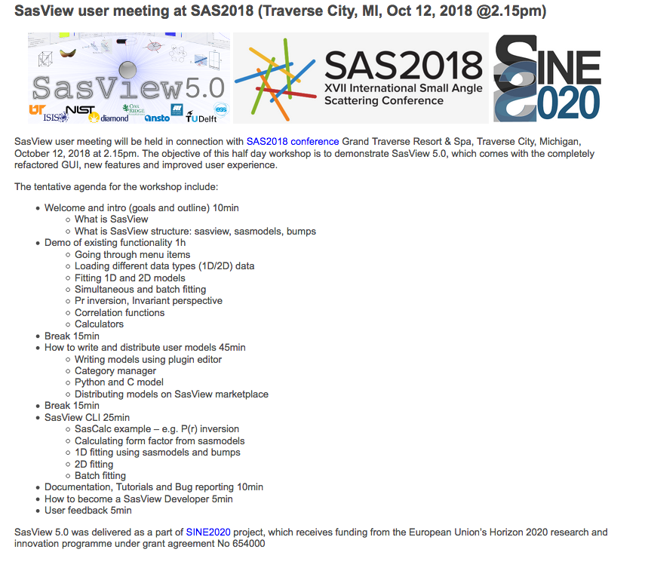
SAS2018 SasView user meeting
(Andrew, ESS)
(Paul, NIST or Andrew and Piotr, ESS)
(Tim, DLS)
(Wojtek, ESS)
+75 persons signed up
(Paul, NIST)

Slide 4
DRAM Timeline and milestones (2019)
Planned | Description
’19-01 | PaNOSC recruit(s) started. Linda Udby and Peter Willendrup seconded. 1 person recruited.
’19-02 | Data view integrated. Data on detector can be live-visualized with EC (Widget from Mantid).
’19-03 | Reduction view integrated. Reduced data can be live-visualized with EC (Widget from Mantid).
’19-05 | Software performance and integration testing validated. Data can be reduced and analyzed on the fly for expected flux of LoKI when in full operation Post batch processing can be performed on CPH cluster
’19-06 | Proof of operation (reduction). Data can be reduced on the fly for expected flux of LoKI when in full operation. Data are received from DAQ & Streaming system. Data can be post rereduced on cluster Need to be able to define the scaling parameter for the architecture rather than actually physically demonstrate
’19-09 | SINE2020 completed

Slide 5
Updated timeline diagram
- delays in core development
- recruitment pretty much on track
Updates with handwriting

Slide 6
DMSC integration milestones – on track (v.5 – April 2018)
1. Cph server room
Start procurement
Procurement complete
Server room tested and validated
Hardware and link
installed and configured
CUB
access date
2. Lund server room
CUB ready for installation
DMSC hardware installed in CUB
Data available
in Scicat
3. DAQ & Streaming
NeXus file definition ready
BrightnESS complete
File writer complete
Data available for
reduction and analysis
DAQ & Exp.Control
Integrated on
test beamline
4. Experiment Control
Data view
integrated
Proof of
exp. Control
of DAQ
Reduction view
integrated
5. Data Reduction
Data reduced on the fly
Proof of Operation
Software performance &
Integration testing validated
6. Data Analysis
Integration of
Analysis & reduction software
SINE2020 ends
Proof of Operation
0. DMSC
Data processing for some flux
Data set and rate defined for acceptance testing
Data processing for expected flux
Batch post-processing
Full integration
DMSC ready for BOI
External dep
V20 epics &timing
networks available
V20 closes

Slide 7




Progress – external funding
European | PaNOSC funded ☺ NMIStar rejected ☹ Feedback on two other EU proposals related to imaging expected in October and November (2-3 post doc years per proposal) MAX4ESSFUN projects ended
Swedish | VR project with Lund University and ISIS (TR-SAXS/SANS). First publication submitted and first experiments performed. Collaboration with Lisa Arleth’s group (UCPH). VR project with Chalmers, UCPH, and ISIS (modelling of dynamic structure factor). Biannual status meetings, plan for research and publications, Thomas Farmer, ISIS, is making good progress. Chalmers project (modelling of chemical order). Mattias graduated! 1st publication on its way. Presentation(s) at JCNS workshop. Co-proposer of VR project with Chalmers on modelling of engineering and powder diffraction data.

Slide 8
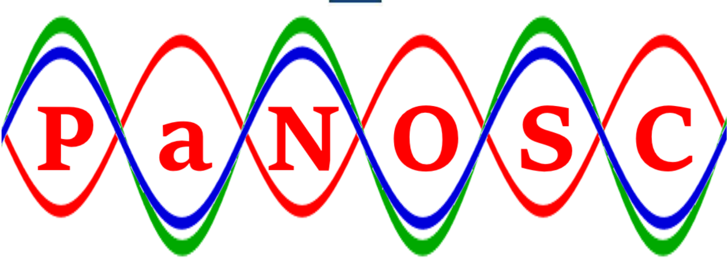
PaNOSC in relation to DRAM
PaNOSC. All work packages are of interest for DRAM, most noticeably:
#WP | Title and Scope | DRAM staffing
WP4: | Data analysis services. Remote access to analysis services, remote desktops, Jupyter notebooks. | ~0 PM
WP5: | Virtual Neutron and x-raY Laboratory (ViNYL). Optical simulations and virtual experiments. | ~30 PM & deputy WP leader.
WP8: | Staff and user training. Sustainability of e-neutrons.org and expansion to photons; e-neutrons.org -> pan-learning.org or pan.education to be hosted by ESS. Courses for staff and users on FAIR data and capabilities of ESFRIs. | ~36 PM Secondment of P. Willendrup, DTU, and L. Udby, UCPH. THR WP leader.

Slide 9
Sep 7 2018 Assessment of ESS readiness where we are now compared to when we started – trends only!
SasView 5
SasView 4
Mantid
(reduction, QENS, Sxtal)
BornAgain
MAUD
HORACE
McStas 2.5
(2018)
Phenix
DIALS
Fullprof
Mantid
(reduction, QENS, Sxtal)
SpinW
(pySpinW, SpinWcore)
ESS functional requirements
(functionality, performance, usability)
SpinW
NI software
McStas 2.1
(2014)
NI software
BornAgain
ESS non-functional requirements
(sustainability, maintainability, extensibility, reliability)

Slide 10
Sep 7 2018 Assessment of ESS readiness where we are now compared to when we started – trends only!
SasView 5
SasView 4
Mantid
(reduction, QENS, Sxtal)
BornAgain
HORACE
Mantid
(reduction, QENS, Sxtal)
SpinW
(pySpinW, SpinWcore)
ESS functional requirements
(functionality, performance, usability)
SpinW
NI software
NI software
BornAgain
ESS non-functional requirements
(sustainability, maintainability, extensibility, reliability)

Slide 11
d dd
Assessment of sustainability of diffraction software
Mantid
Library
CCTBX
Sxtal (reduction or analysis)
Phenix
DIALS
Powder (Rietveld)
Support for magnetic struct.
nsxtool
Health of developer community
MAUD
Topas
Crys-FML
GSAS II
F.O.X.
Full-prof
Mag2
Pol
Esme-ralda
Jana
Davinci
ShellX
CCSL
Mag-LSQ
Python/C++/Qt
@ github
Framework
Notes:
Xds?

Slide 12
d dd
Assessment of sustainability of diffraction software
SasView
5
Mantid
Library
CCTBX
Sxtal (reduction or analysis)
Phenix
DIALS
Powder (Rietveld)
Support for magnetic struct.
SasView
4
nsxtool
Health of developer community
MAUD
pySpinW
Topas
Crys-FML
GSAS II
SpinWcore
F.O.X.
Full-prof
Mag2
Pol
Esme-ralda
Jana
Davinci
ShellX
SpinW
(matlab)
CCSL
Mag-LSQ
Python/C++/Qt
@ github
Framework
Notes:
Xds?

Slide 13
Tentative strategy for powder diffraction
Near term
Clarify support from other facilities Recruit domain expert Seek external funding |  | Setup DMSC diffraction group Maintain and update resource loaded schedule and roadmap
Hot commissioning | SOUP |  | Operation
Fullprof is ready with as-is UI (collaboration with ILL) MAUD ready (collab. w. Luca) Sustainable Python/Qt alternative for structural chemistry possibly based on ASE and exploiting or learning from ‘likeable’ frameworks 2D Rietveld is properly assessed | New sustainable (and uniform) Python and Qt interface to Fullprof and MAUD perhaps some other Rietveld programs 2D Rietveld implemented for structural chemistry (if useful) |  | Sustainable solution for magnetic structure refinement based on Fullprof or something else
Notes:
Two-fold strategy:
Work on Fullprof
Become independent of Fullprof
Fullprof -> CrysFML which is open source and under version control

Slide 14
Strategy for Sxtal diffraction
Have a workshop and make a strategy!
WISH (ISIS) (Pascal Manuel and Fabio Orlandi) 30 minutes
User experience (Emil Andreasen Klahn) 20 minutes
cctbx (Paul Adams) 40 minutes
reduction: Mantid (Vickie Lynch) 40 minutes
analysis and user experience: Jana2006 (Vaclav Petricek and Margarida Henriques) 40 minutes
Coffee break
FullProf and Esmeralda Laue Suite (input from Juan Rodriguez Carvajal, presented by Céline Durniak) 20 minutes
DaVinci (Andrew Sazonov) 20 minutes
Discussions
IKON satellite meeting Sept 12, 2018
Topic
Welcome, objectives (Thomas Rod) 15min
ESS Instruments / Diffractometers (Werner Schweika) 15 minutes
MAGIC (Xavier Fabrèges) 20 minutes
DREAM (Florence Porcher) 20 minutes
Discussions 20 minutes
Coffee break
TOPAZ (SNS) (2 instrument scientists: Christina Hoffmann and Xiaoping Wang) 40 minutes
Notes:
Draft report on confluence

Slide 15
Tentative conclusions / questions
Data reduction. Stick with Mantid for peak finding and integration and support further improvements
Analysis. Have three separate solutions:
    Life science based on cctbx
    Is Phenix closed source / license an issue?
    Hard condensed matter based on CrysFML as a starting point
    Use ASE as interface? Where do we get inspiration from? GSASII?
    Expand CCTBX with CrysFML functionality? / Convert CrysFML to C++/Python?
    Jana & GSASII?
    Engineering diffraction based on MAUD (and thus also cctbx)
Visualization of structures?
1
2
3

Slide 16
Don’t reinvent the wheel!
(although we already did)
Library / frameworks | Language | UI | Simple struct. | Complex hard | bio str. | Domain
Mantid | C++/Python | Y | Y | ? | N | Neutron scattering
CCTBX | C++/Python | ? | Y | N | Y | Crystallography bio
CrysFML | Fortran95 | N | Y | Y | N | Crystallography hard cond.
ASE | Python | Y | Y | N | N | Manipulation of atomic struct.
nsxtool | C++/Python | Y | Y | ? | ?
Balance avoidance of dependencies against exploitation of domain knowledge
Mantid
ASE
CrysFML
CCTBX

Slide 17
Assessment of analysis software for sx & pwd for hard condensed matter
 |  |  |  | ☺
CCSL | Jana Fullprof | CrysFML
 |  | GSASII
 | Topas | MAUD |  | CCTBX
☹
ESS functional requirements
ESS non-functional requirements

Slide 18
Follow-ups
From last STAP
For next STAP
Recruit data scientists (next year)
General look & feel (not easy)
Start user training (SasView and MuhRec)
Manage expectations (ongoing)
Detailed plans (Jon’s presentation)
Lessons-learned from SasView 5 project
1st roadmap for diffraction to share with community
Instrument specific plans for first eight instruments until steady state operations (have list of generic milestones)

Slide 19
Software progress reports
Background information

Slide 20
Progress: Mantid for reduction
McStas | Mantid for data reduction
4 schools/training events in 2018 ESS-specific instrument-repo Magnon sample prototype from Kim Lefmann ”mslice-light” oriented monitor component, visualising S(q,w) on a 2D q ⨉ E grid Updated Union components from Mads B. Prototype for visualising ESS engineering-model of instrument in McStas Basic needs for GPU support identified after Dresden hackathon Modernised code-generation mechanism (in preparation for McStas 3.0) Bugfixes and improvements to Python layer Simulations of V20 Test Beamline | First implementation of NeXus Geometry format reading. No IDF instruments now possible. Better comparable performance. Significant improvements in instrument visualisation speeds across framework. Live kafka histogram listening and broadcasting Hardware requirement report compiled Workspace 2.0 design and prototype developed Z-order prototype for faster sparse MD data structure Two new hires at DMSC Ongoing support for V20 Test Beamline

Slide 21
Progress analysis – Imaging & Engineering
NI software (MuhRec, KipTool, Nitools) | Eng. Diffraction
More traction in community. MuhRec version with improved UX released MuhRec demonstrated at WCNR-18 (40-50 participants) Seems likely that J-PARC code for Bragg edge analysis will become part of NI suite on github Started to consider Python bindings / interface Steering committee meetings and rolling roadmap in place Better understanding of hardware requirements and UX Convergence of DMSC and ODIN team’s understanding Better test coverage Full support for NeXUS Scattering correction implemented | Starts to see way forward Fruitful workshop at DMSC Most noticeably, MAUD got funding: Java -> C++ Will use CCTBX library Tamas Ungar very interested in collaborating
Instrument team is going for latest (still to be developed) detector technology | Need to setup collaboration

Slide 22
Progress analysis – Large-scale structures
SasView | BornAgain
Close to be ready for SOUP, although delayed Final details implemented. New version 5 introduced to and evaluated by other developers at code camp Serious QA, many GUI bugs revealed New developer at ISIS has contributed significantly Alpha-version will be presented at SAS2018 with more than 75 persons participating Tutorials at summer schools | Extended to specular reflectometry Specular reflectometry implemented and ready for testing Better integration between ESS and MLZ. Wojtek involved in reviewing and testing. Extra developer started at MLZ Instrument scientists (promised to) engage / test
 | Further improvement of MLZ and ESS coordination Small developer community Alternative Python reflectometry codes on their way, making it harder to consolidate around BornAgain Need to find additional scope for SCG-MLZ
SasView management slow to release, but some promised changes for Version 5.x SasView developer community works at different pace than ESS developers Need to compile lessons-learned

Slide 23
Progress analysis - Spectroscopy
QENS | INS
Slow but kind of working cross-facility effort Collaboration between ESS / STFC ISIS / ILL Development of a universal QENS fitting model library (~10 models) Python / Doc tests / Repository on github Examples in Jupyter notebooks using different “standard” fitting engines (lmfit, Mantid, scipy.optimize) User testing in progress | Taking control of spin-dynamics simulations Recruited Simon Ward to drive SpinW development Continuing work on SpinWcore (C++) and Python interface Started to clarify interface between Mantid and PACE project
Slow progress (nobody’s main priority) Slow to get feedback from users Completeness of library What happened to new GUI? Join efforts with SNS (existing “qef” library) | Get Simon W integrated in group Balance need for having a driver versus avoiding single-point-of-failure Start coordinating with PACE project

Slide 24
Progress analysis - Diffraction
Powder diffraction | Single crystal diffraction | Engineering diffraction
Little progress – looking for way forward Céline visited ILL and had discussions with Juan and instrument scientists Some communication but still waiting to kick-off collaboration | Little progress – looking for way forward Workshop during IKON Some solutions upstream: CCTBX has lots of traction (MAUD, PHENIX, DIALS) New algorithms for Mantid prototyped at SNS What to do downstream? | Starts to see way forward Fruitful workshop at DMSC Most noticeably, MAUD got funding: Java -> C++ CCTBX library Tamas Ungar very interested in collaborating
Need to find way forward | Need to decide what to do | Engage with MAUD development

Slide 25
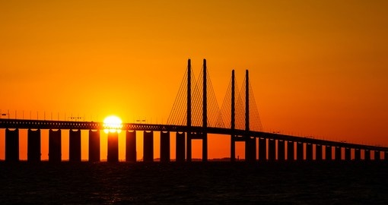
Questions?

