Slide 1
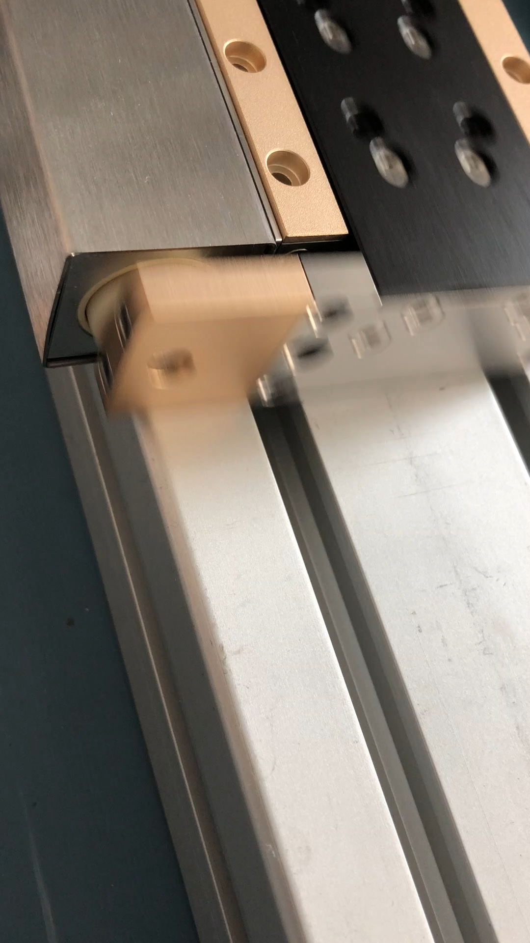
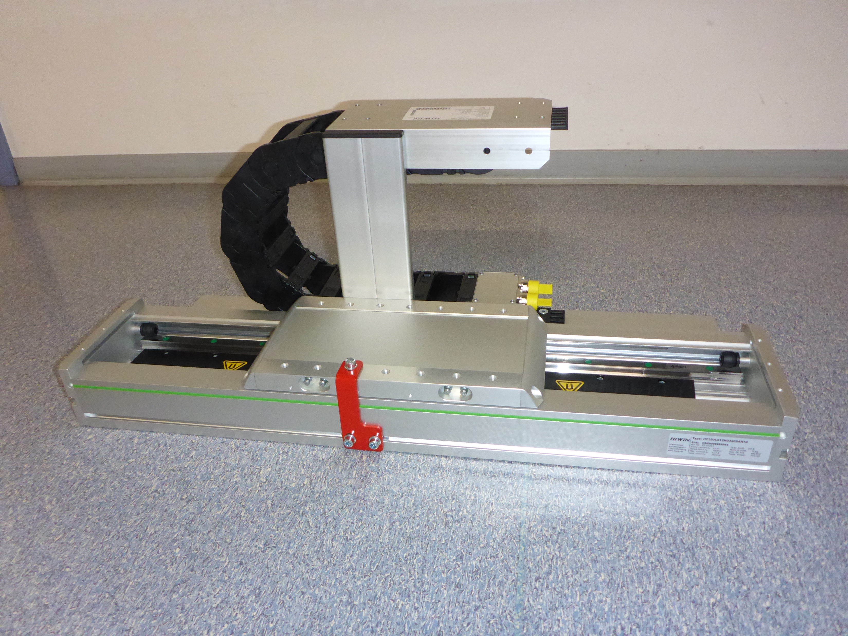


LINEAR Motion Technology
LINEAR-MOTOR
PROJECT
Lund
Critical design review CDR
EVALUATION FOR Neutron Instrumentation
GENERAL short OVERVIEW NIK5.3#5
June 14th, 2018 Michael Klein, KLAUS BUSSMANN
Member of the Helmholtz Association

Slide 2
Linear motion Technology
Responsible:
Motion Control & Automation Group
ESS Lund
Part of the Instrument Technologies Section of the Science Directorate
Motorisation of movements for instrument components
Partner:
JCNS – Jülich Centre for Neutron Science
Forschungszentrum Jülich GmbH Jülich

Slide 3
Overview
... Technical Competences
... Project Support
... Workflow
... First Idea to the Project
... Basics
... Control System
... Linear Motor
... Feedback systems
... Workbench
... Components

Slide 4
technical competences
General
overview
Project-Management
Hydraulic-
systems
Pneumatic-
systems
Automation-
technology
Process-
control
Power-
electronics
Extract and
Influence:
Linear
Motor
Evaluation
Documentation
Scattering
Instrument
Electro-
technology
Informatics
Certification
CAD/CAE
FEM
Simulation
Actuating-
elements +
Sensors
Mechanical-
engineering
Cryogenics-
engineering
Magnet-
technology
Vacuum- +
Radiation-
technology
Quality-Management

Slide 5

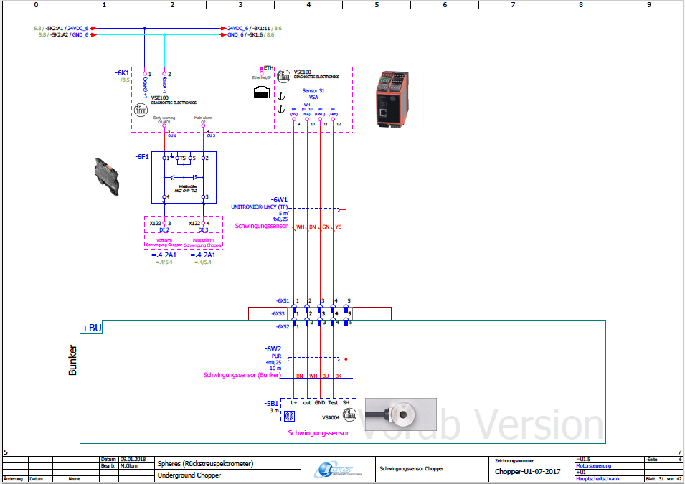
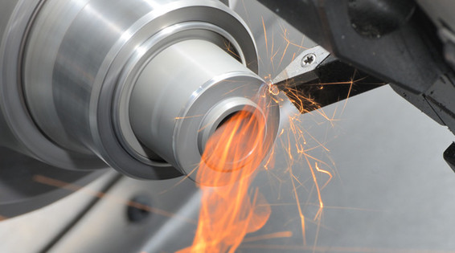
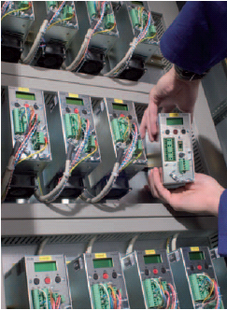
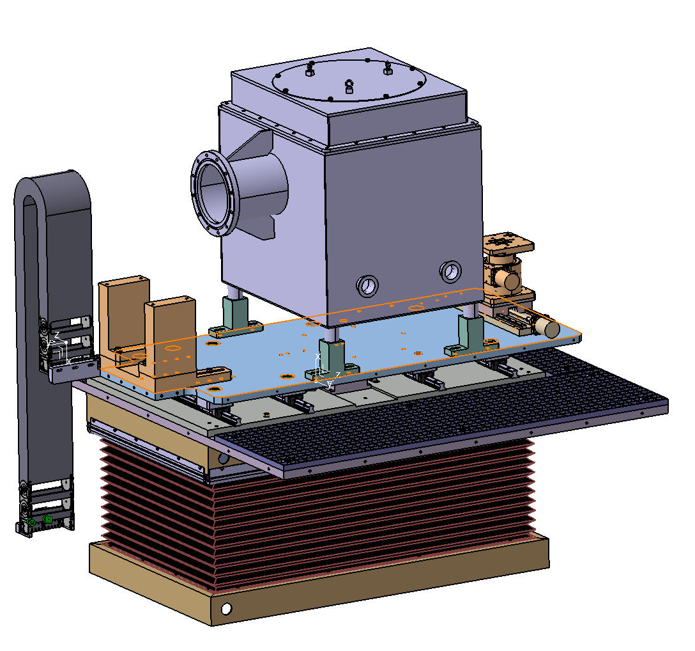
Project Support
ESS – MCA
Motion Control & Automation
Projekt Leadership & Management
JCNS In-House-Support (JCNS-PGI-TA,
Technical Administration)
Administration
Engineering & Design
Mechanical Workshop
Scientific IT Systems
Industrial Safety & Radiation Protection
Partner Support by Center Facilities and Management
(if required)
G-ELI Facility Management - Instrumentation
Process Control
ZEA-1 Central Institute for Engineering & Technology
External Technology Providers

Slide 6
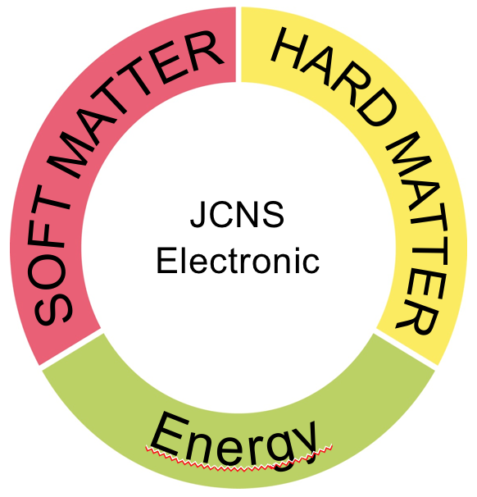
Workflow
Project
Idea
SAT
Site Acceptance
Test + Review
Kick-Off
Meeting
Linear
Motor
Technology
Documentation
Package +
Compendium
Procurement +
Critical Design
Review
Measurement
Review
Commissioning

Slide 7
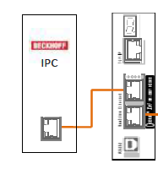
From the first idea to the Project
Integration and Performance Testing of
Linear Servo Motor Controller –
First idea ... Lund April 2015
Start project ... Jülich November 2017
Product-example: Linear motor Jenny Science Swiss

Slide 8
ESS - MCA
Motion Control & Automation
Classical linear motor technology
Basics and fundamentals
Technical standards and guidelines
Documentation templates
Engineering information
Process control quality plan
Timeline
Requirements ESS:
Beckhoff Control & Drive System
Different working loads
Different travel distances
Speed tests and temperature behavior
Fields of application and usability for neutron instruments

Slide 9
Control-system
The simple, hand-adjustable devices of the first hour in the fifties have evolved into fully automatic, computer-driven instruments with error analysis today supported by PLC‘s in the field level.
PLC-Standard EN 61131-3 -> TwinCat 3 Beckhoff
PLCopen, uniform PLC- platform of several companies
Beckhoff IPC-Control-System
Beckhoff EtherCAT fieldbus-components

Slide 10
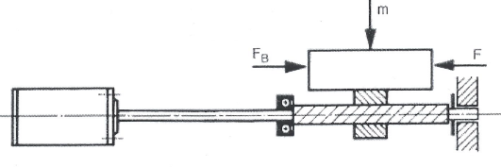
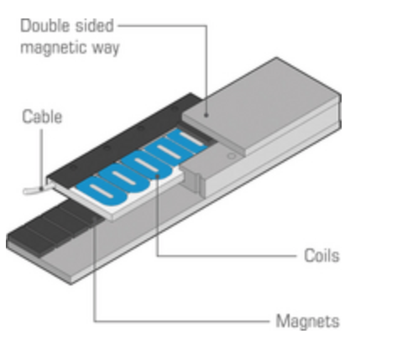
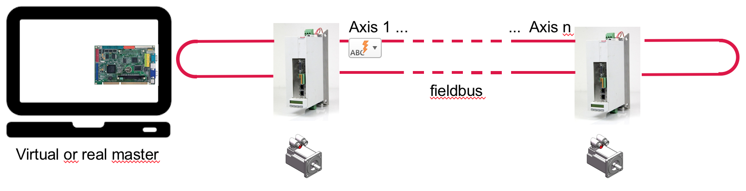
linearmotor
A linear motor is an unfolded rotary permanent-magnet direct drive motor.
free from backlash
free from wear
direct coupling of the payload
large power and speed range,
enclosures, bearings and measuring systems must be designed by the user
dynamic movement
Example: Ironless linear motor
In composite systems, real or virtual masters are used with the support of PLC‘s with technology functions for electronic gear,
cam control, etc.

Slide 11
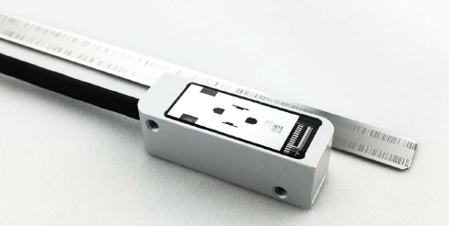
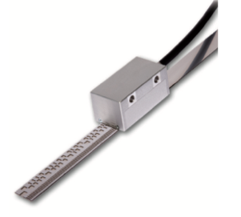
Feedback systems
Distance measurement, translational
Digital drive systems as well as position control loops with feedback systems for data acquisition demand fast data transmission from the measuring devices with high transmission reliability. In addition, further data, such as drive-specific characteristics, correction tables, etc., must be available.
For high system security, the feedback systems must be integrated into error detection routines and offer diagnostic options.
Most common interfaces:
SSI EnDat magnetistrictive BISS-C potentiometry incrementally
Resolver ProfiNet /EtherCAT RS232/485 analogous interferometry
Rugged absolute feedback systems in
state-of-the-art-technology are prefered.
Vacuum suitability and radiation resistance are important selection criteria.

Slide 12
Workbench

Slide 13
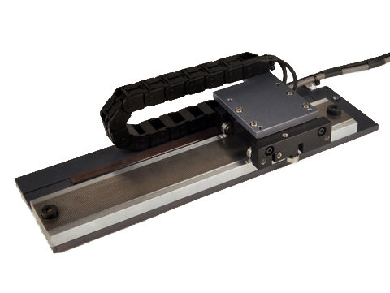
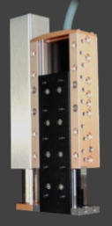
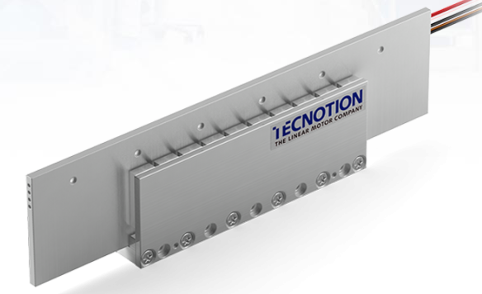
Linear Motor technology
Linear Stepper Stage
with 16“ travel
Absolute encoder
BISS-C
H2W Technologies, Inc.
26380 Ferry Court
Santa Clarita, CA 91350 USA
Linear Motor Stage
with 110 mm travel
ELAX EX 110F20
Absolute encoder
Jenny Science AG
Sandblatte 7a
CH – 6026 Rain
Coilunit
UM12 S Vacuum
Magnet YOKE
UMX 150 Vacuum
Tecnotion
Twenteport West 15
NL – 7609 RD Almelo

Slide 14
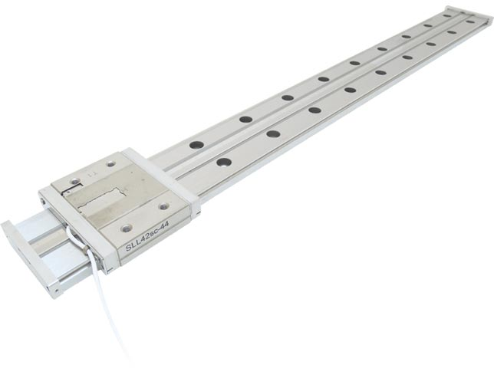
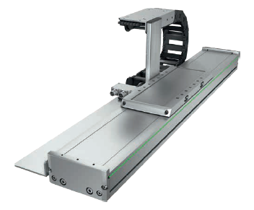
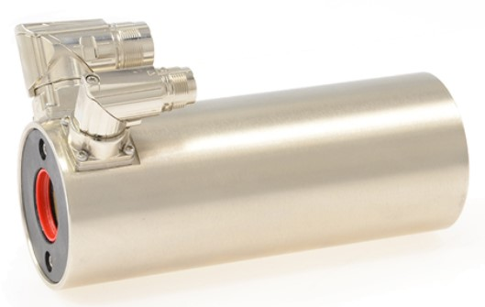
Linear Motor technology
Nanometer Precision
Linear Rail Positioner
600 mm travel
Vacuum
320 mm travel
Absolute encoder
SmarAct GmbH
Schütte-Lanz-Straße 9
D – 26135 Oldenburg
Linear table
with linear motor
HiWin GmbH
Brücklesbünd 2
D – 77654 Offenburg
Linear Module
with stator and slider
170 mm travel
LinMot NTI AG
Bodenaeckerstraße 2
CH – 8957 Spreitenbach

Slide 15
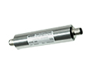
Additional feedbacksystems
Three axis real-time inter-
Ferometer system for
Displacement and tilt
angle measurements
attocube systems AG
Königinstraßen11a
D – 80539 München
Inductive displacement
measuring system
150 mm
SSI
TWK Elektronik GmbH
Heinrichstraße 85
D – 40239 Düsseldorf
Inductive
linear position sensor
700 mm
SSI
Hans Turck GmbH & Co.KG
Witzlebenstraße 7
D – 45472 Mühlheim a.d.Ruhr

Slide 16
Additional feedbacksystems
Absolute track measuring stick with linear scale
BISS-C
Lenght 630 mm
Renishaw GmbH
Karl-Benz-Straße 12
D – 72124 Pliezhausen
Lenght measuring system
absolute
BISS-C
AMO Automatisierung
Meßtechnik Optik GmbH
Nöfing 4
A – 4963 St.Peter am Hart
Linear absolute encoder
650 mm
BISS-C
Numerik Jena GmbH
Im Semmicht 4
D – 07751 Jena

Slide 17
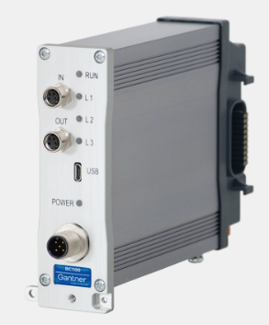
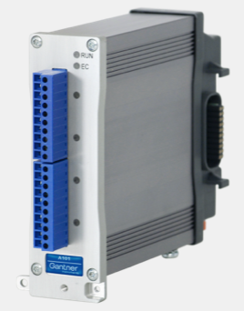
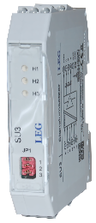
Additional feedbacksystems
Distributed real-time Measurement System
incl. amplifier
EtherCAT
High performance for LVDT
Gantner Instruments GmbH
Montafonerstraße 4
A – 6780 Schruns
Signal Converter
RS422 ... TTL
LEG Industrie Elektronik GmbH
Textilstraße 2
D – 41751 Viersen

Slide 18
MCA – ESS
Motion Control & Automation
Financial framework:
Total cost 311K€
Previous material costs 80 K€
Timeline:
Start November 2017
End May 2019
Conclusion for modern drive technology for neutron scattering:
powerful drives with high performance and sustainability
link of motion and plc-technology
pre-assembled modules in hardware and software
standardization, generic systems

Slide 19
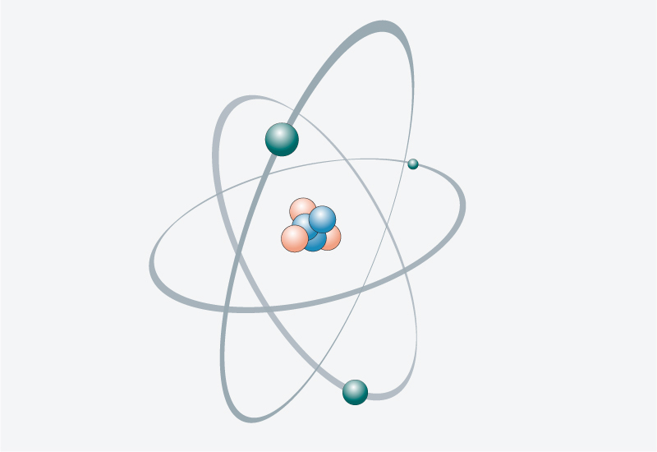
end
Physic and engineering
- an awareness of life -
JCNS – Jülich Centre for Neutron Science
Thank you for your attention
Tack för din uppmärksamhet
We love neutrons

