Slide 1
Measurement Proposals
IN-Kind project NIK5.3#5
Test Package for Linear Motion Technology
Project Critical Design Review, ESS Lund
12 June 2018 I Michael Klein, Klaus Bussmann, JCNS

Slide 2
Overview
Background of this IN-KIND project
What could be tested, measured and investigated? Proposals from JCNS are:
Analysis of the dynamic behavior and the control quality
Performance and Stability
Temperature profile
Force / current monitoring
Disturbance reaction
Synchronously behavior
Environmental influence
Manageability
Comprehensive cost analysis
Draw comparisons
Control System concept
Software concept for motion applications

Slide 3
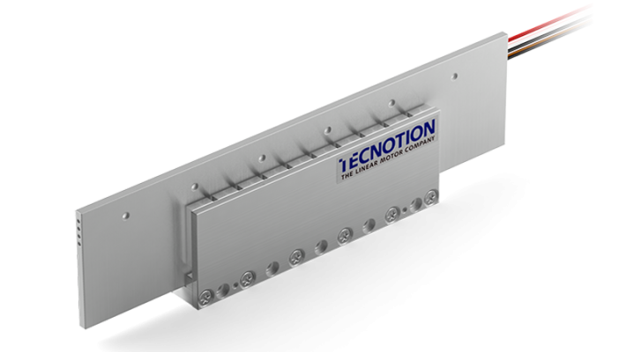
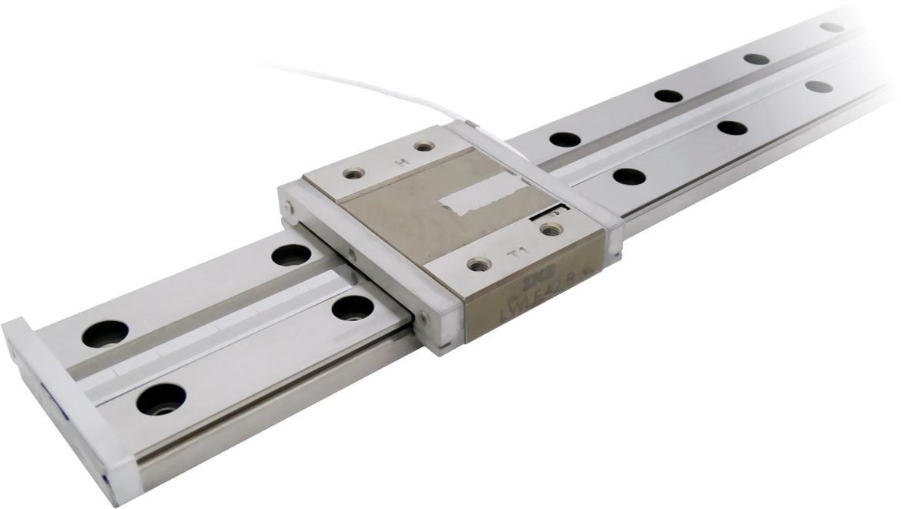
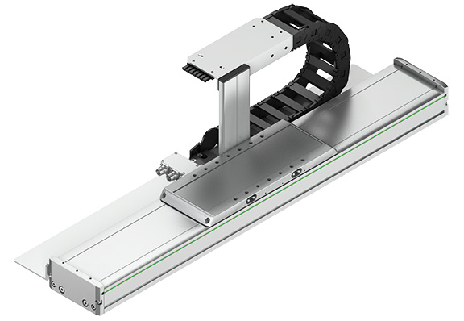
1. Background of this IN-KIND project
ESS would like to investigate the linear motor technology to find out if this technology would also be suitable for use with a neutron scattering instrument
Linear motors that generate linear movements are currently used mainly in positioning and handling systems.
Feed forces are generated in many applications by an electric motor and a gearing mechanism => indirectly translative movemant
Linear motors offer the possibility to generate a direct translative movement without a gearing mechanism => reduction of maintenance work

Slide 4
2. Test proposals from jcns
Analysis of the dynamic behavior and the control quality
Investigation of the dynamic driving profile of the linear motors.
Special interest:
Acceleration behavior
Force behavior
Possible to record the movement profile of the different linear motors that could be loaded with different loads / weights => More Load ≙ Influence on the automatic controller action & the transient response?
Test of the control quality of the different linear motors.
In this test and measurement scope, basically all selected linear motors could be included and compared.

Slide 5
2. Test proposals from jcns
Performance and Stability
One possibility: The analysis of the accuracy and repeatability of the different Feedback systems:
The accuracy of the linear motor system is highly dependent on its feedback system and the mechanical guides and bearings.
Mechanical guides and bearings, the linear motor system and the feedback system have to be well coordinated.
It might be interesting to investigate which feedback systems - is the easiest one to integrate to the construction and the control level? - is working in cooperation with the selected linear motors best and most accurate?
Especially suitable for the feedback systems (commutation & positioning) in cooperation with three phase linear motors

Slide 6
2. Test proposals from jcns
Performance and Stability
Next possibility: the comparison between the positioning measuring systems with BiSS-C/SSI Interface and the ultra-precise Interferometer:
Test and compare the long-term performance of the different feedback systems in comparison to the high-precision interferometer.
Example:
Investigation of accuracy or repeatability of the different feedback systems in continuous operation in a given time „t”. => Which system best matches the performance of the Interferometer?
Measured values in the time „t“ could be collected and forwarded to the control computer
Traced with external software => Curve;
Alternatively:
Long-term performance test for all positioning systems in a given time „t“ with following comparison => Accuracy, repeatability, resolution…

Slide 7
2. Test proposals from jcns
Performance and Stability
Another possibility: the comparison between the iron-core linear motor, and the ironless linear motor:
Investigation of the influence and impact of cogging on iron-core linear motors in comparison to ironless motors.
Cogging:
Result of iron-core design.
“The iron core has “preferred” positions relative to the magnets, and the motor must vary its thrust force to overcome these positions. This results in a motion that is less smooth than that of an ironless linear motor.”
Cogging has negative effects on the synchronous run of the iron-core linear motors and thus on the positioning accuracy.
One feedback system in operation with both, the ironless- and the iron-core linear motor. => Different positioning accuracies with one and the same feedback system recognizable?

Slide 8
2. Test proposals from jcns
Temperature profile
Investigation of the temperature behavior of the linear motors.
Temperature monitoring during continuous operation over a given time „t”.
Optionally:
Measured values transferred to the control computer
Traced with external software => Curve;
Evaluation if external cooling methods are necessary (e.g. fan, water cooling)

Slide 9
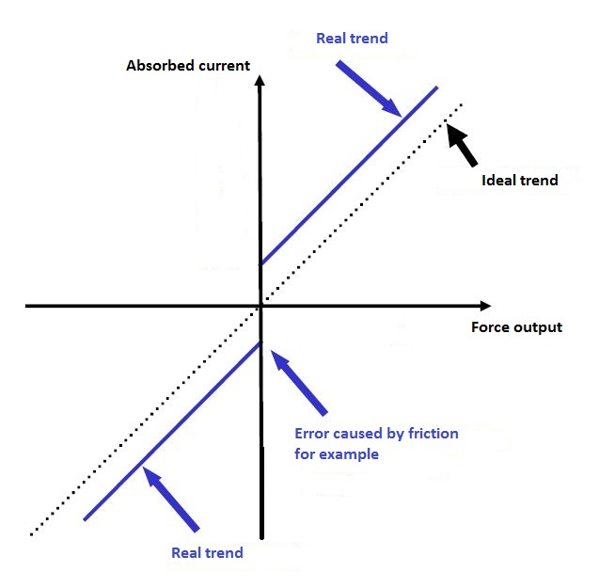
2. Test proposals from jcns
Force / current monitoring
Record of a force-current characteristic curve of the linear motors.
Current- and force measurement is necessary => diagramed in a coordinate system
Direct proportional relationship between absorbed current and delivered force in the linear motor.
In fact the power delivered by the motor depends on various parameters: - mechanical friction, - weight forces due to the mounting position - magnetic sources of error (cogging)
Another test: - load bearings test: Different loads fixed on the linear motor => Different loads have an impact to the acceleration or accuracy of the system? => Can the motor still achieve the data for acceleration specified in the specifications?

Slide 10
2. Test proposals from jcns
Disturbance reaction
Investigation of the disturbance behavior of the different test items.
What happens in the case of influence from outside?
One Option:
Test the behavior of the linear motors in the event of an emergency stop signal.
Would the linear motor immediately stop? (the fixed load experiences a strong jerk)
Would the motor continue in extreme cases until it reaches the limit stop?
Another option:
Test the light sensitivity of the feedback systems.
The lighting conditions can change at the place of installation.
Investigate if this has an impact to the accuracy or repeatability of the systems during operation.

Slide 11
2. Test proposals from jcns
Synchronously behavior
Investigation of the synchronously behavior of the linear motors.
Beneficial to use three-phases linear motors which will be controlled via the dual-channel servo drive (AX5206, Bekchoff).
Feedback system for positioning & commutation + automatic controller action play a central role.
Master / Slave connection could be created.
Both channels of the servo drive (=> both linear motors) could be synchronized.
Possible test-example:
Create a requirement that the defined master – motor will reach the desired position „x” in a certain time „t”.
Slave – motor: moves synchronously to the master, but reaches the desired positon „x” after twice the time „t”.
Influence to the accuracy or repeatability recognizable of the feedback systems?

Slide 12
2. Test proposals from jcns
Environmental influence
Investigation of the influence of environmental conditions on the different test items.
For use in difficult environmental conditions most manufacturers cannot give any statement about the performance or possible limitations. => Radiation hard, vacuum, magnetic fields;
Unfortunately difficult to realize.
Possibility:
Mounting of a linear motor and a feedback system on a separate table.
Delivery to research neutron source. (e.g. FRM II, Garching, Germany)
Expose the test items to a neutron instrument with radiation for one day.
Possible tests: Motor: Performance, automatic controller action, acceleration, braking behavior… Feedback System: Accuracy, Repeatability…
Not possible for each test item because it is very complex to realize.

Slide 13
2. Test proposals from jcns
Manageability
Evaluation of the manageability of the different test items.
Linear motors, and in particular the ironless motors, are designed to work very maintenance-friendly and wear-free.
Possible to investigate at the end of the measurement phase if maintenance would be necessary.
Wear on the motors, feedback systems or mechanical guides can be detected?
Preventive Maintenance necessary?

Slide 14
2. Test proposals from jcns
Comprehensive cost analysis
In contrast to the previous, more technically designed tests a comprehensive cost analysis would offer an economic investigation.
Creation of an evaluation whether the costs for the different test items were justified
Basis: technical investigations (e.g. performance tests)
Useful for the final overall comparison and a final evaluation.
Another possibility:
Market analysis
Increase of costs with the weight load of the linear motors? (linearly or exponentially?)

Slide 15
2. Test proposals from jcns
Draw comparisons
Finally an overall comparison of the various test items could be drawn.
Cost-performance ratio could for each test-item:
Basis: acquisition costs + results from the technical measurements & tests.
Comparison of different linear motors and feedback systems => Afterwards evaluation: which test item has proven most effective?

Slide 16
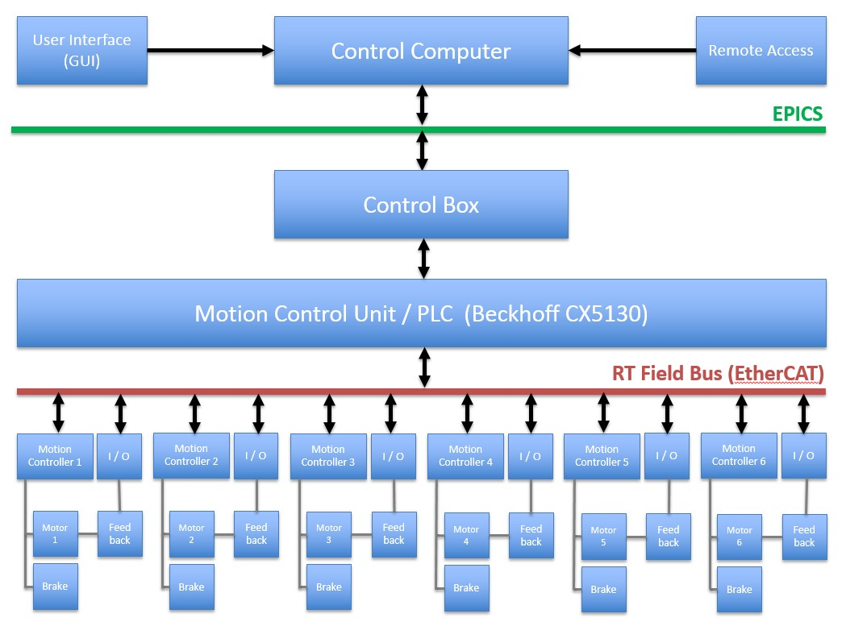
3. Control System concept
Certain control Hardware necessary to control the test items.
Control Computer with enough CPU Power: - To communicate commands belonging to the linear test stages; - Supposed to run EPICS and software providing a GUI;
Software providing a GUI: - control processes related to the linear stages;
Remote access: - To access to the control and measurement system via remote is requested; - External Software?
Motion Controller / PLC: - For control and evaluate the movements of the linear motors; - EtherCAT-PLC serves as a control system to execute the corresponding control software and to control and evaluate feedback signals; - Communication unit ≙ Sending / Receiving commands from a control computer (GUI);
Frequency converter / Servo drive modules: - Necessary for the control of the large (3-phases) linear test motors. - Suitable for EtherCAT

Slide 17
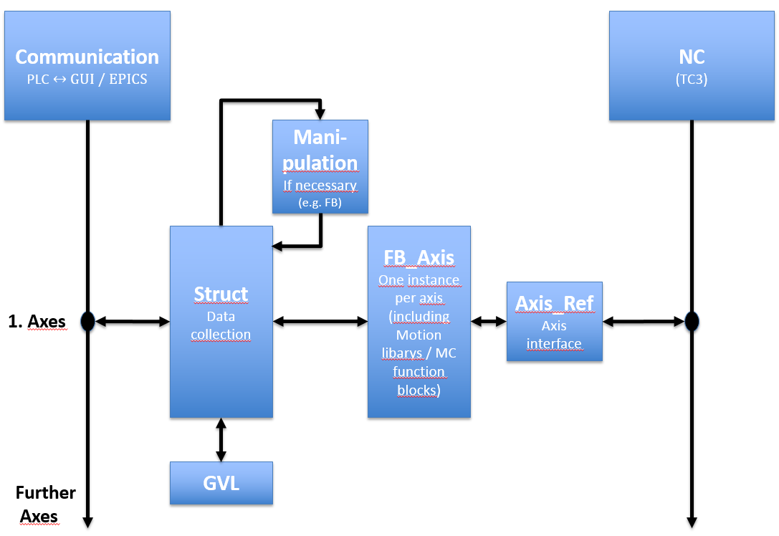
3. Software Concept – motion tasks
Communication block: - Movement commands, position requests etc. could be transferred from the Control Computer (EPICS) to the PLC;
Struct block: - accumulation of all this data could takes place in the structure "Struct"; (e.g. Start, Execute, Done, Error)
GVL block: - Declaration of the variables belonging to the axis;
Manipulation block (if necessary): - Come into action by special treatments(flow control): > several sequences are to be carried out; (cases) > several axes have to cooperate; - “Struct” supplies the data to the “Manipulation“ block - This may influence the “Struct” before movement commands are transferred to the instance “FB_Axis”
FB_Axis block: - One function block “FB_Axis” for all axes; - One instance per axis from “FB_Axis”; - Content of “ FB_Axis“ = PLC-open movement commands (MC function blocks) from various motion libraries (PTP, flying saw…);
AXIS_REF & NC blocks: - “AXIS_REF“ data type contains axis information and represents the interface between PLC and NC; - “NC” ≙ assembly of function groups used for the control and regulation of axes

Slide 18
3. Software Concept – motion tasks
For each standard axis there could be a main structure "Struct", a part within an entire - or possibly even a separate - global variable list “GVL”, an instance of the function block "FB-Axis" and with "Axis_Ref" an interface between PLC <-> NC
For each additional axis this scheme could be repeated.
Benefits:
keeps the program clear;
simplifies commissioning;
possible to uncouple the communication between the control computer and PLC during comissioning => Comissioning in two steps;
First: Commissioning of the PLC program separately;
Second: - commissioning of the PLC program with the communication between the PLC and the control computer; - corresponding movement commands being supplied from EPICS or the GUI;

