Slide 1
Data Curation Workshop
Tobias Richter & Gareth Murphy
Experiment Control & Data Curation
Data Management and Software Centre
ESS, November 2018

Slide 2
The Objective of DMSC
Minimise the time it takes to understand experimental data
Maximise the scientific impact and scientific success of ESS

Slide 3
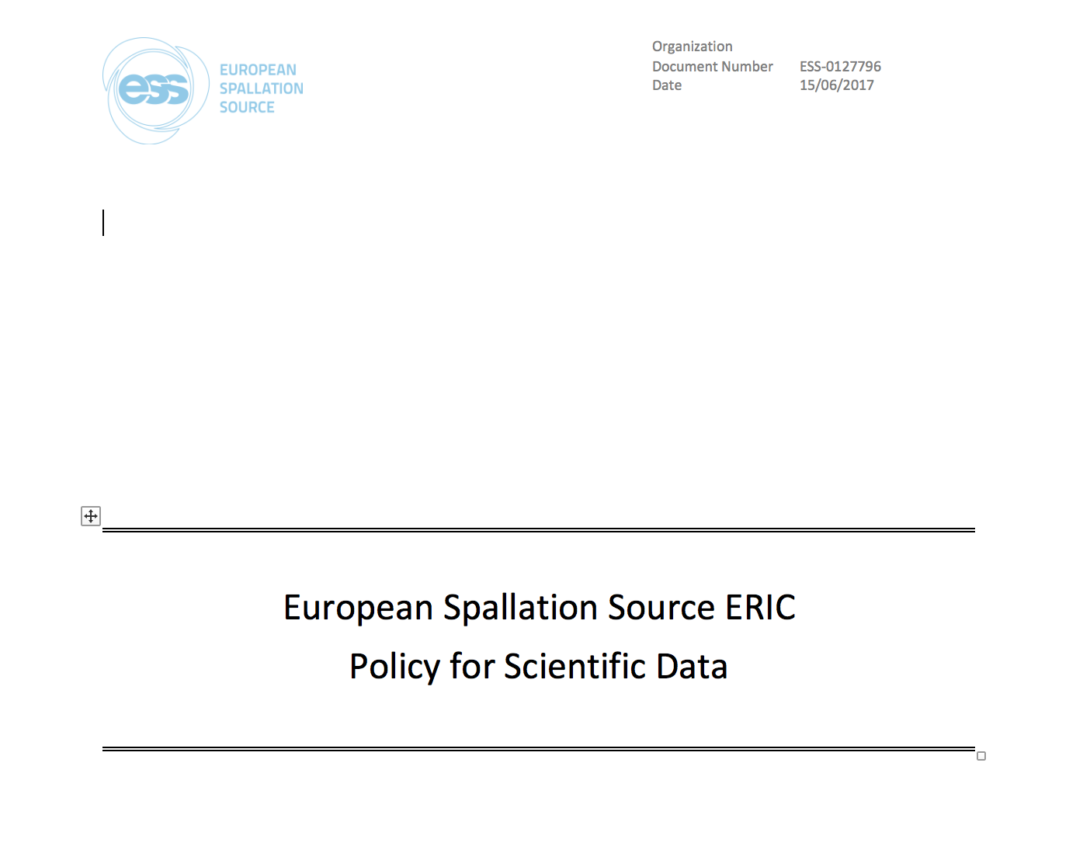
Introduction

Slide 4
Why we have this workshop

Slide 5
Why are we having this meeting now?
We have to scope to develop a data catalogue and curation system for ESS
Together with your partners (PSI & MAX IV) we now have something that has the essential functionality
We need input to develop the right thing for ESS instruments in commissioning or operation
There will be some time before anything is ready for early science

Slide 6
Agenda
Find out about what neutron scatterers do day to day in the wild
Some people kindly provided screenshots, photos, spreadsheets and PDFs as input
We will have questions
Everyone can comment
Find out what is common practise in astronomy
Lunch
More concrete SciCat plans and updates from partner facilities
MAX IV
PSI
Data Reduction Analysis and Modelling
Workflows
Provenance
Notes:
Not BEST practise
Everyone knows the stories from other facilities how awesome their systems are
raw data first

Slide 7
Introduction Round
Notes:
Add what
- Domain you are working in
- connection you have to data catalogues

Slide 8
Who is who
Instrument scientists
DMSC
ECDC
DRAM
PSI
MAX IV

Slide 9
Questions?
Notes:
Add what
- Domain you are working in
- connection you have to data catalogues

