Slide 1
Data flow for neutron imaging
Anders Kaestner, Manuel Morgano, Chiara Carminati, Markus Strobl
Laboratory for Neutron Scattering and Imaging, Paul Scherrer Institut
ESS Data Curation Workshop :: Lund :: Nov 6^{th, 2018}

Slide 2
White beam imaging
Reduction
Analysis
Experiment | Pol reduction | nGI reduction | Normalization |  |  | Artefacts |  | Region statistics (at various stages) |  |  | CT reconstruction |  |  | Registration | Denoising |  | Ratio | Segmentation |  |  | Sequence analysis |  |  | Regions analysis |  |  |  | Visualzation |  |  | Specific analysis
Operations |  |  | Norm to ref | Dose correction | Scattering | Spots | Rings | Line profiles | Area/vol stats | Histograms | Parallel beam | Cone beam | Iterative |  | Linear filters | Edge preserving |  | Manual | User guided | Automatic | Value changes | Shape changes | Displacements | Value | Shape | Position | Frequency | Plots | 2D images | 3D rendering | Image analysis
Output |  | Images |  |  |  |  |  | Images |  |  |  |  |  |  |  |  |  |  |  |  | Images/tables |  |  |  |  |  |  | Graphics
Radiography |  |  | x |  |  | x |  | x |  |  |  |  |  |  | x |  |  | x |  |  |  |  |  | x |  |  |  | x |  |  | x
Radiography sequences (3D) |  |  | x |  |  | x |  | x |  |  |  |  |  | x | x |  | x | x |  |  | x |  |  |  |  |  |  | x |  |  | x
Tomography (CT) |  |  | x |  |  | x |  | x |  |  | x |  |  |  | x |  | x | x |  |  |  |  |  | x |  |  |  | x |  |  | x
CT sequences (4D) |  |  | x |  |  | x |  | x |  |  | x |  |  | x | x |  | x | x |  |  | x |  |  |  |  |  |  | x |  |  | x
Stroboscopic |  |  | x |  |  | x |  | x |  |  |  |  |  |  | x |  | x | x |  |  |  |  |  | x |  |  |  | x |  |  | x
Stroboscopic series (3D) |  |  | x |  |  | x |  | x |  |  |  |  |  |  | x |  | x | x |  |  | x |  |  |  |  |  |  | x |  |  | x
nGI |  | x |  |  |  | x |  | x |  |  | ? |  |  |  | x |  | x | x |  |  |  |  |  | x |  |  |  | x |  |  | x
Polarized | x | x |  |  |  | x |  | x |  |  |  |  |  |  | x |  | x |  |  |  |  |  |  |  |  |  |  | x |  |  | x
2D
3D
2D
2D/3D
2D/3D

Slide 3
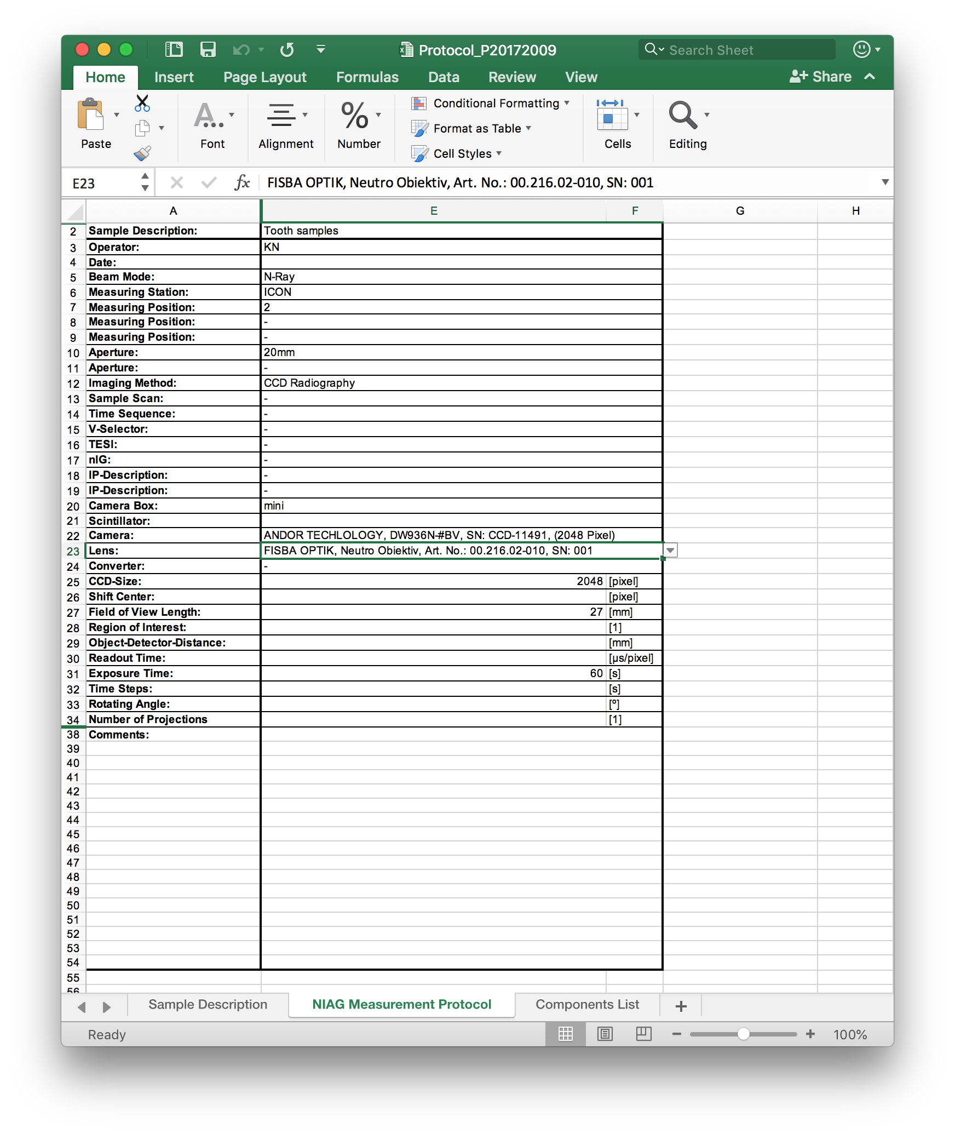
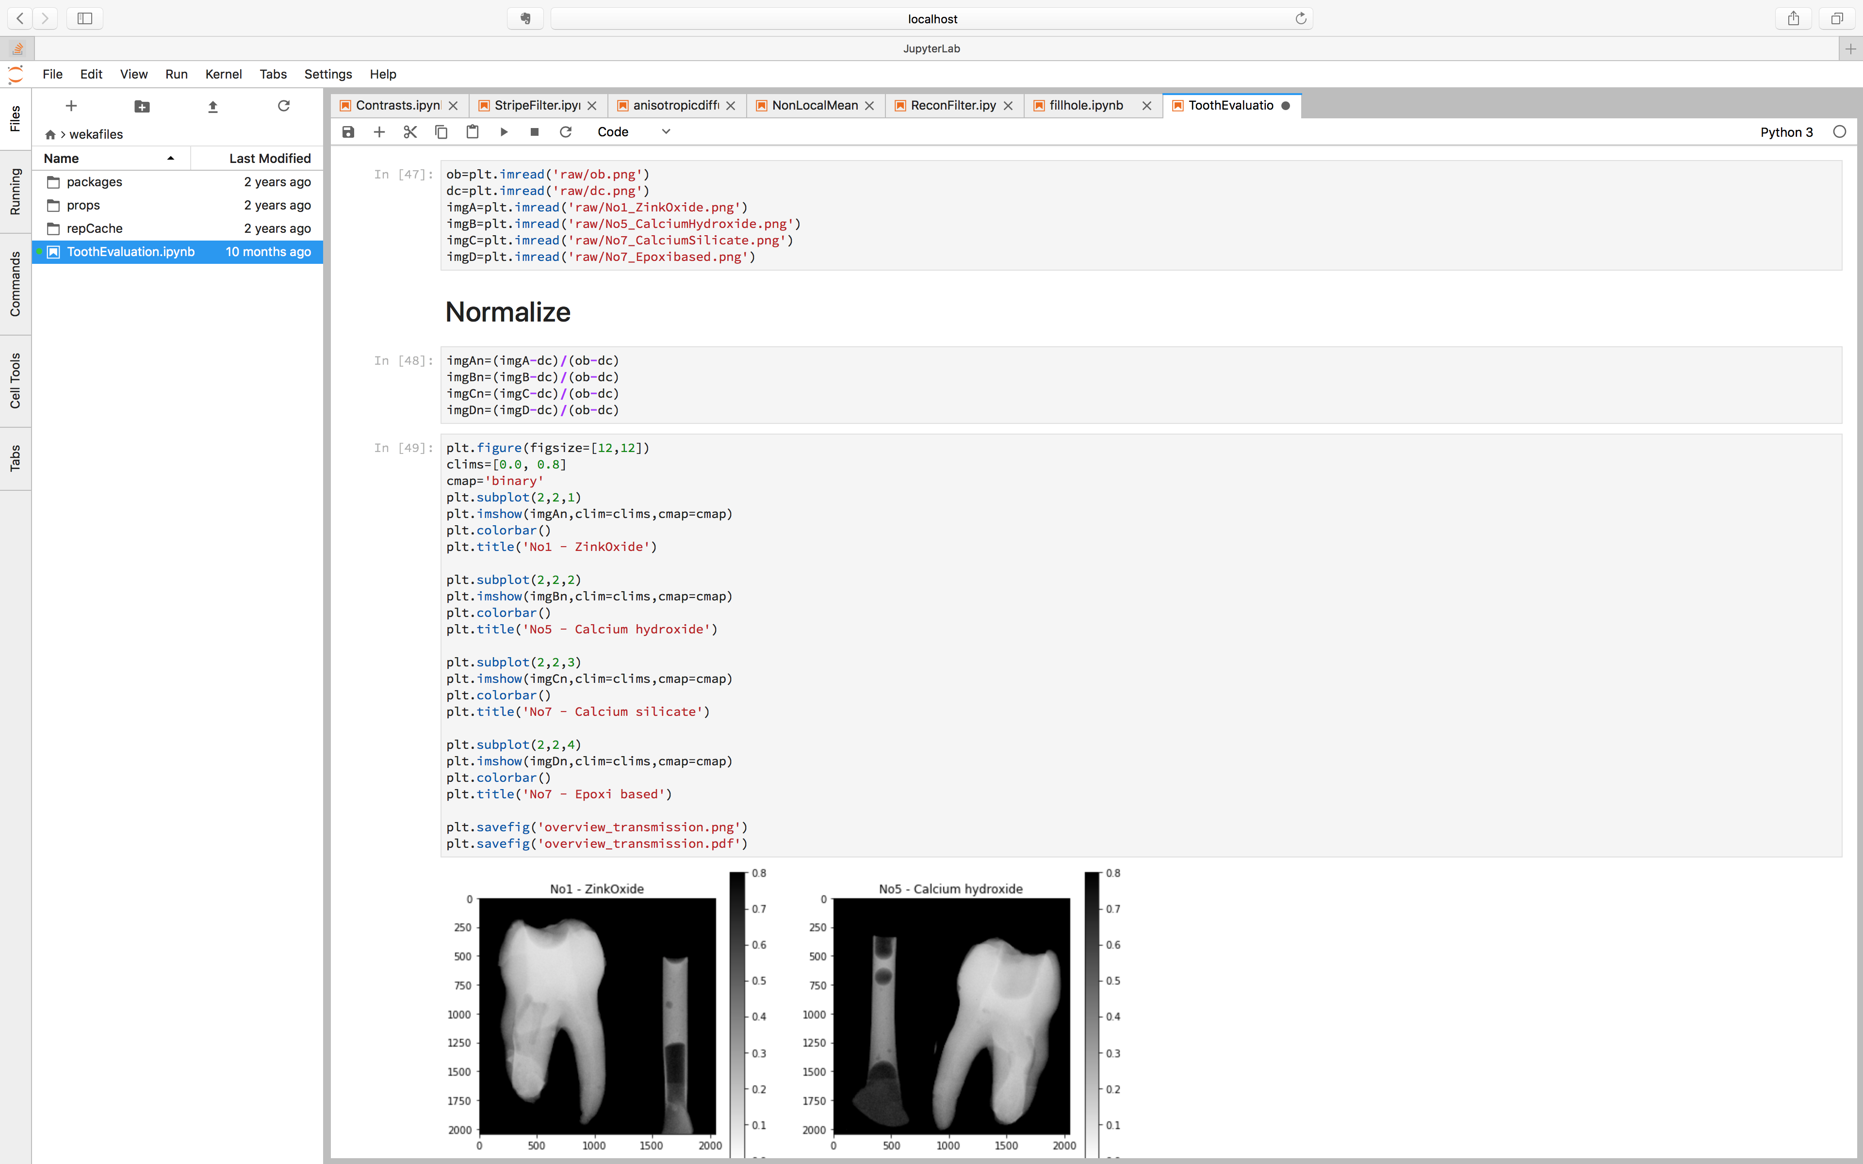
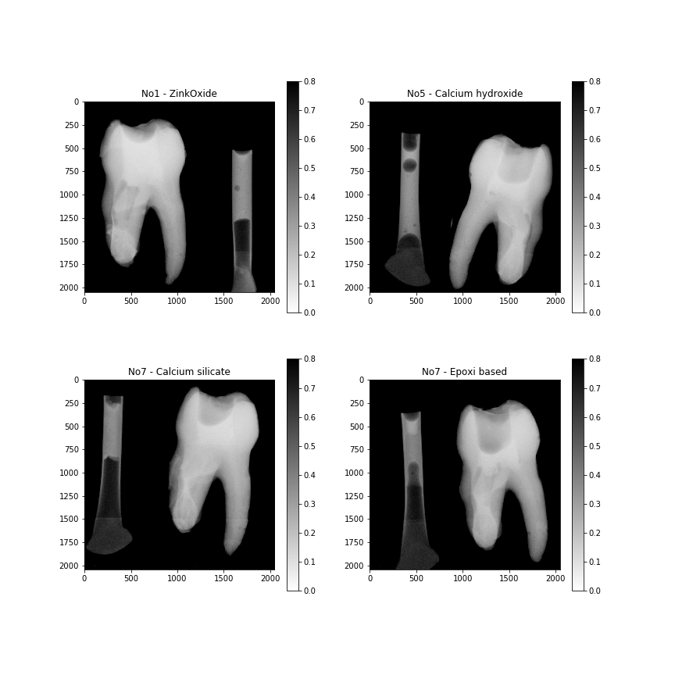
Experiment meta data
Result

Slide 4
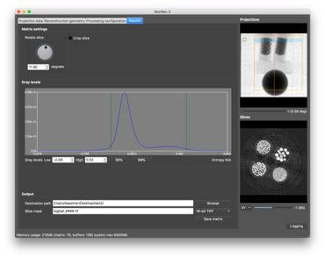
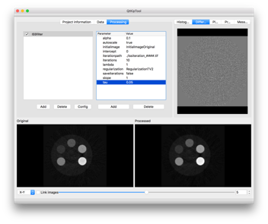
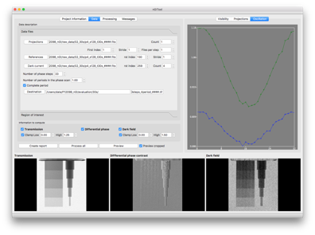
Applications developed at PSI – White beam
MuhRec
CT reconstruction tool
Configurable processing chain
KipTool
General processing tool for 3D images
Converter tools
NIQA tool (not IKC)
Analysis of IAEA QA samples
nGI tool
Reduction of phase stepping scans

Slide 5
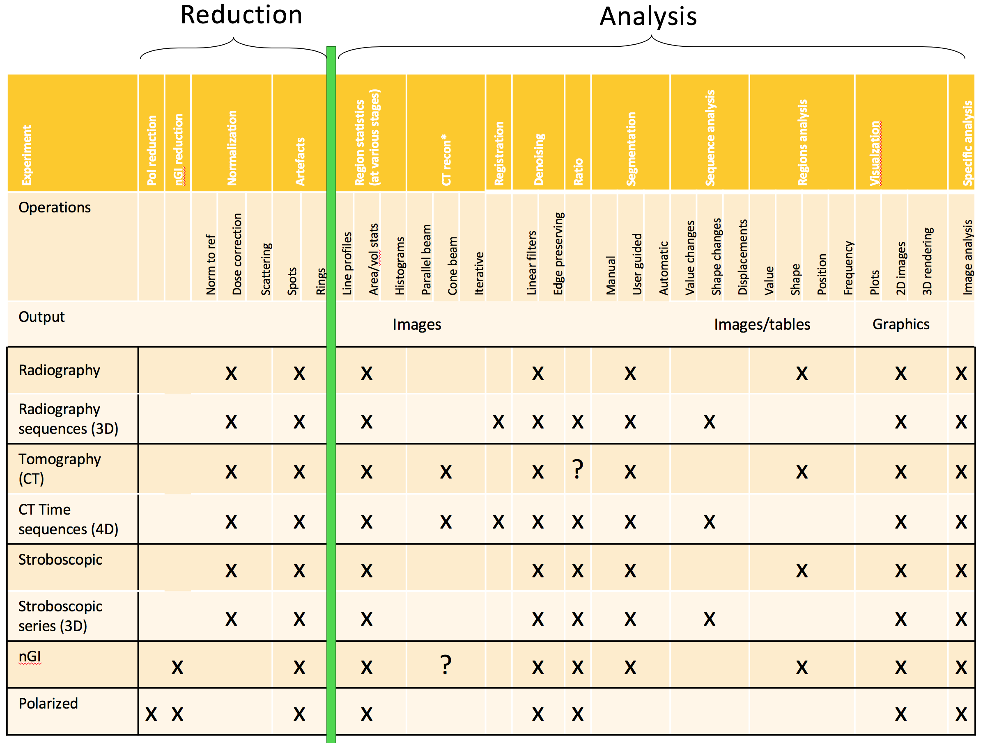
ToF imaging
Reduction
Analysis
Experiment | Overlap correction* | WFM Stitching | Detector alignment | Reshuffle | … | Bragg edge fitting
Multi wavelength imaging | x | x | x |  |  | x
Stroboscopic | x | x | x | x |  | ?

Slide 6
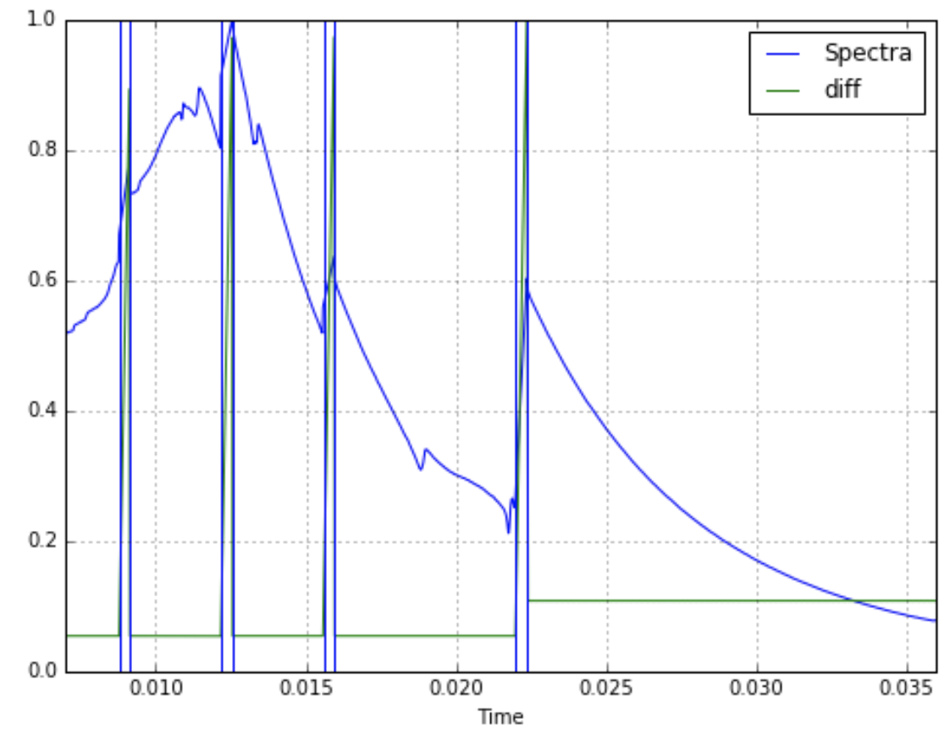
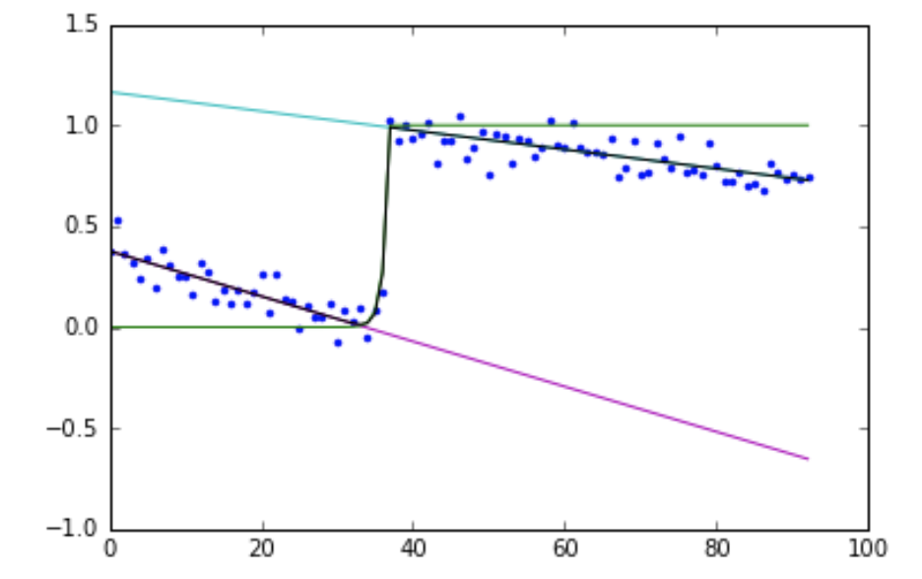
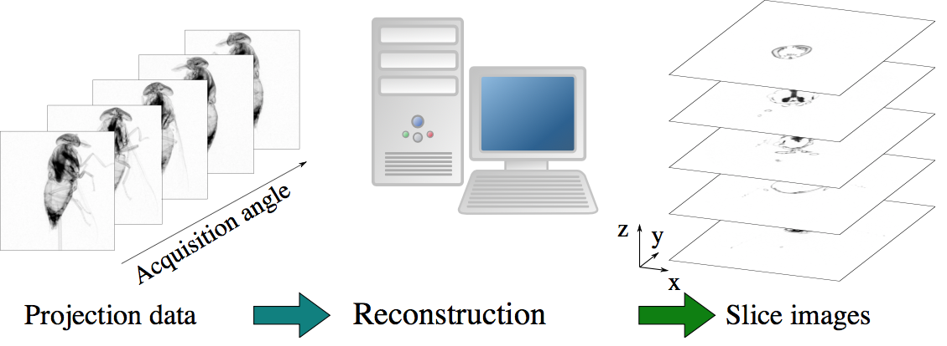
Typical processing chain: ToF imaging
Artefact reduction
Re-binning (time/space)
Denoising
Segmentation
ToF CT
1000x1000 pixels
1000 projections
2000 ToF bins
4Tb
CT
1000³ voxels
2000* ToF bins
4Tb
Bragg edge fitting
1000³ voxels
2000* ToF bins
7 parameters/edge
N x 7 x 4Tb
CLI tools
Python
Mantid
KipTool
MuhRec
Octopus
Python/Matlab
ASTRA
TomoPy
* 2000 volumes is a worst case scenario.
RITS
iBeatles
New code
* 2000 volumes is a worst case scenario.

Slide 7
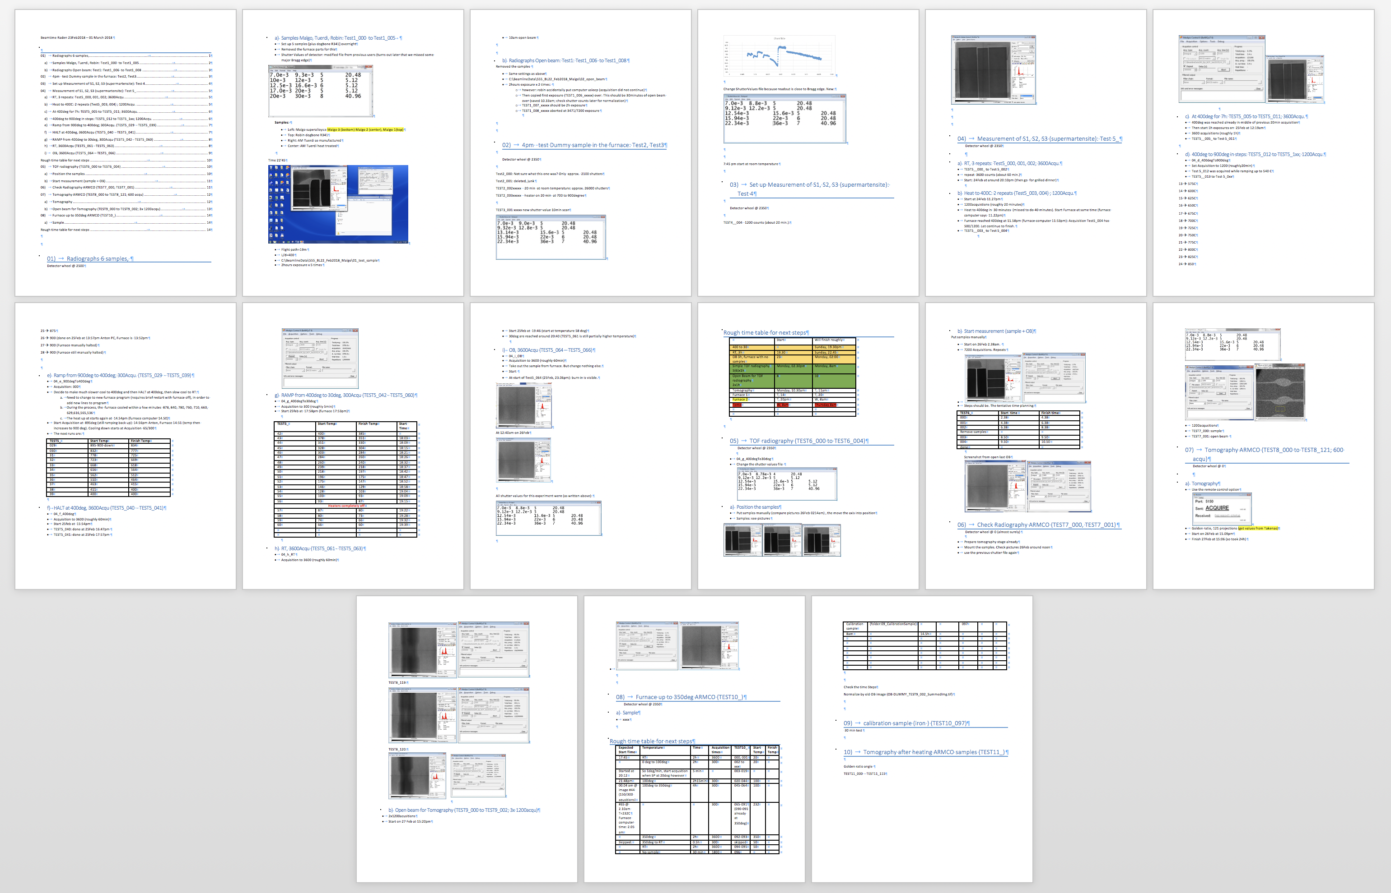
Experiment Logbooks
Traditional paper lab logbooks
Plots added with Pelifix…
Word
Text
Screen shots
Plots
(Pictures)
Missing feature: Convenient way to add pictures (setup, sample, etc.)

