Slide 1
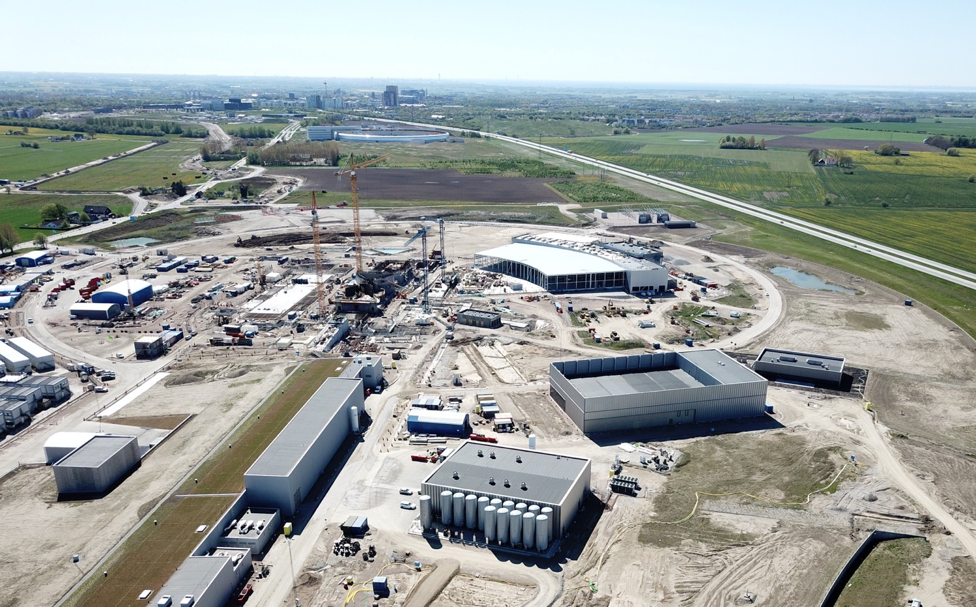
The European Spallation Source
John Womersley, Director General
August 2018

Slide 2
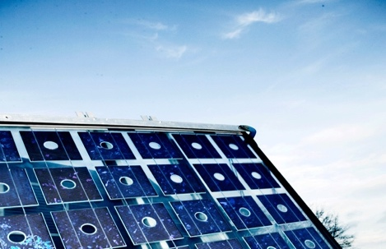
A European Flagship for Research and Innovation
Energy
Next-generation research infrastructure for world leading research in materials science, life sciences and engineering
intense beams of neutrons that will allow the structures of materials and molecules to be understood at the level of individual atoms
Will offer unique capabilities 10-20 times greater than the world’s current best
Key for advances in societally and economically relevant areas from energy storage and generation, to drug design and delivery, novel materials, and environment and heritage, all central to the sustainable development of society
New Materials
Healthcare
Food

Slide 3
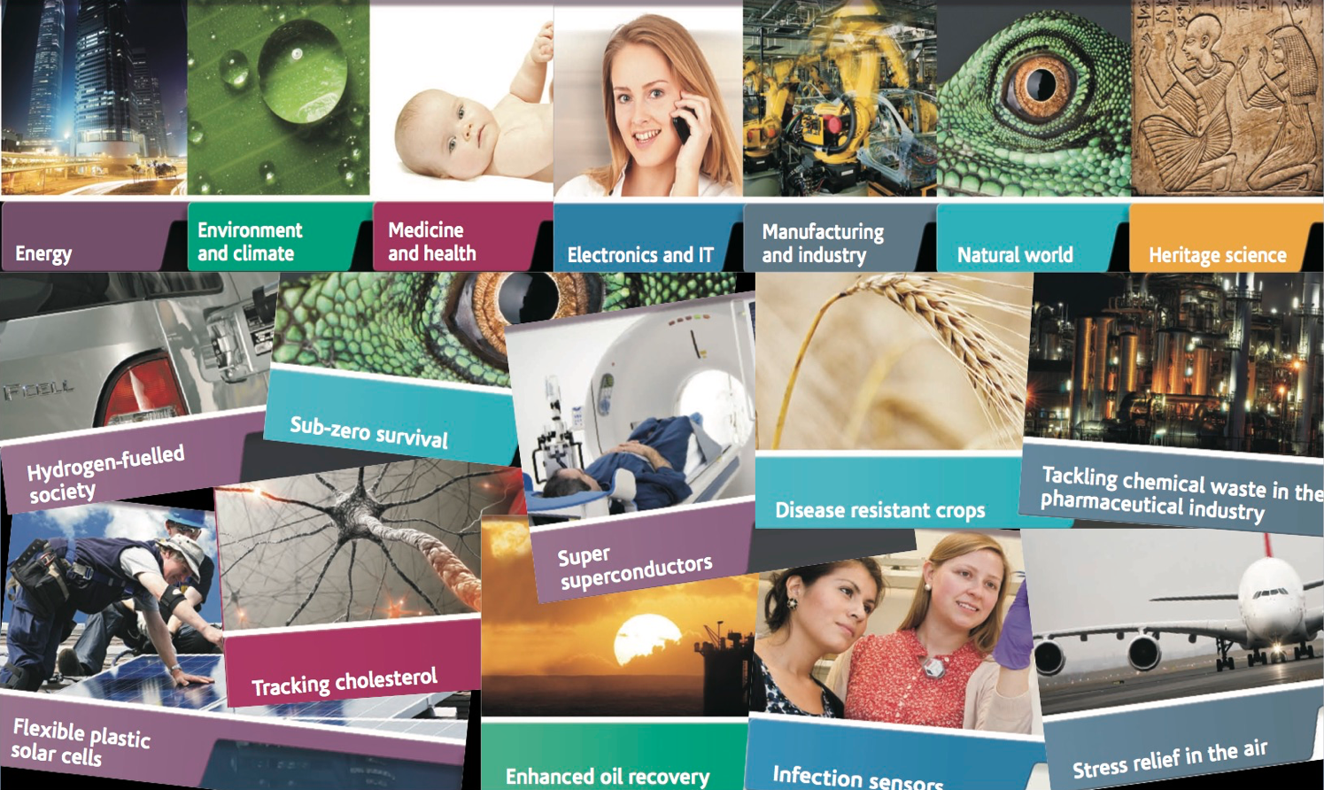
Neutron science

Slide 4
ESS Vision: Build and operate the world’s most powerful neutron source
Reactor sources
Accelerator-driven sources
ESS
Effective thermal neutron flux 10¹⁵ n/cm²-s
J-PARC
NIST
ILL
LANSCE
ISIS
FRM-II
SNS
CSNS
Year

Slide 5
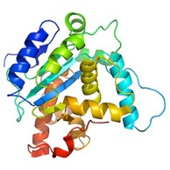
How a spallation source works
instrument
neutrons
moderator
sample
proton accelerator
target
“spallation” is the process that releases neutrons from the target nuclei

Slide 6
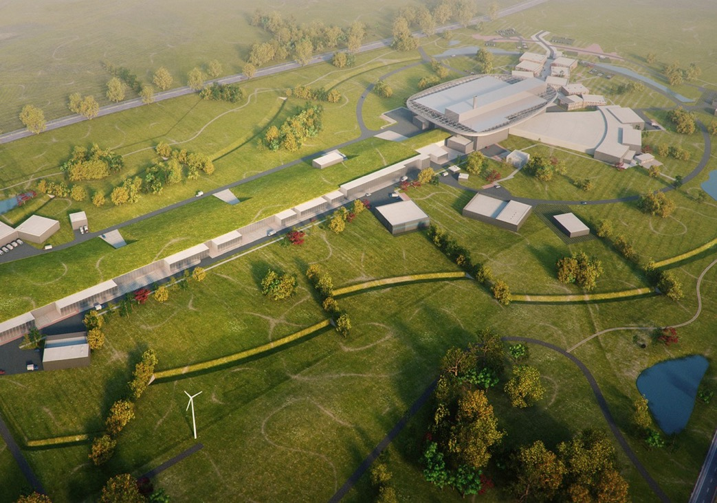
Neutron Production Target
with innovative flat moderator design
Experiments
Superconducting Proton Accelerator

Slide 7
Vision, Mission and Values
ESS Vision
Our vision is to build and operate the world’s most powerful neutron source, enabling scientific breakthroughs in research related to materials, energy, health and the environment, and addressing some of the most important societal challenges of our time.
Mission
To do this, we commit to deliver ESS as a facility that:
Is built safely, on time and on budget
Produces research outputs that are best-in-class both in terms of scientific quality and in terms of socioeconomic impact
Supports and develops its user community, fosters a scientific culture of excellence and acts as an international scientific hub
Operates safely, efficiently and economically, and responds to the needs of its stakeholders, its host states and member states
Develops innovative ways of working, new technologies, and upgrades to capabilities needed to remain at the cutting edge
Core Values
Excellence • Collaboration • Openness • Sustainability

Slide 8
Some numbers
1843 M€ construction cost
5 MW world’s most powerful particle accelerator
2MW at start of operation
15 experimental stations
20 ⨉ more sensitive on average than today’s best
at 2MW
800 experiments per year
2023 first science for users
13 ERIC member nations

Slide 9
Financing and In-Kind
The European Spallation Source ERIC established in 2015
Host Countries Sweden and Denmark
Construction 47.5% Cash Investment ~ 97%
Operations 15%
Non Host Member Countries
Construction 52.5% In-kind Deliverables ~ 70%
Operations 85%
13 European Member Countries

Slide 10
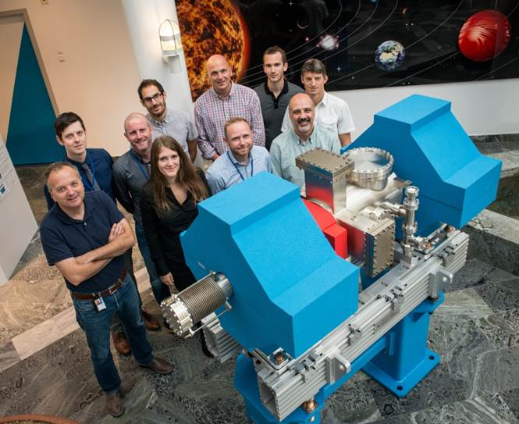
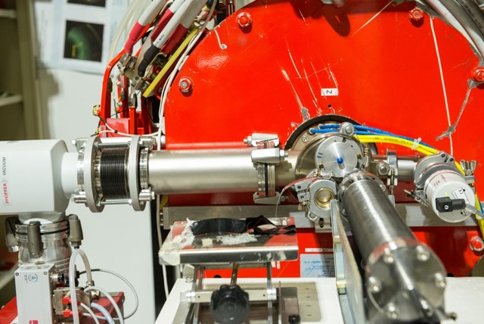
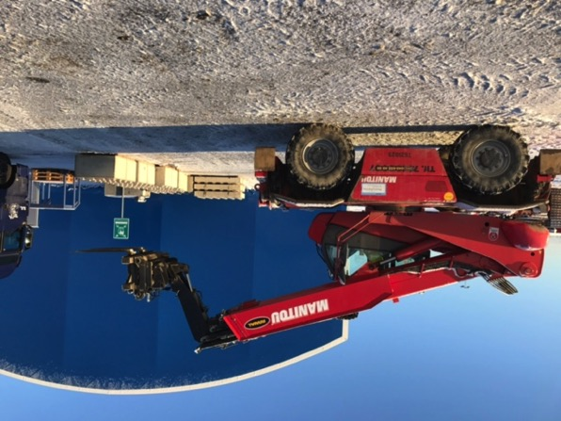
ESS In-kind Partners
Aarhus University
Atomki - Institute for Nuclear Research
Bergen University
CEA Saclay, Paris
Centre for Energy Research, Budapest
Centre for Nuclear Research, Poland, (NCBJ)
CNR, Rome
CNRS Orsay, Paris
Cockcroft Institute, Daresbury
Elettra – Sincrotrone Trieste
ESS Bilbao
Forschungszentrum Jülich
Helmholtz-Zentrum Geesthacht
Huddersfield University
IFJ PAN, Krakow
INFN, Catania
INFN, Legnaro
INFN, Milan
Institute for Energy Research (IFE)
ISIS - Rutherford-Appleton Laboratory, Oxford
Laboratoire Léon Brilouin (LLB)
Lund University
Nuclear Physics Institute of the ASCR
Oslo University
Paul Scherrer Institute (PSI)
Polish Electronic Group (PEG)
Roskilde University
Tallinn Technical University
Technical University of Denmark (DTU)
Technical University Munich (TUM)
Science and Technology Facilities Council
University of Copenhagen (KU)
University of Tartu
Uppsala University
Wigner Research Centre for Physics
Wroclaw University of Technology
Warsaw University of Technology
Zurich University of Applied Sciences (ZHAW)

Slide 11
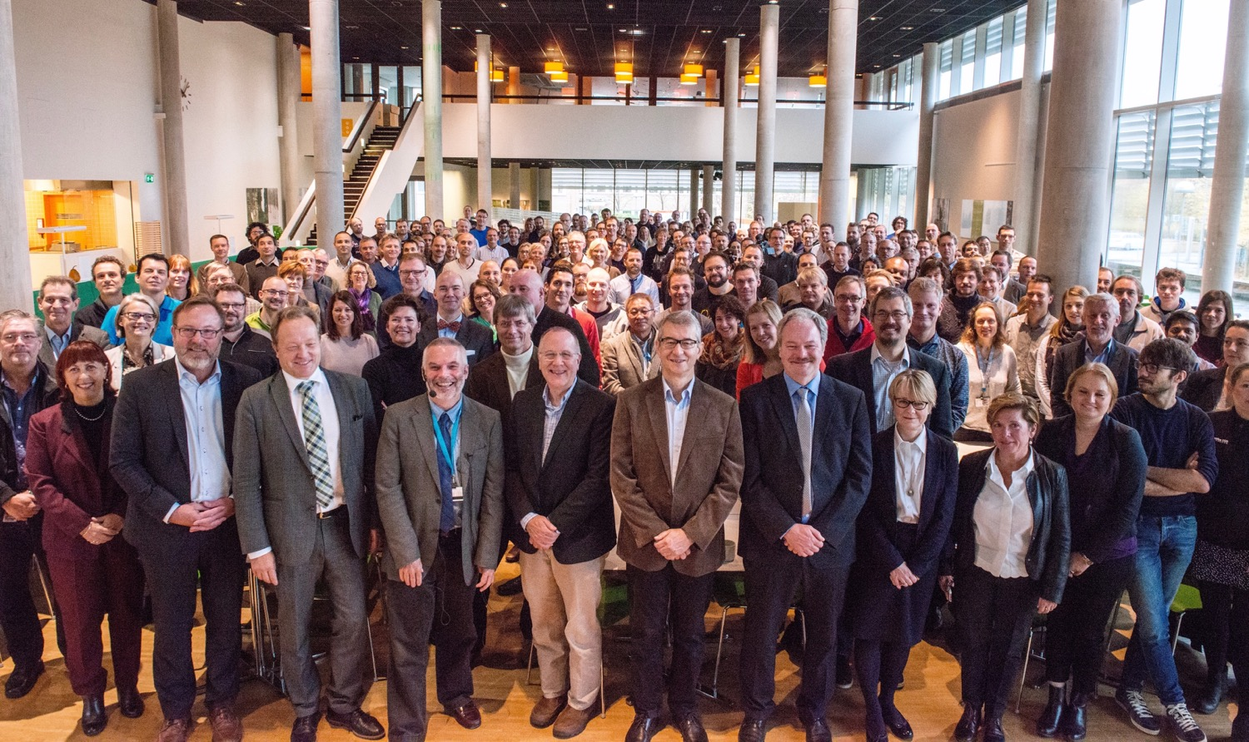
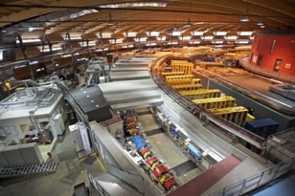
Organisation and People
447
Employees
50
Nationalities
~ 100
Collaborating Institutions
Notes:
Updated September 2017

Slide 12
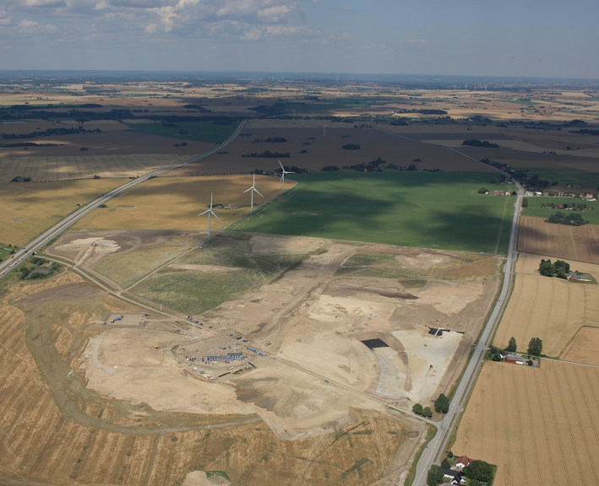
Civil Construction Groundbreaking
September 2014

Slide 14
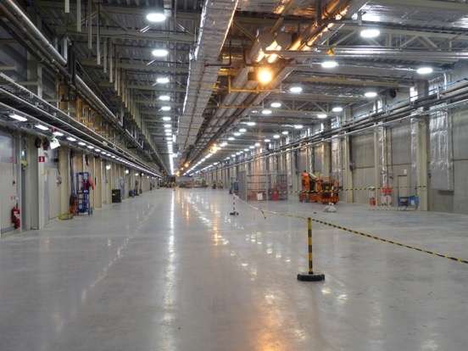
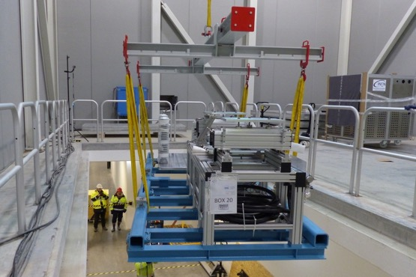
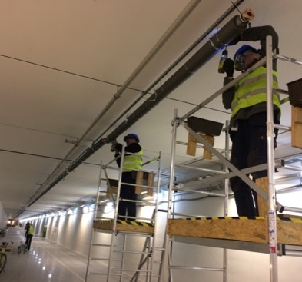
ESS is close to 50% complete
2018 is the peak of construction activity
First buildings have been handed over
In-kind deliveries of high tech equipment arriving
All our staff moved out to site in June this year

Slide 15
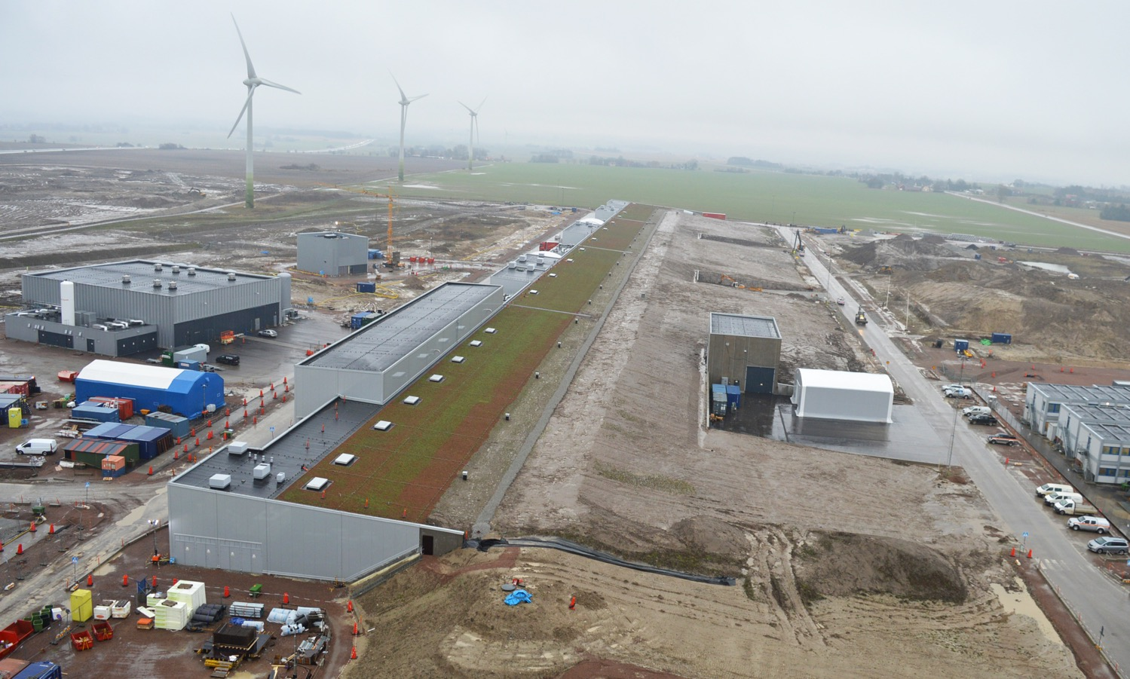
Accelerator & Klystron Gallery

Slide 16
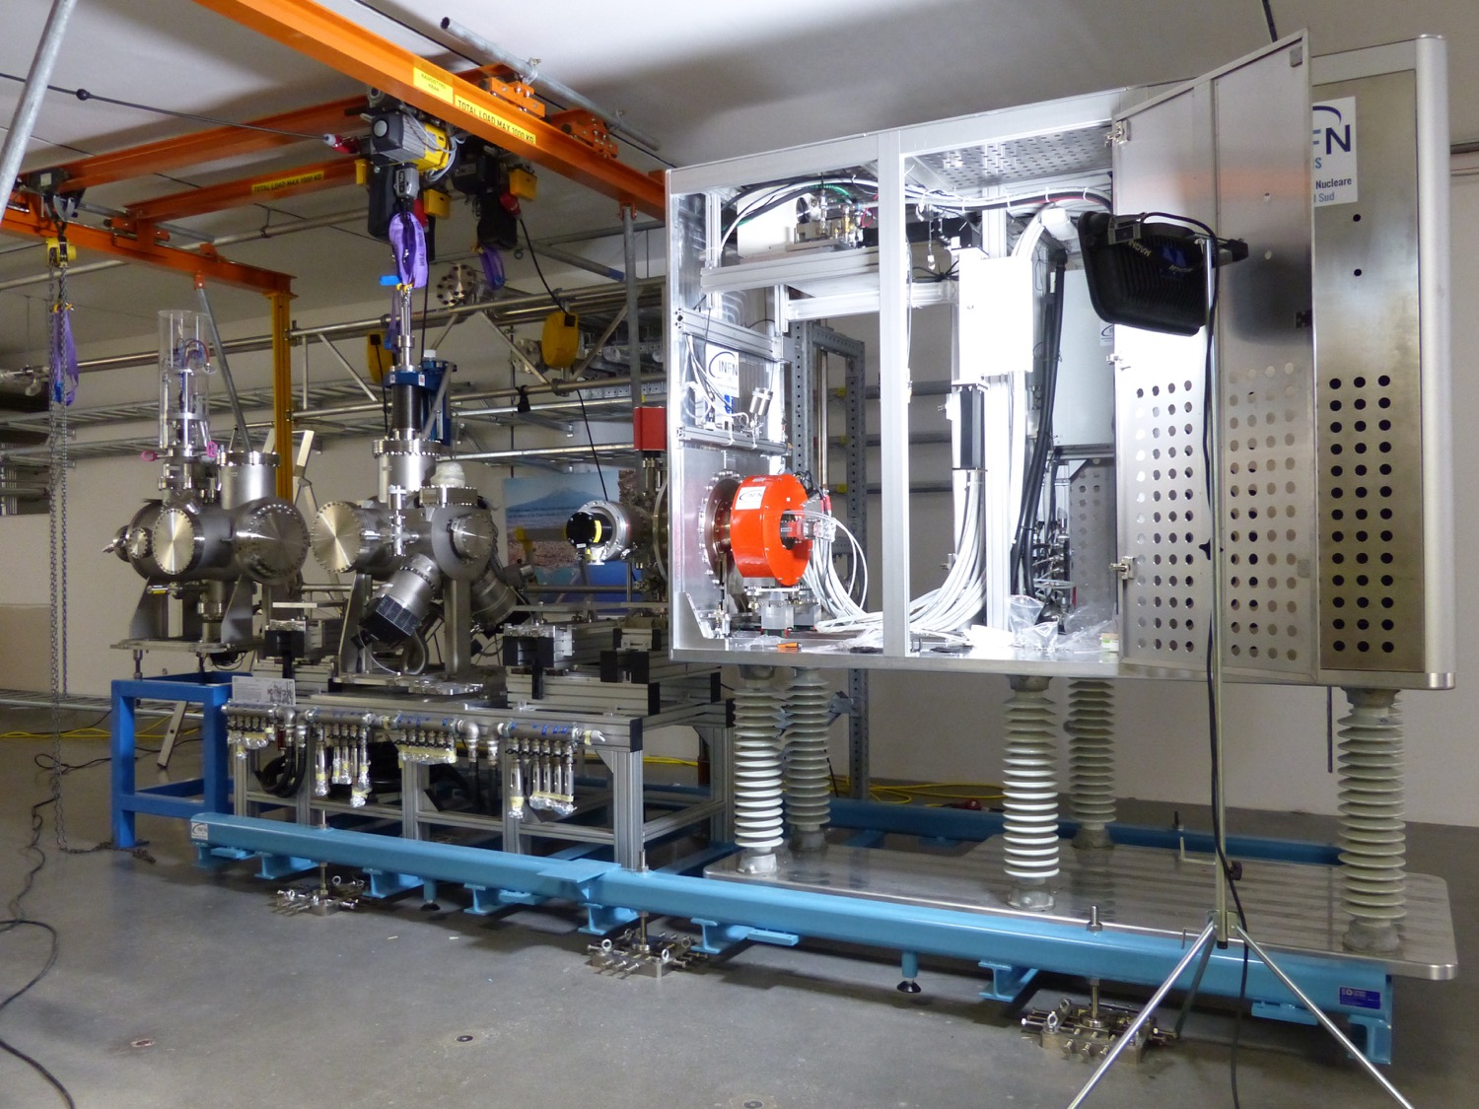
Ion source & LEBT installation

Slide 17
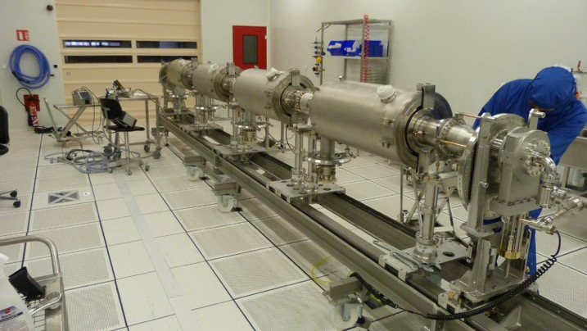
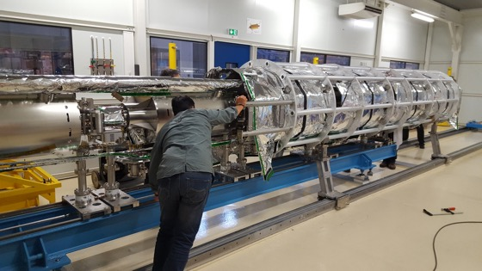
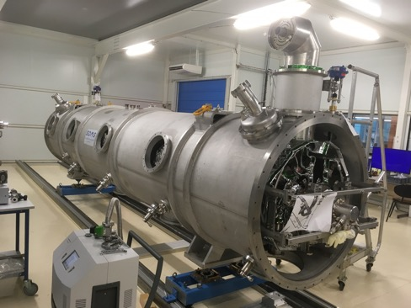
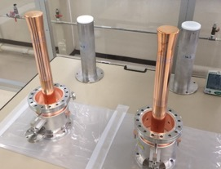
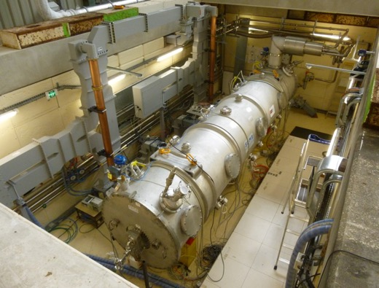
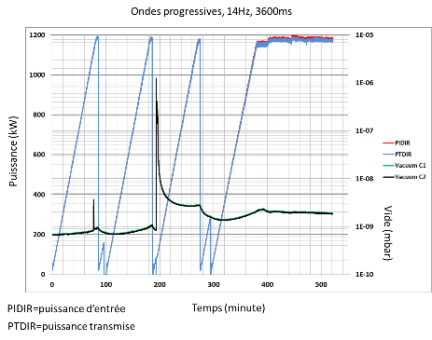
CEA – MB Prototype Cryomodule
March 2017
May 2017
July 2017
Assembly in ISO4 CEA CR
4 medium β 6 cell elliptical SRF cavities (1 LASA/3 CEA)
Cooldown at CEA test stand in Sept 2017
No RF operation due to accidental rupture of coupler ceramic
10 couplers at nominal specs

Slide 18
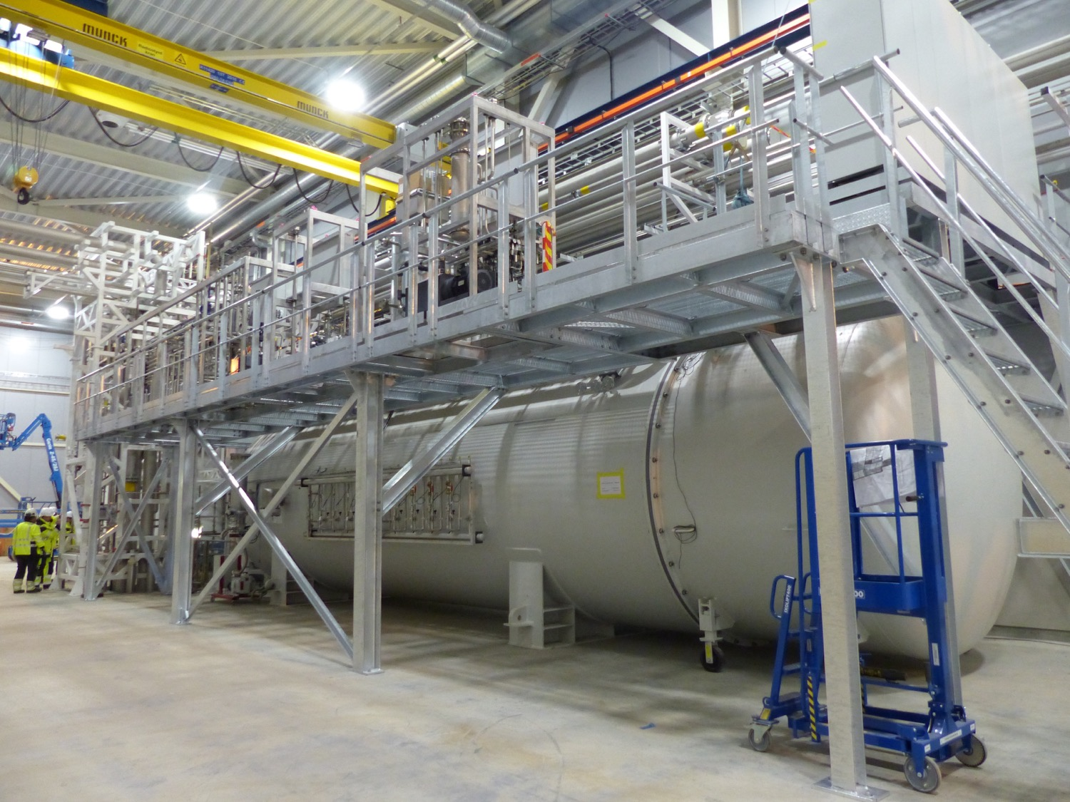
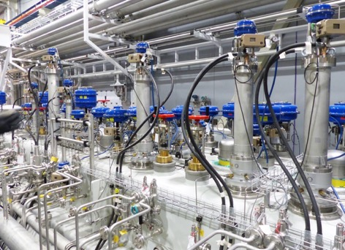
Klystron Gallery Coldbox
ESS is now producing liquid helium

Slide 19
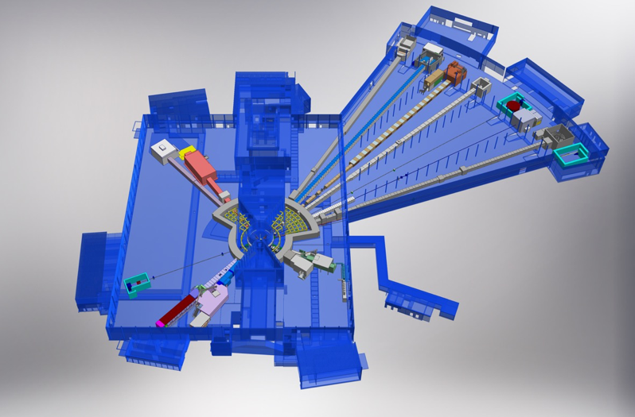
15 experimental stations (“instruments”)
ESS Lead Partners for instrument construction
+
Nuclear Physics Institute
NMX
BEER
+
C-SPEC
BIFROST
MIRACLES
MAGIC
ODIN
T-REX
DREAM
HEIMDAL
LoKI
VESPA
FREIA
SKADI
ESTIA
+
ESS In-Kind Partners also collaborate on sample environment, data management systems etc.
ESS Instrument Layout (December 2016)

Slide 20
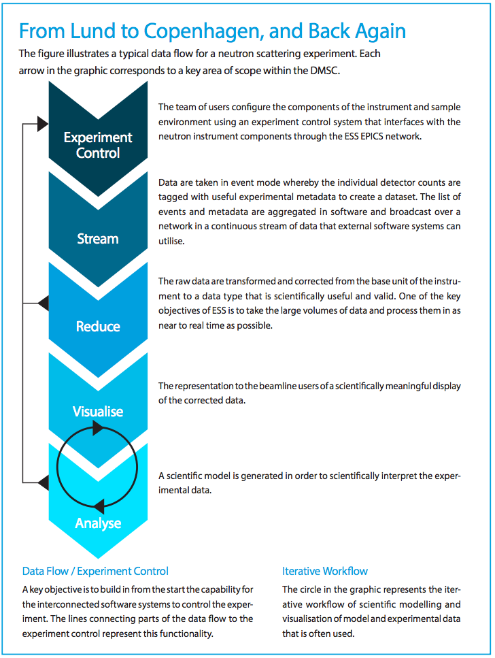
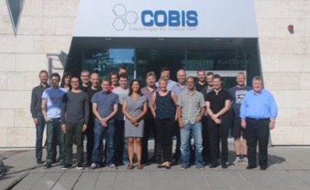
Data Management and Software Centre COBIS, Copenhagen University North Campus
Provide world leading scientific software and scientific computing support for neutron scattering at ESS
Scientific Software
ESS experiment control system, Data acquisition, Data correction software, visualization, and software to model and analyze experimental data sets.
Data center operations
Store and catalogue ESS datasets, provide ESS users remote access to their data, computing for live data correction, and analysis software during and after experiments.
User support
Support ESS users with data treatment and analysis.
20

Slide 21
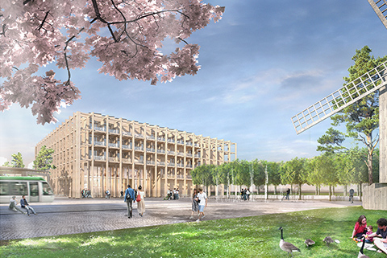
SPACE Building: Reception, exhibition space, guest house for MAX IV and ESS (~100 rooms), office and meeting space, restaurant
Modelled on the Harwell Campus
Swedish Government approval
August 2018
Tramway from Lund C station

Slide 23
Journey to deliver the world’s leading facility for research using neutrons
2025
ESS Construction Phase Complete
2014
Construction Starts on Green Field Site
2023
ESS Starts
User Program
2009
Decision to Site ESS in Lund
2019
Start of Initial Operations Phase
2012
ESS Design Update Phase Complete
2003
European Design of ESS Completed

Slide 24
ESS shows how particle accelerator technology helps to address pressing issues for the planet and society
energy and the environment
health
future economic competitiveness

Slide 25
Thank you!
@johnwomersley @essneutron europeanspallationsource.se

