Slide 1
Program of the day
10:00 - 10:15 Welcome from our host John Womersley 15'
Director General of the European Spallation Source ERIC
10:15 - 11:00 What is the NPAP and its intellectual outputs? 45'
Prof. Anders Karlsson (Lund University / LTH),
Dr. Christine Darve (European Spallation Source ERIC),
11:00 - 11:15 Coffee Break
11:15 - 11:35 Benefits of MOOCs and integrated learning 20'
Deana Nannskog, Project Manager and Educational Concept
Developer at Lund University Commissioned Education
11:35 - 11:50 Collaboration possibilities through knowledge development 15'
Susanne Norrman, Director of Lund University Commissioned
11:55 - 12:40 Dialogue and panel discussion - how can research, higher education and
business form closer partnership to enhance innovation? 45'
Panel participants:
Anna Hall, Program Director Big Science in Sweden
Susanne Norrman, Director LUCE
Dr. Søren Pape Møller, Director Institute for Storage Ring Facilities, Aarhus University
Ulrika Ringdahl, Deputy director Invest in Skåne
12:45 - 13:45 Lunch
13:40 - 16:10 Tour of the ESS and MAX IV facilities (Optional) 2h30'
Notes:
So our next talk is about our Erasmus plus project The Nordic Particle Accelerator Program. We will share our experiences from this project with you.
Then we have coffee. After that Deana Nannskog will discuss Massive open Online Courses and see how these can be used on different levels and different contexts.
Then Susanne Norrman will give her thoughts on collaboration by sharing information
Based on what you have heard we then have a panel discussion on how we can strengthen the interaction between research, education and business. We hope that you all take part in these discussions.

Slide 2

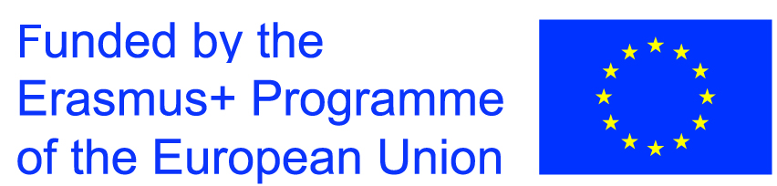

Dialogue Event
NORDIC PARTICLE ACCELERATOR PROJECT
Notes:
John Womersley - Why we are here today?
Text:

Slide 3
Background
MAXIV and ESS
Lund, a European center for accelerator technology
Nordic Particle Accelerator Program (NPAP)
Outcome of NPAP
Notes:
Let’s look at the background for our project.
Two of the worlds best instruments for research are MAXIV and ESS. They are particle accelerators. In MAXIV electrons are accelerated and are guided into the large circular building over there. There they create light.
ESS has a 600 meter long tunnel, that you will see after lunch. In that tunnel protons will be accelerated. The protons smash into a tungsten disc and create a massive flow of neutrons. With this light and these neutrons one can do research that cannot be done anywhere else in the world.
With these two instruments Lund has become a center for accelerator technology. This is why we three years ago started the Nordic Particle Accelerator Program. It is about education in accelerator technology. The outcome is three Summer Schools and three Massive Open Online Courses, MOOCs. We will now share our experiences with you.

Slide 4

MAXIV
ESS
European Spallation Source.
Notes:
Speaker: John Womersley,
Short Bio´of Mr. Womersley and his work
ESS - description, what’s going on now? Visions for the future?

Slide 5
Fun fact
The electrons in MAXIV have an energy of 3 GeV and travel with speed 1079252833 km/h (1 billion 79 million 252 thousand 833 km/h).
Their speed is just 15 km/h below speed of light!

Slide 6
Why the Nordic Particle Accelerator Program (NPAP)?
Fun fact: How many accelerators are there in the world today?
Answer: Approximately 30.000
Notes:
Anders:
Particle accelerators worldwide
So, we have MAXIV and ESS here in Lund. Is that enough for starting our program. Is there a global interest in accelerators? Well we can start with question. How many accelerators are there in the world today?
So there are 30.000. WEhere are they? I mean they should be everywhere. And they are.
(How many particle accelerators in Europe, in the world? Stats.)

Slide 7
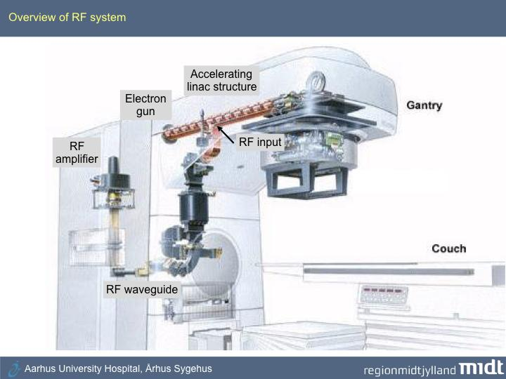
Notes:
All machines for radiotherapy contain a linear electron accelerator, quite similar to the one at MAX IV but only 1.5 meter long That is compared to the 300 m long accelerator at MAXIV.

Slide 8
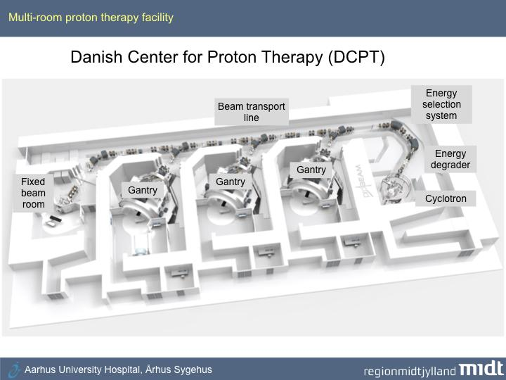
Notes:
There are other particle accelerators at hospitals. This big machine is located in Aarhus and is a proton accelerator for proton therapy. The protons are accelerated in the Cyclotron and are then guided by magnets to the gantry here and then guided down to the patient. With high precision you can then let the protons destroy a tumour without damage the surrounding tissue. Sweden has a similar machine in Uppsala.

Slide 9
The technology of particle accelerators finds applications in many key fields of our lives
Approximately 50 large accelerators
in Europe
Notes:
What about larger accelerators? You can find roughly 50 of them here in Europe. They are used for research in other areas like biomedicine, chemistry, material sciences, nuclear and particle physics. We have MAX IV and ESS here in Lund and in Aarhus, not far from here, they have two synchrotron light sources Astrid one and Astrid two. And new accelerators are starting up all the time worldwide.
So the area of accelerators is constantly growing and enormous sums of money are spent there. But that implies that there is a need for people who know accelerator technology. People that design, improve, run and maintain the machines. People at companies that deliver equipment to accelerators. Even politicians that make decisions regarding equipment for hospitals, need knowledge. These needs of skilled people has been the driving force for us in the team running the Program.
Now, I leave the floor to Christine Darve at ESS was one of the key persons in starting up our program and she will now describe it in more detail.

Slide 10
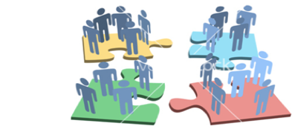
What is the NPAP?
Nordic Particle Accelerator Program
Notes:
Speakers:Christine
As explained, with more than 30’000 particle accelerators in operation worldwide, their design, construction and operation have created a growing demand for training into this specific domain of science and technology.
Achieving this by broadening the opportunities for education in accelerator physics and technology, so as to encourage for example more students to conduct their master’s / Ph.D. projects in connection to the field, as well as encouraging professionals (e.g. medical physicists, radiologists or engineers) to move into the world of accelerator technology.
With this need in Europe for knowledge in accelerator technology, with the building of infrastructures like MAXIV and ESS, hence the development of this new center for excellence in Lund, i will now explain what is the NPAP and how we initiated this program in 2013/14.
---
Christine: For the first time Nordic and European expertise came together to produce content not only for students and researchers but also for professionals and members of the broader community.
Our unique project is developed in cooperation with MAX IV Laboratory, European Spallation Source (ESS), Lund, Uppsala, Aarhus, Oslo and Jyväskylä Universities and in partnership with several European universities – and aims to ensure future European accelerators with expertise in pulsed neutrons and synchrotron radiation technology.

Slide 11
Context for Training in accelerator physics and technology
Cooperation between ESS, MAXIV and Lund University (Faculty of Science and LTH)
Particle Accelerator schools: JUAS, CAS, HASCO, USPAS, ACAS, ASP, etc
EU-TIARA other market surveys
EU-ARIES: Accelerator Research & Innovation for European Science and Society
Notes:
Over the years, several of us at ESS and MAXIV have been actif in the academic arena, by giving courses and supervising students, resulting in strengthen the cooperation between ESS, MaxIV and the academia, in LU.
Collaboration with existing accelerator schools, including the JUAS for 24 years (10 weeks-partnership with CERN and a cluster of 16 European universities), CAS, Hadron Collider School since 2012.
Market surveys, showed the need for training material adapted to more basic understanding of accelerators.

Slide 12
Why do we need new Pedagogical tools for Accelerator science?
School levels are typically advanced
Domains/Field complementarity
To provide sustainable and “users-friendly” tools
⇒ Develop capacity in Northern Europe with emphasize on MAXIV and ESS
Notes:
The main incompatibility with the existing (long or short) summer schools and our target, was that the level was too advanced.
Another important aspect is to increase visibility of the lively activities in accelerator physics and technology in Lund
To strengthen the collaboration between (MAX IV, ESS , and LU) and build a regional/nordic school.

Slide 13



Team building
Nordic Particle Accelerator School 2015 - The proof of Concept
Grant for the Nordic Particle Accelerator Program
Notes:
Based on the observations listed earlier, we built a team to create the NPAS2015:
The objective is to teach the basics of accelerator physics and technology, and to demonstrate for the students that this is an interesting and broad subject, carried out in an international environment. The initiative shall encourage students to pursue a career in accelerator physics and technology.
Limited cost by institutional support.

Slide 14
Erasmus Plus
Strategic partnership and building cross-sectoral bridges
KA2 - Support innovative practices from international to regional to organisational and individual levels.
Notes:
Christine:
Strategic partnership and building cross sectoral bridges: Ultimately, we believe that inviting more people to creatively take part in the knowledge of the area, will enhance engagement and at length expand the field with more creative and innovative minds. But not only that! By bringing more people in from other fields, we have seen that cross sectoral work increases and bridges are being built! As a result, we see innovation opening up and the impact as well as use of accelerator technology increase, benefiting society in a whole other way which would otherwise be impossible if knowledge is left isolated.
The interconnectivity between different fields and sectors, both nationally and transnationally is an important step for us. In fact, our three year transnational project is specifically an Erasmus + programme for strategic partnership and networking (KA2) (have a pic of the funding from EU in PP) This type of programme aims to support the development, transfer and implementation of innovative practices at everything from international, European, national and regional to organisational and individual levels.

Slide 15
Impact and Dissemination
New pedagogical tools and Innovative learning material
Blended mobility of higher education students
Improved education of talented students
Identification of young researchers
Strengthened collaboration between partners
Increased awareness of possible research areas
Channels: partners, accelerator community, web site: http://npap.eu
Notes:
The potential longer term benefits of this program is the intrinsic nature of the MOOC connected to the accelerator school series supported by the new network in the Northern part of Europe.
Blended mobility of higher education students (Lund, Uppsala, Aarhus Universities, Europe, USA, China, Australia)
Channels: partners, collaborating institutions communication tools, web site to spead the result beyond the lifetime of the project

Slide 16
Target groups - Dialogue ?
Students with basic knowledge in physics
Worldwide Universities
Employees at accelerators
Companies
Users
In-Kind ESS collaborations
Hospitals
...more suggestions?
Notes:
What are our target groups. Who will use the MOOCs?
Employees at accelerators (operator, etc..)
Companies (scandinavic, give overview on MAXIV and ESS content)
Users (life science users, accelerator students at MAXIV)
The level is bachelor level in physics, but many of the lectures are on a lower level and it is enough with basic knowledge in physics, like physics courses from gymnasiet.
We intend to use the material in courses at the university. The teacher may pick certain lectures from the MOOC and use them in a course.
For ESS and MAXIV the material can be used for employees.
Companies that deliver, or aim at delivering, equipment to accelerators. For these the MOOCs will be an asset.
Users of accelerators. If you use MAXIV or ESS in your project then you might be interested in how the light or neutrons are created.
•Learning on ESS and MAXIV technical/composition
•Visibility of their work/design??
•Part of the team (Scientific adventure)
•Training
•Keyword and familiarize with technology
•Nutshell of the technical concept used for accelerator:

Slide 17
Intellectual Outputs
•WP01: Two Nordic Particle Accelerator Schools, NPAS, preparation and implementation
•WP02: MOOCs and e-learning materials: preparation and implementation
•WP03: Seminar, webinars and other networking activities
Notes:
In connection to NPAS we will design educational programs in accelerator science that introduce students to the field of accelerator physics using innovative learning and teaching materials. It includes the development of written materials, lectures, web pages, videos, e-modules and a high diversity of new forms of learning, such as on-line & part-time studies, modular learning, virtual mobility, information and communication technology (ICT), and open educational resources (OER), like MOOCs (Massive Open Online Courses), open courseware, and hackathons.
The activity plan for the WP02 could target up to 10.000 participants from all over the world, although only a small proportion of them will complete the course assignments. For those that do, many will opt to receive a certificate (sometimes offered to a small charge) but for most MOOCs regular university credit is not offered for completion. Assignments may consist of multiple choice quizzes and peer assessed mini-projects (essays, case studies, programming tasks etc). Participants interact with each other in forums and via social media, but there is normally very little interaction between individual learners and instructors. Coursera, edX and FutureLearn are three of most well-known MOOC-providers, through which many institutes for higher learning offer their courses.
The NPAP will convey work opportunities in accelerator science for students and for teachers. We will support project-based cooperation between university and industry, and promote cross-disciplinary competencies, entrepreneurial and creative thinking. We will contribute to the establishment of a requested network and platform of accelerator expertise in Scandinavia, extending to the European and worldwide platform.
Companies from Europe will be involved as students and lecturers for the WP01. Due to the nature of the MOOCs, European companies will easily gain knowledge by participating in the courses, as proposed by WP02. Within the WP03, we also foresee the participation of companies via seminars and webinars.
The NPAS will complement the JUAS by providing the required basic knowledge to potential JUAS students.

Slide 18
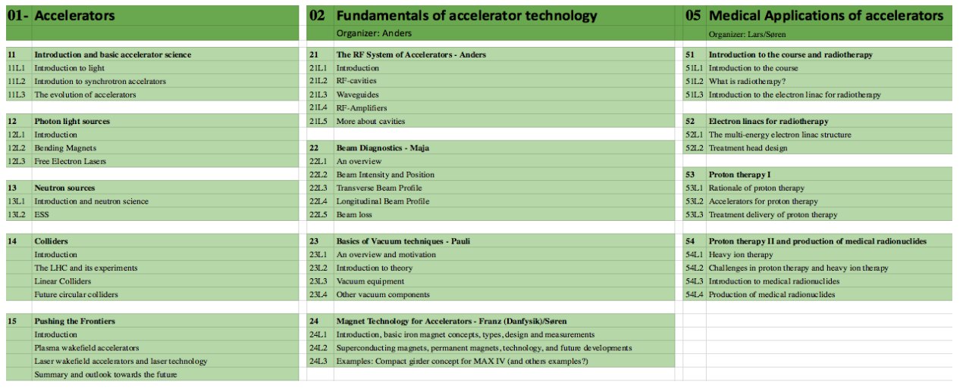
Modularity and implementation of the MOOCs
Introduction to accelerators
Fundamentals of accelerator technology
Medical applications of accelerator
Notes:
Even though the summer schools were a great success, our vision took us to another level. We now wanted to produce meaningful and easily distributed teaching materials that would be accessible, not only to 90 students but to millions of learners around the world - Inviting as many people as we could to the field. That’s when we began translating our teaching materials from the summer schools to the content of Massive Open Online Courses (MOOCs). In this effort, we partnered up with Coursera. Coursera is an american e-learning organisation through which 150 universities and 30 large companies worldwide take part in developing and disseminating MOOCs, reaching an estimated 33 million registered learners on the plattform.
In short, a MOOC, is a framework that delivers learning content digitally and en mass. It is adaptable to the needs of the teacher and learners since it allows for various Our MOOCs are based on a combination of video and text content. But, there are many other ways to present the learning content, through everything from podcasts, videos to traditional text format.

Slide 19
Introduction to accelerators
Accelerator physics
Photon light sources
Neutron sources (ESS)
Colliders
Frontiers
Notes:
The Introduction to accelerators MOOC contains
Accelerator physics
Photon light sources
Neutron sources (ESS)
Colliders
Frontiers

Slide 20
2. Fundamentals of accelerator technology
RF-system
Beam diagnostics
Vacuum technique
Magnets
Notes:
The content of the Fundamentals of accelerator technology MOOC is
RF-system
Beam diagnostics
Vacuum technique
Magnets

Slide 21
3. Medical applications of accelerators
Electron linacs for radiotherapy
Proton and ion therapy
Production of radionuclides
Notes:
Finally, the content of the Medical application MOOC is
Electron linacs for radiotherapy
Proton and ion therapy
Production of radionuclides

Slide 22
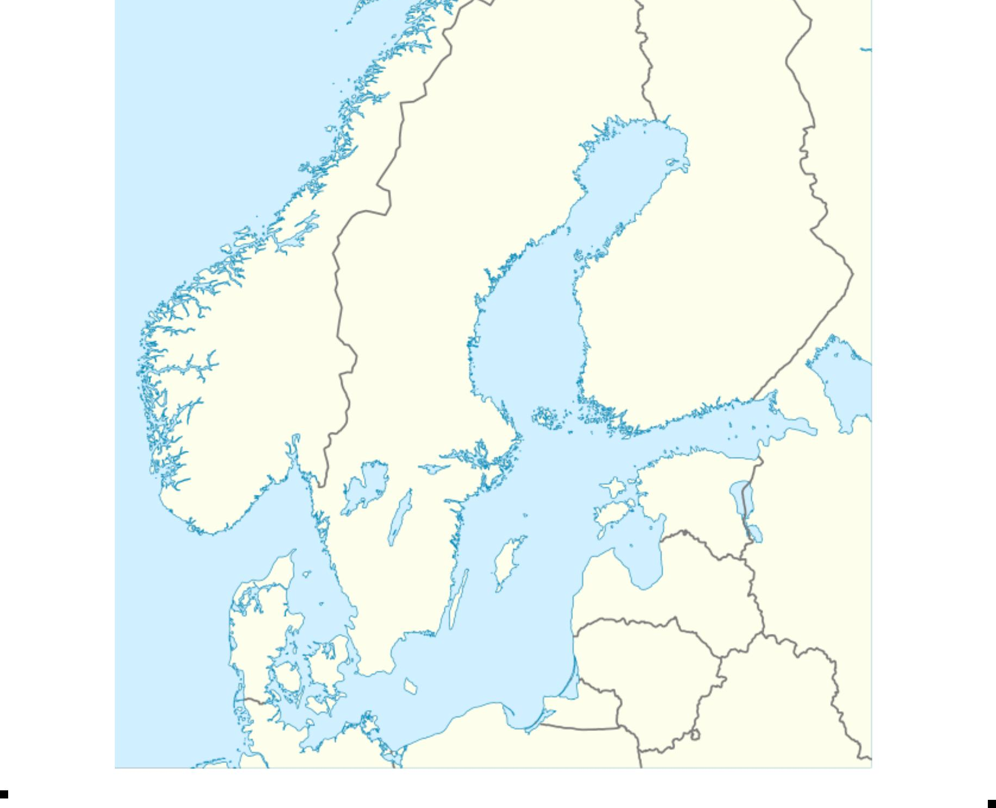
Collaboration & Partnership
Jyväskylää
*
Oslo
Uppsala
Aarhus
ESS, MAXIV, LU
Notes:
In the spring of 2015 we submitted an application for the NPAP to Erasmus+ strategic partnership for higher education and half a year later the application was approved. Before submission we scanned the Nordic countries to find partners.
Aarhus was a given, from Denmark. They have two synchrotron light sources, experience regarding medical applications and a collaboration with ESS.
Then we found Oslo University who are involved in projects at CERN and ESS, so that was our natural choice in Norway. At Jyväskylää in Finland a cyclotron for heavy ions is being run and that competence was crucial for us as well, making Jyväskylää a partner.
Then Uppsala became a partner since they are involved in many projects at CERN and also at ESS (EU-TIARA). Here in Lund MAX IV and ESS were the natural partners, but also Lund University, through my own department. In total seven partners came together for this project and it turned out to be a very good team!
Together expertise in all areas of accelerator technology was represented in the work of delivering three Summer Schools and three Massive Open Online Courses (MOOCs). All partners worked hard top achieve this.

Slide 23
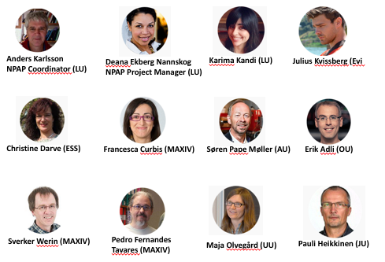
Our NPAP Team
Notes:
AK: NPAP Coordinator Prof. at the Dep. of Electromagnetic Theory at Lund University
Deana Ekberg Nannskog: Project Manager & Educational Concept Designer at the Department of Commissioned Education at Lund University
CD Engineering Scientist at ESS
SV: Prof. at the Dep. of Accelerator Physics at MAX IV Laboratory
Søren Pape Møller (AU): Centre Director at the Dep. of Physics and Astronomy – Institute for Storage Ring Facilities at Aarhus University
EA: Associate Professor at the The Department of Physics at University of Oslo
Pauli Heikkinen
Chief Engineer at the Department of Physics at University of Jyväskyläpauli.heikkinen@jyu.fi
Francesca Curbis
Associate Professor at Department of Accelerator Physics at MAX IV Laboratory, Lund University
Maja Olvegård
Researcher at Department of Physics and Astronomy, FREIA at Uppsala University
Pedro Fernandes Tavares
Accelerator physicist at Department of Accelerator Physics at the The MAX IV Laboratory, Lund University
JK: Julius Kvissberg
Producer of Digital Resources at the Department of Commissioned Education at Lund University
Karima Kandi
Project administrator at the Department of Commissioned Education at Lund U

Slide 24
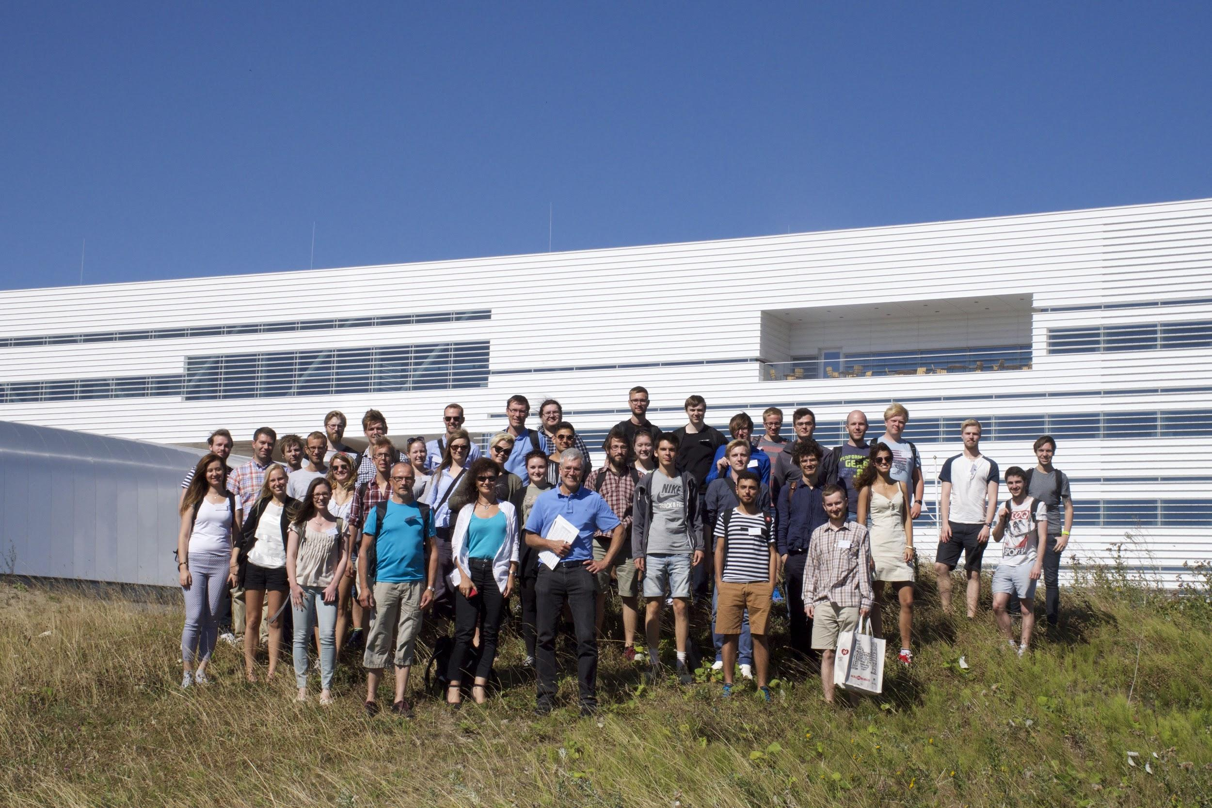
Summer Schools
Notes:
The first part of NPAP was to create a Summer School.
In three Summer Schools we have given 90 students an education in accelerator technology. The first Summer School was held in 2015. This was before the Program had started, but all partners were involved already then. The Summer Schools were held during two weeks in August.

Slide 25
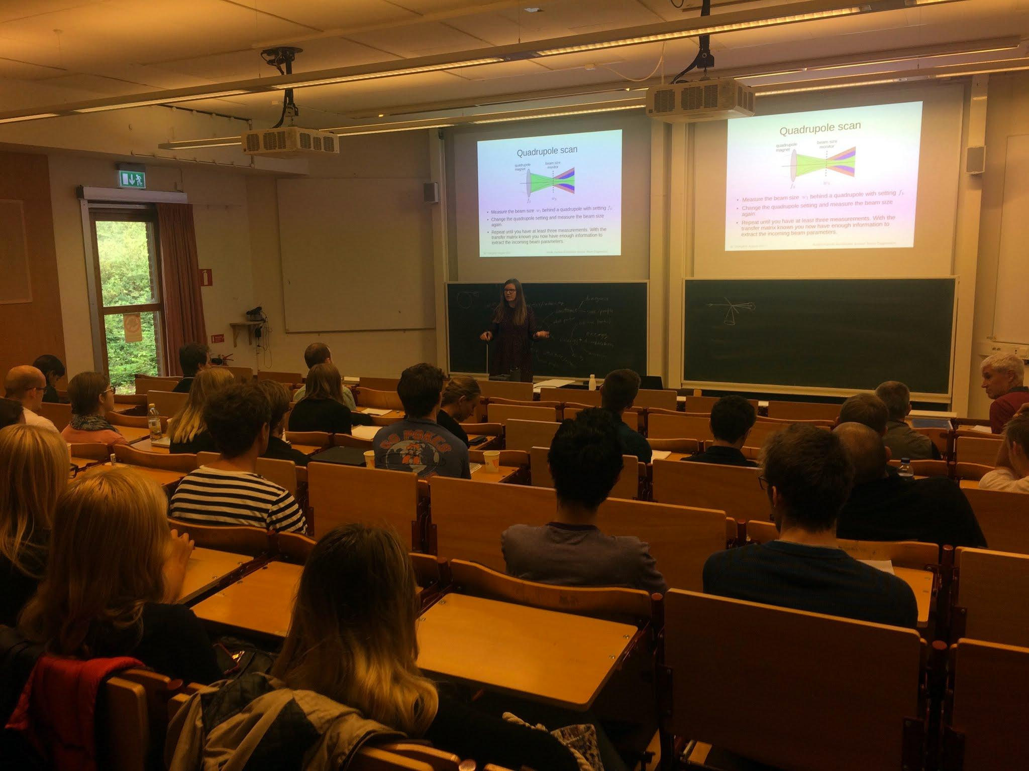
Notes:
We had lectures in the morning from 8.30 to 12.

Slide 26
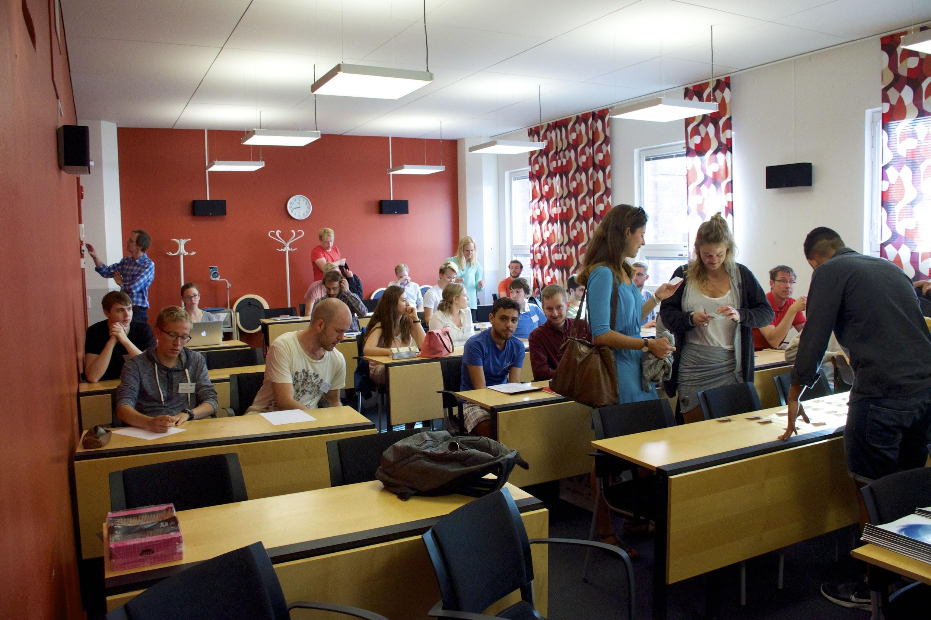
Notes:
In the afternoons we had exercises, or visits to MAXIV and ESS, or project assignments. The examination was a written and oral presentation of the project. The students got 3 ECTS for the course. We were 13 teachers that gave lectures in the summer school. Every part of the course was covered by an expert.

Slide 27
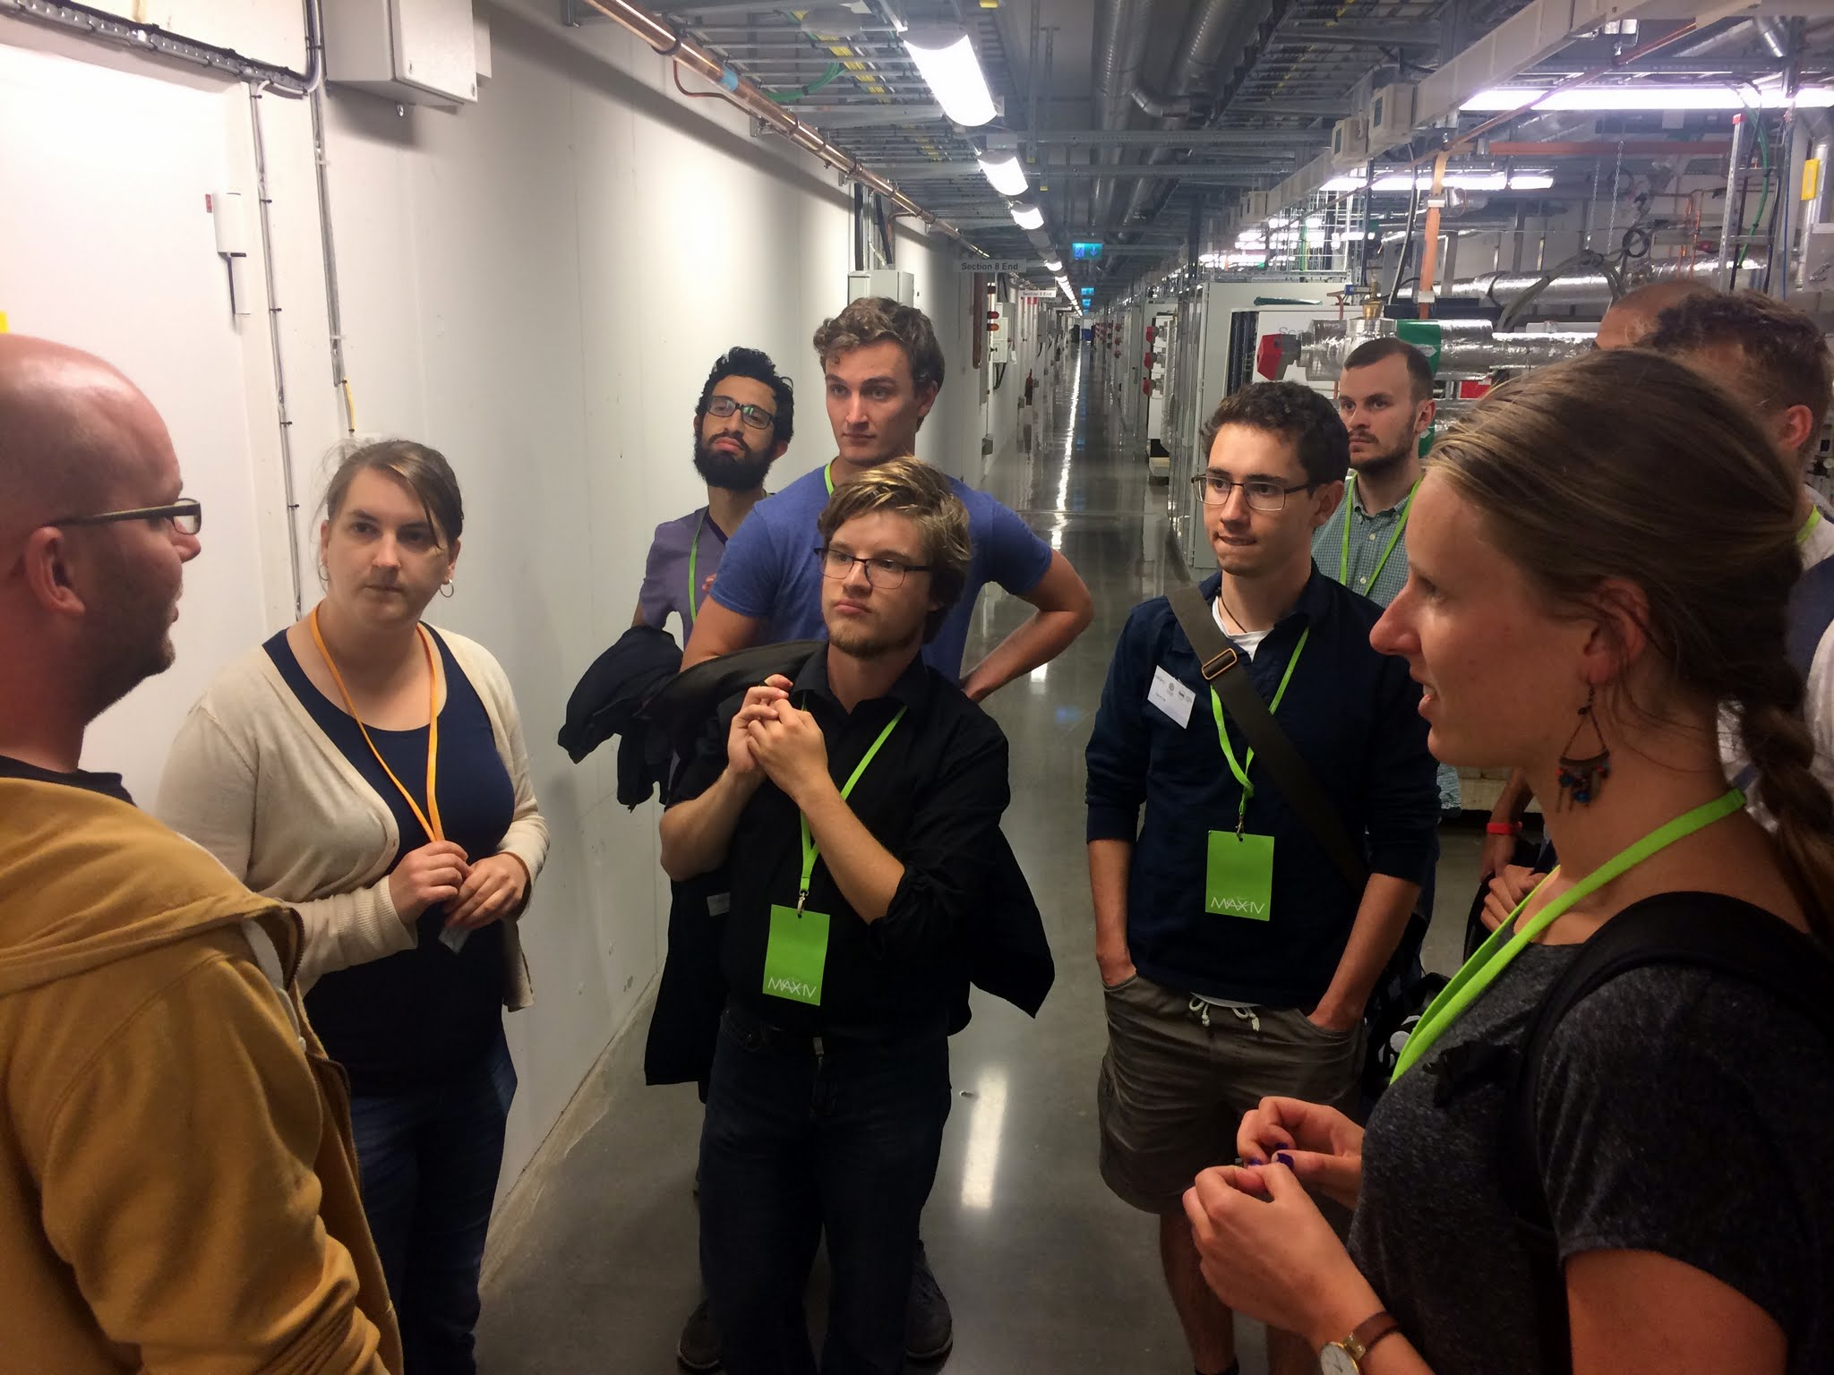
Notes:
Visit to MAXIV
Wer had social activities like a trip to Ven, berbeque in Stadsparken and guided tour in Lund.

Slide 28
MOOC
Massive Open Online Course
Notes:
The Summer Schools were a great success and we gained a lot of experience. We could then go to the next level and that was to build Massive Open Online Courses, or MOOC. I will describe the process of creating a MOOC and then Dena will discuss the concept of MOOC more in detail.
In short, a MOOC, is a framework that delivers learning content digitally and en mass. It is adaptable to the needs of the teacher and learners since it allows for various Our MOOCs are based on a combination of video and text content. But, there are many other ways to present the learning content, through everything from podcasts, videos to traditional text format.

Slide 29
Creating a MOOC
Producer: Julius Kvissberg
Needs of the learners and learning objectives
Modules
Skeletons for modules
Manuscripts for lectures
Film the lectures
Reading materials
Quizzes
Notes:
How do you create a MOOC of high quality? First of all you need a producer with experience from MOOC productions. We contacted Julius Kvissberg, who has been involved in all of the MOOCs developed so far at Lund University. Julius become the boss and he guided us through the process.
We started with long discussions on what are the needs of the learners and what are the learning objectives. Once that was decided we divided each MOOC into modules. Each module was handled by one teacher. The next step was to make a skeleton, or outline, for each module. That helped us to get an overview of the content.
In next phase we wrote manuscripts for the lectures. The lectures were then filmed with professional equipment. There is no improvisation in the lectures, we read the manuscripts from a screen word by word.
Finally the skeletons were filled with the lectures, the reading materials and the quizzes. There are two types of quizzes, the quizzes without grading after each lecture, and the graded quizzes. The graded ones are for those who like to get a diploma.

Slide 30
Our three MOOCs
Introduction to accelerators
Fundamentals of accelerator technology
Medical applications of accelerators
Ee
Notes:
The output was the three MOOCs
Introduction to accelerators
Fundamentals of accelerator technology
Medical applications of accelerators

Slide 31
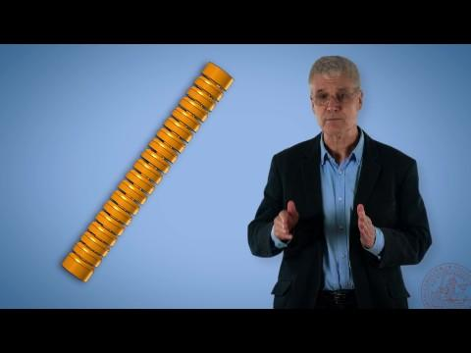
Closing film
Notes:
Julius has made a short movie with some movie clips from the MOOCs

Slide 32
Deana Nannskog
slide 34-37

Slide 33

Benefits of MOOCs and integrated learning
Notes:
So welcome back everyone!
My name is Deana Nannskog and I’ve been project managing the NPAP-project in my role as educational concept developer at the Department of Commissioned Education at Lund university.
I’m here to share with you why MOOCs are “the magical endeavours of the future” and how they can benefit a more integrated learning approach.
The Swedish government as well as top-universities and organisations around the world say that - this is one of the types of learning - we need to open our doors for.
But first I want to get back a bit to the NPAP-project.
Ok, so we have now had the opportunity of learning from Anders and Christine:
Why the Nordic Particle Accelerator project/programme was initiated
Who was involved
The NPAP’s overall objective and its outputs have been introduced to you:
that is - the summershools, the pedagogical development of the staff, and finally we now know more about our 3 MOOCs. What they contain and how we developed them from teaching materials at the level of higher education

Slide 34
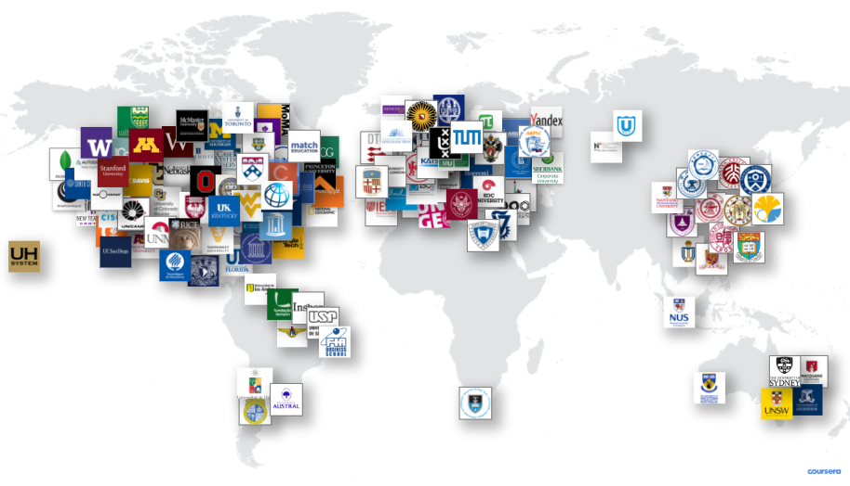
A global learning ecosystem
Notes:
Coursera.org is the global e-learning platform where our MOOCs will be published in September - so yes this is a VIP pre-launch and you are all invited!
By publishing our MOOCs on the Coursera platform we are reaching 33 million active learners around the world who come there to learn something new.
Will they find our MOOCs interesting, meaningful and useful? We are convinced that they will!
Lund university is one of 150 top-ranked universities represented on the platform and apart from our three newly created NPAP MOOCs we have also produced several other MOOCs: “Sustainable cities”, “Greening the economy”, “Sexual and reproductive health and rights” to mention some of the most prominent.
This year there are 2,800 active courses, over 250 specializations, and 10 degrees ranging up to masters level on the platform.
Over 900 companies use MOOCs at Coursera to transform talent in times of unprecedented change - most likely - to meet the demands of functional flexibility.
Since most MOOCs are free of charge - well you might have to pay around 30-50 USD if you want a certificate or a diploma - this stands in sharp contrast to the approximately 15 billions USD globally spent by companies in the year 2015 on professional training. Surveys show that the perceived return of investment was as low as 20-30 %.

Slide 35
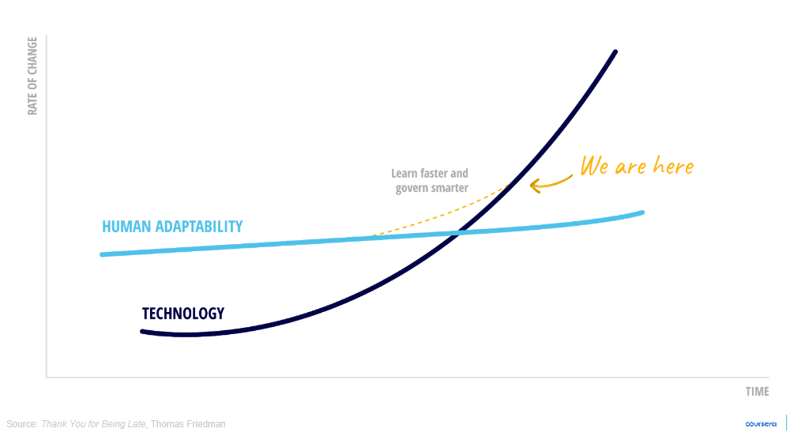
Our future is discretionary
Notes:
The future of work and the future of learning are converging because the world is changing at a faster and faster rate.
Being in the middle of one of Northern Europe’s most knowledge-intensive areas,
all of us have probably heard about how technological advances and automation is changing the demands of current
as well as future organisations and workforces.
As an educational concept developer I think In many ways technology is offering us the opportunity for amazing advances,
but we need to keep up with the demands that come along many of the changes.
Here, Friedman offers a theory on how technical advances around the world - demonstrated by the black line -
are surpassing our human adaptability - which is represented by the blue line.
Frankly, Friedman is convinced that we won’t keep up. Unless - as explained by the yellow line - we become really comfortable with dealing with uncertainty, unpredictability and change, all components in what I call discretionary work.
So, how can we become better problem-solvers and in turn better adapt to the demands which we are facing? Especially when it comes to knowledge-intensive and discretionary work?
Well, most researchers concerned with organizational development agree that we need to broaden what we learn,
- that is - learn more about different subjects - at least to some extent -
but we also need to learn new things in smart and efficient ways. This is where MOOCs have proven to be effective.
The benefits of smart learning is probably easy to recognize, so instead I want to highlight the benefits of cross-sectoral and open learning which often aren’t as straight forward.
The thing is -
that for the same reasons we are seeing a shift towards more open innovative processes,
we need to open up the learning content in the same way.
So what’s the reason for opening it up? Well, we won't be able to predict all the challenges that the future will bring.
Think of it as a really good football-team where all the players have a different set of abilities and competences but together they work to cover all angles and in the end the win the game. Together. Because, the more they know the more they cover.
So by opening up learning and encouraging cross-field learning, our readiness to embrace change and future knowledge demands will be stronger.
In my work I have learned that organisations and companies often fear that their employees are wasting resources on learning as soon as they dabble in something that doesn’t have a direct link to present obvious demands.
Yet, this is where the first mistake is made. We might not understand now, why a specialist in innovation should learn general knowledge of how an accelerator works, until the day accelerator technology and the field of innovation need to merge.
Again, we know that fields are crossing over and merging with others, especially the field of technology. Opening up learning is therefore a proactive strategy for the future.
So what is the future calling for - more and smarter ways to learn and more cross-sectoral and integrated learning.

Slide 36

Challenges ahead
Notes:
The challenges before us aren’t easy I’d say, since easily accessible cross-sectoral or cross-fields knowledge and flexible integrated learning are yet to be implemented on a broader scale - in other words - we are currently in an early phase in its development.
The reasons for this immaturity is often explained by silo-thinking like “This is not my area, that has nothing to do with my subject” and so forth. Also since time is often scarce, people feel the need to make, what they think are rational choices in their educational development, hence taking courses more “close to home”.
The lack of openness and bridges between sectors, business, research/higher education and the public sector - in turn is resulting in low capacity to meet the demands of flexibility.
This is why we need MOOCs, to familiarize ourselves with more fields through accessible knowledge - when and wherever we want - and to discover unexpected links as well as potential synergy between areas.
That’s why, in my opinion, we need to put more effort into
having these open dialogues with each other
listening to each other’s needs and ideas
collaborating to build those bridges missing. Hopefully we’ll start building some bridges at our panel-discussion later today.
·
Thank you!

Slide 37
Collaboration possibilites through knowledge development
20 AUGUST 2018
(QS Ranking 2015/2016)
Notes:
My name is Susanne Norrman and I’m head of a department at Lund university called LUCE. Our mission is to develop custom-designed trainings and knowledge development programmes for companies and organisations both in Sweden and internationally

Slide 38
Strategic plan of Lund University 2017–2026
Vision
A world-class university that works to understand, explain
and improve our world and the human condition
Priority areas
Education and research are to be intertwined
Stimulating active collaboration to solve societal challenges
Continued development as an international university
Well-developed leadership and collegiality
Students, employees and visitors are to be offered attractive environments
The potential of MAX IV and ESS is to be fully exploited
Notes:
I would first of all like to highlight the strategic plan of LU

Slide 39
Collaboration with society
Collaboration in research and development
Strategic partnerships and cooperation agreements
Technology transfer and innovation support system (ex LU Innovation)
A structure for knowledge transfer, training and development (ex LUCE)
University
Business
Government
One of the universities’ three duties - became law in 1977
Notes:
When it comes to collaboration with society, it is of course a very important activity for the university and since it became law in 1977 it is one of the universities’ three duties
Today we have
alot of collaboration within research and development
LU also has, since a few years back, strategic partnerships and cooperation agreements with companies and public organisations.
Technology transfer and innovation Support system (ex LU Innovation)
A structure for knowledge transfer, training and development (ex LUCE)

Slide 40

Lund University Commissioned Education

Slide 41
Lund University Commissioned Education
  LUCE is a central-level office which can provide custom-designed educational programmes drawing from the strength of all Lund University faculties.
  Contact point for companies, organisations and authorities seeking business/organisational and staff development

Slide 42
Commissioned education - a strategic tool
  an important, but currently underutilized, channel to communicate both general knowledge and the latest research results and thus contribute to life-long learning and development of society
  helps identify the needs and experiences of the outside world and brings back both to education and research, which contributes to the university's quality development.
Notes:
en viktig, men idag underutnyttjad, kanal för att föra ut både generell kunskap

Slide 43
Commissioned education - a strategic tool
A meeting-platform for scientists and course participants for exchange of ideas and experience
Opens for commissioned projects and external collaborations
  One way of contributing to internationalization
  Complete solutions – tailored to your needs
  More flexible and adaptable to the needs of society

Slide 44
Key Figures
160 courses and programmes
3900 participants
40 % of participants non resident in Sweden
80/20
National/International customers
MEUR 9 in turnover

Slide 45
Challenges for the universities
create a clearer supply of lifelong learning activities
make this supply accesible and flexible
participate in and create opportunities for dialogue in order to get stakeholders input to what education is needed
Notes:
When it comes to the universities participation in life-long learning and knowledge development activities we can do much more than we are doing today. commissioned education is, as I mentioned before , an underutilized tool for cooperating with the univeristy. So what do we need to do?
Vi har kompetens och kunskap som är av relevans, men ändå så är vi inte så ”stora” som vi skulle kunna vara inom det livslånga lärandet.
Vi måste tydliggöra utbudet! – vi kan inte tro att yrkesverksamma söker på samma sätt som studenterna – att antagning.se ska räcka – att vi ska kunna få folk att söka 2 ggr per år 6 mån innan en kurs börjar. Det görs på andra sätt, men dessa måste utvecklas!
Vi måste göra det tillgängligt och flexibelt – val av leveransform; fart och tidpunkt (sommar/kväll)
Saknar verktyg för att systematiska fånga upp efterfrågan - inom professionsutb så finns en fungerande samverkan och lärosätena arbetar nära utbildningarna;

Slide 46
How do we find out the needs of society?
Notes:
What are the knowledge needs of the future? What competence development needs will the companies and organisations have in the near and distant future? Many sectors of society experience constant change and they need constant knowledge updates to “keep up” and at the same time be “in line with” the latest research.
Regular labour market statistics and forecasts are done but usually too general.
Time conflict – knowledge intensive industry – needs very specific and need to me tailored and just in time
”Just right”
Vi har idag de arbetsmarknadsprognoser som görs på nationell, regional och lokal nivå.
Regionala högskolor oftare en regional förankring än de breda univ
Sökande till fristående kurser – var en indikator, men långsam och inte helt tillförlitlig
SKL – viss fortbildning fungerar utmärkt där en tydlig dialog förs
I kunskapsekonomin finns en konflikt – arbetar med med debiterbartid så läggs mindre tid på kompetensutv från arb giv sida.
Teknikföretag – här har UoH konkurrensfördel – eftersom de har den senaste forskningen.
Vinnova,
Tillväxtverket, etc

Slide 47

What dialogues/ meeting places do we have today?
What do we need?
Notes:
Meeting places?
Alot of meetings take place each day and on many different levels – need to be systemized.
Tydligare samverkan med arbetslivet inom professionsutbildningarna för lärare och sjuksökerskor, men detta är svårare att ha när det saknas en tydlig avnämare eller när det saknas ett konkret behov.
Competence networks
Collaboration agreements
Collaboration partners
Dialogmöten på olika teman
We constantly try to find the right platforms and networks, but here we still need to work more. This event today is one good start.

Slide 48
Possibilities for the future
Lifelong learning now on the agenda
New technologies
New financing possibilities
Develop new knowledge development programmes in close collaboration with industry and public sector
…
Notes:
...so we invite all of you that have needs or ideas that you want to develop to contact us and we hope to develop more, and new projects together.

Slide 49




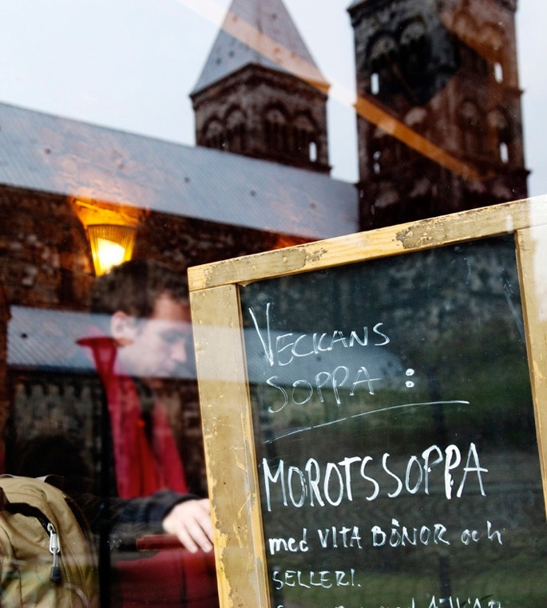


Slide 50
One of Northern Europe’s most knowledge-intensive areas

Slide 51

Greater Copenhagen
Finland
Norway
Sweden
Home to 4 million inhabitants
and Scandinavia’s largest recruitment
base of highly-skilled employees.
Denmark
Notes:
Greater Copenhagen

Slide 52
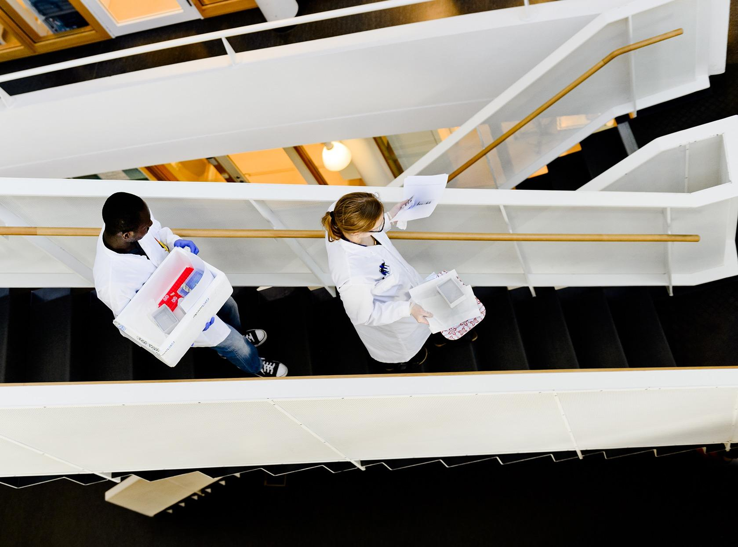
With world class research facilities.

Slide 53
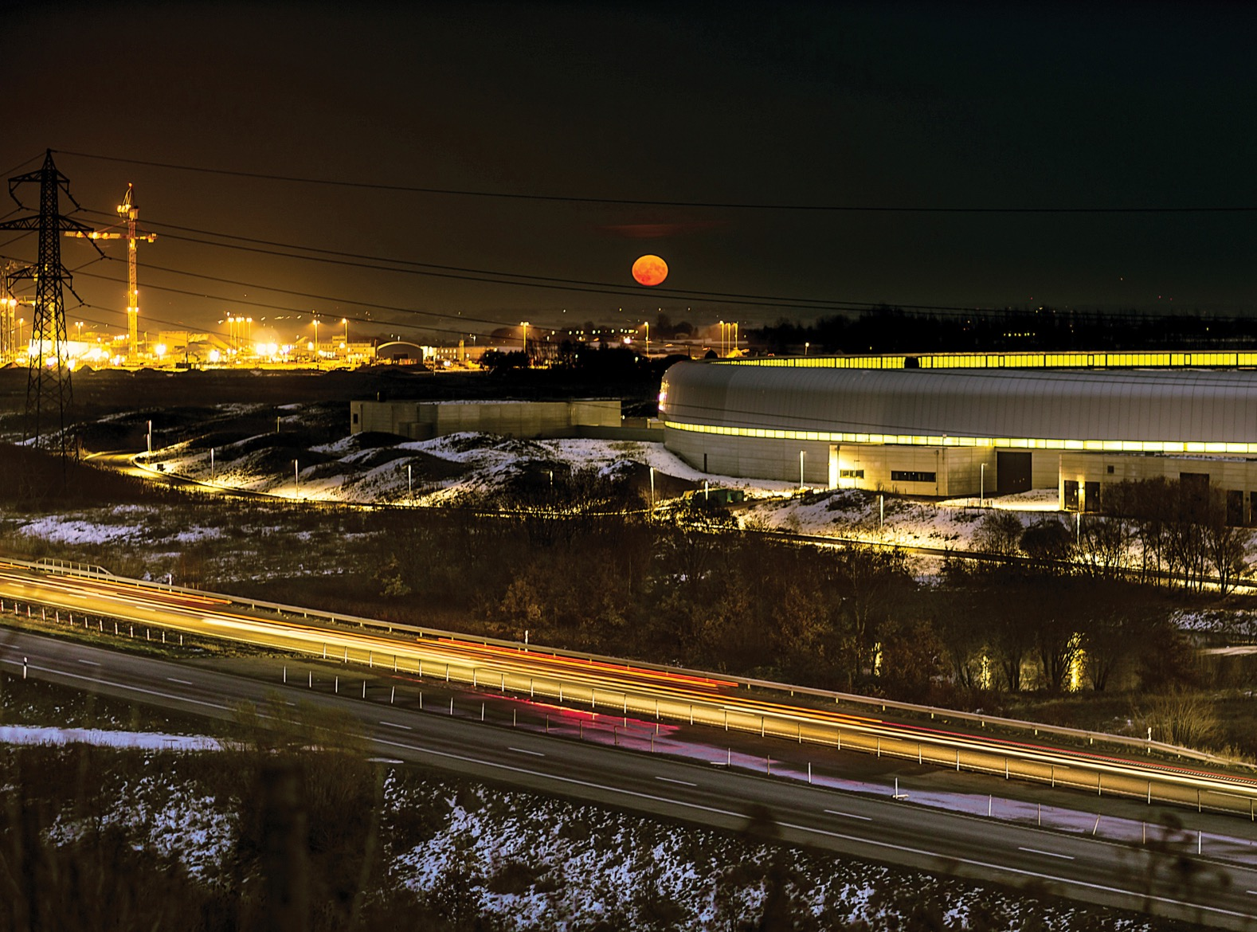
14 000 researchers, 190 000 students, 19 research parks and incubators and 17 higher education institutions.
Notes:
Greater Copenhagen: one of the world’s strongest research regions
The highest concentration of highly-qualified workers in northern Europe
17 universities
190 000 students
14 000 researchers
A hub for ideas, science and culture
A large proportion of the business sector has its origins in research
International airport (Copenhagen)

Slide 54
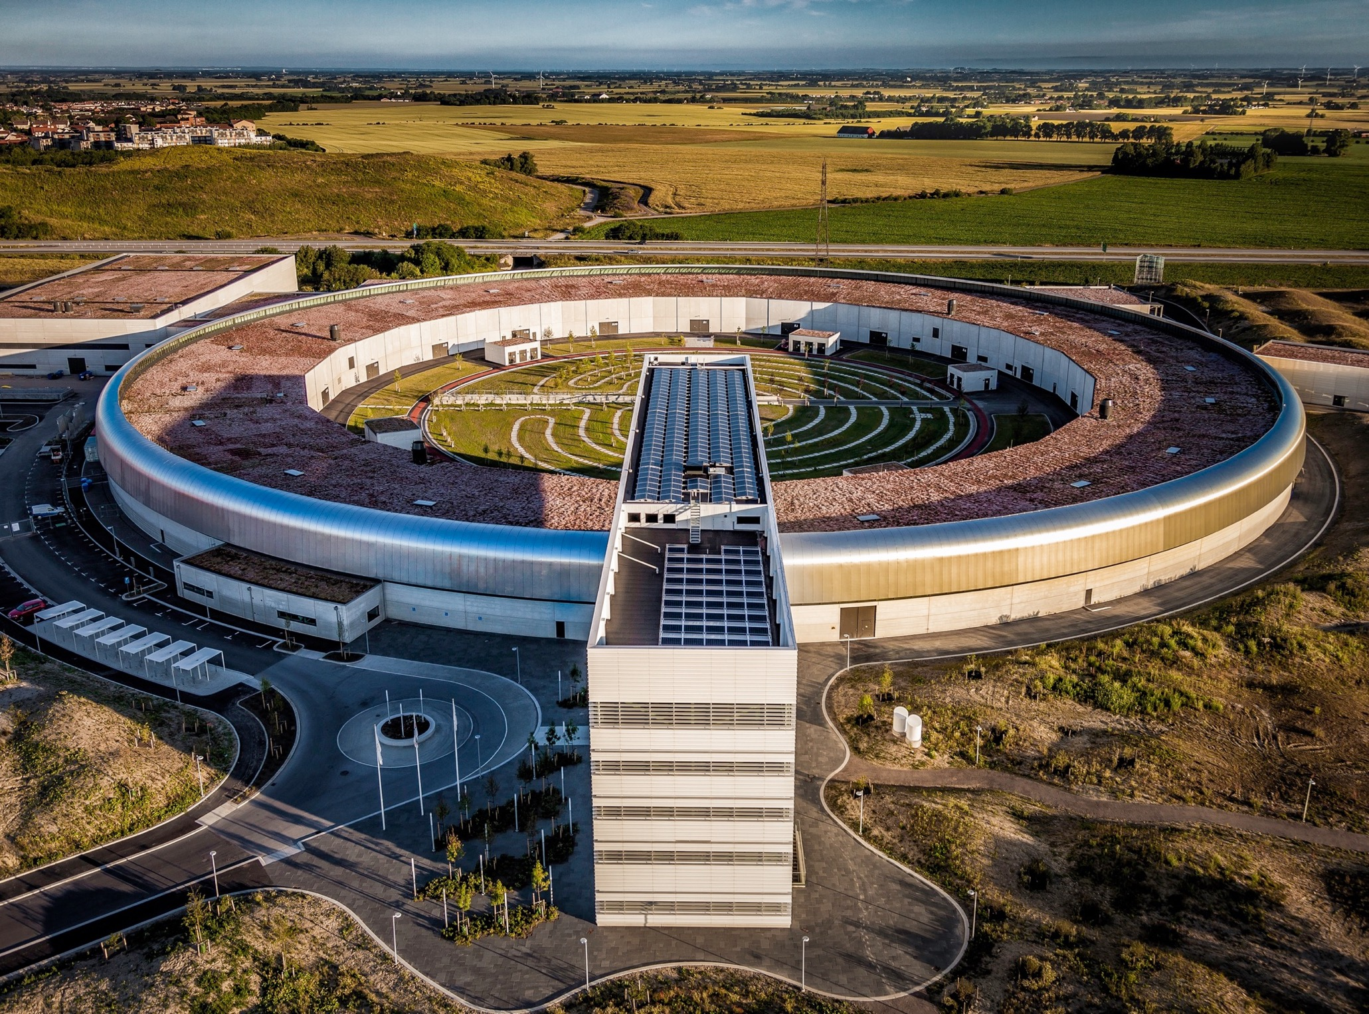
MAX IV – the most brilliant X-rays for research.
Notes:
World-leading synchrotron radiation laboratory
Using synchrotron radiation to study materials
at the atomic scale
For scientific breakthroughs within medicine, engineering and science
Inaugurated June 2016
Mikael Eriksson, the brain behind the MAX IV.

Slide 55
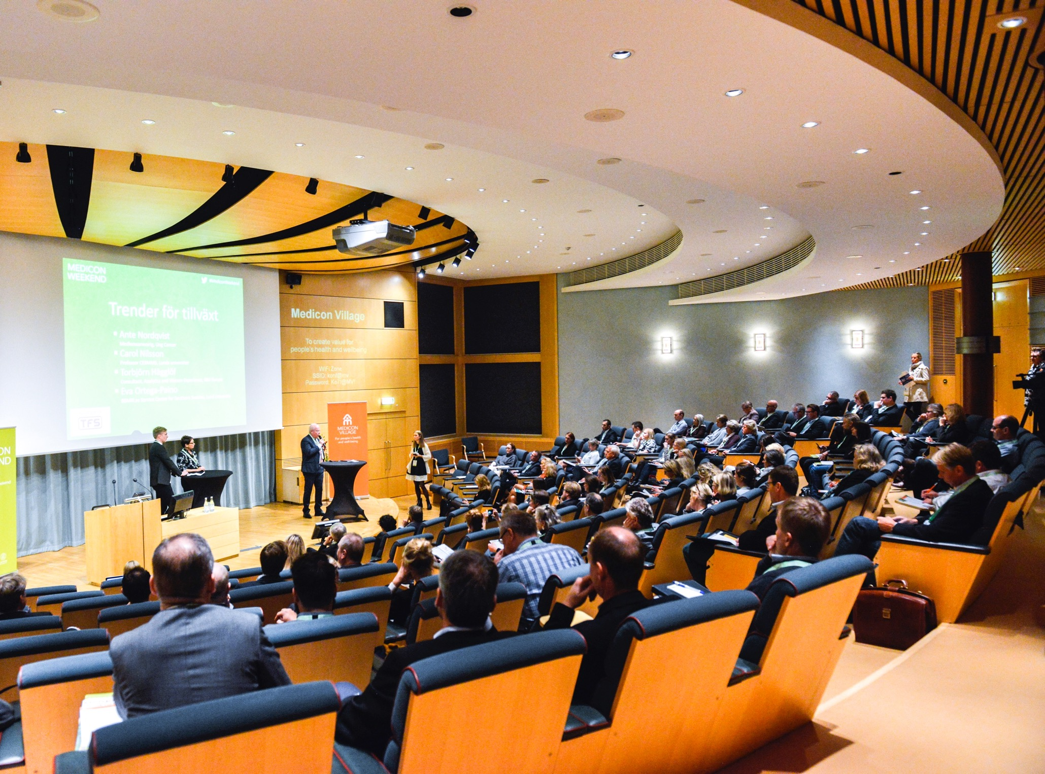
Medicon Village, a world-class infrastructure for Life Science
Notes:
A world-class infrastructure for Life Science
Collaborative community for research, innovation
and entrepreneurship
80 000 sqm research park
30 000 sqm laboratories
Cancer, Diabetes, Nano Medicine and more.
Initiated by Lund University in a triple helix collaboration.
120 companies/organisations and 1 600 staff

Slide 56

One of Europe's most successful meeting places for visionaries, entrepreneurs and venture capital
– Ideon Science Park.
Notes:
350 companies, the majority of which have their origins in research from Lund University

Slide 57
Some innovations from Lund
The artificial kidney (Gambro)
Diagnostic ultrasound
Bricanyl – asthma medicine
Nicorette – nicotine gum to quit smoking
Axis – printer and camera servers
Oatly – oat drink
Proviva – probiotic fruit drink
Orbital Systems – the world´s most water-efficient shower
Endodrill – instrument for cancer diagnostics
Notes:
1946 The artificial kidney (Gambro)
1953 Diagnostic ultrasound
1966 Bricanyl – asthma medicine
1967 Nicorette – nicotine gum to quit smoking
1971 Modern ventilator (ServoVentilator)
1984 Axis – printer and camera servers
1990 Oatly – oat drink
1991 Proviva – probiotic fruit drink
1993 Qlik – software for data visualisation
1995 Bluetooth
1997 Precise Biometrics – fingerprint reader
2005 Hövding – invisible bicycle helmet with airbag function
2007 A1M Pharma – diagnosis and treatment of pre-eclampsia
2010 SenzaGen – allergy testing without experiments on animals
2011 cTrap – cloth that blocks toxic substances on humidity-damaged surfaces
2012 Orbital Systems – the world’s most water-efficient shower
2013 Endodrill – instrument for cancer diagnostics
2015 Uniti – electric city car

Slide 59
Questions for Dialogue
1. What's your experience of working with MOOCs in organisations?
2. How would you define the needs of knowledge from your organisation's point of view?
3. What are the most significant factors driving the growth of companies, would you say?
4. How do your organisation/partners determine what type of knowledge is important?
5. How can we create valuable learning content in trans-sectoral networks?

Slide 60
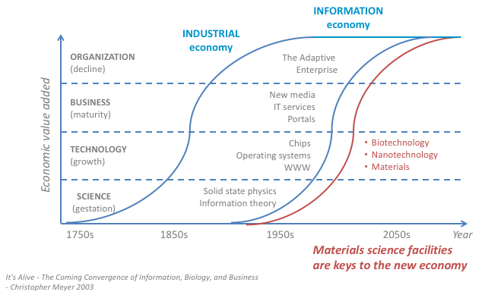
Technological Paradigm Evolution
Notes:
Materials for Dialogue
WW2; DNA discovery, sputnik launch; transistor invention, IC invention, desktop computer
à Knowledge based economy
Courbes des developments des paradigme / exemple / modele / courant technologique
Utilisant l’innovation et les developments scientifiques comme programmes/support/fondations
Releve le defi ! De la competivite europeenne afin de gerer de nouveaux emplois
Revolution technologique – industrielle – boulversement technologique
Information economy: data-driven society – societe dirigee par de large quantite de donnee
Provide foundation in new areas – apporte / fournisse les fondations
Values: Respect
Stakeholders: Intervenants, partie prenante, les acteurs, etre partie prenante
Use platfom to base the technology, dvp, INNOvation
Ex:
Nano bio information and cognitive à material research ..
Take the challenge now – european competiveness -- > new job
Devpt curve with technological paradigm

Slide 61
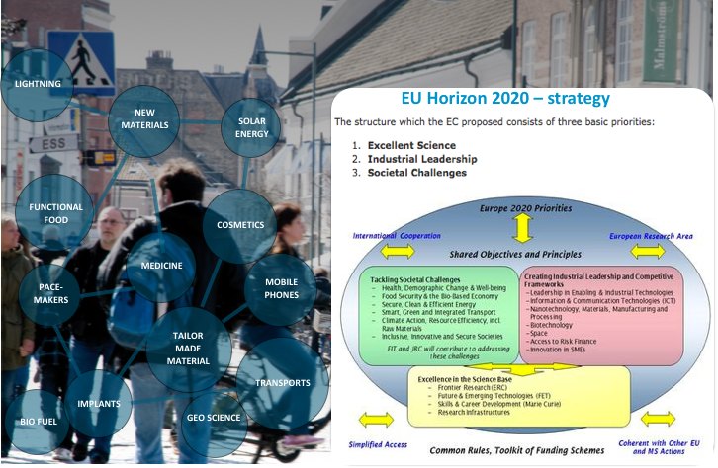
Materials, Life Science and Society
Notes:
To cope with the multidisciplinary societal challenges
The development of neutron scattering over the past 40 years has been from the initial studies of basic solid state physics in model systems, to detailed studies of complex systems with applications. Similar development can be expected in the next 40 years.
Today society: Material science, bio
Connect scientific field : target a larger scientific communities
to support innovation, capacity building and industry
Neutrons are everywhere
The major players in the industry take the challenge of sustainable development seriously - taking actions that combine strong economic performance with sound environmental management and attention to social conditions.
Take the challenge we all face of constant innovation in a modern society in which knowledge is the cornerstone of long-term growth, making education is absolute priority.

Slide 62
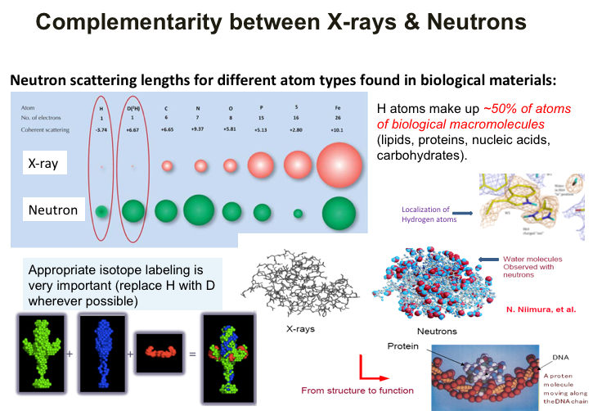

Slide 63
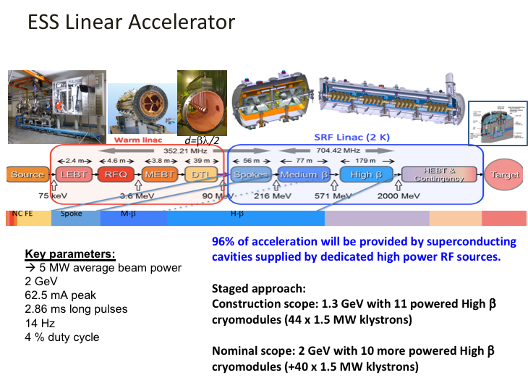

Slide 64
