Slide 1
Operation of
Target Safety System (TSS)
Mikael Olsson
Control Engineer, TSS
www.europeanspallationsource.se
12 October, 2018

Slide 2
Outline
TSS introduction
  Purpose, layout, functions
TSS state machine
TSS safety parameters
TSS in Main Control Room (MCR)
TSS maintenance

Slide 3
TSS purpose
Electrical and I&C system that prevents and mitigates radiation doses to the public
Allocated to defense in depth level 3 = safety SSC
As such, TSS shall be independent of Machine protection (MP, level 2) and Basic process control system (BPCS, level 1)
Other systems
TSS
Operation & monitoring
- software based
Reset, start
Operational system
Independence/isolation
Radiation safety system
Safety logic
- hardware based
Safety actuators
Safety sensors
Safety logic
– software based

Slide 4
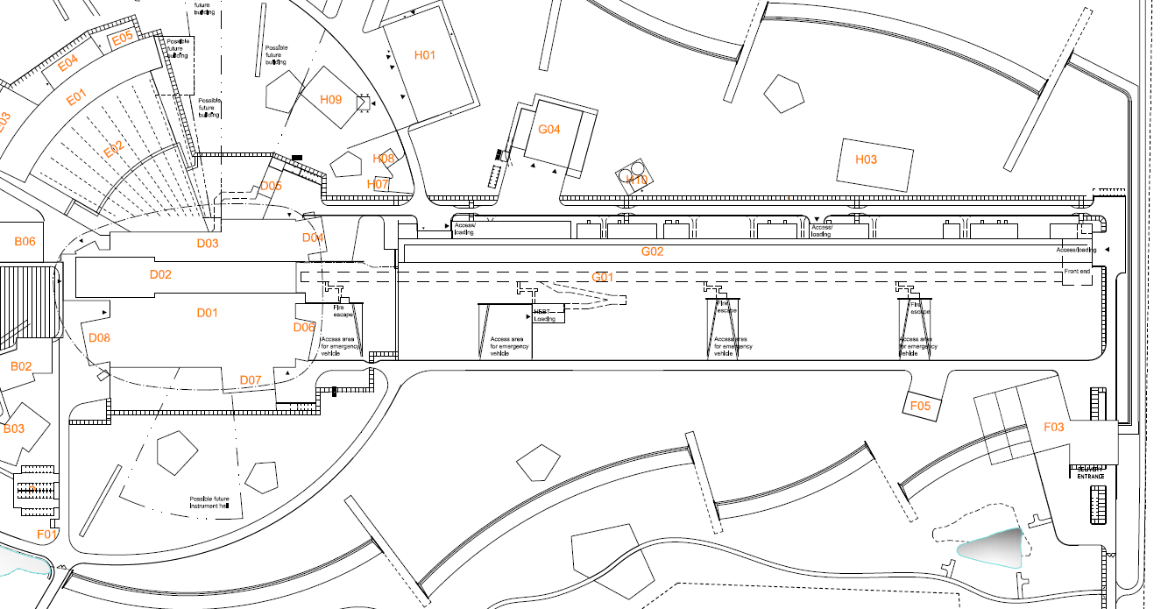



TSS layout
MCR
- operation
Target buidling
Klystron gallery (G02)
Front end building
TSS #1
- application software hub
Target utility block
- monitoring
- manual mode setting
Dipole magnet
- manual mode setting
RFQ
- Stop beam
Ion source
- Stop beam

Slide 5
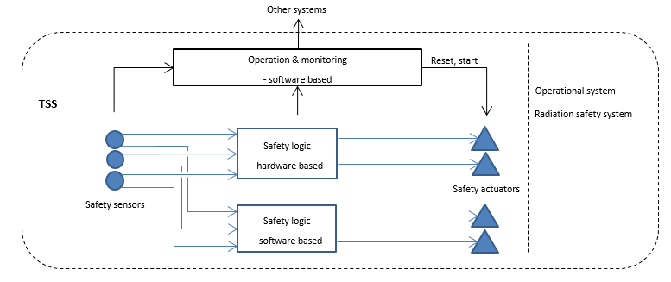
TSS functions
Operational functions
  Reset/start
  Static beam permit (bypass of TSS safety functions)
    makes TSS beam permit independent of Target Station conditions
    to allow operation of the Accelerator during Target maintenance
  Alarm handling
  Maintenance
  Monitoring
  Archiving
Safety functions
  Automatic stop of proton beam production, in case of abnormal conditions in Target
  Manual stop (also used to turn off TSS for maintenance reasons)
  Main reason why TSS exists

Slide 6
TSS state machine
- operational modes and mode transitions
Modes:
‘TSS: No beam’
  TSS safe state
  TSS actuators prevent power supply to Ion source and RFQ
  TSS maintenance, periodic tests
‘TSS: Allow beam’
  TSS allows beam production
Transitions:
‘Reset’
  Makes the TSS actuators ready for start
‘Start‘
  Only possible after Reset
  Allows power supply to ION-source & RFQ
‘Automatic Trip’
  Automatic stop, if safety conditions are not OK
‘Manual Stop’
  Emergency stop
  Controlled stop (to turn off TSS for maintenance)
‘Manual bypass activated’
  Static permit for beam production
TSS: No beam
Auxiliary power supply off
Reset & Start
Automatic Trip or
Manual Stop
Reset & Start
& Manual bypass activated
Manual Stop
TSS: Allow beam
Allow beam
- on Target
Allow beam
- on Dump
Safety functions activated
Safety functions activated,
but bypassed
Prior to allowing beam production, the TSS safety parameters must be verified to be within acceptable limits. The verification is performed manually (via graphical user interfaces in MCR). When all parameters are within acceptable limits, the operator will press ‘Reset’ followed by ‘Start’.
This verification implies that systems like the Target wheel, Primary helium cooling loop and Monolith vacuum are fully operational before beam is allowed to the Target.

Slide 7
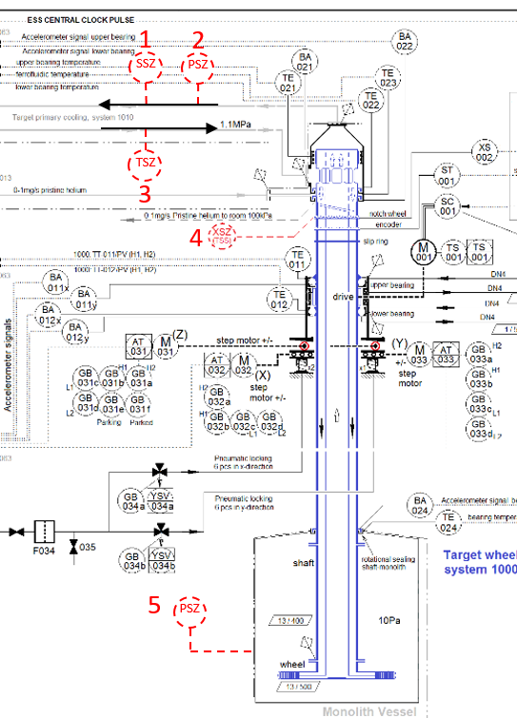
TSS safety parameters
Trip levels for TSS safety parameters chosen as far away as possible from operational limits, but with respect to identified accident scenarios
Operational limits for BPCS and MP expected to be defined within TSS range, in order to detect and prevent deviations from normal operation
This way, TSS acts only if both BPCS and MP fail to act
It is assumed that BPCS and MP limits are within OLC, and that TSS limits are outside.
TSS trip levels are defined
MP and BPCS operational limits are not yet defined
TSS
MP
BPCS
Operational Limits and Conditions (OLC)

Slide 8
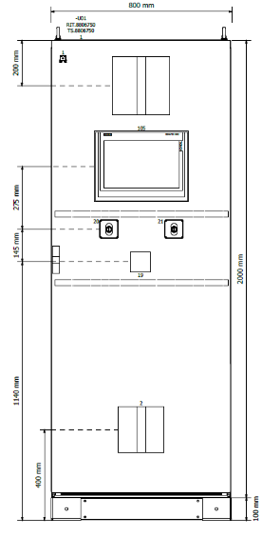


TSS in MCR
TSS dedicated cabinet
  reset/start
  stop
  monitoring via TSS local HMI
    detailed status
    alarm handling
Monitoring via Operator workstation
  TSS overview, general status
  alarm display
  no action
  via EPICS network
Archiving of TSS data
  for post-mortem analyses
  via EPICS network
MCR

Slide 9
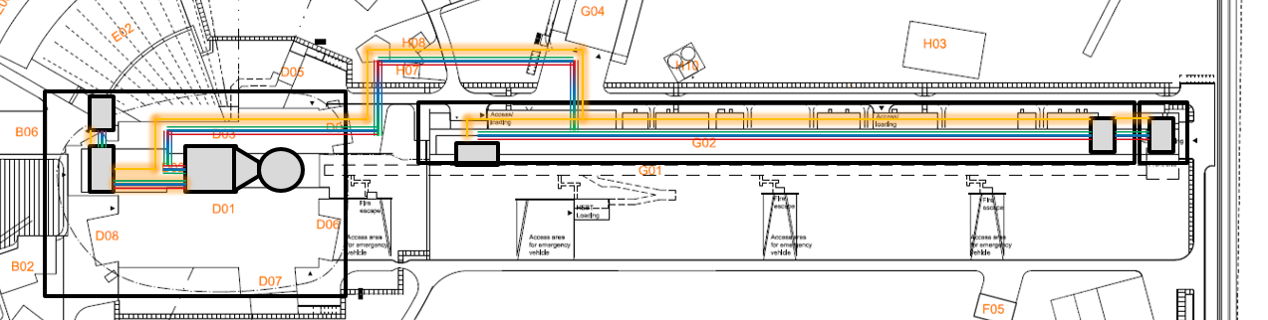
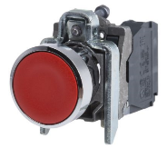


TSS operational mode
- Manual bypass activation
Condition 1 + 2:
Prevent power supply to dipole magnet by redundant TSS manual breakers
Condition 3:
Additional bypass setting by TSS manual switches
All
conditions
fulfilled?
Pushed?
Assures beam directed to Dump
Assures bypass of safety functions
If YES:
override with ‘Allow beam’
If YES:
override with
‘Not
Allow beam’
TSS safety parameters:
Helium
mass flow
Helium pressure
Helium temperature
Wheel speed
Monolith pressure
Beam permit

Slide 10
TSS maintenance
Planned maintenance is performed during shutdown
  In safe state mode ‘TSS: No beam’
Unplanned maintenance concept:
  It will be possible to isolate and repair one sensor part (channel) of TSS in all modes of operation of the ESS
  TSS will then operate with limited functionality (1oo2 instead of 2oo3)
  To avoid spurious trips, i.e. increased availability

Slide 11
Summary
- Safety, Availability, Operations
Safety
  TSS operates independently of BPCS and MP
  ESS relies on BPCS and MP to maintain safe operations of the facility
    It is expected that MP monitors the same parameters that TSS monitors (and more) and catches a developing event early
    It is expected that BPCS and MP operating limits are well within the TSS trip points
  TSS acts only when everything else that should have acted fails
  TSS trip points are not tuned to beam power – set for 5 MW beam
  TSS maintenance planned in TSS mode ‘No beam’ (TSS safe state)
Asset protection
  TSS does not address asset protection
    It is expected that MP monitors Target Station systems to protect equipment
Availability & Operations
  TSS has two modes to ‘Allow beam’ (to Target or Dump) for the sole purpose of benefiting accelerator operations and facility availability
  TSS is operated mainly from MCR
    Exception: activate/de-activate ‘Allow beam to Dump’ (bypass) locally in process area
  TSS has three channels to increase availability – design allows operation with 1oo2 voting

Slide 12
Thank you

Slide 13
Extra slides…

Slide 14
Use case
- Allow beam
Manual action in process area
TSS: No beam
Manual action in MCR
Operation: Beam request
To Target
Beam direction?
To Dump
De-activate bypass of TSS safety functions
Activate bypass of TSS safety functions
Operational procedure
Other operational systems
Operator
workstation
Manual action
Check TSS safety parameters
TSS HMI
Manual action
Process not ready
No
OK?
Yes
TSS: Reset
TSS: Reset
Manual action
TSS: Start
TSS: Start
Manual action
TSS: Allow beam on Target
TSS: Allow beam on Dump

Slide 15
Use case 2
- Stop
Manual action in process area
TSS: Allow beam
Manual action in MCR
Operation: Shutdown request
Low = controlled stop
Severity?
High = emergency stop
Is beam produced?
No
Yes
Stop beam production
Other operational systems
TSS: Stop
TSS: No beam

Slide 16
Use case 3
- TSS alarm during normal operation
Manual action in process area
TSS: Allow beam
Manual action in MCR, TSS local HMI
Manual action in MCR, EPICS HMI
Supervise TSS
TSS alarm
Analyze alarm
Severity?
Low
Mid
High
Acknowledge alarm, and keep running with limited functionality
Controlled stop
Emergency stop
TSS: No beam

Slide 17
TSS architecture
RFQ power
Ion source power
TSS
Helium pressure
Wheel speed
Manual stop
Helium mass flow
Helium temperature
Monolith pressure
A
Relay
PLC
Relay
2oo3
Switch
1
B
Relay
PLC
Switch
3
C
Relay
PLC
Safety PLC
2oo3
Switch
4
Switch
2
Target wheel
Dipole magnet
Beam dump
Proton beam
RFQ
Ion source
Machine protection
Basic process control system

Slide 18
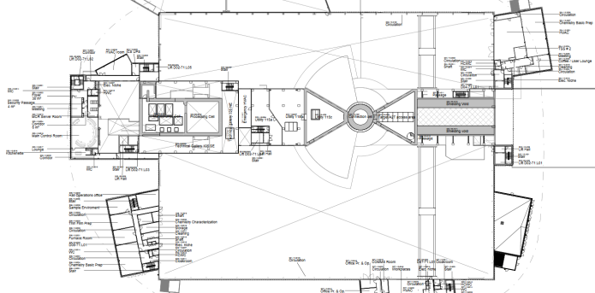
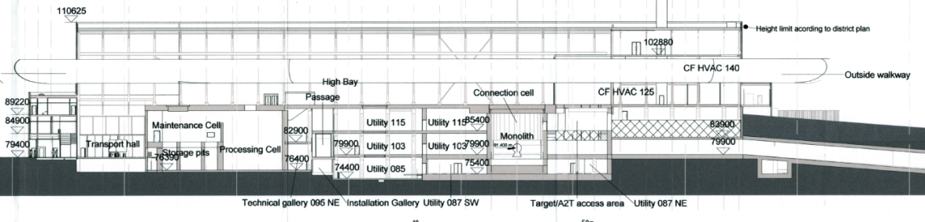

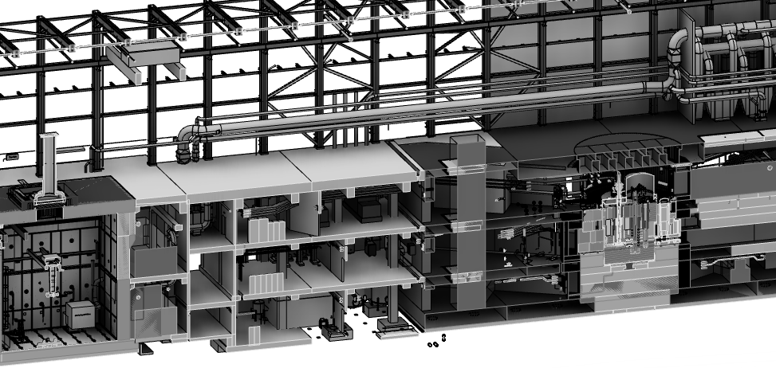
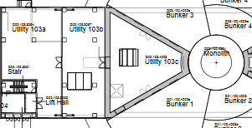
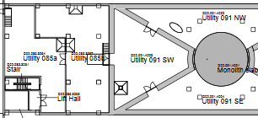
Target utility area (D02)
D02.115.3064
D02.115.3067
D02.115.4003
D02.115.4001
Relay 2oo3
Ion source
RFQ
PLC 2oo3
TSS #1

Slide 19
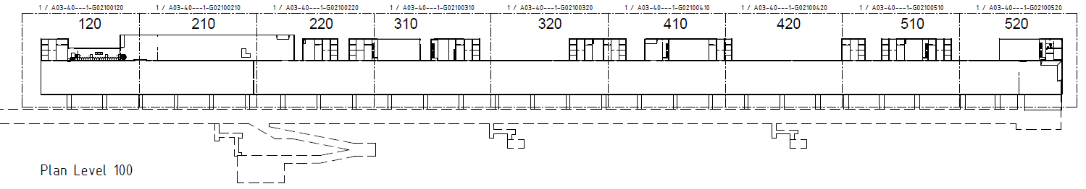
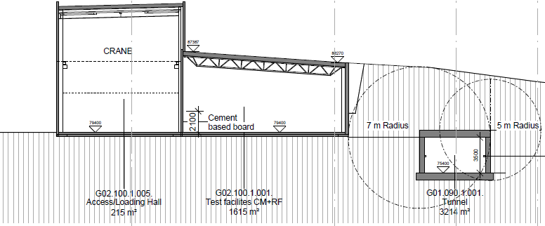
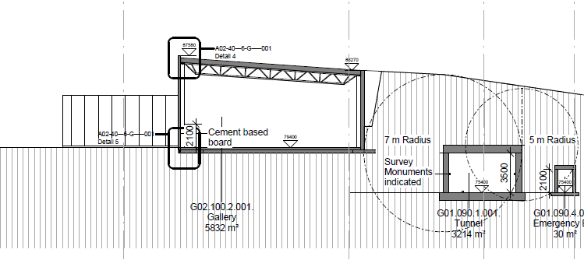
Klystron gallery (G02)

Slide 20
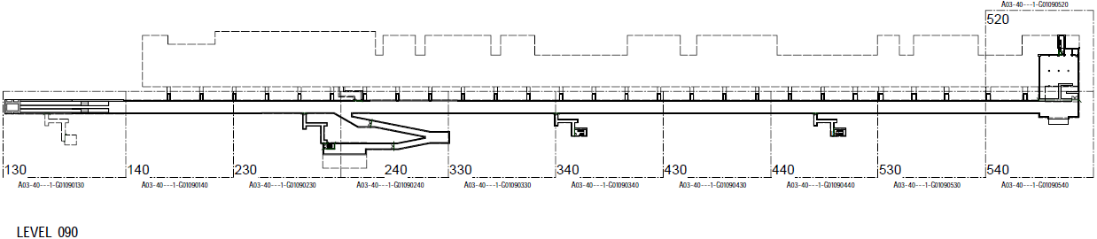
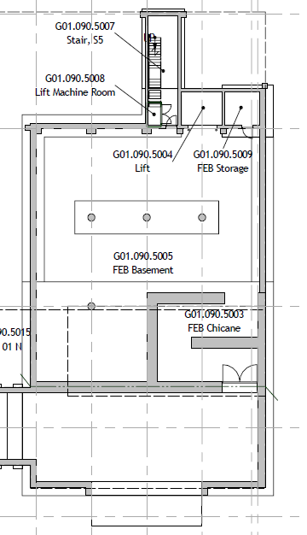
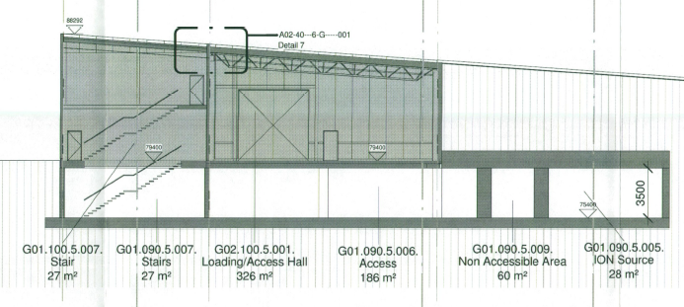
Front end building (G01)

