Slide 1
Integrated Operation of ESS Accelerator and Target
Timo Korhonen for the ICS, Accelerator and Target Divisions
www.europeanspallationsource.se
2018-10-18
Notes:
1

Slide 2
Agenda
Introduction
Status and path forward
Accelerator-Target interactions
  Operating modes
  Interfaces: Accelerator-Target-ICS
Examples of issues and scenarios
2

Slide 3
Introduction
Integrated Operation of Accelerator and Target
  A few years back, a group was working on these issues
  Status of many systems was still immature
  Things have crystallized and we need to pick up the work
How do we bring the systems together?
  Initial commissioning
  Operating sequences: ramping up from shutdown to neutron production
Accelerator and Target have many dependencies
  Communication goes over ICS (the control system)
  This needs a lot of interaction between divisions
  We shall also involve the neutron users in the discussions
3

Slide 4
Working Plan
Systematic planning is needed
  Working group, Interdisciplinary and inter-divisional
  Accelerator, Target, Neutron instruments, ICS
  Operations should drive this, with help of ICS
    ICS has interfaces to all relevant systems
Issues to be clarified
  Where is interaction needed? Some examples:
    Beam modes, Beam permits, Sequences
    Beam alignment to target (rotating)
    Beam “pattern” data distribution
    “Backwards” data from Target
      Allowed power – cooling loops
4

Slide 5
Working Plan (cont.)
Work out and document mechanisms of interaction
  Develop operating scenarios; e.g.
    Initial alignment of target with probe beam
    Operating in production
  Document interactions in each scenario
    Technical writer to help
    Identify for each scenario the data collection and analysis needs (valuable input for ICS developers)
  Verify that the implementation is feasible and reasonable
    From each stakeholder’s point of view
  Reflect this in control room applications
    Operations – ICS interaction
5

Slide 6
Operation of the ESS accelerator
The accelerator works at a constant 14 Hz rate
  Beam repetition rate can be different!
    Not every cycle contains beam
  Main reasons for the constant rate:
    Stability of RF systems
    Large inertia of the target wheel
Permutations with repetition rate
  Simple, even patterns: 14 Hz, 7 Hz, 2 Hz, 1 Hz
    Issues with charge deposition on target
Inter-operation issue
  We may have to mask out certain target sectors
  How to organise this synchronisation?
    Communication from target wheel to the accelerator
6

Slide 7
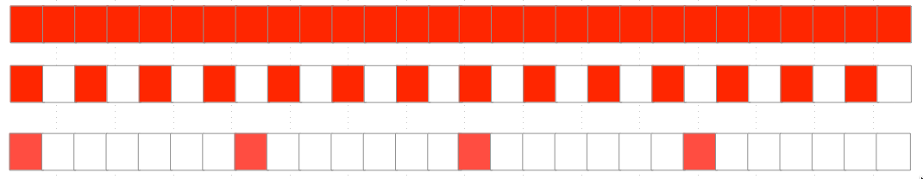
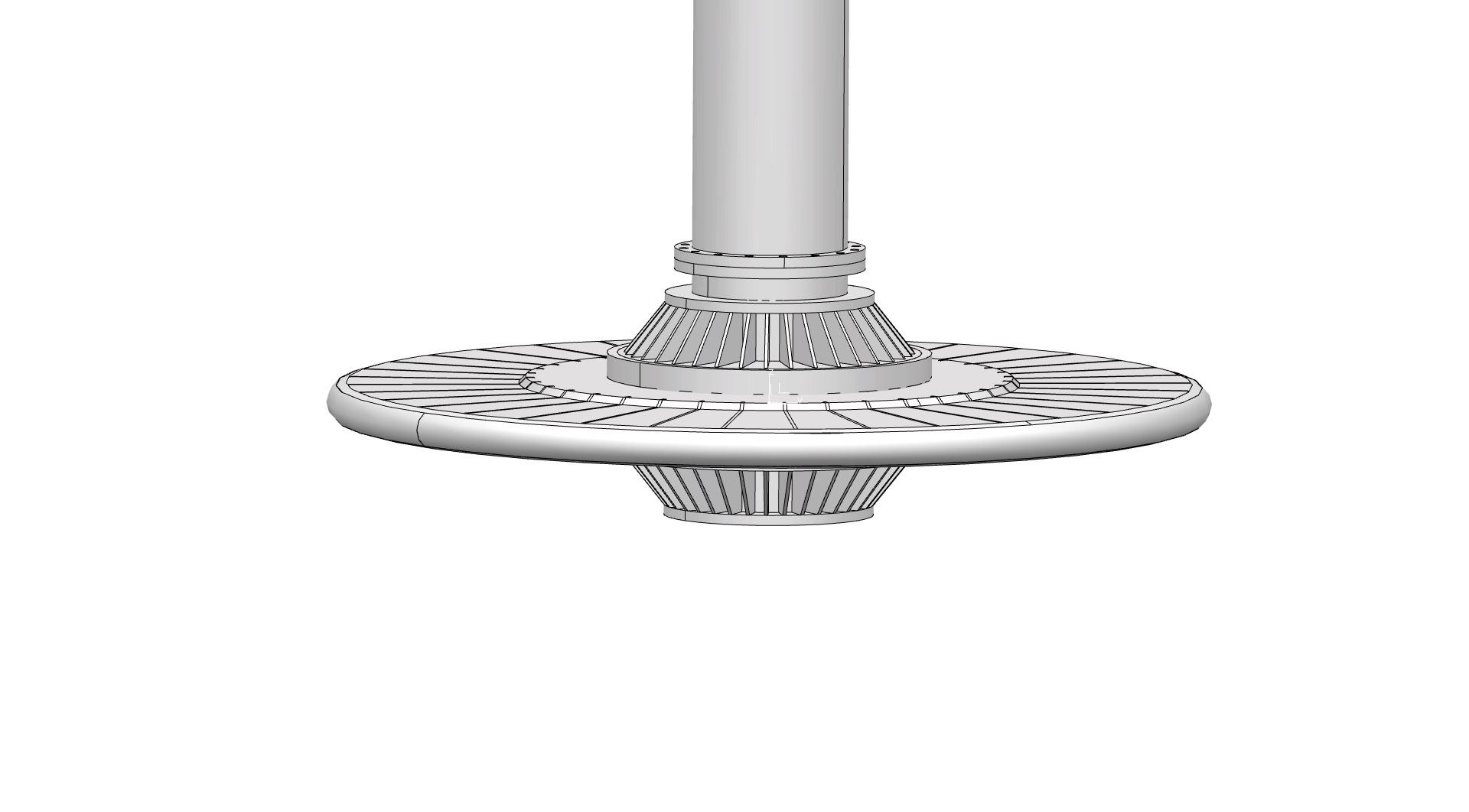


Implications: target “painting”
14 Hz
7 Hz
2 Hz
Painting with 2 Hz
All sectors covered, after 7 turns, 18 seconds
Modulation, or changing targeted sectors is needed!
Sectors have to be addressable by the accelerator (timing system)
Sectors may have to be disabled (no beam on #)
  Shall they be interlocked?
Fixed, pre-programmed sequences of cycles are not sufficient!
Painting with 7 Hz
Without modulation, only odd-numbered sectors would get beam
Notes:
Does MPS need to interlock on “forbidden” sectors?

Slide 8
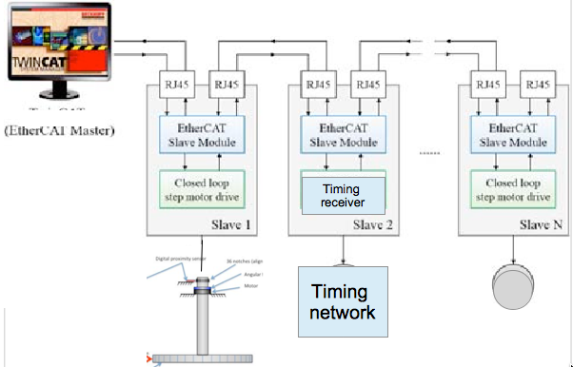
Target wheel – timing synchronisation
Wheel Motion controller: EtherCAT
We can integrate EtherCAT and EPICS/Timing system with an “EtherCAT Slave FMC”, contributed by our in-kind partner in Estonia.
EVR in the Motion Controller EPICS IOC can feed back the sector information to central timing “sequencer” node.
We “only” need this to synchronise the “sector 1”
  …after each restart or de-phasing
This will open up many other possibilities

Slide 9
Target Cooling systems stabilisation
Cooling systems in target have to transport the heat from proton beam
    Target Wheel cooling
    Moderators (Helium, water)
    Reflectors, shielding plugs, etc.
Power can change very rapidly – transient handling!
    Ramping up and down can be controlled but beam drops not
    5 MW can go to 0 MW instantaneously
Intended/incident beam power (value) has to be given to target “somehow”
    Beam power is not a simple variable:
      Pulse width, repetition rate, beam current, proton energy
Target systems also need to tell what they can receive from the accelerator
    Can influence parameters in the production mode
  That is, bidirectional data exchange.
    Not just “simple” process control but highly interactive
How is machine protection (in target) involved?
    Has been discussed but details of implementation need work
    Influence on the control designs

Slide 10
Beam pattern information
Beam pattern information includes:
  Beam destinations
  Beam modes (power in terms of pulse length, rep rate, etc.)
  Beam/No beam in the next pulse
  Intended beam current
  Intended pulse duration (after choppers)
  Sector information (Target sector # that shall receive the next pulse)
  Pulse ID (number incrementing at 14 Hz, to identify each pulse)
  Other items, list not yet complete
    (ESS-0225673, Data Model Specification for the ESS Timing System, still in draft.)
Important items for configuration of subsystems
  Beam destination, Beam mode (details in next slide)
  These define the limits of machine operation
  Other items used where they are useful, but not always

Slide 11
Accelerator Mode Handling (#1)
Destinations:
              None
  Beam to LEBT Stop (Faraday Cup)
  Beam to MEBT Stop (Faraday Cup)
  Beam to DTL Stop(s) (Faraday Cup), Spokes (Faraday Cup)
  Beam to Medium Beta Stop
  Beam to Tuning Dump
  Beam to Target
Beam modes (not all listed here):
  Probe beam (5 µs, low repetition rate) – first beam through a section; non-damaging
  Fast tuning beam (5 µs, up to 14 Hz repetition rate)
  Slow tuning beam (up to 100 µs, low repetition rate
  Long pulse (up to 2860 µs, very low repetition rate)
  Production (up to 2860 µs, 14 Hz, 62.5 mA)
Combination of these two parameters fully describes the accelerator operation in terms of controls
Additional information is “soft” – for information and does not need to be propagated with tight time constraints
  (Shutdown/Studies/Startup/…)
Information as messaging (can be EPICS, for displays, archiving and logbooks)

Slide 12
Accelerator Mode Handling (#2)
Beam destinations and modes are propagated via the timing system
For guaranteed synchronous delivery, even if not time-critical
BCM
BLM
Rastering
Timing
system
Constant verification at high rate >>14Hz
MPS/BIS
MPS/BIS
MPS/BIS
Sub-systems need to configure themselves for a new mode
  Remove beam permit until configuration is done
MPS inhibits beam as long as modes are inconsistent

Slide 13
Accelerator Mode Handling (#3)
Sequence:
Operator action to change mode (can be automated in the future)
Switch off beam (control action, automatic)
Propagate new modes (via timing)
MPS inhibits beam until
  Modes are consistent, and
  All subsystems (connected to MPS) are OK to handle the mode
    Only those upstream of the active destination are considered
Switch beam on (possibly automatic)
This is a regular operation – no interlocks or exceptions recorded
All MPS-relevant systems, in accelerator as well as target, have to react
  MPS handles this – but conditions have to be clear

Slide 14
Example issue: Initial target commissioning
Aligning the target sector with proton beam
  How do we know that beam hits at the right angle
  Use probe beam; no damage potential
  Target wheel is rotating
    Otherwise TSS will trip
  BCM can verify time of arrival
    But is not a direct measurement
    Target (Proton Beam Window) imaging
      With fiducial markers on the target sector
    What if we cannot see the signal from PBW imaging (too weak)?
I am sure that all this can be worked out…
  But not without good communication and documentation

Slide 15
Example issue: target sectors
Handle each of the 36 sectors as individual ones
Implications:
  Target monitoring instruments have to be aware of the sector receiving beam
    Instrument data has to be attached to the specific sector
    In many cases rules out solutions that cannot interface to timing (e.g. PLCs)
  Possibility to prohibit beam to a specific sector
    Beam scheduling (“supercycle”) becomes more involved
      Not just an “editor” but needs dynamic actions
    Application has to consider forbidden sectors
  Sector number has to be synchronized before beam start
    Requires communication between timing system and Target Wheel control

Slide 16
Conclusions
Basic methods, technologies and sequences of handling beam in the accelerator have been defined.
These have to be aligned with target control system and operational sequences
  Required interactions to be clarified
Many details still to be worked out
  And documented…
A lot of inter-divisional work is required
  Accelerator, Target, NSS, ICS
  Systematically documented operating scenarios
  Pick up the preparation work again, now with detailed knowledge
16

Slide 17

Acknowledgements
Thanks to many colleagues who helped in collecting the material:
Andreas Jansson, Marc Munoz, Inigo Alonso, Tom Shea, Daniel Lyngh, Mikael Olsson, Linda Coney, Kristoffer Sjögreen, Yong Joong Lee, Stephane Gabourin, Riccard Andersson and many others.
(names not in any particular order)
17

