Slide 1
Accelerator Operation
Marc Munoz
Accelerator Operation, Accelerator Division
www.europeanspallationsource.se
17 October, 2018

Slide 2
Control Room and Operation
Equipment handover
License
Safety Readiness Review
Beam Permit
Beam commissioning
Operation
Control Room Operation
Hardware commissioning
NOTE: GREEN FIELD FACILITY/EVERYTHING NEW/TAKES TIME
NOTE: We will be commissioning in stages

Slide 3
Operation Organization
Accelerator Operation Section
  2 members since October 2018
  Inside the Beam Physics, Operations and Beam Diagnostics Group
  Operations section is responsible for planning, organising and leading the operations work in control room.
  In control of already handed over equipment
Coordination with the Beam Commissioning, Testing, and Installation activities

Slide 4
Operational Instructions
Instructions in how to operate the Neutron Source and document the activities
We will try to develop most of them ahead of Operations in order to implement training
However, most of them will be developed during Beam Commissioning or testing of the systems
System instructions and documentation are part of the equipment handover

Slide 5
Operational Limits and Conditions
ESS-0357253
Define the safe mode of operation of the facility
Any activity violating the OLC limits or requirements must be terminated immediately and SSM shall be notified according to the ESS rules for reporting unplanned events to SSM
Would be updated at each stage of the commissioning and for operations
Can set limits for maximum current, power, etc, produced in the Accelerator
Part of the training for operators and Shift Leaders

Slide 6
Roles and Responsibilities
Defined in ESS-0149550
Roles defined
  Crew:
    The team of operators and accelerator physicists or engineers, in charge of operating the ESS neutron source (Accelerator, Target) and technical infrastructure from the one of the Neutron Source Control Room (MCR or LCR) at a given time. It consists of one MCR Shift Leader and one or more Operators.
  (MCR) Shift Leader
  Operator
  Study Leader

Slide 7
Shift Leader
The MCR Shift Leader is responsible to ensure the safe operation of the ESS neutron source (Accelerator and Target), and is in charge of operations during the shift. The MCR Shift Leader is the safety point of contact as described in the ESS Emergency preparedness plan
Responsibilities:
  Ensure a safe operation of the ESS neutron source (Accelerator, Target) and technical infrastructure.
  Perform the functions defined in the ESS Emergency Preparedness Plan.
  Ensure that the logbook for the shift is kept.
  Ensure that the neutron source (Accelerator and Target) runs inside the operations envelope kept according to the log-book keeping practices .
  Authorize changes in the beam mode and destination inside the current operations envelope.
  Contact the Operations Manager, in case that there is a need to modify the operations envelope or in the event of a major fault.
  Be the point of contact for questions concerning safety (radiological or conventional).
  Supervise and guide the work of the operators.
  During Machine Development and Commissioning shifts, the Shift Leader should work together with the Study Leader, to ensure that the studies can take place while ensuring the safety of the operation.
  Issue keys to the PSS controlled areas and monitor the placement of the keys.
  Ensure updating RAMI databases and preventive maintenance of components of the Accelerator.

Slide 8
Operator
The operators operate the neutron source (Linac and Target) and technical infrastructure under the instructions and supervision of the MCR Shift Leader.
The responsibilities of the Operators are:
  Follow the instructions of the Shift Leader.
  Help the Shift Leader to:
  Monitor the status of the Linac.
  Monitor the status of the Target.
  Monitor the status of the cryosystem.
  Monitor the conventional facility systems concerning the Linac and Target.
  Notify the MCR Shift Leader of any anomalous condition of the neutron source (Linac or Target) and technical infrastructure.
  Perform simple interventions in components in the klystron gallery or the tunnel.

Slide 9
Study Leader
The Study Leader is an Accelerator/Target Physicist or Engineer in charge of a Machine Development Study or Commissioning Activity, under the supervision of the Shift Leader.
The responsibilities of the Study Leader are:
  Keep the logbook for the studies.
  Follow the limits set by the operations envelope.
  Ensure that the plan for the study is followed.

Slide 10
From Beam Commissioning to Operations
We will try to treat Beam Commissioning as close as possible to real Operations
This way we will better prepared for Operation with NSS user
Future operators (some at least) should be involved with the BC
Ramping of operators in parallel to ramping of the number of hours of operation
Operators needed for 24/7 operation

Slide 11
Main Control Room
Should be ready end October 2020

Slide 12
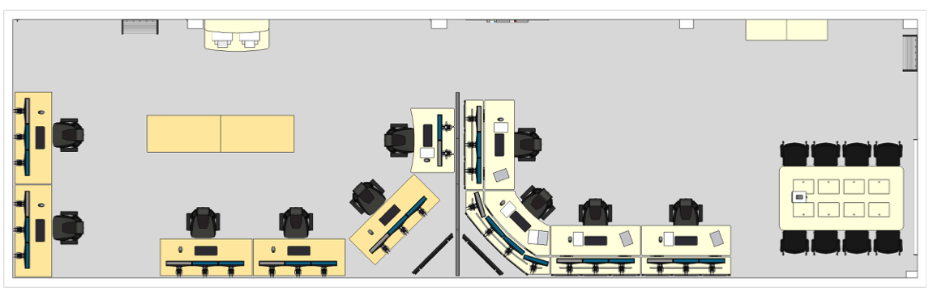
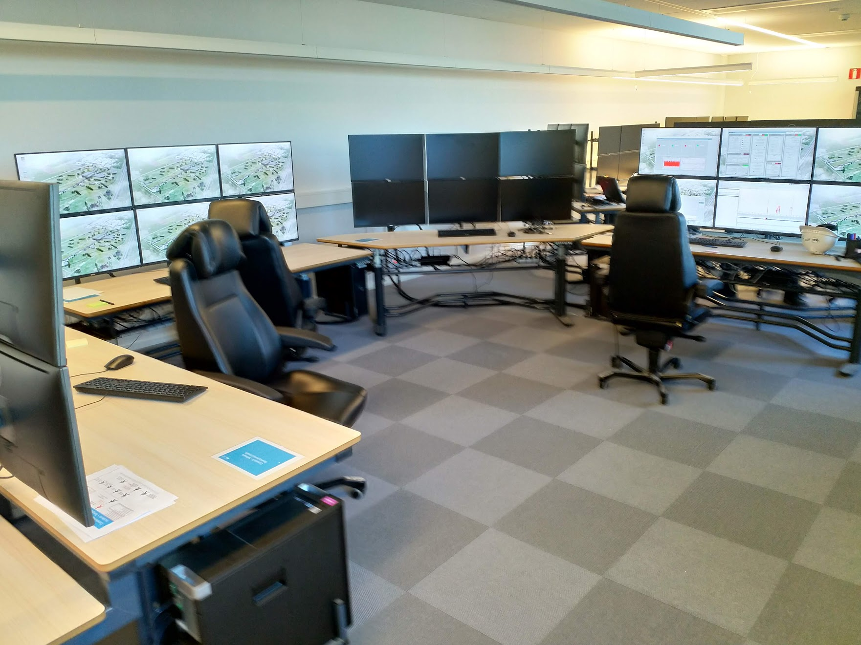
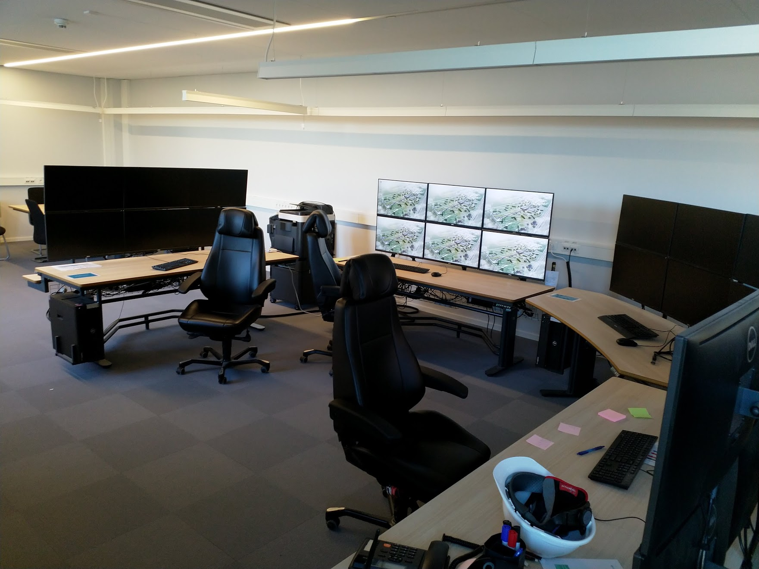
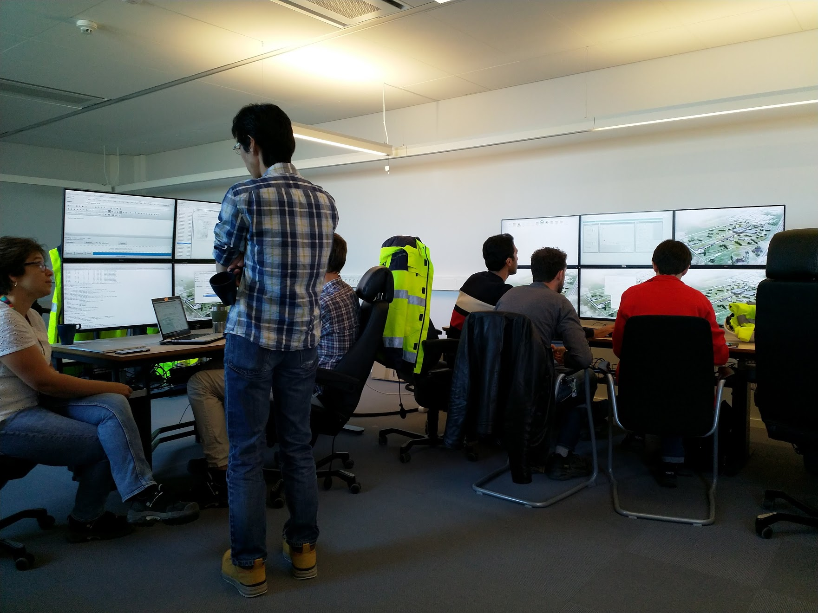
Local Control Room
Beam Commissioning
Shift Leader
Cryo+Test

Slide 13
Shift Organization during initial BC
1 shift per day 8h30 to 16h30
Only working days
1 Shift Leader, 1 Study Leader, as many experts as required
Shift Leader always present (either in the LCR or FB) with beam
We are in construction, installation and commissioning simultaneously
We follow the rules for construction site

Slide 14
Shift Leaders in the initial run
3 AO, plus 1 BP, and 2 from Linac Group
Required by our License
Training defined in ESS-0290889
  Coordinated by AO
  List of documentation to read
  Seminars and presentation
  Hand on training for some systems
  Final certification by doing a shift with Marc during Operation
  We will use this training to prepare the operators one in the future

Slide 15
Daily meeting
8:30 am daily meetings in control room where the plan of the day (commissioning) is announced and installation coordinators are present to comment/inform about possible conflicting activities
Standing meeting, chaired by the Shift Leader

Slide 16
PSS0
Safe box in the LCR for the PSS0 box key
  To be replaced by a card controlled safe box, including logging of
The Shift Leader has the responsibility to operate the PSS0, and can delegate the actual act of the key exchange to another trained Shift Leader
All changes in the state of the PSS should be logged in the logbook

Slide 17
Tools used
Logbook
CSS
Archiver
Jira
Confluence
Jupyter
OpenXAL

Slide 18
Logbook
Guidelines described in ESS-0146509
Temporary solution using the PSI Midas logbook, until the permanent olog (or other) solution is deploy
All entries and data will be moved to the new system
Several logbooks instances, with one devoted to Operations
Thread for every shift, with unique shift ID
In the technical network, accessible from the offices, and using the VPN from outside

Slide 19
Control System Studio
Main tool to build control system applications
  Collaboration between SNS, FRIB, BNL, DESY, ITER and ESS
  Eclipse based
Display Builder selected to create the OPIs
Access to the archiver
Save/restore
BEAST (Alarm handler)

Slide 20
JIRA
Sometimes is difficult to know to which jira project to assign a problem
New jira project to track issues concerning operations during BC
AO will forward the issues to the correct project inside ESS if it can not be fixed by AO

Slide 21
Jupyter and OpenXAL
Jupyter notebooks for python scripts
OpenXAL java applications for Beam Physics scripts
PV status viewer web server: monitoring of PVs

Slide 22
Main problems during initial run
Issues with old BOY OPIs with some version of CSS
Slow approval of news OPIs
No Alarm limits in any (except one) EPICS pvs
Archiver was not configured
  Problems with archiving big waveforms
  Rate and limits not defined
  What to archive?
PVs names

Slide 23
Future plans
Hiring of operators
  Following ESS rules
  Plans: 2 dedicated Operators/Shift Leaders early next year
Update of the training
  Discussions with Fermilab to use a similar approach to them
  More oriented to operators

Slide 24
Some examples

Slide 26
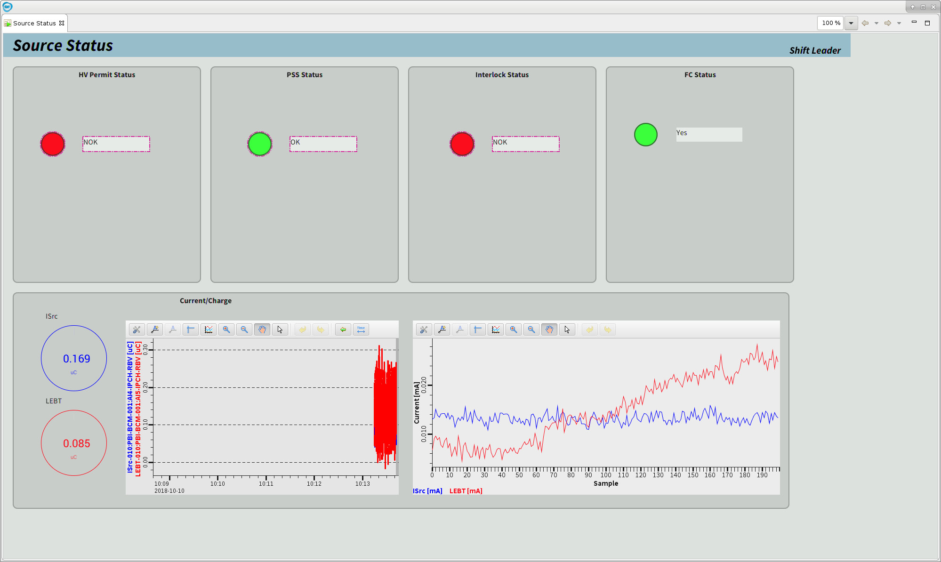
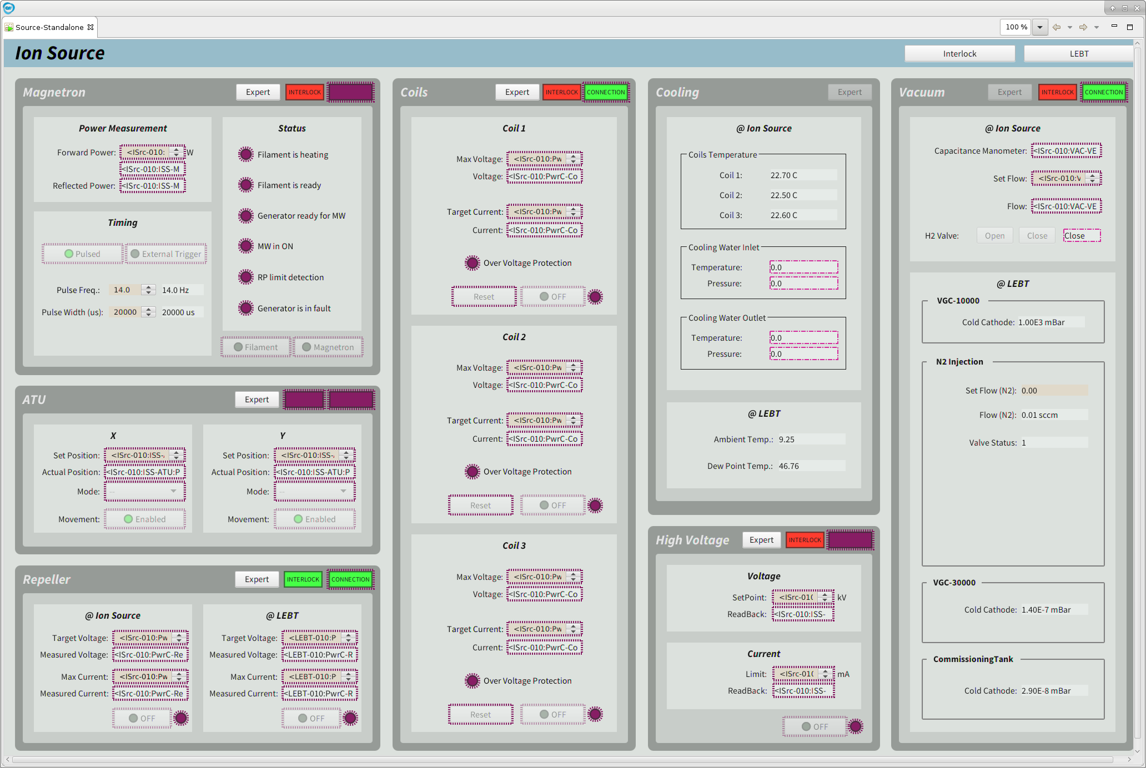
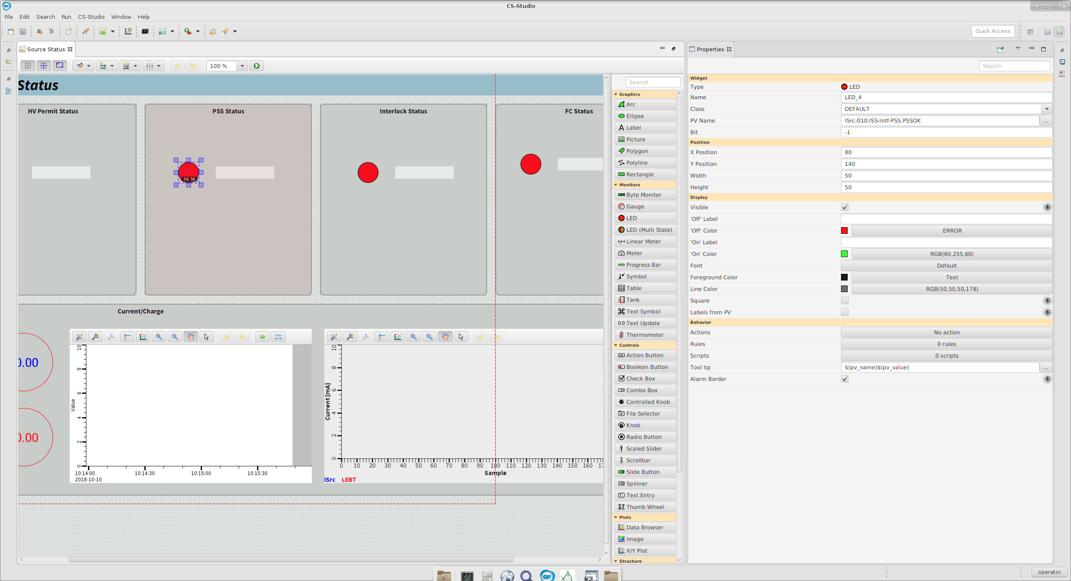
Some OPIs

Slide 27
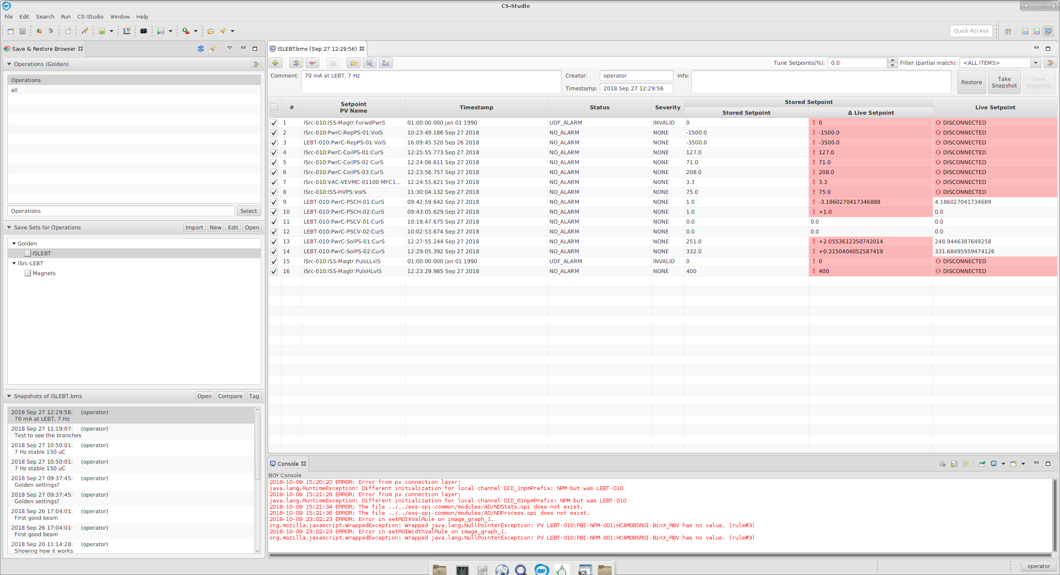
Save/Restore

Slide 28
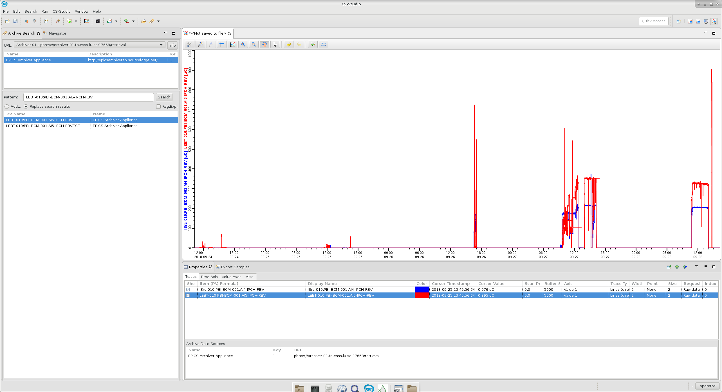
Archiver

Slide 29
Jupyter

Slide 30
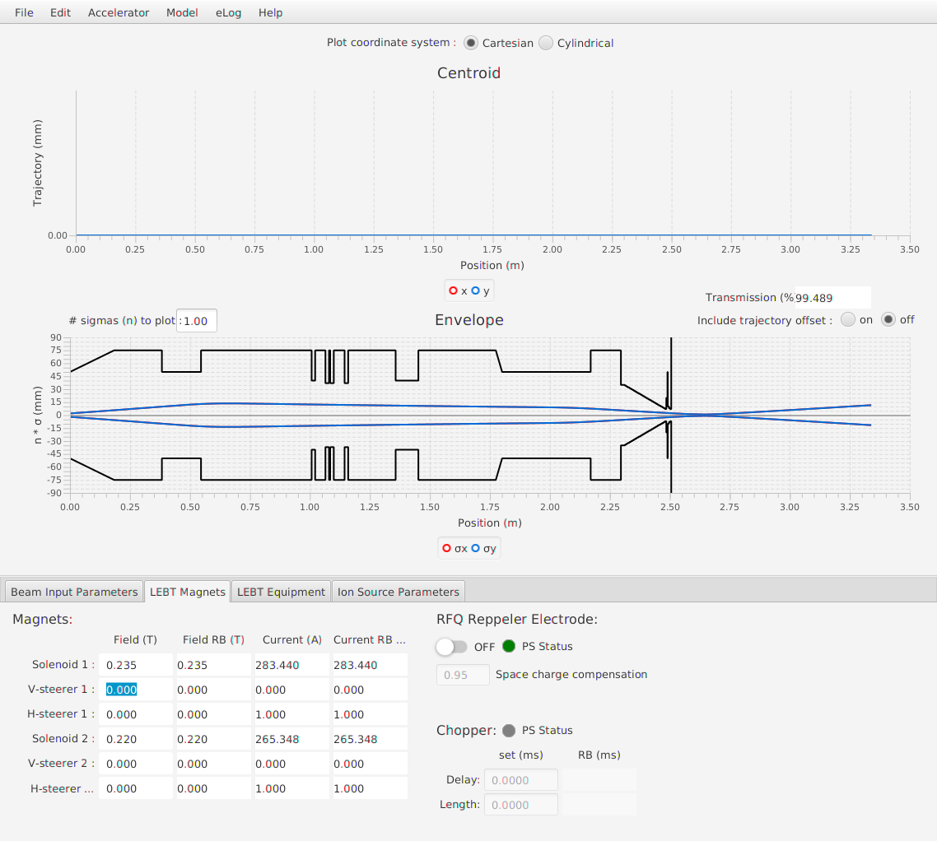
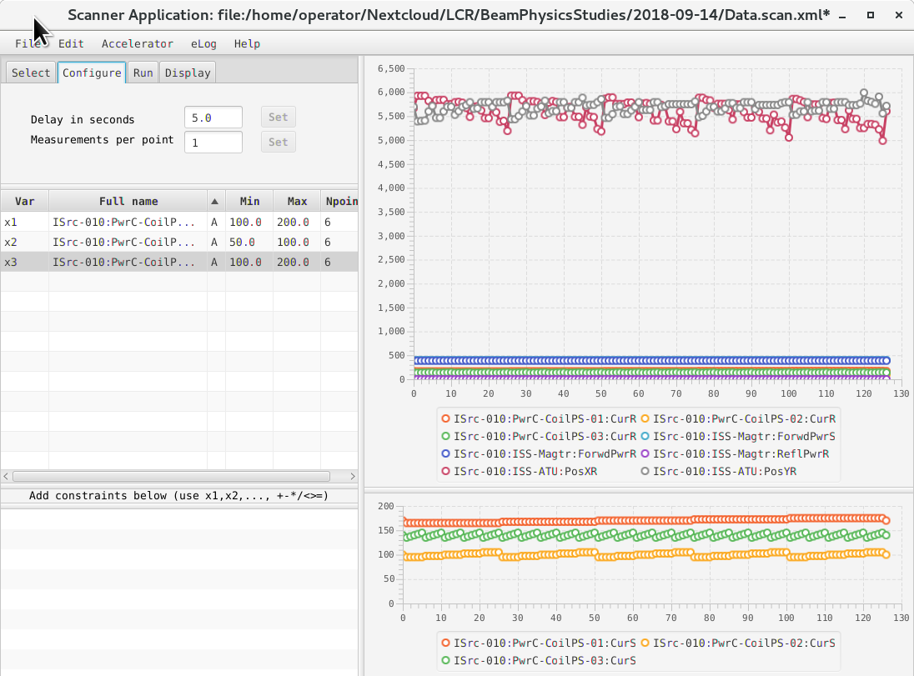
OpenXAL

Slide 31
PV Status Monitor

