Slide 1
Roles and responsibilities for Testing and Commissioning at AD
Mats Lindroos
www.europeanspallationsource.se
October 10, 2018

Slide 2
A few highlights
Changes to IK and installation organization at AD
  AD installation coordinator: Peo Gustavsson
  AD In-Kind manager: Håkan Danared (support from Ebbe Malmstedt)
Proposal to recruit a Head of Testing and Commissioning for Accelerator and ICS

Slide 3
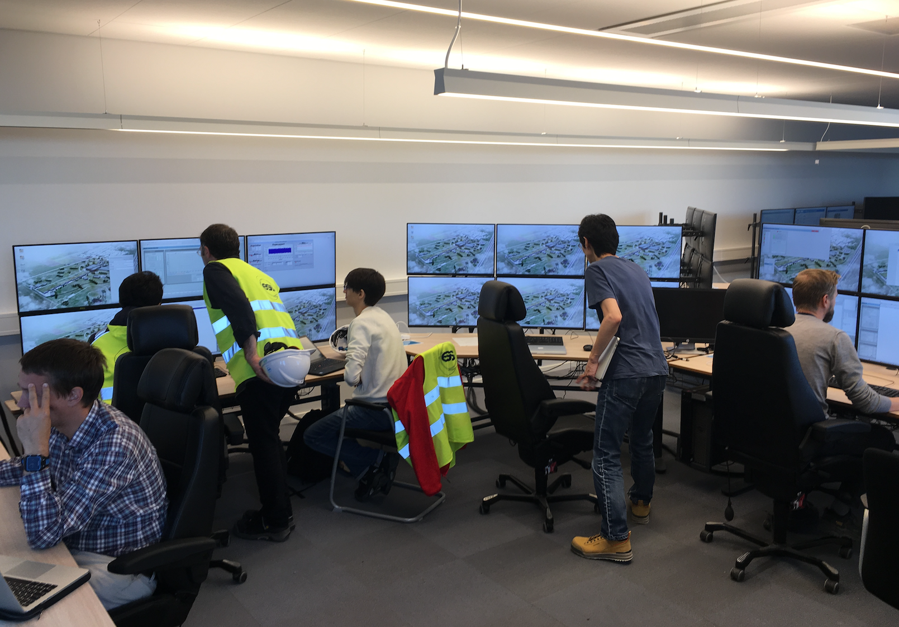
Operation with day shift has started

Slide 4
Accelerator Systems (sub-) Project (ACCSYS) – organization
WBS/WP# | TITLE | LEADER | EXT. WP | DEPUTY WP LEADER for EXTERNAL WPS | PCC
11 11.01 | ACCSYS MANAGEMENT | M. LINDROOS J.G. WEISEND II | NO |  | 110100001 & 110100002
11.02 | ACCELERATOR PHYSICS | M. ESHRAQI | NO |  | 110200001
11.03 | NORMAL CONDUCTING FRONT END | S. GAMMINO | YES | E. SARGSYAN | 110300001
11.04 | SPOKE CRYOMODULES | G. OLRY | YES | C. DARVE | 110400001
11.05 | ELLIPTICAL CRYOMODULES | P. BOSLAND | YES | C. DARVE | 110500001
11.06 | BEAM DELIVERY SYSTEMS | S. MØLLER | YES | I. ALONSO | 110600001
11.07 | BEAM DIAGNOSTICS | T. SHEA | MIX |  | 110700001
11.08 | RF SYSTEMS | M. JENSEN | MIX |  | 110800001
11.09 | Not used
11.10 | TEST STANDS | W. HEES | MIX |  | 111000001
11.11 | CRYOGENICS | P. ARNOLD | MIX |  | 111100001
11.12 | VACUUM | M. JUNI-FERRERA | MIX |  | 111200001
11.13 | SAFETY & OPS | L. TCHELIDZE | NO |  | 111300001
11.14 | LINAC | H. DANARED | NO |  | 111400001
11.15 | ELECTRICAL SUPPORT | F. JENSEN | NO |  | 111500001
11.16 | COOLING SUPPORT | A. LUNDMARK | NO |  | 111600001
11.17 | POWER CONVERTERS | C. MARTINS | MIX |  | 111700001
11.18 | ENGINEERING RESOURCES | obsolete | NO |  | 119900001
11.19 | SUPERCONDUCTING RF | P. PIERINI | NO
11.98 | GENERAL INSTALLATION SUPPORT | PO GUSTAFSSON | NO |  | 119800001
11.99 | INSTALLATION | PO GUSTAFSSON | NO |  | -
Accelerator Collaboration Board (ACB) – meets twice annually:
Reps from each IKC & collaborating institute (one elected as chair)
ESS Technical Director
ACCSYS Sub-Project leader
Accelerator Technical Board (ATB) – meets quarterly:
AccMT & all WP leaders and deputies
Reps of all contracted institutes if not already a WP leader
ESS Machine Management Team members invited
Accelerator (Project) Management Team (AccMT) – meets weekly:
Mats Lindroos: Project Leader
Caroline Prabert: Administration
John Weisend II: Dep. Proj Leader (WP 1) & STS (WPs 11,12,15,16)
Lena Gunnarsson & Magnus Israelsson: Project Planners
Diana Bergenholtz: Controller
Lali Tchelidze: Section leader Operations, including radiation safety (WP13)
Peo Gustafsson: Installation coordinator and infrastructure sub-project leader (WP 98)
Håkan Danared: Linac systems leader (WPs 3,4,5,6,14) and IKC coordination manager
Andreas Jansson: Beam Physics, Diagnostics, Init ops planning mgr (WPs 2,7)
Anders Sunesson: RF power systems leader (WPs 8,17)
Note: Section Leaders (AD line) can be called to participate in AccMT meetings
IKC coordination, IKC liaisons & BrightNESS IKC ‘field coordination’:
Håkan Danared: IKC coord mgr Ebbe Malmstedt (C): assists overall IKC coord and risk manager at AD
Georg Hulla: for WP 3 IKC Felix Schlander: for WP 4 & WP 5
Frank Hellström (C): for WP 3 IKC Nuno Elias: for WP 4 & WP 5 IKC
Fredrik Håkansson (C): for WP 4 & 5

Slide 5





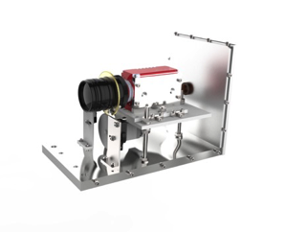
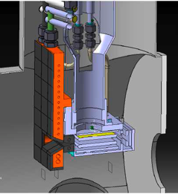
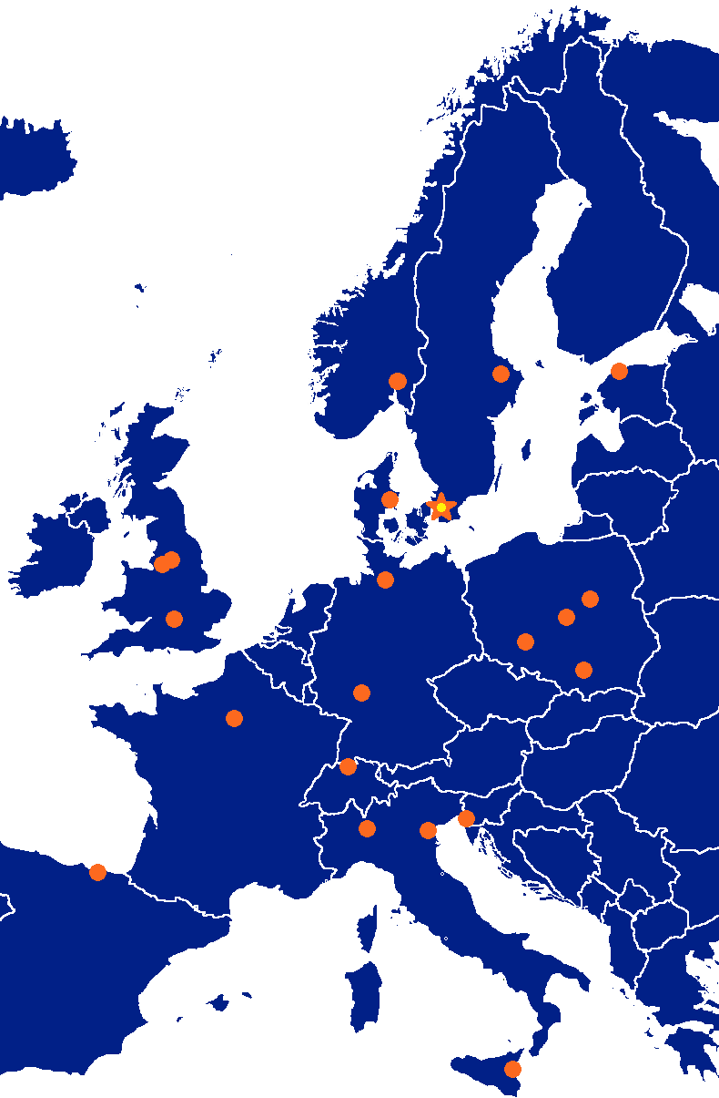





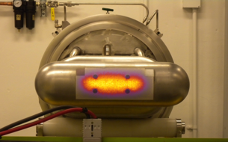

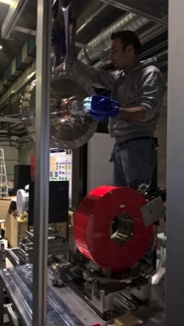

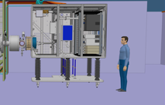

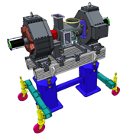




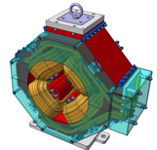


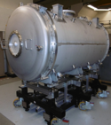

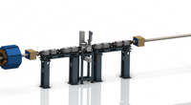













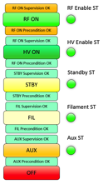


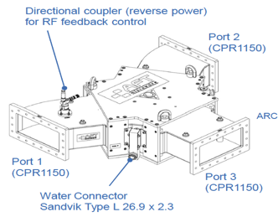
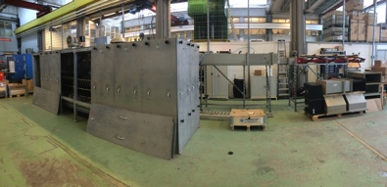
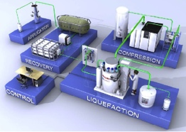


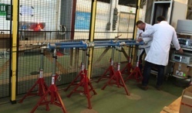





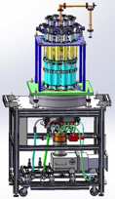
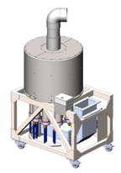

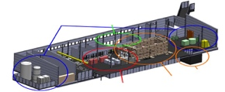
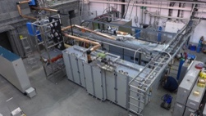
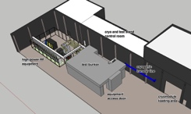
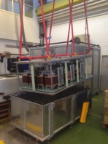
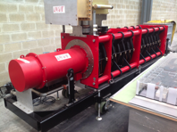
Accelerator Collaboration - Accelerator
352.21 MHz
704.42 MHz
2.4 m
4.6 m
3.8 m
39 m
56 m
77 m
179 m
Target
Source
LEBT
RFQ
MEBT
DTL
Spokes
Medium β
High β
HEBT & Contingency
75 keV
3.6 MeV
90 MeV
216 MeV
571 MeV
2000 MeV
5

Slide 6
Testing and commissioning
Testing and commissioning at the ESS accelerator project refers to testing of installed equipments without beam and commissioning of equipment with beam
  For cryoplants at ESS we have used the term commissioning for the start of helium production (no beam)
The testing phase starts when the equipments is installed at ESS in the position it will be used for accelerator operation. This is for many commercial systems associated with a Site Acceptance Test and the associated Test Readiness Review.
The beam commissioning phase starts after the Safety readiness reviews and the hand over of equipment from system owners to operation

Slide 7
AD organization, focus on planning
Mats Lindroos – Head of Division
Håkan Danared – Deputy Head of Division
John Weisend II – Deputy (sub) Project Leader
Administration
Caroline Prabert
Inga Tejedor
WeiYing Li
Planning and Project Control
Lena Gunnarsson
Magnus Israelsson
Karen Jonsdottir (Sept-Oct)
Diana Bergenholtz
Ciprian Plostinar
Installation
Peo Gustafsson
Olle Lagerblad
Dennis de Wit (C)
Carl-Johan Hårdh (C)
Mats Pålsson (C)
Pontus Jönsson (C)
Jenny Cerne (C)
Rasmus Johansson (C)
Nicolas Eke (C)
Dennis Schön (C)
IKC Coordination
Håkan Danared
Ebbe Malmstedt (C)
Quality
Björn Rundcrantz (C) (from 1st Oct)
Beam Physics, Operations & Beam Diagnostics
Andreas Jansson - GL
Linac
Håkan Danared- GL
Cecilia Maiano
Iñigo Alonso
Radio Frequency Systems
Anders Sunesson- GL
Specialized Technical Services
John Weisend II – GL
Gunilla Jacobsson
Accelerator Installation and infratsructure group
Vacant – GL

Slide 8
Organisation of Testing and Commissioning at AD and ICS
Sub project leads, AD and ICS
Testing and Commissioning manager
T & S planning/coordination Testing
T & S planning/coordination Commissioning
System owner 1
System owner 2
System owner 3
System owner 4
System owner N
Close coordination with ESS operations manager, installation managers and Operation section leader is important

Slide 9
Proposal for Head of Testing and Commissioning role at AD and ICS
This new role is driven by the need to more tightly coordinate activities between divisions, as well as between testing and commissioning phase, and eventual transition to initial operation.
Responsibility:
  Coordinate all testing and commissioning activities for acceleratort and related ICS projects
    Based on the input from the installation, testing and commissioning planners from the two divisions
    Make cross-cutting judgements calls when needed
    Ensure the overall integrity of the testing and commissioning plan
  Prepares and follow up for AD and ICS for Safety Readiness Reviews (SRRs)
Authority:
  To set priorities, change the testing and commissioning schedule and decide on start and stop of different system activities.
  Approve system readiness for transition from one phase to another, e.g. from testing to beam commissioning and beam commissioning to operation
Reports to:
  Head of accelerator and Head of ICS
Assure strong links to Operations manager, operation section leader, installation manager, ESH and other sub-projects

Slide 10
Reporting and resources
The testing and commissioning manager will belong to the accelerator divisions line organisation
The testing and commissioning manager will coordinate with ICS deputy project manager and relevant ICS work package managers
ICS and AD will handle resource allocation through the normal request/allocation process
  Additional coordination is needed inside ICS which will be provided by the deputy project manager

Slide 11
Planning
All high level milestones and activities in P6
Detailed planning in JIRA with locked P6 milestones
Reconciliation with P6 of JIRA planning monthly

Slide 12
Technical and Scientific planning/coordination for Testing and Commissioning
Two existing staff members at Accelerator Division are already doing this work
They are responsible for planning/coordination of hardware testing and beam commissioning, respectively.
They are coordinating activities within their specific area, and are working within the schedule boundaries set by the overall project plan.

Slide 13
System owners and operation section leader
Each system installed has an owner who is responsible for the actual testing and commissioning activities of that subsystem.
Control of equipment to be commissioned with beam is handed over to the section leader for operations at AD before the SRR. Following this, work on such equipment has to be coordinated with operations via the control room.
The section leader for operation at AD is in control *⁾ of the all equipment that is in operation, and runs a daily operations meeting where the plan of the day for (system testing and) commissioning is discussed and agreed. Installation is also represented at this meeting. The control room shift leader is also in charge of operating the Personnel Safety System.
The plan of the week (and longer term) is coordinated with installation, and presented at a weekly joint installation/testing/commissioning meeting.
*⁾ Equipment specialists remain owners of the equipment and handles e.g. maintenance actions, modifications and upgrades of the equipment when the operational schedule permits

Slide 14
Critical Path – September 2018

Slide 15
Near Critical Path
ISrc to Beam Dump (BOD)
26/4/2021
ISrc to DTL1
ISrc to DTL4
RBOT
11/11/2019
13/7/2020
9/8/2021
2018
2019
2020
2021
17/12/18 - 12/07/19
RFQ + DTL 1 RF System
27/05/19 - 31/01/20
Full NC Linac RF System
04/03/19 - 15/11/19
Elliptical CDS
19/08/19 - 15/11/19
SPK CDS
18/11/19 - 28/08/20
SPK CM
18/11/19 - 27/11/20
MBL CM
01/06/20 - 07/08/20
HBL CM
05/08/19 - 20/12/19
HEBT LWU
06/01/20 - 05/06/20
HBL LWU
08/06/20 - 04/09/20
A2T LWU
24/08/20 - 16/10/20
SPK LWU
19/10/20 - 19/02/21
MBL LWU
12/08/19 - 25/09/20
SPK RF Power Stations

Slide 16
ACC – Top 5 Risk Mitigation Status (data from Exonaut)
Value of cost risk = 13,59 M€ (13,59 M€ last month)
Latest risk workshop: CEA & ESS WP4 & WP5, May 17, 2018 ; Next workshop: TBD
Risk ID | Event |  | Potential Impact C – Cost S – Schedule Q – Quality and Function | Proba-bility | Mitigation Measures | Due Date
240 | Insufficient accelerator and ICS coordination |  | C: - S: 7-9 M Q: (1) Top lvl req. | 5 | Develop strategy On-going. Further follow up meeting/review is planned on the firmware framework | 180131 180131
63 | Installation complexity under-estimated |  | C: 945 S: 4-6 M Q: (3) Several req. | 3 | Implement new organization, defining roles and resp. for best possible progress in the project Develop a detailed installation plan that optimizes installation within the limited time available Workshop performed and lessons leaned | 180315 180215 180116
242 | Lack of spares when needed |  | C: 3,3 M€ S: 7-9 M Q: - | 4 | Decision on SRF fascility Identify and quantify amount per system, find funding | - TBD
241 | CE marking has to be implemented |  | C: 3,2 M€ S: 0-3 M Q: (3) Several req. | 5 | Define ESS ambition level Inform and discuss with all institutions On-going. Discuss, agree and create CR | 180315 171215 180315
296 | Lack of staff to support, maintain and consolidate installed equipment due to delayed access to initial operations funds. |  | C: 3.1 M€ S: 4-6 M Q: (3) Several req. | 3 | Seek additional/timely funding to mitigate cost exposure Staff and competence planning for I.O. | 180501 180501
Mitigation actions performed since last report |  | Various treated risks identified and closed. Many treated some time ago, but not registered as such until now. WP2 risks revised. Risk review ongoing with all WP leaders. R295. Higher cost estimated for new logistic and transport organizational structure. Level to be determined and inserted. CEA-ESS Transferred and Shared Risks are analized with the respective WP.

Slide 17
Summary
We are proposing a new role as Testing and commissioning manager for the Accelerator and related ICS projects
This new role is driven by the need to more tightly coordinate activities between divisions, as well as between testing and commissioning

