Slide 1
TAC – 181018
Infrastructure Project
AD component installation
Peo Gustavsson

Slide 2
Outline
Infra structure Project
AD installation Project (Infrastructure and Component installation)
Harmonized ways of working at ESS
  Important roles
  The Installation Readiness Review (IRR)
  The Installation Binder ”Practical Use”
  The RAMS ”Practical Use”
  ESS Work Orders ”Mandatory for all installation work”
  ESS NCR process “Non conformity report”

Slide 3
Infra structure Project

Slide 4
Introduction ”Infrastructure project”
The Installation started with the Front End Building (FEB) installation, a lesson learned (LL) on the work was performed.
The outcome of the LL gave the need to improve:
  design and installation documents
  material definition and management
  control and follow-up (design and project)
  management involvement and support
  better defined roles, responsibilities and processes
The Infrastructure project was initiated to address the outcome of the LL

Slide 5
Infrastructure “Project organisation”
PM
Peo Gustavsson
PA/PC/Admin.
Ciprian/Fredrik
Design
Anton L
Installation
Olle L
Testing (SAT1)
Inigo A
QA/QC
Björn R
Electrical DD
High V / Low V
Jonas W
Sub contractors
EL
Sub contractors
Process/Pipe/Mech
CM/DM/Change mgt
Patrik W
Civil
CF Pre Ops
Sub contractors
Civil
Electrical
TBD
Cabel DB
Design, installation and test follow up
Process/Pipe/Mech DD
Piero V
Process
Anton L
OSH
Nic E
System Design / Owner
Frithiof J
System Design / Owner
Anton L

Slide 6
Detailed design tasks
Electric
Process
Cable Database
    Cables
    Connectors
Raceways & Cable routing
Termination/Connectors
Power distribution
Grounding
Rack installation
Spatial integration & Coordination
Pipe and pipe support
  Tunnel
  Gallery
Structural analysis
Component selection
Spatial integration & Coordination

Slide 7
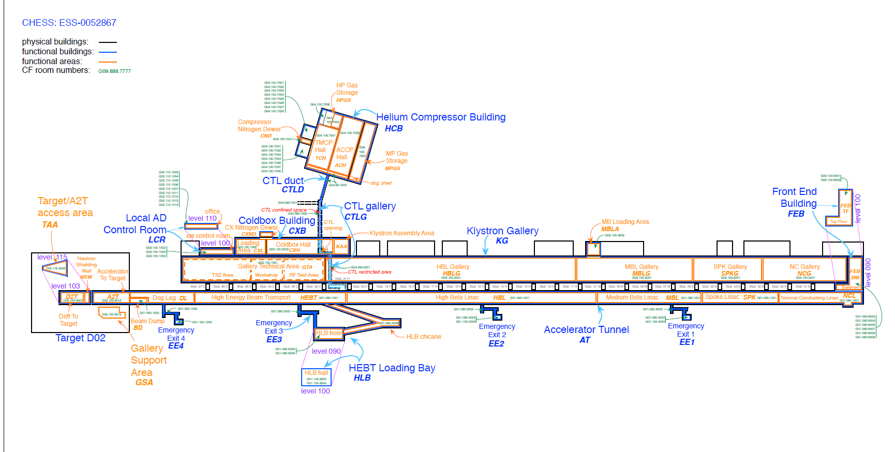

Slide 8
Take home message
The strategy for infrastructure installation is;
  Use Skanska org for installation of Mech. Infra structure
  Project Baseline design-hand over to Detail design NCF/ SPOKE, completed
  Detail design trough ext contractor - for Peiping and raceways, started
  The work is done in a phased approach to support AD component installation
  The installation will be done in bigger packages, eg. NCF/ SPOKE
STUB pipe material and Tooling order placed-Inst start week 40/41
Next steeps
  Cabling pulling & termination design RFQ/MEBT/DTL
  Baseline M-beta and H-beta Peiping and raceways

Slide 9
What to do 2019
“Design and installation strategy”
Design for G01 & G02;
  Cable trays and pipes
  Cable routing and termination (NCL and SPOK)
  All grounding design (components not included)
  Power distribution
Installation
All cable trays and pipes in G02
Cable pulling and termination NCL and SPOK
  RFQ/MEBT/DTL
  SPOK

Slide 10
FEB (Front End Building) phase 1 and 2
Phase 1
  Cable trays, Cabinets and cooling pipes
Phase 2
  Remaining pipe work
  Installation Cooling skids
  Cables and connectors
  PDUs (power distribution units)
Pipe-work went according to plan
challenges
  Availability of specified cables, Changes to cables and connectors
  Design not fully finalized, reviews of documents not formalized, late changes to design
  Late delivery of PDUs & incomplete (rebuilt on site)
The inspection documentation handed of 1 week before the SRR (Safety Readiness Review)

Slide 11
”FEB and Tunnel” installations completed today
Process
  All pipes installed
    2000 m
    473 welds
    47 valves
  2 Cooling skid under construction (RFQ & Ion Source)
    Installed
  Instrument air in the tunnel installed and tested
  28/28 pressure tests completed
Electrical
  3000 m cable trays
  5000 m cables pulled
  300 cables (42 types)
  600 cable terminations/ connectors

Slide 12
Infrastructure project fact and figures ”look ahead”
Process
  10 496 meters of pipes
  App. 6000 welds
  App. 5000 valves
  App. 300 large supports
  App. 1000 small supports
Electrical
  > 10 000 m cable trays
  > 900 000 metre cable
  24 902 cable in the DB
  49 804 cable term ends
  > 200 JB
  204 cable types
  40 power distribution busbars
  6 UPS-units with associated sub-distribution
  800 control racks and 100-120 cooling units to be installed
  120 grounding bus bars, 3000m of grounding cables

Slide 13
AD installation Project
Infrastructure and Component installation

Slide 14
Take home message
AD will change the set up for Installation;
  Current approach - Component installation and Infrastructure project separated
AD Will merge Infra structure project with component installation to one installation project
Main purposes for the change is;
  Simplify – Reduce the current amount of interfaces
  Clarify – Responsibilities, one AD installation coordinator, uniform implementation of processes
  Clarify – Responsibilities for planning and reporting (Own org and IK part.)
  Use of resources – Improve and coordinate use of common resources
  Clarify and align Infra project installation planning with component installation
Budget allocation, Infra project budget (WP 15/16 +CR) and WP 98

Slide 15
Introduction “Project changes over time”
The project consist of mainly 2 high level phases
Engineering phase
Construction phase
Design and planning
AD Project
WP x -------------------------- WP z
Installation & Commissioning
AD Project
Installation Commissioning
Mainly Installation and commissioning focus
Components matrixed for installation and testing
Mainly component focus
Installation & Commissioning matrixed

Slide 16
Implementation
“Daily stand up” meetings in the buildings
“Daily” meeting in “installation room”
  Principal agenda
    Plan/Comply or explain deviation/Issues (meetings outside)
Weekly Meetings
  Installation detailed working and follow up meetings (weekly)
    Detail planning and organization of installation activities
    Service needs (eg. transportation, storage, tools, workshops)
    Installation binder
  Installation meeting “Information” (Friday)
    Share information
    General presentations
    Status updates
    Safety /quality aspects
    Issues solved/new

Slide 17
Harmonized ways of working at ESS

Slide 18
Introduction
ESS is implementing harmonized ”ways of working”
  Installation Readiness Review (IRR)
  Installation binder (IB)
  The work order process (WO)
  NCR (non conformity process)
Services and support
  Information can be found at ESS Installation web page
https://confluence.esss.lu.se/category/essinst

Slide 19
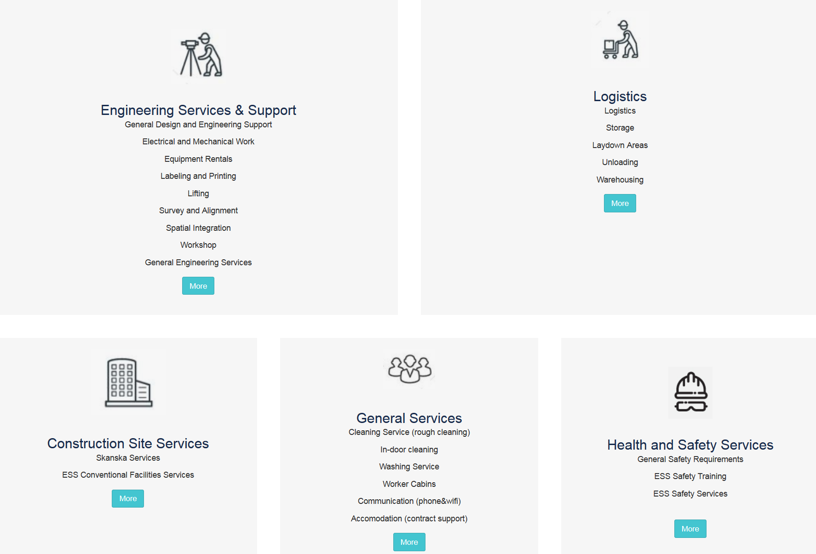
ESS Installation web page

Slide 20
Interface – In Kind – ESS WP to
– Installation Package lead
AD installation coordinator
IK partner
Installation package lead
AD Work package lead
AD Liaison Officers
Responsible for;
Installation binder
IRR
Work order
NCR

Slide 21
The Installation Binder (IB)

Slide 22
The Installation binder (IB)

Slide 23
The Installation Readiness Review (IRR)

Slide 24
Purpose IRR Documentation
The purpose with Installation Readiness Review is to;
review if the necessary preparations have been performed
and the supporting documentation are in place for the upcoming installation.
Good shape – Proceed
Minor things to fix before start – Keep start date
Major things to fix before start – Reschedule installation
Part of package not ready – Split package

Slide 25
RAMS
Practical Use

Slide 26
The RAMS
What does RAMS stand for?
Risk Assessment Method Statement
What’s the purpose with a RAMS?
Identify hazards and associated risks for an activity and determine if sufficient controls are in place (to reduce the risks to an acceptable level)
Who is responsible for preparing the RAMS?
Installation Package Lead for making sure it’s prepared.
What does a RAMS consist of?
The RAMS consists of two parts:
A method statement, i.e. a detailed break down/description of the work to be carried out and material to be used to perform this task
A risk assessment, i.e. identify the risks associated to the work steps detailed in the method statement.

Slide 27
ESS Work Orders
Mandatory for all installation work
www.europeanspallationsource.se
June 05, 2018

Slide 28
Introduction
The Work order (WO) control the release of work and work/ safety
  some aspects are ;
    No work shall be executed unless it is planed and organized
    Synchronize the work with other parallel work (same area)
    To control plant conditions and equipment
    To plan and organize delimitations and tag outs.
    “becomes more and more important when entering in to the test and commissioning phase!”
The work order will mainly state:
    Installation activity start and end time.
    Summary of the activity.
    Documents related to this activity. (RAMS)
    Any need for delimitations/tag outs

Slide 29
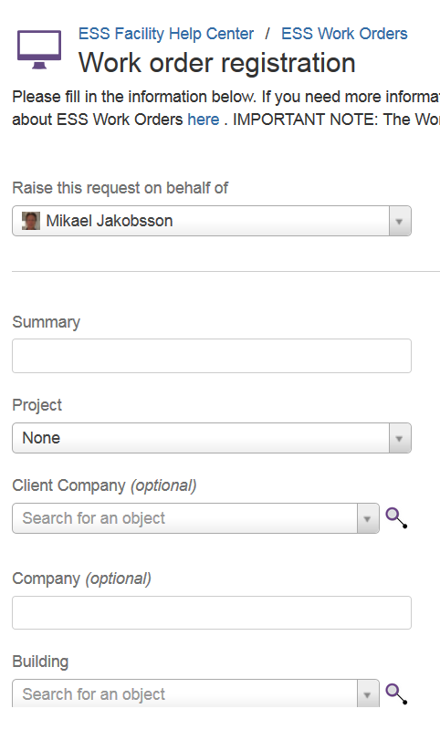
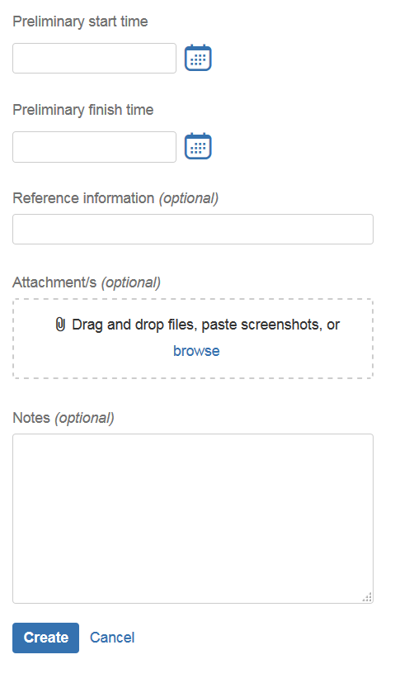
Registering WOs
Minor work
6 fields + RAMS
(attached)
Normal work
6 fields + link to
installation Binder

Slide 30
ESS NCR Process
Mandatory for all installation work
www.europeanspallationsource.se
June 05, 2018

Slide 31
Installation Non-Conformity Reports
The purpose of Non-Conformity Reports (NCR) is to have a structured way to handle deviations during installation.
The routine should support a short turnaround time that prevents unnecessary waiting time at site.
The routine should also make sure that we in an organized and controlled way can follow the deviation and to final approval and closure.

Slide 32
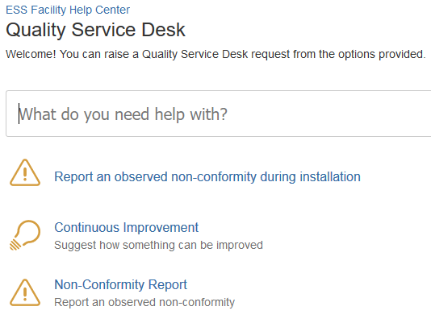
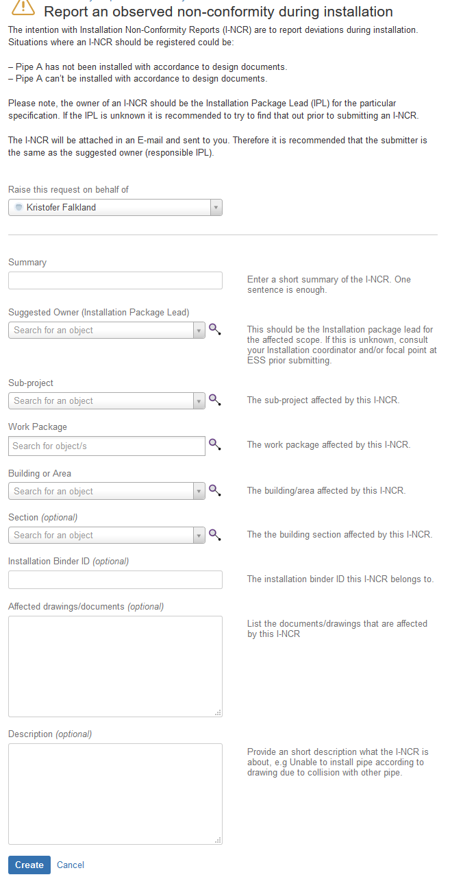
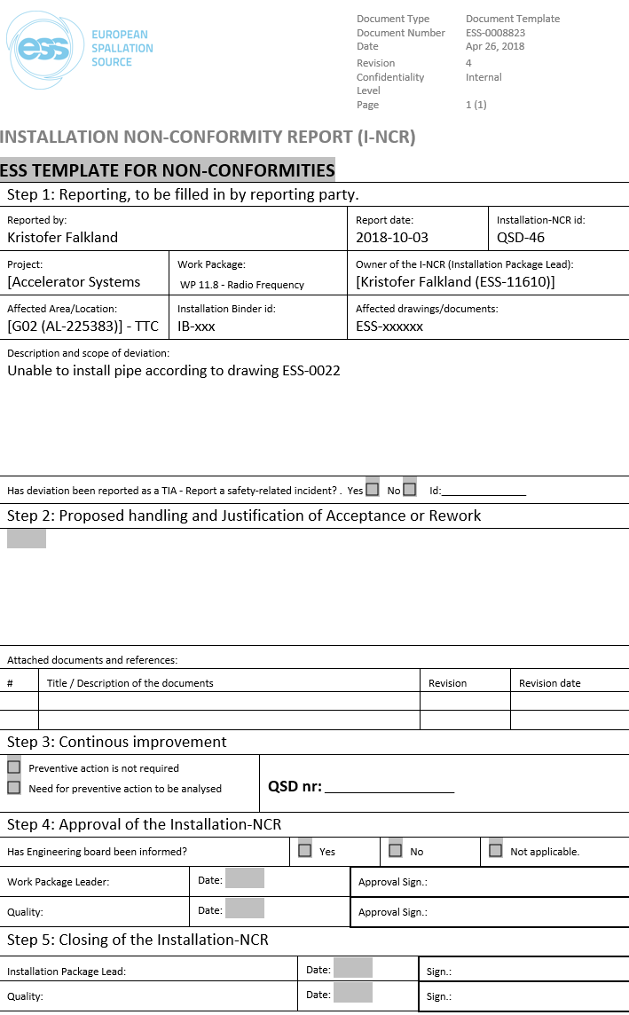
Installation Non-Conformity Reports
Template and form
Form for I-NCR
Template for I-NCR

Slide 33
Back up slides

