Slide 1
Accelerator Testing Planning
aTAC#18
Iñigo Alonso, Lead Engineer, Linac Group
www.europeanspallationsource.se
October 18, 2018

Slide 2

Outline
Strategy
Planning
Status
Lessons (being) learned
Notes:
I am responsible for planning/coordination of hardware testing, by coordinating activities in that area, and working within the schedule boundaries set by the overall project plan.

Slide 3
Strategy
Manufacturing
Installation
Commissioning
Operations
Perform FAT
Perform Installation
Test & Inspect
Perform SAT
Perform System Tests
Perform Licensing
Factory Acceptance Tests
Installation Inspections
Site Acceptance Tests
Verification & Validation Tests
IRR
TRR
SAR
ORR
SRR
The main purpose of the testing activities is to verify that the systems and components meet their requirements and operational goals, i.e. they are verification and validation activities.
Notes:
Fitting into the bigger picture (Installation, Testing and Commissioning Plan)
For more details on the high level reviews, see the High Level Readiness talk by John Weisend II
Installation Readiness Review (IRR)
Examines the final technical design, emphasising on interfaces between components, subsystems, controls integration, plans, staff, and tooling required for the installation work itself.
Test Readiness Review (TRR)
Ensures that the product, its test equipment, support personnel, and test procedures are ready for the verification activities.
System Acceptance Review (SAR)
Ensures that all requirements are fulfilled by: examining the facility, end products, documentation, test data as well as analysis supporting the verification activities.
Operational Readiness Review (ORR)
Ensures that facility, personnel, and procedures have reached the required maturity for hand-over to operations phase.

Slide 4

Strategy: Pragmatic approach
Centralize coordination to get some consistency, but give teams agency to use the appropriate practices for themselves.
  We try to minimize disruptions to ongoing work.
It is better to adopt a good-enough approach quickly than a perfect one eventually, but it will nonetheless require an effort from everybody to adopt it.
  It is challenging with the available resources.
Notes:
The experts on each system know best what and how needs to be tested.

Slide 5

Planning: Priorities
Realistic time allocation in the ITC plan
  Add and link detailed activities in JIRA
Milestones linked between JIRA & P6
Key dependencies
  Links to other Accelerator systems and other divisions (CF, ICS…)
  Correct Gateways/Reviews (TRR, SRR…)
Additional support
  Identify relevant Permits (internal, SSM…)
  Ensure Safety Measures (RAMS, WSCP…)
Notes:
Reconciliation with P6 of JIRA planning monthly

Slide 6

Status: Procedures
Use of ESS procedures to coordinate plans:
  Handbook for Engineering Management, ESS-0092276
    Graphical Workflow, ESS-0093443
  Procedure for Prepare for Installation and Installation, ESS-0102864
  Procedure for Test, Verification and Commissioning, ESS-0102865
  Handbook for System Verification, ESS-0117128
  Accelerator System Verification Plan, ESS-0005458

Slide 7
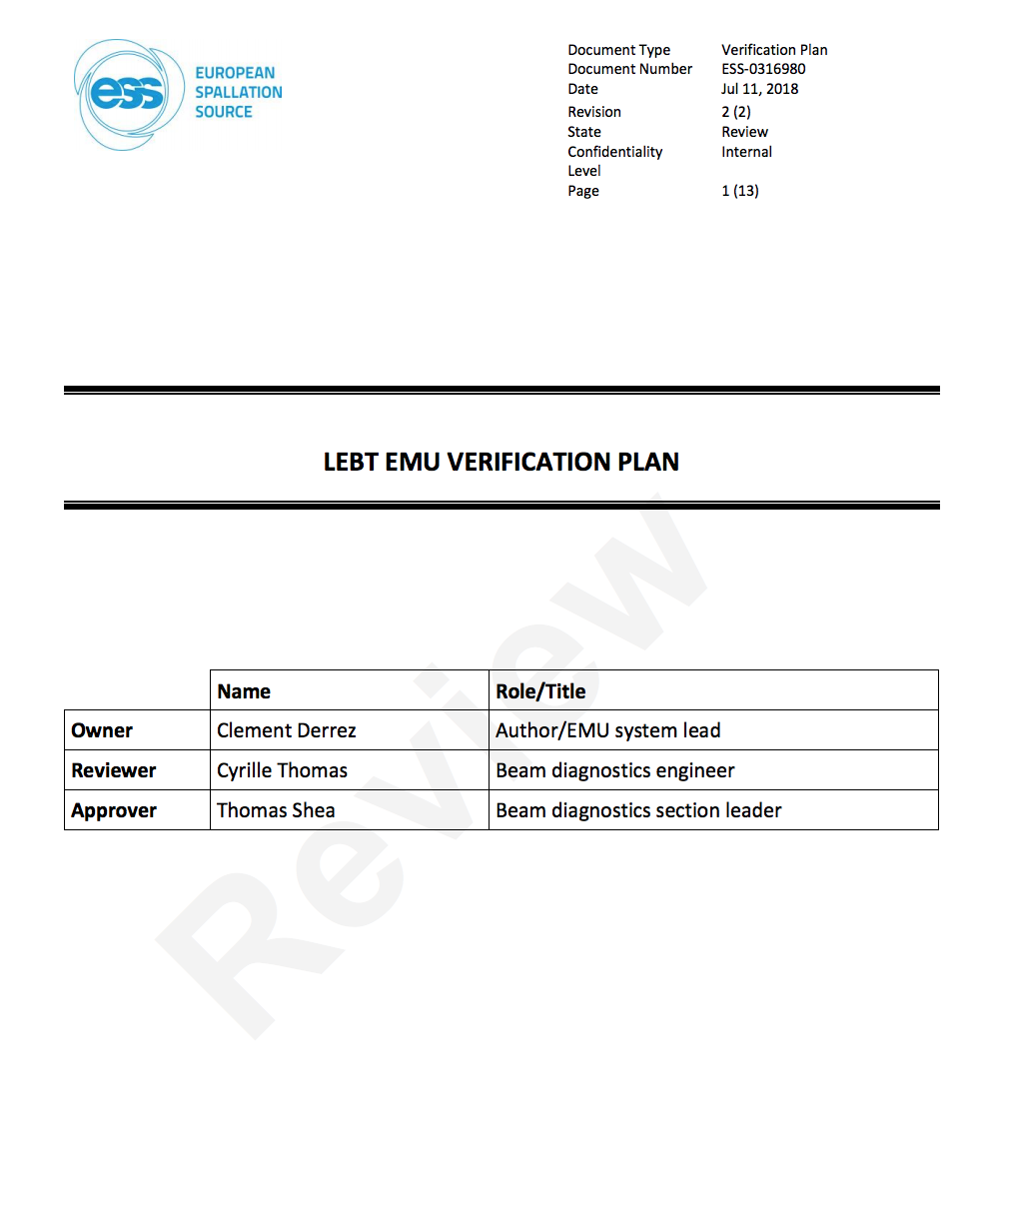
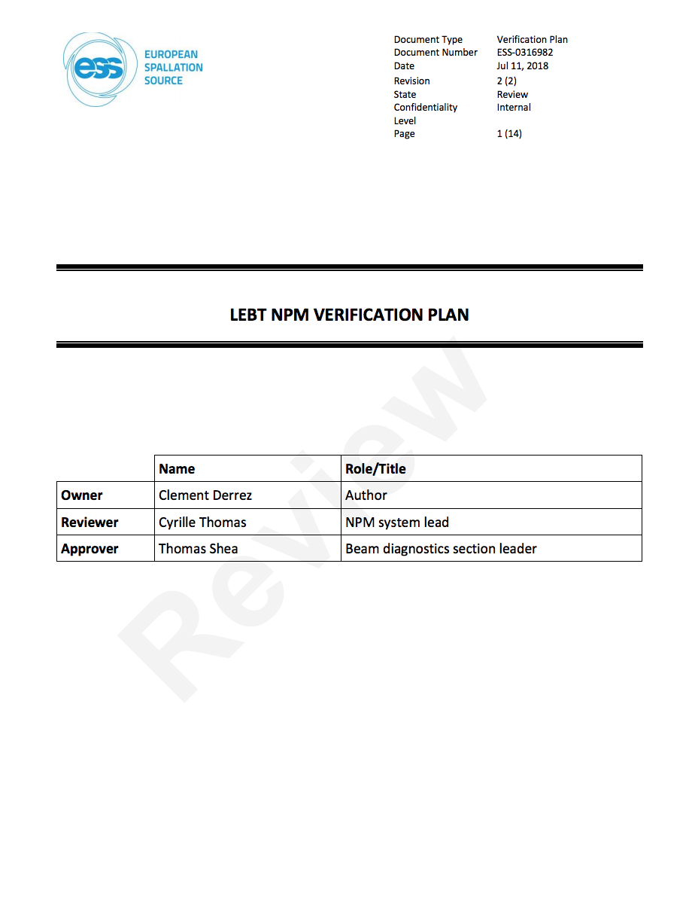
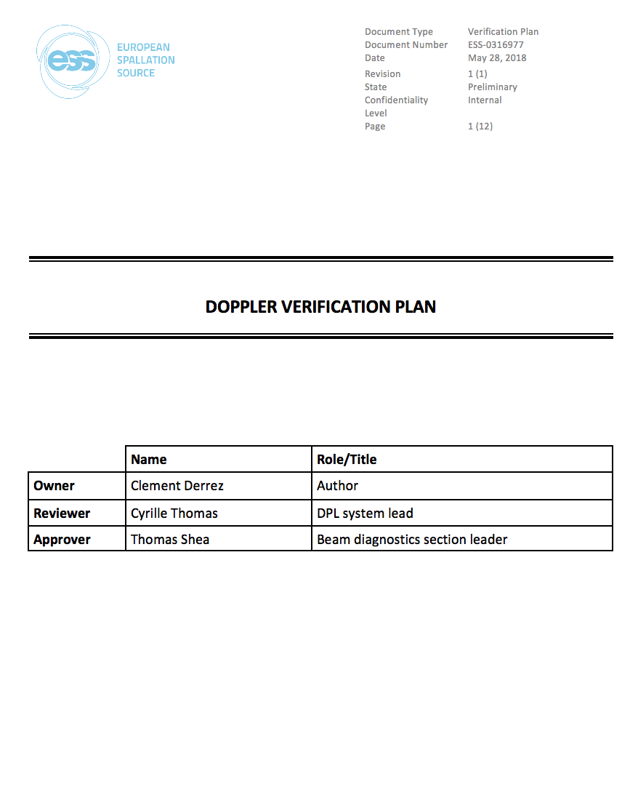
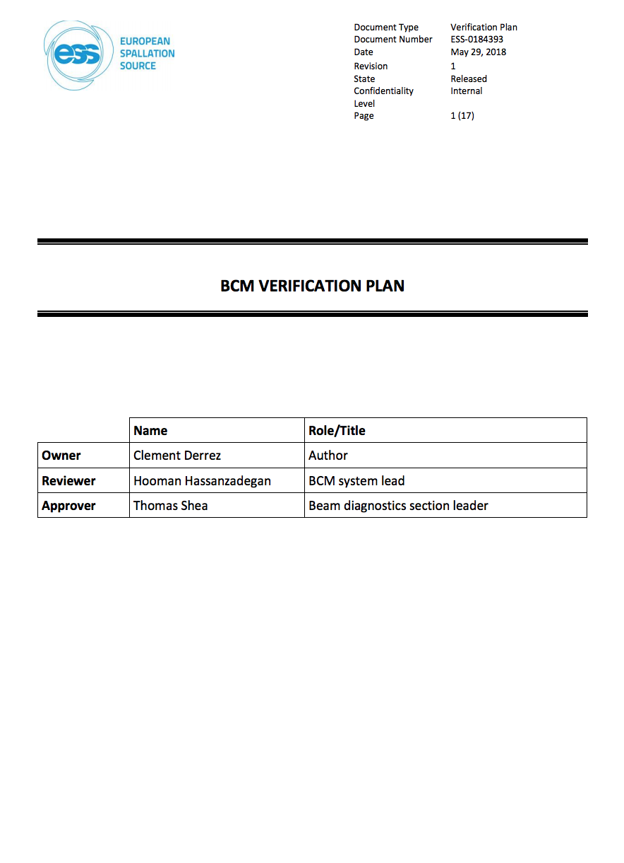
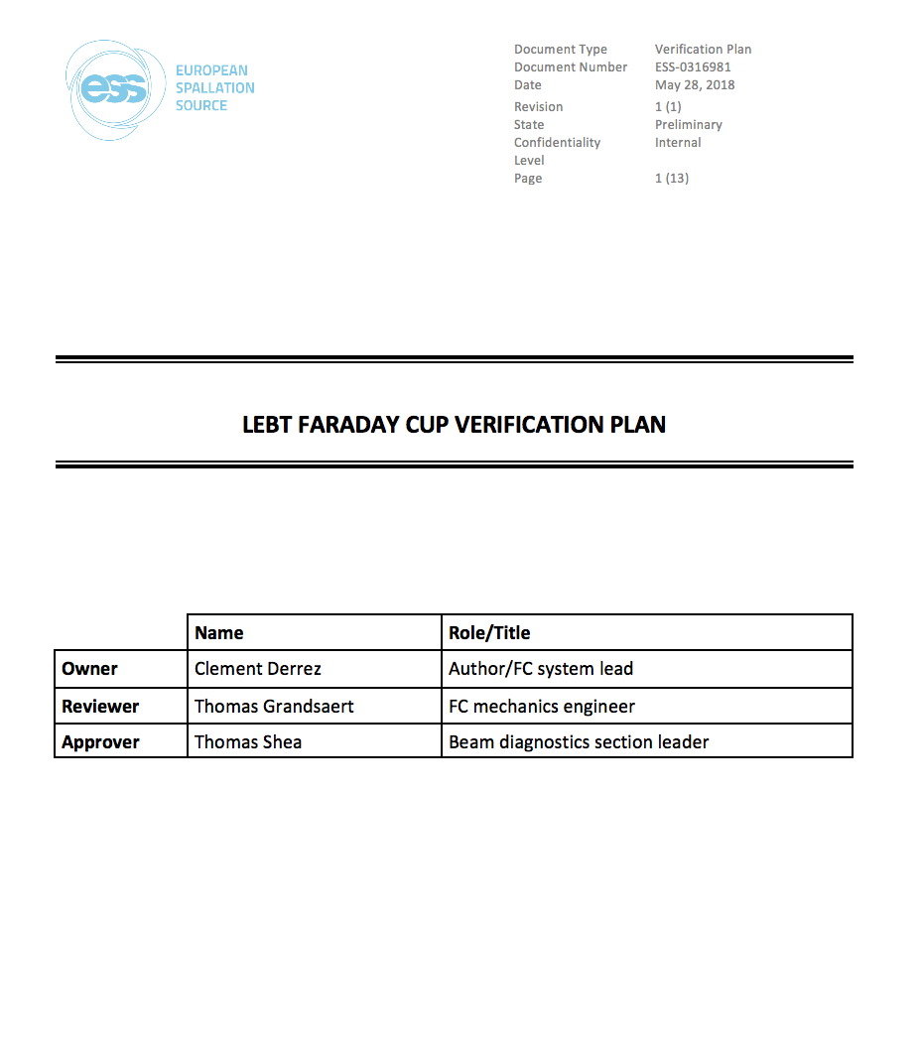
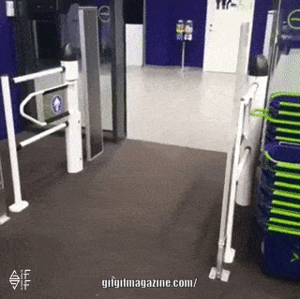
Status: Verification Plans
BCM verification plan
LEBT EMU verification plan
DPL verification plan
LEBT NPM verification plan
LEBT FC verification plan
HIPOT Testing for vacuum cables
Gamma Blockers Verification Plan
RSMS Test Procedures
…
Notes:
ESS-0184393
ESS-0316980
ESS-0316977
ESS-0316982
ESS-0316981
ESS-0306087
ESS-0127783
ESS-0092221

Slide 8
Status: Planned activities (NC Linac)
System | Local tests | Integrated tests
RFQ Cooling Water |  | PLC comm. w/ controls, Closed loop test (dry run)
RFQ Vacuum | Leak tests
RFQ EMR | RFQ tuning
RFQ |  | Test comm. w/ LLRF
MEBT Cooling Water | Manifold inst.
MEBT Vacuum | Leak tests | Integrated tests
MEBT EMR | Buncher tuning | Controls tests, Tuner comm. w/ LLRF, RF conditioning
MEBT Bilbao rack equipment | Local tests
MEBT Beam Instrumentation |  | Tests w/o beam (x9)
MEBT Magnets |  | Integrated tests
MEBT Chopper |  | Integrated tests
MEBT MPS |  | Tests
MEBT |  | Dry run
DTL EMR |  | RF conditioning 1, 2-4, 5
DTL | Local HW tests: 1, 2, 3, 4, 5 | Dry run: 1, 2, 3, 4, 5, HW verification w/ beam

Slide 9
ISrc & LEBT Testing and Commissioning Lessons Learned
Session held 2018/10/12
Worked well:
  PSS is working great
  Weekly meeting to organise the SRR was very useful
  Vacuum documentation was excellent from the controls point of view
  Good team building experience
  Great support from technicians and Area Coordinators
To be improved:
  Changing conditions lead to need for re-testing
  FAT documentation lacking
  Sequence of tests (PSS...) needs to be more explicit
  Management disconnect, lack of engagement
  Quality inspections for all installations, make no assumptions
  Verification plans missing (sometimes), and they should also include integration tests
  Cramming activities to meet “arbitrary” deadlines leads to inefficiencies
  Infrastructure plan still under development, coordination needed
  TRR was too weak
Suggestions:
  Clear checklists
  Clarify the safety responsibility during testing
  Balance the paperwork vs hands-on work
  SRR ≭ Beam RR, minimalistic and focused on safety
  Dry runs
Report in preparation

Slide 10

Testing-related learned lessons from other projects
Lessons learned in different topics:
  Leadership
  Planning
  Communication
  Documentation
  Control systems
Collected from the proceedings of several conferences, as well as during the workshop held on Tuesday:
  NuMI Lessons to Learn, S. Childress, Fermilab, 29 Sep 2008
  Overview and Lessons Learned of the Jefferson Lab Cryomodule Production for the CEBAF 12 GeV Upgrade, North American PAC 29 September–04 October 2013 (WEZAA2)
  The Spallation Neutron Source Beam Commissioning and Initial Operations, ORNL/TM-2015/321
  ProtoDUNE - lesson learned, D. Mladenov CERN EP/NU, LBNF Cryostat final design review, SURF 21-22 August 2017
  MAX IV Laboratory, Milestones and Lessons Learned Vincent Hardion on behalf of KITS Group, MAXIV ICALEPCS 2015
  MAXIV STATUS, KITS MAXIV, 29th Tango meeting, Krakow
  Workshop on Testing and Commissioning, ESS, Lund, 16 Oct 2018 (link)
    Diamond Commissioning, Mark Heron
    SNS Commissioning, Mike Plum
    RF commissioning at XFEL, Julien Branlard
Notes:
References to some of the sources:
NuMI Lessons to Learn, S. Childress, Fermilab, 29 Sep 2008
Overview and Lessons Learned of the Jefferson Lab Cryomodule Production for the CEBAF 12 GeV Upgrade, North American PAC 29 September–04 October 2013 (WEZAA2)
The Spallation Neutron Source Beam Commissioning and Initial Operations, ORNL/TM-2015/321
ProtoDUNE - lesson learned, D. Mladenov CERN EP/NU, LBNF Cryostat final design review, SURF 21-22 August 2017
MAX IV Laboratory, Milestones and Lessons Learned Vincent Hardion on behalf of KITS Group, MAXIV ICALEPCS 2015
MAXIV STATUS, KITS MAXIV, 29th Tango meeting, Krakow

Slide 11
Testing-related learned lessons from other projects
Leadership
  “While our reviews are essential, many times they do not go into enough depth to really find many more subtle but major problems. For any challenging technical project, it is essential to have broad based lead technical experience at a decision making level.”
  “Better/Faster way to resolve disputes, or ideally avoid them altogether.”
  “Changing an established organisation is extremely difficult.”

Slide 12
Testing-related learned lessons from other projects
Planning
  “Some tests fail, allow for plenty of time for testing.”
  “More time to evaluate/trade-off installation/operation impacts.”
  “Integrate detailed schedule of activities including resources and interdependencies (Civil, beam transport, cryogenics, high power-rf, instrumentation, controls & safety)”
  “Early operation of the frontend at SNS provided an opportunity for integrated tests of most of the basic accelerator systems, e.g. the control system, timing, machine protection, RF, vacuum and high level software.”
  “Be prepared to take out installed equipment (storage, maintenance, documentation, testing, training, etc).”
  “Commissioning a large accelerator facility necessitates parallel Hardware and Beam commissioning.”
  “Parallelising activities has limits.”
  “Deep system test of each device, from hardware to the synoptic (~fully operational for the commissioning).”
  “Large part of the project was spent on the subsystems tests (SST): the goal was to deliver the system ready for the commissioning with the fewest experienced defects. The SST helped to discover the discrepancy in the connection chain. For example the steering and the protection system of every single magnet has been all tested from the power supply to the report of the correct field of the magnet on the synoptic GUI.”
  “Expect surprises: even the best checklist won't catch everything.”
  “Start tests as soon as the kit is ready for test, not to some arbitrary schedule.”

Slide 13
Testing-related learned lessons from other projects
Communication
  “Diligent communication between all relevant stakeholders is essential to deliver an optimal solution”
  “Good communication & cross functional coordination is critical to success”
  “Group should have established a rapport with safety officers.”
  “Have an Electronic Log Book system up and running from day one”
  “Tools will never solve any organisational communication issue”
  “Operators working with and learning from other groups is invaluable experience and proves immensely helpful back in the control room”
  “Accelerator scientists in the control room makes operators better: Questions are answered, issues are approached together, learning happens”

Slide 14

Testing-related learned lessons from other projects
Documentation
  “Procedure documentation, operation training, and testing are time consuming but essential.”
  “Configuration Management: define the source and format of information.”
  “A calibration plan should be developed.”
  “Information gathered early is vital. Document as you go along”
  “Design and follow checklists”

Slide 15
Testing-related learned lessons from other projects
Control systems
  “Software needs to be ready before beam commissioning, and should be tested in advance.”
  “All subsystem had to include the Control System in their test suites. The tests included the access to the functionalities but also the performance and the quality of the responses. The improvement in the configuration management allowed a very fast reconfiguration without regression for all the different subsystems.”

Slide 16
Summary
Short term goals:
  Identify missing activities and V&V plans
  Update the JIRA plan with milestones linked to Primavera
Medium term goals:
  Help producing the missing documentation
  Support the preparation of TRRs and SRRs
  Organise dry runs
Long term goals:
  Make sure the commissioning team gets the hardware they need, reliably tested and on time

Slide 17
Thank you for your attention

Slide 18
Commissioning vs Beam Commissioning
In the context of the Handbook for Engineering Management, “Commissioning” is used for the Verification and Validation phase of all systems, independently of the use of the proton beam.
To show to that the systems are ready from a safety point of view to start ”Beam Commissioning” part of the accelerator, 5 separate Safety Readiness Reviews (SRR) will be held.
ISrc+LEBT
RFQ+MEBT+DTL1
DTL2+DTL3+DTL4
DTL5+Spk+MBL+HBL+HEBT+DmpL
A2T
SRR1
SRR2
SRR3
SRR4
SRR5
Notes:
Hardware Testing / Hardware Commissioning / “Cold” Commissioning
SRR are not linked to the licensing

Slide 19
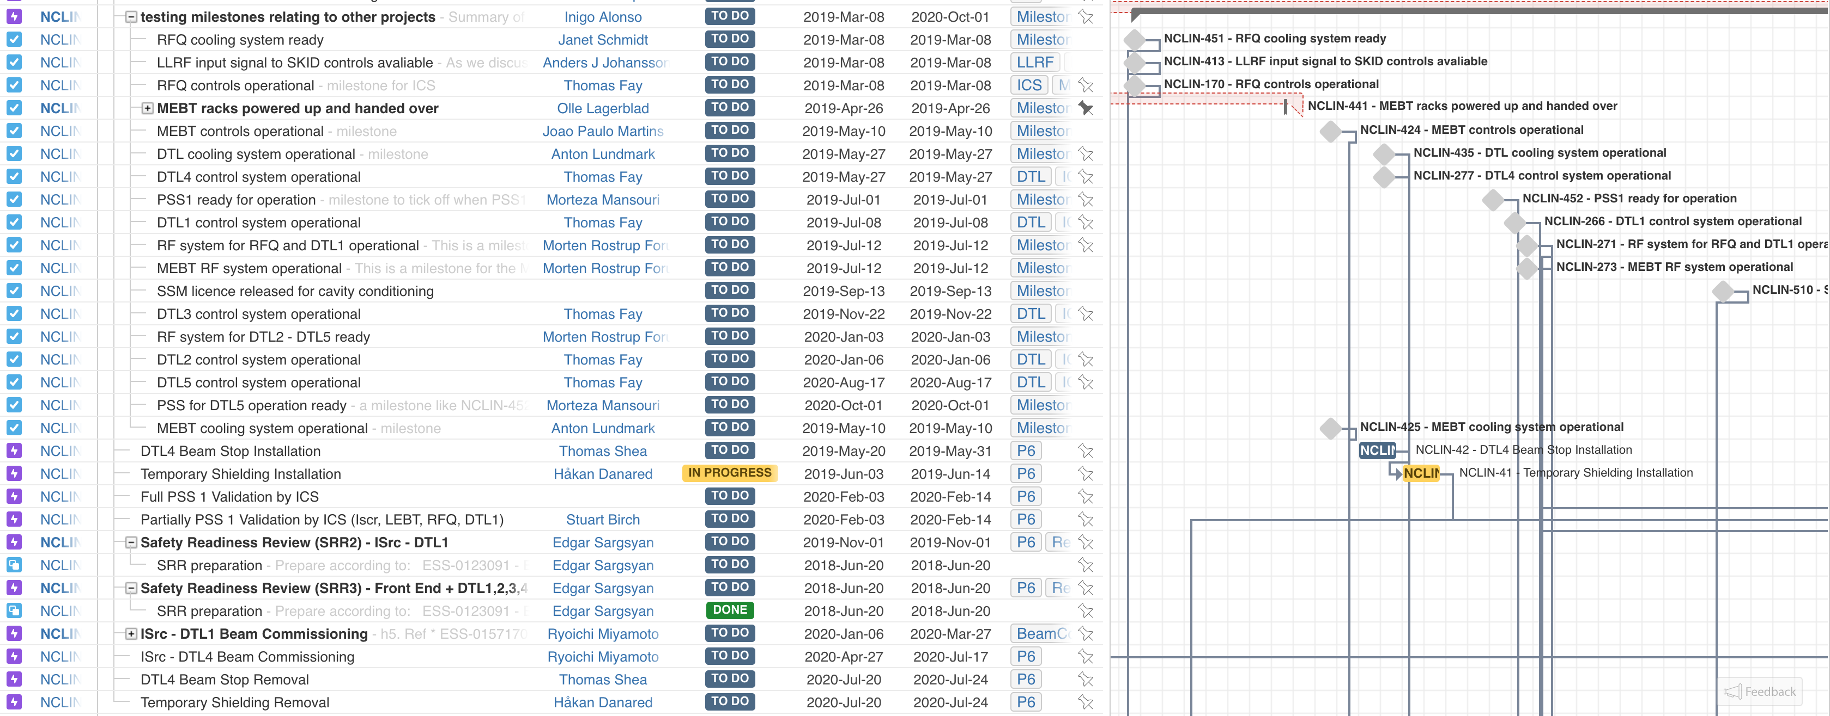
Status: Planned activities (NC Linac)

Slide 20
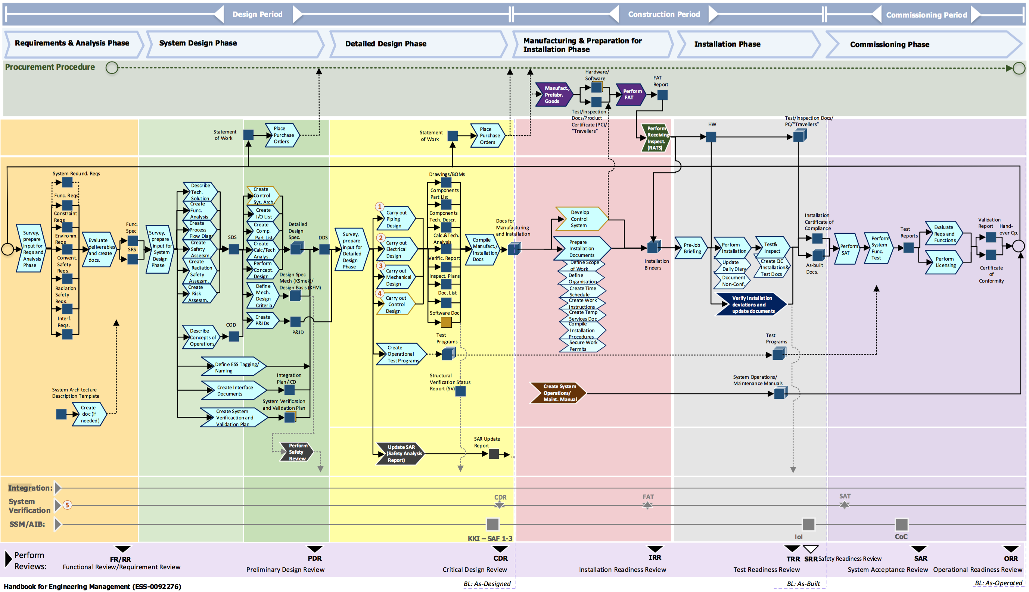
Handbook of Engineering Management

Slide 21

Requirements Engineering
Quality: “Conformance to requirements”
Good requirements engineering practices are a prerequisite to deliver systems that fulfil the Operations needs

